Slide 1
Side channels and covert channels
Part I – Architecture side channels
Slide credits: some slides and figures adapted from David Brumley, AC Chen, and others

Slide 2
Traditional Cryptography
COMMUNICATION CHANNEL
Policy
Confidentiality
Integrity
Authenticity
Alice
Bob
Security Attacks
Mallory
Interception
(Threat)
Confidentiality
(Policy)
Encryption
(Mechanism)
Modification
(Threat)
Integrity
(Policy)
Hash
(Mechanism)
Fabrication
(Threat)
Authenticity
(Policy)
MAC
(Mechanism)

Slide 3
Threat Model
Communication
Channel
Message
Message
E
D
K_{a}
K_{b}
leaked Information
Bob
Alice
Side Channels in the real world
Through which a cryptographic module leaks information to its environment unintentionally
Assumptions
- Only Alice Knows K_{a}
- Only Bob Knows K_{b}
- Mallory has access to E, D and the Communication Channel but does not know the decryption key K_{b}
Mallory

Slide 4
Side Channel Sources
Threat Model & Security Goal
Key dependent
Variations computation time
Cryptographic Algorithms
Traditionally we have handled only
Protocols
Software
Human User
Hardware
Power consumption
EM Radiations
E/D
K
Deployment
& Usage
Real World System

Slide 5
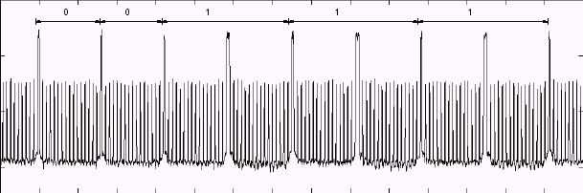
Power Analysis Attack
Idea: During switching CMOS gates draw spiked current
Trace of Current drawn - RSA Secret Key Computation
Only Squaring
Squaring and multiplication
Reported Results : Every Smartcard in the market BROKEN

Slide 6
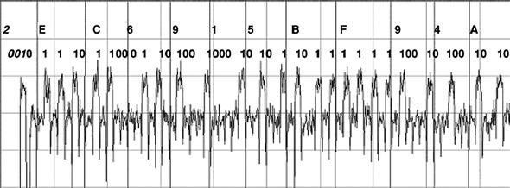

Slide 7
Covert channel vs. Side channel
Covert channel players: Trojan and spy
  Trojan communicates with the spy covertly using the covert channel
  Example: two prisoners communicating by banging on pipes
Side channel players: victim and spy
  Spy attempting to figure out what victim is doing by observing side channel
  Example: My students determining if I am here based on smell of coffee around my office ☺
  Key property: cooperation
  Are covert channels a security concern?

Slide 8
How dangerous is the problem?
What makes a channel a side channel?
  Intended by the primary designer of the system or not
  One check: an implementation artifact
Many side channels require physical access
  The spy has to be able to measure
Today: Architecture based side channels
  Victim and spy run on the same system
  Spy uses the shared architecture components as a side channel

Slide 9
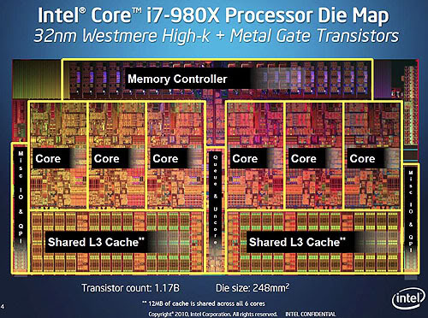
Microarchitecture side channels
Modern processors support multiple programs running at the same time
  Even that is not necessary for many attacks; multiprogramming is enough
  Side channels galore!!
    What one process does can affect others
    Denial of service also possible
  What are examples?

Slide 10
Simple attack—timing based attack
Assumption: we can observe the time a crypto operation takes (maybe time until a packet is sent)
There are variations in the time of encryption based on the key (for the same data)
  By measuring the time, parts of the most likely keys are identified
  See paper by Bernstein for complete description of the attack
Powerful attack
  However, requires known plaintext attack
  Requires access to the server to do the timing and build a key database

Slide 11
Cache missing for fun and profit [Percival]
Paper introduces: Access driven attacks
Spy actively accesses the cache to make the side channel possible

Slide 12
Caching is a source of covert channels
Two processes sharing a memory mapped file
Trojan: accesses a page of the file if it wants to communicate 1
  Page brought into memory
Spy accesses the same page and times the access
  Fast → trojan accessed it! 1
  Slow → No access – 0!
Have to work out some timing issues
Noise could be a problem
Works even if a single core

Slide 13
What if they do not share a file/memory?
Can still communicate!
Focus on removing something rather than bringing it in
Here’s a scenario
  Trojan fills “cache” with its own pages (prime phase)
  Victim accesses different part of memory in a certain pattern
    Cache is limited in size, this replaces some of the trojan’s pages in the shared cache
  Trojan when it re-accesses its pages, experiences misses. Pattern can be used to communicate
Attach where memory is shared called flush-and-reload attack
This variant called prime-and-probe

Slide 14
Common attack L1 side channel
Good for attack:
  L1 caches are fast and small; can probe them quickly
  They often are virtually indexed
    Physically indexed caches are more challenging because you don’t know your physical address
Bad for attack:
  L1 caches are private
    Attack is SMT/hyper-threading or core affinity based
    Harder to get the spy placed on the same core as the process

Slide 15
LLC side channels beginning to be explored
The problem is more difficult
  LLC are larger and slower – harder to probe
  More noise because they are shared among all cores
  Index hashing
  Physically indexed
But more dangerous
  Allows cross-vm attacks on clouds. Have to be on the same machine rather than the same core
Demonstrated under some conditions, but not in general
Plug: we have a grant from NSF to explore this attack
  Let me know if you are interested in participating!

Slide 16
How dangerous is this problem?
Multicore and SMT processors share at least some levels of cache hierarchy
Cache sharing opens the door for two types of attacks
  Side-Channel Attacks
  Denial-of-Service Attacks
We consider software cache-based side channel attacks

Slide 17
Background: Set-Associative Caches
8-way set-associative cache
way 0
way 7
In SMT/CMP processors, caches are shared
A miss by any thread can store a line in any way
Cache lines 64-bytes; we don’t know which byte

Slide 18
Shared Data Caches in SMT Processors
Instruction
Cache
Issue Queue
Register
File
PC
PC
PC
Execution
Units
Data
Cache
Fetch
Unit
PC
PC
PC
PC
Load/Store
Queues
PC
LDST
Units
Decode
Register
Rename
Re-order Buffers
Arch
State
Private Resources
Shared Resources

Slide 19
Advanced Encryption Standard (AES)
One of the most popular algorithms in symmetric key cryptography
  16-byte input (plaintext)
  16-byte output (ciphertext)
  16-byte secret key (for standard 128-bit encryption)
  several rounds of 16 XOR operations and 16 table lookups
secret key byte
Lookup Table
index
Input byte
Notes:
19

Slide 20
Example of Access-Driven Attack
(only attack on set 0 is shown)
Cache is shared between attacker (A) and victim (V)
A
A
A
A
A
V
A
A
A
hit
hit
hit
hit
Miss!
Victim’s access to set 0 determined!

Slide 21
Access-Driven Attack: Example
...
A | A | A | A
A | A | A | A
A | A | A | A
A | A | A | A
A | A | A | A
...
Hit
Hit
Hit
Hit
Hit
...
Notes:
21
A for attacker

Slide 22
Access-Driven Attack: Example
...
A | A | A | A
A | A | A | A
A | V | A | A
A | A | A | A
A | A | A | A
...
Victim
(crypto)
access
Notes:
22
A for attacker

Slide 23
Access-Driven Attack: Example
...
A | A | A | A
A | A | A | A
A | A (V evicted) | A | A
A | A | A | A
A | A | A | A
...
Hit
Miss!
Notes:
23
A for attacker

Slide 24
Simple Attack Code Example
#define ASSOC 8
#define NSETS 128
#define LINESIZE 32
#define ARRAYSIZE (ASSOC*NSETS*LINESIZE/sizeof(int))
static int the_array[ARRAYSIZE]
int fine_grain_timer(); //implemented as inline assembler
void time_cache() {
register int i, time, x;
for(i = 0; i < ARRAYSIZE; i++) {
time = fine_grain_timer();
x = the_array[i];
time = fine_grain_timer() - time;
the_array[i] = time;
}
}

Slide 25
What are possible solutions?
To side channels in general, or to this particular one?
Should this problem be solved in software?
  …and how?
AES-NI: hardware supported instructions for AES encryption
  No table lookup!

Slide 26
Examples of Existing Solutions
Avoiding using pre-computed tables – too slow
Locking critical data in the cache (Wang and Lee, ISCA 07)
  Impacts performance
  Requires OS/ISA support for identifying critical data
Randomizing the victim selection ( Wang and Lee, ISCA 07)
  Significant cache re-engineering
  High complexity
  Requires OS/ISA support to limit the extent to critical data only
Dynamic Memory-to-Cache Remapping (Wang and Lee, 2008)
  Complex hardware
  Significant cache redesign of peripheral circuitry

Slide 27
New Cache Designs for Thwarting Software Cache-based Side Channel Attacks
Zhenghong Wang and Ruby Lee

Slide 28
Proposed Models
The main problem is direct or indirect cache interference
One of the solutions is learning from the attacks and rewrite the software
Pervious solutions are attack specific and have performance degradation
This paper tried to eliminate the root of the problem with minimum impact and low cost
Proposed two solutions
  Partitioning
  Randomization

Slide 29
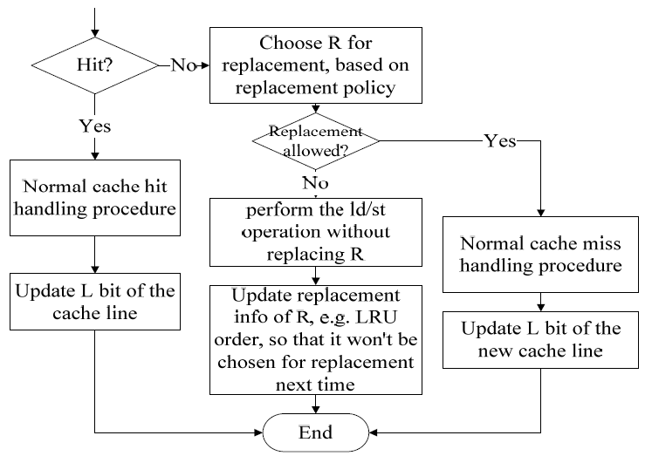
Proposed Models
Partition-Locked Cache (PLCache)
L
ID
Original Cache Line

Slide 30
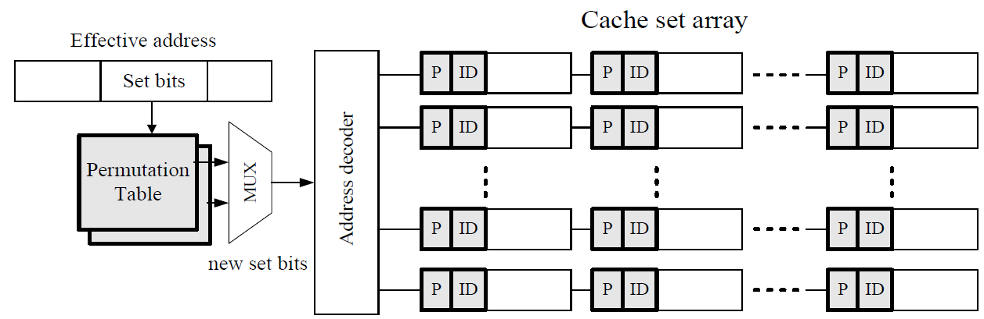
Proposed Models
Random Permutation Cache (RPCache)
  Introducing randomization to the memory-to-cache mapping, which eliminate knowing which cache lines evicted

Slide 31
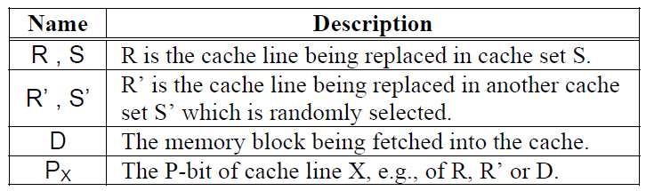
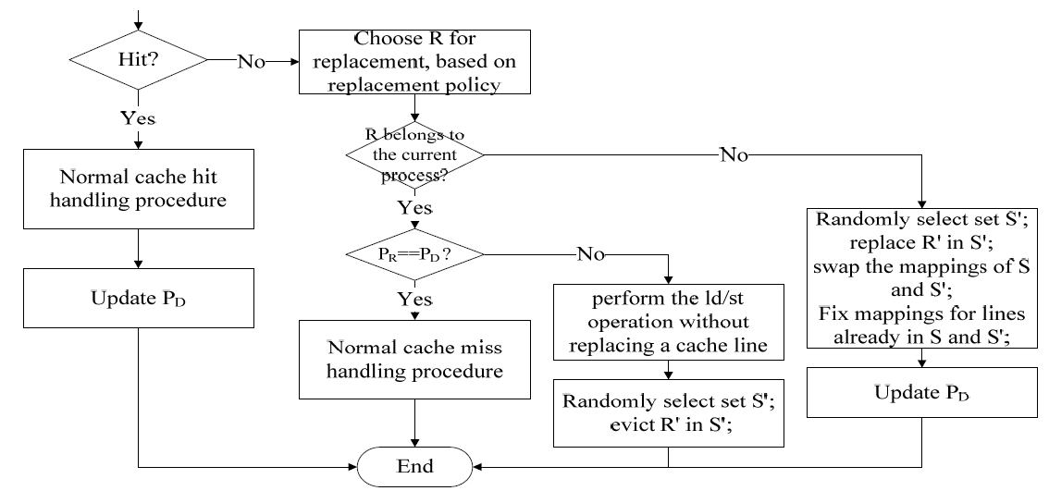
Proposed Models

Slide 32
Proposed Models
Cache
LPCache
RPCache
Victim Access
Attacker discovered miss
Filled by attacker data
Locked cache lines
Replaced cache line

Slide 33
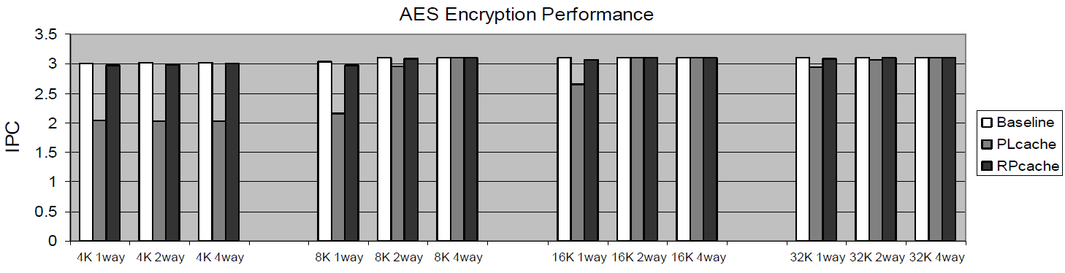
Evaluation
Performance impact on the protected code
  OpenSSL 0.9.7a implementation of AES was tested on a processor with traditional cache, L1 PLcache, and L1 RPcache
  5 Kbytes of the data needed to be protected
  L2 cache is large enough, so there are no performance impact

Slide 34
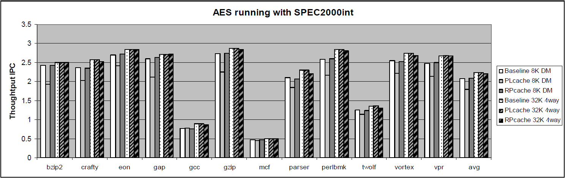
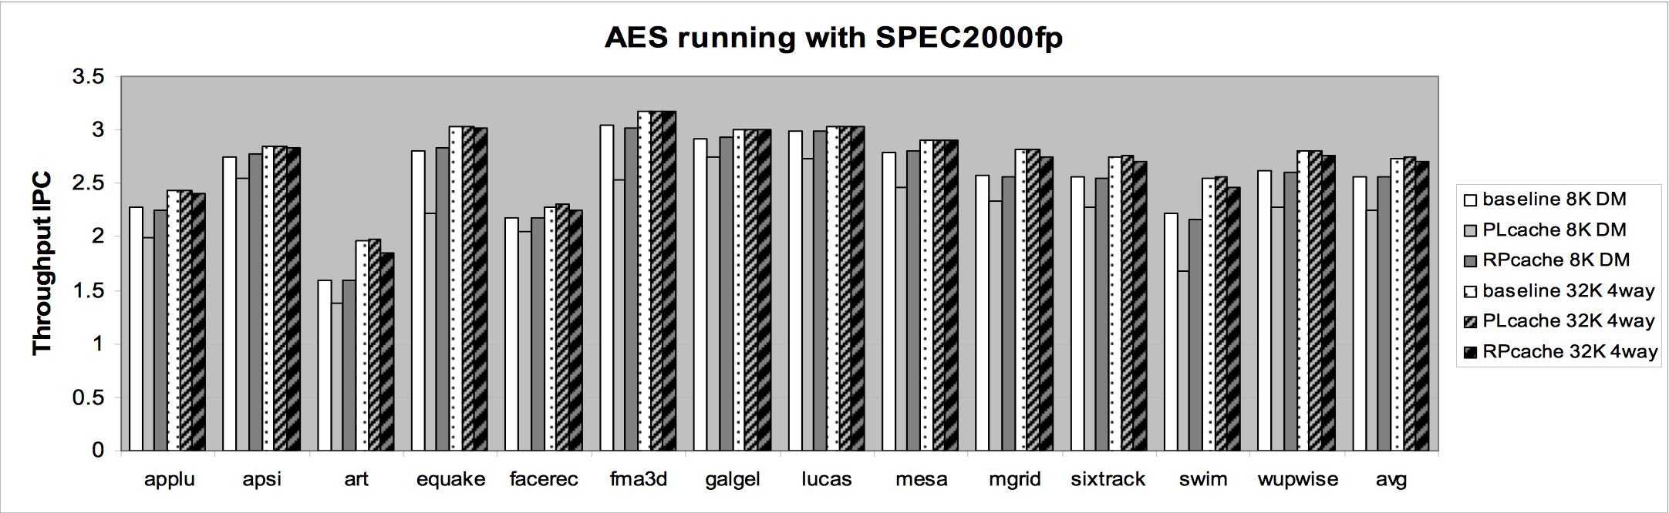
Evaluation
Performance impact on the whole system due to the protected code
  AES runs with another thread simultaneously (SPEC2000fp and SPEC2000int)

Slide 35
Conclusions
Cache-based side channel attacks can impact a large spectrum of systems and users
Software solutions adds significant overhead
Hardware solution are general purpose
PLCache: Minimal hardware cost. However, developers much use there APIs
RPCache: Adds area and complexity to the hardware, but the developer has to do nothing

Slide 36
Non Monopolizable caches
Idea: prevent attacker from monopolizing the cache

Slide 37
Desired Features and NoMo
Desired Solution Features:
  Hardware-only (no OS, ISA or language support)
  Low performance impact
  Low complexity
  Strong security guarantee
  Ability to simultaneously protect against denial-of-service (a by-product of access-driven attack)
Non-Monopolizable (NoMo) Caches
  Some cache ways are reserved for co-scheduled applications, others are shared
  Does not eliminate all leakage, but reduces it dramatically

Slide 38
NoMo Caches
8-way set-associative cache with NoMo-2
T1 | T1 |  |  |  |  | T2 | T2
T1 | T1 |  |  |  |  | T2 | T2
T1 | T1 |  |  |  |  | T2 | T2
T1 | T1 |  |  |  |  | T2 | T2
Shared Ways (leakage surface)
  T1 – ways reserved for Thread 1
  T2 – ways reserved for Thread 2
NoMo Degree - # of ways reserved for each thread
Information only leaks from shared ways
Notes:
38

Slide 39
Dynamic Mode Adjustment
No restrictions when cache is not actively shared
  Timeout counter to detect when to exit NoMo mode
  Counter keeps track of the number of consecutive cycles with no cache accesses from other applications
NoMo mode is entered when a new program starts
  Invalidate lines in Y ways and reserve them
NoMo mode is turned off when counter reaches threshold
  Invalidate and un-reserve
Entry + exit = equivalent to always-on NoMo
Notes:
39

Slide 40
Dynamic Mode Adjustment
New thread enters: invalidate reserved ways, switch to NoMo
NoMo off
NoMo on
Inactivity counter saturates
(one of the threads is inactive)
Notes:
40

Slide 41
NoMo Operation Example
Initial cache usage
F:1 | H:1 |  | C:1 |  |  | K:1
 |  |  | A:1
G:1 |  | B:1 |  | J:1 |  |  | D:1
 | L:1 |  |  | I:1 |  |  | E:1
More cache usage
F:1 | H:1 |  | C:1 |  |  | K:1
 |  |  | A:1 |  | P:1
G:1 |  | B:1 | N:1 | J:1 |  |  | D:1
M:1 | L:1 |  |  | I:1 |  | O:1 | E:1
Thread 2 enters
F:1 | H:1 |  | C:1 | Q:2 |  | K:1
 |  |  | A:1 |  | P:1
G:1 |  | B:1 | N:1 | J:1 |  |  | D:1
M:1 | L:1 |  |  | I:1 |  | O:1 | E:1
NoMo Entry (Yellow = T1, Blue = T2)
F:1 | H:1 |  | C:1 | Q:2 |  | K:1
 |  |  | A:1 |  | P:1
G:1 |  | B:1 | N:1 | J:1 |  |  | D:1
M:1 | L:1 |  |  | I:1 |  | O:1 | E:1
Reserved way usage
F:1 | H:1 | R:2 |  | Q:2 |  | K:1
 | A:1 |  |  |  | P:1
G:1 | B:1 |  |  | J:1 |  |  | D:1
M:1 | L:1 | T:2 | S:2 | I:1 |  | O:1 | E:1
Shared way usage
F:1 | H:1 | R:2 |  | Q:2 |  | K:1
 | A:1 |  |  |  | P:1
G:1 | B:1 |  |  | J:1 |  | N:1 | D:1
M:1 | L:1 | T:2 | S:2 | I:1 | U:2 | O:1 | E:1
Showing 4 lines of an 8-way cache with NoMo-2
X:N means data X from thread N

Slide 42
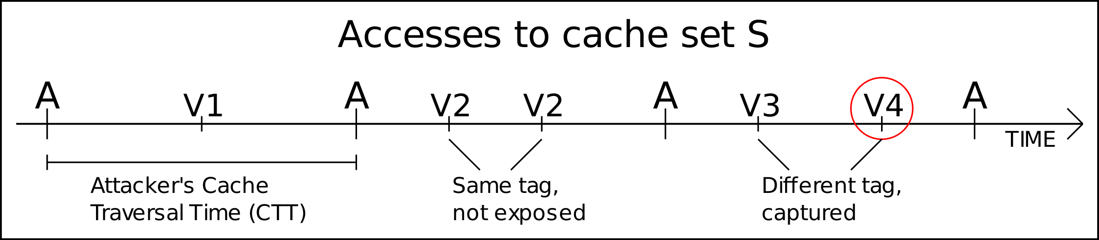
Why Does NoMo Work?
Victim’s accesses become visible to attacker only if the victim has accesses outside of its allocated partition between two cache fills by the attacker.
In this example: NoMo-1
Notes:
42

Slide 43
Evaluation Methodology
  Used Pin-based x86 trace-driven simulator with Pintools
  Evaluated security for AES and Blowfish encryption/decryption
  Ran security benchmarks for 3M blocks of randomly generated input
  Implemented the attacker as a separate thread and ran it alongside the crypto processes
  Assumed that the attacker is able to synchronize at the block encryption boundaries (i.e. It fills the cache after each block encryption and checks the cache after the encryption)
  Evaluated performance on a set of SPEC 2006 Benchmarks.

Slide 44
Metrics for Evaluating Security
  Exposure Rate: percentage of cache accesses by the victim that are visible through the side channel
  Critical Exposure Rate: percentage of CRITICAL accesses by the victim that are visible through the side channel
    Critical accesses are the accesses to pre-computed AES tables

Slide 45
Aggregate Exposure of Critical Data
Notes:
45

Slide 46
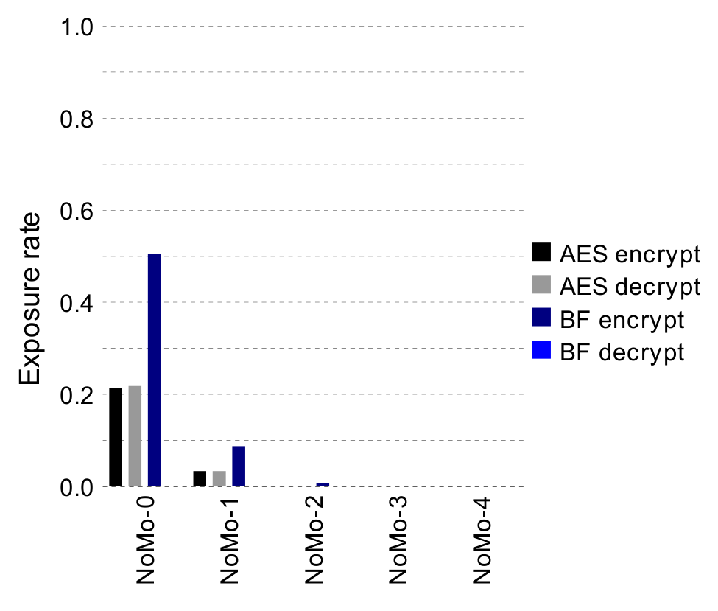
Aggregate Exposure of All Data
Notes:
46

Slide 47
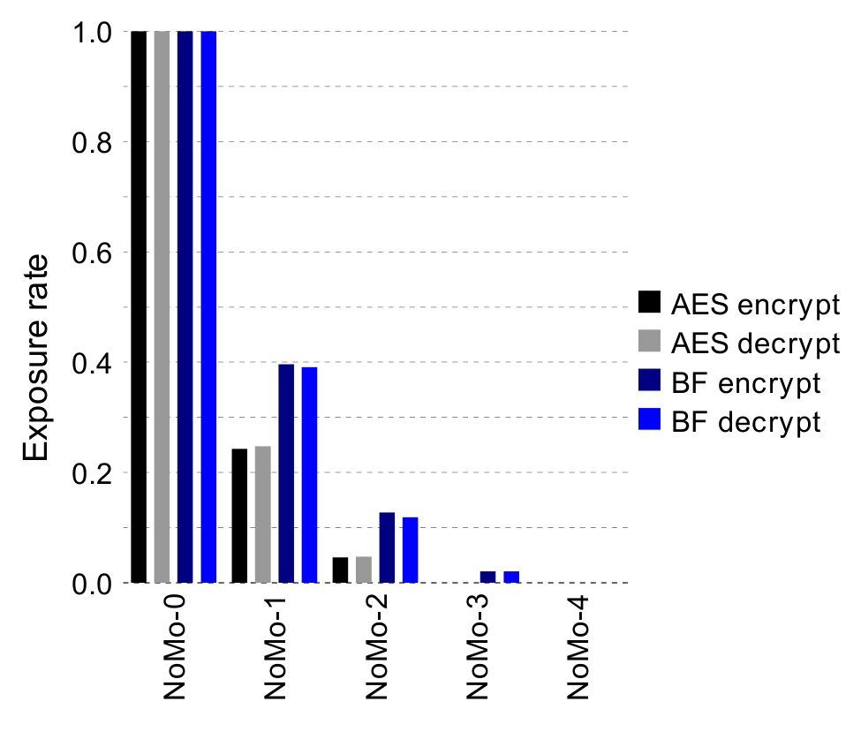
Worst-Case (per block) Exposure of Critical Data
Notes:
47

Slide 48
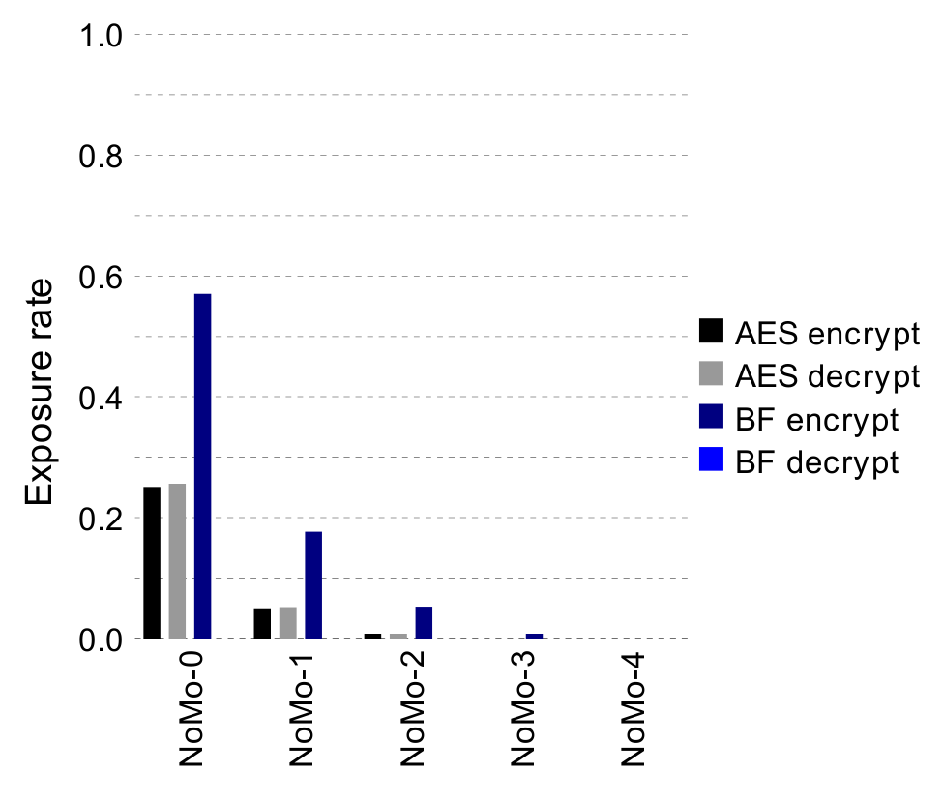
Worst Case (per block) Exposure of All Data
Notes:
48

Slide 49
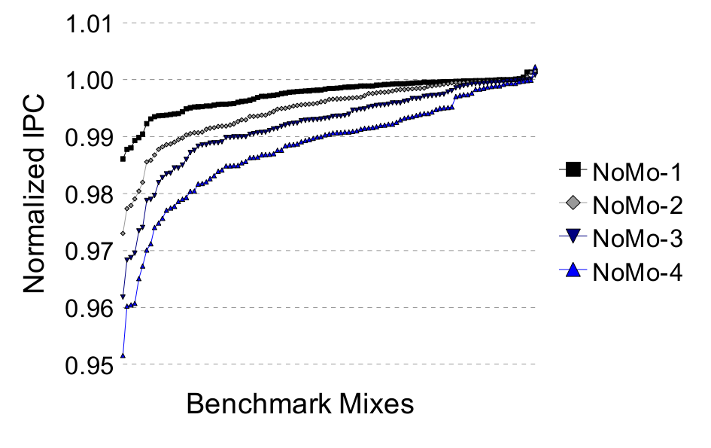
Impact on IPC Throughput (105 2-threaded SPEC 2006 workloads simulated)
Notes:
49

Slide 50
Impact on Fair Throughput (105 2-threaded SPEC 2006 workloads simulated)
Notes:
50

Slide 51
NoMo Design Summary
Practical and low-overhead hardware-only design for defeating access-driven cache-based side channel attacks
Can easily adjust security-performance trade-offs by manipulating degree of NoMo
Can support unrestricted cache usage in single-threaded mode
Performance impact is very low in all cases
No OS or ISA support required

Slide 52
A High-Resolution Side-Channel Attack on Last-Level Cache
Mehmet Kayaalp, IBM Research
Nael Abu-Ghazaleh, University of California Riverside
Dmitry Ponomarev, State University of New York at Binghamton
Aamer Jaleel, Nvidia Research
The 53rd Design Automation Conference (DAC), Austin, TX, June 8, 2016

Slide 53
Cache Side-Channel
28 1e 4c 24
09 bf 15 82
30 6f 53 d9
a4 49 2d 0e
f2 85 5c 06
6a 91 4e 0c
c4 fc da a8
d5 37 e9 9c
SubBytes
S-Box
Set-associative cache
sets
ways

Slide 54
Flush+Reload Attack
CPU1
CPU2
Victim
Attacker
1- Flush each line in the critical data
2- Victim accesses critical data
3- Reload critical data (measure time)
L1-I
L1-D
L1-I
L1-D
L2
L2
Shared L3
Cache
Evicted
Time
sets
ways

Slide 55
Prime+Probe: L1 Attack
2-way SMT core
1- Prime each cache set
2- Victim accesses critical data
Victim
Attacker
3- Probe each cache set (measure time)
L1-I
L1-D
L2
L1 Cache
Evicted
Time
sets
ways

Slide 56
Prime+Probe: LLC Attack
CPU1
CPU2
Victim
Attacker
1- Prime each cache set
2- Victim accesses critical data
3- Probe each cache set (measure time)
Back-invalidations
L1-I
L1-D
L1-I
L1-D
L2
L2
Evict critical data
Shared L3
Inclusive
Challenges:
Find collision groups for each cache set
  Discover hardware details
  Identify a minimal set of addresses per cache set
Find which are the critical cache sets
  Find which cache sets incur the most slowdown for the victim
  Among those, look for the expected access pattern

Slide 57
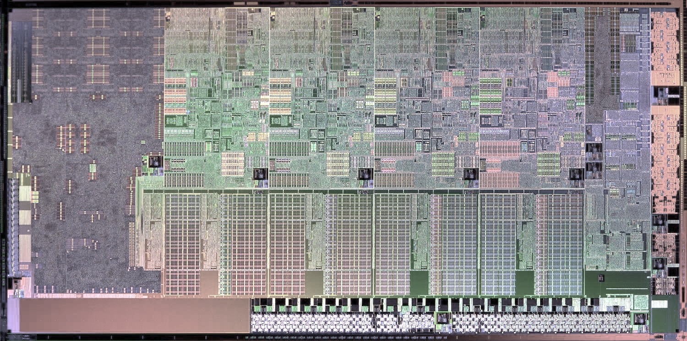
Discovering LLC Details
Intel Sandy Bridge die
4x Cores
4x 2MB
LLC Banks
63
12
0
Virtual Address
virtual page number
page offset
63
12
6
0
L1 Access
tag
set index
line offset
35
12
0
Physical Address
physical page number
page offset
35
17
6
0
LLC Access
tag
set index
line offset
Hash
bank select

Slide 58
Bank Selection and Cavity Sets
<H₀, H₁>:
<00>
<11>
<01>
<10>
Number of ways:
15
16
16
16
cavity
sets
35
17
6
0
tag
set index
line offset
●
●
●
●
●
●
●
●
●
●
●
●
●
●
●
●
●
H₀
●
●
●
●
●
●
●
●
●
●
●
●
●
●
●
●
●
●
●
●
H₁
XOR

Slide 59
Finding Collision Groups
Memory Page
same set index
same set index
x N = Cache Size
number of ways
…
N = (8 MB / 4 KB / 16)
= 128
ɸ = { }
Add page ρ to ɸ
Measure ∆t = t( ɸ ) - t( ɸ - ρ )
If ∆t is high
For each ρ_{i}∈ ɸ
Measure ∆t_{i} = t( ɸ ) - t( ɸ - ρ_{i} )
Add ρ_{i} to the new group if ∆t_{i} is high
Remove the group from ɸ
Repeat until N groups are found
N
ways

Slide 60
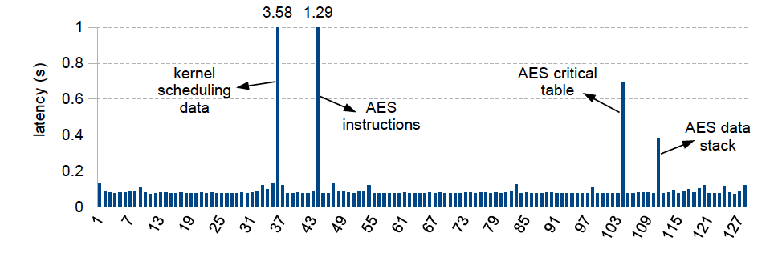
Finding Critical Sets

Slide 61
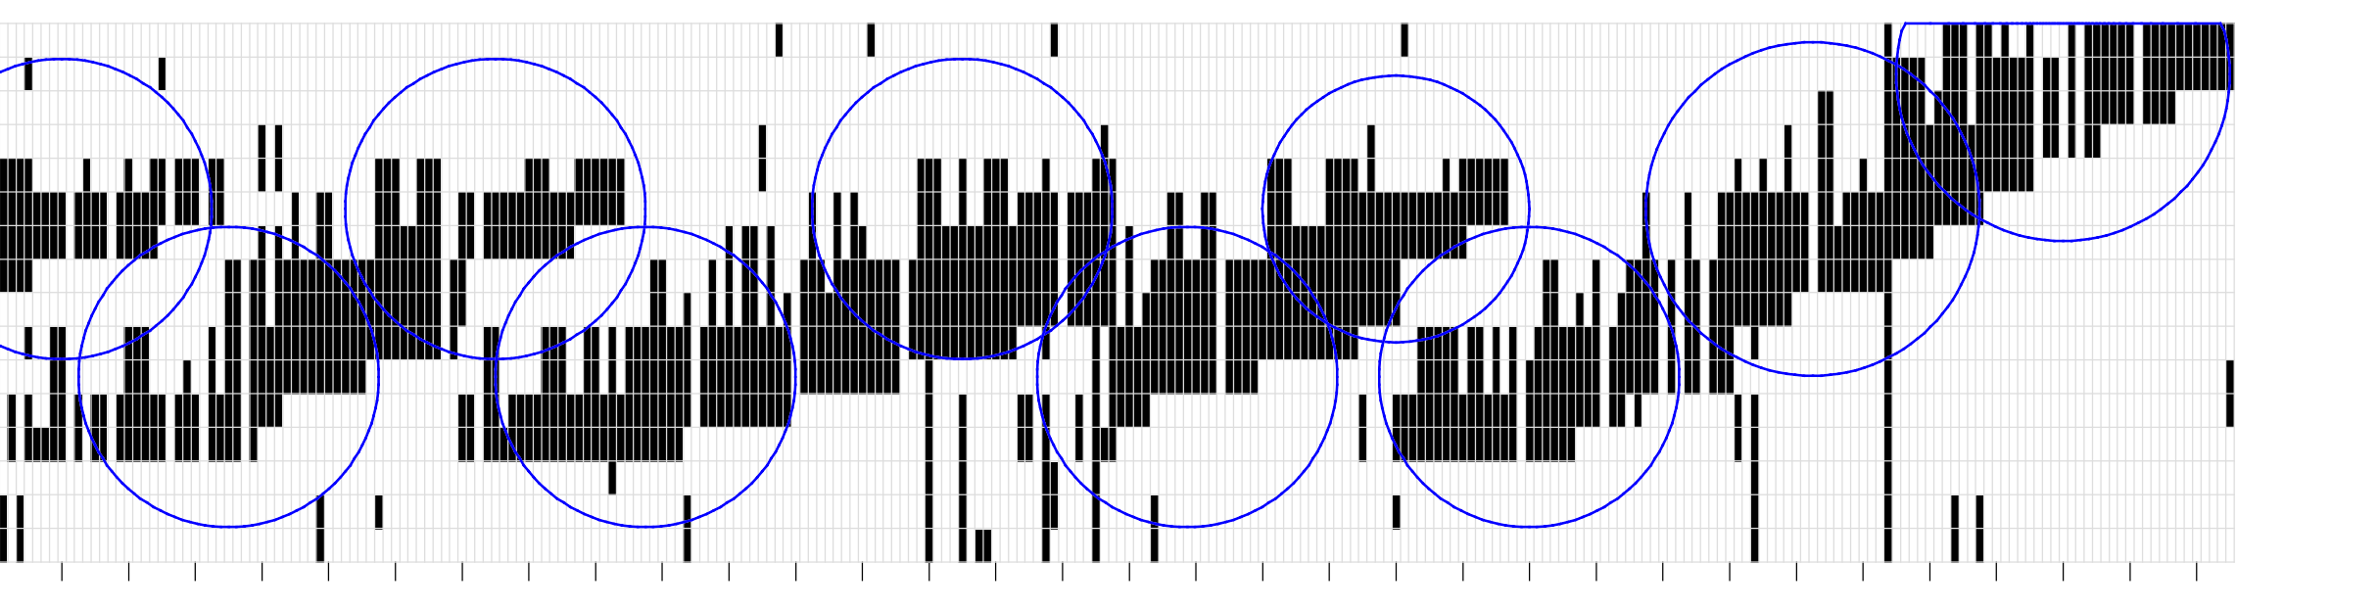
Attack on Instructions
for round = 1:9
if round is even
/* even rounds */
else
/* odd rounds */
/* last round */
sets
time

Slide 62
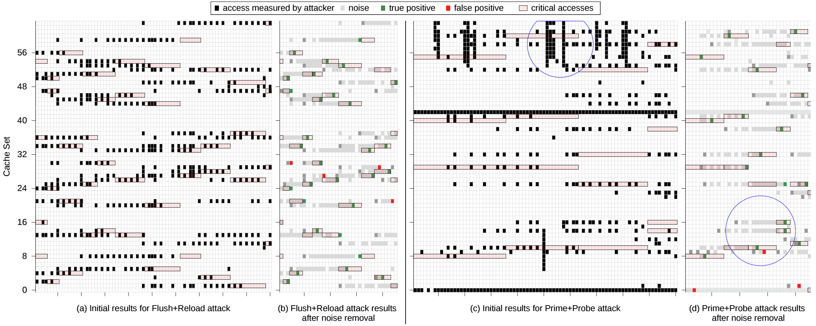
Attack on Critical Table

Slide 63
Attack Analysis
True Positive Rate
# true critical accesses observed
# all critical accesses of the victim
False Discovery Rate (FDR)
# false critical accesses observed
# all measurements of the attacker
Cache Side-Channel Vulnerability (CSV)
CSV = Pearson-correlation (Attacker trace, Victim trace)
TPR =
FDR =

Slide 64
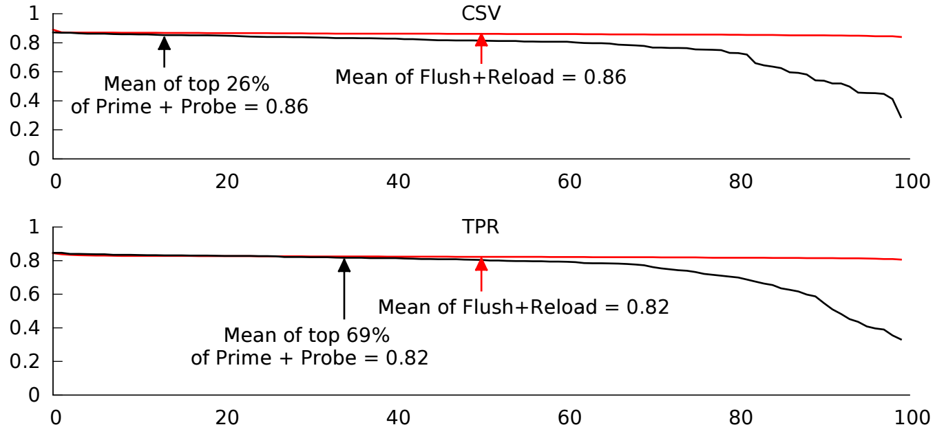
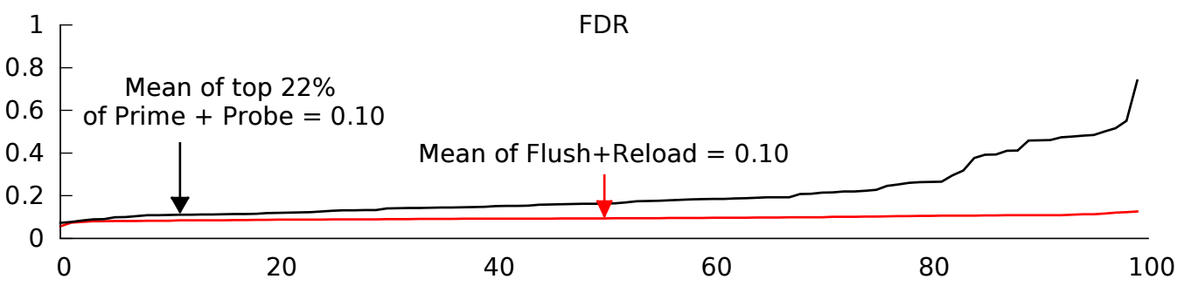
Comparison to Flush+Reload

Slide 65
Summary
A new high-resolution Prime+Probe LLC attack is proposed
It does not rely on large pages or the sharing of cryptographic data between the victim and the attacker
Mechanisms to discover precise groups of addresses that map into the same LLC set in the presence of:
  Physical indexing
  Index hashing
  Varying cache associativity across the LLC sets
Concurrent attack on the instruction and data tp improve the signal and reduce the noise
Not limited to AES and can be applied to attacking any ciphers that rely on pre-computed cryptographic tables (e.g. Blowfish, Twofish)

Slide 66
Other micro-architecture targets?
Are side channels available other than cache?
  Yes! Which resource do you think are possible targets?
Are side-channels possible on Last level caches?
  Yes: first attack demonstrated last year
  Why is it different/more difficult?
    Physical page indexing
    Index hashing
    Size of the cache, speed of the attack
    L1/L2 filter accesses
Each of these problems can be solved

Slide 67
Relaxed Inclusion Caches (DAC’17)
Key idea: Relax inclusion policy for read-only and private data.
Result: Victim process will hit in its local caches avoiding leakage
Publication: “RIC: Relaxed Inclusion Caches for Mitigating Cache-based Side-Channel Attacks ”, by M Kayaalp et al, DAC’2017.

Slide 68
Recall: LLC attack
CPU1
CPU2
Victim
Attacker
1- Prime each cache set
2- Victim accesses critical data
3- Probe each cache set (measure time)
Back-invalidations
L1-I
L1-D
L1-I
L1-D
L2
L2
Evict critical data
Shared L3
Inclusive
Inclusive caches: practical because they provide snoop filtering
As a result, victim always goes through L3, leaking to the attacker
Key idea of RIC: relax inclusion for read-only data and private data
Result: victim will hit in its local caches for such data, avoiding leakage to the attacker through L3

Slide 69
Inclusive vs. Non-Inclusive Caches
(+) simplify cache coherence
(−) waste cache capacity
(−) back-invalidates limits performance
Inclusive Caches
(+) do not waste cache capacity
(−) complicate cache coherence
(−) extra hardware for snoop filtering
Non-Inclusive Caches
Notes:
`

Slide 70
Operation of Inclusive Caches
Invalidated in L1
Victim
Attacker
L1 miss!
L1
L1
Visible access to LLC
LLC
Back-Invalidation

Slide 71
Relaxed Inclusion Caches
Stays in L1
Victim
Attacker
L1 hit!
L1
L1
No visible access to LLC
LLC
Read only

Slide 72
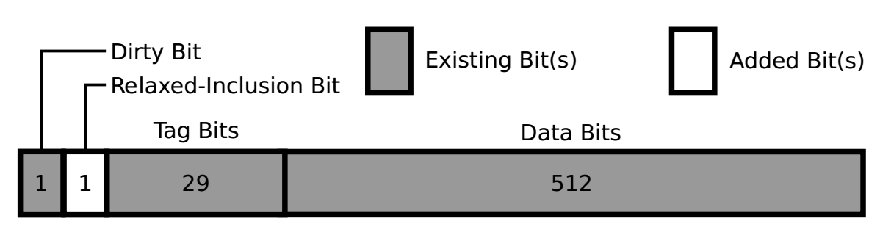
RIC Implementation
A single bit added per cache line

Slide 73
RIC Performance Evaluation: IPC
Normalized IPC for 2MB LLC (top) and 4MB LLC (bottom)
Notes:
Add note for here.

Slide 74
RIC Performance Evaluation: Reduction in Back-invalidates
Reduction in back invalidations
Notes:
This figure shows that the percentage of back invalidates eliminated by RIC is fairly constant across the benchmarks (more elimination in 2MB LLC > we have more replacement in 2MB LLC, so we have more elimination by RIC in this case).

Slide 75
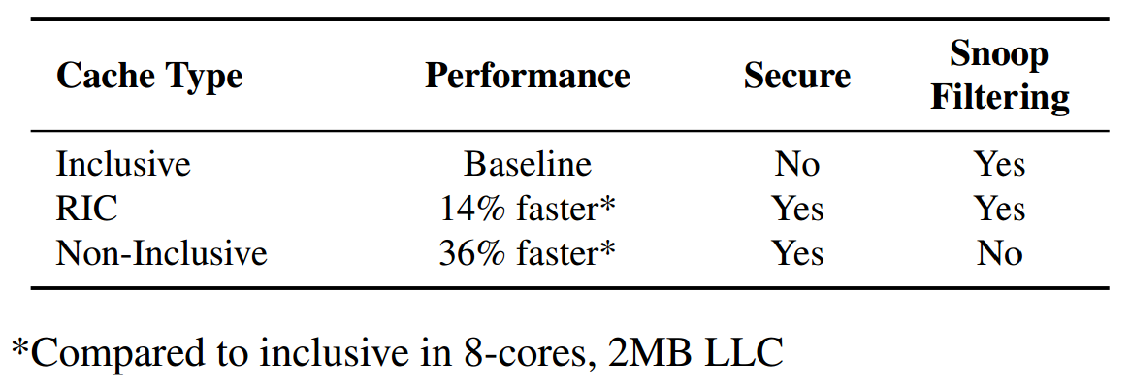
RIC Results Summary

Slide 76
Jump-over-ASLR Attack (MICRO ‘16)
Key idea: Use collisions in branch predictor structures to discover code locations
Bypasses ASLR – widely used security technique
Applies to Kernel and User ASLR
Publication: “Jump over ASLR: Attacking Branch Predictors to Bypass ASLR”, by D. Evtyushkin, D. Ponomarev, N. Abu-Ghazaleh, MICRO 2016.

Slide 77



ASLR Motivation: Return-to-libc
Return to Libc
Existing Library (libc)
Buffer Overflow
Malicious
Input
Return address
Download & Run
Malicious Code
Stack Frame
Victim
Memory

Slide 78
How to Protect from Code Reuse?
Address Space Layout Randomization (ASLR)
  Randomize position of important structures including code segment and libraries
ASLR can be applied to both User space and Kernel space
Implemented on all modern Operating Systems
Protects from Return-to-libc, Return-Oriented Programming and Jump-Oriented programming attacks

Slide 79
ASLR: Stopping the Attack
Return to Libc
ASLR
Existing Library (libc)
Buffer Overflow
Malicious
Input
Return address
Stack Frame
Victim
Memory

Slide 80
Kernel ASLR
Similar Code Reuse Attack applies to OS Kernel
The attacker can make the kernel jump to arbitrary address
The attacker needs to know kernel code layout

Slide 81
Jump-over-ASLR: Attack Overview
Use Branch Target Buffer (BTB) to recover random address bits
Two scenarios:
  One user space process attacking another
  User process attacking Kernel ASLR
Attack capabilities:
  Recover all random bits in Linux Kernel and KVM*
  Recover part of random bits in User Process making brute force attack much faster
* https://github.com/felixwilhelm/mario_baslr/

Slide 82
Branch Target Prediction Mechanism
Branch Target Buffer
Address tag | Target
jmp
A:
A
B
B:
Virtual Address space

Slide 83

User-Level Attack
Victim
Spy
Branch Target Buffer
Address tag | Target
jmp
jmp
A:
A:
A
B
B:
B:
C:
Observation: HIT
Observation: MISPREDICTION

Slide 84
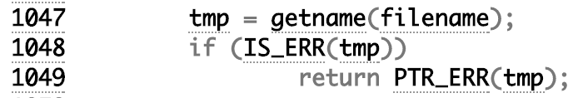
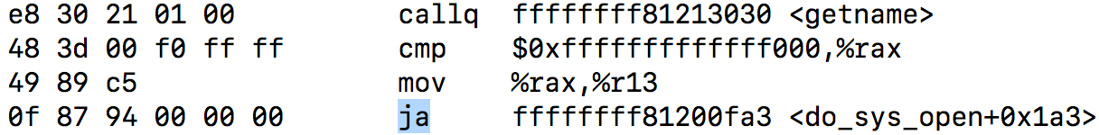
Looking for BTB Collisions
Victim
Spy
ja
jmp
Observations:
ASLR
86 cycles *no contention*
87 cycles *no contention*
100 cycles
89 cycle *no contention*
*COLLISION DETECTED*

Slide 85
Latencies Observed by the Spy on Haswell Processor

Slide 86
Attack Limitations
Not all address bits are used for BTB addressing
This makes possible collisions in higher and lower halves of address space

Slide 87
OS/VMM-Level Attack
OS Space
Branch Target Buffer
jmp
A:
9fe8756
0xffffa9fe8756
Address tag | Target
User Space
B
B:
jmp
A:
0x0000a9fe8756
C:
9fe8756
Collision: match address tag, not target

Slide 88
Latencies Observed by the Spy on Haswell Processor

Slide 89
KASLR in Linux
Result: full KASLR bits recovery in about 60 ms

Slide 90
Mitigating Jump-over-ASLR Attack
Software Mitigations
  Randomize more KASLR bits
    requires reorganization of kernel memory space
  Fine-grained ASLR: randomize at function, block, instruction level
    Performance implications
    Requires recompilation
Hardware Mitigations
  KASLR: prevent user and kernel space collisions
  User-Level: make unique BTB mappings for each process

Slide 91
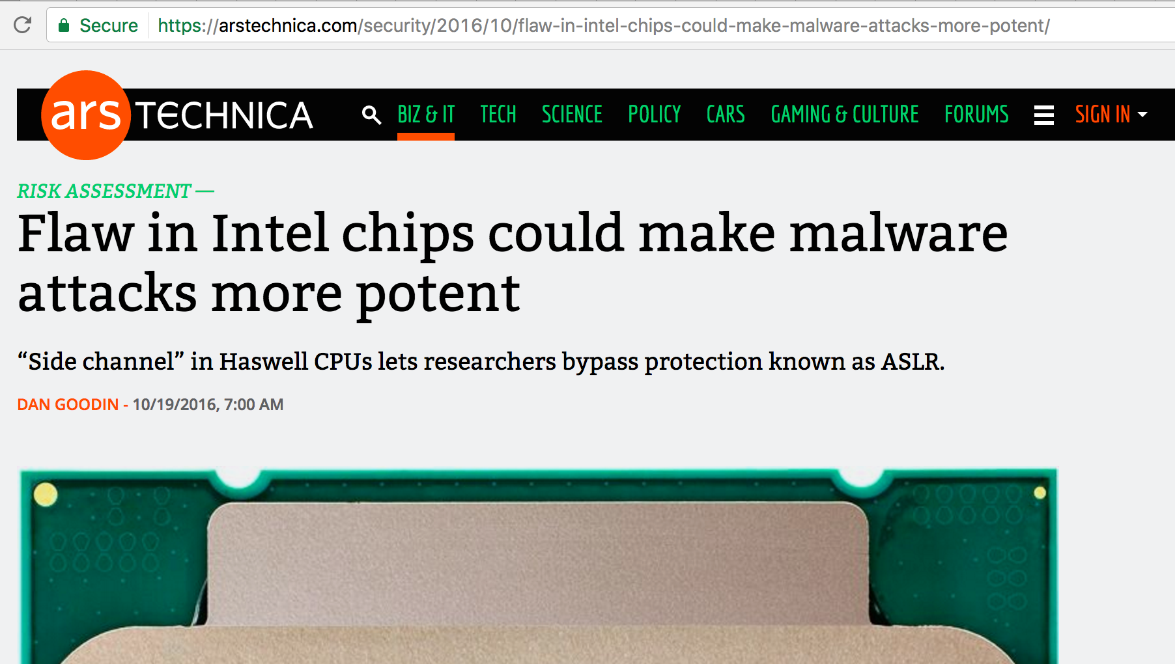
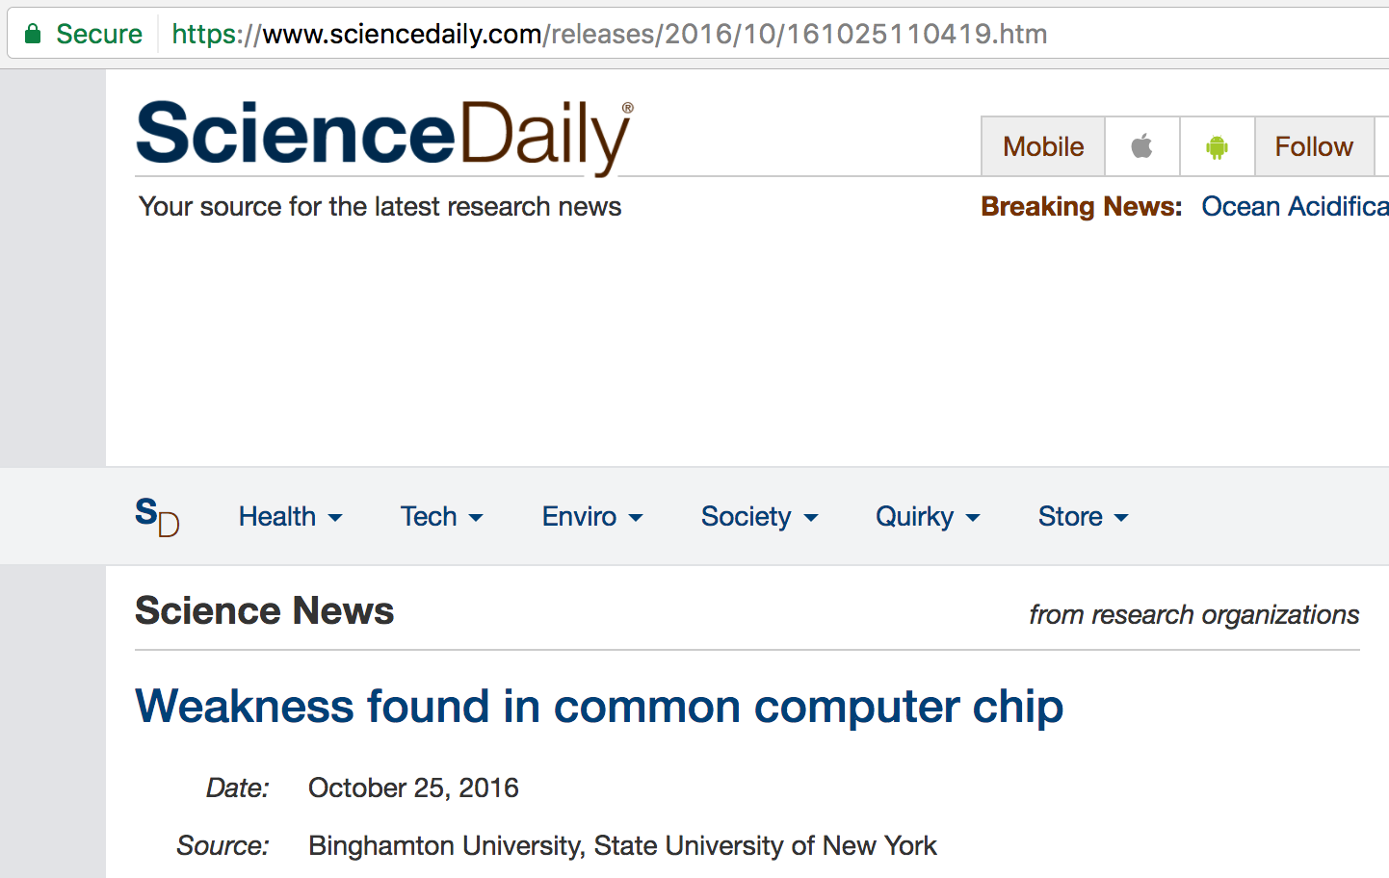
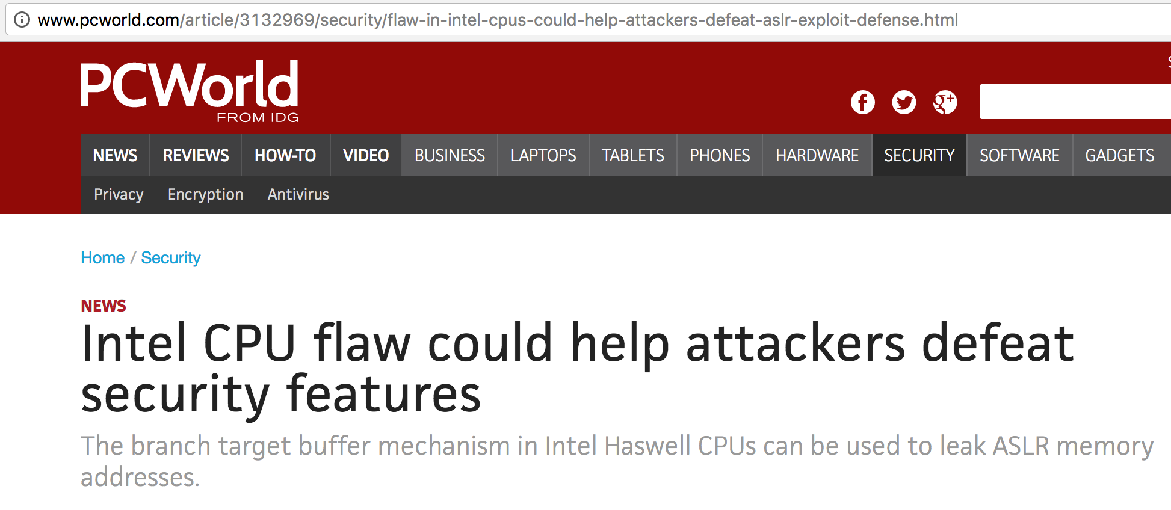
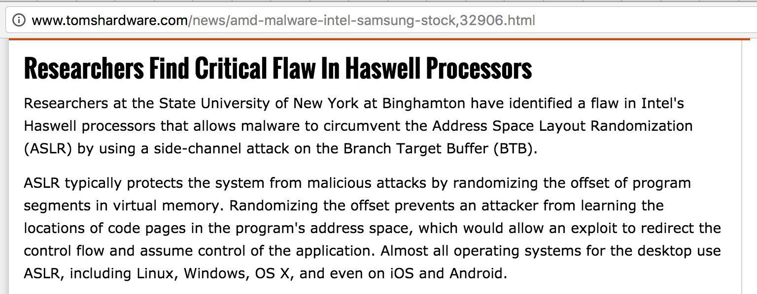
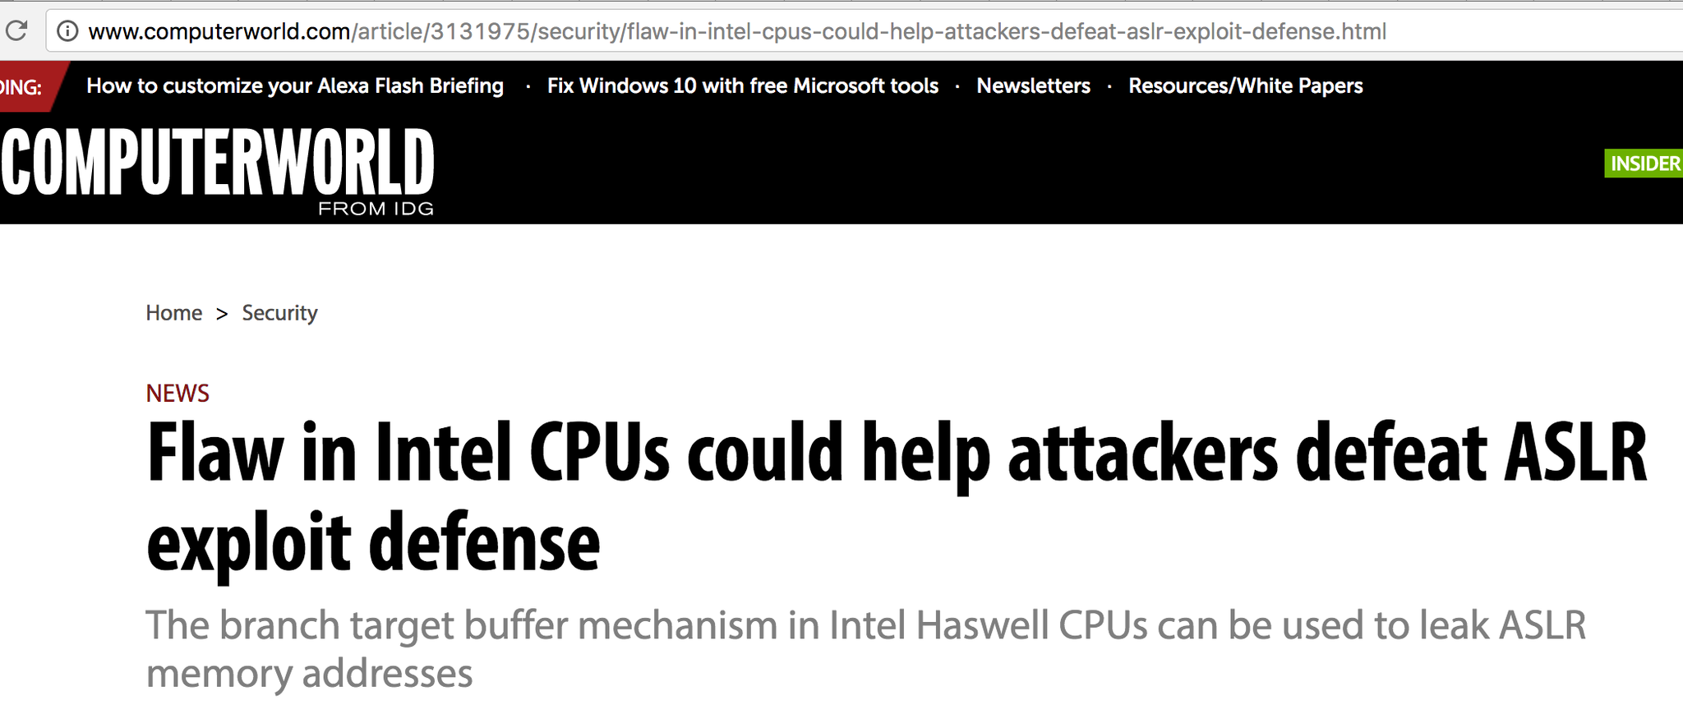
Jump over ASLR Attack in the Media
Ars Technica, Computer World, PC World, TechTarget SearchSecurity, Newswise, SC Magazine, The Register, Inquirer, Hot Hardware, Techfrag, Infosecurity Magazine, Softpedia News, Digital Tdends, Digital Journal, Science Daily, Highlander News, V3, The Stack, LeMondeInformatique, Tom's Hardware

Slide 92
What to do?
Attacks seem to pop up every day!
  Memory – how?
  GPGPU?
  MMU?
  Prefetch attack
  Not to mention covert channels…☹
Modern processors are leaky and there is nothing you can do about it (recent paper title)
  Or is there?
How about non-architectural side channels?
  Yes!

