Slide 1
Advanced Operating Systems (CS 202) Virtualization
Notes:
Some ideas from presentation by Kishore Ramachandran, and whitepapers from VMWare.

Slide 2
Virtualization
One of the natural consequences of the extensibility research we discussed
What is virtualization and what are the benefits?

Slide 3
Virtualization motivation
Cost: multiplex multiple virtual machines on one hardware machine
Cloud computing, data center virtualization
Why not processes?
Why not containers?
Heterogeneity:
Allow one machine to support multiple OS’s
Maintaining compatibility
Other: security, migration, energy optimization, customization, …

Slide 4
How do we virtualize?
Create an operating system to multiplex resources among operating systems!
Exports a virtual machine to the Operating systems
Called a hypervisor or Virtual Machine Monitor (VMM)

Slide 5
Virtualization Models

Slide 6
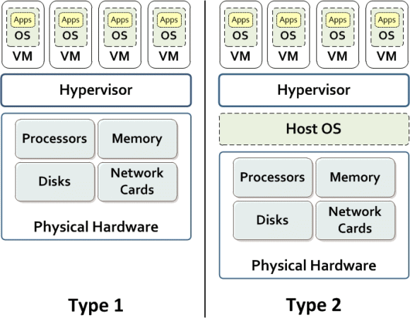
Two types of hypervisors
Type 1: Native (bare metal)
Hypervisor runs on top of the bare metal machine
e.g., KVM
Type 2: Hosted
Hypervisor is an emulator
e.g., VMWare, virtual box, QEMU
Notes:
Figure credit: IBM

Slide 7
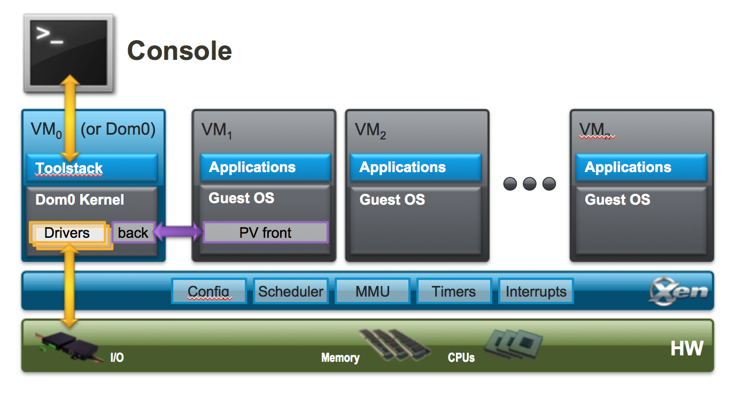
Hybrid organizations
Some hybrids exist, e.g., Xen
Mostly bare metal
VM0/Dom0 to keep device drivers out of VMM

Slide 8
Stepping back – some history
IBM VM 370 (1970s)
Microkernels (late 80s/90s)
Extensibility (90s)
SIMOS (late 90s)
Eventually became VMWare (2000)
Xen, Vmware, others (2000s)
Ubiquitous use, Cloud computing, data centers, …
Makes computing a utility

Slide 9
Full virtualization
Idea: run guest operating systems unmodified
However, supervisor is the real privileged software
When OS executes privileged instruction, trap to hypervisor who executes it for the OS
This can be very expensive
Also, subject to quirks of the architecture
Example, x86 fails silently if some privileged instructions execute without privilege
E.g., popf

Slide 10
Example: Disable Interrupts
Guest OS tries to disable interrupts
the instruction is trapped by the VMM which makes a note that interrupts are disabled for that virtual machine
Interrupts arrive for that machine
Buffered at the VMM layer until the guest OS enables interrupts.
Other interrupts are directed to VMs that have not disabled them

Slide 11
Binary translation--making full virtualization practical
Use binary translation to modify OS to rewrite silent failure instructions
More aggressive translation can be used
Translate OS mode instructions to equivalent VMM instructions
Some operations still expensive
Cache for future use
Used by VMWare ESXi and Microsoft Virtual Server
Performance on x86 typically ~80-95% of native

Slide 12
Binary Translation Example
Guest OS Assembly
Translated Assembly
do_atomic_operation:
cli
mov eax, 1
xchg eax, [lock_addr]
test eax, eax
jnz spinlock
…
…
mov [lock_addr], 0
sti
ret
do_atomic_operation:
call [vmm_disable_interrupts]
mov eax, 1
xchg eax, [lock_addr]
test eax, eax
jnz spinlock
…
…
mov [lock_addr], 0
call [vmm_enable_interrupts]
ret

Slide 13
Paravirtualization
Modify the OS to make it aware of the hypervisor
Can avoid the tricky features
Aware of the fact it is virtualized
Can implement optimizations
Comparison to binary translation?
Amount of code change?
1.36% of Linux, 0.04% for Windows

Slide 14
Hardware supported virtualization (Intel VT-x, AMD-V)
Hardware support for virtualization
Makes implementing VMMs much simpler
Streamlines communication between VM and OS
Removes the need for paravirtualization/binary translation
EPT: Support for shadow page tables
More later…

Slide 15
NUTS and BOLTS

Slide 16
What needs to be done?
Virtualize hardware
Memory hierarchy
CPUs
Devices
Implement data and control transfer between guests and hypervisor
We’ll cover this by example – Xen paper
Slides modified from presentation by Jianmin Chen

Slide 17
Xen
Design principles:
Unmodified applications: essential
Full-blown multi-task O/Ss: essential
Paravirtualization: necessary for performance and isolation

Slide 18
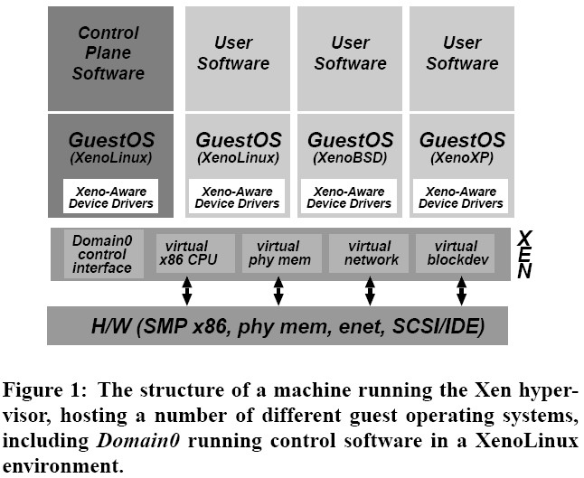
Xen

Slide 19
Implementation summary

Slide 20
Xen VM interface: Memory
Memory management
Guest cannot install highest privilege level segment descriptors; top end of linear address space is not accessible
Guest has direct (not trapped) read access to hardware page tables; writes are trapped and handled by the VMM
Physical memory presented to guest is not necessarily contiguous

Slide 21
Two Layers of Virtual Memory
Physical address → machine address
Host OS’s
View of RAM
Virtual address → physical address
0xFFFFFFFF
Guest OS’s
View of RAM
Guest App’s
View of RAM
0xFFFF
Page 2
0xFF
Page 0
Page 0
Page 3
Page 2
Page 1
Page 1
Page 3
Page 0
Page 3
Page 1
0x00
Page 2
Unknown to the guest OS
Known to the guest OS
0x0000
0x00000000

Slide 22
Guest’s Page Tables Are Invalid
Guest OS page tables map virtual page numbers (VPNs) to physical frame numbers (PFNs)
Problem: the guest is virtualized, doesn’t actually know the true PFNs
The true location is the machine frame number (MFN)
MFNs are known to the VMM and the host OS
Guest page tables cannot be installed in cr3
Map VPNs to PFNs, but the PFNs are incorrect
How can the MMU translate addresses used by the guest (VPNs) to MFNs?

Slide 23
Shadow Page Tables
Solution: VMM creates shadow page tables that map VPN → MFN (as opposed to VPN→PFN)
Guest Page Table
Physical Memory
VPN | PFN
00 (0) | 01 (1)
01 (1) | 10 (2)
10 (2) | 11 (3)
11 (3) | 00 (0)
64
Maintained by the guest OS
Invalid for the MMU
Page 3
48
Page 2
32
Virtual Memory
Page 1
16
64
Page 0
Page 3
0
48
Page 2
32
Shadow Page Table
Machine Memory
Page 1
16
VPN | MFN
00 (0) | 10 (2)
01 (1) | 11 (3)
10 (2) | 00 (0)
11 (3) | 01 (1)
64
Maintained by the VMM
Valid for the MMU
Page 0
Page 3
0
48
Page 2
32
Page 1
16
Page 0
0

Slide 24
Building Shadow Tables
Problem: how can the VMM maintain consistent shadow pages tables?
The guest OS may modify its page tables at any time
Modifying the tables is a simple memory write, not a privileged instruction
Thus, no helpful CPU exceptions :(
Solution: mark the hardware pages containing the guest’s tables as read-only
If the guest updates a table, an exception is generated
VMM catches the exception, examines the faulting write, updates the shadow table

Slide 25
More VMM Tricks
The VMM can play tricks with virtual memory just like an OS can
Balooning:
The VMM can page parts of a guest, or even an entire guest, to disk
A guest can be written to disk and brought back online on a different machine!
Deduplication:
The VMM can share read-only pages between guests
Example: two guests both running Windows XP

Slide 26
Xen VM interface: CPU
CPU
Guest runs at lower privilege than VMM
Exception handlers must be registered with VMM
Fast system call handler can be serviced without trapping to VMM
Hardware interrupts replaced by lightweight event notification system
Timer interface: both real and virtual time

Slide 27
Details: CPU
Frequent exceptions:
Software interrupts for system calls
Page faults
Allow “guest” to register a ‘fast’ exception handler for system calls that can be accessed directly by CPU in ring 1, without switching to ring-0/Xen
Handler is validated before installing in hardware exception table: To make sure nothing executed in Ring 0 privilege.
Doesn’t work for Page Fault

Slide 28
Xen VM interface: I/O
I/O
Virtual devices exposed as asynchronous I/O rings to guests
Event notification replaces interrupts

Slide 29
Details: I/O 1
Xen does not emulate hardware devices
Exposes device abstractions for simplicity and performance
I/O data transferred to/from guest via Xen using shared-memory buffers
Virtualized interrupts: light-weight event delivery mechanism from Xen-guest
Update a bitmap in shared memory
Optional call-back handlers registered by O/S

Slide 30
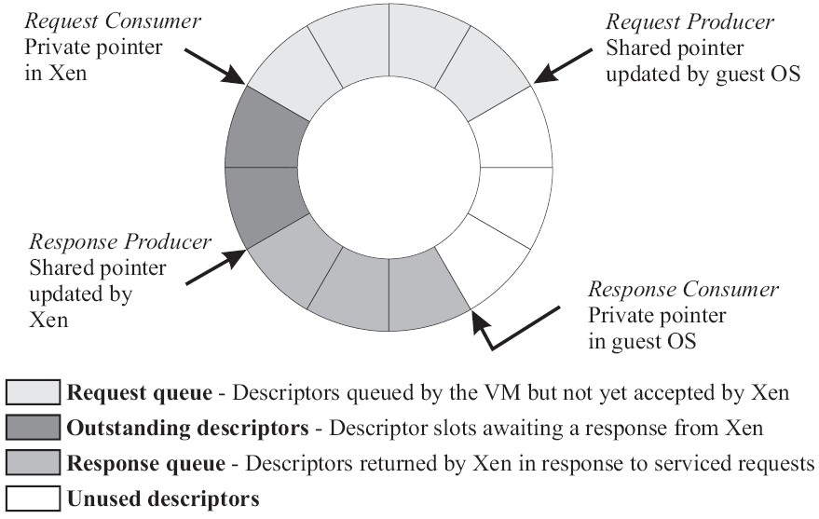
Details: I/O 2
I/O Descriptor Ring:

Slide 31
OS Porting Cost
Number of lines of code modified or added compared with original x86 code base (excluding device drivers)
Linux: 2995 (1.36%)
Windows XP: 4620 (0.04%)
Re-writing of privileged routines;
Removing low-level system initialization code

Slide 32
Control Transfer
Guest synchronously call into VMM
Explicit control transfer from guest O/S to monitor
“hypercalls”
VMM delivers notifications to guest O/S
E.g. data from an I/O device ready
Asynchronous event mechanism; guest O/S does not see hardware interrupts, only Xen notifications

Slide 33
Event notification
Pending events stored in per-domain bitmask
E.g. incoming network packet received
Updated by Xen before invoking guest OS handler
Xen-readable flag may be set by a domain
To defer handling, based on time or number of pending requests
Analogous to interrupt disabling

Slide 34
Data Transfer: Descriptor Ring
Descriptors are allocated by a domain (guest) and accessible from Xen
Descriptors do not contain I/O data; instead, point to data buffers also allocated by domain (guest)
Facilitate zero-copy transfers of I/O data into a domain

Slide 35
Network Virtualization
Each domain has 1+ network interfaces (VIFs)
Each VIF has 2 I/O rings (send, receive)
Each direction also has rules of the form (<pattern>,<action>) that are inserted by domain 0 (management)
Xen models a virtual firewall+router (VFR) to which all domain VIFs connect

Slide 36
Network Virtualization
Packet transmission:
Guest adds request to I/O ring
Xen copies packet header, applies matching filter rules
E.g. change header IP source address for NAT
No change to payload; pages with payload must be pinned to physical memory until DMA to physical NIC for transmission is complete
Round-robin packet scheduler

Slide 37
Network Virtualization
Packet reception:
Xen applies pattern-matching rules to determine destination VIF
Guest O/S required to exchange unused page frame for each packet received
Xen exchanges packet buffer for page frame in VIF’s receive ring
If no receive frame is available, the packet is dropped
Avoids Xen-guest copies; requires pagealigned receive buffers to be queued at VIF’s receive ring

Slide 38
Disk virtualization
Domain0 has access to physical disks
Currently: SCSI and IDE
All other domains: virtual block device (VBD)
Created & configured by management software at domain0
Accessed via I/O ring mechanism
Possible reordering by Xen based on knowledge about disk layout

Slide 39
Disk virtualization
Xen maintains translation tables for each VBD
Used to map requests for VBD (ID,offset) to corresponding physical device and sector address
Zero-copy data transfers take place using DMA between memory pages pinned by requesting domain
Scheduling: batches of requests in round-robin fashion across domains

Slide 40
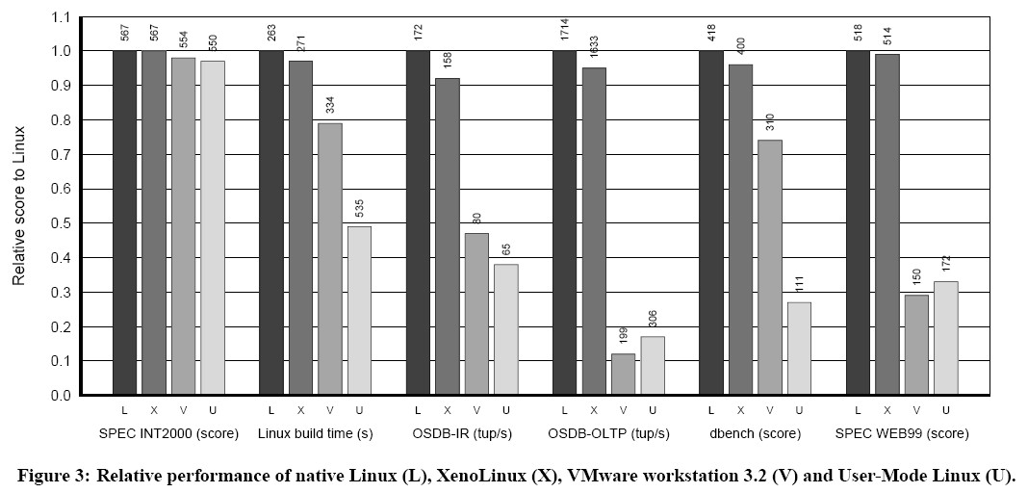
Evaluation

Slide 41
Microbenchmarks
Stat, open, close, fork, exec, etc
Xen shows overheads of up to 2x with respect to native Linux
(context switch across 16 processes; mmap latency)
VMware shows up to 20x overheads
(context switch; mmap latencies)
UML shows up to 200x overheads
Fork, exec, mmap; better than VMware in context switches

Slide 42
VT-x : Motivation
To solve the problem that the x86 instructions architecture cannot be virtualized.
Simplify VMM software by closing virtualization holes by design.
Ring Compression
Non-trapping instructions
Excessive trapping
Eliminate need for software virtualization (i.e paravirtualization, binary translation).

Slide 43
CPU Virtualization with VT-x

Slide 44
VMX
Virtual Machine Extensions define processor-level support for virtual machines on the x86 platform by a new form of operation called VMX operation.
Kinds of VMX operation:
root: VMM runs in VMX root operation
non-root: Guest runs in VMX non-root operation
Eliminate de-privileging of Ring for guest OS.

Slide 45
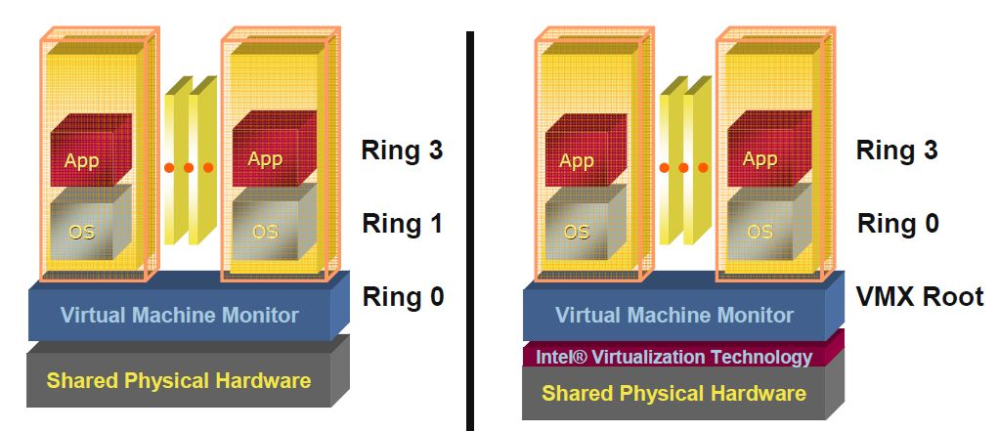
Pre VT-x Post VT-x
VMM ring de-privileging of guest OS | VMM executes in VMX root-mode
Guest OS aware its not at Ring 0 | Guest OS de-privileging eliminated
 | Guest OS runs directly on hardware

Slide 46
VMX Transitions
Transitions between VMX root operation and VMX non-root operation.
Kinds of VMX transitions:
VM Entry: Transitions into VMX non-root operation.
VM Exit: Transitions from VMX non-root operation to VMX root operation.
Registers and address space swapped in one atomic operation.

Slide 47
VMX Transitions
VM 1
VM 2
VM n
VMX Non-Root Operation
Ring 3
Ring 3
Ring 3
Ring 0
Ring 0
Ring 0
VM Entry
VMCS 1
VMCS 2
VMCS n
VM Exit
VMX Root Operation
Ring 3
Ring 0
vmlaunch / vmresume

Slide 48
VMCS: VM Control Structure
Data structure to manage VMX non-root operation and VMX transitions.
Specifies guest OS state.
Configured by VMM.
Controls when VM exits occur.

Slide 49
VMCS: VM Control Structure
The VMCS consists of six logical groups:
Guest-state area: Processor state saved into the guest-state area on VM exits and loaded on VM entries.
Host-state area: Processor state loaded from the host-state area on VM exits.
VM-execution control fields: Fields controlling processor operation in VMX non-root operation.
VM-exit control fields: Fields that control VM exits.
VM-entry control fields: Fields that control VM entries.
VM-exit information fields: Read-only fields to receive information on VM exits describing the cause and the nature of the VM exit.

Slide 50
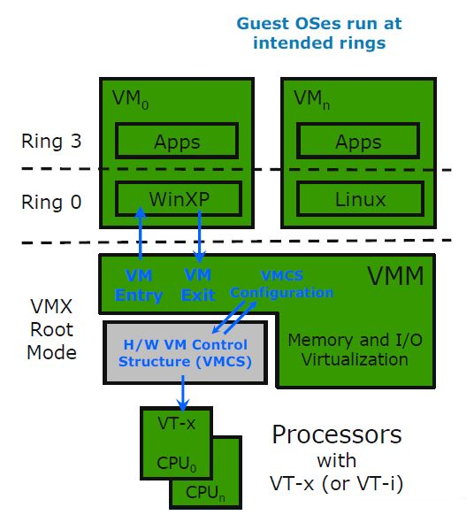
CPU Virtualization with VT-x
Source: [2]

Slide 51
MMU Virtualization with VT-x

Slide 52
VPID: Motivation
First generation VT-x forces TLB flush on each VMX transition.
Performance loss on all VM exits.
Performance loss on most VM entries
Guest page tables not modified always
Better VMM software control of TLB flushes is beneficial.

Slide 53
VPID: Virtual Processor Identifier
16-bit virtual-processor-ID field in the VMCS.
Cached linear translations tagged with VPID value.
No flush of TLBs on VM entry or VM exit if VPID active.
TLB entries of different virtual machines can all co-exist in the TLB.

Slide 54
Virtualizing Memory in Software
Three abstractions of memory:
0
4GB
Current Guest Process
Guest OS
Virtual
Address Spaces
0
4GB
Virtual RAM
Virtual
Frame
Buffer
Virtual
Devices
Virtual
ROM
Physical
Address Spaces
0
4GB
RAM
Devices
Frame
Buffer
ROM
Machine
Address Space

Slide 55
Shadow Page Tables
VMM maintains shadow page tables that map guest-virtual pages directly to machine pages.
Guest modifications to V->P tables synced to VMM V->M shadow page tables.
Guest OS page tables marked as read-only.
Modifications of page tables by guest OS -> trapped to VMM.
Shadow page tables synced to the guest OS tables

Slide 56
Set CR3 by guest OS (1)
Guest
Page Table
Guest
Page Table
Guest
Page Table
Virtual CR3
Real CR3
Shadow
Page Table
Shadow
Page Table
Shadow
Page Table
Source: [6]

Slide 57
Set CR3 by guest OS (2)
Guest
Page Table
Guest
Page Table
Guest
Page Table
Virtual CR3
Real CR3
Shadow
Page Table
Shadow
Page Table
Shadow
Page Table

Slide 58
Drawbacks: Shadow Page Tables
Maintaining consistency between guest page tables and shadow page tables leads to an overhead: VMM traps
Loss of performance due to TLB flush on every “world-switch”.
Memory overhead due to shadow copying of guest page tables.

Slide 59
Nested / Extended Page Tables
Extended page-table mechanism (EPT) used to support the virtualization of physical memory.
Translates the guest-physical addresses used in VMX non-root operation.
Guest-physical addresses are translated by traversing a set of EPT paging structures to produce physical addresses that are used to access memory.

Slide 60
Nested / Extended Page Tables

Slide 61
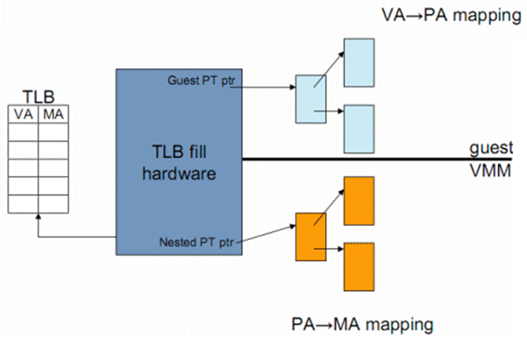
Nested / Extended Page Tables
Source: [4]

Slide 62
Advantages: EPT
Simplified VMM design.
Guest page table modifications need not be trapped, hence VM exits reduced.
Reduced memory footprint compared to shadow page table algorithms.

Slide 63
Disadvantages: EPT
TLB miss is very costly since guest-physical address to machine address needs an extra EPT walk for each stage of guest-virtual address translation.

