Slide 1
Advanced Operating Systems (CS 202) Memory Consistency and RCU intro

Slide 2
Lets start with an example
Code:
Initially A = Flag = 0
P1 P2
A = 23; while (Flag != 1) {;}
Flag = 1; B = A;
Idea:
P1 writes data into A and sets Flag to tell P2 that data value can be read from A.
P2 waits till Flag is set and then reads data from A.
What possible values can B have?

Slide 3
Multi-threaded programs on uniprocessor
Processor executes all threads of program
unspecified scheduling policy
Operations in each thread are executed in order
Atomic operations: lock/unlock etc. for synchronization between threads
Result is as if instructions from different threads were interleaved in some order
Non-determinacy: program may produce different outputs depending on scheduling of threads (eg)
Thread 1 Thread 2
….. ……
x := 1; print(x);
x := 2;
P
MEMORY

Slide 4
Multi-threaded programs on multiprocessor
Each processor executes one thread
let’s keep it simple
Operations in each thread are executed in order
One processor at a time can access global memory to perform load/store/atomic operations
Assume no caching of global data
You can show that running multi-threaded program on multiple processors does not change possible output(s) of program from uniprocessor case
P
P
P
MEMORY

Slide 5
More realistic architecture
Two key assumptions so far:
processors do not cache global data
improving execution efficiency:
allow caching
leads to cache coherence solved as we discussed
Instructions are executed in order
improving execution efficiency:
allow processors to execute instructions out of order subject to data/control dependences
this can change the semantics of the program!
Reordering happens for other reasons too
preventing this requires attention to memory consistency model of processor

Slide 6
Recall: uniprocessor execution
Processors reorder or change operations to improve performance
Registers may eliminate some loads and stores
Load/store buffers may delay/reorder memory accesses
Lockup free caches; split transactions buses; …
Constraint on reordering: must respect dependences
But only sequential ones
Reorderings can be performed either by compiler or processor

Slide 7
Permitted memory-op reorderings
Stores to different memory locations can be performed out of program order
store v1, data store b1, flag
store b1, flag ←→ store v1, data
Loads from different memory locations can be performed out of program order
load flag, r1 load data,r2
load data, r2 ←→ load flag, r1
Load and store to different memory locations can be performed out of program order

Slide 8
Example cause of hardware reordering
Load bypassing
Store buffer
Processor
Memory system
Store buffer holds store operations that need to be sent to memory
Loads are higher priority operations than stores since their results are
needed to keep processor busy, so they bypass the store buffer
Load address is checked against addresses in store buffer, so store
buffer satisfies load if there is an address match
Result: load can bypass stores to other addresses

Slide 9
Problem in multiprocessor context
Canonical model
operations from given processor are executed in program order
memory operations from different processors appear to be interleaved in some order at the memory
Question:
If a processor is allowed to reorder independent operations in its own instruction stream, will the execution always produce the same results as the canonical model?
Answer: no. Let us look at some examples.

Slide 10
Example (I)
Code:
Initially A = Flag = 0
P1 P2
A = 23; while (Flag != 1) {;}
Flag = 1; ... = A;
Idea:
P1 writes data into A and sets Flag to tell P2 that data value can be read from A.
P2 waits till Flag is set and then reads data from A.

Slide 11
Execution Sequence for (I)
Code:
Initially A = Flag = 0
P1 P2
A = 23; while (Flag != 1) {;}
Flag = 1; ... = A;
Possible execution sequence on each processor:
P1 P2
Write A 23 Read Flag //get 0
Write Flag 1 ……
Read Flag //get 1
Read A //what do you get?
Problem: If the two writes on processor P1 can be reordered, it is possible for processor P2 to read 0 from variable A.
Can happen on most modern processors.

Slide 12
Example II
Code: (like Dekker’s algorithm)
Initially Flag1 = Flag2 = 0
P1 P2
Flag1 = 1; Flag2 = 1;
If (Flag2 == 0) If (Flag1 == 0)
critical section critical section
Possible execution sequence on each processor:
P1 P2
Write Flag1, 1 Write Flag2, 1
Read Flag2 //get 0 Read Flag1 //what do you get?

Slide 13
Execution sequence for (II)
Code: (like Dekker’s algorithm)
Initially Flag1 = Flag2 = 0
P1 P2
Flag1 = 1; Flag2 = 1;
If (Flag2 == 0) If (Flag1 == 0)
critical section critical section
Possible execution sequence on each processor:
P1 P2
Write Flag1, 1 Write Flag2, 1
Read Flag2 //get 0 Read Flag1, ??
Most people would say that P2 will read 1 as the value of Flag1.
Since P1 reads 0 as the value of Flag2, P1’s read of Flag2 must happen before P2 writes to Flag2. Intuitively, we would expect P1’s write of Flag to happen before P2’s read of Flag1.
However, this is true only if reads and writes on the same processor to different locations are not reordered by the compiler or the hardware.
Unfortunately, this is very common on most processors (store-buffers with load-bypassing).

Slide 14
Lessons
Uniprocessors can reorder instructions subject only to control and data dependence constraints
These constraints are not sufficient in shared-memory context
simple parallel programs may produce counter-intuitive results
Question: what constraints must we put on uniprocessor instruction reordering so that
shared-memory programming is intuitive
but we do not lose uniprocessor performance?
Many answers to this question
answer is called memory consistency model supported by the processor

Slide 15
Simplest Memory Consistency Model
Sequential consistency (SC) [Lamport]
our canonical model: processor is not allowed to reorder reads and writes to global memory
P1
P2
P3
Pn
MEMORY

Slide 16
Sequential Consistency
SC constrains all memory operations:
Write → Read
Write → Write
Read → Read, Write
Simple model for reasoning about parallel programs
You can verify that the examples considered earlier work correctly under sequential consistency.
However, this simplicity comes at the cost of performance.
Question: how do we reconcile sequential consistency model with the demands of performance?

Slide 17
Is this sequentially consistent?
P1 to P4 are different programs running on different cores
r(x)a means we read memory location x and found the value a
w(x)a means we wrote a to memory location x

Slide 18
Consistency models
Consistency models are not about memory operations from different processors.
Consistency models are not about dependent memory operations in a single processor’s instruction stream (these are respected even by processors that reorder instructions).
Consistency models are all about ordering constraints on independent memory operations in a single processor’s instruction stream that have some high-level dependence (such as flags guarding data) that should be respected to obtain intuitively reasonable results.

Slide 19
Relaxed consistency
Allow reordering for performance, but provide a safety net
E.g., Processor has fence instruction:
Accesses before fence in program order must complete before fence
Accesses after fence in program order must wait for fence
Fences are performed in program order
Weak consistency: programmer puts fences where reordering is not acceptable
Implementation of fence:
processor has counter that is incremented when data op is issued, and decremented when data op is completed
Example: PowerPC has SYNC instruction
Language constructs:
OpenMP: flush
All synchronization operations like lock and unlock act like a fence

Slide 20
Weak ordering picture
fence
program
execution
Memory operations within these
regions can be reordered
fence
fence

Slide 21
Example revisited
Code:
Initially A = Flag = 0
P1 P2
A = 23;
flush; ←memory fence while (Flag != 1) {;}
Flag = 1; B = A;
Execution:
P1 writes data into A
Flush waits till write to A is completed
P1 then writes data to Flag
Therefore, if P2 sees Flag = 1, it is guaranteed that it will read the correct value of A even if memory operations in P1 before flush and memory operations after flush are reordered by the hardware or compiler.
Question: does P2 need a flush between the two statements?

Slide 22
Another relaxed model: release consistency
Further relaxation of weak consistency
Synchronization accesses are divided into
Acquires: operations like lock
Release: operations like unlock
Semantics of acquire:
Acquire must complete before all following memory accesses
Semantics of release:
all memory operations before release are complete
However,
acquire does not wait for accesses preceding it
accesses after release in program order do not have to wait for release
operations which follow release and which need to wait must be protected by an acquire

Slide 23
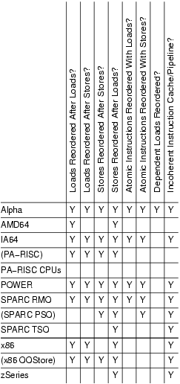
Implementations on Current Processors
Notes:
Notice that atomic instructions cause total ordering on most processors

Slide 24
Comments
In the literature, there are a large number of other consistency models
E.g., Eventual consistency
We will revisit some later…
It is important to remember that these are concerned with reordering of independent memory operations within a processor.
Easy to come up with shared-memory programs that behave differently for each consistency model.
Therefore, we have to be careful with concurrency primitives!
How do we get them right?
How do we make them portable?

Slide 25
Advanced Operating Systems (CS 202) Read Copy Update (RCU)
(some slides from Dan Porter)

Slide 26
Linux Synch. Primitives
Technique | Description | Scope
Per-CPU variables | Duplicate a data structure among CPUs | All CPUs
Atomic operation | Atomic read-modify-write instruction | All
Memory barrier | Avoid instruction re-ordering | Local CPU
Spin lock | Lock with busy wait | All
Semaphore | Lock with blocking wait (sleep) | All
Seqlocks | Lock based on access counter | All
Local interrupt disabling | Forbid interrupt on a single CPU | Local
Local softirq disabling | Forbid deferrable function on a single CPU | Local
Read-copy-update (RCU) | Lock-free access to shared data through pointers | All
Also Read-write locks

Slide 27
Why are we reading this paper?
Example of a synchronization primitive that is:
Lock free (mostly/for reads)
Tuned to a common access pattern
Making the common case fast
What is this common pattern?
A lot of reads
Writes are rare
Prioritize writes
Stale copies are short lived – time heals all wounds
Ok to read a slightly stale copy
But that can be fixed too

Slide 28
Traditional OS locking designs
poor concurrency
Especially if mostly reads
Fail to take advantage of event-driven nature of operating systems
Locks have acquire and release cost
Use atomic operations which are expensive
Can dominate cost for short critical regions
Locks become the bottleneck

Slide 29
Readers/Writers
// number of readers
int readcount = 0;
// mutual exclusion to readcount
Semaphore mutex = 1;
// exclusive writer or reader
Semaphore w_or_r = 1;
writer {
wait(w_or_r); // lock out readers
Write;
signal(w_or_r); // up for grabs
}
reader {
wait(mutex); // lock readcount
readcount += 1; // one more reader
if (readcount == 1)
wait(w_or_r); // synch w/ writers
signal(mutex); // unlock readcount
Read;
wait(mutex); // lock readcount
readcount -= 1; // one less reader
if (readcount == 0)
signal(w_or_r); // up for grabs
signal(mutex); // unlock readcount
}
Naïve implementation – can be done using just atomic instructions

Slide 30
Lock free data structures
Do not require locks
Good if contention is rare
But difficult to create and error prone
RCU is a mixture
Concurrent changes to pointers a challenge for lock-free
RCU serializes writers using locks
Win if most of our accesses are reads

Slide 31
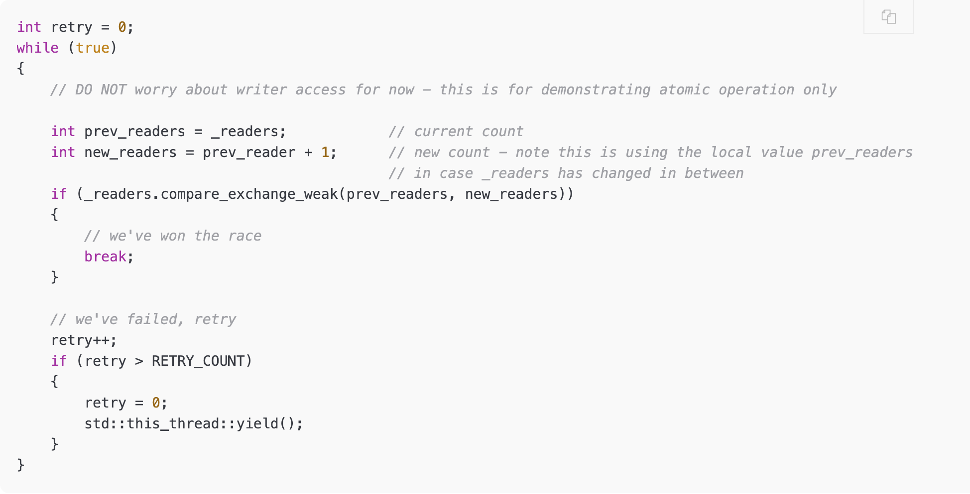
Example of lock free synchronization
Correction: second argument should be _readers
Credit: https://yizhang82.dev/lock-free-rw-lock

