Slide 1
Advanced Operating Systems (CS 202) Synchronization (Part II)

Slide 2
What are the sources of concurrency?
Multiple user-space processes
On multiple CPUs
Device interrupts
Workqueues
Tasklets
Timers

Slide 3
Pitfalls in scull
Race condition: result of uncontrolled access to shared data
if (!dptr->data[s_pos]) {
dptr->data[s_pos] = kmalloc(quantum, GFP_KERNEL);
if (!dptr->data[s_pos]) {
goto out;
}
}
Scull is the Simple Character Utility for Locality Loading (an example device driver from the Linux Device Driver book)

Slide 4
Pitfalls in scull
Race condition: result of uncontrolled access to shared data
if (!dptr->data[s_pos]) {
dptr->data[s_pos] = kmalloc(quantum, GFP_KERNEL);
if (!dptr->data[s_pos]) {
goto out;
}
}

Slide 5
Pitfalls in scull
Race condition: result of uncontrolled access to shared data
if (!dptr->data[s_pos]) {
dptr->data[s_pos] = kmalloc(quantum, GFP_KERNEL);
if (!dptr->data[s_pos]) {
goto out;
}
}

Slide 6
Pitfalls in scull
Race condition: result of uncontrolled access to shared data
if (!dptr->data[s_pos]) {
dptr->data[s_pos] = kmalloc(quantum, GFP_KERNEL);
if (!dptr->data[s_pos]) {
goto out;
}
}
Memory leak

Slide 7
Synchronization primitives
Lock/Mutex
To protect a shared variable, surround it with a lock (critical region)
Only one thread can get the lock at a time
Provides mutual exclusion
Shared locks
More than one thread allowed (hmm…)
Others? Yes, including Barriers (discussed in the paper)

Slide 8
Synchronization primitives (cont’d)
Lock based
Blocking (e.g., semaphores, futexes, completions)
Non-blocking (e.g., spin-lock, …)
Sometimes we have to use spinlocks
Lock free (or partially lock free ☺)
Atomic instructions
seqLocks
RCU
Transactions (next time)

Slide 9
Naïve implementation of spinlock
Lock(L):
While(test_and_set(L));
//we have the lock!
//eat, dance and be merry
Unlock(L) L=0;

Slide 10
Why naïve?
Works? Yes, but not used in practice
Contention
Think about the cache coherence protocol
Set in test and set is a write operation
Has to go to memory
A lot of cache coherence traffic
Unnecessary unless the lock has been released
Imagine if many threads are waiting to get the lock
Fairness/starvation

Slide 11
Better implementation Spin on read
Assumption: We have cache coherence
Not all are: e.g., Intel SCC
Lock(L):
while(L==locked); //wait
if(test_and_set(L)==locked) go back;
Still a lot of chattering when there is an unlock
Spin lock with backoff

Slide 12
Bakery Algorithm
struct lock {
int next_ticket;
int now_serving; }
Acquire_lock:
int my_ticket = fetch_and_inc(L->next_ticket);
while(L->new_serving!=my_ticket); //wait
//Eat, Dance and me merry!
Release_lock:
L->now_serving++;
Comments? Fairness? Efficiency/cache coherence?
Still too much chatter

Slide 13
Anderson Lock (Array lock)
Problem with bakery algorithm:
All threads listening to next_serving
A lot of cache coherence chatter
But only one will actually acquire the lock
Can we have each thread wait on a different variable to reduce chatter?

Slide 14
Anderson’s Lock
We have an array (actually circular queue) of variables
Each variable can indicate either lock available or waiting for lock
Only one location has lock available
Lock(L):
my_place = fetch_and_inc (queuelast);
while (flags[myplace mod N] == must_wait);
Unlock(L)
flags[myplace mod N] = must_wait;
flags[mypalce+1 mod N] = available;
Fair and not noisy – compare to spin-on-read and bakery algorithm
Any negative side effects?

Slide 15
MCS Lock
Each node has:
struct node {
bool got_it;
Next; //successor}
Lock(L, me) Unlock(L,me)
join(L); //use fetch-n-store remove me from L
while(got_it == 0); signal successor (setting got it to 0)

Slide 16
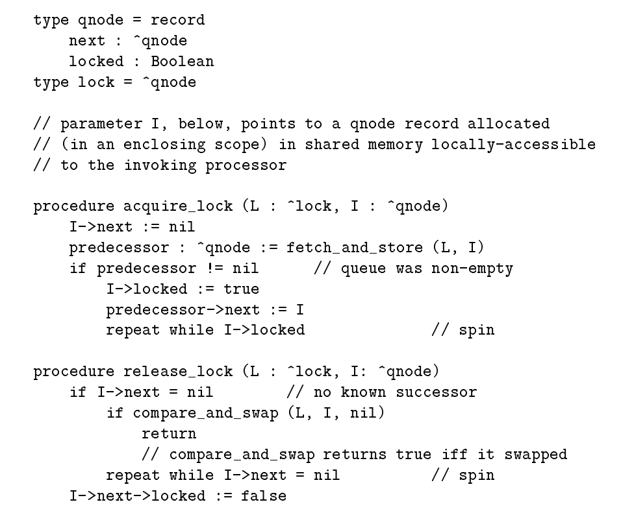
Race condition!
What if there is a new joiner when the last element is removing itself

Slide 17
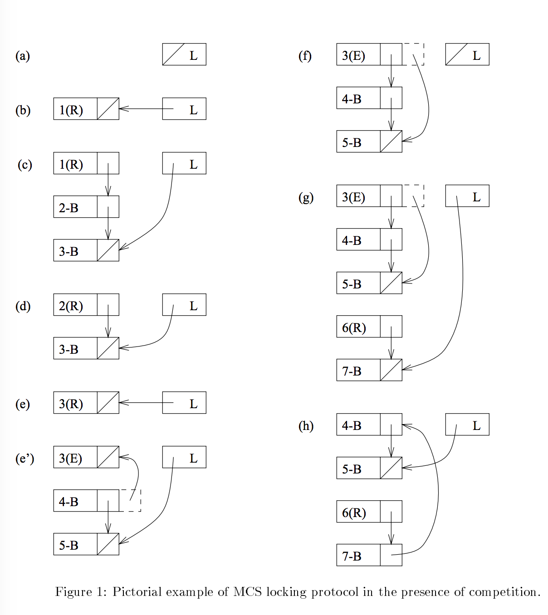

Slide 18
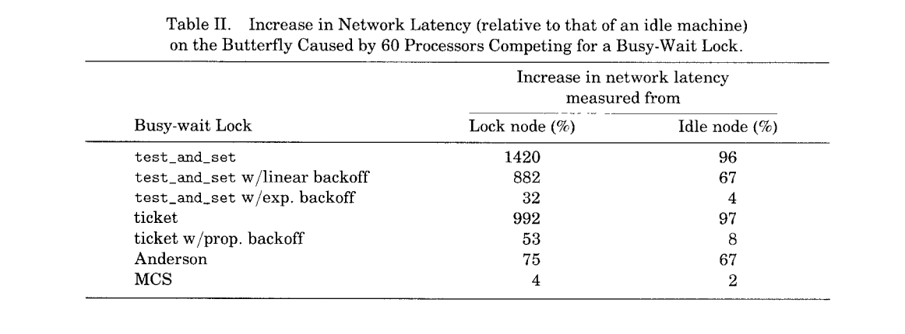
Performance impact

Slide 19
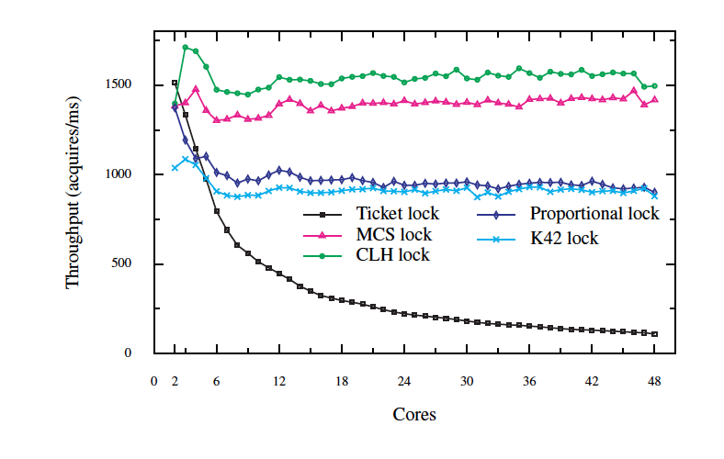
From the Boyd-Wickizer et al paper, “Non-scalable locks are dangerous”
CLH and K42 are MCS variants

Slide 20
Barriers/FYI

Slide 21
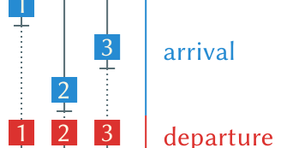
Barriers
Notes:
Figures from https://6xq.net/barrier-intro/

Slide 22
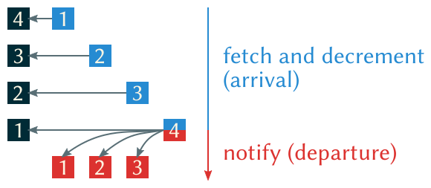
Linear barriers

Slide 23
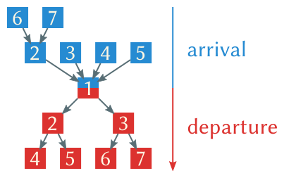
Tree barrier (MCS paper)

Slide 24
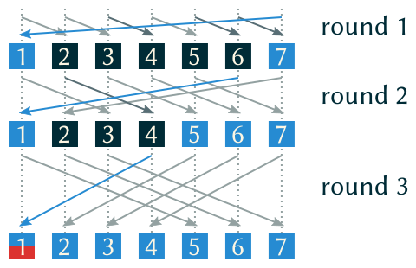
Dissemination Barrier (Hensgen/Finkel)

Slide 25
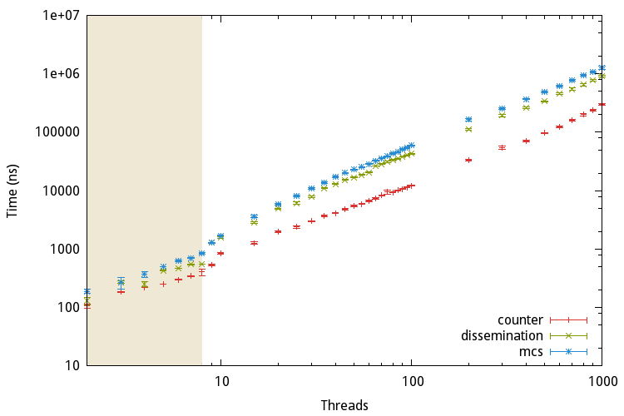
Counter based performs best!
Notes:
On modern prorcessors, counter based performs best. Source code for benchmark and the graph from:
https://6xq.net/barrier-intro/

