Slide 1
Warp Scheduling Basics

Slide 2
Loose Round Robin (LRR)
Goes around to every warp and issue if ready (R)
If warp is not ready (W), skip and issue next ready warp
Issue: Warps all run at the same speed, potentially all reaching memory access phase together and stalling.
All Warps
R
R
W
R
R
R
W
. . .
R
Select
Execution Units

Slide 3
Two-level (TL)
Warps are grouped into two groups:
Pending warps (potentially waiting on long latency instr.)
Active warps (Ready to execute)
Warps move between Pending and Active groups
Within the Active group, issue LRR
Goal: Overlap warps performing computation with warps performing memory access
Pending Warps
P
P
P
P
P
P
P
. . .
P
Active Warps
A
A
A
. . .
A
Select
Execution Units

Slide 4
Greedy-then-oldest (GTO)
Schedule from a single warp until it stalls
Then pick the oldest warp (time warp assigned to core)
Goal: Improve cache locality for greedy warp
All Warps
R
R
W
R
R
R
W
. . .
R
Select
Execution Units

Slide 5
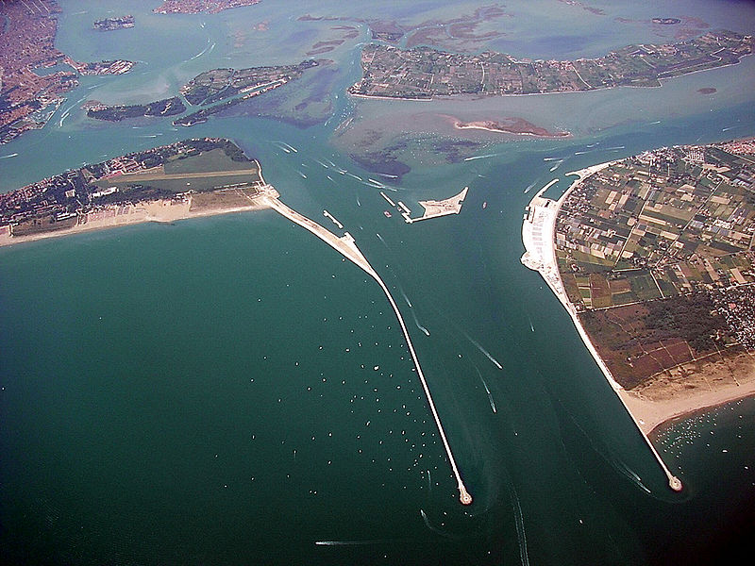
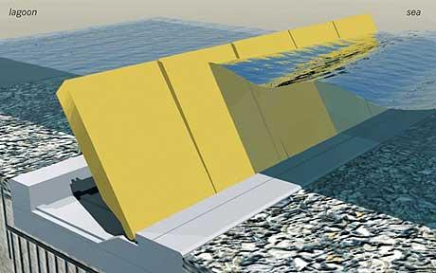
Cache-Conscious Wavefront Scheduling
Timothy G. Rogers¹
Mike O’Connor²
Tor M. Aamodt¹
¹The University of British Columbia
²AMD Research

Slide 6
Wavefronts and Caches
High Level Overview of a GPU
DRAM
DRAM
…
10’s of thousands concurrent threads
High bandwidth memory system
Include data caches
DRAM
L2 cache
Threads in Wavefront
…
Compute Unit
…
Compute Unit
W₁
W₂
…
…
Memory Unit
L1D
ALU
…
Wavefront Scheduler
ALU
ALU

Slide 7
Motivation
Improve performance of highly parallel applications with irregular or data dependent access patterns on GPU
Breadth First Search (BFS)
K-Means (KMN)
Memcached-GPU (MEMC)
Parallel Garbage Collection (GC)
These workloads can be highly cache-sensitive
Increase 32k L1D to 8M
Minimum 3x speedup
Mean speedup >5x

Slide 8
Where does the locality come from?
Classify two types of locality
Intra-wavefront locality
Inter-wavefront locality
Wave₀
Wave₁
Wave₀
LD $line (X)
LD $line (X)
LD $line (X)
LD $line (X)
Hit
Hit
Data Cache
Data Cache

Slide 9
Quantifying intra-/inter-wavefront locality
120
Misses PKI
100
Inter-Wavefront Hits PKI
80
(Hits/Miss) PKI
60
40
Intra-Wavefront Hits PKI
20
0
AVG-Highly Cache Sensitive

Slide 10
Observation
Issue-level scheduler chooses the access stream
Round Robin Scheduler
Greedy then Oldest Scheduler
Wave₀
Wave₁
Wave₀
Wave₁
Wavefront Scheduler
Wavefront Scheduler
ld A
,B,C,D…
ld Z,Y,X,W
ld A,B,C,D…
...
...
...
DC
B
A
WX
Y
Z
ld A,B,C,D
ld Z,Y,X,W
ld A,B,C,D…
DC
B
A
DC
B
A
Memory System
Memory System

Slide 11
Difficult Access Stream
Need a better replacement Policy?
Optimal Replacement using RR scheduler
4 hits
A,B,C,D
E,F,G,H
I,J,K,L
A,B,C,D
E,F,G,H
I,J,K,L
W₀
W₁
W₂
W₀
W₁
W₂
L
D
A
B
C
F
E
LRU replacement
12 hits
A,B,C,D
A,B,C,D
E,F,G,H
E,F,G,H
I,J,K,L
I,J,K,L
W₀
W₀
W₁
W₁
W₂
W₂

Slide 12
Why miss rate is more sensitive to scheduling than replacement
1024 threads = thousands of memory accesses
Ld A
Ld C
…
…
Ld E
…
…
Ld B
Ld D
Ld F
Ld A
Ld C
Ld E
1
2
A
W₀
W₁
W₃₁
…
Replacement Policy
Decision limited to one of A possible ways
Wavefront Scheduler
Decision picks from thousands of potential accesses

Slide 13
Does this ever Happen?
Consider two simple schedulers
90
80
70
Loose Round Robin with LRU
Belady Optimal
Greedy Then Oldest with LRU
60
MPKI
50
40
30
20
10
0
AVG-Highly Cache-Sensitive

Slide 14
Key Idea
Use the wavefront scheduler to shape the access pattern
Greedy then Oldest Scheduler
Cache-Conscious Wavefront Scheduler
Wave₀
Wave₁
Wave₀
Wave₁
Wavefront Scheduler
Wavefront Scheduler
ld A,B,C,D
ld Z,Y,X,W
ld A,B,C,D…
ld Z,Y,X,W…
...
...
...
...
DC
B
A
WX
Y
Z
WX
Y
Z
ld A,B,C,D
ld Z,Y,X,W
ld A,B,C,D…
ld Z,Y,X,W…
WX
Y
Z
DC
B
A
DC
B
A
Memory System
Memory System

Slide 15
CCWS Components
W₂
Locality Scoring System
W₂
W₁
Balances cache miss rate and overall throughput
Score
W₁
W₀
More Details in the Paper
W₀
Time
Lost Locality Detector
Detects when wavefronts have lost intra-wavefront locality
L1 victim tags organized by wavefront ID
Victim Tags
W₀
Tag
Tag
W₁
Tag
Tag
W₂
Tag
Tag

Slide 16
CCWS Implementation
W₂
No W₂ loads
W₂
W₂
W₁
Wave Scheduler
Locality Scoring System
W₁
Score
W₁
W₀
W₀: ld X
W₀
W₀: ld X
W₂: ld Y
W₀
…
Memory Unit
Time
Cache
W₀ detected lost locality
Tag
Y
WID
X
2
Data
0
…
Tag
WID
Data
Victim Tags
More Details in the Paper
W₀,X
W₀
ProbeW₀,X
Tag
X
Tag
W₁
Tag
Tag
W₂
Tag
Tag

Slide 17
Methodology
GPGPU-Sim (version 3.1.0)
30 Compute Units (1.3 GHz)
32 wavefront contexts (1024 threads total)
32k L1D cache per compute unit
8-way
128B lines
LRU replacement
1M L2 unified cache
Stand Alone GPGPU-Sim Cache Simulator
Trace-based cache simulator
Fed GPGPU-Sim traces
Used for oracle replacement

Slide 18
Performance Results
2
LRR
GTO
CCWS
Also Compared Against
A 2-LVL scheduler
Similar to GTO performance
A profile-based oracle scheduler
Application and input data dependent
CCWS captures 86% of oracle scheduler performance
Variety of cache-insensitive benchmarks
No performance degradation
1.5
Speedup
1
0.5
0
HMEAN-Highly Cache-Sensitive

Slide 19
Cache Miss Rate
90
80
70
60
CCWS less cache misses than other schedulers optimally replaced
50
MPKI
40
30
20
Full Sensitivity Study in Paper
10
0
AVG-Highly Cache-Sensitive

Slide 20
Related Work
Wavefront Scheduling
Gerogia Tech - GPGPU Workshop 2010
UBC - HPCA 2011
UT Austin - MICRO 2011
UT Austin/NVIDIA/UIUC/Virginia - ISCA 2011
OS-Level Scheduling
SFU – ASPLOPS 2010
Intel/MIT – ASPLOPS 2012

Slide 21
Conclusion
Different approach to fine-grained cache management
Good for power and performance
High level insight not tied specifics of a GPU
Any system with many threads sharing a cache can potentially benefit
Questions?

