Slide 1
CS/EE 217 – GPU Architecture and Parallel Programming
Introduction
Nael Abu-Ghazaleh, Professor
Department of Computer Science and Engineering
Department of Electrical and Computer Engineering
naelag@ucr.edu
Slide credit: Daniel Wong and others

Slide 2
Welcome!

Slide 3
About me
BS Electrical Engineering, University of Jordan
MS, PhD Computer Engineering, University of Cincinnati
Worked in academia all my life
  State University of New York ~12 years
  Carnegie Mellon University ~3 years
  UCR ~5 years
Area of research: Computer Architecture Security, GPU Microarchitecture, Hardware accelerators, …

Slide 4
Course Goals
Learn how to program GPGPU processors and achieve
  High performance
  Functionality and maintainability
Learn how GPGPUs work
  Microarchitecture
  Design challenges
Technical subjects
  principles and patterns of parallel algorithms
  processor architecture features and constraints
  programming API, tools and techniques

Slide 5
Web Resources
Course website (not ready yet): http://www.cs.ucr.edu/~nael/217-f19
  Handouts and lecture slides, resources …
Piazza for discussions
  Forum for Q&A – course staff read the board, and your classmates often have answers
iLearn for announcements
  ENGR Account Setup
  https://www.engr.ucr.edu/secured/systems/login.php

Slide 6
Attendance/Grading
Attendance
  You are expected to attend all lectures.
  Some slides only make sense in lecture. ☺
Grade Breakdown
  Labs: 30%
  Exam and Final: 40%
  Project: 30%
  Class Participation/Extra Credit: 5%

Slide 7
Lab Policies
3 slip days
15% penalty per late day
If it’s one minute late, it’s still late
No extensions will be given
All labs/projects are due at the end of the due date (midnight)
Projects should be uploaded to iLearn

Slide 8
Academic Honesty
You are allowed and encouraged to discuss assignments with other students in the class.
Any reference to assignments from previous terms or web postings is unacceptable
Any copying of non-trivial code is unacceptable
  Non-trivial = more than a line or so
  Includes reading someone else’s code and then going off to write your own.

Slide 9
Contact
Instructor: Nael Abu-Ghazaleh
  Email: naelag@ucr.edu
  Homepage: https://www.cs.ucr.edu/~nael/217-f19
  Office: WCH 441
  Office Hours: Friday 1-2pm or by appointment
TA: MohammedReza Rezvani
  Email: mohammadreza.rezvani@email.ucr.edu
  Office Hours: TBD
Please sign up on Piazza:
  Signup link: piazza.com/ucr/fall2019/csee217

Slide 10
Textbook/material
D. Kirk and W. Hwu, “Programming Massively Parallel Processors – A Hands-on Approach, Third Edition”
A few papers to read
CUDA by example, Sanders and Kandrot
Nvidia CUDA C Programming Guide
  https://docs.nvidia.com/cuda/cuda-c-programming-guide/

Slide 11

Why Computer Architecture?
AUVSI 2009 (RoboSub)

Slide 12
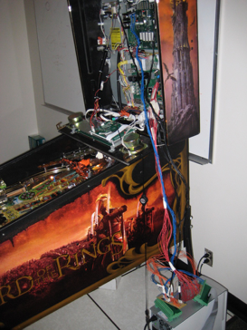
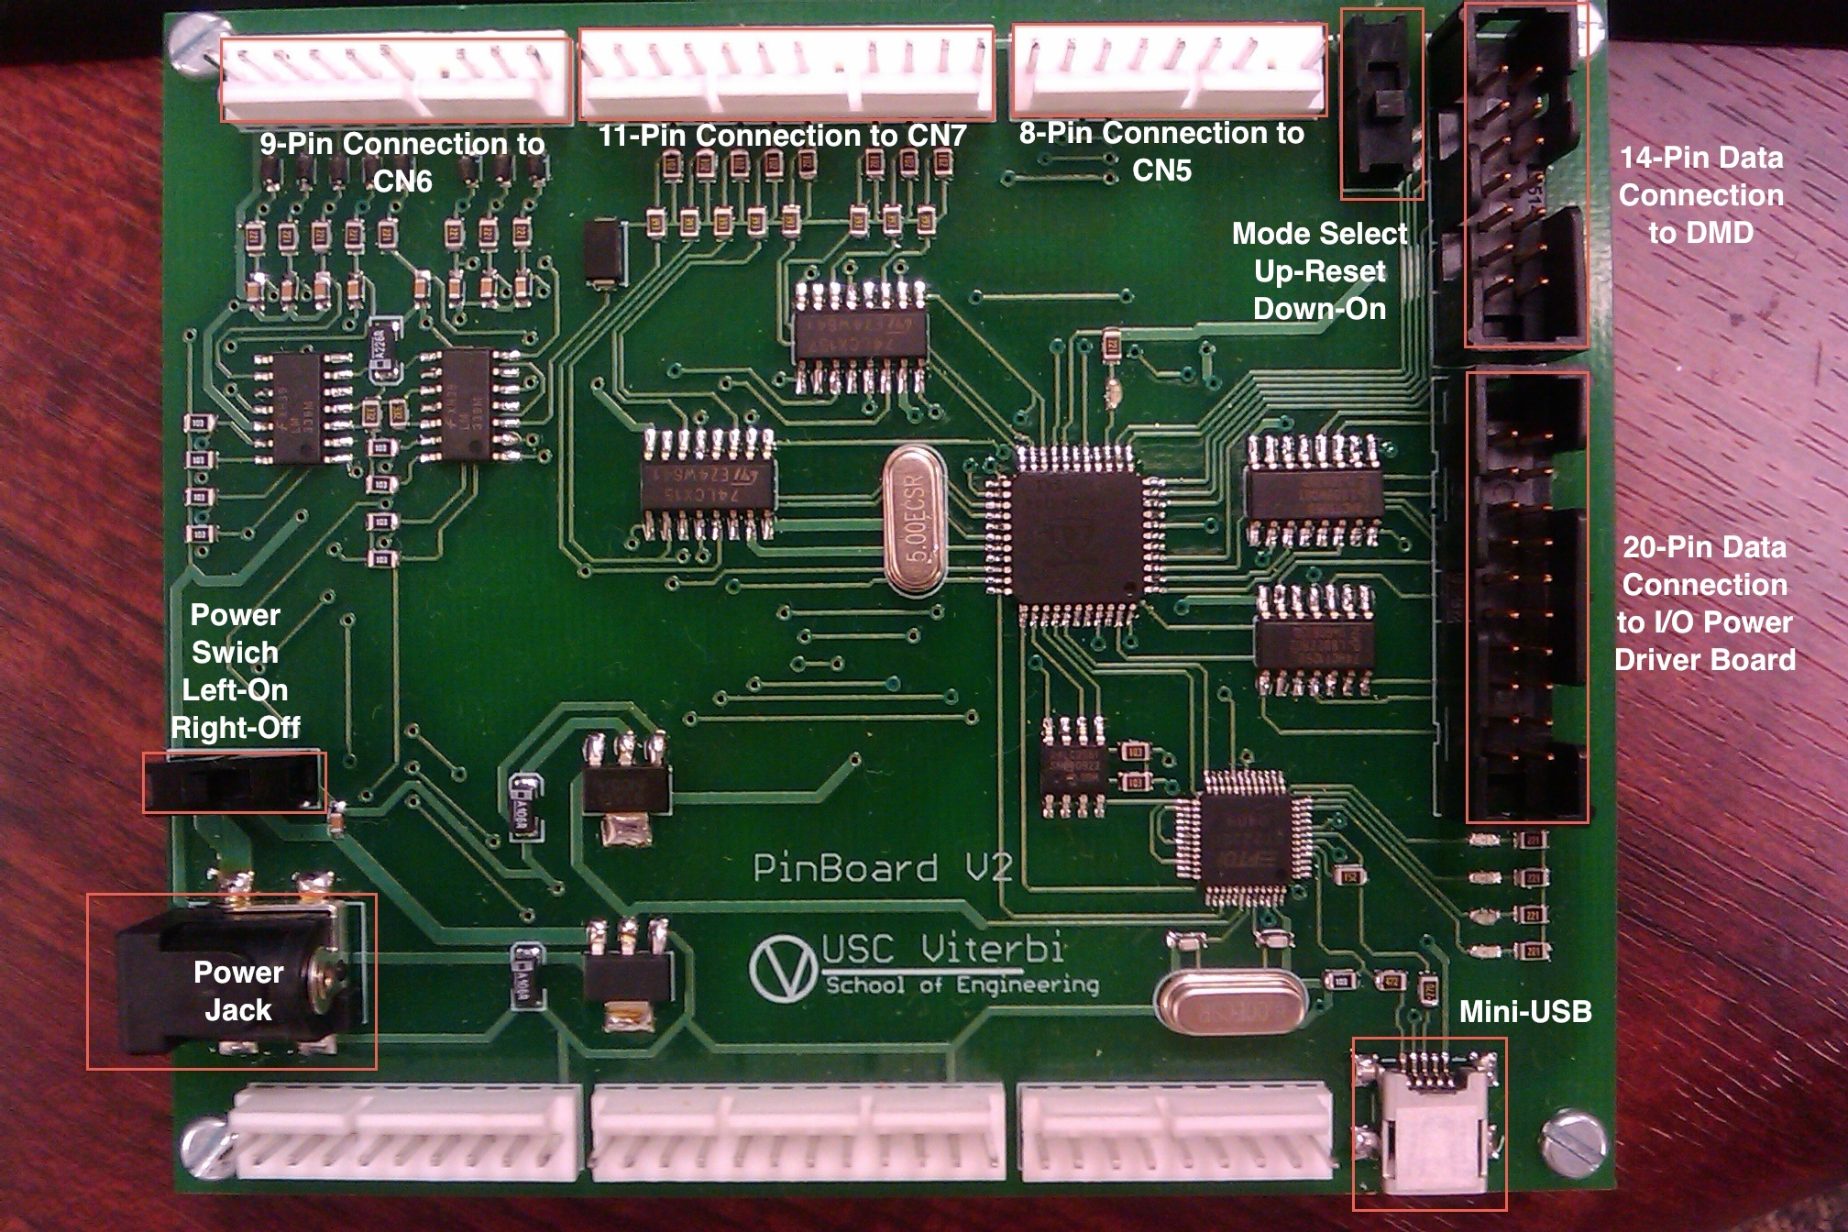
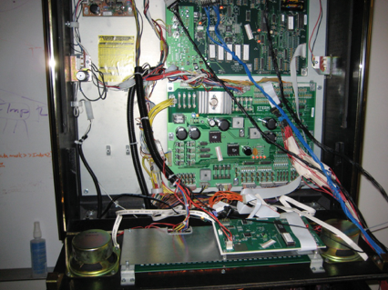
Why Computer Architecture?
Pinball Machines!

Slide 13

Why Computer Architecture?

Slide 14
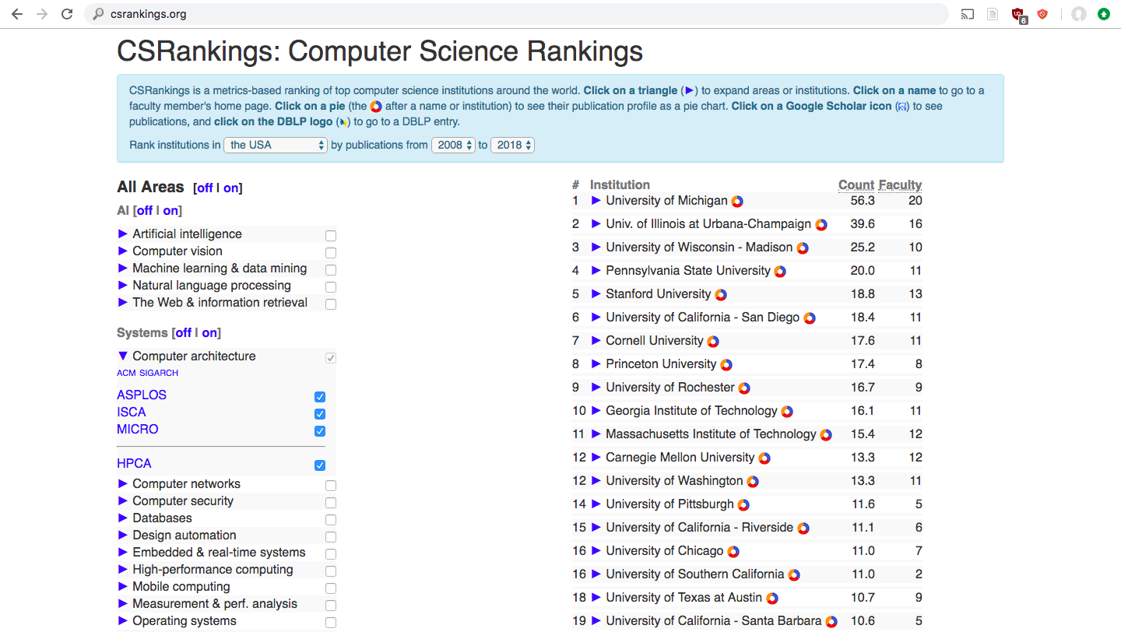
Why Computer Architecture?

Slide 15
Why GPUs?

Slide 16
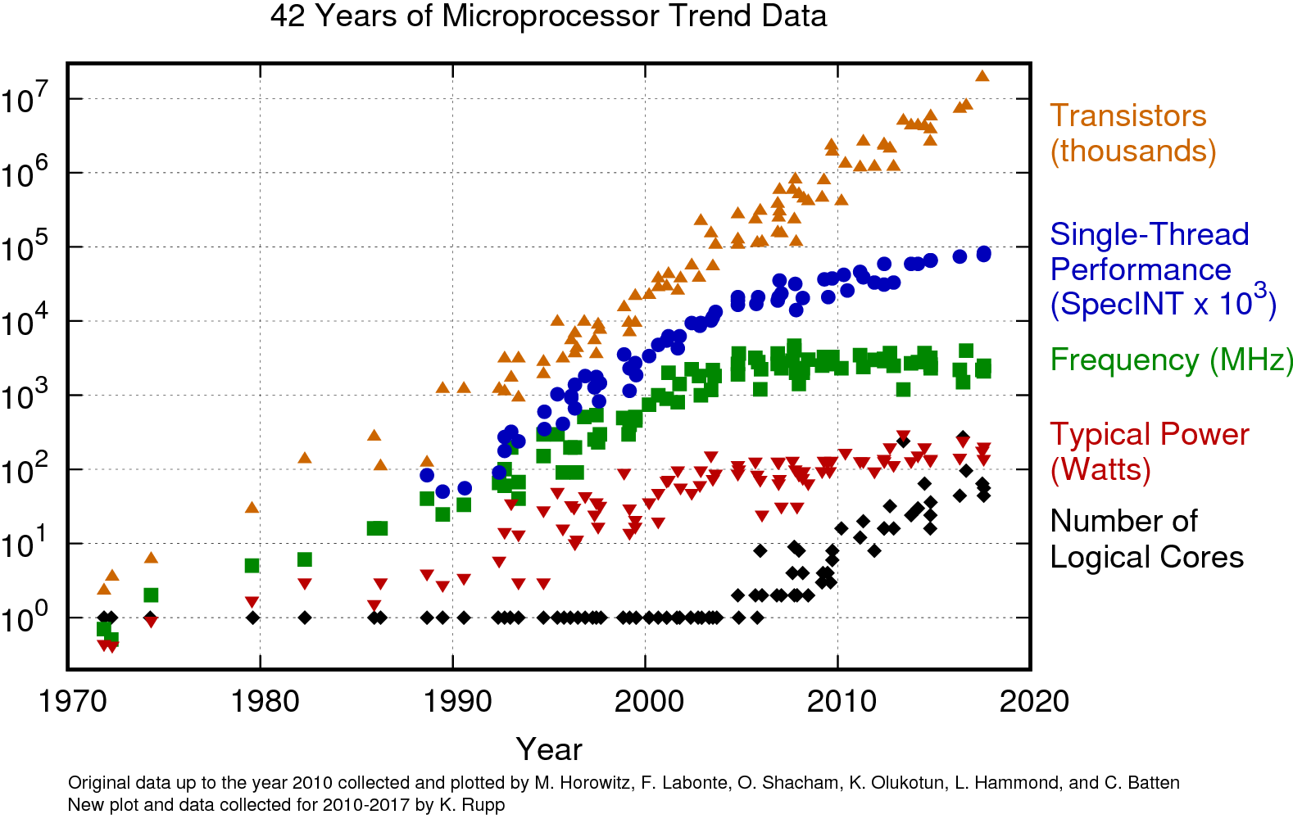

Slide 17
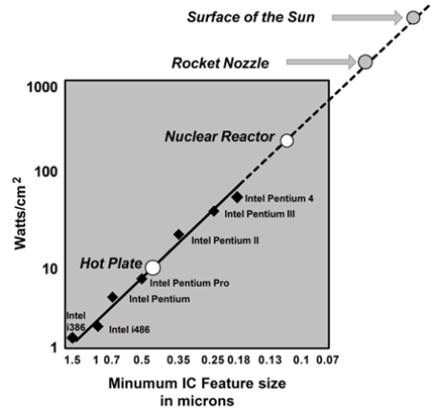

Slide 18
Modern computer architecture is limited by:
Process Technology / Transistor density
(End of Moore’s Law)
Power
(End of Dennard Scaling)
Temperature

Slide 19
General-purpose
(Easier to program)
Single-core
CPU
Multi-core
CPU
GPU
FPGA
ASIC
Specialized
Energy-efficient

Slide 20
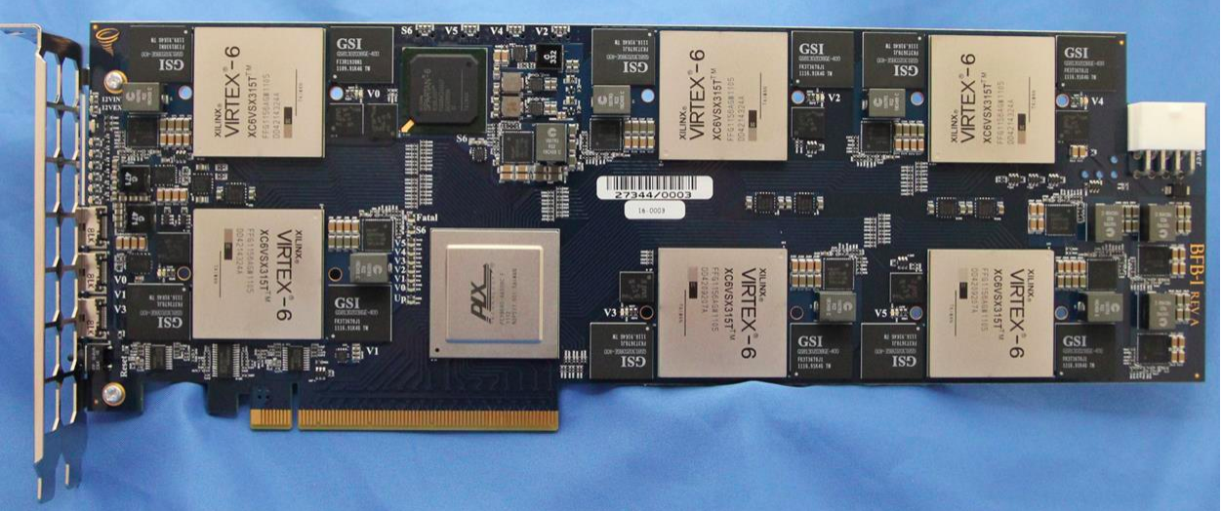
Examples of Specialization
Microsoft Catapult

Slide 21
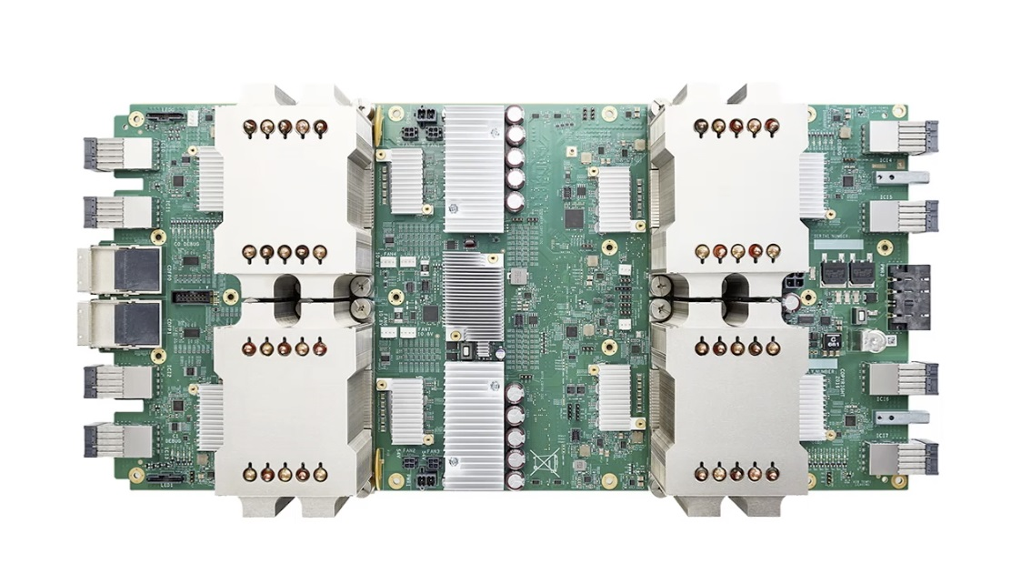
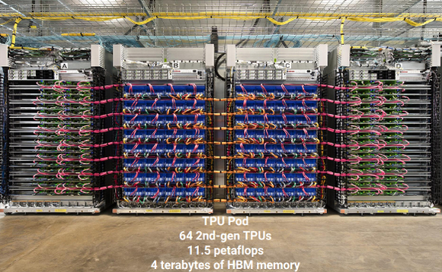
Examples of Specialization
Google TPU - Tensor Processing Unit

Slide 22
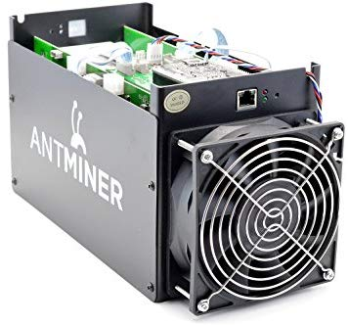
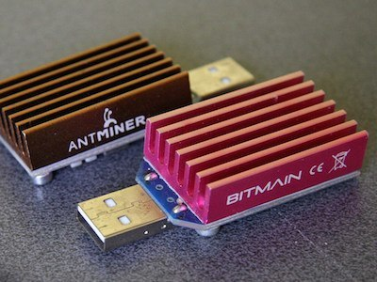
Examples of Specialization
Bitcoin Mining

Slide 23
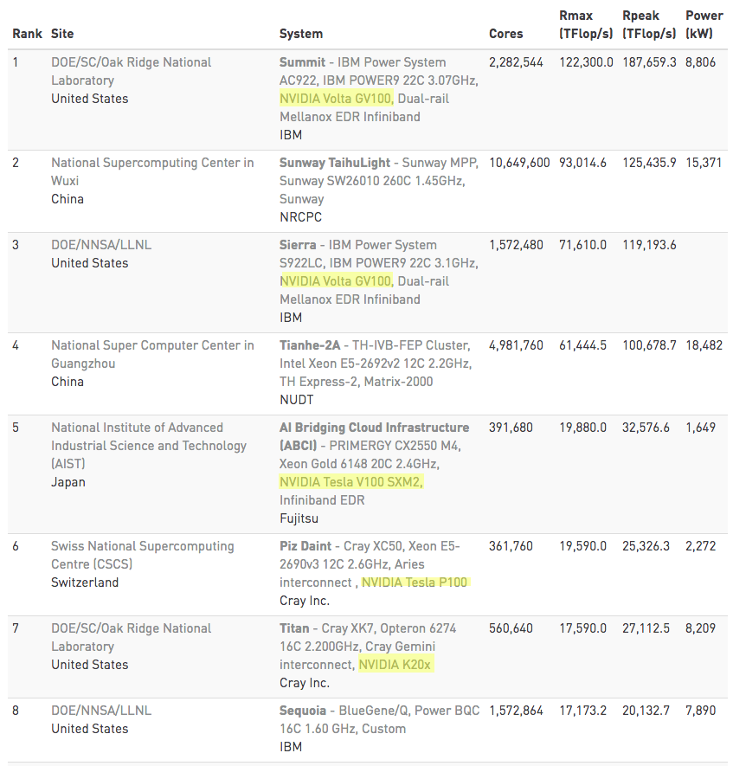
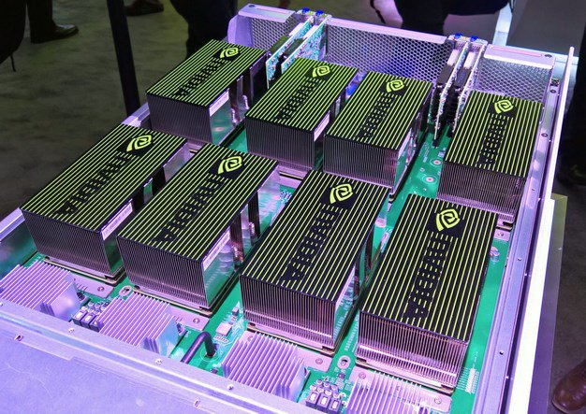
Examples of Specialization
GPUs - Supercomputers

Slide 24




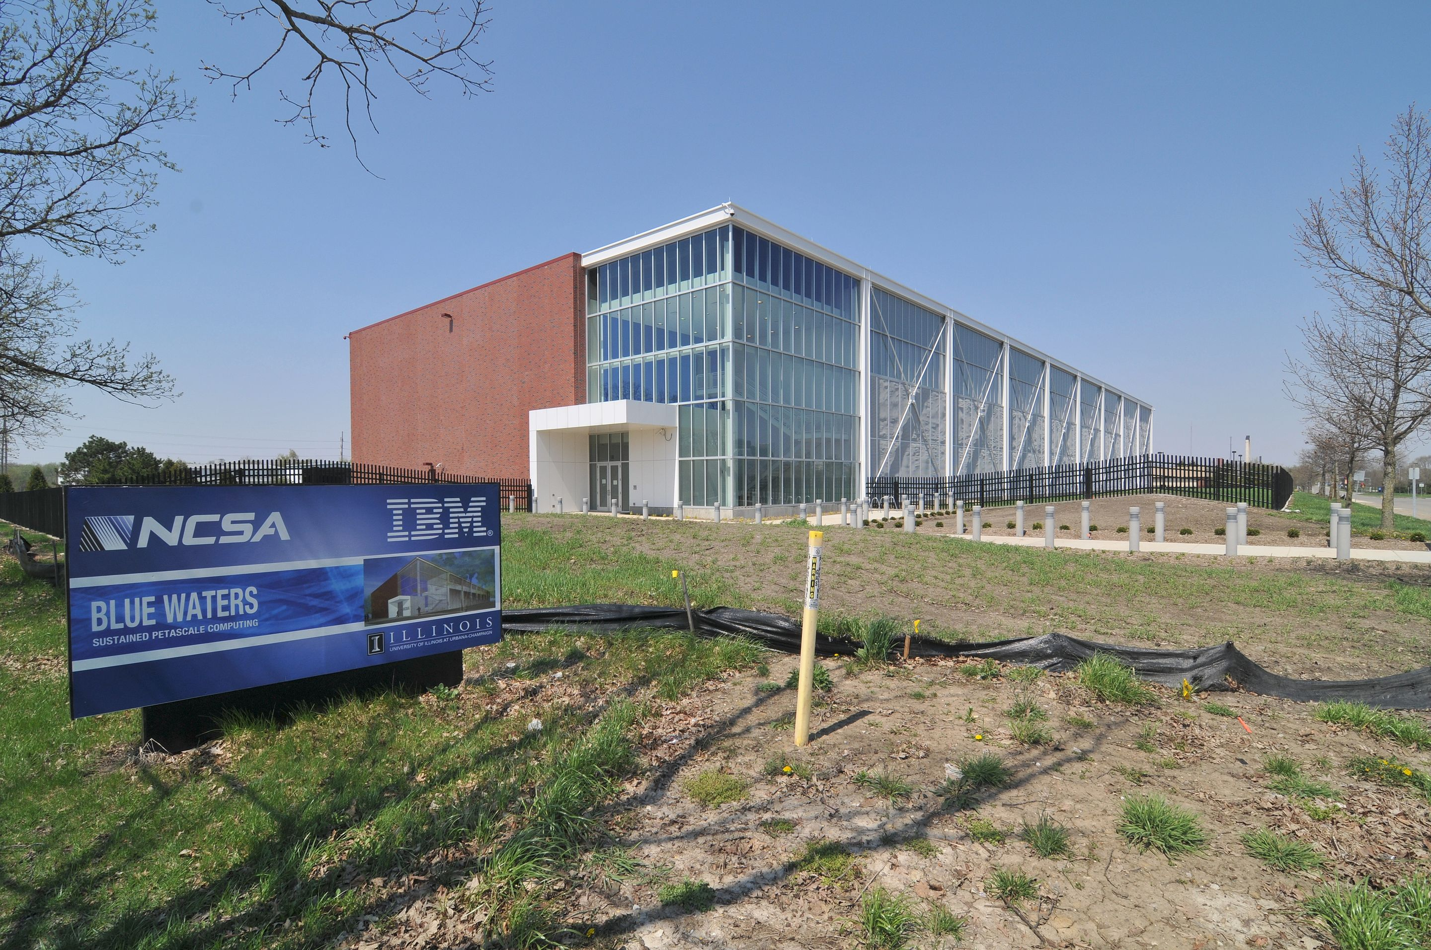
Blue Waters Hardware
Cray System & Storage cabinets:
>300
Compute nodes:
>25,000
Usable Storage Bandwidth:
>1 TB/s
System Memory:
>1.5 Petabytes
Memory per core module:
4 GB
Gemin Interconnect Topology:
3D Torus
Usable Storage:
>25 Petabytes
Peak performance:
>11.5 Petaflops
Number of AMD Interlogos processors:
>49,000
Number of AMD x86 core modules:
>380,000
Number of NVIDIA Kepler GPUs:
>3,000

Slide 25
CPU and GPU have very different design philosophy
GPU
Throughput Oriented Cores
CPU
Latency Oriented Cores
Chip
Chip
Compute Unit
Core
Cache/Local Mem
Local Cache
Registers
SIMD
Unit
Threading
Registers
Control
SIMD Unit

Slide 26
CPUs: Latency Oriented
Large caches
  Convert long latency memory accesses to short latency cache accesses
Sophisticated control
  Branch prediction for reduced branch latency
  Data forwarding for reduced data latency
Powerful ALU
  Reduced operation latency
Control
ALU
ALU
ALU
ALU
CPU
Cache
DRAM

Slide 27
GPUs: Throughput Oriented
Small caches
  To boost memory throughput
Simple control
  No branch prediction
  No data forwarding
Energy efficient ALUs
  Many, long latency but heavily pipelined for high throughput
Require massive number of threads to tolerate latencies
GPU
DRAM

Slide 28
Heterogeneous Computing: Use Both CPU and GPU
CPUs for sequential parts where latency matters
  CPUs can be 10+X faster than GPUs for sequential code
GPUs for parallel parts where throughput wins
  GPUs can be 10+X faster than CPUs for parallel code

Slide 29

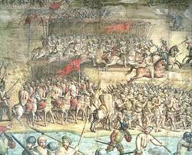


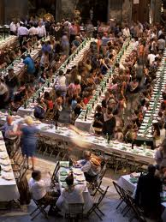

Massive Parallelism - Regularity

Slide 30
Load Balance
The total amount of time to complete a parallel job is limited by the thread that takes the longest to finish
good
bad!

Slide 31


Global Memory Bandwidth
Ideal
Reality

Slide 32


Conflicting Data Accesses Cause Serialization and Delays
Massively parallel execution cannot afford serialization
Contentions in accessing critical data causes serialization

Slide 33
What is the stake?
Scalable and portable software lasts through many hardware generations
Scalable algorithms and libraries can be the best legacy we can leave behind from this era

Slide 34
Questions?

Slide 35
Super Quick
OS/Architecture Review

Slide 36
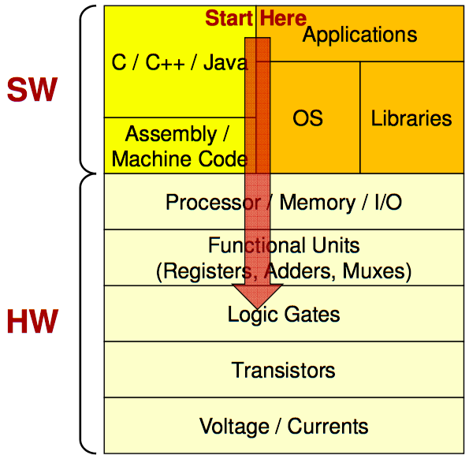
Software-Hardware stack
Credit:: Mark Redekopp, USC

Slide 37
Process vs Thread
Source: https://www.cs.uic.edu/~jbell/CourseNotes/OperatingSystems/4_Threads.html

Slide 38
Virtual Memory
Virtual Memory
Divide memory into equal sized “chunks” or pages (typically 4KB each)
Any chunk of Virtual Memory can be assigned to any chunk of Physical Memory
∞
Stack
Physical Memory
Single
Process
64 MB
Heap
Static
Code
0
0

Slide 39
ISA example - MIPS R-format Instructions
op
rs
rt
rd
shamt
funct
6 bits
5 bits
5 bits
5 bits
5 bits
6 bits
Instruction fields
  op: operation code (opcode)
  rs: first source register number
  rt: second source register number
  rd: destination register number
  shamt: shift amount (00000 for now)
  funct: function code (extends opcode)
Used only for ALU instructions

Slide 40
R-format Example
op
rs
rt
rd
shamt
funct
6 bits
5 bits
5 bits
5 bits
5 bits
6 bits
add $r8, $r17, $r18
special
$r17
$r18
$r8
0
add
0
17
18
8
0
32
000000
10001
10010
01000
00000
100000
00000010001100100100000000100000₂ = 02324020₁₆

Slide 41
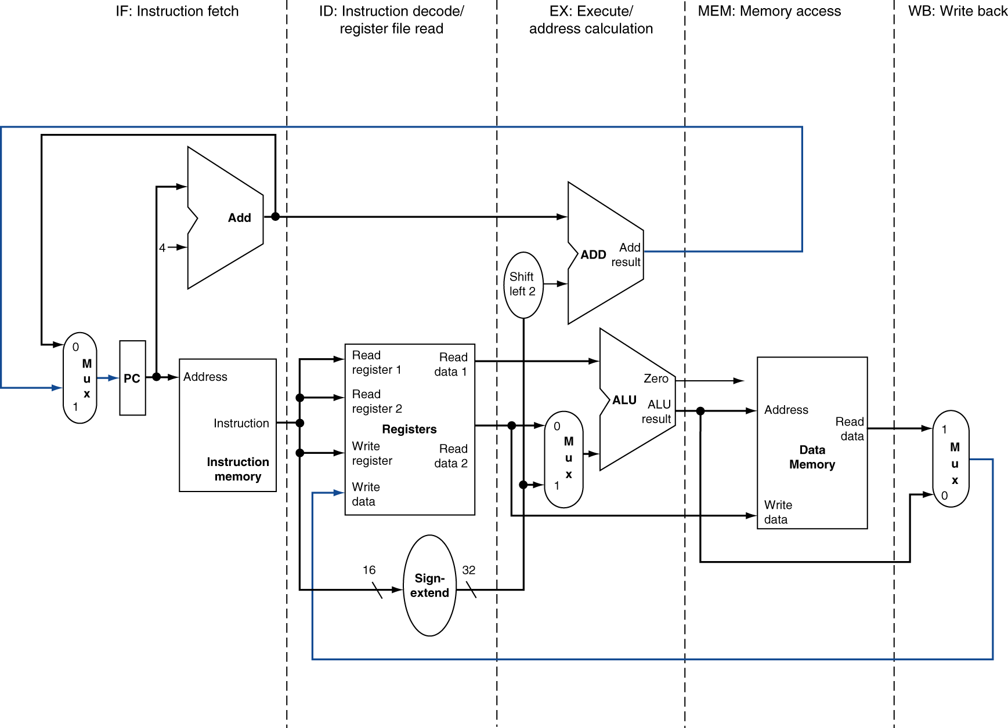
5-stage pipeline

Slide 42
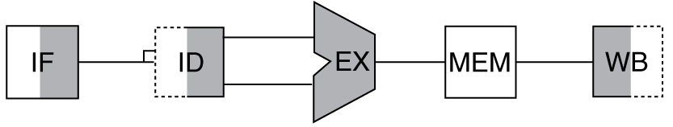
Abstracted CPU
Memory (Off-chip DRAM)
L3 Data Cache
L2 Data Cache
Core
Core
Core
I-$
RF
D-$
RF
. . .
Instr. Cache
Register File
L1 Data Cache
Data
Path
Core
Core

Slide 43
Memory Hierarchy

