Slide 1
CS/EE 217: GPU Architecture and Parallel Programming
Convolution, (with a side of Constant Memory and Caching)

Slide 2
Objective
To learn convolution, an important parallel computation pattern
  Widely used in signal, image and video processing
  Foundational to stencil computation used in many science and engineering
Taking advantage of cache memories

Slide 3
Convolution Applications
A popular array operation used in signal processing, digital recording, image processing, video processing, and computer vision.
Convolution is often performed as a filter that transforms signals and pixels into more desirable values.
  Some filters smooth out the signal values so that one can see the big-picture trend
  Others like Gaussian filters can be used to sharpen boundaries and edges of objects in images..

Slide 4
Convolution Computation
An array operation where each output data element is a weighted sum of a collection of neighboring input elements
The weights used in the weighted sum calculation are defined by an input mask array, commonly referred to as the convolution kernel
  We will refer to these mask arrays as convolution masks to avoid confusion.
  The same convolution mask is typically used for all elements of the array.

Slide 5

Convolution definition
Convolution is to compute the response of linear time invariant system f(t)
for the given input signal g(t).
F(s)
G(s)
G(s)*F(s)
In frequency domain

Slide 6
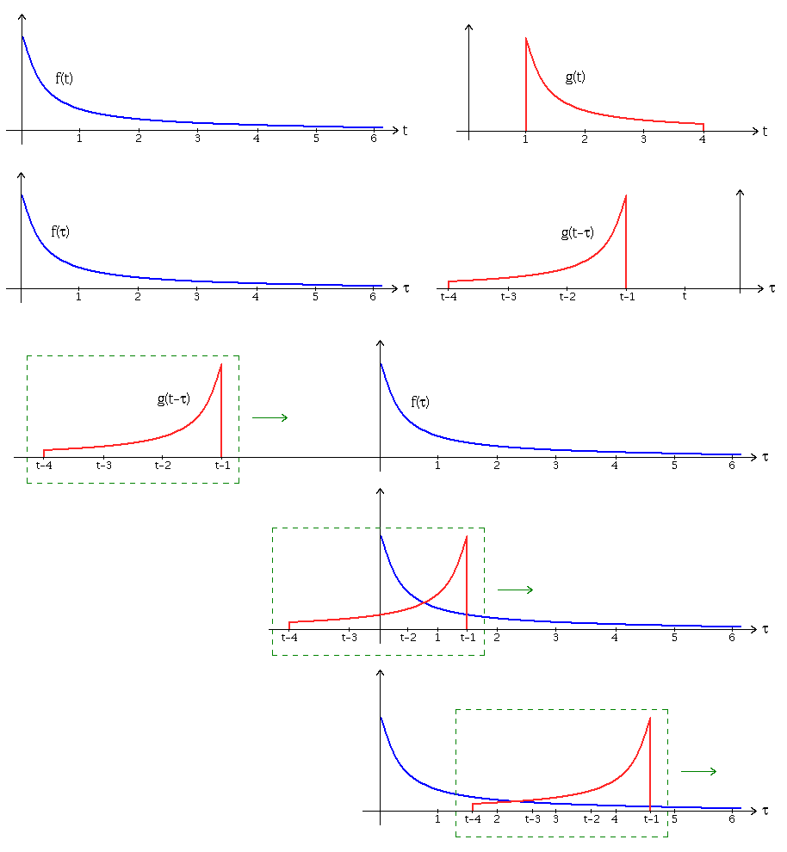
Convolution operation
From the Wikipedia page on convolution

Slide 7
1D Convolution Example
Commonly used for audio processing
  Mask size is usually an odd number of elements for symmetry (5 in this example)
Calculation of P[2]
N
N[0]
N[1]
N[2]
N[3]
N[4]
N[5]
N[6]
P
P[0]
P[1]
P[2]
P[3]
P[4]
P[5]
P[6]
1
2
3
4
5
6
7
3
8
57
16
15
3
3
M
M[0]
M[1]
M[2]
M[3]
M[4]
3
4
5
4
3
3
8
15
16
15

Slide 8
1D Convolution Example
- more on inside elements
Calculation of P[3]
N
N[0]
N[1]
N[2]
N[3]
N[4]
N[5]
N[6]
P
P[0]
P[1]
P[2]
P[3]
P[4]
P[5]
P[6]
1
2
3
4
5
6
7
3
8
57
76
15
3
3
M
M[0]
M[1]
M[2]
M[3]
M[4]
3
4
5
4
3
6
12
20
20
18

Slide 9
1D Convolution Boundary Condition
Calculation of output elements near the boundaries (beginning and end) of the input array need to deal with “ghost” elements
  Different policies (0, replicates of boundary values, etc.)
N
N[0]
N[1]
N[2]
N[3]
N[4]
N[5]
N[6]
P
P[0]
P[1]
P[2]
P[3]
P[4]
P[5]
P[6]
0
1
2
3
4
5
6
7
3
38
57
16
15
3
3
Filled in
M
M[0]
M[1]
M[2]
M[3]
M[4]
3
4
5
4
3
0
4
10
12
12

Slide 10
A 1D Convolution Kernel with Boundary Condition Handling
This kernel forces all elements outside the image to 0
__global__ void convolution_1D_basic_kernel(float *N, float *M, float *P,
int Mask_Width, int Width) {
int i = blockIdx.x*blockDim.x + threadIdx.x;
float Pvalue = 0;
int N_start_point = i - (Mask_Width/2);
for (int j = 0; j < Mask_Width; j++) {
if (N_start_point + j >= 0 && N_start_point + j < Width) {
Pvalue += N[N_start_point + j]*M[j];
}
}
P[i] = Pvalue;
}

Slide 11
2D Convolution
N
P
1
2
3
4
5
6
7
1
2
3
4
5
2
3
4
5
6
7
8
2
3
4
5
6
3
4
5
6
7
8
9
3
4
321
6
7
4
5
6
7
8
5
6
4
5
6
7
8
5
6
7
8
5
6
7
5
6
7
8
5
6
7
8
9
0
1
2
7
8
9
0
1
2
3
M
1
4
9
8
5
1
2
3
2
1
4
9
16
15
12
2
3
4
3
2
3
4
5
4
3
9
16
25
24
21
2
3
4
3
2
8
15
24
21
16
1
2
3
2
1
5
12
21
16
5

Slide 12
2D Convolution Boundary Condition
N
P
1
2
3
4
5
6
7
1
2
3
4
5
2
3
4
5
6
7
8
112
3
4
5
6
3
4
5
6
7
8
9
3
4
5
6
7
4
5
6
7
8
5
6
4
5
6
7
8
5
6
7
8
5
6
7
5
6
7
8
5
6
7
8
9
0
1
2
7
8
9
0
1
2
3
M
0
0
0
0
0
1
2
3
2
1
0
0
4
6
6
2
3
4
3
2
3
4
5
4
3
0
0
10
12
12
2
3
4
3
2
0
0
12
12
10
1
2
3
2
1
0
0
12
10
6

Slide 13
2D Convolution – Ghost Cells
0
0
0
0
0
N
P
0
3
4
5
6
0
2
3
4
5
0
3
5
6
7
179
0
1
1
3
1
0
0
0
0
0
1
2
3
2
1
0
9
16
15
12
0
ghost cells
2
3
4
3
2
3
4
5
4
3
0
8
15
16
15
(apron cells, halo cells)
M
2
3
4
3
2
0
9
20
18
14
1
2
3
2
1
0
2
3
6
1

Slide 14
Access Pattern for M
M is referred to as mask (a.k.a. kernel, filter, etc.)
  Elements of M are called mask (kernel, filter) coefficients
Calculation of all output P elements need M
M is not changed during kernel
Bonus - M elements are accessed in the same order when calculating all P elements
M is a good candidate for Constant Memory

Slide 15
Programmer View of CUDA Memories
(Review)
Each thread can:
  Read/write per-thread registers (~1 cycle)
  Read/write per-block shared memory (~5 cycles)
  Read/write per-grid global memory (~500 cycles)
  Read/only per-grid constant memory (~5 cycles with caching)
Grid
Block (0, 0)
Block (1, 0)
Shared Memory/L1 cache
Shared Memory/L1 cache
Registers
Registers
Registers
Registers
Thread (0, 0)
Thread (1, 0)
Thread (0, 0)
Thread (1, 0)
Host
Global Memory
Constant Memory
Notes:
Global, constant, and texture memory spaces are persistent across kernels called by the same application.

Slide 16
Memory Hierarchies
If every time we needed a piece of data, we had to go to main memory to get it, computers would take a lot longer to do anything
On today’s processors, main memory accesses take hundreds of cycles
One solution: Caches
Notes:
Use backpack analogy

Slide 17
Cache - Cont’d
In order to keep cache fast, it needs to be small, so we cannot fit the entire data set in it
The chip
Processor
regs
L1 Cache
L2 Cache
Main Memory
Notes:
Use back pack analogy here

Slide 18
Cache - Cont’d
Cache is unit of volatile memory storage
A cache is an “array” of cache lines
Cache line can usually hold data from several consecutive memory addresses
When data is requested from memory, an entire cache line is loaded into the cache, in an attempt to reduce main memory requests
Notes:
Cache is transparent vs scratchpad which isn’t

Slide 19
Caches - Cont’d
Some definitions:
  Spatial locality: is when the data elements stored in consecutive memory locations are access consecutively
  Temporal locality: is when the same data element is access multiple times in short period of time
Both spatial locality and temporal locality improve the performance of caches

Slide 20
Scratchpad vs. Cache
Scratchpad (shared memory in CUDA) is another type of temporary storage used to relieve main memory contention.
In terms of distance from the processor, scratchpad is similar to L1 cache.
Unlike cache, scratchpad does not necessarily hold a copy of data that is also in main memory
It requires explicit data transfer instructions, whereas cache doesn’t

Slide 21
Cache Coherence Protocol
A mechanism for caches to propagate updates by their local processor to other caches (processors)
The chip
Processor
Processor
Processor
regs
regs
…
regs
L1 Cache
L1 Cache
L1 Cache
Main Memory
Notes:
Use back pack analogy here.
n computing, cache coherence refers to the consistency of data stored in local caches of a shared resource.
When clients in a system maintain caches of a common memory resource, problems may arise with inconsistent data. This is particularly true of CPUs in a multiprocessing system. Referring to the "Multiple Caches of Shared Resource" figure, if the top client has a copy of a memory block from a previous read and the bottom client changes that memory block, the top client could be left with an invalid cache of memory without any notification of the change. Cache coherence is intended to manage such conflicts and maintain consistency between cache and memory.

Slide 22
CPU and GPU have different caching philosophy
CPU L1 caches are usually coherent
  L1 is also replicated for each core
  Even data that will be changed can be cached in L1
  Updates to local cache copy invalidates (or less commonly updates) copies in other caches
  Expensive in terms of hardware and disruption of services (cleaning bathrooms at airports..)
GPU L1 caches are usually incoherent
  Avoid caching data that will be modified

Slide 23
How to Use Constant Memory
Host code allocates, initializes variables the same way as any other variables that need o be copied to the device
Use cudaMemcpyToSymbol(dest, src, size) to copy the variable into the device memory
This copy function tells the device that the variable will not be modified by the kernel and can be safely cached.

Slide 24
More on Constant Caching
Each SM has its own L1 cache
  Low latency, high bandwidth access by all threads
However, there is no way for threads in one SM to update the L1 cache in other SMs
  No L1 cache coherence
Grid
Block (0, 0)
Block (1, 0)
Shared Memory/L1 cache
Shared Memory/L1 cache
Registers
Registers
Registers
Registers
Thread (0, 0)
Thread (1, 0)
Thread (0, 0)
Thread (1, 0)
Host
Global Memory
Constant Memory
This is not a problem if a variable is NOT modified by a kernel.
Notes:
Global, constant, and texture memory spaces are persistent across kernels called by the same application.

Slide 25
Using Constant memory
When declaring variables, use __const__ <type> restrict
For example:
__global__ void convolution_2D_kernel(float *P, float *N, int height, int width, int channels,
__const__ float restrict *M)
In this case, we are telling the compiler that M is constant and eligible for caching

Slide 26
Any MORE QUESTIONS?
Read Chapter 8

Slide 27
Some Header File Stuff for M
#define KERNEL_SIZE 5
// Matrix Structure declaration
typedef struct {
unsigned int width;
unsigned int height;
unsigned int pitch;
float* elements;
} Matrix;

Slide 28
AllocateMatrix
// Allocate a device matrix of dimensions height*width
// If init == 0, initialize to all zeroes.
// If init == 1, perform random initialization.
// If init == 2, initialize matrix parameters, but do not allocate memory
Matrix AllocateMatrix(int height, int width, int init)
{
Matrix M;
M.width = M.pitch = width;
M.height = height;
int size = M.width * M.height;
M.elements = NULL;

Slide 29
AllocateMatrix() (Cont.)
// don't allocate memory on option 2
if(init == 2) return M;
M.elements = (float*) malloc(size*sizeof(float));
for(unsigned int i = 0; i < M.height * M.width; i++)
{
M.elements[i] = (init == 0) ? (0.0f) :
(rand() / (float)RAND_MAX);
if(rand() % 2) M.elements[i] = - M.elements[i]
}
return M;
}

Slide 30
Host Code
// global variable, outside any function
__constant__ float Mc[KERNEL_SIZE][KERNEL_SIZE];
…
// allocate N, P, initialize N elements, copy N to Nd
Matrix M;
M = AllocateMatrix(KERNEL_SIZE, KERNEL_SIZE, 1);
// initialize M elements
….
cudaMemcpyToSymbol(Mc, M.elements,
KERNEL_SIZE*KERNEL_SIZE*sizeof(float));
ConvolutionKernel<<<dimGrid, dimBlock>>>(Nd, Pd);

