Slide 1
CS/EE 217
GPU Architecture and Parallel Programming
Lecture 3: Kernel-Based
Data Parallel Execution Model

Slide 2
Objective
To understand the organization and scheduling of threads
  Resource assignment at the block level
  Scheduling at the warp level
  SIMD implementation of SIMT execution

Slide 3
A Multi-Dimensional Grid Example
host
device
Grid 1
Block (0, 0)
Block (0, 1)
Kernel 1
Block (1, 0)
Block (1, 1)
Grid 2
Block (1,1)
Kernel 2
(1,0,0)
(1,0,1)
(1,0,2)
(1,0,3)
Thread
(0,0,0)
Thread
(0,0,1)
Thread
(0,0,2)
Thread
(0,0,3)
Thread
(0,0,0)
Thread
(0,1,3)
Thread
(0,1,0)
Thread
(0,1,1)
Thread
(0,1,2)

Slide 5
Multidimensional (Nested) Arrays
Declaration
  T A[R][C];
  2D array of data type T
  R rows, C columns
  Type T element requires K bytes
Array Size
  R * C * K bytes
Arrangement
  Row-Major Ordering
A[0][0]
• • •
A[0][C-1]
•
•
•
•
•
•
A[R-1][0]
• • •
A[R-1][C-1]
int A[R][C];
• • •
A
[0]
[0]
A
[0]
[C-1]
• • •
A
[1]
[0]
A
[1]
[C-1]
• • •
• • •
A
[R-1]
[0]
A
[R-1]
[C-1]
4*R*C Bytes

Slide 6
Nested Array Row Access
Row Vectors
  A[i] is array of C elements
  Each element of type T requires K bytes
  Starting address A + i * (C * K)
int A[R][C];
A[0]
A[i]
A[R-1]
• • •
A
[0]
[0]
A
[0]
[C-1]
• • •
• • •
A
[i]
[0]
A
[i]
[C-1]
• • •
• • •
A
[R-1]
[0]
A
[R-1]
[C-1]
A
A+i*C*4
A+(R-1)*C*4

Slide 7
Strange Referencing Examples
1
5
2
0
6
1
5
2
1
3
1
5
2
1
7
1
5
2
2
1
76
96
116
136
156
Reference Address Value Guaranteed?
  ec[3][3] 76+20*3+4*3 = 148 2
  ec[2][5] 76+20*2+4*5 = 136 1
  ec[2][-1] 76+20*2+4*-1 = 112 3
  ec[4][-1] 76+20*4+4*-1 = 152 1
  ec[0][19] 76+20*0+4*19 = 152 1
  ec[0][-1] 76+20*0+4*-1 = 72 ??
Will disappear

Slide 8
Source Code of the PictureKernel
__global__ void PictureKernel(float* d_Pin, float* d_Pout, int n,int m) {
// Calculate the row # of the d_Pin and d_Pout element to process
int Row = blockIdx.y*blockDim.y + threadIdx.y;
// Calculate the column # of the d_Pin and d_Pout element to process
int Col = blockIdx.x*blockDim.x + threadIdx.x;
// each thread computes one element of d_Pout if in range
if ((Row < m) && (Col < n)) {
d_Pout[Row*n+Col] = 2*d_Pin[Row*n+Col];
}
}

Slide 9
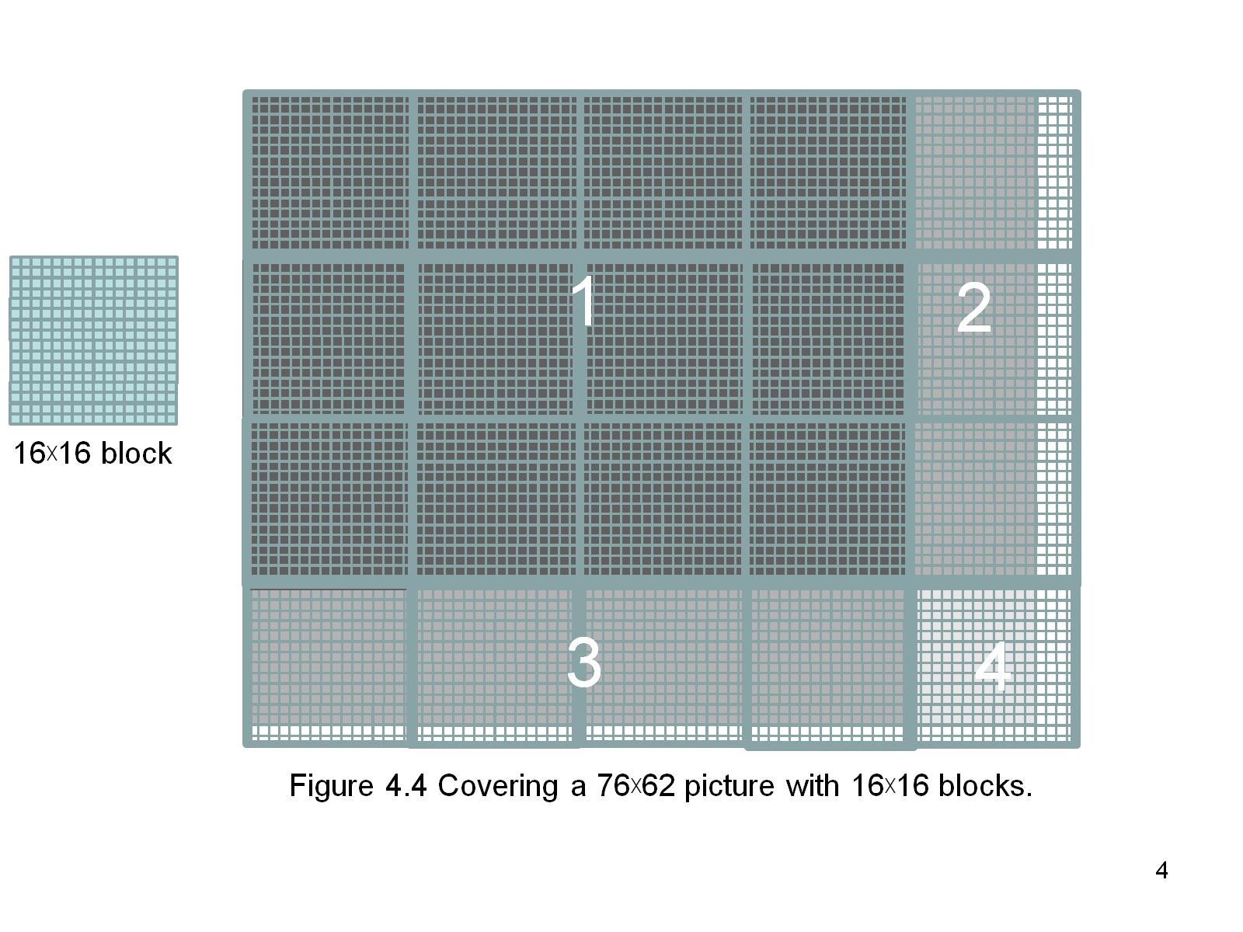
Figure 4.5 Covering a 76×62 picture with 16×blocks.

Slide 10
A Simple Running Example
Matrix Multiplication
A simple illustration of the basic features of memory and thread management in CUDA programs
  Thread index usage
  Memory layout
  Register usage
  Assume square matrix for simplicity
  Leave shared memory usage until later

Slide 11
Square Matrix-Matrix Multiplication
P = M * N of size WIDTH x WIDTH
  Each thread calculates one element of P
  Each row of M is loaded WIDTH times from global memory
  Each column of N is loaded WIDTH times from global memory
N
WIDTH
M
P
WIDTH
WIDTH
WIDTH

Slide 12
Row-Major Layout in C/C++
M_{0,0}
M_{0,1}
M_{0,2}
M_{0,3}
M_{1,0}
M_{1,1}
M_{1,2}
M_{1,3}
M_{2,0}
M_{2,1}
M_{2,2}
M_{2,3}
M_{3,0}
M_{3,1}
M_{3,2}
M_{3,3}
M
M_{0,0}
M_{0,1}
M_{0,2}
M_{0,3}
M_{1,0}
M_{1,1}
M_{1,2}
M_{1,3}
M_{2,0}
M_{2,1}
M_{2,2}
M_{2,3}
M_{3,0}
M_{3,1}
M_{3,2}
M_{3,3}
M
Row*Width+Col = 2*4+1 = 9
M₀
M₁
M₂
M₃
M₄
M₅
M₆
M₇
M₈
M₉
M₁₀
M₁₁
M₁₂
M₁₃
M₁₄
M₁₅

Slide 13
Matrix Multiplication
A Simple Host Version in C
// Matrix multiplication on the (CPU) host
void MatrixMulOnHost(double* M, double* N,
double* P, int Width)‏ {
for (int i = 0; i < Width; ++i)‏
for (int j = 0; j < Width; ++j) {
double sum = 0;
for (int k = 0; k < Width; ++k) {
double a = M[i * Width + k];
double b = N[k * Width + j];
sum += a * b;
}
P[i * Width + j] = sum;
}
}
N
k
j
WIDTH
M
P
i
WIDTH
k
WIDTH
WIDTH
Notes:
Point out that I and j will become global thread indices.

Slide 14
Kernel Function - A Small Example
Main strategy: have each 2D thread block to compute a (TILE_WIDTH)² sub-matrix (tile) of the result matrix
  Each has (TILE_WIDTH)² threads
Generate a 2D Grid of (WIDTH/TILE_WIDTH)² blocks
Block(0,0)
Block(0,1)
P_{0,0}
P_{0,1}
P_{0,2}
P_{0,3}
WIDTH = 4; TILE_WIDTH = 2
Each block has 2*2 = 4 threads
P_{1,0}
P_{1,1}
P_{1,2}
P_{1,3}
P_{2,0}
P_{2,1}
P_{2,2}
P_{2,3}
WIDTH/TILE_WIDTH = 2
Use 2* 2 = 4 blocks
P_{3,0}
P_{3,1}
P_{2,3}
P_{3,3}
What if matrix is not square?
What if width is not a multiple of TILE_WIDTH?
Block(1,0)
Block(1,1)

Slide 15
A Slightly Bigger Example
P_{0,0}
P_{0,1}
P_{0,2}
P_{0,3}
P_{0,4}
P_{0,5}
P_{0,6}
P_{0,7}
P_{1,0}
P_{1,1}
P_{1,2}
P_{1,3}
P_{1,4}
P_{1,5}
P_{1,6}
P_{1,7}
P_{2,0}
P_{2,1}
P_{2,2}
P_{2,3}
P_{2,4}
P_{2,5}
P_{2,6}
P_{2,7}
WIDTH = 8; TILE_WIDTH = 2
Each block has 2*2 = 4 threads
P_{3,0}
P_{3,1}
P_{3,2}
P_{3,3}
P_{3,4}
P_{3,5}
P_{3,6}
P_{3,7}
P_{4,0}
P_{4,1}
P_{4,2}
P_{4,3}
P_{4,4}
P_{4,5}
P_{4,6}
P_{4,7}
P_{5,0}
P_{5,1}
P_{5,2}
P_{5,3}
P_{5,4}
P_{5,5}
P_{5,6}
P_{5,7}
WIDTH/TILE_WIDTH = 4
Use 4* 4 = 16 blocks
P_{6,0}
P_{6,1}
P_{6,2}
P_{6,3}
P_{6,4}
P_{6,5}
P_{6,6}
P_{6,7}
P_{7,0}
P_{7,1}
P_{7,2}
P_{7,3}
P_{7,4}
P_{7,5}
P_{7,6}
P_{7,7}

Slide 16
A Slightly Bigger Example (cont.)
P_{0,0}
P_{0,1}
P_{0,2}
P_{0,3}
P_{0,4}
P_{0,5}
P_{0,6}
P_{0,7}
P_{1,0}
P_{1,1}
P_{1,2}
P_{1,3}
P_{1,4}
P_{1,5}
P_{1,6}
P_{1,7}
P_{2,0}
P_{2,1}
P_{2,2}
P_{2,3}
P_{2,4}
P_{2,5}
P_{2,6}
P_{2,7}
WIDTH = 8; TILE_WIDTH = 4
Each block has 4*4 =16 threads
P_{3,0}
P_{3,1}
P_{3,2}
P_{3,3}
P_{3,4}
P_{3,5}
P_{3,6}
P_{3,7}
P_{4,0}
P_{4,1}
P_{4,2}
P_{4,3}
P_{4,4}
P_{4,5}
P_{4,6}
P_{4,7}
WIDTH/TILE_WIDTH = 2
Use 2* 2 = 4 blocks
P_{5,0}
P_{5,1}
P_{5,2}
P_{5,3}
P_{5,4}
P_{5,5}
P_{5,6}
P_{5,7}
P_{6,0}
P_{6,1}
P_{6,2}
P_{6,3}
P_{6,4}
P_{6,5}
P_{6,6}
P_{6,7}
P_{7,0}
P_{7,1}
P_{7,2}
P_{7,3}
P_{7,4}
P_{7,5}
P_{7,6}
P_{7,7}

Slide 17
Kernel Invocation (Host-side Code)
// Setup the execution configuration
// TILE_WIDTH is a #define constant
dim3 dimGrid(Width/TILE_WIDTH, Width/TILE_WIDTH, 1);
dim3 dimBlock(TILE_WIDTH, TILE_WIDTH, 1);
// Launch the device computation threads!
MatrixMulKernel<<<dimGrid, dimBlock>>>(Md, Nd, Pd, Width);

Slide 18
Kernel Function
// Matrix multiplication kernel – per thread code
__global__ void MatrixMulKernel(double* d_M, double* d_N, double* d_P, int Width)‏
{
// Pvalue is used to store the element of the matrix
// that is computed by the thread
float Pvalue = 0;

Slide 19
Work for Block (0,0) in a TILE_WIDTH = 2 Configuration
blockDim.x
blockDim.y
Col = 0
Col = 1
Col = 0 * 2 + threadIdx.x
Row = 0 * 2 + threadIdx.y
N_{0,0}
N_{0,1}
N_{0,2}
N_{0,3}
N_{1,0}
N_{1,1}
N_{1,2}
N_{1,3}
blockIdx.x
blockIdx.y
N_{2,0}
N_{2,1}
N_{2,2}
N_{2,3}
N_{3,0}
N_{3,1}
N_{3,2}
N_{3,3}
Row = 0
M_{0,0}
M_{0,1}
M_{0,2}
M_{0,3}
P_{0,0}
P_{0,1}
P_{0,2}
P_{0,3}
Row = 1
M_{1,0}
M_{1,1}
M_{1,2}
M_{1,3}
P_{1,0}
P_{1,1}
P_{1,2}
P_{1,3}
M_{2,0}
M_{2,1}
M_{2,2}
M_{2,3}
P_{2,0}
P_{2,1}
P_{2,2}
P_{2,3}
M_{3,0}
M_{3,1}
M_{3,2}
M_{3,3}
P_{3,0}
P_{3,1}
P_{3,2}
P_{3,3}

Slide 20
Work for Block (0,1)
Col = 2
Col = 3
Col = 1 * 2 + threadIdx.x
Row = 0 * 2 + threadIdx.y
N_{0,0}
N_{0,1}
N_{0,2}
N_{0,3}
N_{1,0}
N_{1,1}
N_{1,2}
N_{1,3}
blockIdx.x
blockIdx.y
N_{2,0}
N_{2,1}
N_{2,2}
N_{2,3}
N_{3,0}
N_{3,1}
N_{2,3}
N_{3,3}
Row = 0
M_{0,0}
M_{0,1}
M_{0,2}
M_{0,3}
P_{0,0}
P_{0,1}
P_{0,2}
P_{0,3}
Row = 1
M_{1,0}
M_{1,1}
M_{1,2}
M_{1,3}
P_{0,1}
P_{1,1}
P_{1,2}
P_{1,3}
M_{2,0}
M_{2,1}
M_{2,2}
M_{2,3}
P_{2,0}
P_{2,1}
P_{2,2}
P_{2,3}
M_{3,0}
M_{3,1}
M_{3,2}
M_{3,3}
P_{3,0}
P_{3,1}
P_{3,2}
P_{3,3}

Slide 21
A Simple Matrix Multiplication Kernel
__global__ void MatrixMulKernel(float* d_M, float* d_N, float* d_P, int Width)
{
// Calculate the row index of the d_P element and d_M
int Row = blockIdx.y*blockDim.y+threadIdx.y;
// Calculate the column idenx of d_P and d_N
int Col = blockIdx.x*blockDim.x+threadIdx.x;
if ((Row < Width) && (Col < Width)) {
float Pvalue = 0;
// each thread computes one element of the block sub-matrix
for (int k = 0; k < Width; ++k)
Pvalue += d_M[Row*Width+k] * d_N[k*Width+Col];
d_P[Row*Width+Col] = Pvalue;
}
}

Slide 22
CUDA Thread Block
All threads in a block execute the same kernel program (SPMD)
Programmer declares block:
  Block size 1 to 1024 concurrent threads
  Block shape 1D, 2D, or 3D
  Block dimensions in threads
Threads have thread index numbers within block
  Kernel code uses thread index and block index to select work and address shared data
Threads in the same block share data and synchronize while doing their share of the work
Threads in different blocks cannot cooperate
  Each block can execute in any order relative to other blocks!
CUDA Thread Block
Thread Id #:
0 1 2 3 … m
Thread program
Courtesy: John Nickolls, NVIDIA

Slide 23
History of parallelism
1st gen - Instructions are executed sequentially in program order, one at a time.
Example:
Cycle | 1 | 2 | 3 | 4 | 5 | 6
Instruction1 | Fetch | Decode | Execute | Memory
Instruction2 |  |  |  |  | Fetch | Decode

Slide 24
History - Cont’d
2nd gen - Instructions are executed sequentially, in program order, in an assembly line fashion. (pipeline)
Example:
Cycle | 1 | 2 | 3 | 4 | 5 | 6
Instruction1 | Fetch | Decode | Execute | Memory
Instruction2 |  | Fetch | Decode | Execute | Memory
Instruction3 |  |  | Fetch | Decode | Execute | Memory

Slide 25
History –
Instruction Level Parallelism
3rd gen - Instructions are executed in parallel
Example code 1:
c = b + a;
d = c + e;
Example code 2:
a = b + c;
d = e + f;
Non-parallelizable
Parallelizable

Slide 26
Instruction Level Parallelism (Cont.)
Two forms of ILP:
  Superscalar: At runtime, fetch, decode, and execute multiple instructions at a time. Execution may be out of order
  VLIW: At compile time, pack multiple, independent instructions in one large instruction and process the large instructions as the atomic units.
Cycle | 1 | 2 | 3 | 4 | 5
Instruction1 | Fetch | Decode | Execute | Memory
Instruction2 | Fetch | Decode | Execute | Memory
Instruction3 |  | Fetch | Decode | Execute | Memory
Instruction4 |  | Fetch | Decode | Execute | Memory

Slide 27
History – Cont’d
4th gen – Multi-threading: multiple threads are executed in an alternating or simultaneous manner on the same processor/core. (will revisit)
5th gen - Multi-Core: Multiple threads are executed simultaneously on multiple processors

Slide 28
Transparent Scalability
Hardware is free to assign blocks to any processor at any time
  A kernel scales across any number of parallel processors
Device
Kernel grid
Block 0
Block 1
Device
Block 2
Block 3
Block 0
Block 1
Block 4
Block 5
Block 6
Block 7
time
Block 0
Block 1
Block 2
Block 3
Block 2
Block 3
Block 4
Block 5
Block 6
Block 7
Block 4
Block 5
Each block can execute in any order relative to other blocks.
Block 6
Block 7

Slide 29
Example: Executing Thread Blocks
SM 0
SM 1
t0 t1 t2 … tm
t0 t1 t2 … tm
MT IU
MT IU
Blocks
SP
SP
Threads are assigned to Streaming Multiprocessors in block granularity
  Up to 8 blocks to each SM as resource allows
  Fermi SM can take up to 1536 threads
    Could be 256 (threads/block) * 6 blocks
    Or 512 (threads/block) * 3 blocks, etc.
Threads run concurrently
  SM maintains thread/block id #s
  SM manages/schedules thread execution
Blocks
Shared
Memory
Shared
Memory

Slide 30
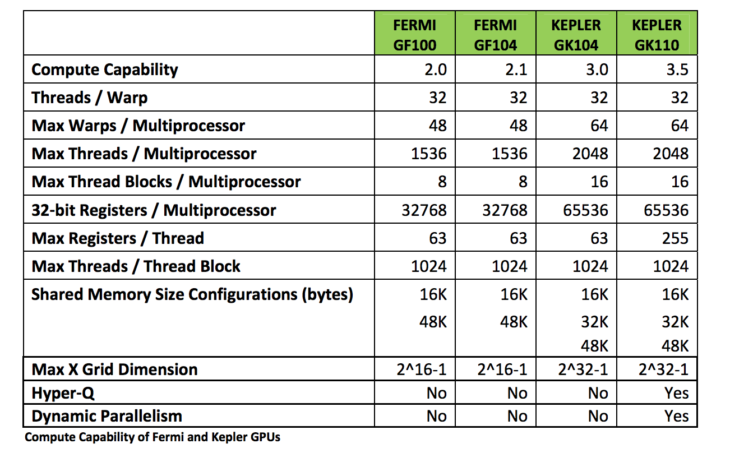
Configuration of Fermi and Kepler

Slide 31
The Von-Neumann Model
Memory
I/O
Processing Unit
Reg
File
ALU
Control Unit
PC
IR
Notes:
Insert von-neumann schematic here

Slide 32
The Von-Neumann Model with SIMD units
Memory
I/O
Processing Unit
Reg
File
ALU
Control Unit
PC
IR
Notes:
Insert von-neumann schematic here

Slide 33
Example: Thread Scheduling
Each Block is executed as 32-thread Warps
  An implementation decision, not part of the CUDA programming model
  Warps are scheduling units in SM
If 3 blocks are assigned to an SM and each block has 256 threads, how many Warps are there in an SM?
  Each Block is divided into 256/32 = 8 Warps
  There are 8 * 3 = 24 Warps
…
Block 1 Warps
…
Block 2 Warps
…
Block 1 Warps
…
…
…
t0 t1 t2 … t31
t0 t1 t2 … t31
t0 t1 t2 … t31
Register File
(128 KB)
L1
(16 KB)
Shared Memory
(48 KB)

Slide 34
Going back to the program
Every instruction needs to be fetched from memory, decoded, then executed.
Instructions come in three flavors: Operate, Data transfer, and Program Control Flow.
An example instruction cycle is the following:
Fetch | Decode | Execute | Memory
Notes:
victoria@samsung.com

Slide 35
Operate Instructions
Example of an operate instruction:
ADD R1, R2, R3
Instruction cycle for an operate instruction:
Fetch | Decode | Execute | Memory

Slide 36
Data Transfer Instructions
Examples of data transfer instruction:
LDR R1, R2, #2
STR R1, R2, #2
Instruction cycle for an data transfer instruction:
Fetch | Decode | Execute | Memory

Slide 37
Control Flow Operations
Example of control flow instruction:
BRp #-4
if the condition is positive, jump back four instructions
Instruction cycle for an arithmetic instruction:
Fetch | Decode | Execute | Memory

Slide 38
How thread blocks are partitioned
Thread blocks are partitioned into warps
  Thread IDs within a warp are consecutive and increasing
  Warp 0 starts with Thread ID 0
Partitioning is always the same
  Thus you can use this knowledge in control flow
  However, the exact size of warps may change from generation to generation
  (Covered next)
However, DO NOT rely on any ordering between warps
  If there are any dependencies between threads, you must __syncthreads() to get correct results (more later).

Slide 39
Control Flow Instructions
Main performance concern with branching is divergence
  Threads within a single warp take different paths
  Different execution paths are serialized in current GPUs
    The control paths taken by the threads in a warp are traversed one at a time until there is no more.
A common case: avoid divergence when branch condition is a function of thread ID
  Example with divergence:
    If (threadIdx.x > 2) { }
    This creates two different control paths for threads in a block
    Branch granularity < warp size; threads 0, 1 and 2 follow different path than the rest of the threads in the first warp
  Example without divergence:
    If (threadIdx.x / WARP_SIZE > 2) { }
    Also creates two different control paths for threads in a block
    Branch granularity is a whole multiple of warp size; all threads in any given warp follow the same path
Notes:
WARP_SIZE

Slide 40
Example: Thread Scheduling (Cont.)
SM implements zero-overhead warp scheduling
  At any time, 1 or 2 of the warps is executed by SM
  Warps whose next instruction has its operands ready for consumption are eligible for execution
  Eligible Warps are selected for execution on a prioritized scheduling policy
  All threads in a warp execute the same instruction when selected

Slide 41
Block Granularity Considerations
For Matrix Multiplication using multiple blocks, should I use 8X8, 16X16 or 32X32 blocks?
  For 8X8, we have 64 threads per Block. Since each SM can take up to 1536 threads, there are 24 Blocks. However, each SM can only take up to 8 Blocks, only 512 threads will go into each SM!
  For 16X16, we have 256 threads per Block. Since each SM can take up to 1536 threads, it can take up to 6 Blocks and achieve full capacity unless other resource considerations overrule.
  For 32X32, we would have 1024 threads per Block. Only one block can fit into an SM for Fermi. Using only 2/3 of the thread capacity of an SM. Also, this works for CUDA 3.0 and beyond but too large for some early CUDA versions.

Slide 42
Any MoRe Questions?
Read Chapter 4!

Slide 43
Some Additional API Features

Slide 44
Application Programming Interface
The API is an extension to the C programming language
It consists of:
  Language extensions
    To target portions of the code for execution on the device
  A runtime library split into:
    A common component providing built-in vector types and a subset of the C runtime library in both host and device codes
    A host component to control and access one or more devices from the host
    A device component providing device-specific functions

Slide 45
Common Runtime Component:
Mathematical Functions
pow, sqrt, cbrt, hypot
exp, exp2, expm1
log, log2, log10, log1p
sin, cos, tan, asin, acos, atan, atan2
sinh, cosh, tanh, asinh, acosh, atanh
ceil, floor, trunc, round
Etc.
  When executed on the host, a given function uses the C runtime implementation if available
  These functions are only supported for scalar types, not vector types

Slide 46
Device Runtime Component:
Mathematical Functions
Some mathematical functions (e.g. sin(x)) have a less accurate, but faster device-only version (e.g. __sin(x))
  __pow
  __log, __log2, __log10
  __exp
  __sin, __cos, __tan

