Slide 1
CS/EE 217 GPU Architecture and Parallel Programming
Lecture 22:
Introduction to OpenCL

Slide 2
Objective
To Understand the OpenCL programming model
  basic concepts and data types
  OpenCL application programming interface - basic
  Simple examples to illustrate basic concepts and functionalities

Slide 3
OpenCL Programs
An OpenCL “program” contains one or more “kernels” and any supporting routines that run on a target device
An OpenCL kernel is the basic unit of parallel code that can be executed on a target device
OpenCL Program
Misc support
functions
Kernel A
Kernel B
Kernel C

Slide 4
OpenCL Execution Model
Integrated host+device app C program
  Serial or modestly parallel parts in host C code
  Highly parallel parts in device SPMD kernel C code
Serial Code (host)‏
Parallel Kernel (device)‏
KernelA<<< nBlk, nTid >>>(args);
. . .
Serial Code (host)‏
Parallel Kernel (device)‏
KernelB<<< nBlk, nTid >>>(args);
. . .

Slide 5
OpenCL Kernels
Code that actually executes on target devices
Kernel body is instantiated once for each work item
  An OpenCL work item is equivalent to a CUDA thread
Each OpenCL work item gets a unique index
__kernel void
vadd(__global const float *a,
__global const float *b,
__global float *result)
{
int id = get_global_id(0);
result[id] = a[id] + b[id];
}

Slide 6
Array of Parallel Work Items
An OpenCL kernel is executed by an array of work items
  All work items run the same code (SPMD)‏
  Each work item has an index that it uses to compute memory addresses and make control decisions
threads
0
1
2
3
4
5
6
7
…
int id = get_global_id(0);
result[id] = a[id] + b [id];
…
6

Slide 7
Work Groups: Scalable Cooperation
Divide monolithic work item array into work groups
  Work items within a work group cooperate via shared memory, atomic operations and barrier synchronization
  Work items in different work groups cannot cooperate
work group 0
work group 1
work group 7
work items
0
1
2
3
4
5
6
7
8
9
10
11
12
13
14
15
56
57
58
59
60
61
62
63
…
int id = get_global_id(0);
result[id] = a[id] + b [id];
…
…
int id = get_global_id(0);
result[id] = a[id] + b [id];
…
…
int id = get_global_id(0);
result[id] = a[id] + b [id];
…
…

Slide 8
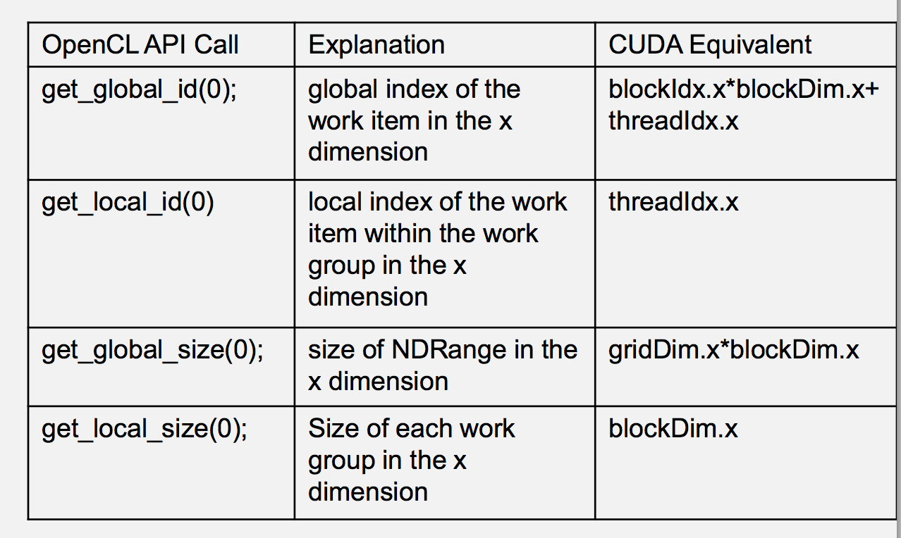
OpenCL

Slide 9
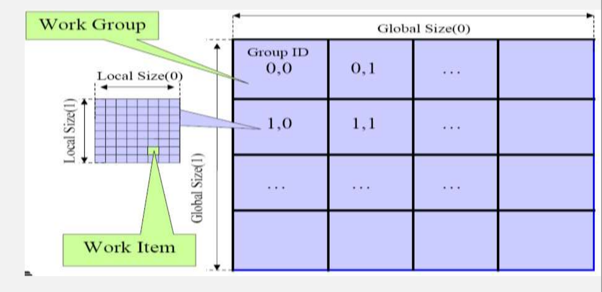
Multidimensional Work indexing

Slide 10
OpenCL Data Parallel Model Summary
Parallel work is submitted to devices by launching kernels
Kernels run over global dimension index ranges (NDRange), broken up into “work groups”, and “work items”
Work items executing within the same work group can synchronize with each other with barriers or memory fences
Work items in different work groups can’t sync with each other, except by launching a new kernel

Slide 11
OpenCL Host Code
Prepare and trigger device code execution
  Create and manage device context(s) and associate work queue(s), etc…
  Memory allocations, memory copies, etc
  Kernel launch
OpenCL programs are normally compiled entirely at runtime, which must be managed by host code

Slide 12
OpenCL Hardware Abstraction
OpenCL exposes CPUs, GPUs, and other Accelerators as “devices”
Each “device” contains one or more “compute units”, i.e. cores, SMs, etc...
Each “compute unit” contains one or more SIMD “processing elements”
OpenCL Device
Compute Unit
PE
PE
PE
PE
PE
PE
PE
PE
Compute Unit
PE
PE
PE
PE
PE
PE
PE
PE

Slide 13
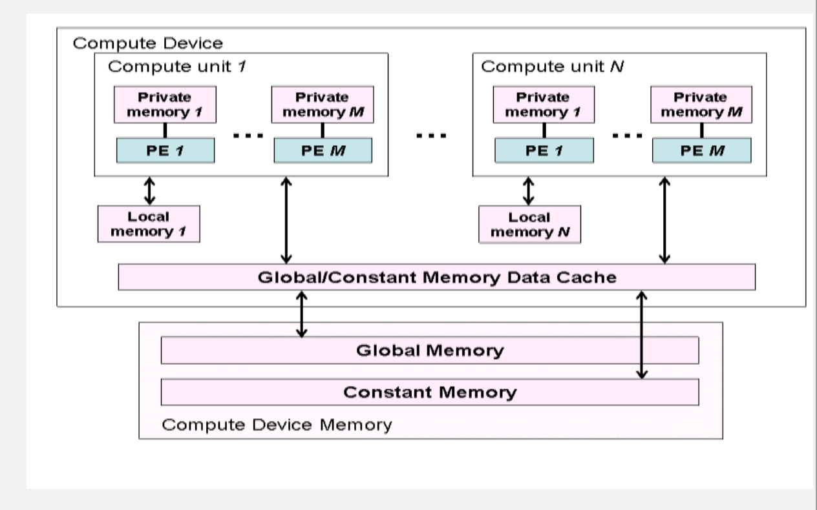

Slide 14
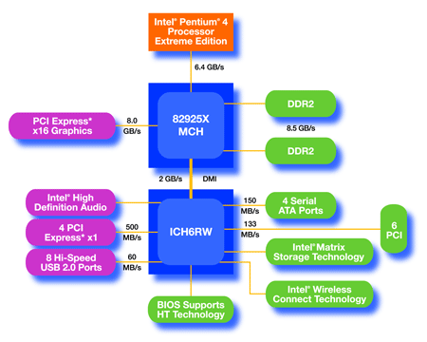
An Example of Physical Reality Behind OpenCL Abstraction
GPU w/
local DRAM
(device)
CPU
(host)

Slide 15
OpenCL Context
Contains one or more devices
OpenCL memory objects are associated with a context, not a specific device
clCreateBuffer() is the main data object allocation function
  error if an allocation is too large for any device in the context
Each device needs its own work queue(s)
Memory transfers are associated with a command queue (thus a specific device)
OpenCL Context
OpenCL Device
OpenCL Device

Slide 16
OpenCL Context Setup Code (simple)
cl_int clerr = CL_SUCCESS;
cl_context clctx = clCreateContextFromType(0, CL_DEVICE_TYPE_ALL, NULL, NULL, &clerr);
size_t parmsz;
clerr = clGetContextInfo(clctx, CL_CONTEXT_DEVICES, 0, NULL, &parmsz);
cl_device_id* cldevs = (cl_device_id *) malloc(parmsz);
clerr = clGetContextInfo(clctx, CL_CONTEXT_DEVICES, parmsz, cldevs, NULL);
cl_command_queue clcmdq = clCreateCommandQueue(clctx, cldevs[0], 0, &clerr);

Slide 17
OpenCL Memory Model Overview
Global memory
  Main means of communicating R/W Data between host and device
  Contents visible to all threads
  Long latency access
We will focus on global memory for now
NDRange
Work Group (0, 0)‏
Work Group (1, 0)‏
local Memory
local Memory
private
private
private
private
Thread (0, 0)‏
Thread (1, 0)‏
Thread (0, 0)‏
Thread (1, 0)‏
Host
Global Memory

Slide 18
OpenCL Device Memory Allocation
clCreateBuffer();
  Allocates object in the device Global Memory
  Returns a pointer to the object
  Requires five parameters
    OpenCL context pointer
    Flags for access type by device
    Size of allocated object
    Host memory pointer, if used in copy-from-host mode
    Error code
clReleaseMemObject()‏
  Frees object
    Pointer to freed object
Grid
Block (0, 0)‏
Block (1, 0)‏
Shared Memory
Shared Memory
Registers
Registers
Registers
Registers
Thread (0, 0)‏
Thread (1, 0)‏
Thread (0, 0)‏
Thread (1, 0)‏
Global
Memory
Host

Slide 19
OpenCL Device Memory Allocation (cont.)‏
Code example:
  Allocate a 1024 single precision float array
  Attach the allocated storage to d_a
  “d_” is often used to indicate a device data structure
VECTOR_SIZE = 1024;
cl_mem d_a;
int size = VECTOR_SIZE* sizeof(float);
d_a = clCreateBuffe(clctx, CL_MEM_READ_ONLY, size, NULL, NULL);
clReleaseMemObject(d_a);

Slide 20
OpenCL Device Command Execution
Application
Command
Cmd Queue
Cmd Queue
Command
OpenCL Device
OpenCL Device
OpenCL Context

Slide 21
OpenCL Host-to-Device Data Transfer
clEnqueueWriteBuffer();
  memory data transfer to device
  Requires nine parameters
    OpenCL command queue pointer
    Destination OpenCL memory buffer
    Blocking flag
    Offset in bytes
    Size (in bytes) of written data
    Host memory pointer
    List of events to be completed before execution of this command
    Event object tied to this command
Asynchronous transfer later
Grid
Block (0, 0)‏
Block (1, 0)‏
Shared Memory
Shared Memory
Registers
Registers
Registers
Registers
Thread (0, 0)‏
Thread (1, 0)‏
Thread (0, 0)‏
Thread (1, 0)‏
Global
Memory
Host

Slide 22
OpenCL Device-to-Host Data Transfer
clEnqueueReadBuffer();
  memory data transfer to host
  requires nine parameters
    OpenCL command queue pointer
    Source OpenCL memory buffer
    Blocking flag
    Offset in bytes
    Size of bytes of read data
    Destination host memory pointer
    List of events to be completed before execution of this command
    Event object tied to this command
Asynchronous transfer later
Grid
Block (0, 0)‏
Block (1, 0)‏
Shared Memory
Shared Memory
Registers
Registers
Registers
Registers
Thread (0, 0)‏
Thread (1, 0)‏
Thread (0, 0)‏
Thread (1, 0)‏
Global
Memory
Host
Notes:
The blocking flag is a boolean type, which specifies when control returns from the function. If it is TRUE (means it is a blocking call), it means that control will not return until the data has been read and copied from device memory. If it is FALSE, then it means control may return and the following statements may be executed, but there is no guarantee that the data copy from device memory has completed. Same applicable to WriteBuffer, except that it’s a write operation.
The offset specifies the offset in bytes from the start of the buffer that you want the data to be read/written to.
The event object (last param) can be tested to see if this command has completed before proceeding with other operations.

Slide 23
OpenCL Host-Device Data Transfer
(cont.)‏
Code example:
  Transfer a 64 * 64 single precision float array
  a is in host memory and d_a is in device memory
int mem_size = 64*64*sizeof(float);
clEnqueueWriteBuffer(clcmdq, d_a, CL_FALSE, 0, mem_size, (const void * )a, 0, 0, NULL);
clEnqueueReadBuffer(clcmdq, d_result, CL_FALSE, 0, mem_size, (void * ) host_result, 0, 0, NULL);

Slide 24
OpenCL Host-Device Data Transfer
(cont.)‏
clCreateBuffer and clEnqueueWriteBuffer can be combined into a single command using special flags.
Eg:
  d_A=clCreateBuffer(clctxt, CL_MEM_READ_ONLY | CL_MEM_COPY_HOST_PTR, mem_size, h_A, NULL);
  Combination of 2 flags here. CL_MEM_COPY_HOST_PTR to be used only if a valid host pointer is specified.
  This creates a memory buffer on the device, and copies data from h_A into d_A.
  Includes an implicit clEnqueueWriteBuffer operation, for all devices/command queues tied to the context clctxt.
Notes:
This combination of flags typically translates to a simple createBuffer operation for that context, followed by multiple clEnqueueWriteBuffer operations for all command queues tied to that context. Thus, for multiple devices tied to that context, using this command will copy data to all devices.
There is no limitation in the spec as to the nature of this call (blocking or not). So, it is upto the driver to choose what to do. Since the blocking behaviour is not defined, and (more importantly), there are no events tied to this command, it is best to reserve its use for read-only data.

Slide 25
OpenCL Memories
__global – large, long latency
__private – on-chip device registers
__local – memory accessible from multiple PEs or work items. May be SRAM or DRAM, must query…
__constant – read-only constant cache
Device memory is managed explicitly by the programmer, as with CUDA
Notes:
Pinned memory buffer allocations are created using the CL_MEM_USE_HOST_PTR flag

Slide 26
OpenCL Kernel Execution Launch
Application
Kernel
Cmd Queue
Cmd Queue
Kernel
OpenCL Device
OpenCL Device
OpenCL Context

Slide 27
OpenCL Kernel Compilation Example
OpenCL kernel source code as a big string
const char* vaddsrc =
“__kernel void vadd(__global float *d_A, __global float *d_B, __global float *d_C, int N) { \n“ […etc and so forth…]
cl_program clpgm;
clpgm = clCreateProgramWithSource(clctx, 1, &vaddsrc, NULL, &clerr);
char clcompileflags[4096];
sprintf(clcompileflags, “-cl-mad-enable");
clerr = clBuildProgram(clpgm, 0, NULL, clcompileflags, NULL, NULL);
cl_kernel clkern = clCreateKernel(clpgm, “vadd", &clerr);
Gives raw source code string(s) to OpenCL
Set compiler flags, compile source, and retreive a handle to the “vadd” kernel

Slide 28
Summary: Host code for vadd
int main()
{ // allocate and initialize host (CPU) memory
float *h_A = …, *h_B = …;
// allocate device (GPU) memory
cl_mem d_A, d_B, d_C;
d_A = clCreateBuffer(clctx, CL_MEM_READ_ONLY |
CL_MEM_COPY_HOST_PTR, N *sizeof(float), h_A, NULL);
d_B = clCreateBuffer(clctx, CL_MEM_READ_ONLY |
CL_MEM_COPY_HOST_PTR, N *sizeof(float), h_B, NULL);
d_C = clCreateBuffer(clctx, CL_MEM_WRITE_ONLY, N *sizeof(float), NULL, NULL);
clkern=clCreateKernel(clpgm, “vadd", NULL);
clerr= clSetKernelArg(clkern, 0, sizeof(cl_mem), (void *)&d_A);
clerr= clSetKernelArg(clkern, 1, sizeof(cl_mem), (void *)&d_B);
clerr= clSetKernelArg(clkern, 2, sizeof(cl_mem), (void *)&d_C);
clerr= clSetKernelArg(clkern, 3, sizeof(int), &N);
Notes:
There is no error-handling code shown in this example (due to lack of space, as they are quite verbose). However, they are very important, especially during debugging errors. I will be demonstrating an example during the lab introduction.

Slide 29
Summary of Host Code (cont.)
cl_event event=NULL;
clerr= clEnqueueNDRangeKernel(clcmdq, clkern, 2, NULL, Gsz,Bsz, 0, NULL, &event);
clerr= clWaitForEvents(1, &event);
clEnqueueReadBuffer(clcmdq, d_C, CL_TRUE, 0, N*sizeof(float), h_C, 0, NULL, NULL);
clReleaseMemObject(d_A);
clReleaseMemObject(d_B);
clReleaseMemObject(d_C);
}

Slide 30
Any MORE Questions?
Read Chapter 14

