Slide 2
Part 3: Research Directions

Slide 3

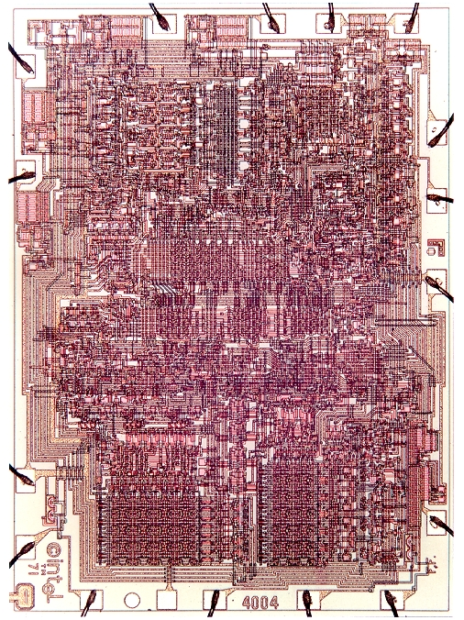

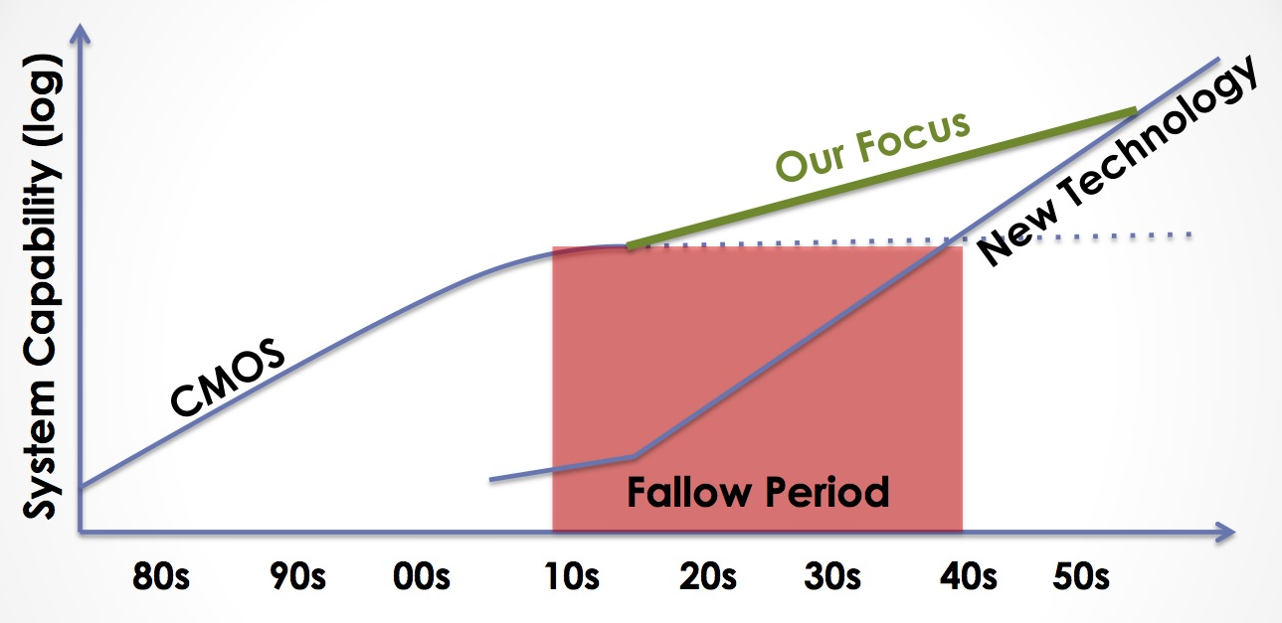

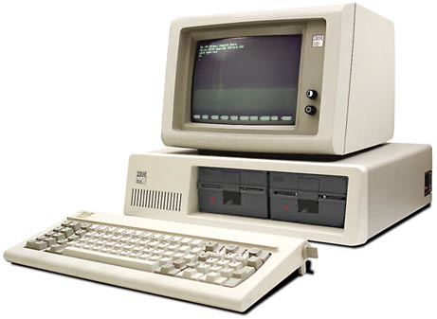

Decreasing cost per unit computation
1971: Intel 4004
2007: iPhone
Advancing Computer Systems without Technology Progress
DARPA/ISAT Workshop, March 26-27, 2012
Mark Hill & Christos Kozyrakis
2012: Datacenter
1981: IBM 5150
Notes:
Increasing transistor density has led to decreasing cost per unit computation… or what is equivalent increased capability per unit cost.
This leads to a rather famous exponential growth curve.
A quick review of the impact of this curve is in order:
- First microprocessor had 2300 transistors basically designed for a souped up calculator
- Today we carry around smartphones that have half a billion transistors in them. A large part of what makes them useful is the computing capability that resulted from technology scaling.
- Of course, not all computation takes place somewhere you can see it. A large amount of computation happens in datacenters that are hidden away out of sight behind the internet.
However, the traditional CMOS scaling that gave us all this is ending. ITRS projects we’ll end at the 7 nm process node. Others may put it at 5 nm. But either way this is happening really soon and likely within the next 10 years.
Of course, there are other technologies being proposed. However, none of them are ready for prime time.
Open question: can we continue increasing function per unit cost without CMOS scaling?

Slide 4
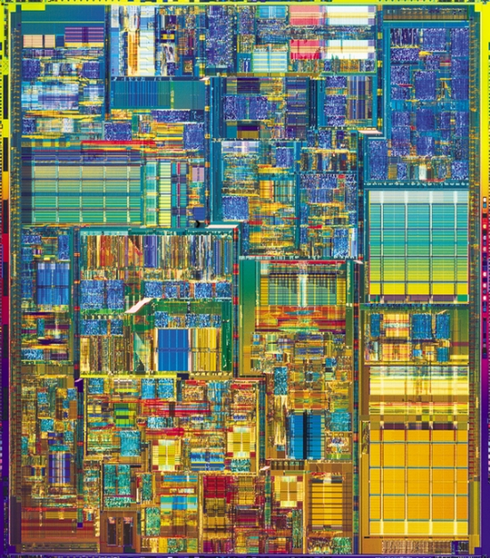
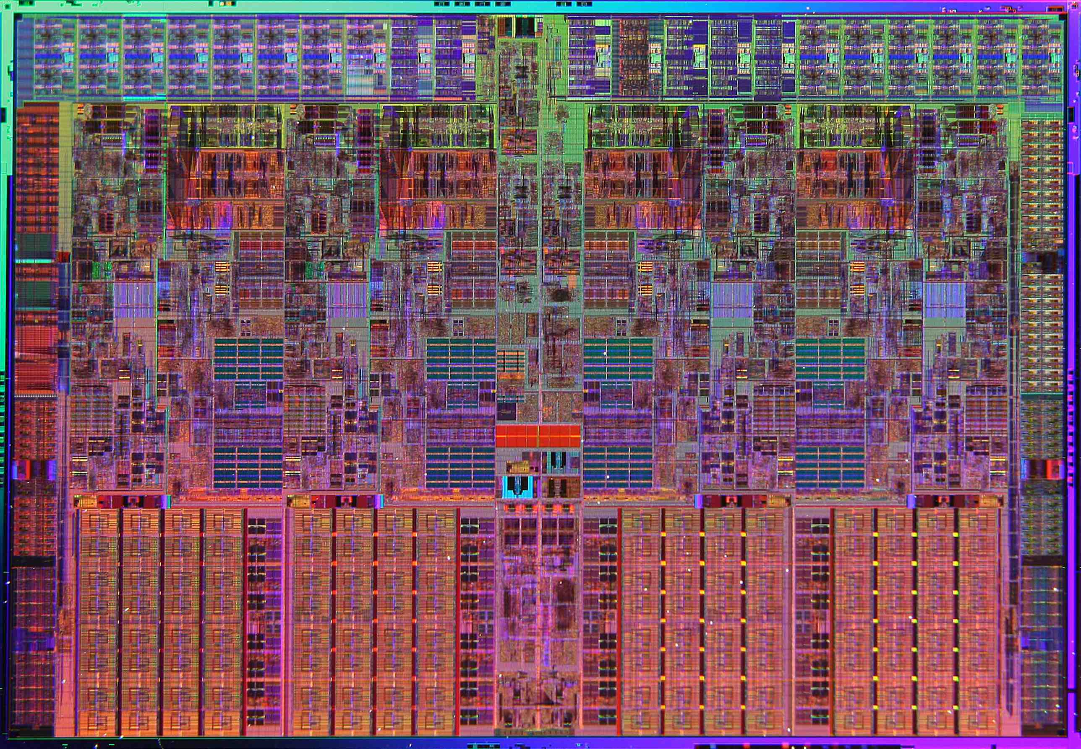
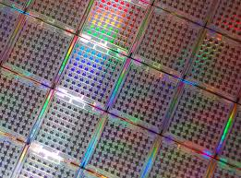
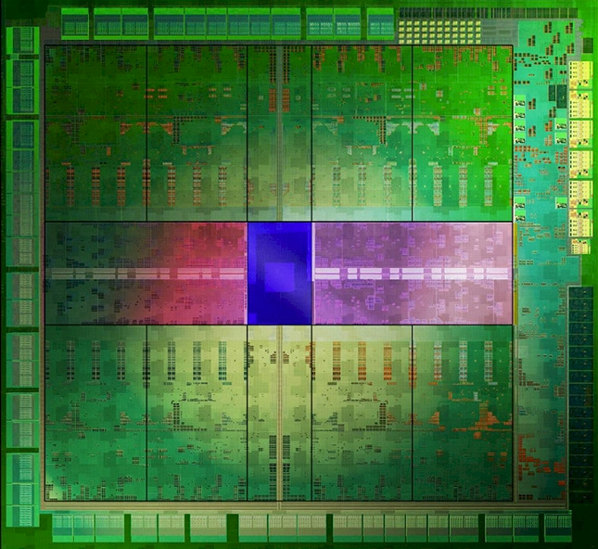
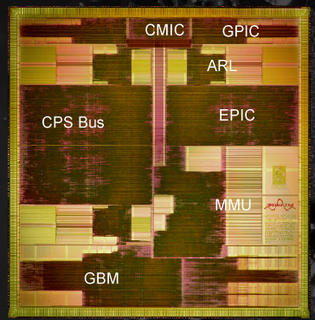
Single Core OoO Superscalar CPU
Better
(how to get here?)
Brawny (OoO) Multicore
Ease of
Programming
Wimpy (In-order) Multicore
16K thread, SIMT Accelerator
ASIC
Hardware Efficiency
Notes:
Approach 1: Start with easy to program hardware and improve HW efficiency
Approach 2: Start with efficient HW and make it easier to program

Slide 5
Start by using right tool for each job…
Ease of
Programming
Hardware Efficiency
Notes:
Approach 1: Start with easy to program hardware and improve HW efficiency
Approach 2: Start with efficient HW and make it easier to program

Slide 6
Amdahl’s Law Limits this Approach
Hard to accelerate
Easy to accelerate

Slide 7
Question: Can dividing line be moved?
easy to accelerate (Acc. Arch1)
easy to accelerate (Acc. Arch2)

Slide 8
Forward-Looking GPU Software
Still Massively Parallel
Less Structured
  Memory access and control flow patterns are less predictable
Less efficient on today’s GPU
Molecular Dynamics
Raytracing
Execute efficiently on a GPU today
Object Classification
Graphics Shaders
…
…
Matrix Multiply

Slide 9
Two Routes to “Better”
Better
Ease of
Programming
Energy Efficiency
Notes:
Approach 1: Start with easy to program hardware and improve HW efficiency
Approach 2: Start with efficient HW and make it easier to program

Slide 10
Research Direction 1:
Mitigating SIMT Control Divergence

Slide 11
Recall: SIMT Hardware Stack
Stack
A/1111
A
Reconv. PC
Next PC
Active Mask
-
-
E
E
1111
TOS
1111
TOS
TOS
TOS
-
-
-
-
-
G
A
E
B
E
1111
1111
1111
1111
1111
E
E
D
D
0110
TOS
E
D
0110
0110
B
B/1111
TOS
TOS
E
E
C
E
1001
1001
C
C/1001
D
D/0110
F
Thread Warp
Common PC
E
E/1111
Thread
1
Thread
2
Thread
3
Thread
4
G/1111
G
A
B
C
D
E
G
A
Time
Potential for significant loss of throughput when control flow diverged!

Slide 12
Performance vs. Warp Size
165 Applications
Convergent Applications
Warp-Size Insensitive Applications
Divergent Applications

Slide 13
Dynamic Warp Formation
(Fung MICRO’07)
Warp 0
Warp 1
Warp 2
A
1 2 3 4
Reissue/Memory
Latency
A
5 6 7 8
A
9 10 11 12
B
1 2 3 4
B
5 6 7 8
B
9 10 11 12
SIMD Efficiency → 88%
C
1 2 -- --
Pack
C
1 2 7 8
Time
C
5 -- 7 8
C
5 -- 11 12
C
-- -- 11 12
D
-- -- 3 4
How to pick threads to pack into warps?
D
-- 6 -- --
D
9 10 -- --
E
1 2 3 4
E
5 6 7 8
E
9 10 11 12
Notes:
Multiple warps interleave execution in core to hide pipeline/memory latency
Breaks up the “static warps”, pack the threads running this instruction into fewer warps to improve efficiency
How should we decide which threads to pack together?

Slide 14
Dynamic Warp Formation:
Hardware Implementation
A: BEQ R2, B
C: …
Thread Scheduler
PC-Warp LUT
Warp Pool
I
s
Warp Update Register T
B
0010
2
s
B
0110
0
B
B
A
5
1
2
2
2
3
3
3
8
PC
OCC
IDX
PC
TID x N
4
Prio
u
TID x N
e
5
2
7
3
8
1011
0110
B
REQ
B
PC A
H
C
C
1001
1101
1
1
C
A
PC
OCC
IDX
C
PC
TID x N
Prio
1
5
6
6
7
4
8
L
Warp Update Register NT
B
o
PC
TID x N
Prio
g
7
i
1
6
4
0100
c
1001
C
TID x N
REQ
C
PC B
H
X
Warp Allocator
Y
X
Y
X
Y
Z
X
Y
Z
X
Y
Z
1
5
1
5
1
5
5
1
5
5
1
5
5
2
6
2
6
2
6
2
2
6
2
2
6
2
3
7
3
7
3
7
3
3
7
3
3
7
3
4
8
4
8
4
8
8
4
8
8
4
8
8
No Lane Conflict

Slide 15
DWF Pathologies: Starvation
B: if (K > 10)
C: K = 10;
else
D: K = 0;
E: B = C[tid.x] + K;
Majority Scheduling
  Best Performing
  Prioritize largest group of threads with same PC
Starvation
  LOWER SIMD Efficiency!
Other Warp Scheduler?
  Tricky: Variable Memory Latency
C
1 2 7 8
C
5 -- 11 12
D
E
9 6 3 4
1 2 7 8
D
E
-- 10 -- --
5 -- 11 12
E
1 2 3 4
1000s cycles
E
5 6 7 8
D
9 6 3 4
E
9 10 11 12
D
-- 10 -- --
Time
E
9 6 3 4
E
-- 10 -- --
Notes:
12:17 – 13:00 – 14:23

Slide 16
DWF Pathologies:
Extra Uncoalesced Accesses
Coalesced Memory Access = Memory SIMD
  1st Order CUDA Programmer Optimization
Not preserved by DWF
E: B = C[tid.x] + K;
#Acc = 3
Memory
No DWF
E
1 2 3 4
0x100
E
5 6 7 8
0x140
E
9 10 11 12
0x180
L1 Cache Absorbs
Redundant
Memory Traffic
#Acc = 9
Memory
With DWF
E
1 2 7 12
0x100
E
9 6 3 8
0x140
L1$ Port Conflict
E
5 10 11 4
0x180
Notes:
14:23 – 16:15
Coalesced Memory Access = Grouping individual word accesses from threads inside a warp into a wide access to a chunk of memory
- Serviced by a single wide access

Slide 17
DWF Pathologies: Implicit Warp Sync.
Some CUDA applications depend on the lockstep execution of “static warps”
  E.g. Task Queue in Ray Tracing
Warp 0
Thread 0 ... 31
Warp 1
Thread 32 ... 63
Warp 2
Thread 64 ... 95
int wid = tid.x / 32;
if (tid.x % 32 == 0) {
sharedTaskID[wid] = atomicAdd(g_TaskID, 32);
}
my_TaskID = sharedTaskID[wid] + tid.x % 32;
ProcessTask(my_TaskID);
Implicit
Warp
Sync.
Notes:
16:15 – 17:22
A single thread in each warp branches off to fetch task for the rest of the warp.

Slide 18
Observation
Compute kernels usually contain divergent and non-divergent (coherent) code segments
Coalesced memory access usually in coherent code segments
  DWF no benefit there
Coherent
Static
Warp
Divergence
Divergent
Dynamic
Warp
Recvg
Pt.
Reset Warps
Coherent
Static
Warp
Coales. LD/ST
Notes:
17:22 – 18:37

Slide 19
Thread Block Compaction
Run a thread block like a warp
  Whole block move between coherent/divergent code
  Block-wide stack to track exec. paths reconvg.
Barrier @ Branch/reconverge pt.
  All avail. threads arrive at branch
  Insensitive to warp scheduling
Warp compaction
  Regrouping with all avail. threads
  If no divergence, gives static warp arrangement
Implicit
Warp Sync.
Starvation
Extra Uncoalesced
Memory Access
Notes:
18:37 – 20:03

Slide 20
Thread Block Compaction
PC
RPC
Active Threads
A
1 2 3 4
A
1 2 3 4
A
E
-
-
1
1
2
2
3
3
4
4
5
5
6
6
7
7
8
8
9
9
10
10
11
11
12
12
A
5 6 7 8
A
5 6 7 8
D
E
--
--
--
--
3
--
4
--
--
--
6
--
--
--
--
--
9
--
10
--
--
--
--
--
A
9 10 11 12
A
9 10 11 12
C
E
1
--
2
--
--
--
--
--
5
--
--
--
7
--
8
--
--
--
--
--
11
--
12
--
A: K = A[tid.x];
B: if (K > 10)
C: K = 10;
else
D: K = 0;
E: B = C[tid.x] + K;
C
1 2 7 8
C
1 2 -- --
C
5 -- 11 12
C
5 -- 7 8
D
9 6 3 4
C
-- -- 11 12
D
-- 10 -- --
D
-- -- 3 4
E
1 2 3 4
D
-- 6 -- --
E
5 6 7 8
D
9 10 -- --
E
9 10 11 12
E
1 2 7 8
E
5 6 7 8
E
9 10 11 12
Time
Notes:
20:03 – 21:45
Here is the same example as before with the block-wide stack.
Clarify that in HW, the active threads are represented as a block-wide active mask.

Slide 21
Thread Compactor
Convert activemask from block-wide stack to thread IDs in warp buffer
Array of Priority-Encoder
C
E
1
2
--
--
5
--
7
8
--
--
11
12
1
5
--
2
--
--
--
7
11
--
8
12
P-Enc
P-Enc
P-Enc
P-Enc
1
5
2
--
7
11
8
12
Warp Buffer
C
1 2 7 8
C
5 -- 11 12

Slide 22
Experimental Results
2 Benchmark Groups:
  COHE = Non-Divergent CUDA applications
  DIVG = Divergent CUDA applications
COHE
Serious Slowdown from
pathologies
DWF
DIVG
No Penalty for COHE
TBC
22% Speedup on DIVG
0.6
0.7
0.8
0.9
1
1.1
1.2
1.3
IPC Relative to Baseline
Per-Warp Stack
Notes:
26:53 – 27:50
We group our benchmarks according to how much they suffer from branch divergence in the first place.

Slide 23
Recent work on warp divergence
Intel [MICRO 2011]: Thread Frontiers – early reconvergence for unstructured control flow.
UT-Austin/NVIDIA [MICRO 2011]: Large Warps – similar to TBC except decouple size of thread stack from thread block size.
NVIDIA [ISCA 2012]: Simultaneous branch and warp interweaving. Enable SIMD to execute two paths at once.
Intel [ISCA 2013]: Intra-warp compaction – extends Xeon Phi uarch to enable compaction.
NVIDIA: Temporal SIMT [described briefly in IEEE Micro article and in more detail in CGO 2013 paper]
NVIDIA [ISCA 2015]: Variable Warp-Size Architecture – merge small warps (4 threads) into “gangs”.

Slide 24
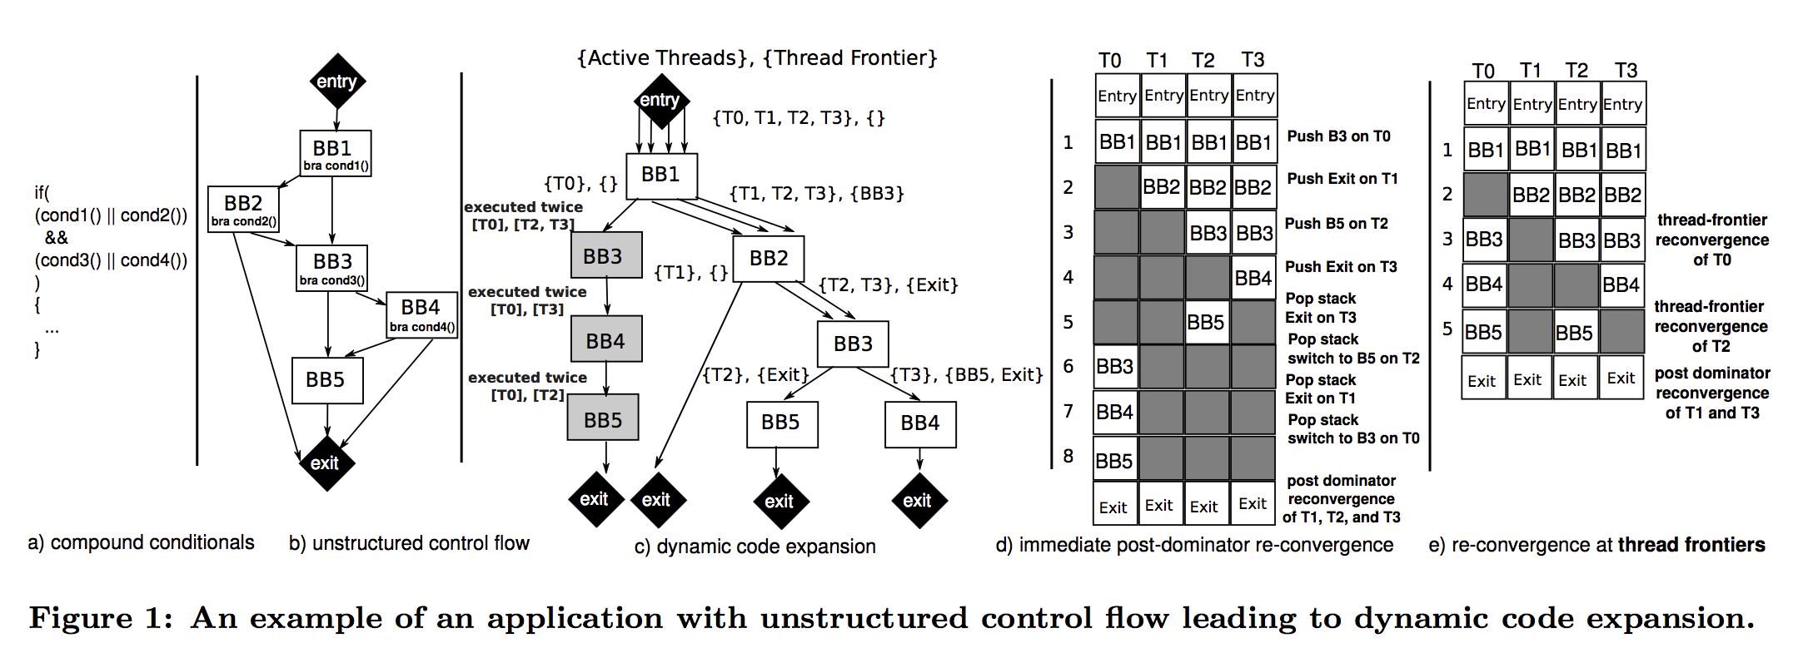
Thread Frontiers
[Diamos et al., MICRO 2011]
+

Slide 25
Temporal SIMT
Spatial SIMT (current GPUs)
Pure Temporal SIMT
32-wide datapath
1-wide
thread
0
thread
31
(threads)
time
1 cyc
time
ld
ld
ld
ld
ld
ld
ld
ld
ld
ld
ld
ld
ld
ld
ld
ld
ld
ld
ld
ld
ld
ld
ld
ld
ld
ld
ld
ld
ld
ld
ld
ld
1 cyc
ld
0
ld
ld
ld
ld
ld
ld
ld
ld
ld
ld
ld
ld
ld
ld
ld
ld
ld
ld
ld
ld
ld
ld
ld
ld
ld
ld
ld
ld
ld
ld
ld
ld
ld
1
ml
ml
ml
ml
ml
ml
ml
ml
ml
ml
ml
ml
ml
ml
ml
ml
ml
ml
ml
ml
ml
ml
ml
ml
ml
ml
ml
ml
ml
ml
ml
ml
ld
2
ad
ad
ad
ad
ad
ad
ad
ad
ad
ad
ad
ad
ad
ad
ad
ad
ad
ad
ad
ad
ad
ad
ad
ad
ad
ad
ad
ad
ad
ad
ad
ad
ld
3
st
st
st
st
st
st
st
st
st
st
st
st
st
st
st
st
st
st
st
st
st
st
st
st
st
st
st
st
st
st
st
st
ld
4
ld
5
1 warp instruction = 32 threads
ld
6
ld
7
ld
8
ld
9
ld
10
[slide courtesy of Bill Dally]

Slide 26
Temporal SIMT Optimizations
Control divergence — hybrid MIMD/SIMT
Scalarization
  Factor common instructions from multiple threads
  Execute once – place results in common registers
  [See: SIMT Affine Value Structure (ISCA 2013)]
32-wide
(41%)
4-wide
(65%)
1-wide
(100%)
[slide courtesy of Bill Dally]

Slide 27
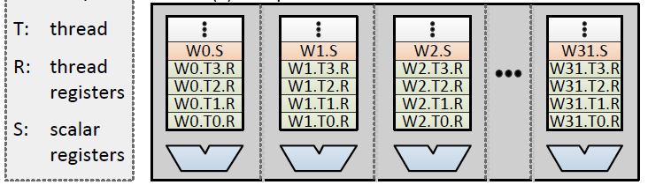
Scalar Instructions in SIMT Lanes
Scalar instruction spanning warp
Scalar register visible to all threads
Temporal execution of Warp
Multiple lanes/warps
[slide courtesy of Bill Dally]
Y. Lee, CGO 2013

Slide 28
Variable Warp-Size Architecture
Most recent work by NVIDIA [ISCA 2015]
Split the SM datapath into narrow slices.
  Extensively studied 4-thread slices
Gang slice execution to gain efficiencies of wider warp.
Slices share an L1
I-Cache and Memory Unit
Slices can execute independently

Slide 29
Divergent Application Performance
Warp Size 4
I-VWS: Break on CF Only
E-VWS: Break + Reform

Slide 30
Convergent Application Performance
E-VWS: Break + Reform
I-VWS: Break on CF Only
Warp Size 4
Warp-Size Insensitive Applications Unaffected

Slide 31
Research Direction 2:
Mitigating High GPGPU Memory Bandwidth Demands

Slide 32
Reducing Off-Chip Access / Divergence
Re-writing software to use “shared memory” and avoid uncoalesced global accesses is bane of GPU programmer existence.
Recent GPUs introduce caches, but large number of warps/wavefronts lead to thrashing.

Slide 33
NVIDIA: Register file cache (ISCA 2011, MICRO)
  Register file burns significant energy
  Many values read once soon after written
  Small register file cache captures locality and saves energy but does not help performance
  Recent follow on work from academia
Prefetching (Kim, MICRO 2010)
Interconnect (Bakhoda, MICRO 2010)
Lee & Kim (HPCA 2012) CPU/GPU cache sharing

Slide 34

Thread Scheduling Analogy
[MICRO 2012]
Human Multitasking
  Humans have limited attention capacity
  GPUs have limited cache capacity
GPU Core
Processor
Cache

Slide 35
Use Memory System Feedback
[MICRO 2012]
Cache Misses
Performance
GPU Core
Thread Scheduler
Processor
Cache
Feedback

Slide 36
Sources of Locality
Intra-wavefront locality
Inter-wavefront locality
Wave₀
Wave₁
Wave₀
LD $line (X)
LD $line (X)
LD $line (X)
LD $line (X)
Hit
Hit
Data Cache
Data Cache

Slide 37
120
Misses PKI
100
Inter-Wavefront Hits PKI
80
(Hits/Miss) PKI
60
40
Intra-Wavefront Hits PKI
20
0
AVG-Highly Cache Sensitive

Slide 38
Scheduler affects access pattern
Round Robin Scheduler
Greedy then Oldest Scheduler
Wave₀
Wave₁
Wave₀
Wave₁
Wavefront Scheduler
Wavefront Scheduler
ld A
,B,C,D…
ld Z,Y,X,W
ld A,B,C,D…
...
...
...
DC
B
A
WX
Y
Z
ld A,B,C,D
ld Z,Y,X,W
ld A,B,C,D…
DC
B
A
DC
B
A
Memory System
Memory System

Slide 39
Use scheduler to shape access pattern
Cache-Conscious Wavefront Scheduling
[MICRO 2012 best paper runner up,
Top Picks 2013, CACM Research Highlight]
Greedy then Oldest Scheduler
Wave₀
Wave₁
Wave₀
Wave₁
Wavefront Scheduler
Wavefront Scheduler
ld A,B,C,D
ld Z,Y,X,W
ld A,B,C,D…
ld Z,Y,X,W…
...
...
DC
B
A
WX
Y
Z
ld A,B,C,D
ld A,B,C,D…
DC
B
A
DC
B
A
Memory System
Memory System

Slide 40
W₂
No W₂ loads
W₂
W₂
W₁
Wave Scheduler
Locality Scoring System
W₁
Score
W₁
W₀
W₀: ld X
W₀
W₀: ld X
W₂: ld Y
W₀
…
Memory Unit
Time
Cache
W₀
detected lost locality
Tag
Y
WID
X
2
Data
0
…
Tag
WID
Data
Victim Tags
W₀,X
W₀
ProbeW₀,X
Tag
X
Tag
W₁
Tag
Tag
W₂
Tag
Tag

Slide 41
2
LRR
GTO
CCWS
1.5
Speedup
1
0.5
0
HMEAN-Highly Cache-Sensitive
Notes:
A 2-LVL scheduler
Similar to GTO performance
A profile-based oracle scheduler
Application and input data dependent
CCWS captures 86% of oracle scheduler performance
Variety of cache-insensitive benchmarks
No performance degradation

Slide 42
Static Wavefront Limiting
[Rogers et al., MICRO 2012]
Profiling an application we can find an optimal number of wavefronts to execute
Does a little better than CCWS.
Limitations: Requires profiling, input dependent, does not exploit phase behavior.

Slide 43
Improve upon CCWS?
CCWS detects bad scheduling decisions and avoids them in future.
Would be better if we could “think ahead” / “be proactive” instead of “being reactive”

Slide 44
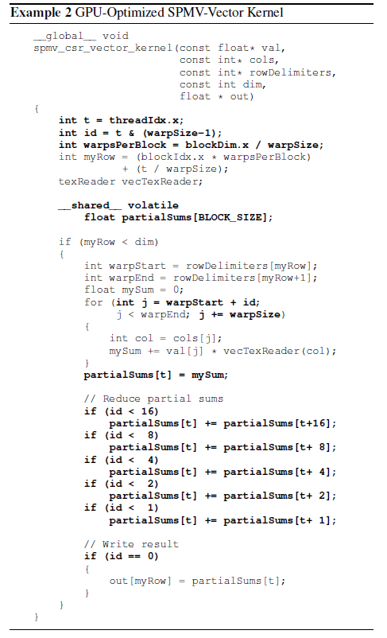
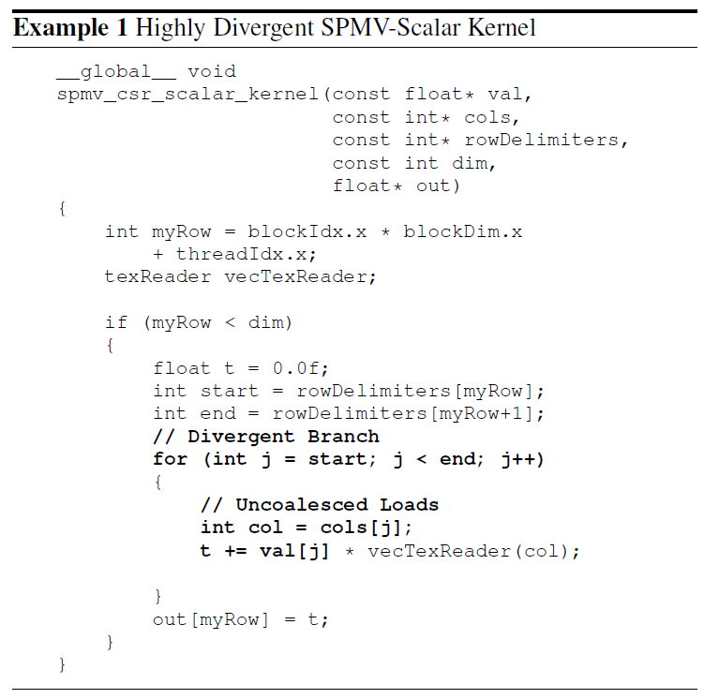


Programmability case study [MICRO 2013]
Sparse Vector-Matrix Multiply
GPU-Optimized Version
SHOC Benchmark Suite
(Oakridge National Labs)
Simple Version
Divergence
Explicit Scratchpad Use
Dependent on Warp Size
Added Complication
Each thread has locality
Parallel Reduction
Using DAWS scheduling
within 4% of optimized with no programmer input

Slide 45
Observations
[Rogers et al., MICRO 2013]
Memory divergence in static instructions is predictable
Data touched by divergent loads dependent on active mask
Main Memory
Divergence
…
load
…
Warp 1
Warp 0
Both Used To Create Cache Footprint Prediction
Main Memory
Main Memory
4 accesses
2 accesses
Warp
Divergence
Warp
Divergence
1
1
1
1
1
0
0
1

Slide 46
Footprint Prediction
Detect loops with locality
Classify loads in the loop
Compute footprint from active mask
Some loops have locality
Some don’t
Limit multithreading here
Loop with locality
while(…) {
load 1
…
load 2
}
Diverged
Not Diverged
Loop with locality
Warp 0
while(…) {
load 1
…
load 2
}
1
1
1
1
1
1
4 accesses
Diverged
Warp 0’s Footprint
= 5 cache lines
+
Not Diverged
1 access

Slide 47
DAWS Operation Example
Cache
Cache
Cache
Example Compressed Sparse Row Kernel
A[0]
Hit
A[0]
Hit x30
A[32]
int C[]={0,64,96,128,160,160,192,224,256};
void sum_row_csr(float* A, …) {
float sum = 0;
int i =C[tid];
while(i < C[tid+1]) {
sum += A[ i ];
++i;
}
…
A[64]
Hit
A[64]
Hit x30
A[160]
A[96]
Hit
A[96]
Hit x30
A[192]
A[128]
Hit
A[128]
Hit x30
A[224]
Stop
Loop
1st Iter.
Go
Warp₁
Divergent Branch
0
1
1
1
Memory Divergence
Warp₀
1
1
1
1
Warp₀
1
0
0
0
2nd Iter.
Go
33rd Iter.
Go
Go
Time₀
Time₁
Time₂
Cache Footprint
Stop
Warp₁
Early warps profile loop for later warps
Warp 0 has branch divergence
Locality Detected
1 Diverged Load Detected
4
4
4
Footprint = 3X1
Want to capture spatial locality
No locality detected = no footprint
Warp₀
Warp₁
Both warps capture spatial locality together
No Footprint
4 Active threads
Footprint decreased
Footprint = 4X1
Warp₀

Slide 48
Sparse MM Case Study Results
Performance (normalized to optimized version)
Within 4% of optimized with no programmer input
Divergent Code Execution time

Slide 49
Memory Request Prioritization Buffer
[Jia et al., HPCA 2014]
W3
W2
W1
W3
W2
W1
W2
W2
W1
W1
Reorder requests by warp ID
W3
W3
Bypass accesses to hot set
Reorder requests by sorting by Warp ID.
Bypass when too many accesses to same cache set.

Slide 50
Priority-Based Cache Allocation in Throughput Processors [Li et al., HPCA 2015]
CCWS leaves L2 and DRAM underutilized.
Allow some additional warps to execute but do not allow them to allocate space in cache:
Warp 0
Normal Warps
Schedule and allocate in L1
Warp 1
Warp 2
Non-Polluting
Warps
Warp 3
Schedule and bypass L1
Warp 4
Warp 5
Throttled Warps
Not scheduled
Warp n-1

Slide 51
Coordinated criticality-Aware Warp Acceleration (CAWA) [Lee et al., ISCA 2015]
Some warps execute longer than others due to lack of uniformity in underlying workload.
Give these warps more space in cache and more scheduling slots.
Estimate critical path by observing amount of branch divergence and memory stalls.
Also, predict if line inserted in line will be used by a warp that is critical using modified version of SHiP cache replacement algorithm.

Slide 52
Other Memory System Performance Considerations
TLB Design for GPUs.
  Current GPUs have translation look aside buffers (makes managing multiple graphics application surfaces easier; does not support paging)
  How does large number of threads impact TLB design?
  E.g., Power et al., Supporting x86-64 Address Translation for 100s of GPU Lanes, HPCA 2014. Importance of multithreaded page table walker + page walk cache.

Slide 53
Research Direction 3:
Coherent Memory for Accelerators

Slide 54
Why GPU Coding Difficult?
Manual data movement CPU ⬄ GPU
Lack of generic I/O , system support on GPU
Need for performance tuning to reduce
  off-chip accesses
  memory divergence
  control divergence
For complex algorithms, synchronization
Non-deterministic behavior for buggy code
Lack of good performance analysis tools

Slide 55
Manual CPU ⬄ GPU Data Movement
Problem #1: Programmer needs to identify data needed in a kernel and insert calls to move it to GPU
Problem #2: Pointer on CPU does not work on GPU since different address spaces
Problem #3: Bandwidth connecting CPU and GPU is order of magnitude smaller than GPU off-chip
Problem #4: Latency to transfer data from CPU to GPU is order of magnitude higher than GPU off-chip
Problem #5: Size of GPU DRAM memory much smaller than size of CPU main memory

Slide 56
Identifying data to move CPU ⬄ GPU
CUDA/OpenCL: Job of programmer ☹
C++AMP passes job to compiler.
OpenACC uses pragmas to indicate loops that should be offloaded to GPU.

Slide 57
Memory Model
Rapid change (making programming easier)
Late 1990’s: fixed function graphics only
2003: programmable graphics shaders
2006: + global/local/shared (GeForce 8)
2009: + caching of global/local
2011: + unified virtual addressing
2014: + unified memory / coherence

Slide 58
Caching
Scratchpad uses explicit data movement. Extra work. Beneficial when reuse pattern statically predictable.
NVIDIA Fermi / AMD Southern Island add caches for accesses to global memory space.

Slide 59
CPU memory vs. GPU global memory
Prior to CUDA: input data is texture map.
CUDA 1.0 introduces cudaMemcpy
  Allows copy of data between CPU memory space to global memory on GPU
Still has problems:
  #1: Programmer still has to think about it!
  #2: Communicate only at kernel grid boundaries
  #3: Different virtual address space
    pointer on CPU not a pointer on GPU => cannot easily share complex data structures between CPU and GPU

Slide 60
Fusion / Integrated GPUs
Why integrate?
  One chip versus two (cf. Moore’s Law, VLSI)
  Latency and bandwidth of communication: shared physical address space, even if off-chip, eliminates copy: AMD Fusion. 1st iteration 2011. Same DRAM
  Shared virtual address space? (AMD Kavari 2014)
  Reduce latency to spawn kernel means kernel needs to do less to justify cost of launching

Slide 61
CPU Pointer not a GPU Pointer
NVIDIA Unified Virtual Memory partially solves the problem but in a bad way:
  GPU kernel reads from CPU memory space
NVIDIA Uniform Memory (CUDA 6) improves by enabling automatic migration of data
Limited academic work. Gelado et al. ASPLOS 2010.

Slide 62
CPU ⬄ GPU Bandwidth
Shared DRAM as found in AMD Fusion (recent Core i7) enables the elimination of copies from CPU to GPU. Painful coding as of 2013.
One question how much benefit versus good coding. Our limit study (WDDD 2008) found only ~50% gain. Lustig & Martonosi HPCA 2013.
Algorithm design—MummerGPU++

Slide 63
CPU ⬄ GPU Latency
NVIDIA’s solution: CUDA Streams. Overlap GPU kernel computation with memory transfer. Stream = ordered sequence of data movement commands and kernels. Streams scheduled independently. Very painful programming.
Academic work: Limit Study (WDDD 2008), Lustig & Martonosi HPCA 2013, Compiler data movement (August, PLDI 2011).

Slide 64
GPU Memory Size
CUDA Streams
Academic work: Treat GPU memory as cache on CPU memory (Kim et al., ScaleGPU, IEEE CAL early access).

Slide 65
Solution to all these sub-issues?
Heterogeneous System Architecture: Integrated CPU and GPU with coherence memory address space.
Need to figure out how to provide coherence between CPU and GPU.
Really two problems: Coherence within GPU and then between CPU and GPU.

Slide 66
Research Direction 4:
Easier Programming with Synchronization

Slide 67
Synchronization
Locks are not encouraged in current GPGPU programming manuals.
Interaction with SIMT stack can easily cause deadlocks:
while( atomicCAS(&lock[a[tid]],0,1) != 0 )
; // deadlock here if a[i] = a[j] for any i,j = tid in warp
// critical section goes here
atomicExch (&lock[a[tid]], 0) ;

Slide 68
Correct way to write critical section for GPGPU:
done = false;
while( !done ) {
if( atomicCAS (&lock[a[tid]], 0 , 1 )==0 ) {
// critical section goes here
atomicExch(&lock[a[tid]], 0 ) ;
}
}
Most current GPGPU programs use barriers within thread blocks and/or lock-free data structures.
This leads to the following picture…

Slide 69
Lifetime of GPU Application Development
Functionality
Performance
E.g. N-Body with 5M bodies
CUDA SDK: O(n²) – 1640 s (barrier)
Barnes Hut: O(nLogn) – 5.2 s (locks)
Time
Fine-Grained Locking/Lock-Free
Transactional Memory
?
Time
Time
Wilson Fung, Inderpeet Singh, Andrew Brownsword, Tor Aamodt
Notes:
Usually, developers can get the application running on GPU after a little bit of initial effort, and spend the rest of their time tuning the application for performance.
For application that require (or benefit from) fine-grained data synchronization, the developer may spend significant effort just to get the code working. As in the usual case, the first working code performs poorly, so effort to tune the application is still required. If the developers spend the effort to tune the code, the reward can be great. For example, O(nLogn) implementation of N-Body is orders of magnitude faster than the naïve implementation, but it is harder to get right because of locks.
Hypothesis 1: For applications that require fine-grained communication between tasks, developers will give up long before the code is working on a GPU, and even if they manage to get the application to run correctly, the performance will initially be bad and they may then decide they have wasted too much time for too little progress.
Hypothesis 2: With TM, the developer will get working code sooner, leaving time to tune the code for performance.
Even if there is a performance overhead for using TM it is a gain for the developer (better performing code with same effort).

Slide 70
Transactional Memory
Programmer specifies atomic code blocks called transactions [Herlihy’93]
Lock Version:
Lock(X[a]);
Lock(X[b]);
Lock(X[c]);
X[c] = X[a]+X[b];
Unlock(X[c]);
Unlock(X[b]);
Unlock(X[a]);
TM Version:
atomic {
X[c] = X[a]+X[b];
}
Potential Deadlock!

Slide 71
Transactional Memory
Programmers’ View:
TX1
Time
TX2
Time
OR
TX2
TX1
Non-conflicting transactions may run in parallel
Conflicting transactions automatically serialized
Memory
Memory
A
TX1
A
TX1
B
TX2
B
TX2
C
C
Commit
D
Abort
Commit
D
Commit
TX2
Commit
Notes:
In the programmers’ view, transactions are executed atomically in some order.
The underlying runtime system can optimistically run non-conflicting transactions in parallel.
Conflicting transactions may be resolved by aborting one of the transaction and restarting it later.

Slide 72
Are TM and GPUs Incompatible?
GPU uarch very different from multicore CPU…
KILO TM [MICRO’11, IEEE Micro Top Picks]
Hardware TM for GPUs
Half performance of fine grained locking
  Chip area overhead of 0.5%
Hardware TM for GPU Architectures
72
Notes:
For those who know something about both TM and GPU, the two may seem to be incompatible concepts.
Yes, GPUs are different from multi core CPUs.
These differences lead to a set of challenges for supporting TM on GPU.
For each of these challenges, I will show you how KILO TM, our hardware TM for GPUs, addresses the challenge.

Slide 73
Research Direction 5:
GPU Power Efficiency

Slide 74
GPU power
More efficient than CPU but
  Consumes a lot of power
  Much less efficient than ASIC or FPGAs
  What can be done to reduce power consumption?
Look at the most power hungry components
  What can be duty cycled/power gated?
  GPUWattch to evaluate ideas

Slide 75
Other Research Directions….
Non-deterministic behavior for buggy code
  GPUDet ASPLOS 2013
Lack of good performance analysis tools
  NVIDIA Profiler/Parallel NSight
  AerialVision [ISPASS 2010]
  GPU analytical perf/power models (Hyesoon Kim)

Slide 76
Lack of I/O and System Support…
Support for printf, malloc from kernel in CUDA
File system I/O?
GPUfs (ASPLOS 2013):
  POSIX-like file system API
  One file per warp to avoid control divergence
  Weak file system consistency model (close->open)
  Performance API: O_GWRONCE, O_GWRONCE
  Eliminate seek pointer
GPUnet (OSDI 2014): Posix like API for sockets programming on GPGPU.

Slide 77
Conclusions
GPU Computing is growing in importance due to energy efficiency concerns
GPU architecture has evolved quickly and likely to continue to do so
We discussed some of the important microarchitecture bottlenecks and recent research.
Also discussed some directions for improving programming model

