Slide 1
CS/ECE 217
GPU Architecture and Parallel Programming
Lecture 16:
GPU within a computing system

Slide 2
Objective
To understand the major factors that dictate performance when using GPU as an compute co-processor for the CPU
  The speeds and feeds of the traditional CPU world
  The speeds and feeds when employing a GPU
  To form a solid knowledge base for performance programming in modern GPU’s

Slide 3
Review- Typical Structure of a CUDA Program
Global variables declaration
Function prototypes
  __global__ void kernelOne(…)
Main ()
  allocate memory space on the device – cudaMalloc(&d_GlblVarPtr, bytes )
  transfer data from host to device – cudaMemCpy(d_GlblVarPtr, h_Gl…)
  execution configuration setup
  kernel call – kernelOne<<<execution configuration>>>( args… );
  transfer results from device to host – cudaMemCpy(h_GlblVarPtr,…)
  optional: compare against golden (host computed) solution
Kernel – void kernelOne(type args,…)
  variables declaration - __local__, __shared__
    automatic variables transparently assigned to registers or local memory
  syncthreads()…
repeat
as needed

Slide 4
Bandwidth –
Gravity of Modern Computer Systems
The Bandwidth between key components ultimately dictates system performance
  Especially true for massively parallel systems processing massive amount of data
  Tricks like buffering, reordering, caching can temporarily defy the rules in some cases
  Ultimately, the performance falls back to what the “speeds and feeds” dictate

Slide 5
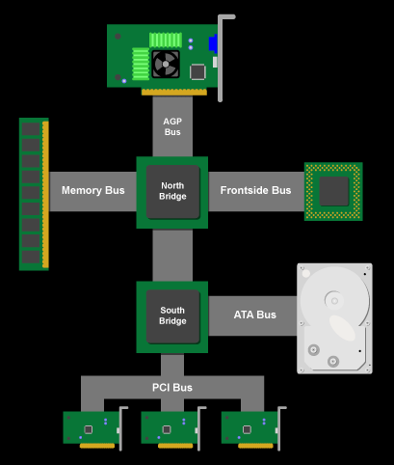
Classic PC architecture
Northbridge connects 3 components that must be communicate at high speed
  CPU, DRAM, video
  Video also needs to have 1st-class access to DRAM
  Previous NVIDIA cards are connected to AGP, up to 2 GB/s transfers
Southbridge serves as a concentrator for slower I/O devices
CPU
Core Logic Chipset

Slide 6
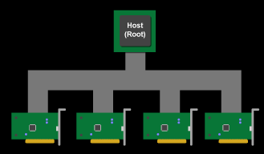
(Original) PCI Bus Specification
Connected to the southBridge
  Originally 33 MHz, 32-bit wide, 132 MB/second peak transfer rate
  More recently 66 MHz, 64-bit, 528 MB/second peak
  Upstream bandwidth remain slow for device (~256MB/s peak)
  Shared bus with arbitration
    Winner of arbitration becomes bus master and can connect to CPU or DRAM through the southbridge and northbridge

Slide 7
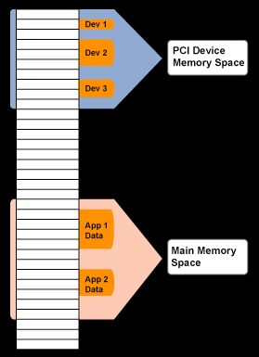
PCI as Memory Mapped I/O
PCI device registers are mapped into the CPU’s physical address space
  Accessed through loads/ stores (kernel mode)
Addresses are assigned to the PCI devices at boot time
  All devices listen for their addresses

Slide 8
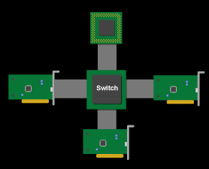
PCI Express (PCIe)
Switched, point-to-point connection
  Each card has a dedicated “link” to the central switch, no bus arbitration.
  Packet switches messages form virtual channel
  Prioritized packets for QoS
    E.g., real-time video streaming

Slide 9
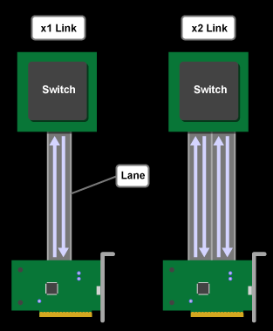
PCIe 2 Links and Lanes
Each link consists of one or more lanes
  Each lane is 1-bit wide (4 wires, each 2-wire pair can transmit 2.5Gb/s in one direction)
    Upstream and downstream now simultaneous and symmetric
  Each Link can combine 1, 2, 4, 8, 12, 16 lanes- x1, x2, etc.
  Each byte data is 8b/10b encoded into 10 bits with equal number of 1’s and 0’s; net data rate 2 Gb/s per lane each way.
  Thus, the net data rates are 250 MB/s (x1) 500 MB/s (x2), 1GB/s (x4), 2 GB/s (x8), 4 GB/s (x16), each way

Slide 10
8/10 bit encoding
Goal is to maintain DC balance while have sufficient state transition for clock recovery
The difference of 1s and 0s in a 20-bit stream should be ≤ 2
There should be no more than 5 consecutive 1s or 0s in any stream
00000000, 00000111, 11000001 bad
01010101, 11001100 good
Find 256 good patterns among 1024 total patterns of 10 bits to encode an 8-bit data
A 25% overhead

Slide 11
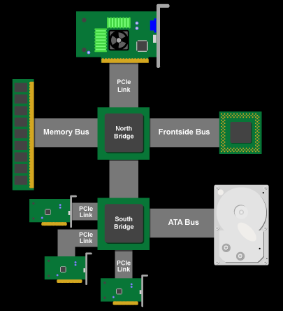
PCIe PC Architecture
PCIe forms the interconnect backbone
  Northbridge/Southbridge are both PCIe switches
  Some Southbridge designs have built-in PCI-PCIe bridge to allow old PCI cards
  Some PCIe I/O cards are PCI cards with a PCI-PCIe bridge
Source: Jon Stokes, PCI Express: An Overview
  http://arstechnica.com/articles/paedia/hardware/pcie.ars

Slide 12
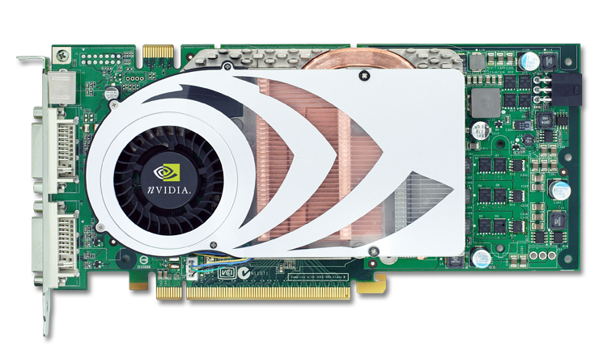
GeForce 7800 GTX
Board Details
SLI Connector
Single slot cooling
sVideo
TV Out
DVI x 2
256MB/256-bit DDR3
  600 MHz
  8 pieces of 8Mx32
16x PCI-Express

Slide 13
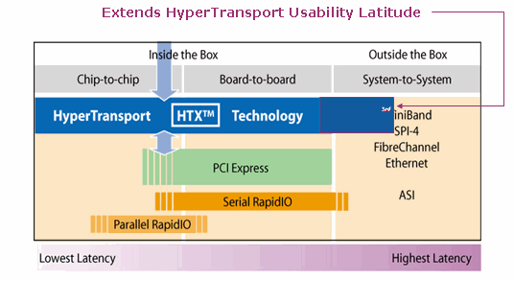
HyperTransport™ Feeds and Speeds
Primarily a low latency direct chip-to-chip interconnect, supports mapping to board-to-board interconnect such as PCIe
HyperTransport ™ 1.0 Specification
  800 MHz max, 12.8 GB/s aggregate bandwidth (6.4 GB/s each way)
HyperTransport ™ 2.0 Specification
  Added PCIe mapping
  1.0 - 1.4 GHz Clock, 22.4 GB/s aggregate bandwidth (11.2 GB/s each way)
HyperTransport ™ 3.0 Specification
  1.8 - 2.6 GHz Clock, 41.6 GB/s aggregate bandwidth (20.8 GB/s each way)
  Added AC coupling to extend HyperTransport ™ to long distance to system-to-system interconnect
Courtesy HyperTransport ™ Consortium
Source: “White Paper: AMD HyperTransport
Technology-Based System Architecture

Slide 14
PCIe 3
A total of 8 Giga Transfers per second in each direction
No more 8/10 encoding but uses a polynomial transformation at the transmitter and its inverse at the receiver to achieve the same effect
So the effective bandwidth is double of PCIe 2

Slide 15
PCIe Data Transfer using DMA
DMA (Direct Memory Access) is used to fully utilize the bandwidth of an I/O bus
  DMA uses physical address for source and destination
  Transfers a number of bytes requested by OS
  Needs pinned memory
Main Memory (DRAM)
CPU
GPU card
(or other I/O cards)
Global Memory
DMA

Slide 16
Pinned Memory
DMA uses physical addresses
The OS could accidentally page out the data that is being read or written by a DMA and page in another virtual page into the same location
Pinned memory cannot not be paged out
If a source or destination of a cudaMemCpy() in the host memory is not pinned, it needs to be first copied to a pinned memory – extra overhead
cudaMemcpy is much faster with pinned host memory source or destination

Slide 17
Allocate/Free Pinned Memory
(a.k.a. Page Locked Memory)
cudaHostAlloc()
  Three parameters
  Address of pointer to the allocated memory
  Size of the allocated memory in bytes
  Option – use cudaHostAllocDefault for now
cudaFreeHost()
  One parameter
  Pointer to the memory to be freed

Slide 18
Using Pinned Memory
Use the allocated memory and its pointer the same way those returned by malloc();
The only difference is that the allocated memory cannot be paged by the OS
The cudaMemcpy function should be about 2X faster with pinned memory
Pinned memory is a limited resource whose over-subscription can have serious consequences

Slide 19
Important Trends
Knowing yesterday, today, and tomorrow
  The PC world is becoming flatter
  CPU and GPU are being fused together
  Outsourcing of computation is becoming easier…

Slide 20
Any MoRe Questions?

