Slide 1
CS/EE 217
GPU Architecture and Parallel Programming
Project Kickoff

Slide 2
Two flavors
Application
  Implement/optimize an realistic application on GPGPUs
Architecture
  Evaluate application performance at the architecture level and sensitivity to architectural features
  Propose new features or algorithms

Slide 3
Two tracks
Basic project—essentially a larger lab.
  Should involve significant coding/optimization but…
  does not necessarily have to be original or research related work
  Could just implement one of the default projects
Research project
  Should review related work
  Should have a goal of publishing a paper
    Even if you don’t get there, that is ok
  More formal project proposal
  In return, you don’t have to take the final exam!

Slide 4
Application projects: Objective
To Build up your ability to translate parallel computing power into science and engineering breakthroughs
  Identify applications whose computing structures are suitable for massively parallel execution
  10-100X more computing power can have transformative effect on these applications
  Much better if you have a client
    You can be the client – bringing an idea from your own research is encouraged.
Develop algorithm patterns that can result in both better efficiency as well as scalability

Slide 5
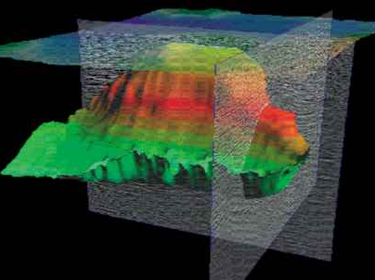
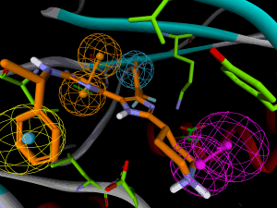
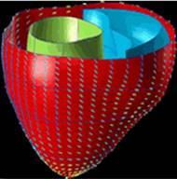
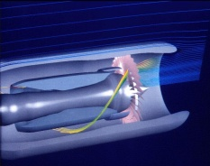
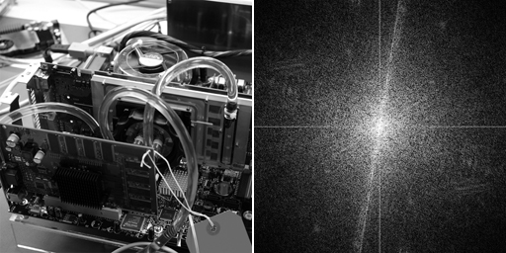

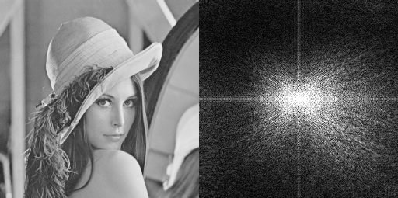
Future Science and Engineering Breakthroughs Hinge on Computing
Computational
Geoscience
Computational
Chemistry
Computational
Medicine
Computational
Modeling
Computational
Physics
Computational
Biology
Computational
Finance
Image
Processing
Notes:
computational is the third leg of science – joining theory and experimentation
replaces Edisonian method

Slide 6


GPU computing is catching on.

Slide 7
GPU computing is catching on.
Financial Analysis
Scientific Simulation
Engineering Simulation
Data Intensive Analytics
Medical Imaging
Digital Audio Processing
Digital Video Processing
Computer Vision
Biomedical Informatics
Electronic Design Automation
Statistical Modeling
Ray Tracing Rendering
Interactive Physics
Numerical Methods
280 submissions to GPU Computing Gems
  ~90 articles included in two volumes

Slide 8
Faster is not “just Faster”
2-3X faster is “just faster”
  Do a little more, wait a little less
  Doesn’t change how you work
5-10x faster is “significant”
  Worth upgrading
  Worth re-writing (parts of) the application
100x+ faster is “fundamentally different”
  Worth considering a new platform
  Worth re-architecting the application
  Makes new applications possible
  Drives “time to discovery” and creates fundamental changes in Science

Slide 9
How much computing power is enough?
Each jump in computing power motivates new ways of computing
  Many apps have approximations or omissions that arose from limitations in computing power
  Every 10x jump in performance allows app developers to innovate
  Example: graphics, medical imaging, physics simulation, etc.
Application developers do not take it seriously until they see real results.

Slide 10
Why didn’t this happen earlier?
Computational experimentation is just reaching critical mass
  Simulate large enough systems
  Simulate long enough system time
  Simulate enough details
Computational instrumentation is also just reaching critical mass
  Reaching high enough accuracy
  Cover enough observations

Slide 11
A Great Opportunity for Many
New massively parallel computing is enabling
  Drastic reduction in “time to discovery”
  1st principle-based simulation at meaningful scale
  New, 3rd paradigm for research: computational experimentation
The “democratization” of power to discover
    $2,000/Teraflop in personal computers today
    $5,000,000/Petaflops in clusters today
    HW cost will no longer be the main barrier for big science
This is once-in-a-career opportunity for many!
Notes:
Mention Petascale, ECE498AL, and IACAT

Slide 12
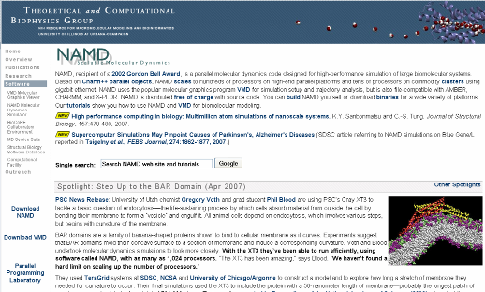
VMD/NAMD Molecular Dynamics
240X speedup over sequential code
Computational biology

Slide 13
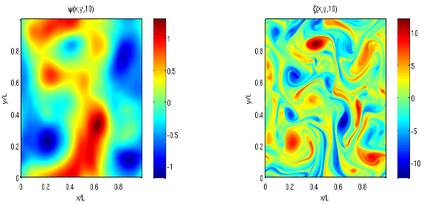
Matlab: Language of Science
15X with MATLAB CPU+GPU
http://developer.nvidia.com/object/matlab_cuda.html
Pseudo-spectral simulation of 2D Isotropic turbulence

Slide 14
Prevalent Performance Limits
Some microarchitectural limits appear repeatedly across the benchmark suite:
Global memory bandwidth saturation
  Tasks with intrinsically low data reuse, e.g. vector-scalar addition or matrix-vector multiplication product
  Computation with frequent global synchronization
    Converted to short-lived kernels with low data reuse
    Common in simulation programs
Thread-level optimization vs. latency tolerance
  Since hardware resources are divided among threads, low per-thread resource use is necessary to furnish enough simultaneously-active threads to tolerate long-latency operations
  Making individual threads faster generally increases register and/or shared memory requirements
  Optimizations trade off single-thread speed for exposed latency

Slide 15
What you will likely need to hit hard.
Parallelism extraction requires global understanding
  Most programmers only understand parts of an application
Algorithms need to be re-designed
  Algorithmic effect on parallelism and locality is often hard to maneuver
Real but rare dependencies often need to be pushed aside
  Error checking code, etc., parallel code is often not equivalent to sequential code
Getting more than a small speedup over sequential code is very tricky
  ~20 versions typically experimented for each application

Slide 16
Ideas for projects
Your own research!
An application you are interested in.
GPU computing Gems
Parboil benchmark: Collections of best parallel programming projects for CPU/GPU computing
Rodinia Benchmark
Talk to me if you are interested in architecture projects
http://impact.crhc.illinois.edu/Parboil/parboil.aspx

Slide 17
Architecture Proposals
Either a workload evaluation study running workloads in a simulator
  Explore impact of different architecture parameters on performance
  Provide insights into what causes the differences in behavior
Propose and evaluate improvements
  E.g., warp scheduler competition
  http://www.sigarch.org/2015/08/06/call-for-papers-1st-gpu-warpwavefront-scheduling-championship/

Slide 18
Project website come up soon
Deadlines and details of deliverables
Standard programming project
Standard architecture project (scheduler competition)

Slide 19
Any More Questions?

