Slide 1
CS/EE 217 GPU Architecture and Parallel Programming
Lecture 11
Parallel Computation Patterns – Parallel Prefix Sum (Scan)

Slide 2
Objective
To master parallel Prefix Sum (Scan) algorithms
  frequently used for parallel work assignment and resource allocation
  A key primitive to in many parallel algorithms to convert serial computation into parallel computation
  Based on reduction tree and reverse reduction tree
Reading –Efficient Parallel Scan Algorithms for GPUs
  https://research.nvidia.com/sites/default/files/publications/nvr-2008-003.pdf

Slide 3
(Inclusive) Prefix-Sum (Scan) Definition
Definition: The all-prefix-sums operation takes a binary associative operator ⊕, and an array of n elements
[x₀, x₁, …, x_{n-1}],
and returns the array
[x₀, (x₀ ⊕ x₁), …, (x₀ ⊕ x₁ ⊕ … ⊕ x_{n-1})].
Example: If ⊕ is addition, then the all-prefix-sums operation on the array [3 1 7 0 4 1 6 3],
would return [3 4 11 11 15 16 22 25].

Slide 4
A Inclusive Scan Application Example
Assume that we have a 100-inch sausage to feed 10
We know how much each person wants in inches
  [3 5 2 7 28 4 3 0 8 1]
How do we cut the sausage quickly?
How much will be left
Method 1: cut the sections sequentially: 3 inches first, 5 inches second, 2 inches third, etc.
Method 2: calculate Prefix scan
  [3, 8, 10, 17, 45, 49, 52, 52, 60, 61] (39 inches left)

Slide 5
Typical Applications of Scan
Scan is a simple and useful parallel building block
  Convert recurrences from sequential :
  for(j=1;j<n;j++)
  out[j] = out[j-1] + f(j);
  into parallel:
  forall(j) { temp[j] = f(j) };
  scan(out, temp);
Useful for many parallel algorithms:
radix sort
quicksort
String comparison
Lexical analysis
Stream compaction
Polynomial evaluation
Solving recurrences
Tree operations
Histograms
Etc.

Slide 6
Other Applications
Assigning camp slots
Assigning farmer market space
Allocating memory to parallel threads
Allocating memory buffer for communication channels
…

Slide 7
An Inclusive Sequential Scan
Given a sequence [x₀, x₁, x₂, ... ]
Calculate output [y₀, y₁, y₂, ... ]
Such that y₀ = x₀
y₁ = x₀ + x₁
y₂ = x₀ + x₁+ x₂
…
Using a recursive definition
y_{i} = y_{i − 1} + x_{i}

Slide 8
A Work Efficient C Implementation
y[0] = x[0];
for (i = 1; i < Max_i; i++) y[i] = y [i-1] + x[i];
Computationally efficient:
N additions needed for N elements - O(N)!

Slide 9
How do we do this in parallel?
What is the relationship between Parallel Scan and Reduction?
  Multiple reduction operations!
  What if we implement it that way?
How many operations?
  Each reduction tree is O(n) operations
  Reduction trees of size n, n-1, n-2, n-3, … 1
  Very work inefficient! Important concept

Slide 10
A Slightly Better Parallel Inclusive Scan Algorithm
T0 | 3 | 1 | 7 | 0 | 4 | 1 | 6 | 3
Read input from
device memory to
shared memory
Each thread reads one value from the input
array in device memory into shared memory array T0.
Thread 0 writes 0 into shared memory array.

Slide 11
A Slightly Better Parallel Scan Algorithm
T0 | 3 | 1 | 7 | 0 | 4 | 1 | 6 | 3
(previous slide)
Iterate log(n)
times: Threads stride to n: Add pairs of elements stride elements apart. Double stride at each iteration. (note must double buffer shared mem arrays)
Stride 1
T1 | 3 | 4 | 8 | 7 | 4 | 5 | 7 | 9
Active threads: stride to n-1 (n-stride threads)
Thread j adds elements j and j-stride from T0 and writes result into shared memory buffer T1 (ping-pong)
Iteration #1
Stride = 1

Slide 12
A Slightly Better Parallel Scan Algorithm
T0 | 3 | 1 | 7 | 0 | 4 | 1 | 6 | 3
Read input from
device memory to
shared memory.
Iterate log(n)
times: Threads stride to n: Add pairs of elements stride elements apart. Double stride at each iteration. (note must double buffer shared mem arrays)
Stride 1
T1 | 3 | 4 | 8 | 7 | 4 | 5 | 7 | 9
Stride 2
T0 | 3 | 4 | 11 | 11 | 12 | 12 | 11 | 14
Iteration #2
Stride = 2

Slide 13
A Slightly Better Parallel Scan Algorithm
Read input from
device memory to
shared memory. Set first element to zero and shift others right by one.
Iterate log(n)
times: Threads stride to n: Add pairs of elements stride elements apart. Double stride at each iteration. (note must double buffer shared memory arrays)
Write output from shared memory to device memory
T0 | 3 | 1 | 7 | 0 | 4 | 1 | 6 | 3
Stride 1
T1 | 3 | 4 | 8 | 7 | 4 | 5 | 7 | 9
Stride 2
T0 | 3 | 4 | 11 | 11 | 12 | 12 | 11 | 14
Stride 4
T1 | 3 | 4 | 11 | 11 | 15 | 16 | 22 | 25
Iteration #3
Stride = 4

Slide 14
Handling Dependencies
During every iteration, each therad can overwrite the input of another thread
  Need barrier synchronization to ensure all inputs have been properly generated
  All threads secure input operand that can be overwritten by another thread
  Barrier synchronization to ensure that threads have secured their inputs
  All threads perform addition to write output

Slide 15
Work inefficient scan kernel
__shared__ float XY[SECTION_SIZE];
int i = blockIdx.x * blockDim.x + threadIdx.x;
//load into shared memory
if (i < InputSize) { XY[threadIdx.x] = X[i];}
//perform iterative scan on XY
for (unsigned int stride = 1; stride <= threadIdx.x; stride *=2) {
__synchthreads();
float in1 = XY[threadIdx.x – stride];
__synchthreads();
XY[threadIdx.x]+=in1;
}

Slide 16
Work Efficiency Considerations
The first-attempt Scan executes log(n) parallel iterations
  The steps do (n-1), (n-2), (n-4),..(n- n/2) adds each
  Total adds: n * log(n) - (n-1) → O(n*log(n)) work
This scan algorithm is not very work efficient
  Sequential scan algorithm does n adds
  A factor of log(n) hurts: 20x for 10^6 elements!
A parallel algorithm can be slow when execution resources are saturated due to low work efficiency

Slide 17
Improving Efficiency
A common parallel algorithm pattern:
Balanced Trees
  Build a balanced binary tree on the input data and sweep it to and from the root
  Tree is not an actual data structure, but a concept to determine what each thread does at each step
For scan:
  Traverse down from leaves to root building partial sums at internal nodes in the tree
    Root holds sum of all leaves
  Traverse back up the tree building the scan from the partial sums

Slide 18
Parallel Scan - Reduction Step
x₀
x₁
x₂
x₃
x₄
x₅
x₆
x₇
+
+
+
+
Time
∑x_{0..}x₁
∑x_{2..}x₃
∑x_{4..}x₅
∑x_{6..}x₇
+
+
∑x_{0..}x₃
∑x_{4..}x₇
+
In place calculation
∑x_{0..}x₇
Final value after reduce

Slide 19
Reduction Step Kernel Code
// scan_array[BLOCK_SIZE*2] is in shared memory
for(int stride=1; stride<= BLOCK_SIZE; stride *=2)
{
int index = (threadIdx.x+1)*stride*2 - 1;
if(index < 2*BLOCK_SIZE)
scan_array[index] += scan_array[index-stride];
stride = stride*2;
__syncthreads();
}

Slide 20
Inclusive Post Scan Step
x₀
∑x_{0..}x₁
x₂
∑x_{0..}x₃
x₄
∑x_{4..}x₅
x₆
∑x_{0..}x₇
+
∑x_{0..}x₅
Move (add) a critical value to a central location where it is needed

Slide 21
Inclusive Post Scan Step
x₀
∑x_{0..}x₁
x₂
∑x_{0..}x₃
x₄
∑x_{4..}x₅
x₆
∑x_{0..}x₇
+
∑x_{0..}x₅
+
+
+
∑x_{0..}x₂
∑x_{0..}x₄
∑x_{0..}x₆

Slide 22
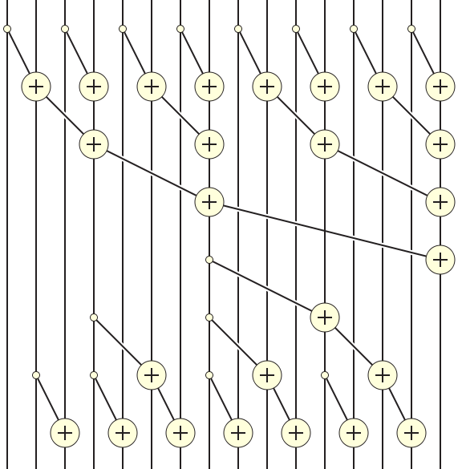
Putting it Together

Slide 23
Any more questions?

