Slide 1


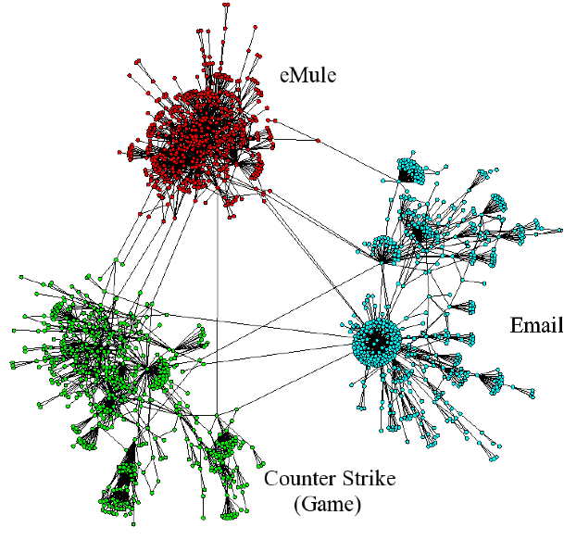
Profiling-by-Association:
A Resilient Traffic Profiling Solution for the Internet Backbone
Marios Iliofotou (UC Riverside)
Brian Gallagher (LLNL) Tina Eliassi-Rad (Rutgers University)
Guowu Xi (UC Riverside) Michalis Faloutsos (UC Riverside)
ACM CoNEXT, December 1st 2010

Slide 2

Profiling Internet traffic
Who is using my network and for what?
Which applications are running in my network?
Internet Service Provider (ISP)
Application Breakdown
Why is this useful?
Traffic engineering
Network planning
Internet
Assign traffic to
different applications

Slide 3
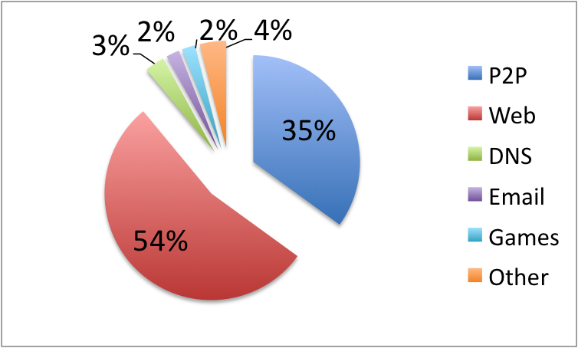
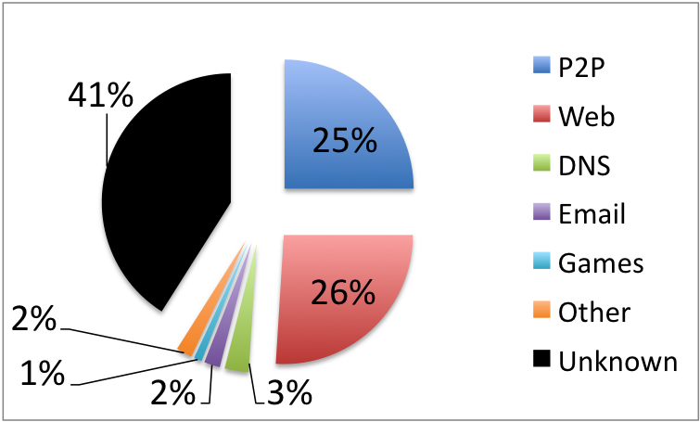
Profiling traffic is challenging
There is a gap between what network administrators want and what existing tools can provide
What we want
What we get with existing tools
We present a tool that:
Profiles ALL the traffic
Has high prediction accuracy (~90%)
Traffic profiling results using
deep packet inspection
(data are from a peering link
between two ISP is the US)

Slide 4
Why traffic profiling is challenging?
Obfuscation at multiple levels
  Users and applications try to hide their traffic
    e.g., Peer-to-peer (P2P)
What existing profilers use:
How to evade them:
Level-1
Port Numbers
Use random ports
Payload
Signatures
Encryption
Level-2
Level-3
Flow Statistics
Payload padding

Slide 5

Profiling end-hosts is more robust, but …
Sensitive to partial visibility at the backbone
  Significantly affects behavioral host-profiling solutions
    BLINC [Karagiannis et al. 2005]
Availability of information can be limited (e.g., P2P)
  Googling the Internet [Trestian et al. 2008]
We need a tool that can profile traffic:
Even when ports, payload, and flows are obfuscated
At the backbone, where we have partial visibility
For P2P applications successfully, which is more challenging
Monitored link
[Kim et al. 2008]
The more flows we see for a host,
the easier is to profile him successfully
Profiler
Easy for long lived servers,
hard for
short lived P2P IPs
233.14.60.67

Slide 6
Outline
Introduction
Profiling-by-Association (PBA) framework
Our PBA-based profiling algorithms
Experimental results
Conclusions

Slide 7
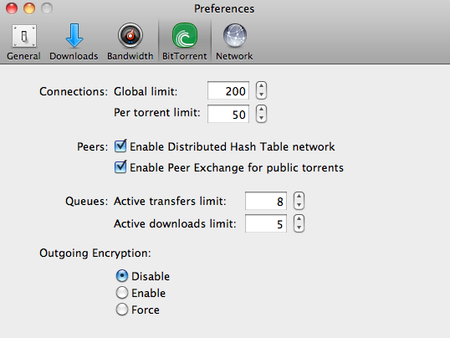
Not all traffic is hard to profile
Is easier to profile traffic from:
  Popular servers (Web, Email, DNS, etc.)
    E.g., white lists, Googling the Internet [Trestian et al. 2008]
  Some P2P hosts that do not hide their traffic
The default in many P2P clients
is not to encrypt traffic. Some
users keep these settings.

Slide 8
Connectivity does not lie
We can exploit the “social” interactions of hosts
  E.g., P2P host tend to have many flows with other P2P hosts
Graph representation of Internet traffic:
- Nodes = IP addresses
- Edges = TCP/UDP flows
P2P
Our two key observations:
It is easy to profile some IP hosts
Social interactions among hosts contain valuable information
P2P
SMTP
(email)
Email
online game
Traffic from a real-world ISP in the US

Slide 9
Our approach: Profiling-by-Association
A systematic way of utilizing our observations
Initial Knowledge
Phase A
Seeding
Network
Traffic
Nodes= IP addresses
Edges= flows (TCP/UDP)
Profiled
Network
Traffic
Use ONLY Connectivity
(PBA)
Phase B
Inference
We no longer need:
ports, payload, or
flow features

Slide 10
Outline
Introduction
Profiling-by-Association (PBA) framework
Our PBA-based profiling algorithms
  NLC (neighboring link classifier)
  HYP (hyper-graph classifier)
  CLUST, CSEED, C+NLC (in the paper)
Experimental results
Conclusions

Slide 11
1) The neighboring link classifier (NLC)
Uses local structure of the graph
  Classify an edge using information from its neighbors
ep₁
ep₂
web
u
x 0.5
+
x 0.5

Slide 12
The basic steps of NLC
known
host
known
host
After seeding, 10% edges labeled
After NLC₁, 80% edges labeled
After NLC₂, 90% edges labeled
After NLC₃, 100% edges labeled
Profiled by association: 90% of edges
known host
Notes:
11

Slide 13
2) The HYP algorithm
Uses global structure of the graph
Known email servers
P2P
Known P2P
Known gamers
Two main steps:
Graph clustering:
Use connectivity to
identify communities
Exploit seeds:
Use knowledge about few hosts to profile each community
SMTP
(email)
online game
Community: A group of nodes in a graph that are more
densely connected internally than with the rest of the graph.
(The Louvain method by Blondel et al. outperformed other methods.)

Slide 14
2) The HYP algorithm (cont.)
What if we have mixed clusters?
  Re-apply graph clustering to each such cluster
  Stop when we have a homogeneous cluster
How do we profile clusters with no seeds?
HYPer-graph
NLC
?

Slide 15
Outline
Introduction
Profiling-by-Association (PBA) framework
Our PBA-based profiling algorithms
Experimental results
Conclusions

Slide 16
Evaluating at four backbone traces
Ground truth: using a payload classifier
Seeding configurations
  Randomly selected X% of IPs
  Intentionally causing errors
  Seeding using existing profilers
    BLINC, Coral Reef (in the paper)
Evaluation
  Averaged over 20 runs
  Small standard error
Accuracy=

Slide 17
Comparing NLC and HYP on four trace
HYP is more robust to the specifics of a trace
Accuracy
This trace has
more hosts
with multiple
applications
1% of hosts as seeds

Slide 18
Our methods are robust to deficient seeds
Bad seeds
40% with errors
Few seeds
Accuracy
Accuracy
Hosts as seeds
Hosts as seeds
We can make up for bad seeds using more seeds
Results are from the BRAZ trace

Slide 19
Connectivity does not lie (except when it does)
Hosts may try to evade the PBA profilers by:
  Eliminating their associations
    It will defeat the very purpose of the application (e.g., P2P)
  Confusing their associations
P2P
X = Total links from known P2P towards other applications
We add
more such links
Open more
connections
towards other
applications
SMTP
(email)
online game

Slide 20
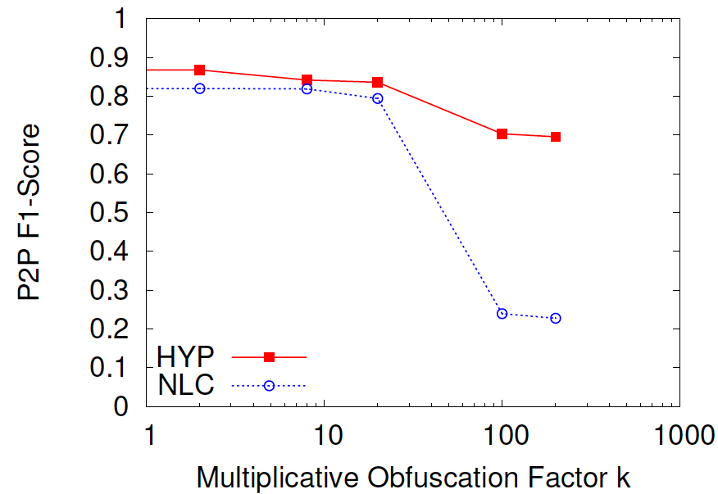
HYP is robust to Connectivity Obfuscation
We increase the number of observed connections from P2P hosts towards other applications
  k = how many times more connections we add
20x
200x
k
Results are from the BRAZ trace

Slide 21
Outline
Introduction
Profiling-by-Association (PBA) framework
Our profiling algorithms
Experimental results
Conclusions

Slide 22
NLC is susceptible to connectivity obfuscation
Use random ports
Level-1
Port Numbers
HYP is robust to all four
levels of obfuscation
Encryption
Level-2
Payload
Signatures
Payload padding
Level-3
Flow Statistics
Random connections to servers
Level-4
Local Connectivity

Slide 23
Compared to the state-of-the-art
HYP
HYP

Slide 24
Conclusions
Users can change what they control
  Ports, payload, flow statistics, local connections
Changing the global structure of connectivity
is more challenging for evaders
  Our HYP algorithm shows robustness to all four levels
  of obscurations (ports, payload, flow, connectivity)
Profiling by associations is a powerful new approach for profiling Internet backbone traffic
  ~90% accuracy with knowledge of only 1% of IP hosts

Slide 25


Thank You!
Questions/Discussion?
This work was sponsored by:

