Slide 1
Lecture 3
Communications

Slide 2
Why communications?
When computers need to exchange information to perform a computation (joint), they need to communicate.
In this slide set, we will study two types of communications:
  Remote Procedure Calls (RPC)
  Message Oriented Communications
  Chapter 4 of book

Slide 3
What are RPCs?
Distributed systems are especially suited for providing services (e.g., MapReduce)
Explicit message passing can be used for communications between processes – but do not conceal communications.
How do we access services ?
  Simply allow programs to call procedures that are located execute on other machines
    Process 1 on Machine A calls Procedure2 on Machine B.
    Blocks and waits for the procedure to return
    Continues execution
  Message passing hidden from programmer
This method is called Remote Procedure Call or RPC for short
RPC is widely used and forms the basis for communications in many distributed systems.

Slide 4
Challenges
While the basic idea is simple, hard to implement.
Procedure executes on a different machine with a different address space.
Passing parameters and results is necessary.
Fault tolerance and synchronization

Slide 5
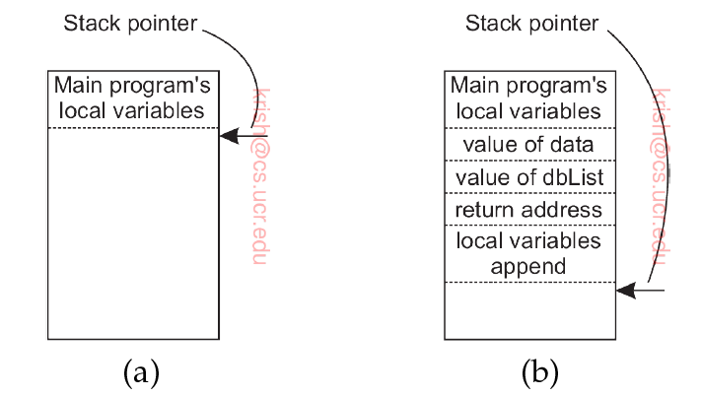
Arguments
Conventionally, arguments are passed by value or by reference (pointers).
e.g., append(data, dBList);
  Copy-by-value or Copy-by-reference
  The data may be values of local variables and dBList maybe a pointer to a list.
  These are then pushed to the
  Stack
  Programmer doesn’t need to
  Know what append does. Only
  pass arguments.

Slide 6
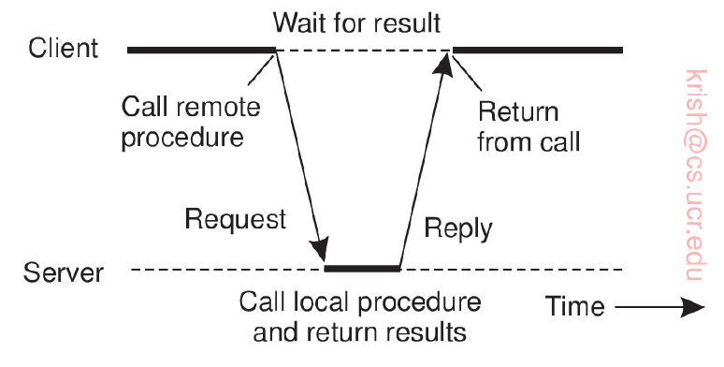
Principles of RPC
The procedure is executed on a remote machine.
  What do we do ?
There is a different version of append() running on the client.
  Called a client stub
It does not perform an append operation – instead it packs the parameters into a message which is sent to a server.
Using send()

Slide 7
Principle of RPC (2)
The client then blocks itself until the reply from server gets back.
Server’s OS passes message to a server stub.
  Equivalent to client stub.
  Waits for incoming requests by calling receive()
Unpacks parameters from message and then calls the server procedure in the usual way.
  As if being called directly by the client.
Performs its work and returns result.

Slide 8
Principles of RPC (3)
When the result is received, (using receive()) it unblocks the client stub.
The client stub inspects message, unpacks result, and copies it to the caller.
  It returns in the usual way.
  The caller gets control – and all it knows is that the data has been appended to dBList.

Slide 9
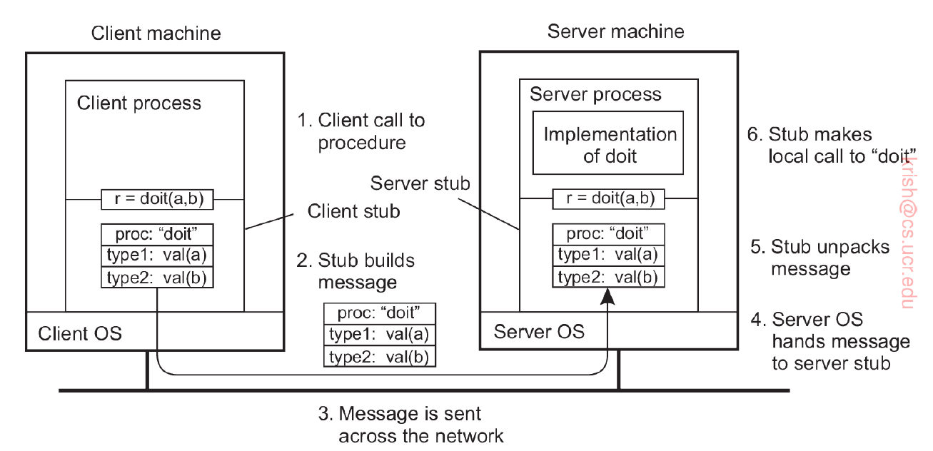
Steps of RPC

Slide 10
Parameter marshaling
Packing parameters into messages is called parameter marshaling.
Needed because the parameters (e.g., data and dBList) sent over the network are correctly interpreted.
Little Endian vs Big Endian byte ordering
  Standardized to Big Endian
Transform the data to a machine and network independent format (essential)
  Can be done with programming support.

Slide 11
Pointers
How are pointers or references passed?
  Cannot just forbid pointer and reference parameter passing.
Solution : Copy the entire data structure
  Effectively replaces copy-by-reference to copy-by-value/restore (return restores the reference)
  Not semantically exact but good enough
When client knows that the referred data is read only – no need for restore.

Slide 12
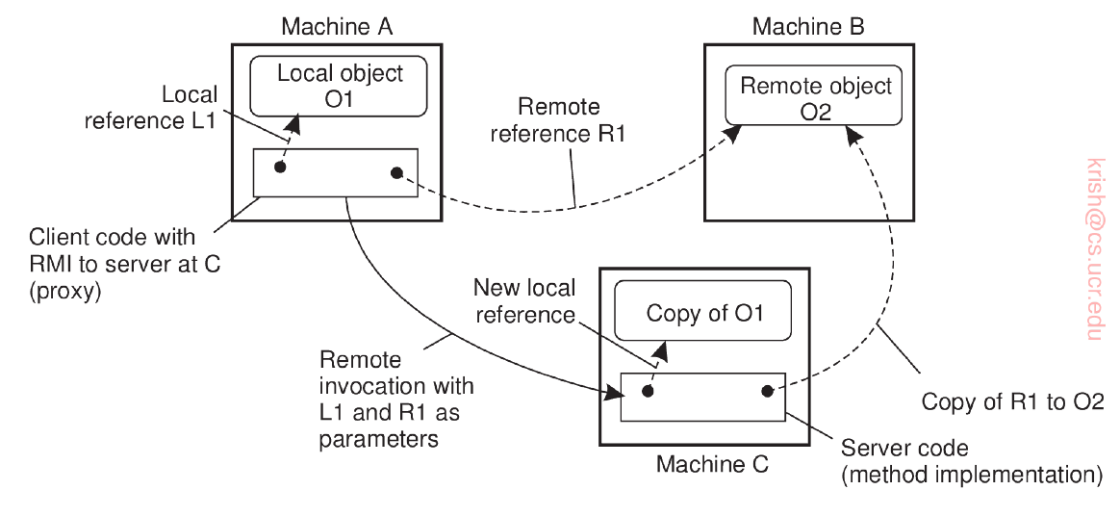
More complex parameter passing
The Machine A is executing a RPC on Machine C; There is a local object and a remote object.

Slide 13
Interface Definition Language
Often specified by means of an Interface Definition Language (IDL).
  Example the DCE RPC – from the Open Software Foundation
Defining the message format
Representation of different (simple) data structures such as integers, characters etc.
Protocol of use (e.g., TCP)
Notes:
DCE: Distributed Computing Environment

Slide 14
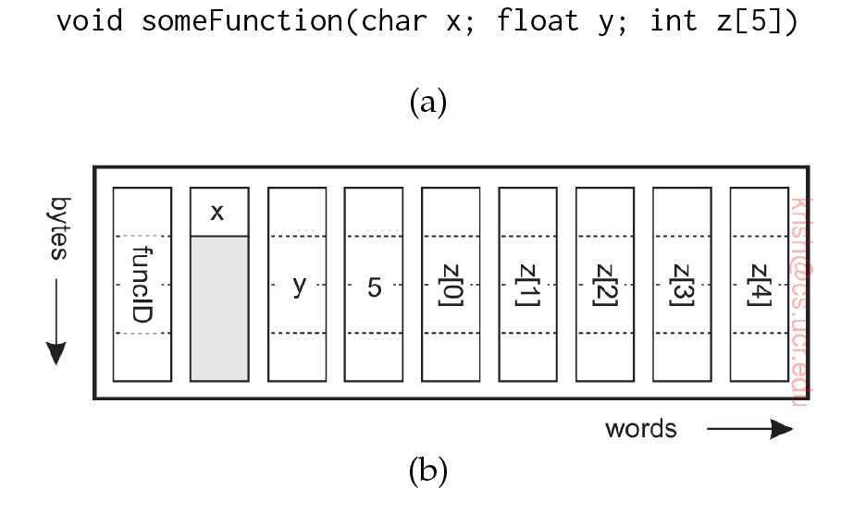
Stub Generation
Rules for how to encode.
Example: Character in rightmost byte of a word, with the following 3 bytes empty.
A float is a whole word
An array is a group of words equal to the array length; preceded by size.

Slide 15
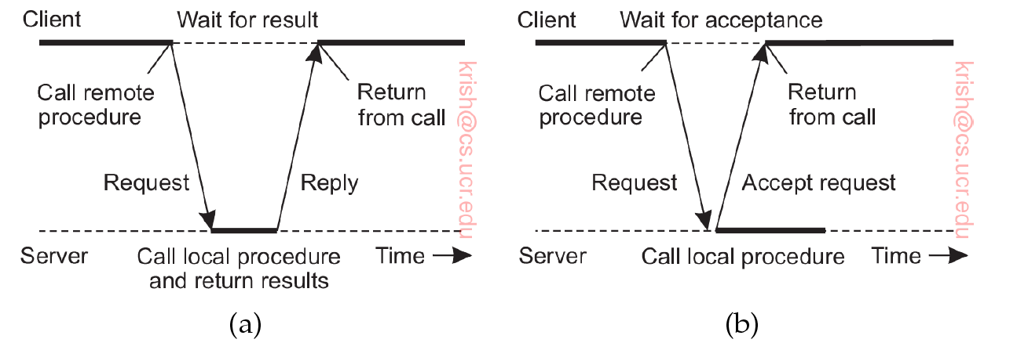
Asynchronous RPC
Sometimes the RPC does not have to return a result to the client
Blocking an issue
Asynchronous RPC eliminates this issue.
  Server ACKS request at which point client continues.

Slide 16
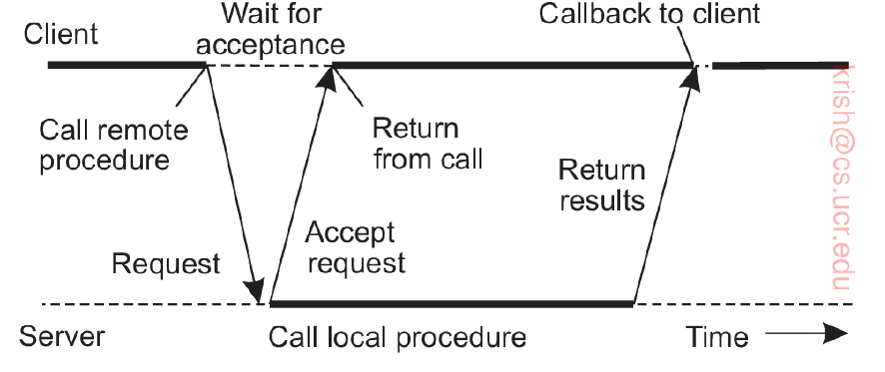
Asynchronous RPCs with returns
Client may not want to wait for the RPC to return
  For example, MapReduce where client interacts with many servers simultaneously.
Combine RPC with callback (a user defined function which is invoked upon a certain event like message receipt)

Slide 17
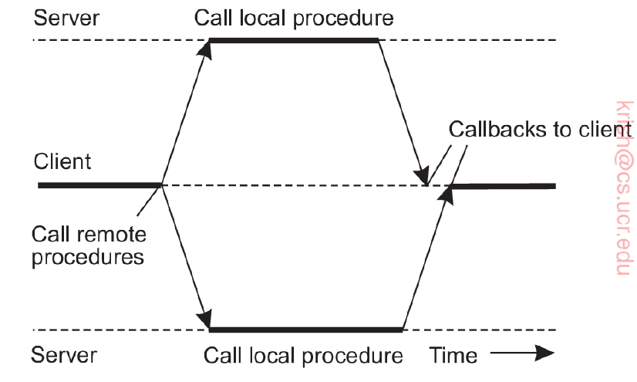
Multicast RPC
Allows sending procedure requests to multiple servers (e.g., MapReduce)

Slide 18
Message-oriented communication
RPC enhance access transparency (not evident to user).
Not sure that the receiving side is executing at the time a request is issued.
Messaging solves this problem

Slide 19
Sockets
Many distributed systems and applications leverage the underlying transport protocol (TCP).
  Offers reliability
Uses socket interface
A communication interface that is exported to the user space via APIs.
Applications can write data that are to be sent over the underlying network.

Slide 20
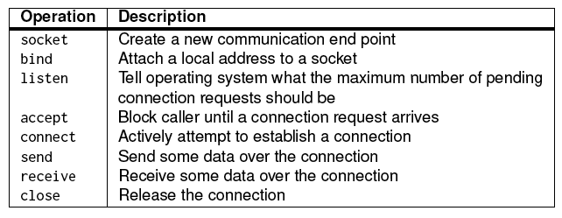
Socket operations in TCP/IP
Socket operations need to be executed both on the client and server sides.

Slide 21
Server side operations
Create a socket with the socket() system call
Bind the socket to an address using the bind() system call. For a server socket on the Internet, an address consists of a port number on the host machine.
Listen for connections with the listen() system call
Accept a connection with the accept() system call. This call typically blocks until a client connects with the server.
  The server forks off a process which handles the actual connection.
Send and receive data

Slide 22
Client side operations
Create a socket with the socket() system call
Connect the socket to the address of the server using the connect() system call
Send and receive data. There are a number of ways to do this, but the simplest is to use the read() and write() system calls.
  Simply read or write to the socket.

Slide 23
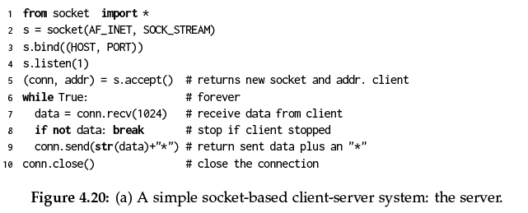
Example: server
Server adds an * and returns data

Slide 24
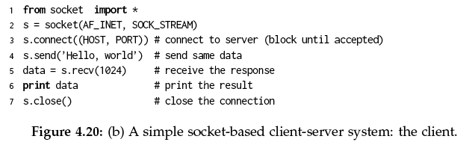
Example: Client
Client reads and prints data that is received

Slide 25
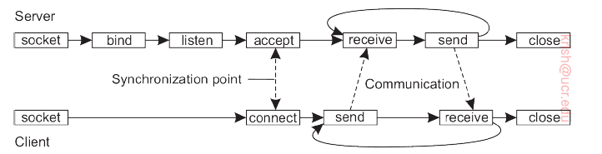
Pictorial description

Slide 26
Limitations
Sockets simple and elegant
However, limited and when realizing distributed computations mistakes are possible.
Also unicast – one to one and relies on TCP (or UDP).

Slide 27
Messaging patterns
To make network programming easier, we leverage a key observation.
Messaging applications (or components thereof) typically rely on some simple patterns.
Enhancing sockets for these patterns can ease development of distributed applications
  ZeroMQ

Slide 28
Properties of ZeroMQ
Uses TCP, but application developer does not have to worry about the setting up or maintaining of connections.
Supports many-to-one communications
  A socket can be bound to many addresses
  Server listens to multiple ports using a blocking receive operation.
Also supports one to many: multicast (later)
Asynchronous: Sender can continue after submitting message to the underlying communication subsystem

Slide 29
Socket pairing
ZeroMQ establishes a higher level of abstraction by pairing sockets.
Each pair corresponds to a specific communication pattern:
  Request Reply
  Publish Subscribe
  Pipeline

Slide 30
Request Reply
Traditional client-server type communications.
Client uses a request socket (REQ) to send a request message.
Server uses a reply socket (of type REP).
Simplifies matters for developers – they do not need to call listen or accept

Slide 31
Publish Subscribe
Clients subscribe to specific messages published by servers.
Only messages to which the client has subscribed are transmitted.
If server publishes messages to which no one subscribes, they are lost.
Thus, this is essentially what is called as a multicast from the server to all its subscribing clients.
Server runs socket type PUB, and client must use SUB type sockets

Slide 32
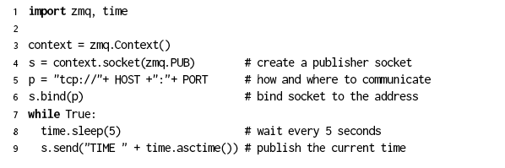
Example server
Naïve time server; publishes its current local time using a PUB socket.
Local time published every 5 seconds.

Slide 33
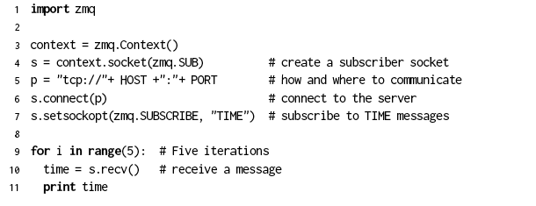
Example client
Client creates a SUB socket and connects to the servers PUB socket; if the tag is TIME (this is what the client subscribes to), it retrieves the time and prints five times.
Notes:
Server may be publishing many things. Here the setsockopt will ensure that the client is subscribing to TIME messages.

Slide 34
Pipeline
Process seeks to push out results (as opposed to pulling as in publish/subscribe)
Does not care about which other process pulls results – the first available is fine.
A pulling process may get results from multiple processes – will do so from the first pushing process.
Intent: Keep as many processes working as possible, pushing results through a pipeline of processes as quickly as possible.

Slide 35
Message Passing Interface (MPI)
Sockets deemed insufficient for two reasons:
  Wrong level of abstraction (only receive, send; need finer granularity as we will see)
  Designed for communication over networks : general purpose and not high speed enough.
Need for a hardware and platform independent interface for communication across a group of processes handling a specific task
  MPI or Message Passing Interface
  Takes place within a group
  Process within a group assigned an identifier (group ID, process ID)

Slide 36
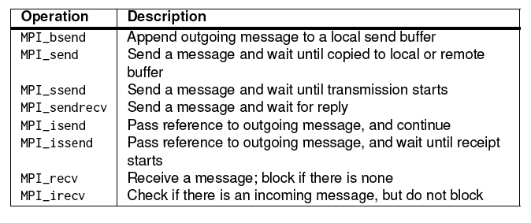
Operations in MPI
Variants offer different levels of synchrony
  Blocking versus non-blocking
    For example, MPI_ssend has the process blocking until the message transmission starts to the receiver.
    MPI_recv is blocking but MPI_irecv is non-blocking
    Can pass pointers (reference) to the outgoing message to prevent need for copies

Slide 37
Message Queuing Systems
Also called Message Oriented Middleware or MOM for short.
Support for completely asynchronous communications.
Buffering capacity for messages (storage) even when the sender or receiver is active.
Persistent and asynchronous : supports message transfers that can take minutes.

Slide 38
Model
Applications insert messages in specific queues.
These messages might be forwarded via multiple communication servers to the destination server.
  If the destination server is down interim, the message is stored at an intermediate server and delivered later
Each application could have a queue (private) to which other applications send messages.
  Sharing queues possible but more complex.

Slide 39
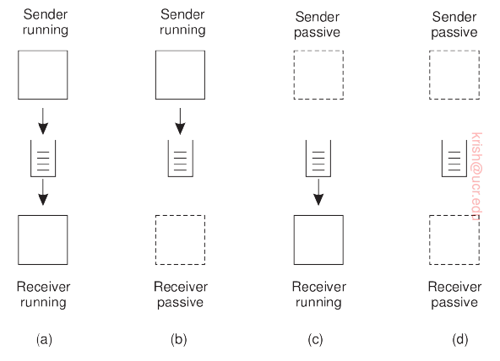
Possible combinations

Slide 40
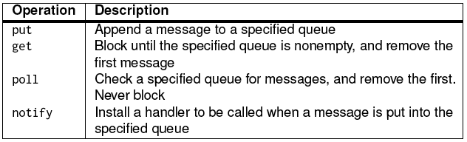
Operations
Most queuing systems allow a process to have a handler that is automatically invoked when a message is inserted
Callbacks can also be used to start the process in such cases.
  Typically implemented using daemon which continuously monitors receiver queues

Slide 41
Architecture
Commonly there are what are called queue managers that handle these application centric queues.
How to name ?
  Need for a contact address
    Could use (host, port) but fall back to socket type identifiers.
    Need naming
  Map of name to address – lookup table ?
    When a new queue is added, all tables need to be updated.

Slide 42
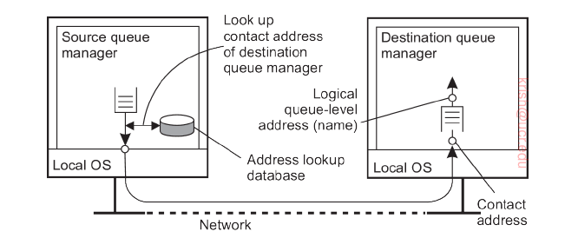
Look up depiction

Slide 43
Overlay Network
The implicit assumption here is that the queue manager of an application A, can directly contact the queue manager of an application B.
  Not viable at scale
This would require special queue managers that incorporate routing functionalities.
So you can envision an application layer network – which is called an “overlay”.

Slide 44
Message Brokers
Need for translation of message semantics across applications.
For example, one application may have messages containing a table from a database where:
  special end-of-record delimiter
  known fixed length
Recipient may expect a different delimiter and variable length fields.
Message brokers perform translations
  Broker plugins are subprograms that are application specific towards achieving this goal.

Slide 45
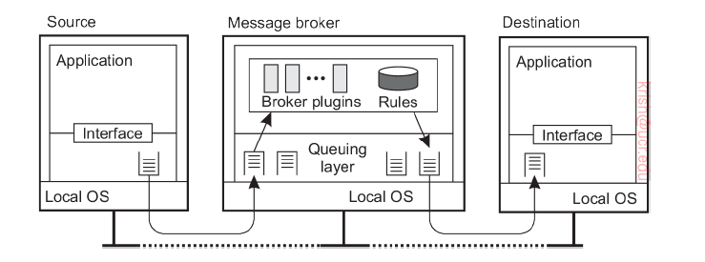
Organization of a message broker

Slide 46
IBM WebSphere
A practical message queuing system
A wealth of literature (see book and referenced papers).
All queues are managed by queue managers.
Each queue manager is responsible for removing messages from its send queues and forwarding to other queue managers.
Likewise, it picks up messages from the network and stores in appropriate input queue.
Message sizes have a maximum size (4 MB), and queue (buffer) sizes are specified (2 GB).

Slide 47
Message channels
Abstractions of transport layer connections
Unidirectional reliable connection between a sending and receiving queue manager.
  For example, TCP connection
The two ends of a message channel are managed by message channel agents (MCAs)
  Sending MCA: Check send queues, wrap in TCP/IP packet, sending to the receive MCA
  Receiving MCA: Listen, unwrap and store unwrapped message in appropriate queue.

Slide 48
Message channels (cont)
Both sending and receiving MCAs must be up and running.
When the message is first put in the queue, a trigger is set off – which invokes a handler to start the sending MCA.
One can also start an MCA over the network – a control message to a daemon that is listening on the other side.
Channels are stopped automatically when no messages dropped in queues for a pre-specified time.

Slide 49
MCA Attributes
Attribute values of sending and receiving MCA should be compatible.
One way is to negotiate these before the channel set up
  Same transport protocol
  FIFO ordering of messages (inserted in send queue, picked up from receive queue)
  Maximum message length

Slide 50
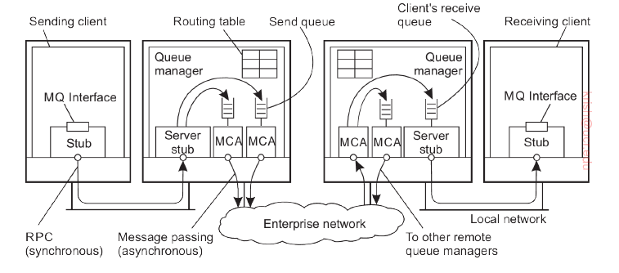
General organization depiction
Application uses RPC to communicate with the queue manager based on synchronous communication if the latter is on a different machine.

Slide 51
Addressing and routing
Address in MQ consists of two parts
  Name of queue manager to which the message is to be delivered.
  Destination queue under that manager to which the message is to be appended.
In addition, routes are to be specified.
Use of routing tables – the entry specifies the local send queue to which the message is to be appended.
  This specifies which queue manager the message is to be forwarded.

Slide 52
Routing tables
Routes are explicitly stored in a queue manager using routing tables.
Each entry is a pair (destQM, sendQ)
  destQM → destination queue manager
  sendQ → name of local send queue
A routing table entry is called an alias in MQ.
When an intermediate (not destination) QM gets a message, it extracts the name of the destQM and does a routing table look up to find which send queue is to be used (to append the message).

Slide 53
Alias table
Each queue manager has a systemwide unique name.
But changing this name, will affect all applications that send messages to it.
To alleviate problems a local alias for queue manager names is isued.
An alias defined with a QM (say QM1) is another name for a different queue manager (QM2), but is available only to applications interfacing with QM1.
  Alias allows the use of the same (logical) name for a queue even if that queue name changes.

Slide 54
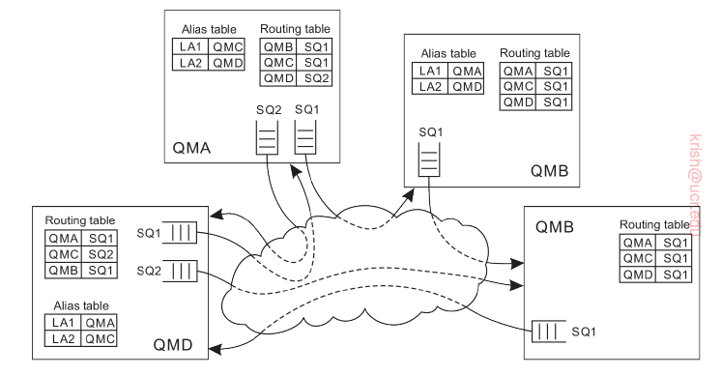
Example
QMC
Let us assume an application linked to QMA wants to send a message.
It can refer to a remote QM (QMC) refering to an alias LA1.

Slide 55
Example (2)
QMC
QMA looks up the alias and maps it to QMC. Route to QMC is found in the routing table and indicates message to be appended to SQ1.

Slide 56
Example (3)
QMC
This causes messages to be transferred to QMB. QMB uses its routing table to insert message in SQ1 to be sent to QMC.

