Slide 1
Lecture 2
MapReduce in brief

Slide 2
Source
MapReduce: Simplified Data Processing in Large Clusters
  Jefferey Dean and Sanjay Ghemawat
  OSDI 2004

Slide 3

Example Scenario
Genome data from roughly one million users
  125 MB of data per user
Goal: Analyze data to identify genes that show susceptibility to Parkinson’s disease

Slide 4


Other Example Scenarios
Ranking web pages
  100 billion web pages
Selecting ads to show
  Clickstreams of over one billion users

Slide 5
Lots of Data!
Although the derived tasks are simple, Petabytes or even exabytes of data
Impossible to store data on one server
Will take forever to process on one server
Need distributed storage and processing
How to parallelize?

Slide 6
Desirable Properties of Soln.
Scalable
  Performance grows with # of machines
Fault-tolerant
  Can make progress despite machine failures
Simple
  Minimize expertise required of programmer
Widely applicable
  Should not restrict kinds of processing feasible

Slide 7
Distributed Data Processing
Strawman solution:
  Partition data across servers
  Have every server process local data
Why won’t this work?
Inter-data dependencies:
  Ranking of a web page depends on ranking of pages that link to it
  Need data from all users who have a certain gene to evaluate susceptibility to a disease

Slide 8
MapReduce
Distributed data processing paradigm introduced by Google in 2004
Popularized by open-source Hadoop framework
MapReduce represents
  A programming interface for data processing jobs
    Map and Reduce functions
  A distributed execution framework
    Scalable and fault-tolerant

Slide 9
Map Operation
The Map operation is applied to each “record” to compute a set of intermediate key value pairs.
  Example → Temperature records between 1951 and 1955
Map function needs to be written by the user.
MapReduce Library groups together the values associated with a key I (e.g. year) and passes them to the Reduce function.

Slide 10
Reduce Operation
Reduce function also written by user.
Merges together the values provided to form a smaller set of values
  (e.g., Maximum temperature seen in each year)

Slide 11
MapReduce: Word count
map(key, value): //filename, file contents
  for each word w in value:
  EmitIntermediate(w, "1");
reduce(key, list(values)): //word, counts
int result = 0;
for each v in values:
result += ParseInt(v);
Emit(AsString(result));
Notes:
Emits each word and a count of occurences (here just 1). Key → document name or file name; Value → file contents in terms of words (is that word in the document)?
Reduce function → key is the word; it parses the list and simply sums together all counts emitted for a particular word.

Slide 12
Other examples
Distributed Grep
  Map: Emits a line if a match is found to a pattern (key)
  Reduce: Identity that simply shows the intermediate data
Count of URL Access frequency
  Map: Processes log of web page requests and outputs <URL, 1>
  Reduce: Adds the values for the same URL and outputs <URL, count>

Slide 13
Execution
Map invocations distributed across multiple machines
  Need automatic partitioning of input data input to M splits
    Parallelly process each split
Reduce invocations are distributed by partitioning the intermediate key space into R pieces using a partitioning function (e.g., a hash(key)mod R).

Slide 14
MapReduce Execution
Partition
Map
Coalesce
Reduce
(k₁, v₁)
.
.
(a, b)
(w, p)
(a, b)
(a, q)
(a, s)
(k₁, v₁)
(k₂, v₂)
.
.
.
.
.
.
.
(k_{n}, v_{n})
(k¹, v¹)
(w, x)
(y, r)
(c, d)
(k_{i}, v_{i})
.
.
(c, d)
(c, t)
(k², v²)
(w, p)
(w, x)
(y, z)
(a, s)
(c, t)
(a, q)
(k³, v³)
(k_{j}, v_{j})
.
.
(y, r)
(y, z)
(k⁴, v⁴)
Notes:
Coalesce – the process wherein all a new partition is created based on the key (hash(key)mod R). In this example, a , c, w, are the keys – and these are now input to a different machine performing the reduce operaiton.

Slide 15
MapReduce: PageRank
Compute rank for web page P as average rank of pages that link to P
Initialize rank for every web page to 1
Map(a web page W, W’s contents)
  For every web page P that W links to, output (P, W)
Reduce(web page P, {set of pages that link to P})
  Output rank for P as average rank of pages that link to P
Run repeatedly until ranks converge

Slide 16
MapReduce Execution
Partition
Map
Coalesce
Reduce
(k₁, v₁)
.
.
(a, b)
(w, p)
(a, b)
(a, q)
(a, s)
(k₁, v₁)
(k₂, v₂)
.
.
.
.
.
.
.
(k_{n}, v_{n})
(k¹, v¹)
(w, x)
(y, r)
(c, d)
(k_{i}, v_{i})
.
.
(c, d)
(c, t)
(k², v²)
(w, p)
(w, x)
(y, z)
(a, s)
(c, t)
(a, q)
(k³, v³)
(k_{j}, v_{j})
.
.
(y, r)
(y, z)
(k⁴, v⁴)
When can a Reduce task begin executing?

Slide 17
Synchronization Barrier
Partition
Map
Coalesce
Reduce
(k₁, v₁)
.
.
(a, b)
(w, p)
(a, b)
(a, q)
(a, s)
(k₁, v₁)
(k₂, v₂)
.
.
.
.
.
.
.
(k_{n}, v_{n})
(k¹, v¹)
(w, x)
(y, r)
(c, d)
(k_{i}, v_{i})
.
.
(c, d)
(c, t)
(k², v²)
(w, p)
(w, x)
(y, z)
(a, s)
(c, t)
(a, q)
(k³, v³)
(k_{j}, v_{j})
.
.
(y, r)
(y, z)
(k⁴, v⁴)

Slide 18
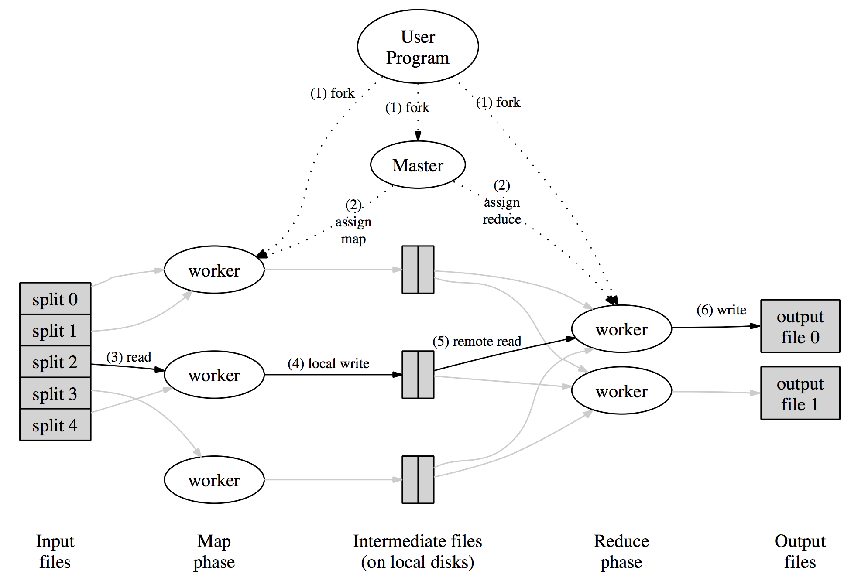
Fault Tolerance via Master

Slide 19
Workflow (Map)
MapReduce library in the user program splits input files into M pieces.
Worker assigned the map task, reads content of the corresponding input split – parses key/value pairs and passes the pair to the user-defined Map function.
  The intermediate pair produced by Map stored in local memory

Slide 20
Workflow (Reduce)
The buffered pairs are partitioned into R regions using the partitioning function (e.g., the hash)
Locations of these pairs are sent to master who sends it to reduce workers.
Reduce workers uses remote procedure calls to read the buffered data.
After reading data, it groups them according to the key (sorts).
It iterates over the intermediate data and for each key encountered.

Slide 21
Failures
Worker failures
  Master pings workers periodically.
    No response within a certain time indicates failure.
    Tasks reset to idle and reassigned.
      Note that completed map tasks are re-executed since results stored on local discs and could become inaccessible.
Master failures (unlikely)
  Periodically, checkpoints (later) the master state (which tasks are idle, in progress, completed) and the identity of the workers.
  Return to the last checkpoint.

