Slide 1
Lecture 1
Introduction

Slide 2
Course Objectives
Learn about basics of distributed systems.
Main things
  Globally consistent views across machines
  Consensus between distributed entites
  Fault tolerance and how to achieve
  Example systems
An introduction level graduate course.

Slide 3
Contact
Srikanth V. Krishnamurthy
Office hours
  zoom
E-mail: krish@cs.ucr.edu
Web: www.cs.ucr.edu/~krish
Office Hours: Thursdays 4.00 – 5.00 (only if I receive e-mail by noon that day requesting the office hour).

Slide 4
Book and references
Textbook (downloadable)
  Distributed Systems by Maarten Van Steen and Andrew S. Tanenbaum
Other papers as I refer to them
For Project (next): Conference papers from SOSP, OSDI, EuroSys, USENIX ATC, Security or Networking conferences (need to be from top like Sigcomm, NSDI, or USENIX security, NDSS, Oakland – as long as they have a distributed systems flavor
  Please check with me if the venue is reasonable.
Will provide PDF with instructions in a few days.

Slide 5
Expected Evaluation Metrics
3 Quizzes
  First two quizzes each 15 % of the grade.
  Third quiz (cumulative) 20 % -- last day of class.
  You will be given 50 minutes to take the first two and 80 minutes for the last one.
Project 50 % (10% for abstract and 40% for final report)
For project:
  Since this is a graduate course!
    Find papers on distributed systems (e.g., Challenges in distributed execution of actuations in IoT) – from recent systems or security conferences.
    Read at least 4 papers that are related to each other
    Put together a four page summarized report on what you have learnt
      Like a survey – but should contain your thoughts and ideas and what you think are open problems that one might go about addressing (no need for solutions).
Quiz 1
Quiz 3
Midterm

Slide 6
Groups for Project and Abstract
Work in pairs (find a partner)
Need to let me know who your partner is by end of Week 3 (January 24).
  If I don’t hear from you, I will randomly assign a partner.
Provide the title of the key paper by Week 5 (with venue)
You should send me an abstract (no more than a page) telling me a bit about the “key” paper on which your project will be based and what you are trying to do in Week 5. Deadline: February 14th.
  I can look at it and give you some feedback.
  The earlier you give me this abstract, the more time you will have after my feedback.
    If I say the paper is not appropriate you will need to find a new one and send me within a week.

Slide 7
Other issues
Have some travel this quarter.
Will need to record 1-3 zoom lectures.
  You can listen to those and we can meet during office hours if you have questions.
  I will try to be as detailed as possible when making the recording.
  Possible dates : Week 2 (Jan 16), early Feb - Feb 4 and Feb 13.

Slide 8
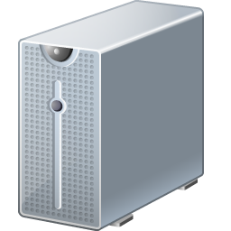
What is a Distributed System?
Multiple interconnected computers that cooperate to provide some service
Network

Slide 9
Reality
Distributed systems a reality because of the emergence of networking (local or wide area)
Could be a handful of computers or in the extreme case, millions (think IoT)
They maybe connected by a wired network or wireless
  Computers can fail, be added, may leave the system.

Slide 10
Example Scenario
Consider user issuing search query to Google
Google’s objectives in serving query?
  Resilience to failures
  Low latency
  Most relevant results
Discuss: What distributed systems necessary to achieve these goals?

Slide 11
Google in 1997

Slide 12
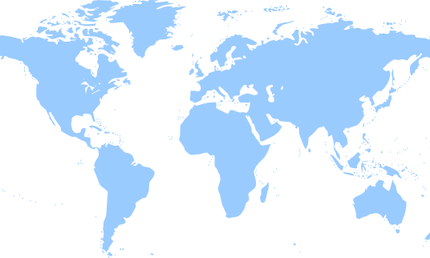

Geo-Distributed Services

Slide 13
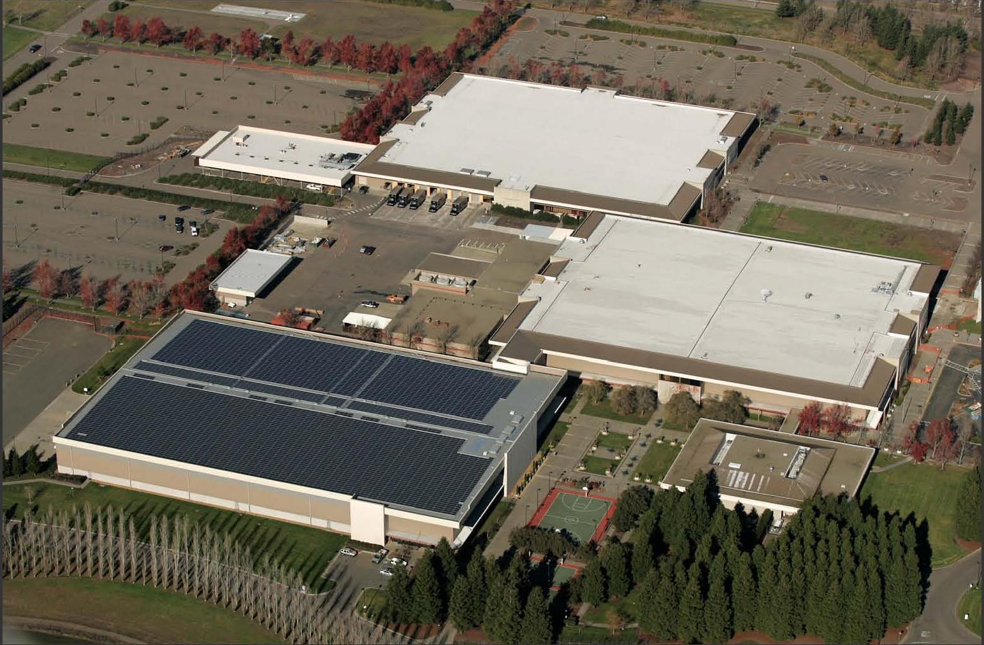
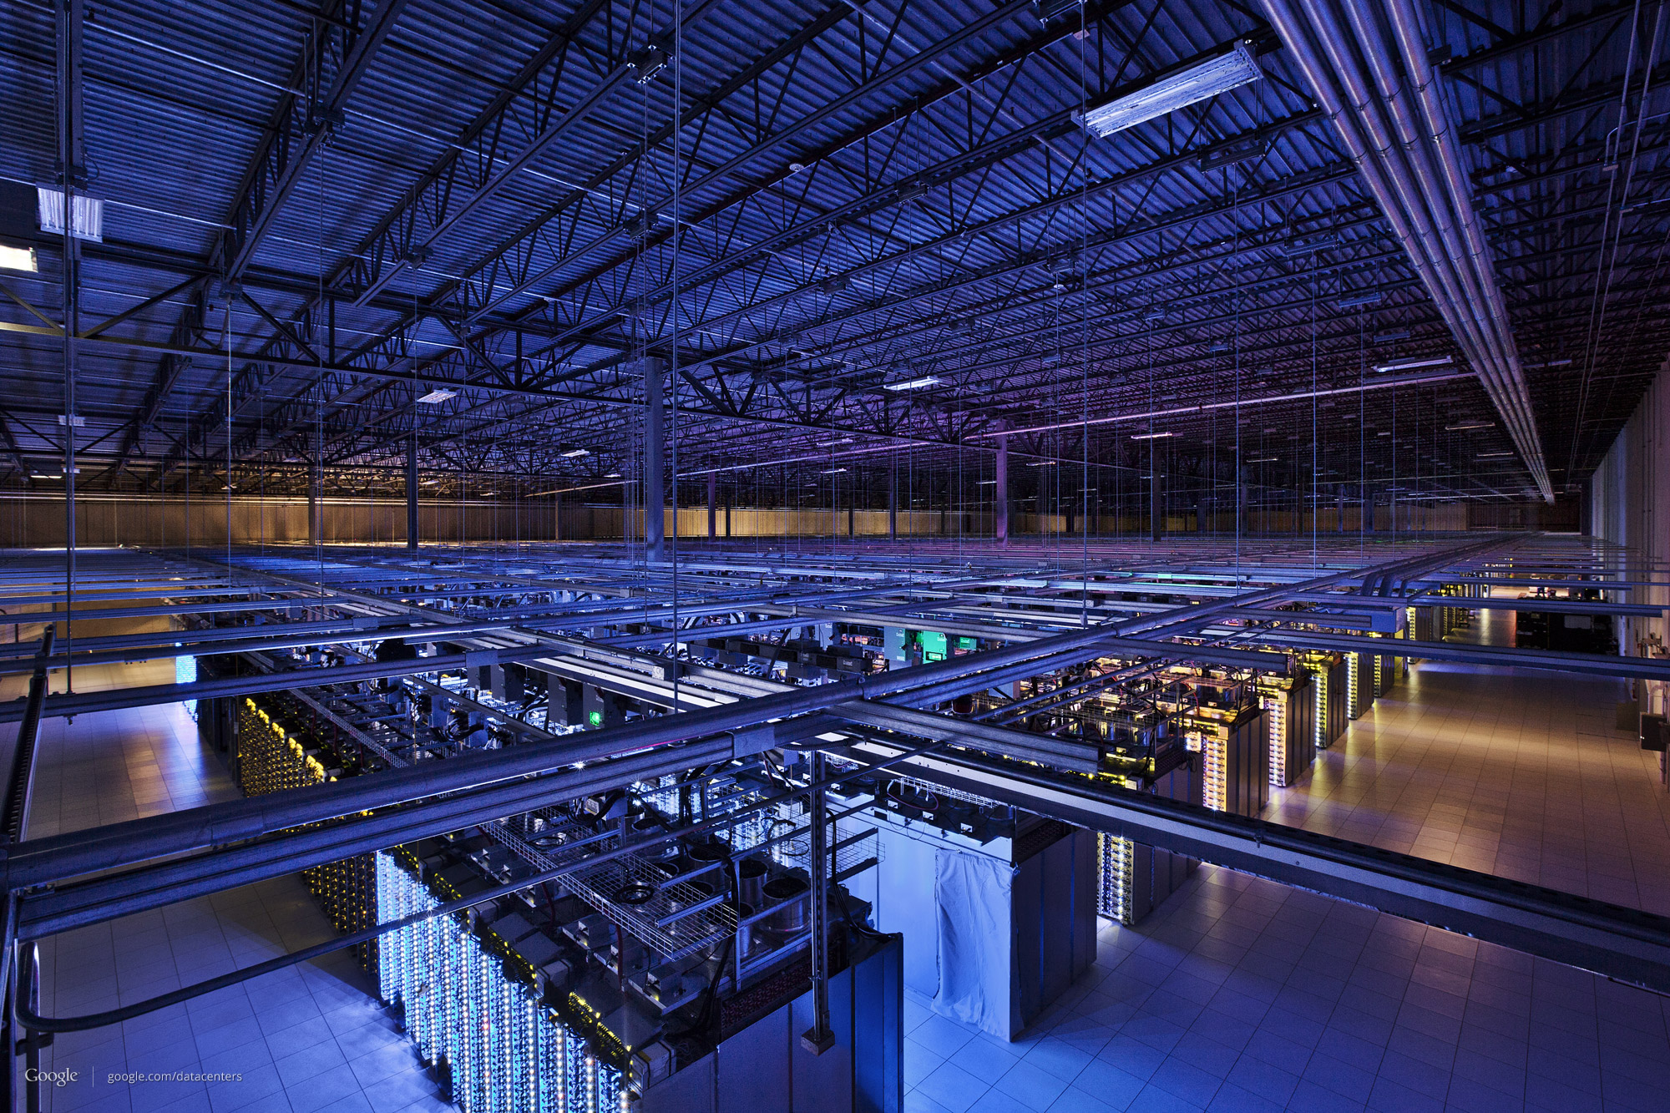
Data Centers
Spread services and data storage/processing across 100s of thousands of machines

Slide 14
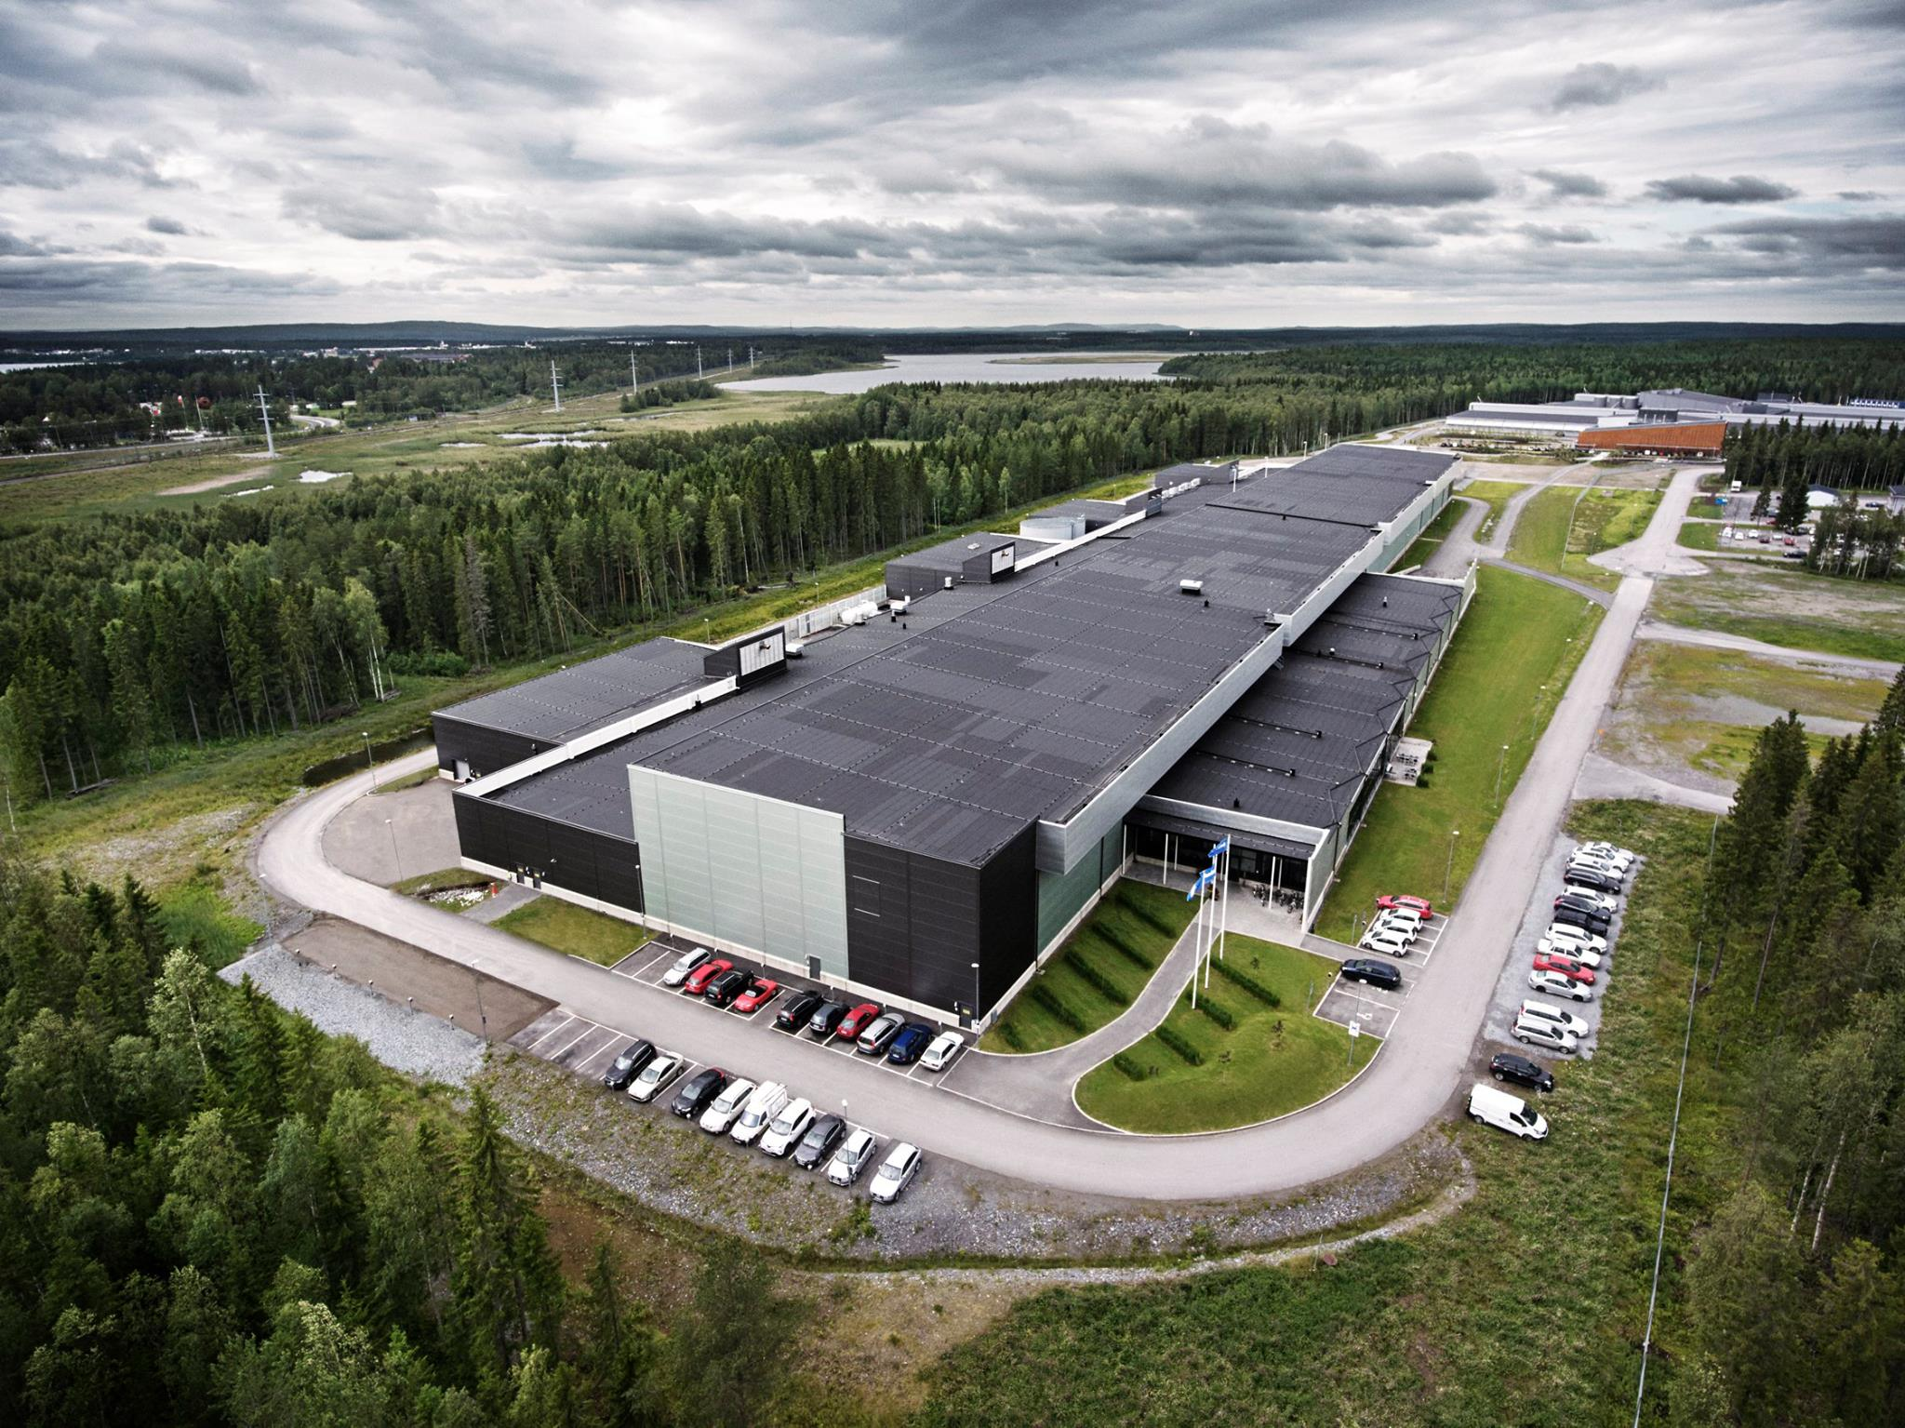

Slide 15
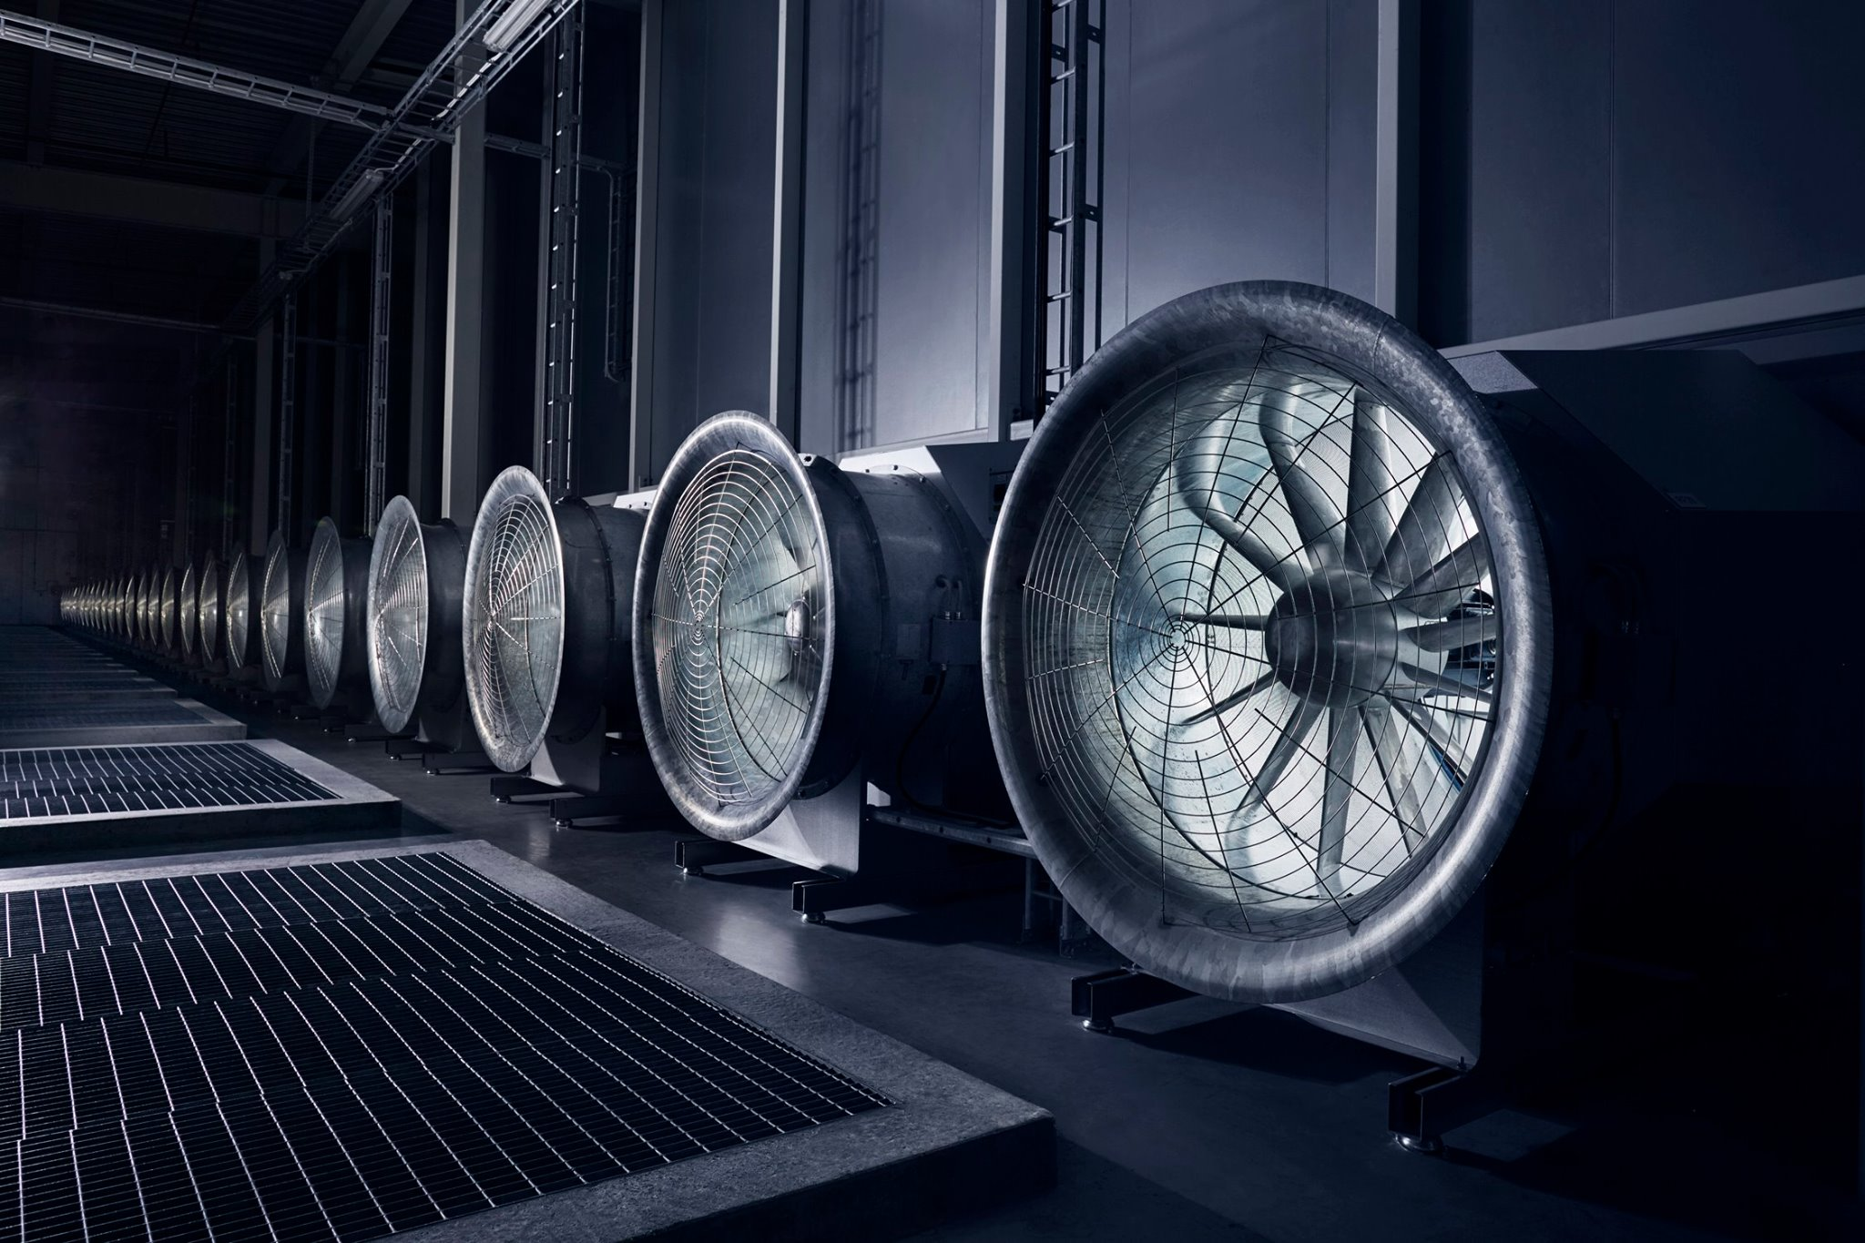

Slide 16
Why Distributed Systems?
Conquer geographic separation
  Facebook and Google customers span the planet
Build reliable systems with unreliable components
Aggregate systems for higher capacity
  CPU cycles, memory, disks, network bandwidth
  Cost grows non-linearly
Customize computers for specific tasks
  Example: cache server, speech-to-text conversion server

Slide 17
Challenge 1: Partial failures
“A distributed system is one where you can’t get your work done because some machine you’ve never heard of is broken.” – Leslie Lamport

Slide 18
Facebook’s Pineville Data Center
Contents (approx.):
  200K+ servers
  500K+ disks
  10K network switches
  300K+ network cables
At any instant, likelihood that all components correctly functioning?

Slide 19
Challenge 2: Ambiguous failures
If a server doesn’t reply, how to tell if
  The server has failed
  The network is down
  Neither; they are both just slow
Makes failure detection hard

Slide 20
Challenge 3: Concurrency
Why not partition users across machines?
Shared State

Slide 21
Challenge 3: Concurrency
How to ensure consistency of distributed state in the face of concurrent operations?
Use mutex, semaphore, etc.?
  Not easy
Need to synchronize based on unreliable messages

Slide 22
Other Challenges
Performance at scale
  Example: Amazon redesigns software services for every order of magnitude change in scale
Testing
  Nearly impossible to test/reproduce every possible scenario
  Cannot test at production scale

