Slide 1
CS161 – Design and Architecture of Computer
Main Memory
Slides adapted from Onur Mutlu (CMU)

Slide 2
18-447 Computer Architecture Lecture 21: Main Memory
Prof. Onur Mutlu
Carnegie Mellon University
Spring 2015, 3/23/2015

Slide 3
Why Is Memory So Important? (Especially Today)

Slide 4
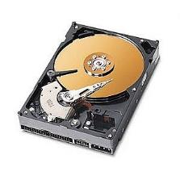
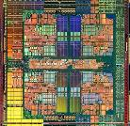
The Main Memory System
Main memory is a critical component of all computing systems: server, mobile, embedded, desktop, sensor
Main memory system must scale (in size, technology, efficiency, cost, and management algorithms) to maintain performance growth and technology scaling benefits
Processor
and caches
Main Memory
Storage (SSD/HDD)

Slide 5
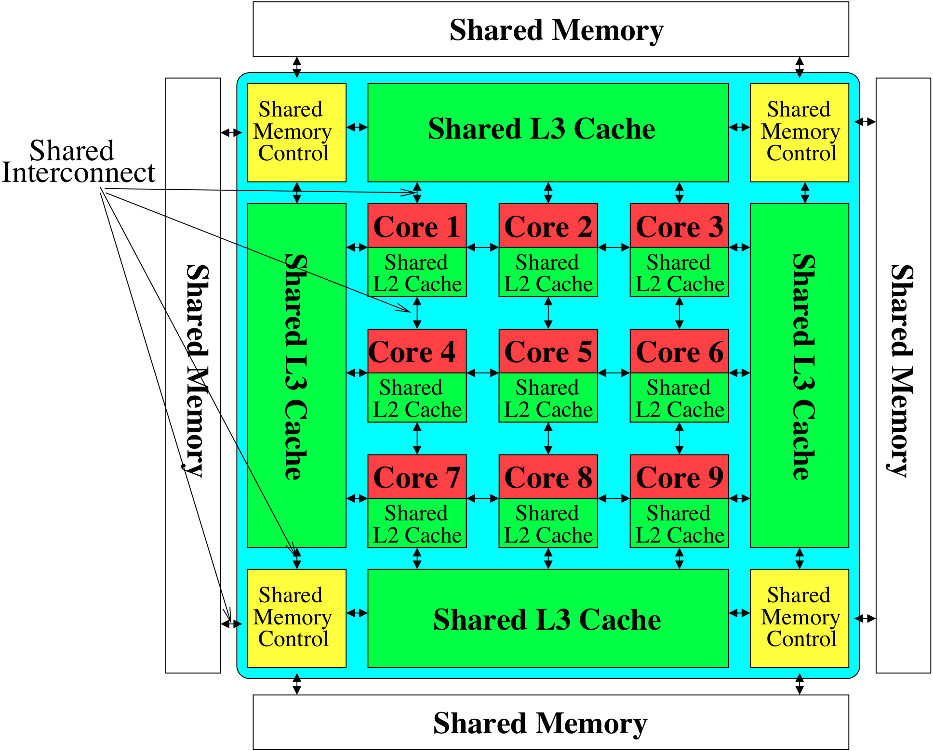
Memory System: A Shared Resource View
Storage

Slide 6
State of the Main Memory System
Recent technology, architecture, and application trends
lead to new requirements
exacerbate old requirements
DRAM and memory controllers, as we know them today, are (will be) unlikely to satisfy all requirements
Some emerging non-volatile memory technologies (e.g., PCM) enable new opportunities: memory+storage merging
We need to rethink/reinvent the main memory system
to fix DRAM issues and enable emerging technologies
to satisfy all requirements

Slide 7
Major Trends Affecting Main Memory (I)
Need for main memory capacity, bandwidth, QoS increasing
Main memory energy/power is a key system design concern
DRAM technology scaling is ending

Slide 8
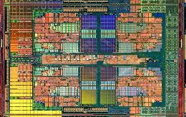
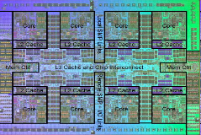
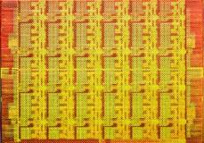
Demand for Memory Capacity
More cores ➔ More concurrency ➔ Larger working set
Modern applications are (increasingly) data-intensive
Many applications/virtual machines (will) share main memory
Cloud computing/servers: Consolidation to improve efficiency
GP-GPUs: Many threads from multiple parallel applications
Mobile: Interactive + non-interactive consolidation
…
AMD Barcelona: 4 cores
IBM Power7: 8 cores
Intel SCC: 48 cores

Slide 9
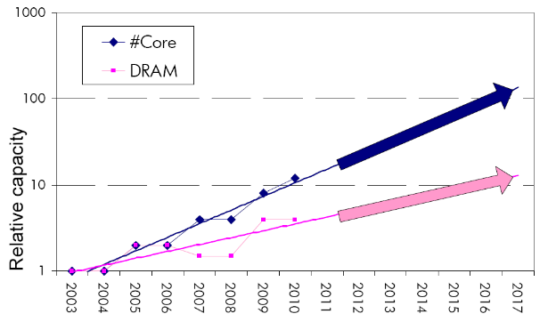
Example: The Memory Capacity Gap
Core count doubling ~ every 2 years
DRAM DIMM capacity doubling ~ every 3 years
Memory capacity per core expected to drop by 30% every two years
Trends worse for memory bandwidth per core!

Slide 10
Major Trends Affecting Main Memory (II)
Need for main memory capacity, bandwidth, QoS increasing
Multi-core: increasing number of cores/agents
Data-intensive applications: increasing demand/hunger for data
Consolidation: Cloud computing, GPUs, mobile, heterogeneity
Main memory energy/power is a key system design concern
DRAM technology scaling is ending

Slide 11
Major Trends Affecting Main Memory (III)
Need for main memory capacity, bandwidth, QoS increasing
Main memory energy/power is a key system design concern
IBM servers: ~50% energy spent in off-chip memory hierarchy [Lefurgy, IEEE Computer 2003]
DRAM consumes power when idle and needs periodic refresh
DRAM technology scaling is ending

Slide 12
Major Trends Affecting Main Memory (IV)
Need for main memory capacity, bandwidth, QoS increasing
Main memory energy/power is a key system design concern
DRAM technology scaling is ending
ITRS projects DRAM will not scale easily below X nm
Scaling has provided many benefits:
higher capacity, higher density, lower cost, lower energy

Slide 13
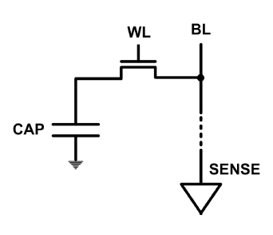
The DRAM Scaling Problem
DRAM stores charge in a capacitor (charge-based memory)
Capacitor must be large enough for reliable sensing
Access transistor should be large enough for low leakage and high retention time
Scaling beyond 40-35nm (2013) is challenging [ITRS, 2009]
DRAM capacity, cost, and energy/power hard to scale

Slide 14
Evidence of the DRAM Scaling Problem
Row of Cells
Wordline
Row
Victim Row
Row
Aggressor Row
V_{LOW}
Opened
V_{HIGH}
Closed
Row
Victim Row
Row
Repeatedly opening and closing a row enough times within a refresh interval induces disturbance errors in adjacent rows in most real DRAM chips you can buy today
Kim+, “Flipping Bits in Memory Without Accessing Them: An Experimental Study of DRAM Disturbance Errors,” ISCA 2014.

Slide 15
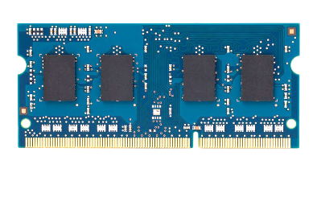
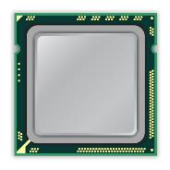
x86 CPU
DRAM Module
loop:
mov (X), %eax
mov (Y), %ebx
clflush (X)
clflush (Y)
mfence
jmp loop
X
Y
Notes:
We demonstrate the errors on multiple x86 systems. Shown to the bottom-left is a “disturbance kernel”. When executed, it forces two rows to be opened and closed one after the other – over and over again. Consequently, it induces many errors in the module.

Slide 16
x86 CPU
DRAM Module
loop:
mov (X), %eax
mov (Y), %ebx
clflush (X)
clflush (Y)
mfence
jmp loop
X
Y
Notes:
We demonstrate the errors on multiple x86 systems. Shown to the bottom-left is a “disturbance kernel”. When executed, it forces two rows to be opened and closed one after the other – over and over again. Consequently, it induces many errors in the module.

Slide 17
x86 CPU
DRAM Module
loop:
mov (X), %eax
mov (Y), %ebx
clflush (X)
clflush (Y)
mfence
jmp loop
X
Y
Notes:
We demonstrate the errors on multiple x86 systems. Shown to the bottom-left is a “disturbance kernel”. When executed, it forces two rows to be opened and closed one after the other – over and over again. Consequently, it induces many errors in the module.

Slide 18
x86 CPU
DRAM Module
loop:
mov (X), %eax
mov (Y), %ebx
clflush (X)
clflush (Y)
mfence
jmp loop
X
Y
Notes:
We demonstrate the errors on multiple x86 systems. Shown to the bottom-left is a “disturbance kernel”. When executed, it forces two rows to be opened and closed one after the other – over and over again. Consequently, it induces many errors in the module.

Slide 19
Observed Errors in Real Systems
A real reliability & security issue
In a more controlled environment, we can induce as many as ten million disturbance errors
CPU Architecture | Errors | Access-Rate
Intel Haswell (2013) | 22.9K | 12.3M/sec
Intel Ivy Bridge (2012) | 20.7K | 11.7M/sec
Intel Sandy Bridge (2011) | 16.1K | 11.6M/sec
AMD Piledriver (2012) | 59 | 6.1M/sec
Kim+, “Flipping Bits in Memory Without Accessing Them: An Experimental Study of DRAM Disturbance Errors,” ISCA 2014.
Notes:
When we executed the code on four different processors, all four of them yielded errors. Intel Haswell has the most errors, at 23 thousand, because it has the highest rate of accessing DRAM.
Later on, I’ll show that we can induce as many as ten million disturbance errors in a more controlled environment.
From this, we conclude that disturbance errors are a serious reliability issue.

Slide 20
Main Memory

Slide 21
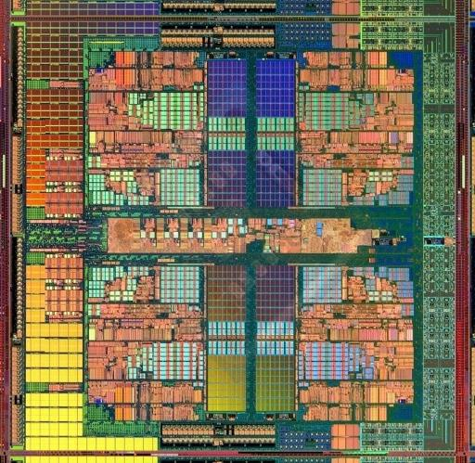
Main Memory in the System
CORE 0
L2 CACHE 1
CORE 1
L2 CACHE 0
SHARED L3 CACHE
DRAM INTERFACE
DRAM MEMORY CONTROLLER
DRAM BANKS
L2 CACHE 2
CORE 3
CORE 2
L2 CACHE 3

Slide 22
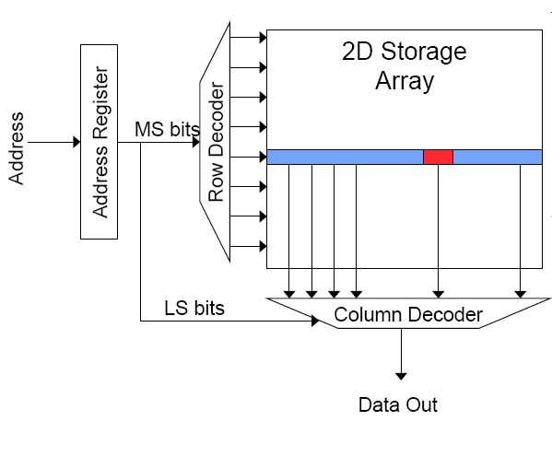
Review: Memory Bank Organization
Read access sequence:
1. Decode row address & drive word-lines
2. Selected bits drive bit-lines
• Entire row read
3. Amplify row data
4. Decode column address & select subset of row
• Send to output
5. Precharge bit-lines
• For next access

Slide 23
Review: DRAM (Dynamic Random Access Memory)
row enable
Bits stored as charges on node capacitance (non-restorative)
bit cell loses charge when read
bit cell loses charge over time
Read Sequence
1. address decode
2. drive row select
3. selected bit-cells drive bitlines
(entire row is read together)
4. a “flip-flopping” sense amp amplifies and regenerates the bitline, data bit is mux’ed out
5. precharge all bitlines
Refresh: A DRAM controller must periodically read all rows within the allowed refresh time (10s of ms) such that charge is restored in cells
_bitline
RAS
bit-cell array
2^{n} row x 2^{m}-col
(n≈m to minimize
overall latency)
n
2^{n}
m
2^{m}
sense amp and mux
1
A DRAM die comprises
of multiple such arrays
CAS

Slide 24
The DRAM Subsystem

Slide 25
DRAM Subsystem Organization
Channel
DIMM
Rank
Chip
Bank
Row/Column
Cell

Slide 26
Page Mode DRAM
A DRAM bank is a 2D array of cells: rows x columns
A “DRAM row” is also called a “DRAM page”
“Sense amplifiers” also called “row buffer”
Each address is a <row,column> pair
Access to a “closed row” (Closed Page Policy)
Activate command opens row (placed into row buffer)
Read/write command reads/writes column in the row buffer
Precharge command closes the row and prepares the bank for next access
Access to an “open row” (Open Page Policy)
No need to Activate
Keep row open until conflict

Slide 27
DRAM Bank Operation
Access Address:
(Row 0, Column 0)
Columns
(Row 0, Column 1)
(Row 0, Column 85)
(Row 1, Column 0)
Row address 0
Row address 1
Row decoder
Rows
Row Buffer
CONFLICT !
HIT
Row 1
HIT
Row 0
Empty
Column address 0
Column mux
Column address 0
Column address 1
Column address 85
Data

Slide 28
The DRAM Chip
Consists of multiple banks (8 is a common number today)
Banks share command/address/data buses
The chip itself has a narrow interface (4-16 bits per read)
Changing the number of banks, size of the interface (pins), whether or not command/address/data buses are shared has significant impact on DRAM system cost

Slide 29
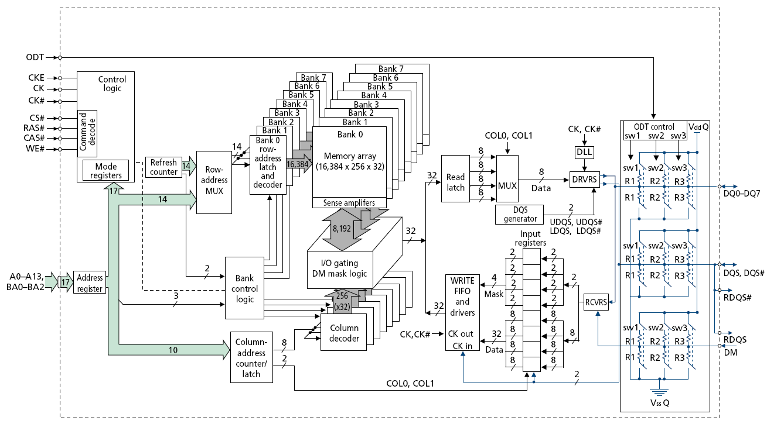
128M x 8-bit DRAM Chip

Slide 30
DRAM Rank and Module
Rank: Multiple chips operated together to form a wide interface
All chips comprising a rank are controlled at the same time
Respond to a single command
Share address and command buses, but provide different data
A DRAM module consists of one or more ranks
E.g., DIMM (dual inline memory module)
This is what you plug into your motherboard
If we have chips with 8-bit interface, to read 8 bytes in a single access, use 8 chips in a DIMM

Slide 31
A 64-bit Wide DIMM (One Rank)

Slide 32
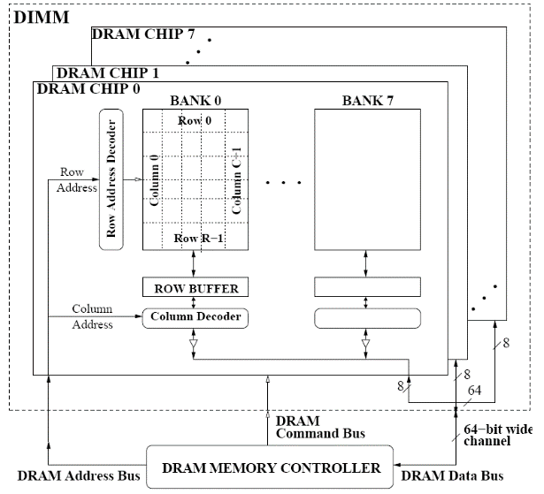
A 64-bit Wide DIMM (One Rank)
Advantages:
Acts like a high-capacity DRAM chip with a wide interface
Flexibility: memory controller does not need to deal with individual chips
Disadvantages:
Granularity: Accesses cannot be smaller than the interface width

Slide 33
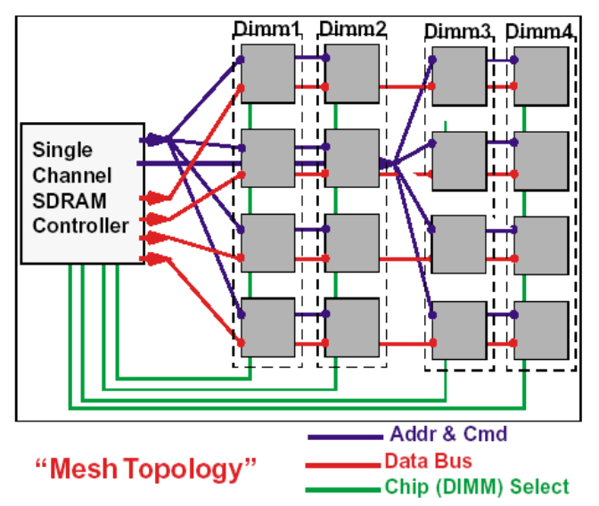
Multiple DIMMs
Advantages:
Enables even higher capacity
Disadvantages:
Interconnect complexity and energy consumption can be high
→ Scalability is limited by this

Slide 34
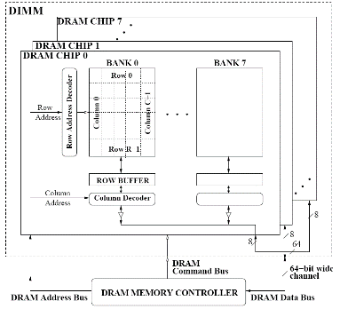
DRAM Channels
2 Independent Channels: 2 Memory Controllers (Above)
2 Dependent/Lockstep Channels: 1 Memory Controller with wide interface (Not Shown above)

Slide 35
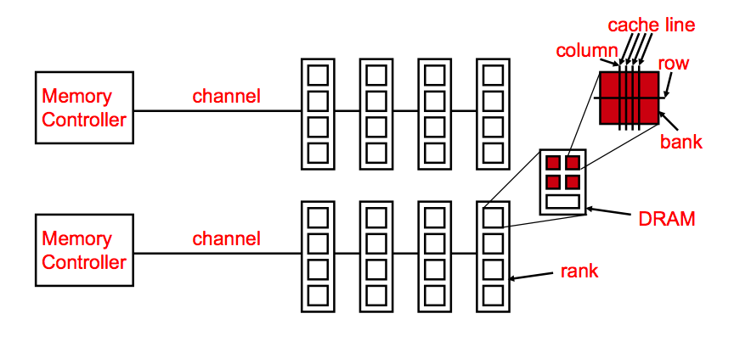
Generalized Memory Structure

Slide 36
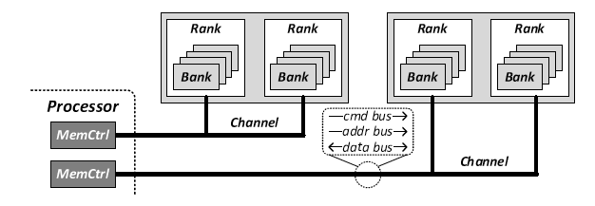
Generalized Memory Structure

Slide 37
The DRAM Subsystem The Top Down View

Slide 38
DRAM Subsystem Organization
Channel
DIMM
Rank
Chip
Bank
Row/Column
Cell

Slide 39
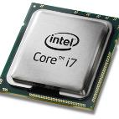
The DRAM subsystem
“Channel”
DIMM (Dual in-line memory module)
Processor
Memory channel
Memory channel

Slide 40
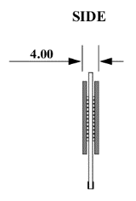
Breaking down a DIMM
DIMM (Dual in-line memory module)
Side view
Front of DIMM
Back of DIMM

Slide 41
Breaking down a DIMM
DIMM (Dual in-line memory module)
Side view
Front of DIMM
Back of DIMM
Rank 0: collection of 8 chips
Rank 1

Slide 42
Rank
Rank 0 (Front)
Rank 1 (Back)
<0:63>
<0:63>
Addr/Cmd
CS <0:1>
Data <0:63>
Memory channel

Slide 43
Breaking down a Rank
. . .
Chip 0
Chip 1
Chip 7
Rank 0
<0:63>
<0:7>
<8:15>
<56:63>
Data <0:63>

Slide 44
Breaking down a Chip
8 banks
Chip 0
Bank 0
<0:7>
<0:7>
<0:7>
...
<0:7>
<0:7>

Slide 45
Breaking down a Bank
2kB
1B (column)
row 16k-1
Bank 0
...
row 0
<0:7>
Row-buffer
1B
1B
1B
...
<0:7>

Slide 46
DRAM Subsystem Organization
Channel
DIMM
Rank
Chip
Bank
Row/Column
Cell

Slide 47
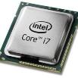
Example: Transferring a cache block
Physical memory space
0xFFFF…F
Channel 0
...
DIMM 0
Mapped to
0x40
Rank 0
64B
cache block
0x00

Slide 48
Example: Transferring a cache block
Physical memory space
Chip 0
Chip 1
Rank 0
Chip 7
0xFFFF…F
. . .
...
<0:7>
<8:15>
<56:63>
0x40
64B
cache block
Data <0:63>
0x00

Slide 49
Example: Transferring a cache block
Physical memory space
Chip 0
Chip 1
Rank 0
Chip 7
0xFFFF…F
. . .
Row 0
Col 0
...
<0:7>
<8:15>
<56:63>
0x40
64B
cache block
Data <0:63>
0x00

Slide 50
Example: Transferring a cache block
Physical memory space
Chip 0
Chip 1
Rank 0
Chip 7
0xFFFF…F
. . .
Row 0
Col 0
...
<0:7>
<8:15>
<56:63>
0x40
64B
cache block
Data <0:63>
8B
0x00
8B

Slide 51
Example: Transferring a cache block
Physical memory space
Chip 0
Chip 1
Rank 0
Chip 7
0xFFFF…F
. . .
Row 0
Col 1
...
<0:7>
<8:15>
<56:63>
0x40
64B
cache block
Data <0:63>
8B
0x00

Slide 52
Example: Transferring a cache block
Physical memory space
Chip 0
Chip 1
Rank 0
Chip 7
0xFFFF…F
. . .
Row 0
Col 1
...
<0:7>
<8:15>
<56:63>
0x40
8B
64B
cache block
Data <0:63>
8B
0x00
8B

Slide 53
Example: Transferring a cache block
Physical memory space
Chip 0
Chip 1
Rank 0
Chip 7
0xFFFF…F
. . .
Row 0
Col 1
...
<0:7>
<8:15>
<56:63>
0x40
8B
64B
cache block
Data <0:63>
8B
0x00
A 64B cache block takes 8 I/O cycles to transfer.
During the process, 8 columns are read sequentially.

