Slide 1
A Just-in-Time Customizable Processor
Liang Chen∗, Joseph Tarango†, Tulika Mitra∗, Philip Brisk†
∗School of Computing, National University of Singapore
†Department of Computer Science & Engineering, University of California, Riverside
{chenliang, tulika}@comp.nus.edu.sg,
{jtarango, philip}@cs.ucr.edu
Session 7A: Efficient and Secure Embedded Processors
Notes:
Hello Everyone, I am Joseph Tarango; graduate student at UC Riverside. I am here to present a collaborative work between Liang Chen, Dr. Tulika Mitra, Dr. Philip Brisk, and myself; “A Just-in-Time Customizable Processor.”

Slide 2
What is a Customizable Processor?
Application-specific instruction set
Extension to a traditional processor
Complex multi-cycle instruction set extensions (ISEs)
Specialized data movement instructions
Instruction & Data in
Control Logical Unit
Data out
Extended
Arithmetic Local Unit
Notes:
Lets start with what is a processor; a processor or central processing unit is a system in which executes given instructions on data in a sequential manner. The processor is made of two fundamental components: control logical unit and arithmetic logic unit. The control logical unit is the mechanism that moves data operations to the correct arithmetic operation. The arithmetic logical unit is the mechanism in which manipulations to data are made relating to number theory. A customizable processor is an extension to the traditional processor enabling for simple or complex multi-cycle instructions used within a specific application. To setup these custom instructions; usually we need to employ a custom memory interface to handle the complex data movements within the data path.

Slide 3
ASIP Model
Application-Specific Instruction-set Processor (ASIP)
Tailored to benefit a specific application with the flexibility of the CPU and performance of an Application Specific Integrated Circuit (ASIC)
These use static logic to speedup specific operator chains seen frequently and usually high cost within the CPU.
These ISEs are tightly coupled into the CPU pipeline and significantly reduce energy and CPU time.
ASIPs lack flexibility and ISEs must be known at ASIC design time; requiring firmware (software application) to be developed before the ASIC is designed.
Base Core
+
+
I
+
-
-
&
&
~
ISEs instantiated in customized circuits
High Parallelism
Low Energy
High Performance
No Flexibility with ISEs
Notes:
An Application-Specific Instruction-Set Processors (ASIP) with highly optimized Instruction-Set Architecture (ISA) can offer high performance for the specific application domain. However, designing an ASIP requires long turn-around time. In traditional extensible processors, designers statically customize the processor by adding application-specific ISEs, using customized circuits tightly integrated with the processor pipeline. These traditional extensible processors provide high performance and energy efficiency; however, they lack flexibility as they are highly specialized cores restricted to accelerating specific applications.

Slide 4
Dynamically Extendable Processor Model
These use dynamic logic to speedup specific operator chains seen frequently and usually high cost within the CPU.
These ISEs are loosely coupled into the CPU pipeline and significantly reduce energy and CPU time.
Very flexible and ISEs can be done post design time; allowing firmware (software application) to be developed in parallel the ASIC design.
High cost to reconfigure the fabric usually in the milliseconds range or larger depending on the size of the reconfigurable fabric.
Developing ISEs requires a hardware synthesis design and planning.
Base Core
Reconfigurable Fabric
+
-
+
+
&
-
~
ISEs accommodated on reconfigurable fabric
Very Flexible ISEs
Medium Energy
Medium Performance
Slow to Swap
Programmability
Notes:
Extensible processors have emerged to be promising alternatives to ASIPs. An extensible processor typically consists of a base processor and a set of instruction set extension (ISE) (also referred as custom instruction in literature) components. These ISE components help to extend the base ISA through customization or reconfiguration according to the specific applications. To increase flexibility, ISEs can be synthesized on a reconfigurable fabric that has been integrated into the processor forming a dynamically extensible processor. With the provided reconfigurability, the application-specific instruction set customization can be done in the post-fabrication phase. On the other hand, the cost of reconfiguration can be quite high, and the ideal choice of the fabric, whether fine-grained or coarse-grained remains an open question.

Slide 5
JiTC Processor Model
These use near to ideal logic to speedup specific operator chains seen frequently and usually high cost within the CPU.
These ISEs are tightly coupled into the CPU pipeline and significantly reduce energy and CPU time.
Flexible to the ISA and the accelerator programming is transparent to the firmware (software application) development
Low cost to reconfigure the fabric takes one-two cycles to fully reconfigure.
Developing ISEs is done within the compiler, so software automatically mapped onto the fabric.
Profiling and compiler optimizations can be done on the fly and binaries can be swapped.
+
+
-
Base Core
+
-
&
SFU
~
I
&
Just-in-Time Customizable core
Fast Swapping
Programmability
Medium Flexible ISEs
High Performance
Low-Medium Energy
Notes:
Our approach is to use a flexible model where we analyze highly used operator chains to exploit tightly coupled speedup with high flexibility. These extensions are a subset of operators transparent to the development and can be enabled at any phase of the design process. The benefit to this design strategy is that the processor can be used across a wide application model; while maintaining high flexibility and speedup with low reconfiguration cost. As the application data sets adapt the application can be re-profiled and compiled for optimized speedup.

Slide 6
Comparison of ISE Models
+
+
Base Core
Base Core
-
Base Core
+
-
+
+
I
+
-
Reconfigurable Fabric
&
+
+
SFU
~
-
&
&
+
-
~
&
-
~
I
ISEs instantiated in customized circuits
&
ISEs accommodated on reconfigurable fabric
Just-in-Time Customizable core
High Parallelism
Low Energy
High Performance
No Flexibility with ISEs
High Development Costs
Very Flexible ISEs
Medium Energy
Medium Performance
Slow to Swap
Difficult to Program
Fast Swapping
Automatic & Easily Programmed
Medium Flexible ISEs
High Performance
Low-Medium Energy
Notes:
Comparing the three models of ISE processors, we have static at design time, dynamic using a fully reconfigurable fabric, and ours which is dynamic based on an application/ISA exploitation. With static the ISEs are set at design time and cannot be changed, using a fully-reconfigurable we can re-use the ISEs over and over again swapping them out but swapping ISEs come at a reconfiguration price and higher latency, with our design we use a specialized coarse-grain approach to exploit specific set of the ISA we know will take advantage among several application without the high reconfiguration penalty.

Slide 7
Supporting Instructions-Set Extension
Application
Compile
Binary with ISEs
Profile
Identification
ISE Select & Map
Specialized
Functional
Unit (SFU)
ISE
I$
RF
D$
RF
OP
Fetch
Decode
Execute
Memory
Write-back
Notes:
The model for supporting custom instructions is we use the traditional compiler to take C programs to the intermediate representations, then we proceed to identify candidates for code accelerations. We then profile the code to detect the most frequently used candidates and accelerate those which are most used. From here, we develop a directed acyclic graph to be used for the architecture mapping. The figure in light green is the integration of ASICs to the processor. The adaptation involves directly interfacing to the register file; as to not slow the overall clock frequency or introduce unnecessary control logic to the system.

Slide 8
ISE Design Space Exploration
Input: R1
Input: R2
Input: R3
Input: Imm
*
Instruction Level Parallelism (ILP)
Compiler extracts ISEs from an application (domain)
Avg. parallelism is stable across our application domain
4-inputs, 2-outputs suffices
Inter-operation Parallelism
+
>>
&
Constrain critical path into single cycle through operator chaining and hardware optimizations.
>>
>>
Output 1
Output 2
Dataflow Graph (DFG) of an Instruction Set Extension (ISE)
Notes:
ILP extraction and exploitation is fundamental to computer architecture research. In terms of ISE identification, increasing the I/O bandwidth to/from an ISE leads to wider dataflow graphs with higher ILP [2, 3, 32]; however, prior work [32, 11, 10] has reported that up to four inputs and two outputs are sufficient to achieve ISEs with near-optimal speedup in most cases. Therefore, we study ISEs with at most four inputs and two outputs in this work. Section 7 describes the experimental setup.

Slide 9
Exploring Inner-Operator Parallelism
Mediabench
Mibench
(a) Average parallelism
Mediabench
Mibench
(b) Maximal parallelism
*Very minimal amount of parallelism detected
Notes:
The average parallelism of an ISE is defined as (average parallelism=#of total operations/critical path length); where the critical path length is the number of operations along the longest path in the DFG corresponding to the ISE. For example, in Figure 2, the critical path length is 5 and the average parallelism is 6/5 = 1.2. The average parallelism captures the ILP available within ISEs, i.e., the average number of independent operations that can execute in parallel per cycle. The maximal parallelism is the maximum number of DFG operations executing concurrently using the As Late As Possible (ALAP) scheduling policy. For example, in Figure 2, with an ALAP scheduling, the ADD operation executes in parallel with the first shift, so the maximal parallelism for the ISE is 2.

Slide 10
Operator Critical Path Exploration
*ISEs with a longer critical path tend to achieve the higher speedups
Notes:
We analyzed the average and maximal parallelism of ISEs found in 21 applications (Mibench and Mediabench). We found that the average parallelism is close to 1, and that the maximum parallelism never exceeds 2, across all of the applications (see Appendix C.1 for detailed data). These experiments confirm that ISEs with up to 4 inputs and 2 outputs have limited ILP, and at most two parallel functional units should suffice to exploit this limited parallelism.

Slide 11
Hot Operator Sequences
Hot sequence
Cold sequence
A – Arithmetic: Add, Sub
L – Logic: And, Or, Not, Xor, etc.
M – Multiply
S – Shift: Logical & Arithmetic
W – Bit Select or Data Movement
(a) Two-operator chain
(b) Three -operator chain
Notes:
Our objective is to design an SFU that exploits operation chaining; however, the SFU cannot possibly support every possible operation sequence. Thus the first step is to identify ”hot” sequences, i.e., those that appear frequently in ISEs across a wide variety of applications. The primary objective of the SFU is to execute the hot sequences efficiently. First, we classify the operations into five groups: arithmetic operations (A type), logical operations (L type), shift (S type), wire (W type), and multiplication operations (M type). W type operations are essentially move instructions that are converted to wiring when synthesized as part of an ISE. All operations belonging to each class have approximately equal latencies, and can be implemented using a single physical execution block. A sequence is hot if it occurs above a certain threshold; we use a threshold value of 5%, which captures the most frequent sequences. We restrict the number of operators per sequence to 3, as the average critical path length does not exceed 3 (see Figure 3). Figure 4 shows the hot sequences from an analysis of the 21 Mibench and Mediabench applications. Only a handful of operator chains (colored in red) appear frequently: there are five hot two-operator sequences and six hot three-operator sequences. The frequency of occurrence of each sequence is averaged across the benchmarks; certain sequences may occur frequently in some, but not all, of the applications. For example, the sequence MWA has a frequency of 66% in theTiff2bwapplication; however it only has 5% frequency averaged across all benchmarks.

Slide 12
Selected Operator Sequences
Two operator chains:
A – Arithmetic: Add, Sub
L – Logic: And, Or, Not, Xor, etc.
M – Multiply
S – Shift: Logical & Arithmetic
W – Bit Select or Data Movement
A+A
A+S
L+L
S+A
S+L
Two operator chains:
A/L+A/L
S+A/L
A/L+S
Three operator chains:
Three operator chains:
A/L+S+A/L+S
A+S+A
L+L+S
L+S+A
S+A+S
Consider A and L as equivalent
A/L+S+A/L A/L+A/L+S
S+A/L+S
Data path merging
(a) Identified hot sequences
(b) Optimized sequences
(c) Merged sequence (data path)
M+W+A
W+M+W
M+A
M
M+A
Consider W as a configurable wire connection
Data path merging
The 11 hot sequences are: AA, AS, LL, SA, SL, ASA, LLS, LSA, SAS, MWA, WMW.
Regular Expressions for Hot Sequences
Basic Functional Unit (BFU) | (A|L|ɛ)(S|ɛ)(A|L|ɛ)(S|ɛ)
Complex Functional Unit (CFU) | (M|A|ɛ)
Notes:
To support sequences A and L, the shift length is set to zero; to support sequence S, the ALU performs an identity operation (e.g., OR identical inputs) on the input operand. A regular expression that enumerates all possible sequences supported by the basic functional unit is (A| L| ε)(S| ε), where ε is the empty string.

Slide 13
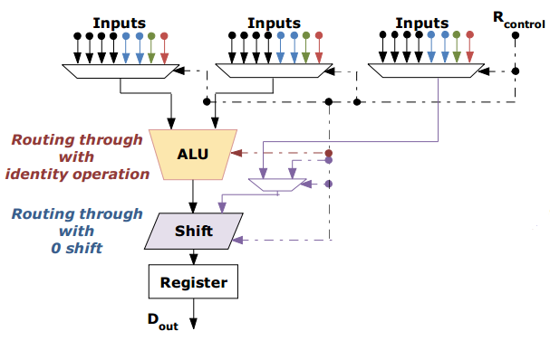
Basic Functional Unit Design
Inputs
Black represents inputs from Register File
Blue from Complex unit
Green Neighbor BFU
Red This BFU
R_{control}: Reconfiguration Stream
Functionality
ALU includes a bypass
Shift can be set from input or reconfiguration steam
Local feedback from register
Notes:
In exploring the design space, we investigated several traditional architectures and develop a generic functional unit. The generic functional unit consists of a two input operands into an arithmetic logical unit followed by a logical shift structure and register to save the result. The loop back structure allows us to map in a time orientated manner versus a spatial approach reducing the reconfigurable accelerator area.

Slide 14
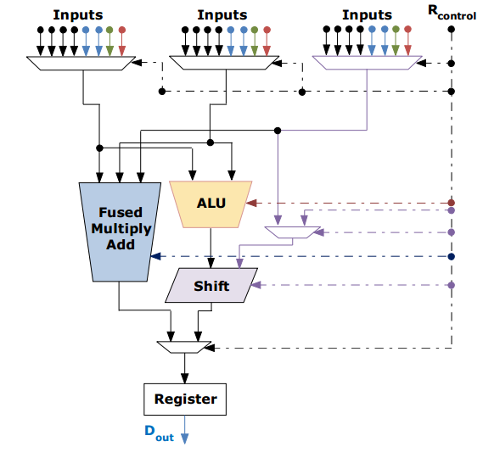
Complex Functional Unit Design
Inputs
Black represents inputs from Register File
Blue from Complex unit
Green Neighbor BFU
Red This BFU
R_{control}: Reconfiguration Stream
Functionality
MAC in parallel with ALU + Shift
ALU bypass removed to save opcode space
Notes:
The complex functional unit design is similar to the basic functional unit design, expect the operand pass through slots of the ALU instead map to the singed and unsigned MAC computations. If you look at the computational paths, we used two independent path to allow basic functional use when the MAC is not in use.

Slide 15
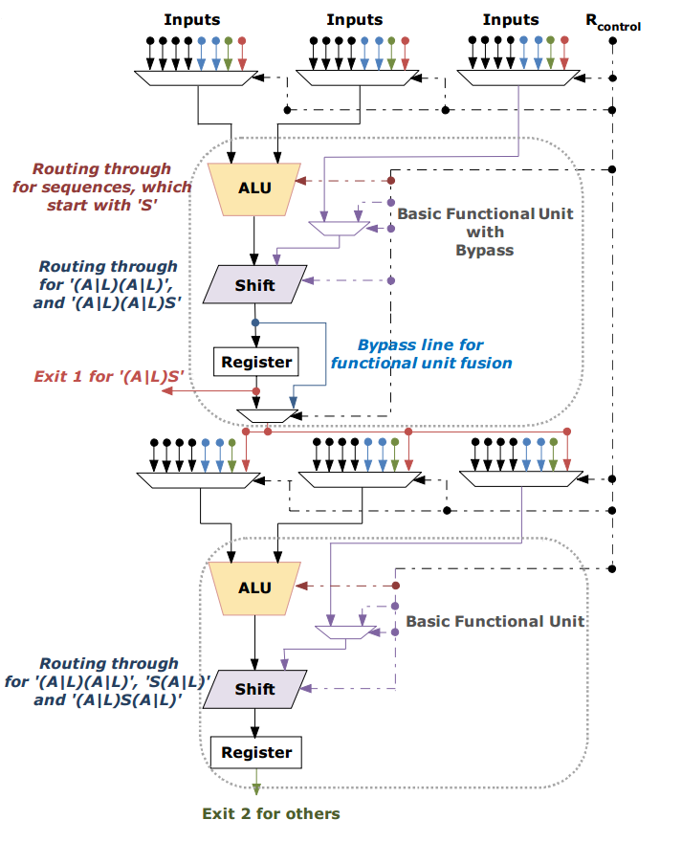
Merged Functional Unit Design
Inputs
Black represents inputs from Register File
Blue from Complex unit
Green Neighbor BFU
Red This BFU
R_{control}: Reconfiguration Stream
Functionality
Independent or chained operation mode
Chained operation mode has critical path equal to the MAC
Carry-out from first unit to second unit enables 64-bit operations
Notes:
In evaluating complex and simple arithmetic chains, we noticed it would be useful to be able to merge computations chains within one string of computations in a chain. In noticing the ability to merge operators within an individual time frame, we developed a novel skip-ahead architecture to produce several computation chains within a single cycle. The skip-ahead architecture allows for up to four simple computations within a single arithmetic chain.

Slide 16
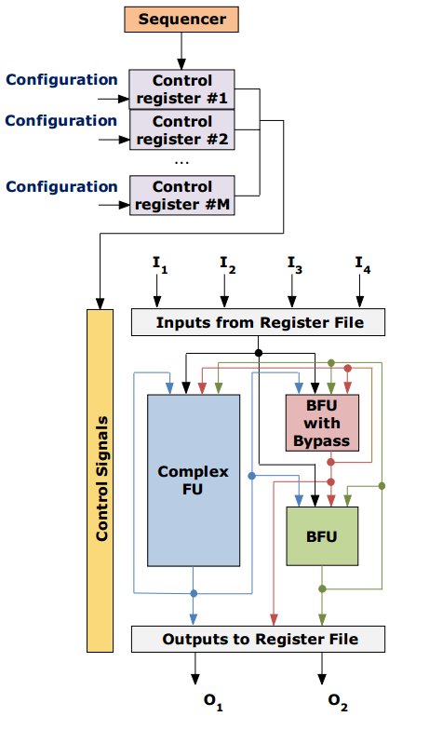
Interconnect Structure
Fully connected topology between FUs
Chained 1-cycle operation for two SFUs in any order
Result selection for any time step in the interconnect
Up to two results produced per time step
Control sequencer enables multiple configurations for a different cycles of one ISE (62 configuration bits total)
Notes:
The interconnect topology for our coarse grained reconfigurable array is a fully connected network with the number of connections being (n²-n)/ 2, in this specific case the interconnect is a clique (3²-3)/2=3. The fully connectivity of the structure allows for the two simple functional units to be combined in an asynchronous manner within a single cycle, independent of the time step for the specific configuration mapping.

Slide 17
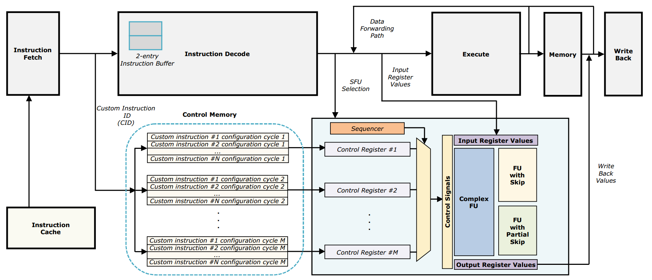
Modified In-Order Pipeline
Instruction buffer allows control memory to meet timing requirements
We support up to 1024 ISEs
ASIPs support up to 20 ISEs
Notes:
Integrating the design to the pipeline, use 2-entry instruction buffer to allow setup of the SFU’s control memory. The initial delay allows the control memory to prepare controller registers to allow custom instruction to occur spatial and temporally.

Slide 18
Modified Out-of-Order Pipeline
CISE Configure
Fetch 1
Configuration
Look-Up Cache
Specialized Functional Units
Fetch 2
Issue
Register Read
CISE Detect
Decode
Execution Units
Rename Registers
Dispatch
Rename Map
Load Store Queue
Write Back
Re-order Buffer
In-Order
Out-Of-Order
Notes:
In integrating the reconfigurable fabric we first set to introduce custom reconfigurable execution units into a 4-way superscalar processor. The processor fetches 4 instruction per cycles, resolves dependencies, sends the instructions to its appropriate execution unit, then it writes its result back in the appropriate order it initially received the instructions. To add custom reconfigurable execution units, we have to identify the custom instruction to execute, configure the custom data path, then dispatch data to its correct unit.

Slide 19
ISE Profiling
Start
Load
Control Data Flow Graph (CDFG) representation
Apply standard compiler optimizations
Loop unrolling, instruction reordering, memory optimizations, etc.
Insert cycle delay times for operations
Ball-Larus profiling
Execute code
Evaluate CDFG hotspots
Multiply
Add
Add
Shift
Subtract
Shift
Loop Conditional Check
Loop Conditional Check
Store
Stop
Notes:
Taking a computation program, how do we indentify patterns for computation acceleration? To start, we want to create a control and data flow graphs of the basic blocks within the application code. From these blocks, we apply current basic block optimizations already in GCC. With these optimized basic blocks we want to associate costs for more expensive operations such as multiplication, division, load, and store instructions. Not all of these basic blocks have associated weights we want to insert performance counts, so when we execute the code for a given or several inputs we can determine the most frequently used basic blocks. These frequency used basic blocks are the key to accelerating computation because if we can reduce these cycle intensive regions then we can reduce the overall runtime.

Slide 20
ISE Identification
Start
Example DFG
Load
Multiply
Input 1
Input 2
Input 3
Input 4
Add
+
Simple
Add
Shift
Complex
<<
Simple
*
Subtract
-
Shift
Simple
Conditional Check
Simple
+
>>
Simple
Conditional Check
Store
Output 1
Output 2
Stop
Notes:
Taking the computation program from the earlier slide, how do we indentify patterns for computation acceleration? Since we were able to profile the computation, we found this large block is one of the computational hotspots. Notice that the large block of instruction is similar to a loop within a loop. Assuming we cannot apply any more loop unrolling or other optimizations, we get the following data flow graph. Within the data flow graph, you can notice many inputs are shared, one intermediate value is used among the operands, and the results are disjoint.

Slide 21
Custom Instructions Mapping
Start
Reduced 6 Cycles to 1 Cycle, 5 Cycle Reduction
Load
Multiply
Input 1
Input 2
Input 3
Input 4
Add
+
Stage 1 – Start
Add
BFU0
Shift
<<
*
Subtract
-
Stage 2 – ½ Cycle
Shift
CFU
Conditional Check
+
BFU1
>>
Conditional Check
Store
Stage 3 – 1 Cycle
Output 1
Output 2
Stop
Notes:
Taking the computation block from the earlier slide, we are able to map what use to be a six cycle computational block into a single cycle computation. The mapping onto our coarse grain reconfigurable array saved five cycles in a single time step. Using advanced techniques we also support operations that require multiple time steps and additional inputs.

Slide 22
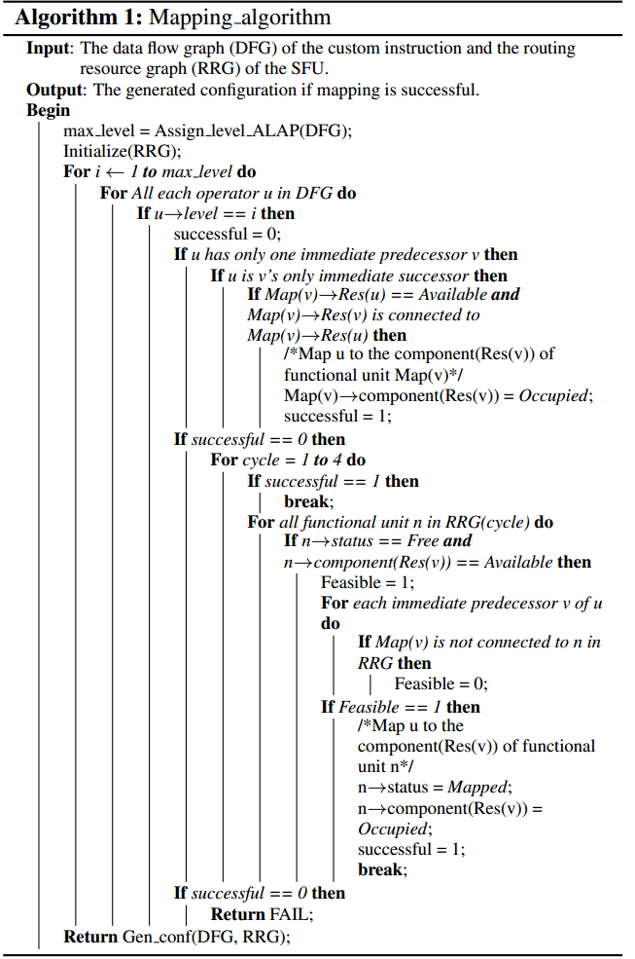
Schedule ISE using ALAP
Input: r1
Input: r2
①
*
Input: r3
Input: Imm 3
②
+
>>
③
&
④
Output: r4
>>
⑤
>>
⑥
Output: r5
DFG of a custom instruction with 4 inputs and 2 outputs
Notes:
We employ greedy heuristics for scheduling and mapping. For scheduling operations, we use As Late As Possible strategy (ALAP) and mapping in mapping we use a Routing Resource Graph (RRG); which is used in the Field Programmable Gate Array (FPGA) domain space. Within the mapping we do not allow control flow or memory accesses within ISE mapping. The graph at the top shows an operator set, we map each operation based on its computation level and resources for each time step.

Slide 23
Routing Resource Graph (RRG)
Input: r1
Input: r2
Input: r3
Input: Imm 3
Multi-Cycle Mapping
JiTC Supports 4 time steps
Cycle 0, reconfiguration
ⓐ
ⓔ
ⓑ
ⓖ
ⓕ
ⓒ
ⓓ
Cycle 1, reconfiguration
ⓗ
ⓛ
ⓘ
ⓝ
ⓜ
ⓙ
Within the RRG mapping we exclude memory accesses
ⓚ
Output: r4
Output: r5

Slide 24
Map ISE onto the Reconfigurable Unit
Input: r1
Input: r2
Input: r3
Input: Imm 3
Cycle 0, reconfiguration
①
③
>>
*
+
>>
+
②
*
Imm3
r3
r2
r1
r4
r5
Cycle 1, reconfiguration
>>
④
&
>>
&
⑤
>>
Imm3
r3
r2
r1
⑥
>>
Output: r4
Output: r5

Slide 25
Experimental Setup
Modified Simple Scalar to reflect synthesis results
Decompiled binary to detect custom instruction
Runtime analysis used to select best candidates to replace with ISEs
Recompiled new JITC binary with reconfiguration memory initialization files
SFU operates at 606 MHz (Synopsys DC, compile-ultra)
The configuration parameters are chosen to closely match realistic in-order embedded processor (ARMCortex-A7) and out-of-order embedded processor (ARM Cortex-A15).
 | In-Order | Out-of-Order
Pipeline Execution Units | 1 way | 4 Ways
L1 I-Cache | 32KB, 2-Way, 1 cycle hit
L1 D-Cache | 32KB, 2-Way, 1 cycle hit
L2 Unified Cache | 512KB, 4-Way, 10 cycle hit
Control Memory | 32KB
Notes:
We modeled our experimental setup in hardware and software to closely resemble the ARM A7 and ARMA15 processors. Our compiler decompiled binaries to detect ISEs then profiled code based on a wide range of datasets, then we recompiled the binary with memory initialization files allowing the application binary to be compiled in a Just-in-Time manner.

Slide 26
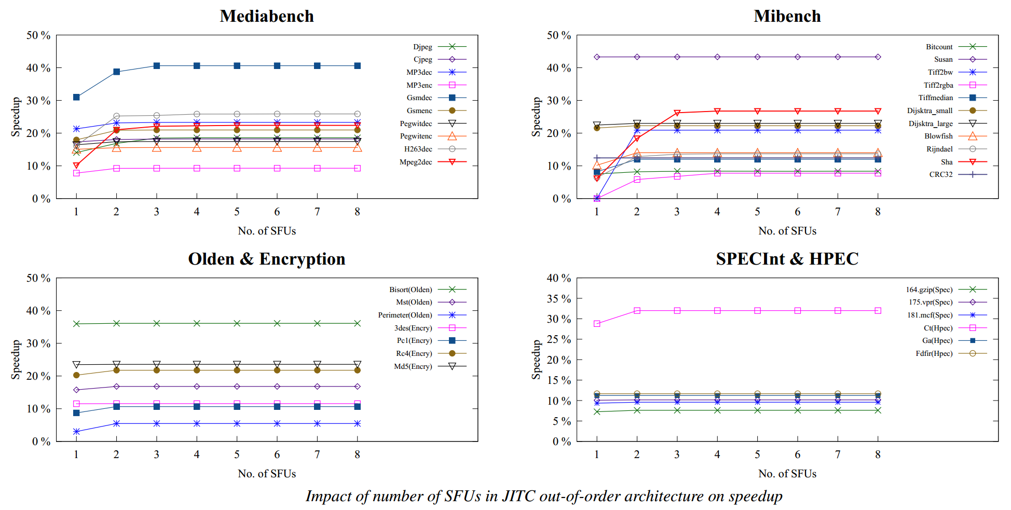
Experimental Out-of-Order Execution Unit Determination
No speedup achieved after 4 SFU units within out-of-order execution
Notes:
As you can see from the benchmarks for out- of order processors we do not achieve any further speedup after 4 SFUs.

Slide 27
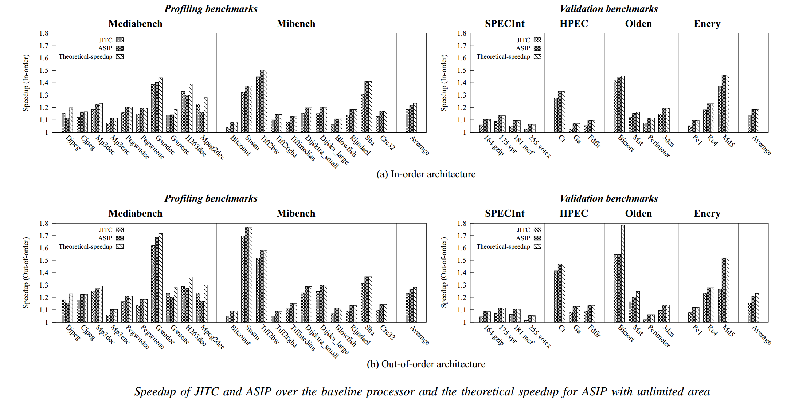
Experimental Runtime Results
Average of 18% speedup for in-order processor, 21% for ASIPs, 23% for theoretical
Average of 23% speedup for out-of-order processor, 26% for ASIPs, 28% for theoretical
Achieved 94.3-97.4%, (in-order), 95.98-97.54% (out-of-order) in speedup compared to ASIPs
Notes:
When running CPU benchmarks, we were able to obtain 18%, 23% speedup for in-order and out-of-order processing, respectively. From the results, we can see that we achieve close to custom processor implementations with the flexibility to speedup 14 additional applications from SPECInt, HPEC, Olden, and Encrypt benchmark suites to perform cross validation of the SFU design. More importantly, JiTC has huge advantage in terms of ﬂexibility: we need a different extensible processor to accelerate each application, while a single JiTC core can accelerate all the different applications with minimal performance loss. This is the fundamental reason why for some large benchmarks, JiTC can outperform extensible processor which is area-constrained to support limited number of feasible ISEs.
In order to stress test the design of our architecture, we attempt to accelerate applications from benchmark suites with completely different characteristics compared to the embedded space. We chose SPECInt [25], Encryption, Olden, and HPEC [16] benchmark suites for this evaluation. HPEC is derived from HPCC [22], [13] and PCA [20] both targeting general-purpose high-performance computing.
JiTC still achieves similar speedup to extensible processors, around 96% on an average for both in-order and out-of-order executions. This conﬁrms that even though the JiTC core was designed to accelerate embedded applications, the design is ﬂexible enough to support a completely different application domain, e.g., SPEC and HPEC. However, for these benchmarks, the speedup achieved using customization (extensible processor or JiTC) is limited to around 1.10X. This is because these benchmarks have lower ratio of ALU operations and smaller basic blocks [8], characteristics that are not ideal for customization.

Slide 28
Summary
Average of 18%, 23% speedup
94.3-97.4%, (in-order), 95.98-97.54% (out-of-order) in speedup compared to ASIPs
On Average, SFU occupies 3.21% to 12.46% of the area of ASIPs
ISE latency is nearly identical from ASIP to JITC
For JITC, ISEs on average contain 2.53 operators
JITC ISEs can have from 1 to 4 time steps for an individual custom instruction
90% of ISEs can be executed in one time step
99.77% of ISEs can be mapped in 4 time steps
(7%, 4%) overhead compared to a (simple, complex) execution path
Notes:
In conclusion, our JiTC system achieved 18 and 23 percent, respectively, for in order and out-of-order execution. The average area is just a fraction of the area of know ASIPs with nearly identical latency and on average our ISEs contain 2.53 operators per ISE with patterns varying 1 to 4 time steps. The ISEs used had 90% map to a single time step and 99.77% ISEs were covered in 4 time steps. Compared to a simple and complex execution path we only carry a 7% and 4% overhead.

Slide 29
Conclusion
We proposed a Just-in-time Customizable (JITC) processor core that can accelerate executions across application domains.
We systematically design and integrate a specialized functional unit (SFU) into the processor pipeline.
With the supported from modified compiler and enhanced decoding mechanism, the experimental results show that JITC architecture offers ASIP-like performance with far superior flexibility.
Notes:
In conclusion, our JiTC system achieved 18 and 23 percent, respectively, for in order and out-of-order execution. The average area is just a fraction of the area of know ASIPs with nearly identical latency and on average our ISEs contain 2.53 operators per ISE with patterns varying 1 to 4 time steps. The ISEs used had 90% map to a single time step and 99.77% ISEs were covered in 4 time steps. Compared to a simple and complex execution path we only carry a 7% and 4% overhead.

Slide 30
Questions
Notes:
Any questions?

Slide 31
Supplemental Slides

Slide 32
Design Flow Design
CI1
Fetch
Instruction fetch
hot basic block
CI2
Instruction decode
CI3
Binary with custom instructions
CI
NI
Configuration CI1
Load
Context register
CFUs
Normal FUs
code
Configuration CI2
CDFG
Configuration CI3
…
Configurations for custom instructions
Processor
Instrumented MIMO custom instruction generator
Adapted Simplescalar infrastructure

Slide 33
Designing the Architecture
Standard Cell Design 45 nm
Choose array arithmetic structures to achieve maximum performance for standard cell fabrication
Designed and optimized elementary components for design constraints
Determined area and timing for composed components
Notes:
Using standard cell design techniques, we choose array arithmetic structures to achieve maximum performance for standard cell fabrication. We designed and optimized elementary components for our design constraints; then determined area and timing for composed components.

Slide 34
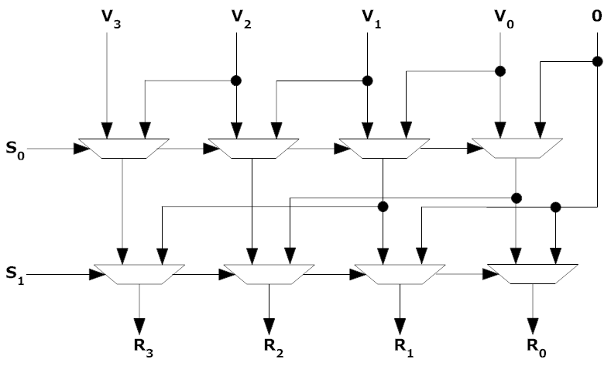
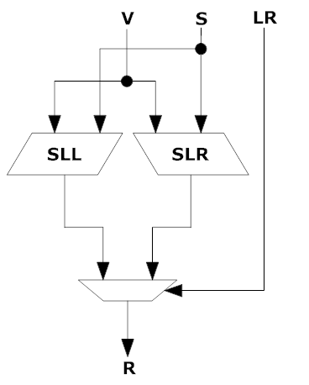
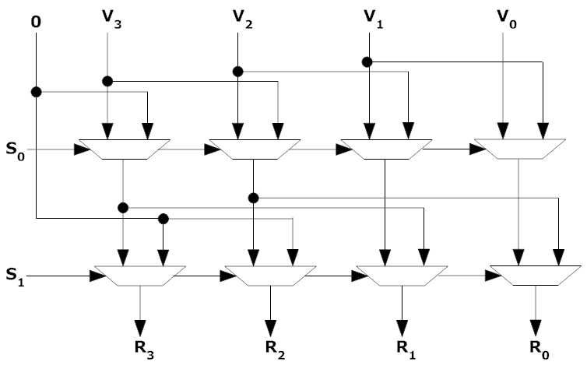
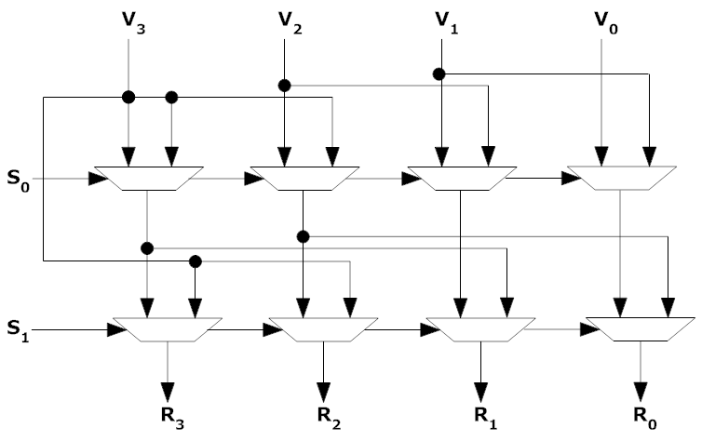
Shifter Design
Inputs:
Outputs:
SLL – Shift Left Logical
Example Algorithm:
Arithmetic Shift Right power of two
Shows the combination of the logical left and right shifter architecture into a single unit we call Shifter.
Multiplexor-based power of two shifters
The area, depth, and time delay of the shifter is log n
Unlike arithmetic shift, the logical shifters do not preserve the sign of the input
SRL – Shift Right Logical
SRL – Shift Right Arithmetic
Notes:
The shifter design uses a power of two shifter design which is log n in area, depth, and delay. The algorithm on the right defines the generated structure using within our design for standard cell.

Slide 35
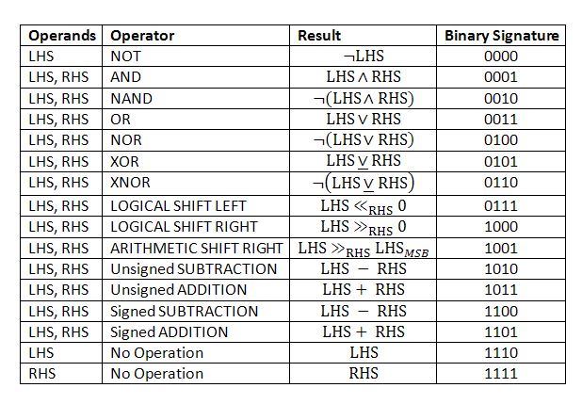
ALU Design
Operand Pass through design
All Boolean Operations
Parallel Addition / Subtraction design
Depth - O(log n)
Area –
Fanout -
Inputs:
Outputs:
Algorithm: Sklansky Parallel-Prefix Carry-Look Ahead Adder
Notes:
The arithmetic logical unit for our functional unit used a unique set of operations optimized for our benchmarks which consists of all basic Boolean logical operations, logical/arithmetic shift, and addition/subtraction. Our adder design uses a Sklansky Parallel-Prefix Carry-Look Ahead Adder architecture, which is log n in depth, ½ n log n in area and ½ n within internal fanout.

Slide 36
MAC Design
4-bit Array Multiplier Structure for PP
Multiply Accumulate
partial product (PP)generation, carry-save addition of PP, final parallel Final addition
Multiply
Baugh-Wooley for unsigned
Braun for Signed
Area n²
Delay n
Notes:
The MAC design used a Baugh-Wooley for unsigned Braun for signed partial products followed by Sklansky Parallel-Prefix Carry-Look Ahead addition of these partial products.
*** Recommends Deleting. – Philip
*** Possibly giving away too much architecture, which should be in journal extension. -Joe

Slide 37
Experimental Synthesis Results
Unit | Area (μm²) | Delay (ns)
Small ALU | 45919 | 1.5300
Medium ALU | 48064 | 1.53991
Large ALU | 49866 | 1.57984
Basic Functional Unit | 9856 | 0.7585
Complex Functional Unit | 49780 | 1.8011
Fused Basic Functional Unit | 27913 | 1.7998
Specialized Functional Unit | 80502 | 1.8099
Specialized Functional Unit (Ultra Optimizations) | 80502 | 1.64998
SFU operates at 555 MHz & 606 MHz using ultra optimizations for synthesis
SFU occupies 80502 μm² area
Notes:
We designed the subsystems with in the SFU to compete with variations of ARM based ALUs as you can see our optimized design closely competes with the ALUs with a delta of (0.07014, 0.11998) ns. The design is barely two times the size with supporting up to 6 operations per cycle, where the traditional ALU is 1 operation per cycle.

Slide 38
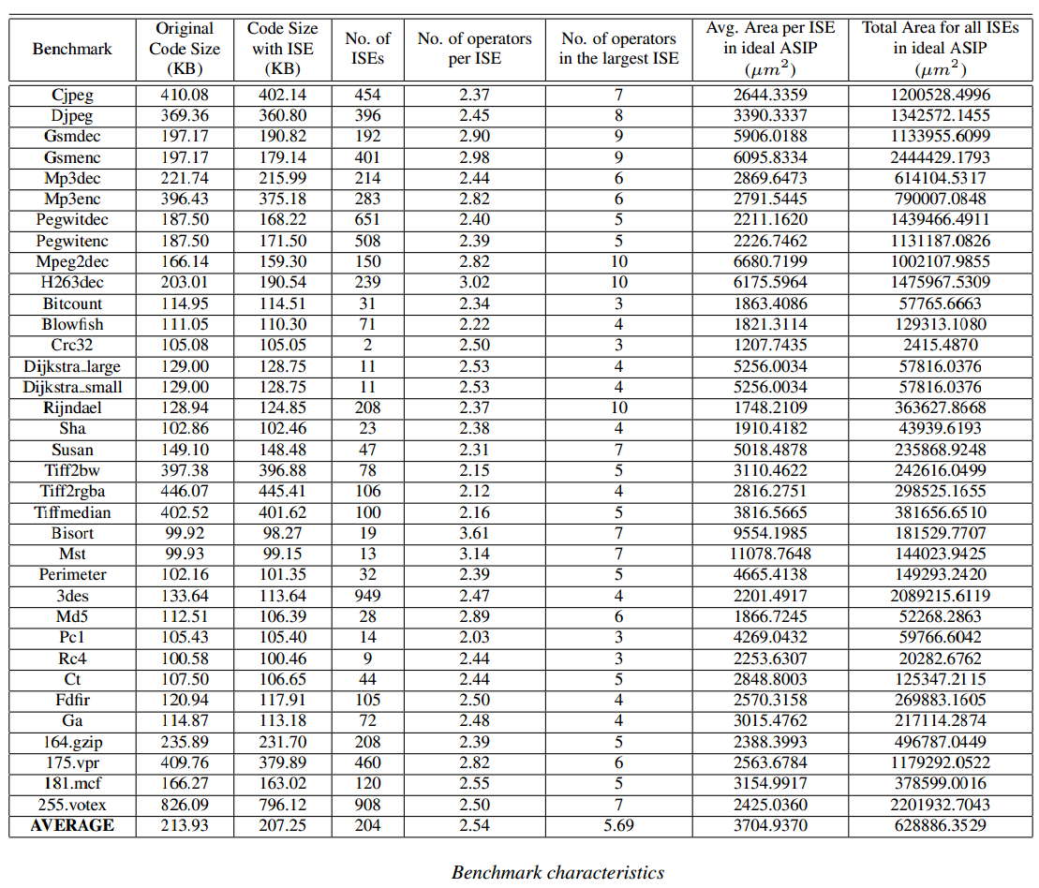
Benchmark Details
Notes:
You can see here that the number of custom instructions for the benchmarks are in the range of 2-949, which ASIPS usually only can support a fraction of potential custom instructions, our model allows for inclusion of thousands of custom instructions.

Slide 39
JiTC Capability
ISE latency is nearly identical from ASIP to JITC
For JITC, ISEs on average contain 2.53 operators
JITC ISEs can have from 1 to 4 time steps for an individual custom instruction
90% of ISES can be executed in one time step
99.77% of ISEs can be mapped in 4 time steps
32-bit ISA (Instruction Set Architecture)
Merge two-five instruction entries to have full ISE use
8-bit opcode (operation code)
4-bits per register
10-bits encode the CID (Custom Instruction Identification)
4 Addressing Modes (RRRR, RRRI, RRII, RIII)
Latency Distribution of ISEs on ASIP and SFU
Opcode
Imm
RS2
RS1
RD
31
23
15
11
7
3
0
(a) Regular instruction format
Opcode
RD2
CID
RD1
31
23
17
7
3
0
First 32-bit encoding format
RS4
RS3/Imm3
RS2/Imm2
RS1/Imm1
31
23
15
7
0
Second 32-bit encoding format
(b) ISE format
Notes:
JiTC allows for nearly identical latency to ASIPs and contains 2.53 operators. From our analysis, 90% of ISE are completed in one cycle and 99.77% of ISEs can be mapped within 4 time steps. Our ISE was developed for a 32-bit ISA, which 2-5 instruction entries are merged into one ISE. Our custom instruction ID occupies 10 bits and we support 4 addressing modes.

