Slide 1


Instruction Set Extension for Dynamic Time Warping
Joseph Tarango, Eammon Keogh, Philip Brisk
{jtarango,eamonn,philip}@cs.ucr.edu
http://www.cs.ucr.edu/~{jtarango,eamonn,philip}

Slide 2
Outline
Motivation
Time-Series Background
Custom processor process
Application Analysis
Refining ISE to support Floating-Point
Floating-Point Core Data paths
Experimental Comparison
Analysis of Results
Conclusion & Future work

Slide 3

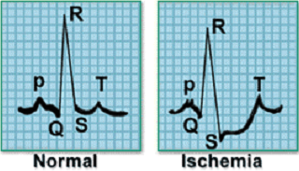
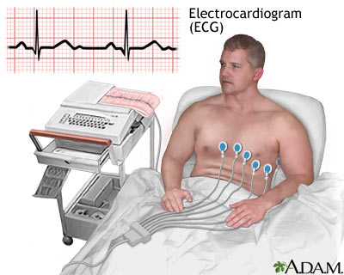
Custom Processors to Time-Series
What is the link?
Cyber-physical systems
What is a Cyber-physical system?
The merger of data quantified from the physical world then processed on computational devices.
http://www.nsf.gov/funding/pgm_summ.jsp?pims_id=503286
Motivation - Suppose you want to check the health of the heart.
How would you do it?
Sensors + Analog to Digital Converter + Microprocessor + Intelligent Similarity Classification Algorithm + Database
Sensor - To do this we would use an ECG, with measurements from 125Hz-500Hz.
Microprocessor – an energy efficient and fast, custom processor!
Algorithm – Accurate and fast, UCR Suite!
  *A hospital charges $34,000 for a daylong EEG session to collect 0.3 trillion datapoints.
*Image take from: http://lungcancer.ucla.edu/adm_tests_electro.html

Slide 4
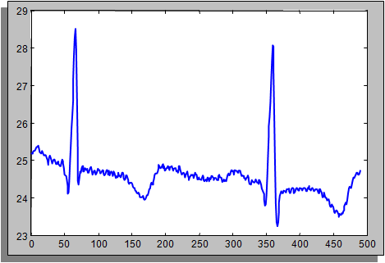
What is a Time-Series?
6.9771532e-001
8.3555610e-001
2.1199925e+000
5.0304004e+000
4.1208873e+000
2.6446407e+000
2.8049135e+000
4.0172945e+000
5.2017709e+000
5.2985477e+000
5.1660207e+000
4.4315405e+000
4.0937909e+000
Sequence of points sampled at a regular rate of time.
Formal Definition:
Ordered List of a particular data type, T = t₁, t₂, …, t_{m}
We consider only subsequences, of an entire sequence. T_{i,k} = t_{i}, t_{i+1}, …, t_{i+k}
Objective is to match a subsequence T_{i,k} as a candidate, C, against the query Q; where |C| =|Q| = n
The Euclidean Distance between C and Q is denoted by ED(Q,C) = (∑_{i=1 to n}(q_{i}-c_{i})²)^{1/2}

Slide 5
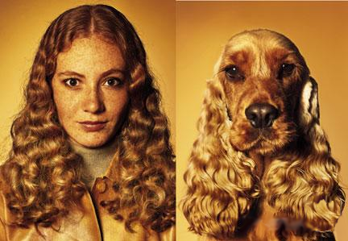
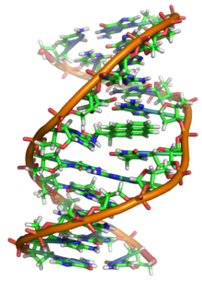
What is Similarity?
cod, pod, dog, deadbeef
Similarity - The comparable likeness, resemblance, determined by features.
We can determine this either by individual characteristics or general structure.

Slide 6
Assumptions
Time Series Subsequences must be Z-Normalized
  In order to make meaningful comparisons between two time series, both must be normalized.
  Offset invariance.
  Scale/Amplitude invariance.
Dynamic Time Warping is the Best Measure (for almost everything)
  Recent empirical evidence strongly suggests that none of the published alternatives routinely beats DTW.
B
C
A

Slide 7
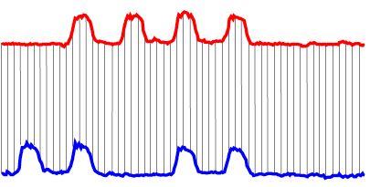
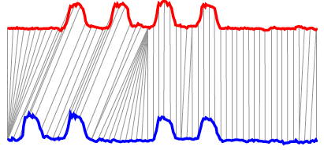
Euclidean Distance vs. Dynamic Time Warping
ED is bijective (one-to-one) function, which can miss by offsets and stretching
On the other hand, we might want partial alignment (many-to-many), familiarly known as Dynamic Time Warping (DTW)
Euclidean Distance
Dynamic Time Warping (DTW)
Different metrics to compute the similarity between two time-series; DTW enables alignment between sequences; Euclidean distance does not.

Slide 8
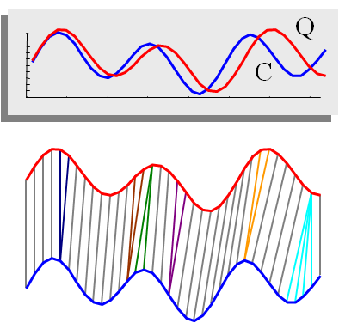
Dynamic Time Warping
The matrix shows every possible warp the two series can have, which is important in determining similarity.
C
Q

Slide 9
Bounding Warp Paths
Prevent Pathological Warps & Bound
C
U
Q
U_{i} = max(q_{i-r} : q_{i+r})
L_{i} = min(q_{i-r} : q_{i+r})
Q
L
Sakoe-Chiba Band
C
U
Q
L
*Adapted Dr. Eamonn Keogh previous works.

Slide 10
Optimizations (1)
Early Abandoning Z-Normalization
  Do normalization only when needed (just in time).
  Small but non-trivial.
  This step can break O(n) time complexity for ED (and, as we shall see, DTW).
  Online mean and std calculation is needed.

Slide 11
Optimizations (2)
Reordering Early Abandoning
  Do not blindly compute ED or LB from left to right.
  Order points by expected contribution.
Idea
- Order by the absolute height of the query point.
- This step only can save about 30%-50% of calculations.

Slide 12
Optimizations (3)
Reversing the Query/Data Role in LB_Keogh
  Make LB_Keogh tighter.
  Much cheaper than DTW.
  Triple the data.
  -------------------
  Online envelope calculation.
Envelop on Q
Envelop on C

Slide 13
What is a Customizable Processor?
Applications-Specific Instruction-Set Processor (ASIP)
  Extends the arithmetic logic unit to support more complex instructions using Instruction-Set Extension (ISE)
  Complex multi-cycle ISEs
  Additional data movement instructions for extended logic functionality
Instruction & Data in
Control Logical Unit
Data out
Extended
Arithmetic Local Unit

Slide 14
Supporting Instructions-Set Extension
Application
Compile
Binary with CISEs
Profile
Identification
ISE Select & Map
Double Precision ISE Cores
I$
RF
D$
RF
Fetch
Decode
Execute
Memory
Write-back

Slide 15
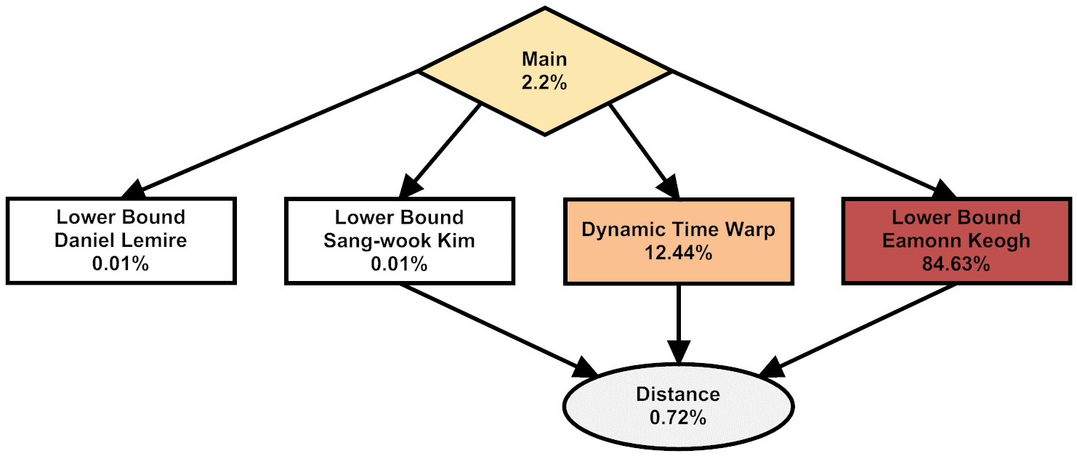
Time-Series Application Analysis
Using ISE detection techniques, we were able to generate this call graph.
Since Floating-Point has never been evaluated for ISEs, we had to manually analyze the data for code acceleration.

Slide 16
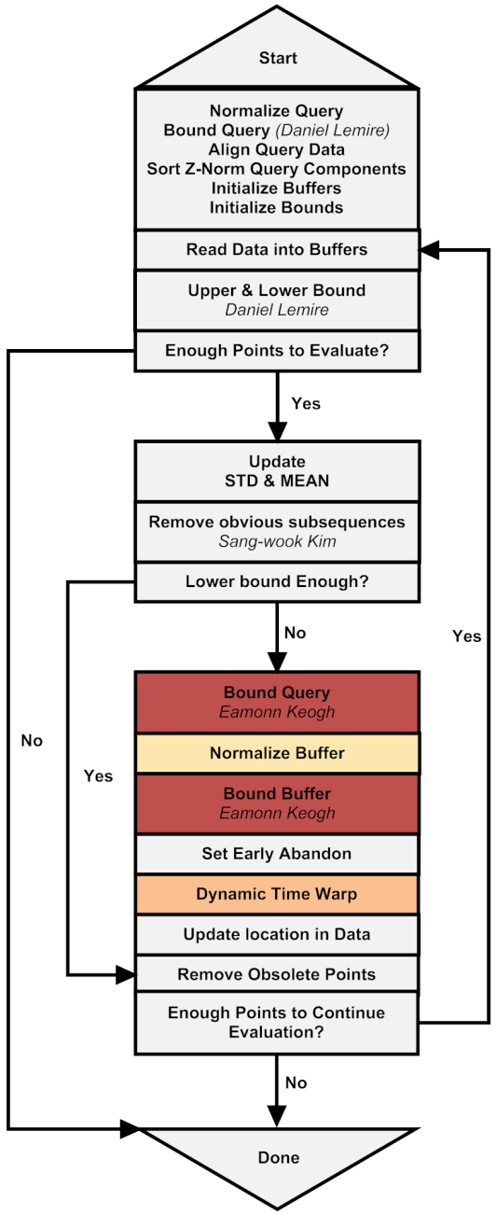
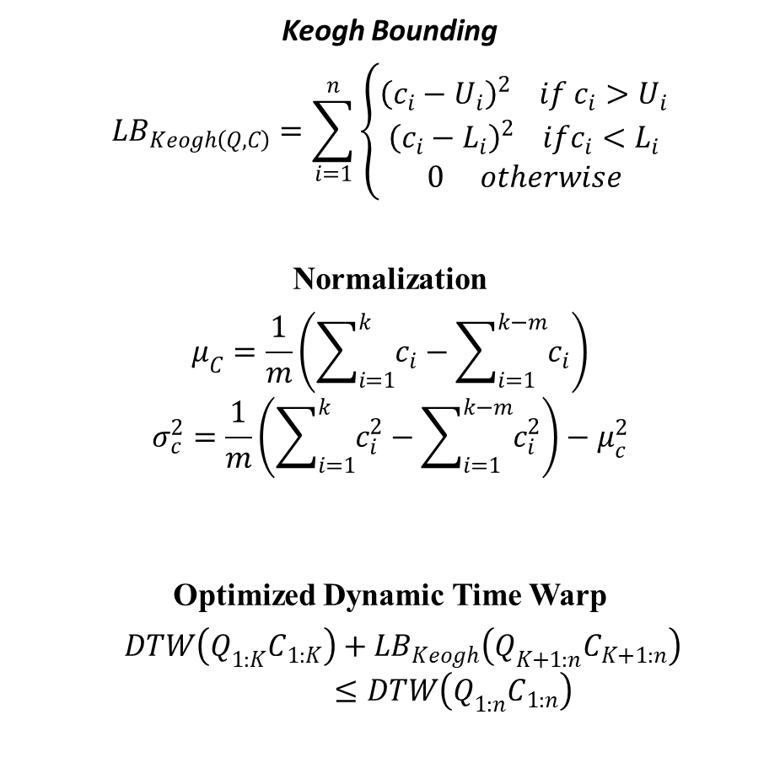
Application Control Flow
Keogh Bounding
$$LB_{Keogh\left(Q,C\right)}=\sum_{i=1}^{n}{\left\{\begin{matrix}{\left(c_{i}−U_{i}\right)}^{2} if c_{i}>U_{i} \\ {\left(c_{i}−L_{i}\right)}^{2} ifc_{i}<L_{i} \\ 0 otherwise\end{matrix}\right.}$$
Normalization
$$μ_{C}=\frac{1}{m}\left(\sum_{i=1}^{k}{c_{i}}−\sum_{i=1}^{k−m}{c_{i}}\right)$$
$$σ_{c}^{2}=\frac{1}{m}\left(\sum_{i=1}^{k}{c_{i}^{2}}−\sum_{i=1}^{k−m}{c_{i}^{2}}\right)−μ_{c}^{2}$$
Optimized Dynamic Time Warp
$DTW\left(Q_{1:K}C_{1:K}\right)+{LB}_{Keogh}\left(Q_{K+1:n}C_{K+1:n}\right)$
$≤DTW\left(Q_{1:n}C_{1:n}\right)$

Slide 17
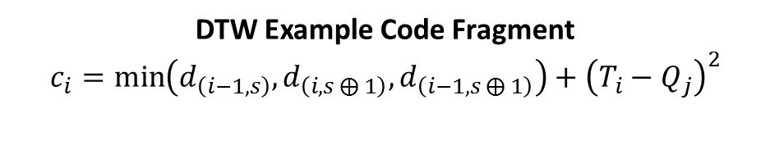
ISE Profiling
Enter Dynamic Time Warp
Generate Control and Data Flow Directed Acyclic Graphs (CDFG) for Basic Blocks
Apply Basic Block optimizations
  Loop unrolling, instruction reordering, memory optimizations, etc.
Insert cycle delay times for operations
Ball-Larus profiling
Execute code
Evaluate CDFG Hotspots
Initialize Cost Matrix
Column & Row Initiation
Compare
Compare
Subtract
Multiply
Add
Loop Conditional Check
Early Abandon Check
DTW Example Code Fragment
$$c_{i}=\min\left(d_{\left(i−1, s\right)}, d_{\left(i, s⨁{1}\right)},d_{\left(i−1, s⨁{1}\right)}\right)+{\left(T_{i}−Q_{j}\right)}^{2}$$
Loop Conditional Check
Return Warp Path

Slide 18
ISE Identification
Enter Dynamic Time Warp
Example DFG
Initialize Cost Matrix
Column & Row Initiation
Input 1
Input 2
Input 3
Input 4
Input 5
Compare
-
Compare
>
Inter-operation Parallelism
Subtract
>
*
Multiply
Add
Constrain critical path through operator chaining and hardware optimizations.
Loop Conditional Check
+
Early Abandon Check
Loop Conditional Check
Output 1
Return Warp Path

Slide 19
ISE Mapping
Enter Dynamic Time Warp
Enter Dynamic Time Warp
Initialize Cost Matrix
Initialize Cost Matrix
Column & Row Initiation
Column & Row Initiation
Compare
DTW ISE
Compare
…
Subtract
Loop Conditional Check
Multiply
Early Abandon Check
Add
Loop Conditional Check
Loop Conditional Check
Return Warp Path
Early Abandon Check
Replace highest impact hot basic blocks with ISEs
Generate ISE hardware path and software operations
Unroll Loop, for hardware pipelining
Re-order memory accesses for pipelined ISEs
Loop Conditional Check
Return Warp Path

Slide 20
Application Benefits
Decreased
Computation Cycles (energy & time)
Memory accesses (energy & time)
Instruction fetch and decode (energy)
Increased
System power by introducing custom hardware (energy)
Net Result
Reduced overall energy consumption
Reduced computation time
Smaller code size
More room for compiler optimizations
  E.G. Register coloring, code reordering, etc.
Enter Dynamic Time Warp
Initialize Cost Matrix
Column & Row Initiation
DTW ISE
…
Loop Conditional Check
Early Abandon Check
Loop Conditional Check
Return Warp Path

Slide 21
Iterative ISE Insertion
Latencies of ISEs in software (with and without pipelining), using floating-point operators, and specialized hardware ISE logic.
Determine ISE cycle latencies
  Software
  FPU (Blocking)
  ISEs (Pipelined)
Adding all ISEs reduce the computation cycles by 3.43 x 10¹² cycles
6.86x potential speedup

Slide 22
Pipelined Core Details
Synthesis summary of the double-precision floating-point arithmetic operators
Evaluate Simple Operators
Identify
  Critical path latency
  Area constraints
  Pipeline possibilities
Synthesis summary of the four ISEs introduced to accelerate the DTW application.
Evaluate Complex ISE Operators
Identify
  Critical path latency
  Remove redundant circuitry
    Floating-Point normalizations
  Pipeline to match processor path

Slide 23
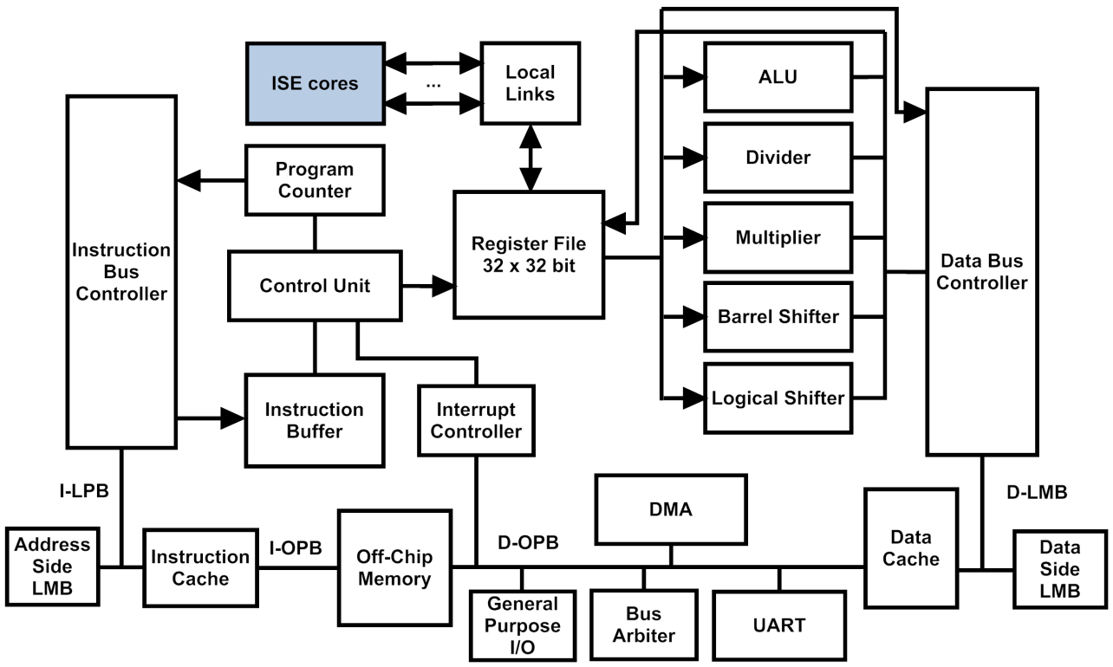
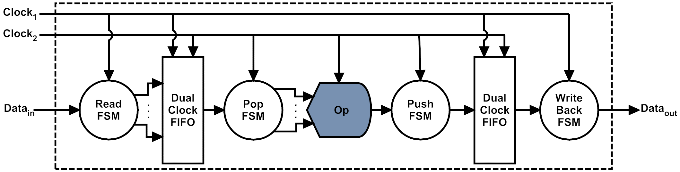
ISE Core Integration
System Design
Core interface featuring fast point-to-point interface for ISE cores.
The cycle delay for interfacing to the cores is single cycle and does not add to the critical path of the overall architecture.
The interface only requires two additional assembly instruction to support all ISEs.
When not in use, the custom Interface assigns low voltage to operator saving switching energy
ISE interface, with dual-clock FIFOs and finite state machine (FSM) control.

Slide 24
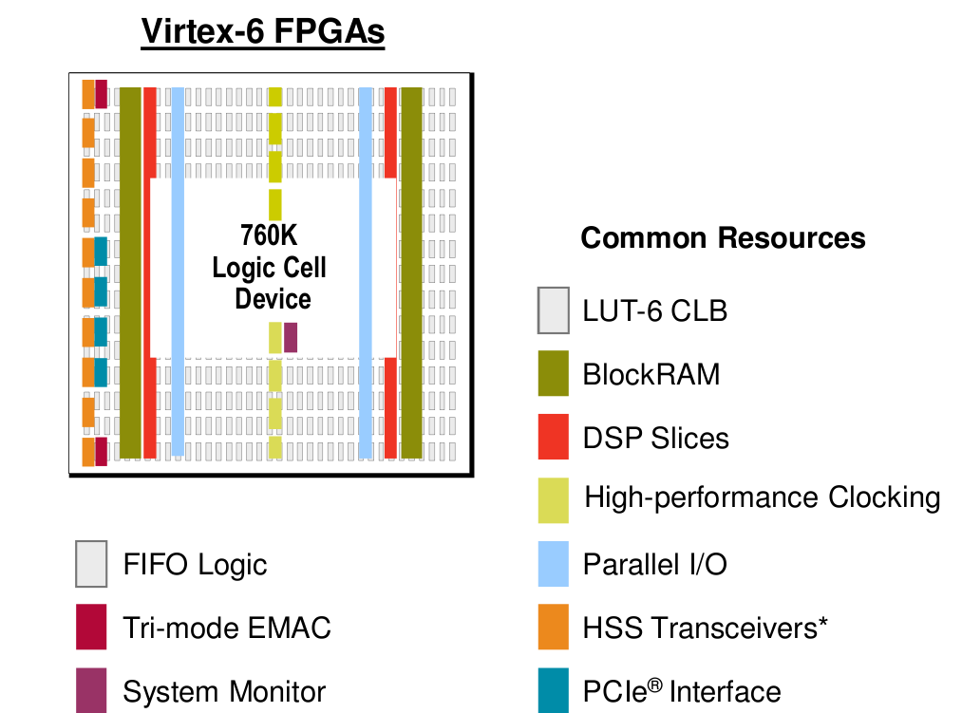
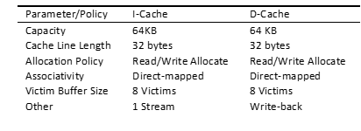
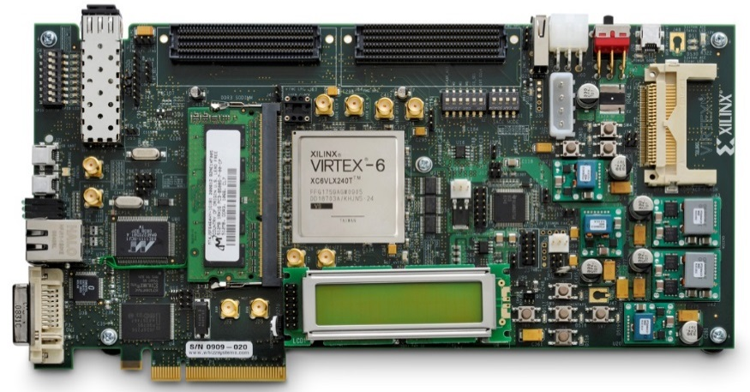
Experimental Setup
Emulation Platform
System Settings
Single core at 100MHz
Integer division
64-bit integer multiplier
2048 branch target cache
Virtex 6 ML605 FPGA
Cache Configuration

Slide 25
Impact of ISEs on Application
Execution Time of Processor Configurations for DTW at Varying Compiler Optimization Levels
2500
Execution Time (seconds)
2000
1500
1000
500
0
-O0
-O1
-O2
-O3
Baseline CPU
Baseline CPU + ISE-(Norm, DTW)
Baseline CPU + FPU
Baseline CPU + ISE-(Norm, DTW, Accum)
Baseline CPU + ISE-Norm
Baseline CPU + ISE-(Norm, DTW, Accum, SD)

Slide 26


Power Analysis
Peak Power and Energy Consumption of Processor Configurations for DTW at –O3 Compiler Optimization
10000
Energy Consumption (Joules)
4.43W
Power (Watt)
7500
4.50W
5000
4.52W
4.55W
2500
4.57W
0
Baseline
FPU
1 ISE
2 ISEs
3 ISEs
4 ISEs
Baseline CPU
Baseline CPU + ISE-(Norm, DTW)
Baseline CPU + FPU
Baseline CPU + ISE-(Norm, DTW, Accum)
Baseline CPU + ISE-Norm
Baseline CPU + ISE-(Norm, DTW, Accum, SD)

Slide 27
Area Usage
Resource Usage of DTW Processor Configurations
20000
12.1%
Slice Registers
11.3%
Resource Count
Slice LUTs
10.3%
5.3%
15000
Block RAMs
9.5%
4.9%
4.6%
4.1%
8.3%
3.6%
10000
2.3%
4.3%
5000
1.2%
1.7%
1.6%
1.8%
1.9%
2.0%
0
Baseline
FPU
1 ISE
2 ISEs
3 ISEs
4 ISEs

Slide 28

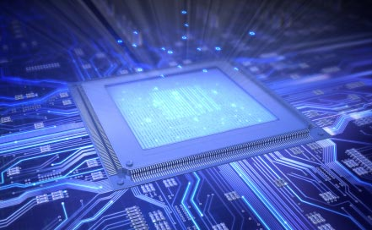
Results Summary
Speedup
Best software to best ISEs gives 4.86x speedup.
Compared to pipelined FPU, we are 1.42x
Area Of Baseline to ISE version
Memory increases 0.8%
LUTs increase 7.8%
Slices increase 3%
Energy
ISEs use 71% less energy of the pure software execution energy with twice area usage.
ISEs use 35% less energy than FPU

Slide 29
Conclusion & Future Work
We have made a case for DTW in real world sensor networks.
With the benefits of DTW ASIPs we can expect to get 4.87 times faster results with 78% less energy.
Investigate root cause for loss of precision in fixed-point calculations.
Determine best (numerical) strategy for embedded computation space.
Extend ISE identification to consider floating-point calculations as a practical candidate for ASIPs.
Build a lighter weight microcontroller to handle fixed and floating-point computations.

Slide 30

Questions

