Slide 1

Accelerating the Dynamic Time Warping Distance Measure Using Logarithmic Arithmetic
Joseph Tarango, Eamonn Keogh, Philip Brisk
{jtarango,eamonn,philip}@cs.ucr.edu
http://www.cs.ucr.edu/~{jtarango,eamonn,philip}

Slide 2
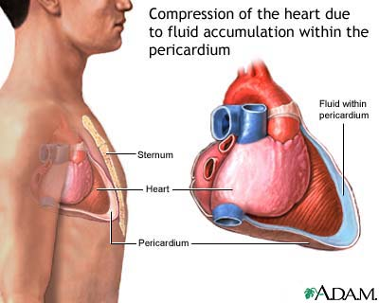
Motivation
100% fatality rate if left untreated
Influx of fluid raises the heart muscle’s perfusion threshold
Heart starves for oxygen and stops pumping blood
Easy to treat
Puncture pericardium and drain fluid
Hard to detect
People are not (yet?) born with integrated sensors
Stringent real-time constraints between onset and death
https://gs1.wac.edgecastcdn.net/8019B6/data.tumblr.com/tumblr_loeis9vfDe1qi4jh5o1_400.jpg

Slide 3
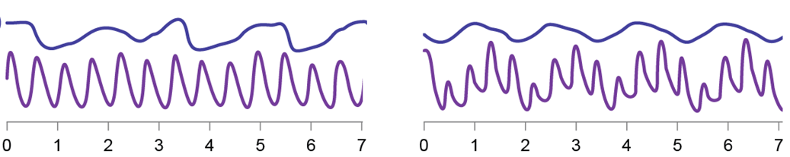

Pulsus Paradoxus
Normal
Pulsus Paradoxus
Respiration
PPG
(Photoplethysmographic)
Pulse shows interference from respiration
Under pericardial tamponade, inhalation reduces the heart’s ability to pump blood
Real-time detection is computationally tractable on a bedside device at the hospital
We need more efficient solutions for real-time monitoring

Slide 4
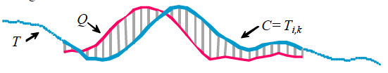
Time Series (Formal Definition)
Ordered sequence of data points
  T = (t₁, t₂, …, t_{m})
In the online context, consider a subsequence
  T_{i,k} = (t_{i}, t_{i+1}, …, t_{i+k})
Query
Candidate
C = T_{i,k}
Q
T

Slide 5
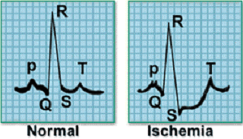
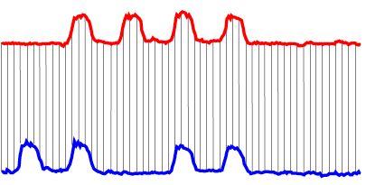

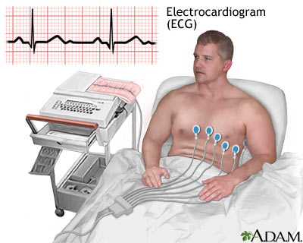
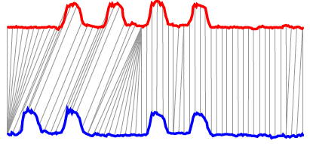

Time Series Similarity
Euclidean Distance (ED)
Dynamic Time Warping (DTW)

Slide 6
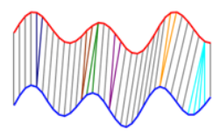

DTW
Conceptual Idea:
Enumerate all possible warping paths
Choose the one of minimum cost
Implementation:
Dynamic programming computes an optimal solution in quadratic time
C
Q

Slide 7
The Case for DTW
“… similarity search is the bottleneck for virtually all time series data mining algorithms.” [SIGKDD 2012]
“After an exhaustive literature search of more than 800 papers [PVLDB 2008], we are not aware of any distance measure that has been shown to outperform DTW by a statistically significant amount on reproducible experiments.” [SIGKDD 2012]
“We can exactly search under DTW much faster than the current state-of-the-art Euclidean distance search algorithms.” [SIGKDD 2012]

Slide 8
Objective and Contribution
Design application-specific DTW processor with HW acceleration
  Performance
  Energy consumption
  Start with highly optimized DTW software [SIGKDD 2012]
  Double-precision floating-point arithmetic written in C
  Prior work [CODES-ISSS 2013]
  DTW processor derived from SIGKDD software
This talk: DTW processor using logarithmic number systems (LNS)
  Higher performance
  Reduced energy consumption
  Reduced area

Slide 9
Logarithmic Number System (LNS)
Represent X as logX
The good news
  log(XY) = logX + logY (fixed-point +)
  log(X/Y) = logX – logY (fixed-point -)
  log(X^{n}) = nlogX (fixed-point *)
  log(X^{1/n}) = (1/n)*logX (fixed-point /)
The bad news
  log(X ± Y) = logX + log(1 ± 2^{logB – logA}) (ROM)
  Conversion to/from LNS (log/exp)

Slide 10
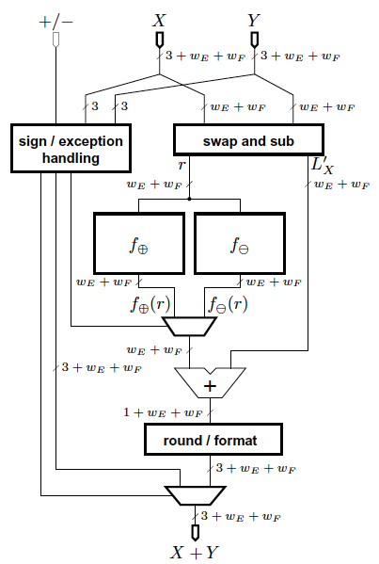
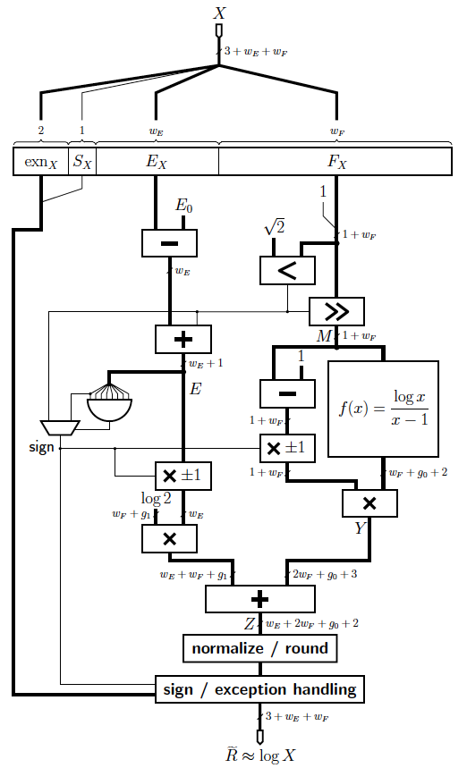
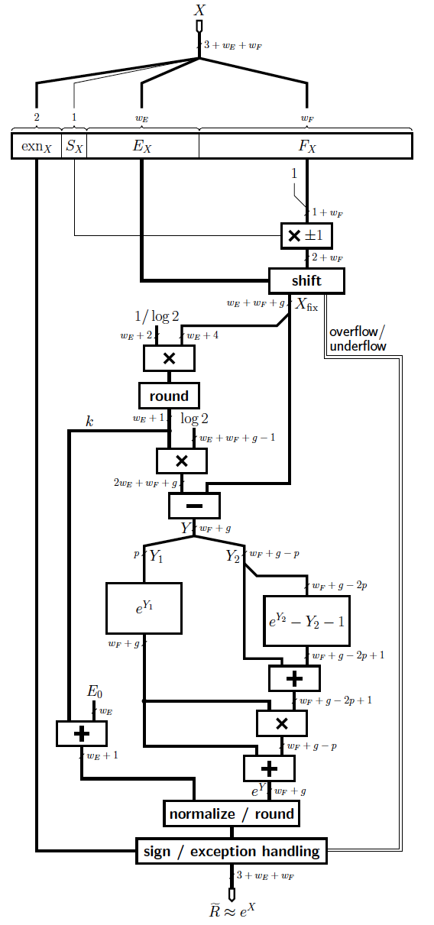
LNS Operators
Based on work by F. de Dinechin and J. Detrey
[Asilomar 2003, 2005; ASAP 2005; DSD 2005; JMM 2006]

Slide 11





Z-Normalization
C
C
C
C
Q
Q
Q
Q
Arithmetic Mean
[SIGKDD 2012, CODES-ISSS 2013]
Geometric Mean
(Good for LNS)

Slide 12
Bounding Warp Paths and LB_Keogh
C
U
Q
U_{i} = max(q_{i-r} : q_{i+r})
L_{i} = min(q_{i-r} : q_{i+r})
Q
L
Sakoe-Chiba Band
C
U
Q
L
DTW < threshold ==> Match
If LB_Keogh > threshold, then DTW > threshold
No match ==> no need to compute DTW

Slide 13

Early Abandoning, Reordering and Reversing the Query/Candidate
Stop as soon as you exceed the threshold

Slide 14
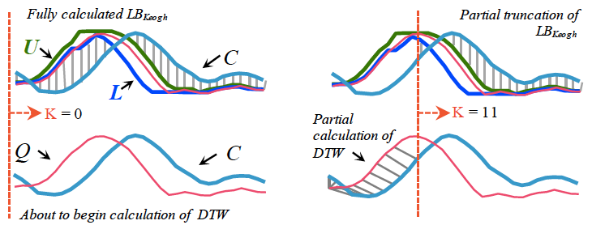


Early Abandoning DTW

Slide 15
Cascading Lower Bounds
LB_KimFL
A and D O(1) Time
LB_Kim
A, B, C, D O(n) Time
C
A
D
B
Tightness of lower bound

Slide 16
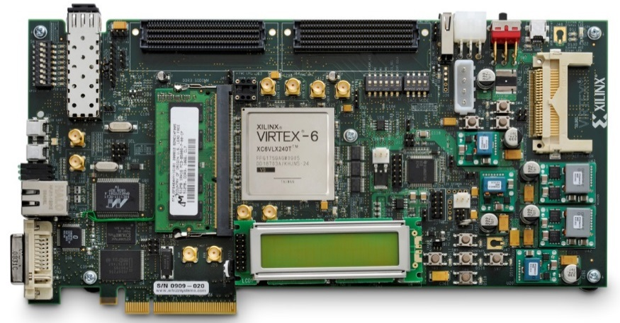
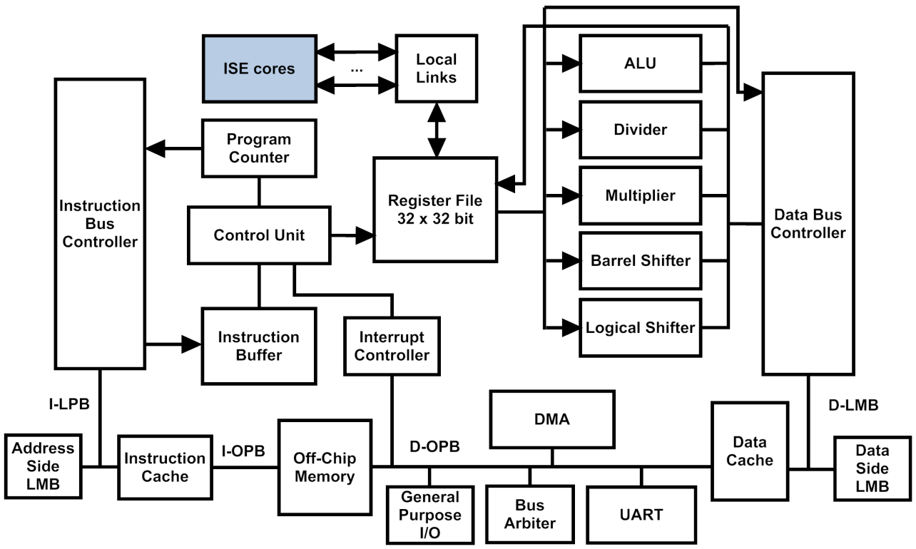
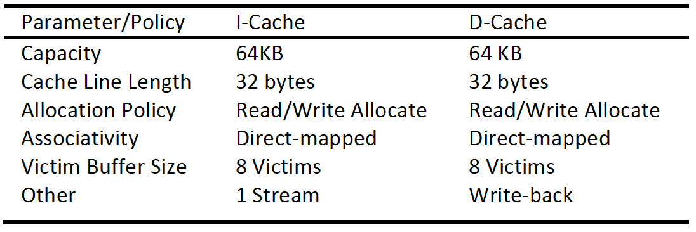
Experimental Platform
Xilinx EK-V6-ML605-G
Microblaze Processor
  1 core, 100 MHz
  Integer divider
  64-bit multiplier
  2048-bit branch target cache
Cache Configuration

Slide 17
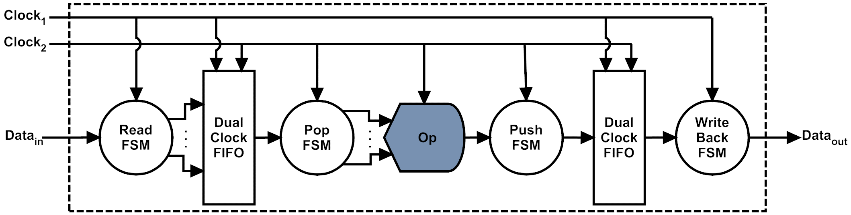
ISE I/O Interface
MicroBlaze operates on 32-bit data
  Double-precision FP / LNS use 64-bit data
  2 cycles to transfer each operand to/from the ISE

Slide 18
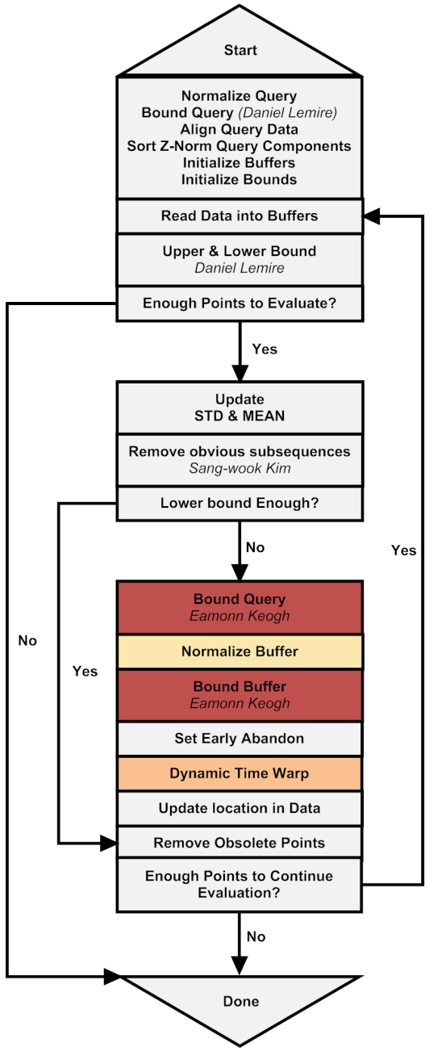
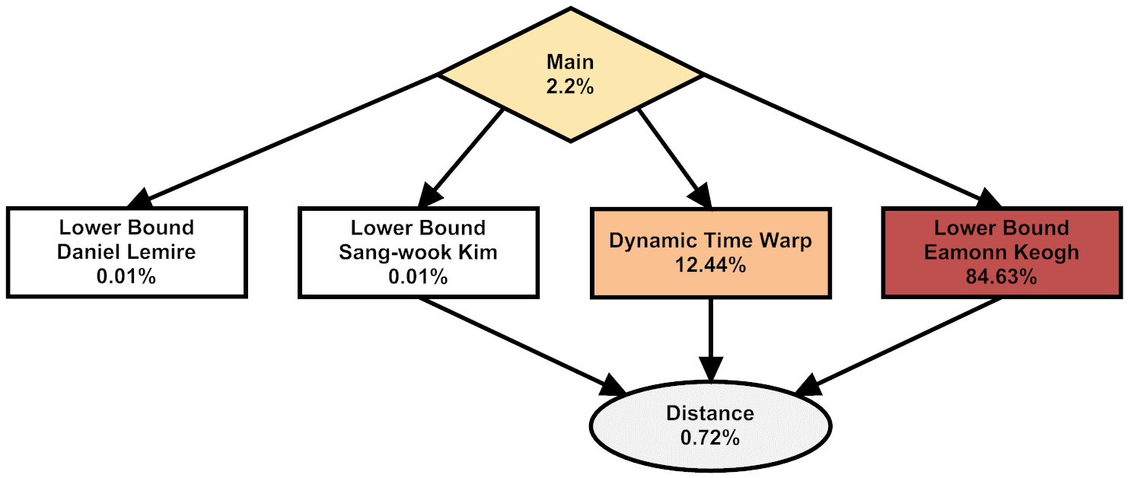
Software Profile
Four instruction set extensions
ISE-Norm (Normalization)
ISE-DTW (DTW)
ISE-ACCUM (Accumulation)
ISE-ED (Euclidean Distance)
[CODES-ISSS 2013]

Slide 19
FP vs. LNS Operators and ISEs
Latency
FP
LNS
ADD/SUB
MUL
DIV
ISE-Norm
ISE-DTW
ISE-Accum
ISE-ED
ALU Ops
ISEs
LNS operator latency is dominated by data transfer overhead
FP operator latency is dominated by the operator

Slide 20
FP vs. LNS Operators and ISEs
Area (FPGA Resources)
ADD/SUB
MUL
DIV
ISE-Norm
ISE-DTW
ISE-Accum
ISE-ED
ALU Ops
ISEs
LUT FFs
Slice LUTs
Slice Regs
LNS operators are significantly smaller

Slide 21
Speedup
(Normalized to Baseline MicroBlaze)
gcc at optimization level –O3 used for all experiments
FP ISE operators are pipelined
LNS-based ISEs offer higher performance than FP ISEs

Slide 22
Energy Consumption (Joules)
Baseline
Baseline + FPU
Baseline + FP ISEs
Baseline + LNS ISEs
gcc –O3 used in all experiments reported here

Slide 23
Conclusion and Future Work
LNS vs. Floating-point Instruction Set Extensions for DTW Processor
  Faster (8.7x vs. 4.9x)
  More energy efficient (8.5x vs. 4.7x)
  Cheaper (FP ISEs are 3.6x larger than LNS)
Future Work
  Vary the precision of arithmetic operators
  Scale up the system
    More candidates
    More queries
    More cores (more ISEs? shared ISEs? Etc.)

