Slide 1
Multiple Sequence Alignment

Slide 2
Outline
Dynamic Programming in 3-D
Progressive Alignment
Popular Progressive Alignment (ClustalW)
Scoring Multiple Alignment
Entropy
Sum of Pairs Alignment
Tree Alignment
Partial Order Alignment (POA)
A-Bruijin (ABA) Approach to Multiple Alignment

Slide 3


Multiple Alignment versus Pairwise Alignment
Up until now we have only tried to align two sequences.

Slide 4


Multiple Alignment versus Pairwise Alignment
Up until now we have only tried to align two sequences.
What about more than two? And what for?

Slide 5
Multiple Alignment versus Pairwise Alignment
Up until now we have only tried to align two sequences.
What about more than two? And what for?
A faint similarity between two sequences becomes significant if present in many.
Multiple sequence alignment can reveal subtle similarities that pairwise alignment does not reveal.

Slide 6
Generalizing the Notion of Pairwise Alignment
Alignment of 2 sequences is represented as a
2-row matrix
In a similar way, we represent alignment of 3 sequences as a 3-row matrix
A T _ G C G _
A _ C G T _ A
A T C A C _ A
Score: more conserved columns, better alignment

Slide 7
Alignments = Paths in…
Align 3 sequences: ATGC, AATC,ATGC
 | A | -- | T | G | C
 | A | A | T | -- | C
 | -- | A | T | G | C

Slide 8
Alignment Paths
0 | 1 | 1 | 2 | 3 | 4
x coordinate
 | A | -- | T | G | C
 | A | A | T | -- | C
 | -- | A | T | G | C

Slide 9
Alignment Paths
Align the following 3 sequences:
ATGC, AATC,ATGC
0 | 1 | 1 | 2 | 3 | 4
x coordinate
 | A | -- | T | G | C
0 | 1 | 2 | 3 | 3 | 4
y coordinate
 | A | A | T | -- | C
 | -- | A | T | G | C

Slide 10
Alignment Paths
0 | 1 | 1 | 2 | 3 | 4
x coordinate
 | A | -- | T | G | C
0 | 1 | 2 | 3 | 3 | 4
y coordinate
 | A | A | T | -- | C
0 | 0 | 1 | 2 | 3 | 4
z coordinate
 | -- | A | T | G | C
Resulting path in (x,y,z) space:
(0,0,0)→(1,1,0)→(1,2,1) →(2,3,2) →(3,3,3) →(4,4,4)

Slide 11
Aligning Three Sequences
source
Same strategy as aligning two sequences
Use a 3-D “Manhattan Cube”, with each axis representing a sequence to be aligned
For global alignment, go from source to sink
sink

Slide 12
2-D vs 3-D Alignment Grid
V
W
2-D edit graph
3-D edit graph

Slide 13
2-D Cell versus 2-D Alignment Cell
In 2-D, 3 edges in each unit square
In 3-D, 7 edges in each unit cube

Slide 14
Architecture of 3-D Alignment Cell
(i-1,j-1,k-1)
(i-1,j,k-1)
(i-1,j-1,k)
(i-1,j,k)
(i,j,k-1)
(i,j-1,k-1)
(i,j-1,k)
(i,j,k)

Slide 15
Multiple Alignment: Dynamic Programming
cube diagonal: no indels
s_{i,j,k} = max
δ(x, y, z) is an entry in some given 3-D scoring matrix/function
s_{i-1,j-1,k-1} + δ(v_{i}, w_{j}, u_{k})
s_{i-1,j-1,k} + δ (v_{i}, w_{j}, _ )
s_{i-1,j,k-1} + δ (v_{i}, _, u_{k})
s_{i,j-1,k-1} + δ (_, w_{j}, u_{k})
s_{i-1,j,k} + δ (v_{i}, _ , _)
s_{i,j-1,k} + δ (_, w_{j}, _)
s_{i,j,k-1} + δ (_, _, u_{k})
face diagonal: one indel
cube edge: two indels

Slide 16
DP Multiple Alignment: Running Time
For 3 sequences of length n each, the running time is 7n³; O(n³)
For k sequences, build a k-dimensional Manhattan cube, with running time (2^{k}-1)(n^{k}); O(2^{k}n^{k})
Conclusion: The dynamic programming approach for alignment between two sequences is easily extended to k sequences but it is impractical due to exponential running time. Some branch-and-bound technique can be applied to save time (like in algorithm MSA)

Slide 17
Multiple Alignment Induces Pairwise Alignments
Every multiple alignment induces pairwise alignments
x: AC-GCGG-C
y: AC-GC-GAG
z: GCCGC-GAG
Induces:
x: ACGCGG-C; x: AC-GCGG-C; y: AC-GCGAG
y: ACGC-GAC; z: GCCGC-GAG; z: GCCGCGAG

Slide 18
Reverse Problem: Constructing a Multiple Alignment from Pairwise Alignments
Given 3 arbitrary pairwise alignments:
x: ACGCTGG-C; x: AC-GCTGG-C; y: AC-GC-GAC
y: ACGC--GAC; z: GCCGCA-GAG; z: GCCGCAGAG
Can we construct a multiple alignment that induces
them?

Slide 19
Reverse Problem: Constructing a Multiple Alignment from Pairwise Alignments
Given 3 arbitrary pairwise alignments:
x: ACGCTGG-C; x: AC-GCTGG-C; y: AC-GC-GAG
y: ACGC--GAC; z: GCCGCA-GAG; z: GCCGCAGAG
can we construct a multiple alignment that induces
them?
NOT ALWAYS
Pairwise alignments may be inconsistent

Slide 20
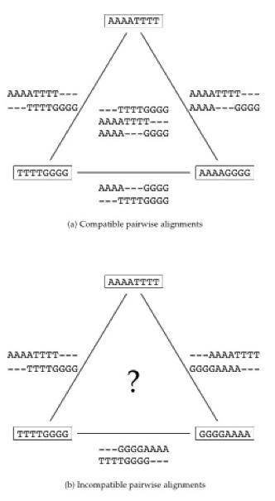
Combining Optimal Pairwise Alignments into a Consistent Multiple Alignment
Can combine pairwise alignments into a multiple alignment
Can not combine pairwise alignments into any consistent multiple alignment

Slide 21
Constructing Multiple Alignment from Pairwise Alignments
From an optimal multiple alignment, we can induce pairwise alignments between all pairs of sequences, although they are not necessarily optimal
It is difficult to infer a ``good” multiple alignment from optimal pairwise alignments between all sequences; but practical multiple alignment algorithms are still based on optimal pairwise alignments

Slide 22
Profile Representation of Multiple Alignment
- A G G C T A T C A C C T G
T A G – C T A C C A - - - G
C A G – C T A C C A - - - G
C A G – C T A T C A C – G G
C A G – C T A T C G C – G G
A 1 1 .8
C .6 1 .4 1 .6 .2
G 1 .2 .2 .4 1
T .2 1 .6 .2
- .2 .8 .4 .8 .4

Slide 23
Profile Representation of Multiple Alignment
- A G G C T A T C A C C T G
T A G – C T A C C A - - - G
C A G – C T A C C A - - - G
C A G – C T A T C A C – G G
C A G – C T A T C G C – G G
A 1 1 .8
C .6 1 .4 1 .6 .2
G 1 .2 .2 .4 1
T .2 1 .6 .2
- .2 .8 .4 .8 .4
In the past we were aligning a sequence against a sequence
Can we align a sequence against a profile (as a probabilistic sequence)?
Can we align a profile against a profile?

Slide 24
Aligning Alignments
Given two alignments, can we align them?
Hint: We can think of each column as a probabilistic letter.
x GGGCACTGCAT
y GGTTACGTC-- Alignment 1
z GGGAACTGCAG
w GGACGTACC Alignment 2
v GGACCT---

Slide 25
Aligning Alignments
Given an alignment of two alignments, how do we score it?
Hint: think of each alignment as a profile or sequence of probabilistic letters
x GGGCACTGCAT
y GGTTACGTC--
z GGGAACTGCAG Combined (pairwise) alignment
w GGACGTACC--
v GGACCT-----

Slide 26
Multiple Alignment: Greedy Approach
Choose most similar pair of strings and combine into a profile, thereby reducing alignment of k sequences to an alignment of of k-1 sequences/profiles. Repeat.
This is a heuristic greedy method.
u₁= ACGTACGTACGT…
u₂ = TTAATTAATTAA…
u₃ = ACTACTACTACT…
…
u_{k} = CCGGCCGGCCGG
u₁= ACg/-TACg/tTACg/cT…
u₂ = TTAATTAATTAA…
…
u_{k} = CCGGCCGGCCGG…
k-1
k

Slide 27
Greedy Approach: Example
Consider these 4 sequences
s1 GATTCA
s2 GTCTGA
s3 GATATT
s4 GTCAGC

Slide 28
Greedy Approach: Example (cont’d)
There are = 6 possible alignments. Using
the score: match = 1 and mismatch/indel = -1.
s2 GTCTGA
s4 GTCAGC (score = 2)
s1 GAT-TCA
s2 G-TCTGA (score = 1)
s1 GAT-TCA
s3 GATAT-T (score = 1)
s1 GATTCA--
s4 G—T-CAGC (score = 0)
s2 G-TCTGA
s3 GATAT-T (score = -1)
s3 GAT-ATT
s4 G-TCAGC (score = -1)

Slide 29
Greedy Approach: Example (cont’d)
s₂ and s₄ are closest; combine:
s2 GTCTGA
s4 GTCAGC
s_{2,4} GTCt/aGa/c (profile)
new set of 3 sequences:
s₁ GATTCA
s₃ GATATT
s_{2,4} GTCt/aGa/c

Slide 30
Progressive Alignment
Progressive alignment is a variation of greedy algorithm with a somewhat more intelligent strategy for choosing the order of alignments
Progressive alignment works well for closely related sequences, but deteriorates for distant sequences
  Gaps in alignments are permanent
  Use profiles to compare alignments

Slide 31
ClustalW
One of the popular multiple alignment tools (cited 75968/33175 times as of 4/30/2025)
‘W’ stands for ‘weighted’ (different parts of the alignment are weighted differently)
Three-step process
  1. Construct pairwise alignments
  2. Build guide tree
  3. Progressive alignment guided by the tree

Slide 32
Step 1: Pairwise Alignment
Align the sequences against each other, giving a similarity matrix
Similarity = exact matches / sequence length (percent identity)
v₁ v₂ v₃ v₄
v₁ -
v₂ .17 -
v₃ .87 .28 -
v₄ .59 .33 .62 -
(.17 means 17 % identical)

Slide 33
Step 2: Guide Tree
Create Guide Tree using the similarity matrix
  ClustalW uses the neighbor-joining method
  Guide tree roughly reflects evolutionary relationship

Slide 34
Step 2: Guide Tree (cont’d)
v₁
v₃
v₄
v₂
v₁ v₂ v₃ v₄
v₁ -
v₂ .17 -
v₃ .87 .28 -
v₄ .59 .33 .62 -
Calculate:
v_{1,3} = alignment (v₁, v₃)
v_{1,3,4} = alignment((v_{1,3}),v₄)
v_{1,2,3,4} = alignment((v_{1,3,4}),v₂)

Slide 35
Step 3: Progressive Alignment
Start by aligning the two sibling sequences
Following the guide tree, align more sequences or previously constructed alignments
Insert gaps as necessary
FOS_RAT PEEMSVTS-LDLTGGLPEATTPESEEAFTLPLLNDPEPK-PSLEPVKNISNMELKAEPFD
FOS_MOUSE PEEMSVAS-LDLTGGLPEASTPESEEAFTLPLLNDPEPK-PSLEPVKSISNVELKAEPFD
FOS_CHICK SEELAAATALDLG----APSPAAAEEAFALPLMTEAPPAVPPKEPSG--SGLELKAEPFD
FOSB_MOUSE PGPGPLAEVRDLPG-----STSAKEDGFGWLLPPPPPPP-----------------LPFQ
FOSB_HUMAN PGPGPLAEVRDLPG-----SAPAKEDGFSWLLPPPPPPP-----------------LPFQ
. . : ** . :.. *:.* * . * **:
Dots and stars show how well-conserved a column is.
Both sequences and regional gaps are weighted. Deeper sequences and gaps in loops are down-weighted and gaps near other gaps are up-weighted.

Slide 36
Multiple Alignment: Scoring
Number of matches (multiple longest common subsequence score)
Entropy score
Sum of pairs (SP-score)
Tree score

Slide 37
Multiple LCS Score
A column is a “match” if all the letters in the column are the same
Only good for very similar sequences
AAA
AAA
AAT
ATC

Slide 38
Entropy
Consider the frequency of every letter in each column of multiple alignment
  p_{A} = 1, p_{T}=p_{G}=p_{C}=0 (1st column)
  p_{C} = 0.75, p_{A} = 0.25, p_{G}=p_{T}=0 (2nd column)
  p_{A} = 0.25, p_{T} = 0.25, p_{C}=0.25 p_{G}=0.25 (3rd column)
Compute entropy of each column
AAA
ACT
ACG
ACC

Slide 39
Entropy: Example
Best case
Worst case

Slide 40
Multiple Alignment: Entropy Score
Entropy for a multiple alignment is the sum of entropies of its columns:
Σ _{over all columns} Σ _{X=A,T,G,C} p_{X} logp_{X}
This could be used to score pairwise alignment of profiles.

Slide 41
Entropy of an Alignment: Example
column entropy:
-( p_{A}logp_{A} + p_{C}logp_{C} + p_{G}logp_{G} + p_{T}logp_{T})
A | A | A
A | C | C
A | C | G
A | C | T
Column 1 = -[1*log(1) + 0*log0 + 0*log0 +0*log0]
= 0
Column 2 = -[(¹/₄)*log(¹/₄) + (³/₄)*log(³/₄) + 0*log0 + 0*log0]
= -[ (¹/₄)*(-2) + (³/₄)*(-.415) ] = +0.811
Column 3 = -[(¹/₄)*log(¹/₄)+(¹/₄)*log(¹/₄)+(¹/₄)*log(¹/₄) +(¹/₄)*log(¹/₄)] = 4* -[(¹/₄)*(-2)] = +2.0
Alignment entropy = 0 + 0.811 + 2.0 = +2.811
Note that we want to minimize the entropy (cost).

Slide 42
Multiple Alignment Induces Pairwise Alignments
Every multiple alignment induces pairwise alignments
x: AC-GCGG-C
y: AC-GC-GAG
z: GCCGC-GAG
Induces:
x: ACGCGG-C; x: AC-GCGG-C; y: AC-GCGAG
y: ACGC-GAG; z: GCCGC-GAG; z: GCCGCGAG

Slide 43
Derive Pairwise Alignments from a Multiple Alignment
From a multiple alignment, we can derive pairwise alignments between all sequences, although they are not necessarily optimal
This is like projecting a 3-D multiple alignment path on to a 2-D face of the cube

Slide 44
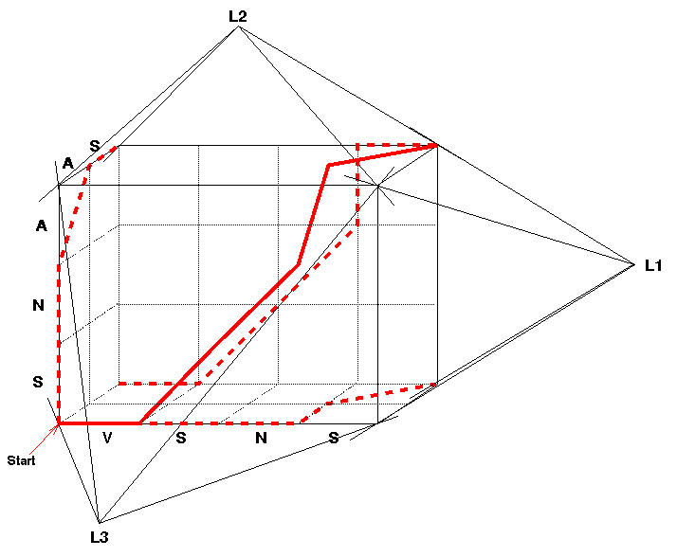
Multiple Alignment Projections
A 3-D alignment can be projected onto the 2-D plane to represent an alignment between a pair of sequences.
All 3 pairwise projections of the multiple alignment

Slide 45
Sum-of-Pairs Score (SP-Score)
Consider pairwise alignment of sequences
a_{i} and a_{j}
induced from a multiple alignment of k sequences
Denote the score of this suboptimal (not necessarily optimal) pairwise alignment as
s*(a_{i}, a_{j})
Sum up the pairwise scores as the score of the multiple alignment:
s(a₁,…,a_{k}) = Σ_{i<j} s*(a_{i}, a_{j})

Slide 46
Computing SP-Score
Aligning 4 sequences: 6 pairwise alignments
Given a multiple alignment of sequences a₁,a₂,a₃,a₄:
s(a₁…a₄) = Σs*(a_{i},a_{j}) = s*(a₁,a₂) + s*(a₁,a₃)
+ s*(a₁,a₄) + s*(a₂,a₃)
+ s*(a₂,a₄) + s*(a₃,a₄)
Affine gap penalty can be easily incorporated

Slide 47
Alternative Definition of SP-Score (columns are treated independently and no affine gaps)
a₁
.
a_{k}
ATG-C-AAT
A-G-CATAT
ATCCCATTT
To calculate the score of each column :
(
x
,...,
x
)
1
k
⎛
⎞
s
s*(
k
pairs of letters
⎜
⎟
⎜
⎟
2
⎝
⎠
Here s* represents the given score between two letters.
A
G
1
Score=3
1
1
−μ
Score=1–2μ
A
1
A
C
−μ
G
Column 1
Column 3
This is actually equivalent to scores used in a profile alignment.

Slide 48
Tree-Score
ATG-C-AAT
A-G-CATAT
ATCCCATTT
y
x
To calculate the tree-score of the 3rd column, we need to find nucleotides (or spaces) x and y such that the following sum is maximized:
s(G,y) + s(G,y) + s(y,x) + s(C,x)
This maximum sum is the tree-score of the 3rd column, and can be computed by dynamic programming (aka the small parsimony problem).

Slide 49
Theorem
Multiple alignment with any of these scores is NP-hard (Wang and Jiang’94).
Multiple alignment with SP-cost can be approximated with ratio 2 (Gusfield’93; Bafna, Lawler and Pevzner’94) and multiple alignment with tree-cost has a polynomial-time approximation scheme (PTAS) (Wang, Jiang and Lawler’94).
Multiple alignment with LCS score cannot be approximated within ratio O( ) for some

Slide 50
Gusfield’s Center-Star Algorithm for Approximating SP-Cost
Let the sequences be a₁,…,a_{k} and denote their optimal multiple alignment SP-cost as c*(a₁,…,a_{k}).
For each i, let c_{i} = Σ_{j≠i} c(a_{i}, a_{j}), where c(a_{i}, a_{j}) denotes the optimal pairwise alignment cost between sequences a_{i} and a_{j}, and is a distance measure.
Fix an i that minimizes c_{i} and induce a multiple alignment from the optimal pairwise alignments between a_{i} and the rest of the sequences.
Theorem. Let c'(a₁,…,a_{k}) be the SP-cost of this multiple alignment. Then c'(a₁,…,a_{k}) ≤ (2 - 2/k) c*(a₁,…,a_{k}).
Proof. For any j, Σ_{h≠j} c*(a_{h}, a_{j}) ≥ c_{j} ≥ c_{i}. So, c*(a₁,…,a_{k}) = ½ Σ_{j} Σ_{h} c*(a_{h}, a_{j}) ≥ ½ Σ_{j} c_{j} ≥ k/2 c_{i}. Or, equivalently, c_{i} ≤ 2/k c*(a₁,…,a_{k}).
Assume the triangle inequality: c'(a_{h}, a_{j}) ≤ c'(a_{i}, a_{h}) + c'(a_{i}, a_{j}).
Hence, c'(a₁,…,a_{k}) = ½ Σ_{j} Σ_{h} c'(a_{h}, a_{j}) ≤ (k-1) Σ_{j} c' (a_{i}, a_{j}) (by the triangle inequality) = (k-1) Σ_{j} c(a_{i}, a_{j}) = (k-1) c_{i} ≤ (2 - 2/k) c*(a₁,…,a_{k}).
Open: Can SP-cost be approximated with a constant ratio less than 2?
a₁
a_{k}
a₂
…
a_{i}
…
a_{j}

Slide 51
The Lifting Algorithm for Approximating Tree-Cost of Wang-Jiang-Lawler
ATGCAAT
AGCATAT
ATCCCATTT
Let T be a given evolutionary tree whose leaves are labeled with sequences a₁,…,a_{k} and whose internal (ancestral) nodes are unlabeled.
Multiple alignment with the minimum tree-cost is equivalent to labeling each internal node with a sequence so that the total pairwise alignment cost on all edges of the tree T would be minimized.
The Lifting Algorithm: Lift a descendent leaf sequence to each internal node to achieve a minimum possible overall cost. This can be done by dynamic programming!
Theorem. The cost achieved by the lifting algorithm is at most twice of the optimal cost.
Proof. By averaging over all possible liftings and using the triangle inequality.
Note: This can be improved to a PTAS.

Slide 52
Multiple Alignment: History
1975 Sankoff
Formulated multiple alignment problem and gave dynamic programming solution
1988 Carrillo-Lipman
Branch-and-Bound approach for MSA
1990 Feng-Doolittle
Progressive alignment
1994 Thompson-Higgins-Gibson: ClustalW
Most popular multiple alignment program
1998 Morgenstern et al.: DIALIGN
Segment-based multiple alignment
2000 Notredame-Higgins-Heringa: T-coffee (cited 8949 times)
Using the library of pairwise alignments
2002/2013 MAFFT (cited 16736/41029 times)
2004 MUSCLE (cited 49112 times)
2005 ProbCons (cited 1494 times as of 5/1/2025)
What’s next?

Slide 53
Problems with Multiple Alignment
Multidomain proteins evolve not only through point mutations but also through domain duplications and domain recombinations
Although MSA is a 30 year old problem, there were no MSA approaches for aligning rearranged sequences (i.e., multi-domain proteins with shuffled domains) prior to 2002
Often impossible to align all protein sequences throughout their entire length

Slide 54
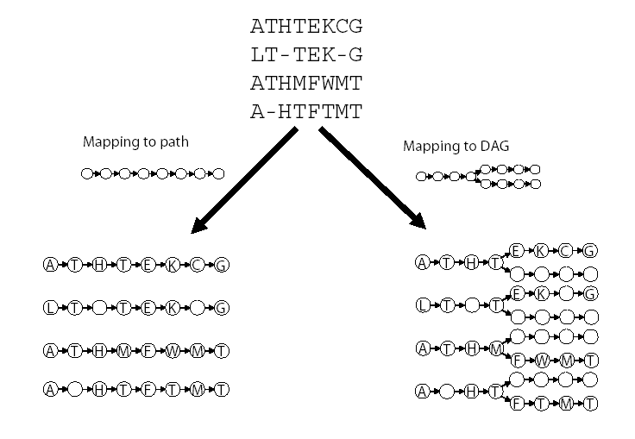
POA vs. Classical Multiple Alignment Approaches

Slide 55
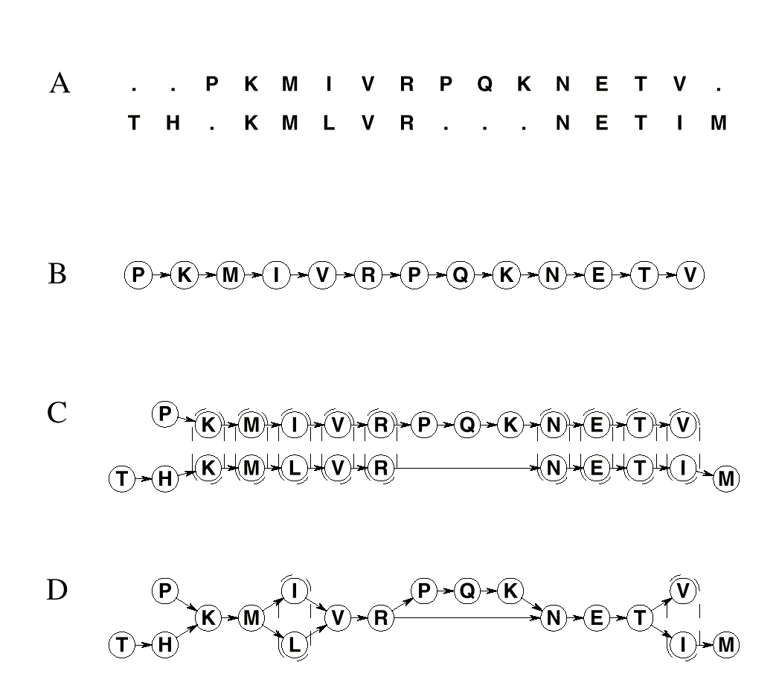
Alignment as a Graph
Conventional Alignment
Protein sequence as a path
Two paths
Combined graph (partial order) of both sequences

Slide 56
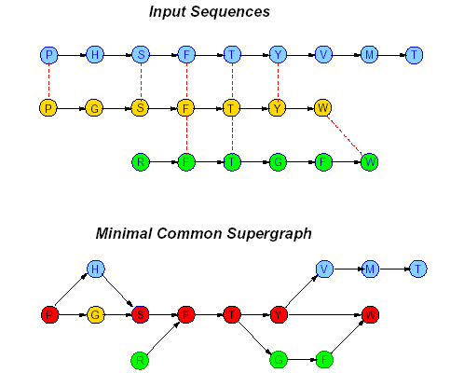
Solution: Representing Sequences as Paths in a Graph
Each protein sequence is represented by a path. Dashed edges connect “equivalent” positions; vertices with identical labels are fused.

Slide 57
Partial Order Multiple Alignment
Two objectives:
Find a graph that represents domain structure
Find mapping of each sequence to this graph
Solution
PO-MSA (Partial Order Multiple Sequence Alignment) – for a set of sequences S is a graph such that every sequence in S is a path in G.

Slide 58
Partial Order Alignment (POA) Algorithm
Aligns sequences onto a directed acyclic graph (DAG)
Guide Tree Construction
Progressive Alignment Following Guide Tree
Dynamic Programming Algorithm to align two PO-MSAs (PO-PO Alignment).

Slide 59
PO-PO Alignment
We learned how to align one sequence (path) against another sequence (path).
We need to develop an algorithm for aligning a directed graph against a directed graph.

Slide 60

Dynamic Programming for Aligning Two Directed Graphs
S(n,o) – the
optimal score
n: node in G
o: node in G’
Scoring:
match/mismatch: aligning two nodes with score s(n,o)
deletion/insertion:
  omitting node n from the alignment with score Δ(n)
  omitting node o with score Δ(o)

Slide 61
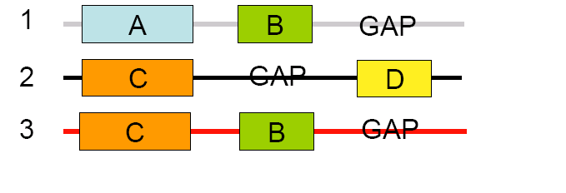
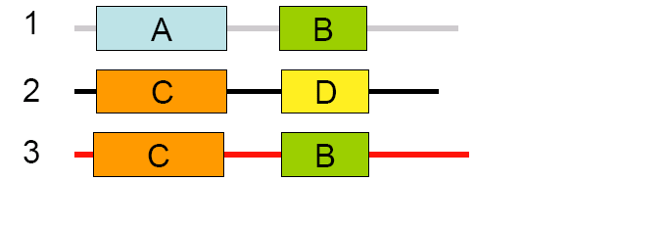
Row-Column Alignment
Input Sequences
Row-column
alignment

Slide 62
POA Advantages
POA is more flexible: standard methods force sequences to align linearly
PO-MSA representation handles gaps more naturally and retains (and uses) all information in the MSA (unlike linear profiles)

Slide 63
A-Bruijn Alignment (ABA)
POA- represents alignment as directed graph; no cycles
ABA - represents alignment as directed graph that may contains cycles

Slide 64
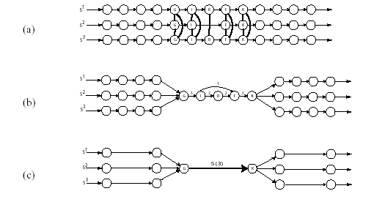
ABA

Slide 65
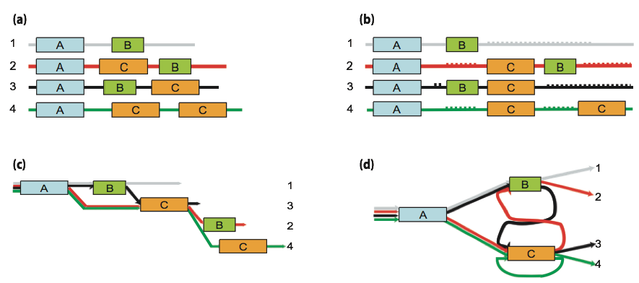
ABA vs. POA vs. MSA

Slide 66
Advantages of ABA
ABA more flexible than POA: allows larger class of evolutionary relationships between aligned sequences
ABA can align proteins that contain duplications and inversions
ABA can align proteins with shuffled and/or repeated domain structure
ABA can align proteins with domains present in multiple copies in some proteins

Slide 67
ABA: multiple alignments of protein
ABA handles:
Domains not present in all proteins
Domains present in different orders in different proteins

Slide 68
Credits
Chris Lee, POA, UCLA http://www.bioinformatics.ucla.edu/poa/Poa_Tutorial.html

