Slide 1
Finding Regulatory Motifs in DNA Sequences

Slide 2
Outline
Implanting Patterns in Random Text
Gene Regulation
Regulatory Motifs
The Motif Finding Problem
Brute Force Motif Finding
The Median String Problem
Search Trees
Branch-and-Bound Motif Search
Branch-and-Bound Median String Search
Consensus and Pattern Branching: Greedy Heuristics
PMS: Exhaustive Motif Search

Slide 3
Random Sample
atgaccgggatactgataccgtatttggcctaggcgtacacattagataaacgtatgaagtacgttagactcggcgccgccg acccctattttttgagcagatttagtgacctggaaaaaaaatttgagtacaaaacttttccgaatactgggcataaggtaca tgagtatccctgggatgacttttgggaacactatagtgctctcccgatttttgaatatgtaggatcattcgccagggtccga gctgagaattggatgaccttgtaagtgttttccacgcaatcgcgaaccaacgcggacccaaaggcaagaccgataaaggaga tcccttttgcggtaatgtgccgggaggctggttacgtagggaagccctaacggacttaatggcccacttagtccacttatag gtcaatcatgttcttgtgaatggatttttaactgagggcatagaccgcttggcgcacccaaattcagtgtgggcgagcgcaa cggttttggcccttgttagaggcccccgtactgatggaaactttcaattatgagagagctaatctatcgcgtgcgtgttcat aacttgagttggtttcgaaaatgctctggggcacatacaagaggagtcttccttatcagttaatgctgtatgacactatgta ttggcccattggctaaaagcccaacttgacaaatggaagatagaatccttgcatttcaacgtatgccgaaccgaaagggaag ctggtgagcaacgacagattcttacgtgcattagctcgcttccggggatctaatagcacgaagcttctgggtactgatagca

Slide 4
Implanting Motif AAAAAAAGGGGGGG
atgaccgggatactgatAAAAAAAAGGGGGGGggcgtacacattagataaacgtatgaagtacgttagactcggcgccgccg acccctattttttgagcagatttagtgacctggaaaaaaaatttgagtacaaaacttttccgaataAAAAAAAAGGGGGGGa tgagtatccctgggatgacttAAAAAAAAGGGGGGGtgctctcccgatttttgaatatgtaggatcattcgccagggtccga gctgagaattggatgAAAAAAAAGGGGGGGtccacgcaatcgcgaaccaacgcggacccaaaggcaagaccgataaaggaga tcccttttgcggtaatgtgccgggaggctggttacgtagggaagccctaacggacttaatAAAAAAAAGGGGGGGcttatag gtcaatcatgttcttgtgaatggatttAAAAAAAAGGGGGGGgaccgcttggcgcacccaaattcagtgtgggcgagcgcaa cggttttggcccttgttagaggcccccgtAAAAAAAAGGGGGGGcaattatgagagagctaatctatcgcgtgcgtgttcat aacttgagttAAAAAAAAGGGGGGGctggggcacatacaagaggagtcttccttatcagttaatgctgtatgacactatgta ttggcccattggctaaaagcccaacttgacaaatggaagatagaatccttgcatAAAAAAAAGGGGGGGaccgaaagggaag ctggtgagcaacgacagattcttacgtgcattagctcgcttccggggatctaatagcacgaagcttAAAAAAAAGGGGGGGa

Slide 5
Where is the Implanted Motif?
atgaccgggatactgataaaaaaaagggggggggcgtacacattagataaacgtatgaagtacgttagactcggcgccgccg acccctattttttgagcagatttagtgacctggaaaaaaaatttgagtacaaaacttttccgaataaaaaaaaaggggggga tgagtatccctgggatgacttaaaaaaaagggggggtgctctcccgatttttgaatatgtaggatcattcgccagggtccga gctgagaattggatgaaaaaaaagggggggtccacgcaatcgcgaaccaacgcggacccaaaggcaagaccgataaaggaga tcccttttgcggtaatgtgccgggaggctggttacgtagggaagccctaacggacttaataaaaaaaagggggggcttatag gtcaatcatgttcttgtgaatggatttaaaaaaaaggggggggaccgcttggcgcacccaaattcagtgtgggcgagcgcaa cggttttggcccttgttagaggcccccgtaaaaaaaagggggggcaattatgagagagctaatctatcgcgtgcgtgttcat aacttgagttaaaaaaaagggggggctggggcacatacaagaggagtcttccttatcagttaatgctgtatgacactatgta ttggcccattggctaaaagcccaacttgacaaatggaagatagaatccttgcataaaaaaaagggggggaccgaaagggaag ctggtgagcaacgacagattcttacgtgcattagctcgcttccggggatctaatagcacgaagcttaaaaaaaaggggggga

Slide 6
Implanting Motif AAAAAAGGGGGGG with Four Mutations
atgaccgggatactgatAgAAgAAAGGttGGGggcgtacacattagataaacgtatgaagtacgttagactcggcgccgccg acccctattttttgagcagatttagtgacctggaaaaaaaatttgagtacaaaacttttccgaatacAAtAAAAcGGcGGGa tgagtatccctgggatgacttAAAAtAAtGGaGtGGtgctctcccgatttttgaatatgtaggatcattcgccagggtccga gctgagaattggatgcAAAAAAAGGGattGtccacgcaatcgcgaaccaacgcggacccaaaggcaagaccgataaaggaga tcccttttgcggtaatgtgccgggaggctggttacgtagggaagccctaacggacttaatAtAAtAAAGGaaGGGcttatag gtcaatcatgttcttgtgaatggatttAAcAAtAAGGGctGGgaccgcttggcgcacccaaattcagtgtgggcgagcgcaa cggttttggcccttgttagaggcccccgtAtAAAcAAGGaGGGccaattatgagagagctaatctatcgcgtgcgtgttcat aacttgagttAAAAAAtAGGGaGccctggggcacatacaagaggagtcttccttatcagttaatgctgtatgacactatgta ttggcccattggctaaaagcccaacttgacaaatggaagatagaatccttgcatActAAAAAGGaGcGGaccgaaagggaag ctggtgagcaacgacagattcttacgtgcattagctcgcttccggggatctaatagcacgaagcttActAAAAAGGaGcGGa

Slide 7
Where is the Motif???
atgaccgggatactgatagaagaaaggttgggggcgtacacattagataaacgtatgaagtacgttagactcggcgccgccg acccctattttttgagcagatttagtgacctggaaaaaaaatttgagtacaaaacttttccgaatacaataaaacggcggga tgagtatccctgggatgacttaaaataatggagtggtgctctcccgatttttgaatatgtaggatcattcgccagggtccga gctgagaattggatgcaaaaaaagggattgtccacgcaatcgcgaaccaacgcggacccaaaggcaagaccgataaaggaga tcccttttgcggtaatgtgccgggaggctggttacgtagggaagccctaacggacttaatataataaaggaagggcttatag gtcaatcatgttcttgtgaatggatttaacaataagggctgggaccgcttggcgcacccaaattcagtgtgggcgagcgcaa cggttttggcccttgttagaggcccccgtataaacaaggagggccaattatgagagagctaatctatcgcgtgcgtgttcat aacttgagttaaaaaatagggagccctggggcacatacaagaggagtcttccttatcagttaatgctgtatgacactatgta ttggcccattggctaaaagcccaacttgacaaatggaagatagaatccttgcatactaaaaaggagcggaccgaaagggaag ctggtgagcaacgacagattcttacgtgcattagctcgcttccggggatctaatagcacgaagcttactaaaaaggagcgga

Slide 8
Why Finding (15,4) Motif is Difficult?
atgaccgggatactgatAgAAgAAAGGttGGGggcgtacacattagataaacgtatgaagtacgttagactcggcgccgccg acccctattttttgagcagatttagtgacctggaaaaaaaatttgagtacaaaacttttccgaatacAAtAAAAcGGcGGGa tgagtatccctgggatgacttAAAAtAAtGGaGtGGtgctctcccgatttttgaatatgtaggatcattcgccagggtccga gctgagaattggatgcAAAAAAAGGGattGtccacgcaatcgcgaaccaacgcggacccaaaggcaagaccgataaaggaga tcccttttgcggtaatgtgccgggaggctggttacgtagggaagccctaacggacttaatAtAAtAAAGGaaGGGcttatag gtcaatcatgttcttgtgaatggatttAAcAAtAAGGGctGGgaccgcttggcgcacccaaattcagtgtgggcgagcgcaa cggttttggcccttgttagaggcccccgtAtAAAcAAGGaGGGccaattatgagagagctaatctatcgcgtgcgtgttcat aacttgagttAAAAAAtAGGGaGccctggggcacatacaagaggagtcttccttatcagttaatgctgtatgacactatgta ttggcccattggctaaaagcccaacttgacaaatggaagatagaatccttgcatActAAAAAGGaGcGGaccgaaagggaag ctggtgagcaacgacagattcttacgtgcattagctcgcttccggggatctaatagcacgaagcttActAAAAAGGaGcGGa
AgAAgAAAGGttGGG
..|..|||.|..|||
cAAtAAAAcGGcGGG

Slide 9
(Old) Challenging Problem
Find a motif in a sample of
- 20 “random” sequences (e.g. 600 nt long)
- each sequence containing an implanted
pattern of length 15 (called motif instance)
- each pattern appearing with 4 mismatches
as a (15,4)-motif instance

Slide 10
Combinatorial Gene Regulation
A DNA microarray experiment showed that when gene X is knocked out, 20 other genes are not expressed (or transcribed)
How can one gene have such drastic effects?

Slide 11
Regulatory Proteins
Gene X encodes a regulatory protein, a.k.a. a transcription factor (TF)
The 20 unexpressed genes rely on gene X’s TF (or simply TF X) to induce transcription
A single TF may regulate multiple genes

Slide 12
Regulatory (or Control) Regions
Every gene contains a regulatory region (RR) typically stretching 100-1000 bps upstream of the transcriptional start site (TSS), also called the promoter that helps to initiate the transcription of the gene
Another kind of RRs are enhancers, which could stretch over 50 kbps and help activate or inhibit the transcription of genes
Located within the RRs are the Transcription Factor Binding Sites (TFBS’s), which are short string patterns, also known as motifs, specific to each transcription factor (TF)
Each TF influences gene expression by binding to its specific sites in the target genes’ RRs

Slide 13
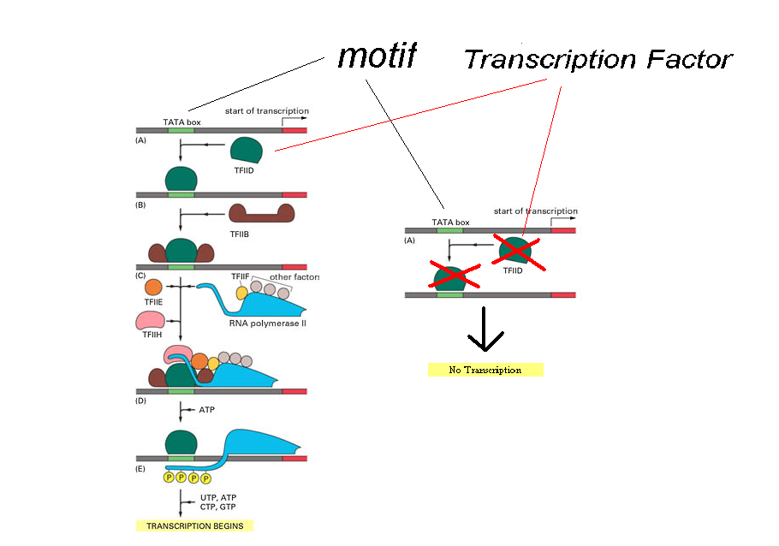
Transcription Factors and Motifs

Slide 14
Transcription Factor Binding Sites
A TFBS can be located anywhere within a
regulatory region
A TFBS may vary slightly across different regulatory regions (or even within the same promoter or enhancer) since non-essential bases could mutate

Slide 15
Motif as Transcription Factor Binding Sites
ATCCCG
gene
TTCCGG
gene
ATCCCG
gene
ATGCCG
gene
ATGCCC
gene

Slide 16
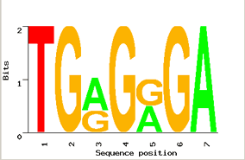
Motif Logos
TGGGGGA
TGAGAGA
TGGGGGA
TGAGAGA
TGAGGGA
Motifs can mutate on non- important bases
The five motif instances in five different (co-regulated) genes have mutations at positions 3 and 5
Representations called motif logos illustrate the conserved and variable regions of a motif

Slide 17
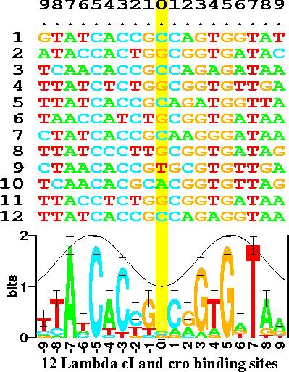
Motif Logos: An Example
(http://www-lmmb.ncifcrf.gov/~toms/sequencelogo.html)

Slide 18
Identifying Regulatory Motifs - Data
Genes are turned on or off by regulatory proteins (TFs)
These proteins bind to upstream regulatory regions (RRs) of genes to either attract or block the RNA polymerase
Each TF binds to certain short DNA sequences (TFBS’s) that form a motif
Since co-regulated genes may share the same motif, their RR sequences are collected for the search for a motif

Slide 19
Identifying Motifs: Complications
We do not know the motif sequence
We do not know where it is located relative to a gene’s transcription start site, if it occurs
A motif may appear slightly differently from one gene to another
How to discern it from “random” motifs?

Slide 20


A Motif Finding Analogy
The Motif Finding Problem is similar to the problem posed by Edgar Allan Poe (1809 – 1849) in his Gold Bug story

Slide 21
The Gold Bug Problem
Given a secret message:
53++!305))6*;4826)4+.)4+);806*;48!8`60))85;]8*:+*8!83(88)5*!;
46(;88*96*?;8)*+(;485);5*!2:*+(;4956*2(5*-4)8`8*; 4069285);)6
!8)4++;1(+9;48081;8:8+1;48!85;4)485!528806*81(+9;48;(88;4(+?3
4;48)4+;161;:188;+?;
Decipher the message encrypted in the fragment

Slide 22
Hints for The Gold Bug Problem
Additional hints:
The encrypted message is in English
Each symbol correspond to one letter in the English alphabet
No punctuation marks are encoded

Slide 23
The Gold Bug Problem: Symbol Counts
Naive approach to solving the problem:
Count the frequency of each symbol in the encrypted message
Find the frequency of each letter in the alphabet in the English language
Compare the frequencies of the previous steps, try to find a correlation and map the symbols to a letter in the alphabet

Slide 24
Symbol Frequencies in the Gold Bug Message
Gold Bug Message:
Symbol | 8 | ; | 4 | ) | + | * | 5 | 6 | ( | ! | 1 | 0 | 2 | 9 | 3 | : | ? | ` | - | ] | .
Frequency | 34 | 25 | 19 | 16 | 15 | 14 | 12 | 11 | 9 | 8 | 7 | 6 | 5 | 5 | 4 | 4 | 3 | 2 | 1 | 1 | 1
English Language:
e t a o i n s r h l d c u m f p g w y b v k x j q z
Most frequent Least frequent

Slide 25
The Gold Bug Message Decoding: First Attempt
By simply mapping the most frequent symbols to the most frequent letters of the alphabet:
sfiilfcsoorntaeuroaikoaiotecrntaeleyrcooestvenpinelefheeosnlt
arhteenmrnwteonihtaesotsnlupnihtamsrnuhsnbaoeyentacrmuesotorl
eoaiitdhimtaecedtepeidtaelestaoaeslsueecrnedhimtaetheetahiwfa
taeoaitdrdtpdeetiwt
The result does not make sense

Slide 26
The Gold Bug Problem: l-tuple count
A better approach:
Examine frequencies of l-tuples, combinations of 2 symbols, 3 symbols, etc.
“The” is the most frequent 3-tuple in English and “;48” is the most frequent 3-tuple in the encrypted text
Make inferences of unknown symbols by examining other frequent l-tuples

Slide 27
The Gold Bug Problem: the ;48 clue
Mapping “the” to “;48” and substituting all occurrences of the symbols:
53++!305))6*the26)h+.)h+)te06*the!e`60))e5t]e*:+*e!e3(ee)5*!t
h6(tee*96*?te)*+(the5)t5*!2:*+(th956*2(5*h)e`e*th0692e5)t)6!e
)h++t1(+9the0e1te:e+1the!e5th)he5!52ee06*e1(+9thet(eeth(+?3ht
he)h+t161t:1eet+?t

Slide 28
The Gold Bug Message Decoding: Second Attempt
Make inferences:
53++!305))6*the26)h+.)h+)te06*the!e`60))e5t]e*:+*e!e3(ee)5*!t
h6(tee*96*?te)*+(the5)t5*!2:*+(th956*2(5*h)e`e*th0692e5)t)6!e
)h++t1(+9the0e1te:e+1the!e5th)he5!52ee06*e1(+9thet(eeth(+?3ht
he)h+t161t:1eet+?t
“thet(ee” most likely means “the tree”
Infer “(“ = “r”
“th(+?3h” becomes “thr+?3h”
Can we guess “+” and “?”?

Slide 29
The Gold Bug Problem: The Solution
After figuring out all the mappings, the final message is:
AGOODGLASSINTHEBISHOPSHOSTELINTHEDEVILSSEATWENYONEDEGRE
ESANDTHIRTEENMINUTESNORTHEASTANDBYNORTHMAINBRANCHSEVENT HLIMBEASTSIDESHOOTFROMTHELEFTEYEOFTHEDEATHSHEADABEELINE
FROMTHETREETHROUGHTHESHOTFIFTYFEETOUT

Slide 30
The Solution (cont’d)
Punctuation is important:
A GOOD GLASS IN THE BISHOP’S HOSTEL IN THE DEVIL’S SEA,
TWENY ONE DEGREES AND THIRTEEN MINUTES NORTHEAST AND BY NORTH,
MAIN BRANCH SEVENTH LIMB, EAST SIDE, SHOOT FROM THE LEFT EYE OF
THE DEATH’S HEAD A BEE LINE FROM THE TREE THROUGH THE SHOT,
FIFTY FEET OUT.

Slide 31
Solving the Gold Bug Problem
Prerequisites to solve the problem:
Need to know the relative frequencies of single letters, and combinations of two and three letters in English
Knowledge of all the words in the English dictionary is highly desired to make accurate inferences

Slide 32
Motif Finding and The Gold Bug Problem: Similarities
Nucleotides in motifs encode for a message in the “genetic” language. Symbols in “The Gold Bug” encode for a message in English
In order to solve the problem, we analyze the frequencies of patterns in DNA/Gold Bug message.
Knowledge of established regulatory motifs makes the Motif Finding problem simpler. Knowledge of the words in the English dictionary helps to solve
the Gold Bug problem.

Slide 33
Similarities (cont’d)
Motif Finding:
In order to solve the problem, we analyze the frequencies of patterns in the nucleotide sequences
In order to solve the problem, we analyze the frequencies of patterns in the nucleotide sequences
Gold Bug Problem:
In order to solve the problem, we analyze the frequencies of patterns in the text written in English

Slide 34
Similarities (cont’d)
Motif Finding:
Knowledge of established motifs reduces the complexity of the problem
Gold Bug Problem:
Knowledge of the words in the dictionary is highly desirable

Slide 35
Motif Finding and The Gold Bug Problem: Differences
Motif Finding is harder than Gold Bug problem:
We don’t have the complete dictionary of motifs
The “genetic” language does not have a standard “grammar”
Only a small fraction of nucleotide sequences encode for motifs; the size of data is enormous

Slide 36
The Motif Finding Problem
Given a random sample of DNA sequences (e.g., RRs of co-regulated genes):
cctgatagacgctatctggctatccacgtacgtaggtcctctgtgcgaatctatgcgtttccaaccat
agtactggtgtacatttgatacgtacgtacaccggcaacctgaaacaaacgctcagaaccagaagtgc
aaacgtacgtgcaccctctttcttcgtggctctggccaacgagggctgatgtataagacgaaaatttt
agcctccgatgtaagtcatagctgtaactattacctgccacccctattacatcttacgtacgtataca
ctgttatacaacgcgtcatggcggggtatgcgttttggtcgtcgtacgctcgatcgttaacgtacgtc
Find the pattern that is implanted in each of the individual sequences, namely, the motif

Slide 37
The Motif Finding Problem (cont’d)
Additional information:
The hidden sequence is of length 8
The pattern is not exactly the same in each sequence because random point mutations may occur in the sequences
The pattern appears once in each sequence

Slide 38
The Motif Finding Problem (cont’d)
Patterns revealed with no mutations:
cctgatagacgctatctggctatccacgtacgtaggtcctctgtgcgaatctatgcgtttccaaccat
agtactggtgtacatttgatacgtacgtacaccggcaacctgaaacaaacgctcagaaccagaagtgc
aaacgtacgtgcaccctctttcttcgtggctctggccaacgagggctgatgtataagacgaaaatttt
agcctccgatgtaagtcatagctgtaactattacctgccacccctattacatcttacgtacgtataca
ctgttatacaacgcgtcatggcggggtatgcgttttggtcgtcgtacgctcgatcgttaacgtacgtc
acgtacgt
consensus string

Slide 39
The Motif Finding Problem (cont’d)
Patterns with 2 point mutations:
cctgatagacgctatctggctatccaGgtacTtaggtcctctgtgcgaatctatgcgtttccaaccat
agtactggtgtacatttgatCcAtacgtacaccggcaacctgaaacaaacgctcagaaccagaagtgc
aaacgtTAgtgcaccctctttcttcgtggctctggccaacgagggctgatgtataagacgaaaatttt
agcctccgatgtaagtcatagctgtaactattacctgccacccctattacatcttacgtCcAtataca
ctgttatacaacgcgtcatggcggggtatgcgttttggtcgtcgtacgctcgatcgttaCcgtacgGc

Slide 40
The Motif Finding Problem (cont’d)
Patterns with 2 point mutations:
cctgatagacgctatctggctatccaGgtacTtaggtcctctgtgcgaatctatgcgtttccaaccat
agtactggtgtacatttgatCcAtacgtacaccggcaacctgaaacaaacgctcagaaccagaagtgc
aaacgtTAgtgcaccctctttcttcgtggctctggccaacgagggctgatgtataagacgaaaatttt
agcctccgatgtaagtcatagctgtaactattacctgccacccctattacatcttacgtCcAtataca
ctgttatacaacgcgtcatggcggggtatgcgttttggtcgtcgtacgctcgatcgttaCcgtacgGc
Can we still find the motif, now that we have 2 mutations?

Slide 41
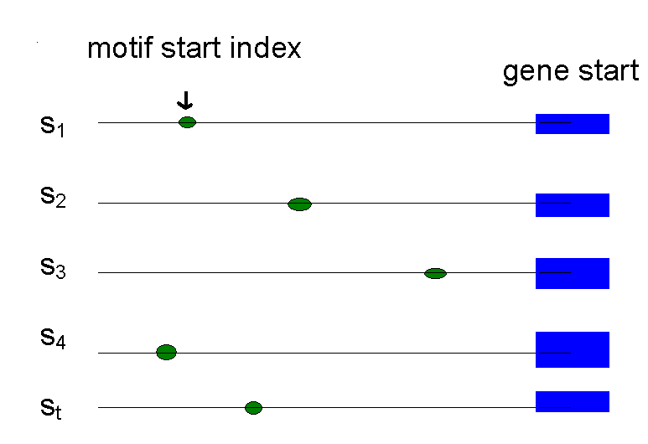
Representing Motifs
We consider the location of each occurrence of the motif (called a motif instance)
The motif start positions in all sequences are represented as s = (s₁,s₂,…,s_{t})
This is complete but not very intuitive

Slide 42
Motifs: Profiles and Consensus
a G g t a c T t
C c A t a c g t
Alignment a c g t T A g t
a c g t C c A t
C c g t a c g G
_________________
A 3 0 1 0 3 1 1 0
Profile C 2 4 0 0 1 4 0 0
G 0 1 4 0 0 0 3 1
T 0 0 0 5 1 0 1 4
_________________
Consensus A C G T A C G T
Line up the patterns given by their start indices
s = (s₁, s₂, …, s_{t})
Construct profile matrix with frequencies of each nucleotide in each column (also called PSSM or PWM)
Consensus nucleotide at each position has the highest frequency in the column

Slide 43
Consensus
Think of consensus as an “ancestral” motif instance, from which mutated motif instances emerged
The distance between a motif instance and the consensus sequence is generally less than that between two motif instances

Slide 44
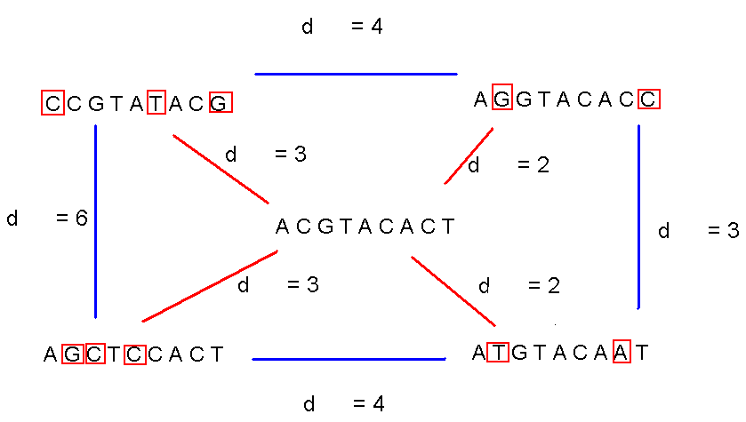
Consensus (cont’d)

Slide 45
Evaluating Motifs
We have a guess about the motif, but how “good” is this motif?
Need to introduce a scoring function to compare different guesses to allow us to choose the “best” one.

Slide 46
Defining Some Terms
t - number of sample DNA sequences
n - length of each DNA sequence
DNA - sample of (co-regulated) DNA sequences (t x n array of nucleotides)
l - length of the motif (l-mer)
s_{i} - starting position of the motif in sequence i
s = (s₁, s₂,…, s_{t}) - vector of motif’s starting positions

Slide 47
Parameters
cctgatagacgctatctggctatccaGgtacTtaggtcctctgtgcgaatctatgcgtttccaaccat
agtactggtgtacatttgatCcAtacgtacaccggcaacctgaaacaaacgctcagaaccagaagtgc
aaacgtTAgtgcaccctctttcttcgtggctctggccaacgagggctgatgtataagacgaaaatttt
agcctccgatgtaagtcatagctgtaactattacctgccacccctattacatcttacgtCcAtataca
ctgttatacaacgcgtcatggcggggtatgcgttttggtcgtcgtacgctcgatcgttaCcgtacgGc
l = 8
DNA
t=5
n = 69
s
s₁ = 26 s₂ = 21 s₃= 3 s₄ = 56 s₅ = 60

Slide 48
Scoring Motifs
l
Given s = (s₁, …, s_{t}) and DNA:
Score(s,DNA) =
a G g t a c T t
C c A t a c g t
a c g t T A g t
a c g t C c A t
C c g t a c g G
_________________
A 3 0 1 0 3 1 1 0
C 2 4 0 0 1 4 0 0
G 0 1 4 0 0 0 3 1
T 0 0 0 5 1 0 1 4
_________________
Consensus a c g t a c g t
Score 3+4+4+5+3+4+3+4=30
t

Slide 49
The Motif Finding Problem
If starting positions s=(s₁, s₂,… s_{t}) are given, finding consensus is easy even with mutations in the sequences because we can simply construct the profile matrix and find the resultant consensus
But… the starting positions s are usually not given. How can we find the “best” profile matrix or consensus?

Slide 50
The Motif Finding Problem: Formulation
Goal: Given a set of DNA sequences, find a set of l-mers, one from each sequence, that maximizes the consensus score
Input: A t x n matrix of DNA and l, the length of the pattern to find
Output: A vector of t starting positions s = (s₁, s₂, …, s_{t}) maximizing Score(s,DNA)

Slide 51
The Motif Finding Problem: Brute Force Solution
Compute the scores for each possible combination of starting positions s
The best score will determine the best motif (and thus the best profile and consensus pattern) in DNA
More specifically, we want to maximize Score(s,DNA) by varying the starting positions s_{i}, where:
s_{i} = [1, …, n-l+1]
i = [1, …, t]

Slide 52
BruteForceMotifSearch
BruteForceMotifSearch(DNA, t, n, l)
bestScore ← 0
for each s=(s₁,s₂, . . ., s_{t}) from (1,1, . . ., 1) to (n-l+1, . . ., n-l+1)
if (Score(s,DNA) > bestScore)
bestScore ← Score(s, DNA)
bestMotif ← (s₁,s₂ , . . . , s_{t})
return bestMotif

Slide 53
Running Time of BruteForceMotifSearch
Varying among (n - l + 1) positions in each of the t sequences, we’re looking at (n - l + 1)^{t} sets of starting positions
For each set of starting positions, the scoring function requires l operations, so the complexity is l (n – l + 1)^{t} = O(l n^{t})
It means that for t = 8, n = 1000, l = 10 we must perform approximately 10²⁵ computation steps – it will take billions of years

Slide 54
The Median String Problem
Given a set of t DNA sequences, find a pattern (string of length l ) that appears in all t sequences with the minimum number of mutations
This pattern (called a median string) will be the motif (i.e., as its consensus)

Slide 55
Hamming Distance
Hamming distance
d_{H}(v,w) is the number of nucleotide pairs that do not match when v and w are aligned. For example:
d_{H}(AAAAAA,ACAAAC) = 2

Slide 56
Total Distance: An Example
Given v = “acgtacgt”
acgtacgt
cctgatagacgctatctggctatccacgtacgtaggtcctctgtgcgaatctatgcgtttccaaccat
acgtacgt
agtactggtgtacatttgatacgtacgtacaccggcaacctgaaacaaacgctcagaaccagaagtgc
acgtacgt
aaacgtacgtgcaccctctttcttcgtggctctggccaacgagggctgatgtataagacgaaaatttt
acgtacgt
agcctccgatgtaagtcatagctgtaactattacctgccacccctattacatcttacgtacgtataca
acgtacgt
ctgttatacaacgcgtcatggcggggtatgcgttttggtcgtcgtacgctcgatcgttaacgtacgtc
v is the sequence in red, x is the sequence in blue
TotalDistance(v,DNA) = 0
d_{H}(v, x) = 0
d_{H}(v, x) = 0
d_{H}(v, x) = 0
d_{H}(v, x) = 0
d_{H}(v, x) = 0

Slide 57
Total Distance: Definition
Given an l-mer v, for each DNA sequence i, compute all d_{H}(v, x), where x is an l-mer with some starting position s_{i} (1 < s_{i} < n – l + 1)
Find the minimum of d_{H}(v, x) among all l-mers x in sequence i. This is the Hamming distance between v and sequence i
TotalDistance(v,DNA) is the sum of the minimum Hamming distances for each DNA sequence i
TotalDistance(v,DNA) = min_{s} d_{H}(v, s), where s is the set of starting positions s₁, s₂,…, s_{t}

Slide 58
Total Distance: Example
Given v = “acgtacgt”
acgtacgt
cctgatagacgctatctggctatccacgtacAtaggtcctctgtgcgaatctatgcgtttccaaccat
acgtacgt
agtactggtgtacatttgatacgtacgtacaccggcaacctgaaacaaacgctcagaaccagaagtgc
acgtacgt
aaaAgtCcgtgcaccctctttcttcgtggctctggccaacgagggctgatgtataagacgaaaatttt
acgtacgt
agcctccgatgtaagtcatagctgtaactattacctgccacccctattacatcttacgtacgtataca
acgtacgt
ctgttatacaacgcgtcatggcggggtatgcgttttggtcgtcgtacgctcgatcgttaacgtaGgtc
v is the sequence in red, x is the sequence in blue
TotalDistance(v,DNA) = 1+0+2+0+1 = 4
d_{H}(v, x) = 1
d_{H}(v, x) = 0
d_{H}(v, x) = 2
d_{H}(v, x) = 0
d_{H}(v, x) = 1

Slide 59
The Median String Problem: Formulation
Goal: Given a set of DNA sequences, find a median string with the minimum total distance
Input: A t x n matrix DNA and l, the length of the motif to be found
Output: A string v of l nucleotides that minimizes TotalDistance(v,DNA) over all strings of that length

Slide 60
Median String Search Algorithm
MedianStringSearch (DNA, t, n, l)
bestWord ← AAA…A
bestDistance ← ∞
for each l-mer v from AAA…A to TTT…T if TotalDistance(v,DNA) < bestDistance
bestDistance←TotalDistance(v,DNA)
bestWord ← v
return bestWord
Time complexity: O(l tn 4^{l} ).

Slide 61
Motif Finding Problem == Median String Problem
The Motif Finding is a maximization problem while Median String is a minimization problem
One is sequence-based and the other pattern-based.
However, the Motif Finding problem and Median String problem are computationally equivalent
Need to show that minimizing TotalDistance is equivalent to maximizing Score, with the median string as the consensus string

Slide 62
We are looking for the same thing
l
a G g t a c T t
C c A t a c g t
Alignment a c g t T A g t
a c g t C c A t
C c g t a c g G
_________________
A 3 0 1 0 3 1 1 0
Profile C 2 4 0 0 1 4 0 0
G 0 1 4 0 0 0 3 1
T 0 0 0 5 1 0 1 4
_________________
Consensus a c g t a c g t
Score 3+4+4+5+3+4+3+4
TotalDistance 2+1+1+0+2+1+2+1
Sum 5 5 5 5 5 5 5 5
At any column i Score_{i} + TotalDistance_{i} = t
Because there are l columns
Score + TotalDistance = l * t
Rearranging:
Score = l * t - TotalDistance
l * t is constant and thus the minimization of the right side is equivalent to the maximization of the left side
t

Slide 63
Motif Finding Problem vs. Median String Problem
Why bother reformulating the Motif Finding problem into the Median String problem?
The Motif Finding Problem needs to examine all the combinations of s. That is (n - l + 1)^{t} combinations!!!
The Median String Problem needs to examine all 4^{l} combinations of v. This number is relatively smaller, usually

Slide 64
Motif Finding: Improving the Running Time
Recall BruteForceMotifSearch:
BruteForceMotifSearch(DNA, t, n, l)
bestScore ← 0
for each s=(s₁,s₂, . . ., s_{t}) from (1,1, . . ., 1) to (n-l+1, . . ., n-l+1)
if (Score(s,DNA) > bestScore)
bestScore ← Score(s, DNA)
bestMotif ← (s₁,s₂ , . . . , s_{t})
return bestMotif

Slide 65
Structuring the Search
How can we perform the line
for each s=(s₁,s₂, . . ., s_{t}) from (1,1, . . ., 1) to (n-l+1, . . ., n-l+1) ?
We need a method for efficiently structuring and navigating all possible motifs
This is the same as enumerating all t-digit numbers where each digit is in range [1,n-l+1]

Slide 66
Median String: Improving the Running Time
MedianStringSearch (DNA, t, n, l)
bestWord ← AAA…A
bestDistance ← ∞
for each l-mer v from AAA…A to TTT…T if TotalDistance(v,DNA) < bestDistance
bestDistance←TotalDistance(v,DNA)
bestWord ← v
return bestWord

Slide 67
Structuring the Search
For the Median String Problem, we need to consider all 4^{l} possible l-mers (or l-digit numbers):
aa… aa
aa… ac
aa… ag
aa… at
.
.
tt… tt
How to organize such a search?
l

Slide 68
Alternative Representation of the Search Space
Let A = 1, C = 2, G = 3, T = 4
Then the sequences from AA…A to TT…T become:
11…11
11…12
11…13
11…14
.
.
44…44
Notice that the sequences above simply list all numbers as if we were counting on base 4 without using 0 as a digit
l

Slide 69
Linked List
Suppose l = 2
aa ac ag at ca cc cg ct ga gc gg gt ta tc tg tt
Here we need to visit all the predecessors of a sequence before visiting the sequence itself
Start

Slide 70
Linked List (cont’d)
Linked list is not the most efficient data structure for motif finding
Let’s try grouping the sequences by their prefixes
aa ac ag at ca cc cg ct ga gc gg gt ta tc tg tt

Slide 71
Search Tree (for the Median String Problem)
a- c- g- t-
aa ac ag at ca cc cg ct ga gc gg gt ta tc tg tt
root
--

Slide 72
Analyzing the Search Tree
Characteristics of a search (solution) tree:
The (full) sequences are stored on its leaves
The parent sequence is a prefix of the sequences at its children
How can we move through the tree?

Slide 73
Moving through the Search Tree
Four general moves in a search tree that we are about to consider:
Visit the next leaf (from left to right)
Visit all the leaves
Visit the next node (in DFS)
Bypass the children of a node (i.e., pruning)

Slide 74
Visit the Next Leaf
Given a current leaf a , we need to compute the “next” leaf:
NextLeaf( a,L, k ) // a : the array of digits
for i ← L to 1 // L: length of the array
if a_{i} < k // k : max digit value
a_{i} ← a_{i} + 1
return a
a_{i} ← 1
return a

Slide 75
NextLeaf (cont’d)
The algorithm is common addition in radix k:
Increment the least significant digit
“Carry the one” to the next digit position when the digit is at maximal value

Slide 76
NextLeaf: Example
Moving to the next leaf:
1- 2- 3- 4-
11 12 13 14 21 22 23 24 31 32 33 34 41 42 43 44
Current Location
--

Slide 77
NextLeaf: Example (cont’d)
Moving to the next leaf:
1- 2- 3- 4-
11 12 13 14 21 22 23 24 31 32 33 34 41 42 43 44
Next Location
--

Slide 78
Visit All Leaves
Printing all permutations in ascending order:
AllLeaves(L,k) // L: length of the sequence
a ← (1,...,1) // k : max digit value
while forever // a : array of digits
output a
a ← NextLeaf(a,L,k)
if a = (1,...,1)
return

Slide 79
Visit All Leaves: Example
Moving through all the leaves in order:
1- 2- 3- 4-
11 12 13 14 21 22 23 24 31 32 33 34 41 42 43 44
1 2 3 4 5 6 7 8 9 10 11 12 13 14 15
--
Order of steps

Slide 80
Depth First Search
So we can search leaves
How about searching all vertices of the tree?
We can do this with a depth first search

Slide 81
Visit the Next Vertex
NextVertex(a,i,L,k) // a : the array of digits
if i < L // i : prefix length
a _{i+1} ← 1 // L: max length
return ( a,i+1) // k : max digit value
else
for j ← l to 1
if a_{j} < k
a_{j} ← a_{j} +1
return( a,j )
return(a,0)

Slide 82
Example
Moving to the next vertex:
1- 2- 3- 4-
11 12 13 14 21 22 23 24 31 32 33 34 41 42 43 44
Current Location
--

Slide 83
Example
Moving to the next vertices:
1- 2- 3- 4-
11 12 13 14 21 22 23 24 31 32 33 34 41 42 43 44
Location after 5 next vertex moves
--

Slide 84
Bypass Move
Given a prefix (internal vertex), find next vertex after skipping all its children
Bypass(a,i,L,k) // a: array of digits
for j ← i to 1 // i : prefix length
if a_{j} < k // L: maximum length
a_{j} ← a_{j} +1 // k : max digit value
return(a,j)
return(a,0)

Slide 85
Bypass Move: Example
Bypassing the descendants of “2-”:
1- 2- 3- 4-
11 12 13 14 21 22 23 24 31 32 33 34 41 42 43 44
Current Location
--

Slide 86
Example
Bypassing the descendants of “2-”:
1- 2- 3- 4-
11 12 13 14 21 22 23 24 31 32 33 34 41 42 43 44
Next Location
--

Slide 87
Revisiting Brute Force Search
Now that we have method for navigating the tree, lets look again at BruteForceMotifSearch

Slide 88
Revisiting BruteForceMotifSearch
BruteForceMotifSearchAgain(DNA, t, n, l)
s ← (1,1,…, 1)
bestScore ← Score(s,DNA)
while forever
s ← NextLeaf (s, t, n-l+1)
if (Score(s,DNA) > bestScore)
bestScore ← Score(s,DNA)
bestMotif ← (s₁,s₂, . . . , s_{t})
return bestMotif

Slide 89
Can We Do Better in Motif Search?
Vector s = (s₁, s₂, …,s_{t}) may already have a weak profile from the first i instances (s₁, s₂, …,s_{i}) = (s, i)
Every new instance may add at most l to Score
Optimism: If all subsequent t-i instances (s_{i+1}, …s_{t}) add
(t – i ) * l to Score(s,i,DNA)
If Score(s,i,DNA) + (t – i ) * l < BestScore, it makes no sense to search the vertices of the subtree
Use ByPass()

Slide 90
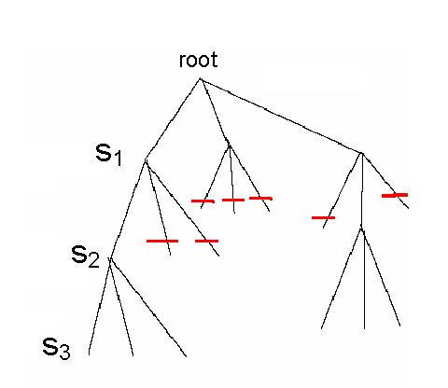
Branch-and-Bound Algorithm for Motif Search
Since each level of the tree goes deeper into the search, discarding a prefix discards all following branches
This saves us from looking at (n–l +1)^{t-i} leaves
Use NextVertex() and ByPass() to navigate the tree

Slide 91
Pseudocode for Branch-and-Bound Motif Search
BranchAndBoundMotifSearch(DNA,t,n,l)
s ← (1,…,1) // the leftmost (or first) leaf of the search tree
bestScore ← 0
i ← 1 // (s,1) = (1) represents the first child of the root of the search tree
while i > 0
if i < t
optimisticScore ← Score(s, i, DNA) + (t – i )*l
if optimisticScore < bestScore
(s, i) ← Bypass(s,i,t, n-l +1)
else
(s, i) ← NextVertex(s,i,t,n-l +1)
else
if Score(s,DNA) > bestScore
bestScore ← Score(s)
bestMotif ← (s₁,s₂,…,s_{t})
(s,i) ← NextVertex(s,i,t,n-l +1)
return bestMotif

Slide 92
Median String Search Improvements
Recall the computational difference between motif search and median string search
The Motif Finding Problem needs to examine all (n-l +1)^{t} combinations of s
The Median String Problem needs to examine 4^{l} combinations of v. This number is relatively small
We want to use median string algorithm with the Branch-and-Bound trick as well

Slide 93
Branch-and-Bound Applied to Median String Search
Note that if the total distance for a prefix is greater than that for the best word so far,
TotalDistance (prefix, DNA) > BestDistance
then there is no use exploring the remaining part of the word
We can eliminate that branch and BYPASS exploring that branch further

Slide 94
Bounded Median String Search
BranchAndBoundMedianStringSearch(DNA,t,n,l )
s ← (1,…,1) (or AA…A) // the leftmost leaf of the search tree
bestDistance ← ∞
i ← 1 // (s,1) = (1) = A represents the first child of the root
while i > 0
if i < l
prefix ← string corresponding to the first i nucleotides of s
optimisticDistance ← TotalDistance(prefix,DNA)
if optimisticDistance > bestDistance
(s, i ) ← Bypass(s,i,l,4)
else
(s, i ) ← NextVertex(s,i,l,4)
else
word ← nucleotide string corresponding to s
if TotalDistance(word,DNA) < bestDistance
bestDistance ← TotalDistance(word, DNA)
bestWord ← word
(s,i ) ← NextVertex(s,i,l,4)
return bestWord

Slide 95
Improving the Bound
Given an l-mer w, divided into two parts at point i
u : prefix w₁, …, w_{i}
v : suffix w_{i+1}, ..., w_{l}
Find the minimum distance for u in each sequence
Calculate the TotalDistance for u
Note this doesn’t tell us anything about whether u is a part of any motif. We only get a minimum total distance for any string beginning with prefix u

Slide 96
Improving the Bound (cont’d)
Repeating the process for the suffix v gives us a minimum distance for v
Since u and v are two (disjoint) substrings of w, we can assume that the minimum distance for u plus minimum distance for v can only be less than the minimum distance for w

Slide 97
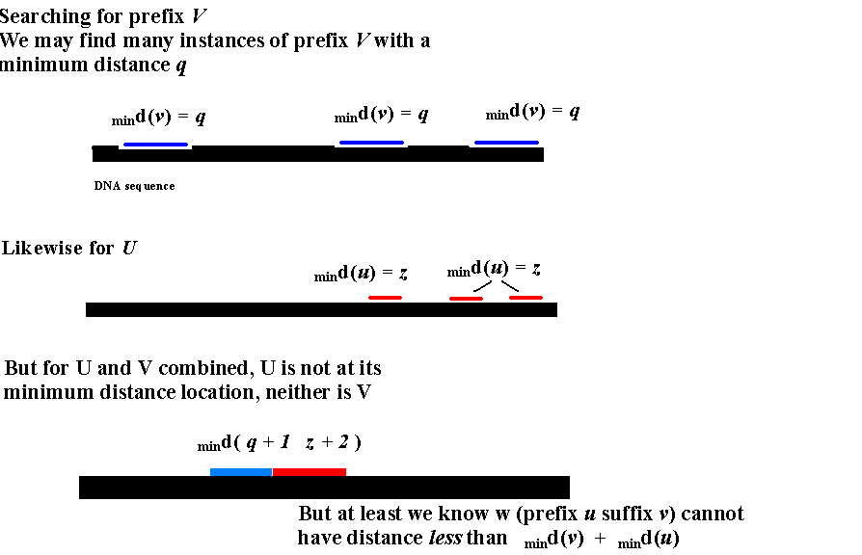
A Better Bound

Slide 98
A Better Bound (cont’d)
If d(prefix) + d(suffix) > bestDistance:
Motif w (prefix.suffix) cannot give a better (lower) distance than d(prefix) + d(suffix)
In this case, we can ByPass()
What if suffix is unknown? Use a string with the same length and the smallest TotalDistance

Slide 99
Better Bounded Median String Search
ImprovedBranchAndBoundMedianStringSearch(DNA,t,n,l)
s = (1, 1, …, 1) (or AA…A)
bestdistance = ∞; bestsubstring[1..l] = ∞
i = 1
while i > 0
if i < l
prefix = nucleotide string corresponding to (s₁, s₂, …, s_{i} )
optimisticPrefixDistance = TotalDistance (prefix, DNA)
if (optimisticPrefixDistance < bestsubstring[ i ])
bestsubstring[ i ] = optimisticPrefixDistance
if (l - i < i )
optimisticSufxDistance = bestsubstring[l -i ]
else
optimisticSufxDistance = 0;
if optimisticPrefixDistance + optimisticSufxDistance > bestDistance
(s, i ) = Bypass(s, i, l, 4)
else
(s, i ) = NextVertex(s, i, l, 4)
else
word = nucleotide string corresponding to (s₁,s₂, …, s_{t})
if TotalDistance( word, DNA) < bestDistance
bestDistance = TotalDistance(word, DNA)
bestWord = word
(s,i) = NextVertex(s, i,l, 4)
return bestWord
WRONG!

Slide 100
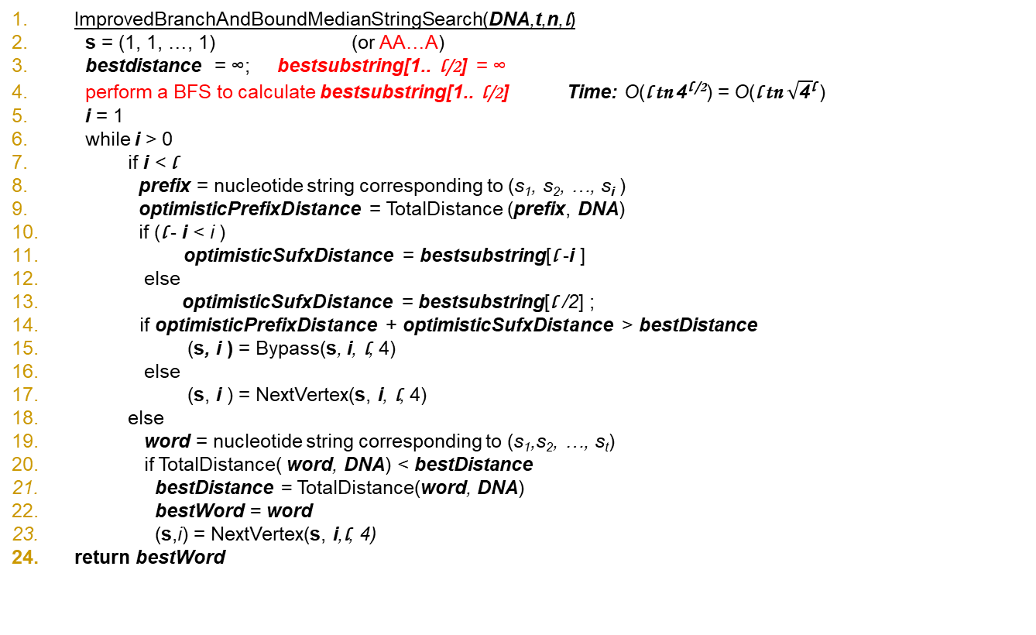
Better Bounded Median String Search

Slide 101
More on the Motif Finding Problem
Exhaustive Motif Search and Median String Search are both exact algorithms
They always find the optimal solution, though they may be too slow to perform practical tasks
Both problems are NP-hard
Many algorithms sacrifice optimality for speed. They are called heuristic algorithms.

Slide 102
CONSENSUS: Greedy Motif Search
Find two closest l-mers in sequences 1 and 2, and form a
2 x l alignment matrix with Score(s,2,DNA)
At each of the following t-2 iterations CONSENSUS, find a “best” l-mer in sequence i from the perspective of the already constructed (i-1) x l alignment matrix for the first (i-1) sequences
In other words, it finds an l-mer in sequence i maximizing
Score(s,i,DNA)
under the assumption that the first (i-1) l-mers have been already chosen
CONSENSUS sacrifices optimal solution for speed: in fact the bulk of the time is actually spent locating the first 2 l-mers

Slide 103
Some Motif Finding Programs
CONSENSUS
Hertz, Stormo (1989)
GibbsDNA
Lawrence et al (1993)
MEME Bailey, Elkan (1995)
RandomProjections Buhler, Tompa (2002)
MULTIPROFILER Keich, Pevzner (2002)
MITRA
Eskin, Pevzner (2002)
Pattern Branching
Price, Pevzner (2003)
Sequence Weighting
Chen, Jiang (2006)

Slide 104
Planted Motif Challenge
Input:
n (promoter) sequences of length m each.
Output:
Motif M, of length l
Motif occurrences in each sequence having a Hamming distance of at most d from M

Slide 105
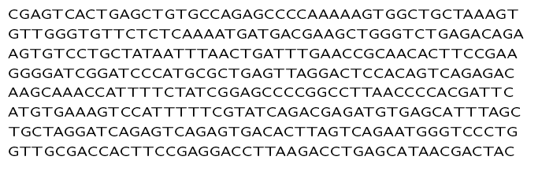
How to proceed?
Exhaustive search? Go over each l-substring, and consider its d-mutations.
Running time is high

Slide 106
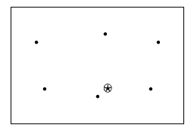
How to search a motif space?
Start from random candidate motifs (seeds)
Search motif space for the star

Slide 107
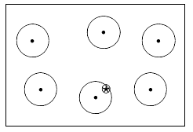
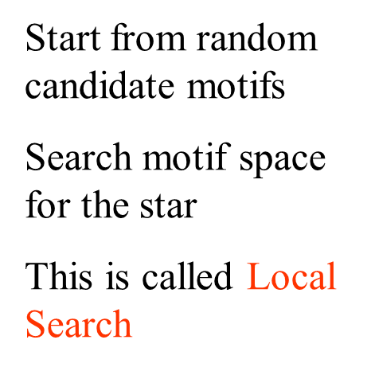
Search small neighborhoods

Slide 108
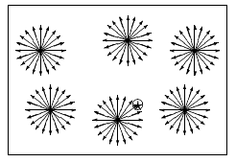
Exhaustive local search
A lot of work, most of it unecessary

Slide 109
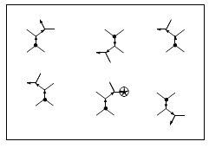
Best Neighbor (of PatternBranching)
Branch from the seed strings (motifs)
Find best neighbor – of the highest score
Don’t consider branches leading to scores not as good as the best score so far (called Hill Climbing)

Slide 110
Scoring
PatternBranching uses total distance score (as in Median String Search)
For each sequence S_{i} in the sample (DNA) S = {S₁, . . . , S_{t}}, let
d(A, S_{i}) = min{d(A, P) | P ∈ S_{i}, |P| = |A|}
Then the total distance of A from the sample is
d(A, S) = ∑ d(A, S_{i}), Si ∈ S
For a pattern A, let D=Neighbor(A) be the set of patterns that differ from A in exactly 1 position. For convenience, add A to Neighbor(A).
We define BestNeighbor(A) as the pattern B ∈ D=Neighbor(A) with lowest total distance d(B, S).

Slide 111
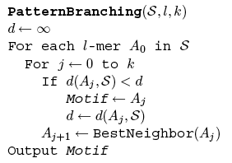
PatternBranching Algorithm

Slide 112
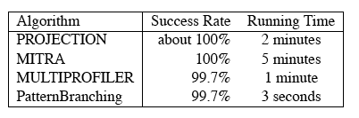
PatternBranching Performance
PatternBranching is faster than other pattern-based algorithms
Motif Challenge Problem:
sample of n = 20 sequences
N = 600 nucleotides long
implanted pattern of length l = 15
k = 4 mutations

Slide 113
PMS (Planted Motif Search)
Generate all possible l-mers from each input sequence S_{i}. Let C_{i} be the collection of these l-mers.
Example:
AAGTCAGGAGT
C_{i} = 3-mers:
AAG AGT GTC TCA CAG AGG GGA GAG AGT

Slide 114
All patterns at Hamming distance d = 1
AAG AGT GTC TCA CAG AGG GGA GAG AGT
CAG CGT ATC ACA AAG CGG AGA AAG CGT
GAG GGT CTC CCA GAG TGG CGA CAG GGT
TAG TGT TTC GCA TAG GGG TGA TAG TGT
ACG ACT GAC TAA CCG ACG GAA GCG ACT
AGG ATT GCC TGA CGG ATG GCA GGG ATT
ATG AAT GGC TTA CTG AAG GTA GTG AAT
AAC AGA GTA TCC CAA AGA GGC GAA AGA
AAA AGC GTG TCG CAC AGT GGG GAC AGC
AAT AGG GTT TCT CAT AGC GGT GAT AGG

Slide 115
Sort the lists
AAG AGT GTC TCA CAG AGG GGA GAG AGT
AAA AAT ATC ACA AAG AAG AGA AAG AAT
AAC ACT CTC CCA CAA ACG CGA CAG ACT
AAT AGA GAC GCA CAC AGA GAA GAA AGA
ACG AGC GCC TAA CAT AGC GCA GAC AGC
AGG AGG GGC TCC CCG AGT GGC GAT AGG
ATG ATT GTA TCG CGG ATG GGG GCG ATT
CAG CGT GTG TCT CTG CGG GGT GGG CGT
GAG GGT GTT TGA GAG GGG GTA GTG GGT
TAG TGT TTC TTA TAG TGG TGA TAG TGT

Slide 116
Eliminate duplicates
AAG AGT GTC TCA CAG AGG GGA GAG AGT
AAA AAT ATC ACA AAG AAG AGA AAG AAT
AAC ACT CTC CCA CAA ACG CGA CAG ACT
AAT AGA GAC GCA CAC AGA GAA GAA AGA
ACG AGC GCC TAA CAT AGC GCA GAC AGC
AGG AGG GGC TCC CCG AGT GGC GAT AGG
ATG ATT GTA TCG CGG ATG GGG GCG ATT
CAG CGT GTG TCT CTG CGG GGT GGG CGT
GAG GGT GTT TGA GAG GGG GTA GTG GGT
TAG TGT TTC TTA TAG TGG TGA TAG TGT

Slide 117
Find motif common to all lists
Follow this procedure for all sequences
Find a motif common to all L_{i} (once duplicates have been eliminated)
This is the planted motif

Slide 118


PMS Running Time
It takes time to
Generate variants
Sort lists Here, m = length of sequence
Find and eliminate duplicates
Running time of this algorithm:
w is the word length of the computer

