Slide 1
DNA Mapping, Brute Force and Branch-and-Bound Algorithms

Slide 2
Outline
Restriction Enzymes and Physical Map
Gel Electrophoresis
Partial Digest Problem
Brute Force Algorithm for Partial Digest Problem
Branch-and-Bound Algorithm for Partial Digest Problem
Double Digest Problem

Slide 3
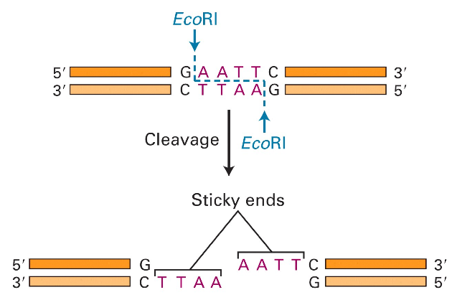
Molecular Scissors
Molecular Cell Biology, 4th edition

Slide 4
Discovering Restriction Enzymes
HindII - first restriction enzyme – was discovered accidentally in 1970 while studying how the bacterium Haemophilus influenzae takes up DNA from the virus
Recognizes and cuts DNA at sequences:
GTGCAC
GTTAAC

Slide 5
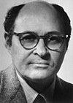
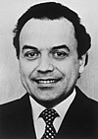

Discovering Restriction Enzymes
My can cut him in small fragmentsfather has discovered a servant who serves as a pair of scissors. If a foreign king invades a bacterium, this servant , but he does not do any harm to his own king. Clever people use the servant with the scissors to find out the secrets of the kings. For this reason my father received the Nobel Prize for the discovery of the servant with the scissors".
Daniel Nathans’ daughter
(from Nobel lecture)
Werner Arber Daniel Nathans Hamilton Smith
Werner Arber – discovered restriction
enzymes
Daniel Nathans - pioneered the application
of restriction for the
construction of genetic
maps
Hamilton Smith - showed that restriction
enzyme cuts DNA in the
middle of a specific sequence

Slide 6
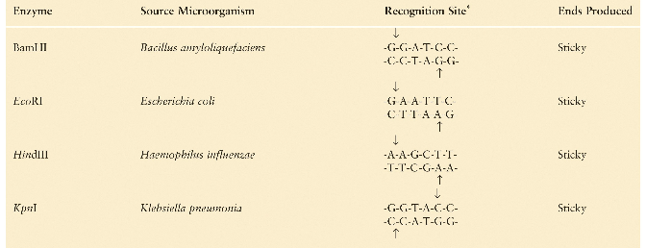
Recognition Sites of Restriction Enzymes
Molecular Cell Biology, 4th edition

Slide 7
Uses of Restriction Enzymes
Recombinant DNA technology
Cloning
cDNA/genomic library construction
DNA mapping

Slide 8
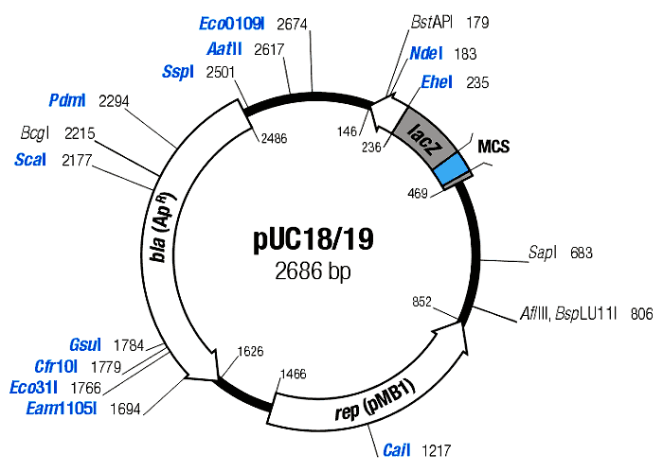
Restriction Maps
• A map showing positions of restriction sites in a DNA sequence.
• If DNA sequence is known then construction of restriction map is a trivial exercise.
• In early days of molecular biology, DNA sequences were often unknown.
• Biologists had to solve the problem of reconstructing restriction maps without knowing DNA sequences.

Slide 9
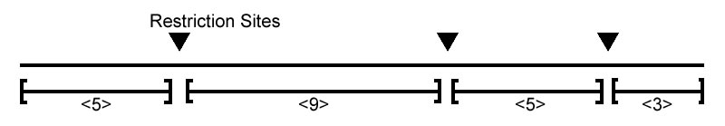
Full/Complete Restriction Digest
• Cutting DNA at each restriction site creates
multiple restriction fragments:
• Is it possible to reconstruct the order of
the fragments from the sizes of the fragments
{3,5,5,9} ?

Slide 10
Complete Restriction Digest: Multiple Solutions
• Alternative ordering of restriction fragments:
vs

Slide 11
Measuring Lengths of Restriction Fragments
Restriction enzymes break DNA into restriction fragments.
Gel electrophoresis is a process for separating DNA by size and measuring sizes of restriction fragments.
Can separate DNA fragments that differ in length by only 1 nucleotide for fragments up to 500 nucleotides long.

Slide 12
Gel Electrophoresis
DNA fragments are injected into a gel positioned in an electric field
DNA are negatively charged near neutral pH
The ribose phosphate backbone of each nucleotide is acidic; DNA has an overall negative charge
DNA molecules move towards the positive electrode

Slide 13
Gel Electrophoresis (cont’d)
DNA fragments of different lengths are separated according to size
Smaller molecules move through the gel matrix more readily than larger molecules
The gel matrix restricts random diffusion so molecules of different lengths separate into different bands

Slide 14
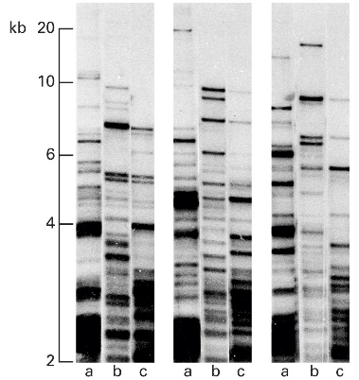
Gel Electrophoresis: Example
Direction of DNA movement
Smaller fragments travel farther
Molecular Cell Biology, 4th edition

Slide 15
Detecting DNA: Autoradiography
One way to visualize separated DNA bands on a gel is autoradiography:
The DNA is radioactively labeled
The gel is laid against a sheet of photographic (X-ray) film in the dark, exposing the film at the positions where the DNA is present

Slide 16
Detecting DNA: Fluorescence
Another way to visualize DNA bands in gel is fluorescence:
The gel is incubated with a solution containing the fluorescent dye ethidium
Ethidium binds to the DNA
The DNA lights up when the gel is exposed to ultraviolet light

Slide 17
Partial Restriction Digest
The sample of DNA is exposed to the restriction enzyme for only a limited amount of time to prevent it from being cut at all restriction sites
Each DNA molecule is cut at most twice. Keep in mind many molecules are present
The experiment generates the set of all possible restriction fragments between every two (not necessarily consecutive) sites, equally likely
The set of fragment sizes is used to determine the positions of the restriction sites in the DNA sequence

Slide 18
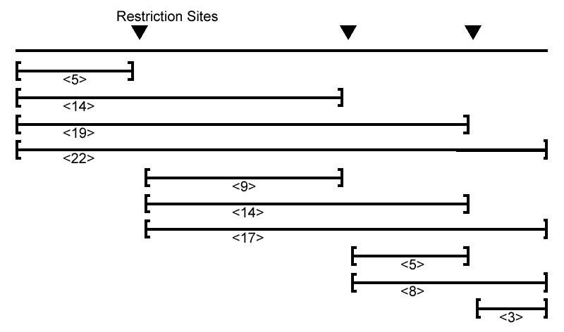
Partial Digest Example
Partial Digest results in the following 10 restriction fragments:

Slide 19
Multiset of Restriction Fragments
We assume that multiplicity of a fragment can be detected, i.e., the number of restriction fragments of the same length can be determined (e.g., by observing twice as much fluorescence intensity for double fragments than for a single fragment)
Multiset: {3, 5, 5, 8, 9, 14, 14, 17, 19, 22}

Slide 20
Partial Digest Fundamentals
X:
the set of n integers representing the location of all sites in the restriction map, including the start and end
n:
the total number of sites
DX:
the multiset of integers representing lengths of each of the C(n,2) fragments produced from a partial digest

Slide 21
One More Partial Digest Example
X | 0 | 2 | 4 | 7 | 10
0 |  | 2 | 4 | 7 | 10
2 |  |  | 2 | 5 | 8
4 |  |  |  | 3 | 6
7 |  |  |  |  | 3
10
Representation of DX = {2, 2, 3, 3, 4, 5, 6, 7, 8, 10} as a two dimensional table, with the elements of
X = {0, 2, 4, 7, 10}
along both the top and left row/column. The element at (i, j) in the table denotes x_{j} – x_{i} for 1 ≤ i < j ≤ n.

Slide 22
Partial Digest Problem: Formulation
Goal: Given all pairwise distance between points on a line, reconstruct the positions of those points
Input: The multiset of pairwise distance L, containing n(n-1)/2 integers
Output: A set X, of n integers, such that DX = L

Slide 23
Partial Digest: Multiple Solutions
It is not always possible to uniquely reconstruct a set X based only on DX.
For example, the set
X = {0, 2, 5}
and (X + 10) = {10, 12, 15}
both produce DX={2, 3, 5} as their partial digest set.
The sets {0,1,2,5,7,9,12} and {0,1,5,7,8,10,12} present a less trivial example of non-uniqueness. They both digest into:
{1, 1, 2, 2, 2, 3, 3, 4, 4, 5, 5, 5, 6, 7, 7, 7, 8, 9, 10, 11, 12}

Slide 24
Homometric Sets
 | 0 | 1 | 2 | 5 | 7 | 9 | 12
0 |  | 1 | 2 | 5 | 7 | 9 | 12
1 |  |  | 1 | 4 | 6 | 8 | 11
2 |  |  |  | 3 | 5 | 7 | 10
5 |  |  |  |  | 2 | 4 | 7
7 |  |  |  |  |  | 2 | 5
9 |  |  |  |  |  |  | 3
12
 | 0 | 1 | 5 | 7 | 8 | 10 | 12
0 |  | 1 | 5 | 7 | 8 | 10 | 12
1 |  |  | 4 | 6 | 7 | 9 | 11
5 |  |  |  | 2 | 3 | 5 | 7
7 |  |  |  |  | 1 | 3 | 5
8 |  |  |  |  |  | 2 | 4
10 |  |  |  |  |  |  | 2
12

Slide 25
Brute Force Algorithms
Also known as exhaustive search algorithms; examine every possible variant to find a solution
Efficient in rare cases; usually impractical
Can be the basis for the design of other algorithms (e.g., branch-and-bound)

Slide 26
Partial Digest: Brute Force
Find the restriction fragment of maximum length M. M is the length of the DNA sequence.
For every possible set
X={0, x₂, … ,x_{n-1}, M}
compute the corresponding DX.
If DX is equal to the experimental partial digest L, then X is output as the correct restriction map.

Slide 27
BruteForcePDP
BruteForcePDP(L, n):
M <- maximum element in L
for every set of n – 2 integers 0 < x₂ < … x_{n-1} < M
X <- {0,x₂,…,x_{n-1},M}
Form DX from X
if DX = L
return X
output “no solution”

Slide 28
Efficiency of BruteForcePDP
BruteForcePDP takes O(M ^{n-2}) time since it must examine all possible sets of positions.
One way to improve the algorithm is to limit the values of x_{i} to only those values that occur in L.

Slide 29
O-notation: an asymptotic upper bound
f(n) = O(g(n)) iff there exist two positive constant c and n₀ such that 0 f(n) cg(n) for all n n₀
cg(n)
f(n)
n₀
For example, 5n + 108 = O(n) and 2n = O(nlog n).

Slide 30
How fast functions grow?
 | 30n | 92n log n | 26n² | 0.68n³ | 2^{n}
100 | 0.003 sec. | 0.003 sec. | 0.26 sec. | 0.68 sec. | 4 x 10¹⁶ yr.
100,000 | 3.0 sec. | 2.6 min. | 3.0 days | 22 yr.
function
n
(Assume one million operations per second.)
For very large data sets, algorithms with a complexity greater than O(n log n) are often impractical!

Slide 31
AnotherBruteForcePDP
AnotherBruteForcePDP(L, n)
M <- maximum element in L
for every set of n – 2 integers 0 < x₂ < … x_{n-1} < M from L
X <- { 0,x₂,…,x_{n-1},M }
Form DX from X
if DX = L
return X
output “no solution”

Slide 32
Efficiency of AnotherBruteForcePDP
It is more efficient, but still slow
If L = {2, 998, 1000} (n = 3, M = 1000), BruteForcePDP will be extremely slow, but AnotherBruteForcePDP will be quite fast
Fewer sets are examined, but runtime is still exponential: O(n^{2n-4})

Slide 33
Branch and Bound Algorithm for PDP
Begin with X = {0}
Remove the largest element in L and place it in X
See if each element fits on the right or left side of the restriction map
When it fits, find the other lengths it creates and remove those from L
Go back to step 1 until L is empty

Slide 34
Branch and Bound Algorithm for PDP
Begin with X = {0}
Remove the largest element in L and place it in X
See if each element fits on the right or left side of the restriction map
When it fits, find the other lengths it creates and remove those from L
Go back to step 1 until L is empty
WRONG ALGORITHM

Slide 35
Branch-and-Bound Algorithm for PDP
search tree from bruteforce
partial solution
complete solution
Define D(y, X) as the multiset of all distances between new site y and all previously determined restriction sites X = {x₁, x₂, …, x_{m}}:
D(y, X) = {|y – x₁|, |y – x₂|, …, |y – x_{m}|}
Then D(y, X) should be contained in L!

Slide 36
PartialDigest Algorithm
PartialDigest(L):
width <- Maximum element in L
DELETE(width, L)
X <- {0, width}
PLACE(L, X)
X: a partial solution.

Slide 37
PartialDigest Algorithm (cont’d)
PLACE(L, X) // Resolve L with respect to X
if L is empty
output X
return
y <- maximum element in L
// Decide if the fragment involves the left or right end
if D(y, X ) is contained in L
Add y to X and remove lengths D(y, X) from L
PLACE(L,X )
Remove y from X and add lengths D(y, X) to L
if D(width-y, X ) is contained in L
Add width-y to X and remove lengths D(width-y, X) from L
PLACE(L,X )
Remove width-y from X and add lengths D(width-y, X ) to L
return

Slide 38
An Example
L = { 2, 2, 3, 3, 4, 5, 6, 7, 8, 10 }
X = { 0 }

Slide 39
An Example
L = { 2, 2, 3, 3, 4, 5, 6, 7, 8, 10 }
X = { 0 }
Remove 10 from L and insert it into X. We know this must be
the length of the DNA sequence because it is the largest
fragment.

Slide 40
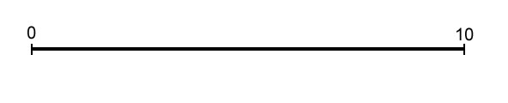
An Example
L = { 2, 2, 3, 3, 4, 5, 6, 7, 8, 10 }
X = { 0, 10 }

Slide 41
An Example
L = { 2, 2, 3, 3, 4, 5, 6, 7, 8, 10 }
X = { 0, 10 }
Take 8 from L and make y = 2 or 8. But since the two cases are symmetric, we can assume y = 2.

Slide 42
An Example
L = { 2, 2, 3, 3, 4, 5, 6, 7, 8, 10 }
X = { 0, 10 }
We find that the distances from y=2 to other elements in X are D(y, X) = {8, 2}, so we remove {8, 2} from L and add 2 to X.

Slide 43
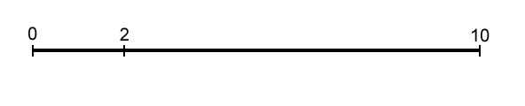
An Example
L = { 2, 2, 3, 3, 4, 5, 6, 7, 8, 10 }
X = { 0, 2, 10 }

Slide 44
An Example
L = { 2, 2, 3, 3, 4, 5, 6, 7, 8, 10 }
X = { 0, 2, 10 }
Take 7 from L and make y = 7 or y = 10 – 7 = 3. We will
explore y = 7 first, so D(y, X ) = {7, 5, 3}.

Slide 45
An Example
L = { 2, 2, 3, 3, 4, 5, 6, 7, 8, 10 }
X = { 0, 2, 10 }
For y = 7, D(y, X ) = {7, 5, 3}. Therefore we
remove {7, 5 ,3} from L and add 7 to X.
D(y, X) = {7, 5, 3} = {|7 – 0|, |7 – 2|, |7 – 10|}.

Slide 46
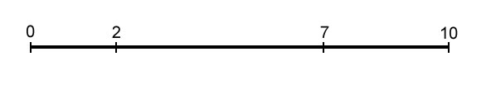
An Example
L = { 2, 2, 3, 3, 4, 5, 6, 7, 8, 10 }
X = { 0, 2, 7, 10 }

Slide 47
An Example
L = { 2, 2, 3, 3, 4, 5, 6, 7, 8, 10 }
X = { 0, 2, 7, 10 }
Take 6 from L and make y = 6. Unfortunately
D(y, X) = {6, 4, 1 ,4}, which is not a subset of L. Therefore we won’t explore this branch.
6

Slide 48
An Example
L = { 2, 2, 3, 3, 4, 5, 6, 7, 8, 10 }
X = { 0, 2, 7, 10 }
This time make y = 4. D(y, X) = {4, 2, 3 ,6}, which is a
subset of L so we will explore this branch. We remove
{4, 2, 3 ,6} from L and add 4 to X.

Slide 49
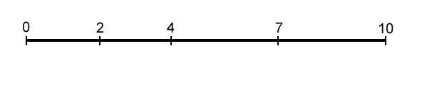
An Example
L = { 2, 2, 3, 3, 4, 5, 6, 7, 8, 10 }
X = { 0, 2, 4, 7, 10 }

Slide 50
An Example
L = { 2, 2, 3, 3, 4, 5, 6, 7, 8, 10 }
X = { 0, 2, 4, 7, 10 }
L is now empty, so we have a solution, which is X.

Slide 51
An Example
L = { 2, 2, 3, 3, 4, 5, 6, 7, 8, 10 }
X = { 0, 2, 7, 10 }
To find other solutions, we backtrack.

Slide 52
An Example
L = { 2, 2, 3, 3, 4, 5, 6, 7, 8, 10 }
X = { 0, 2, 10 }
More backtrack.

Slide 53
An Example
L = { 2, 2, 3, 3, 4, 5, 6, 7, 8, 10 }
X = { 0, 2, 10 }
This time we will explore y = 3. D(y, X) = {3, 1, 7}, which is
not a subset of L, so we won’t explore this branch.

Slide 54
An Example
L = { 2, 2, 3, 3, 4, 5, 6, 7, 8, 10 }
X = { 0, 10 }
We backtracked to the root (actually, a symmetric solution y = 8). Therefore, we have found all the solutions.

Slide 55
Analyzing PartialDigest Algorithm
Still exponential in the worst case, but is very fast on average.
Informally, let T(n) be the time PartialDigest takes to place n cuts.
No branching case: T(n) < T(n-1) + O(n)
Quadratic
Branching case: T(n) < 2T(n-1) + O(n)
Exponential (i.e., O(n2^{n})), but much better than pure BruteForce.

Slide 56
Double Digest Mapping
Double Digest is yet another experimental method to construct restriction maps.
Use two restriction enzymes; three full digests:
One with only first enzyme
One with only second enzyme
One with both enzymes
Computationally, the Double Digest problem is more complex than the Partial Digest problem.

Slide 57
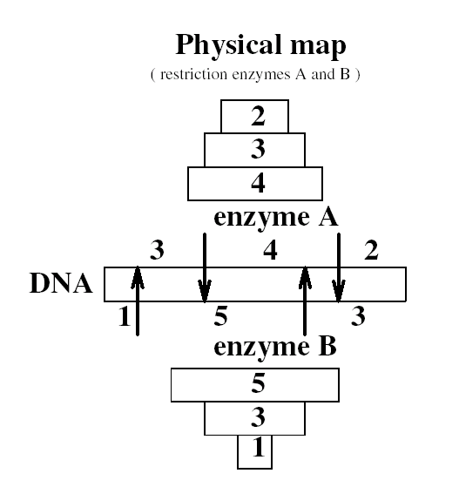
Double Digest: Example

Slide 58
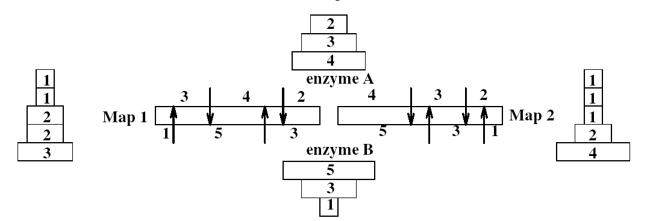
Double Digest: Example
Without the information of dX (i.e., A+B), it is impossible to (uniquely) solve the double digest problem as this diagram illustrates.

Slide 59
Double Digest Problem
Input: dA – fragment lengths from the (complete)
digest with enzyme A.
dB – fragment lengths from the digest with
enzyme B.
dX – fragment lengths from the digest with
both A and B.
Output: A – location of the cuts in the
restriction map for the enzyme A.
B – location of the cuts in the
restriction map for the enzyme B.

Slide 60
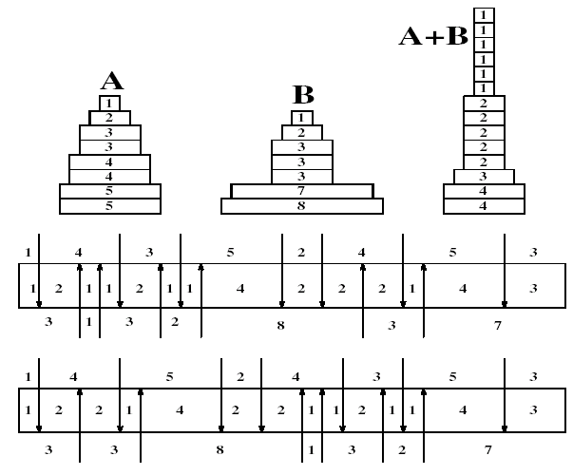
Double Digest: Multiple Solutions

Slide 61
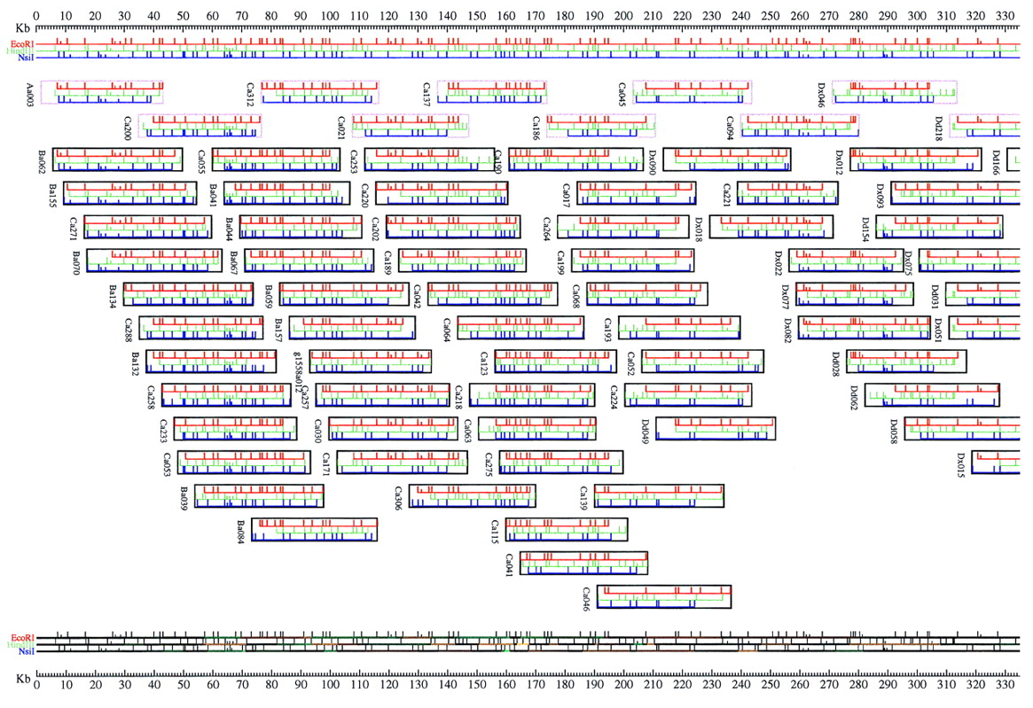
Multiple Complete Digest (MCD) Mapping – a way to map genomes

