Slide 1
Seattle
With Kodiak West Travel

Slide 2
And if you can spare
one more day…

Slide 3
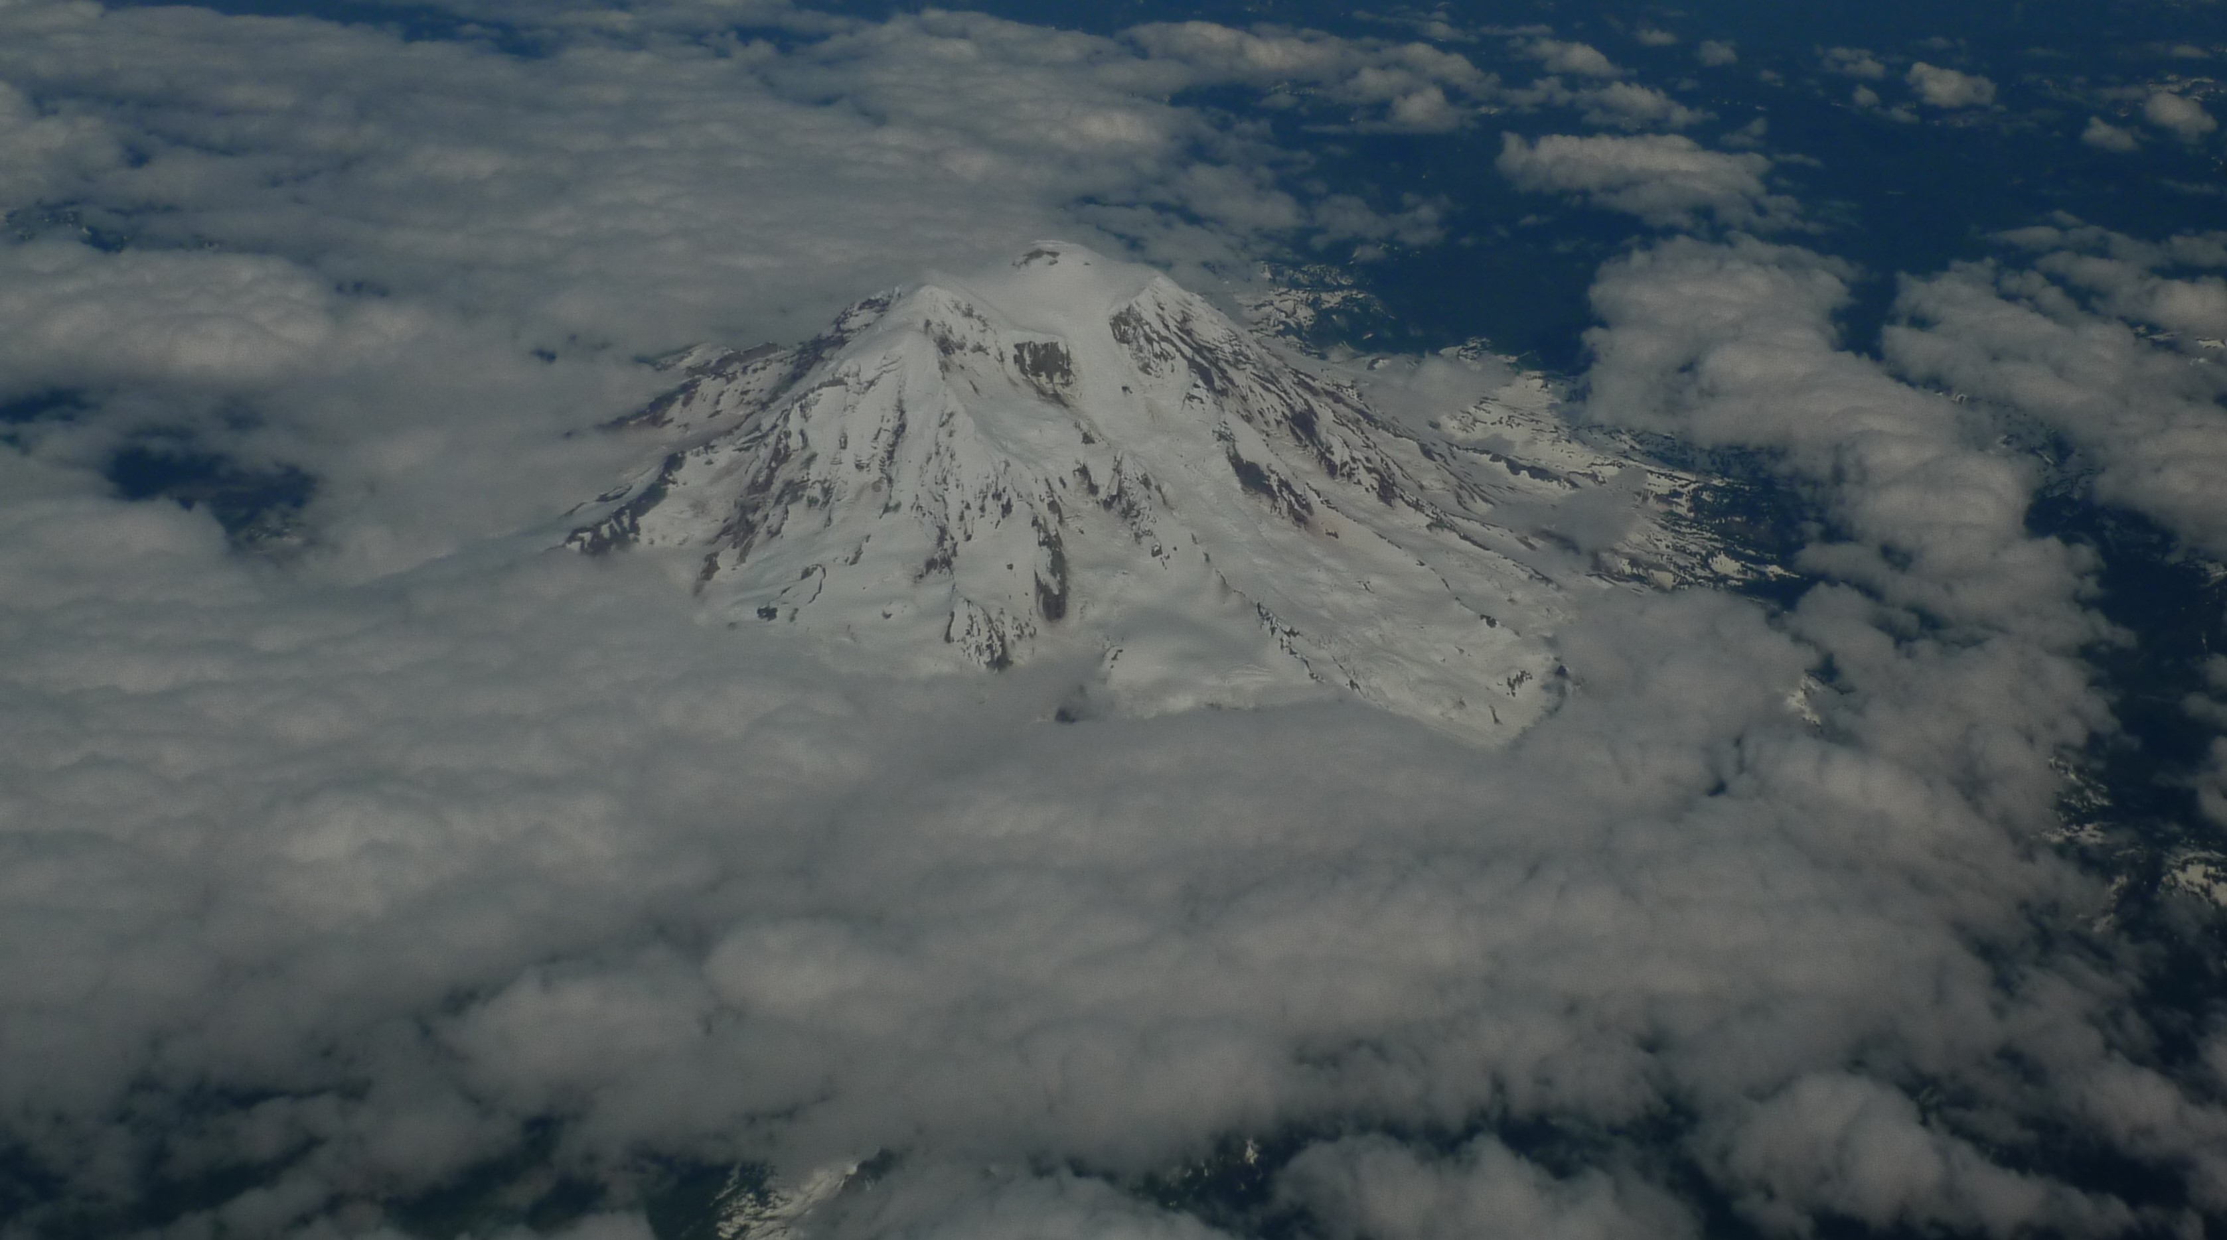
Visit Mt. Rainier National Park!

Slide 4
Visit Seattle
Before or After
Your Cruise to Alaska!
Kodiak West Travel Can Help
You Develop Your Itinerary

Slide 5

Although cruises to Alaska are held during summer months, a visit to Seattle in summer is no guarantee of sunshine! Keep your favorite umbrella handy!

Slide 6
Day One
Sample
Itinerary
Get an early start!
Pike Market for breakfast and shopping
Olympic Sculpture Park and a stroll along the waterfront
Mid-afternoon
  The Seattle Aquarium
Evening
  Seattle Underground Tour

Slide 7
Seattle
Weather
Heavy rain in January to May and October to December
Average yearly precipitation is 37 inches
Average temperature in July and August is 75 degrees

