Slide 1
Hiking Hawaii
With Lehua Adventure Tours

Slide 2
Adventure into the Heart of Hawaii
For those who truly wish to experience the beauty of nature, there is no better way to explore the islands than by foot. While the islands offer a multitude of independent hikes, guided hikes by Lehua Hawaiian Adventures take you into the heart of Hawaii.

Slide 3
Before You Go
Dress in layers
Carry plenty of water
Wear supportive, waterproof shoes
Bring a hiking stick (optional)

Slide 4
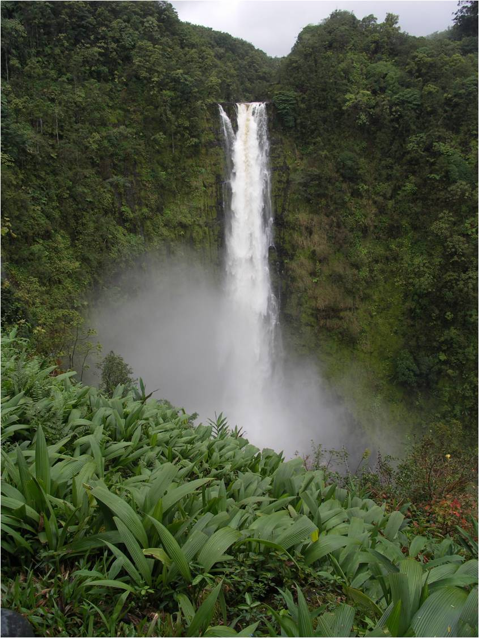
Akaka Falls
Explore nature
Guava groves
Fantastic flora
Waterfalls
Trip information
Departs daily, 8:30 a.m.
Length: 4 miles
Fee: $50

Slide 5
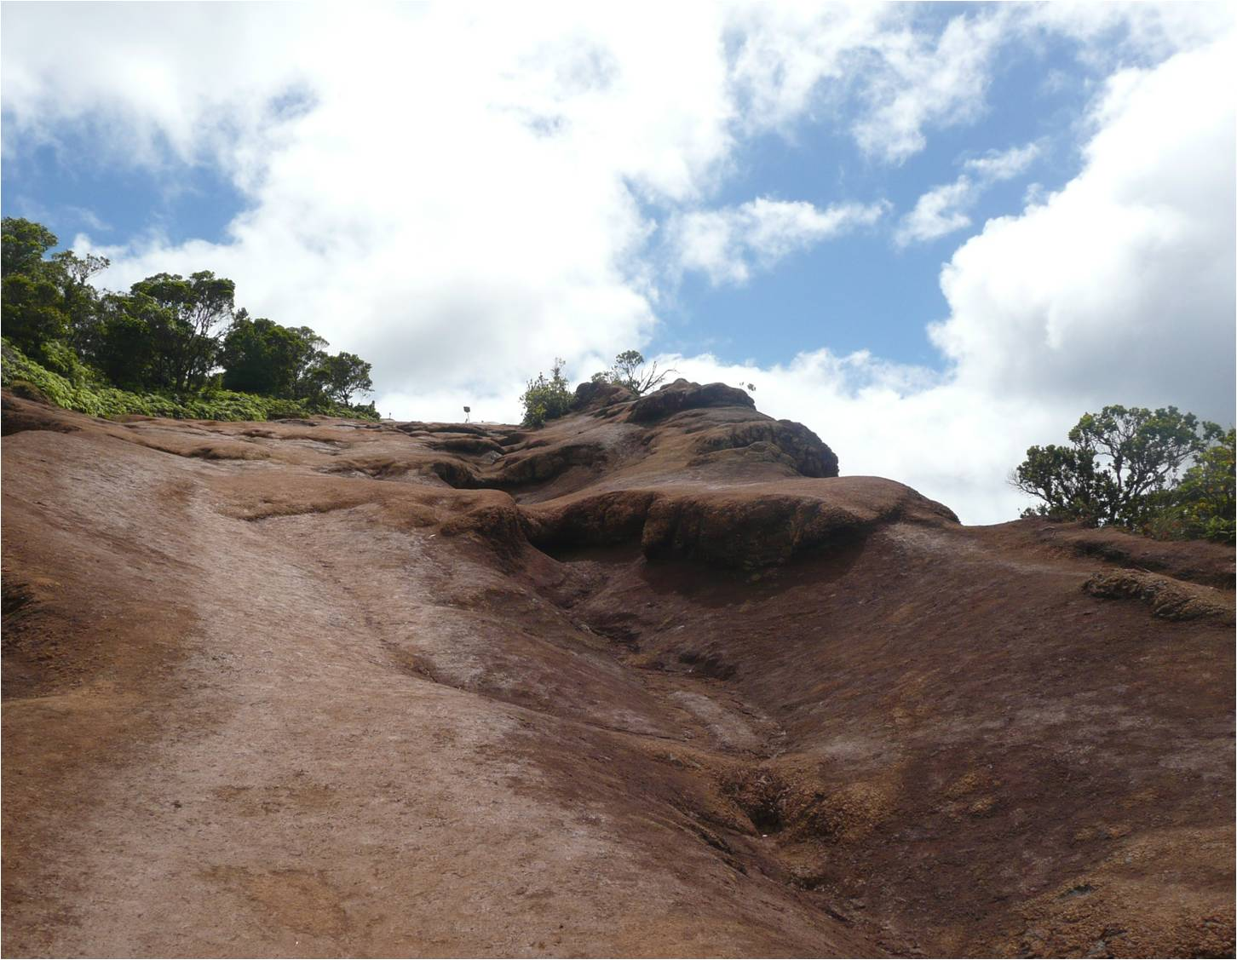
Waimea Canyon and Koke’e State Park
Over 45 trails crisscross the canyon and state park. Contact our office for specific information on the five different expeditions led by our guides .

