Slide 1
Aerial View of Kauai
Lehua Adventure Tours

Slide 2
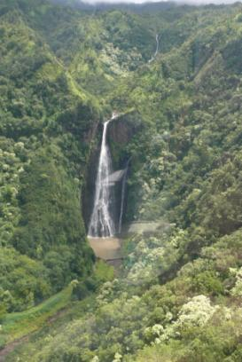
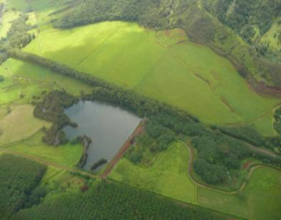
Dramatic Overhead Views
The Jurassic Park Waterfall
Maluhia Road Tree Tunnel

Slide 3
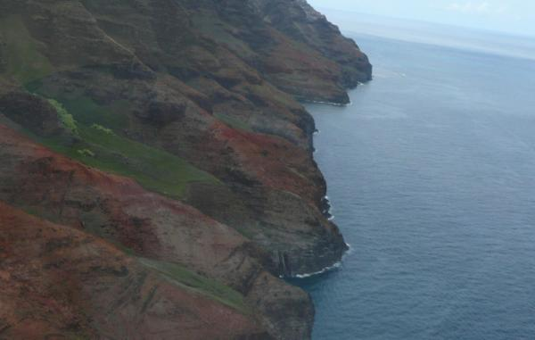
Na Pali Coast
The rugged beauty of this dramatic shoreline will leave you breathless as you soar alongside its lush spires, pristine beaches, and pounding waterfalls.

Slide 4
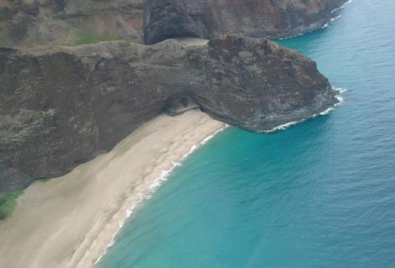
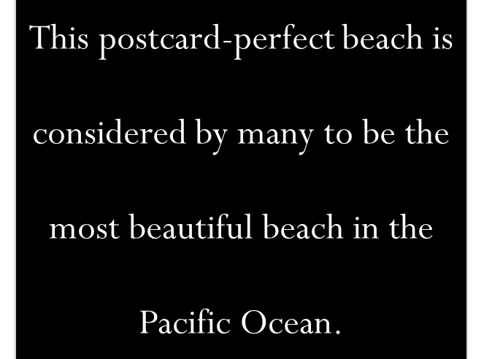
Honopu Beach

Slide 5
Amazing Shorelines
View some of the most spectacular beaches in the Pacific on the western shore of the island of Kauai

Slide 6
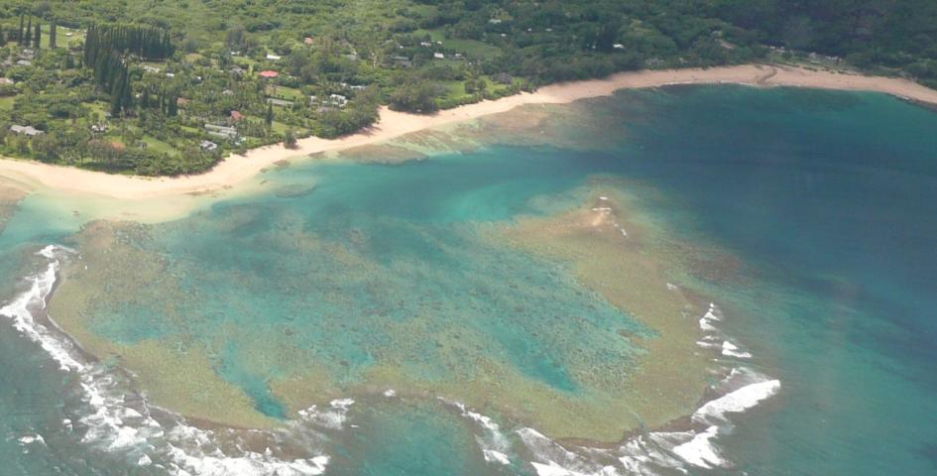
Tunnels Beach
Some of the best snorkeling on Kauai is found at Tunnels Beach. The large reef is home to a variety of fish, sea turtles, eels, and octopus.

