Slide 1
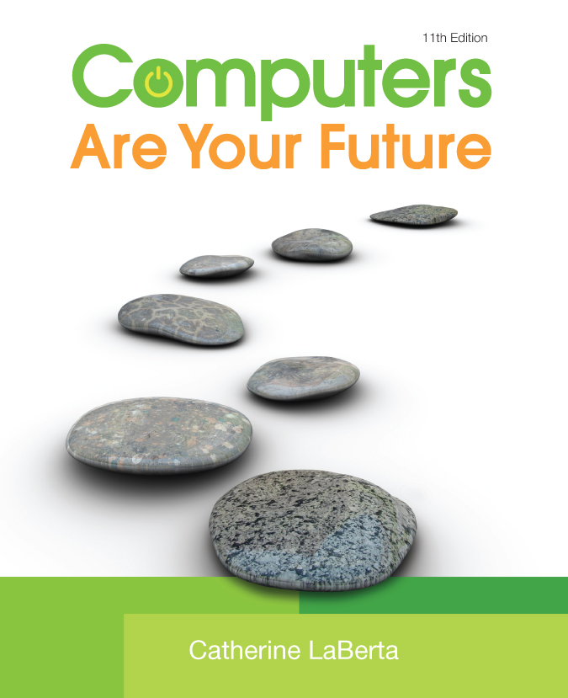
Computers Are Your Future Eleventh Edition
Chapter 9: Privacy, Crime, and Security

Slide 2
All rights reserved. No part of this publication may be reproduced, stored in a retrieval system, or transmitted, in any form or by any means, electronic, mechanical, photocopying, recording, or otherwise, without the prior written permission of the publisher. Printed in the United States of America.
Copyright © 2011 Pearson Education, Inc.
Publishing as Prentice Hall
2

Slide 3
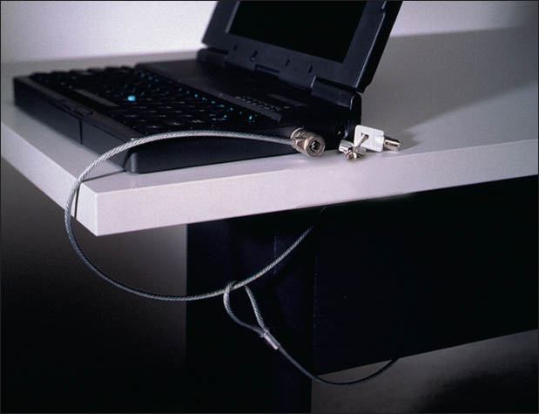
Privacy, Crime, and Security
Notes:
This Is Figure 9.18.

Slide 4
Objectives
Understand how technological developments are eroding privacy and anonymity.
List the types of computer crime and cybercrime.
List the types of computer criminals.
Understand computer system security risks.

Slide 5
Objectives
Describe how to protect your computer system and yourself.
Define encryption and explain how it makes online information secure.
Describe the issues the government faces when balancing the need to access encrypted data and the public’s right to privacy.

Slide 6
Privacy in Cyberspace
Privacy is an individual’s ability to eliminate the collection, use, and sale of confidential personal information.
Maintaining anonymity—the means to communicate without disclosing one’s identity—is more difficult with the use of computers and the Internet.

Slide 7
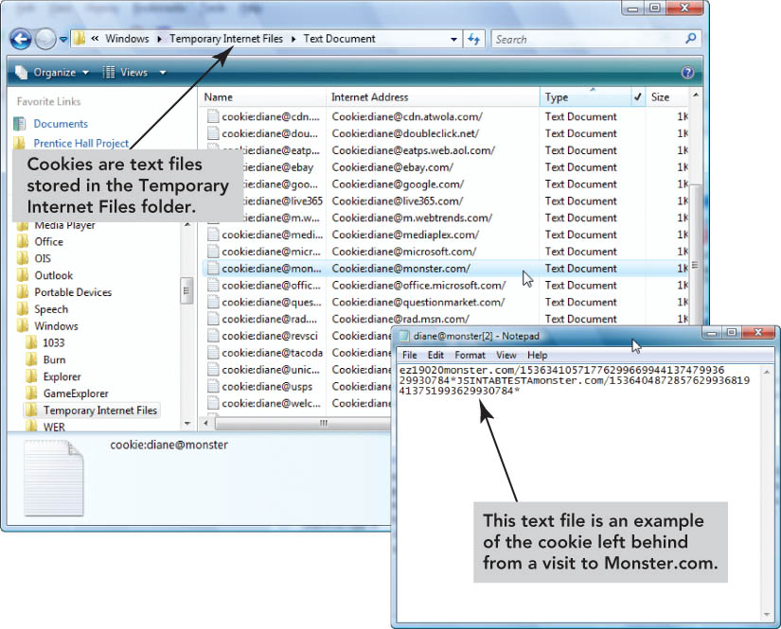
Privacy in Cyberspace
Technologies that jeopardize online anonymity include:
Cookies
Global unique identifiers
Ubiquitous computing
Radio frequency identification
Notes:
This is Figure 9.4.

Slide 8
Privacy in Cyberspace
Cookies are small files written to your hard disk by the Web sites you visit. They can:
Track your browsing habits
Gather personal information without your consent
Can be disabled

Slide 9
Privacy in Cyberspace
A global unique identifer (GUID) is an identification number produced by software or a piece of hardware.
Web servers can read the GUID.
Users are not always aware of the GUID.
If used, companies allow users to opt out.
Civil liberties groups and public concern have decreased the use of GUIDs.

Slide 10
Privacy in Cyberspace
Interacting with multiple networked devices is called ubiquitous computing.
An example is the adjustment of heat or light in an environment based on signals sent by monitors built into clothing.
An active badge can transmit infrared signals to create an electronic trail.
Current devices such as smartphones hold private information that can be exploited if the device is lost or stolen.

Slide 11
Privacy in Cyberspace
Radio frequency identification (RFID) uses radio waves to track a chip or tag.
Used for inventory control in stores
Recognizes microchips in pets
May compromise anonymity and privacy if information stored on RFID tags attached to U.S. passports is misused

Slide 12
Privacy in Cyberspace
Notes:
This is Figure 9.7.

Slide 13
Privacy in Cyberspace
Privacy advocates agree that citizens have the right to:
Be informed when information about them is being collected
Give or deny consent to have their information collected
Legislation currently in place includes:
Fair Credit Reporting Act
Health Insurance Portability and Privacy Act
Family Education Rights and Privacy Act

Slide 14
Privacy in Cyberspace
Protecting privacy online
Use products such as Anonymous Surfing or IronKey Secure USB flash.
Use free Web-based e-mail addresses in chat rooms and for mailing lists.
Tell children not give out personal information.
Complete forms only if you see a privacy statement.
Turn off cookies.

Slide 15
Privacy in Cyberspace
Protecting privacy at home
Create logins and passwords for each person using the computer.
Do not save account numbers or passwords.
Close a secured account site when you are not at a computer.
Do not leave cell phones in public places.
Turn off services not in use, especially Bluetooth.
Verify that devices have secure configurations.

Slide 16
Privacy in Cyberspace
Protecting privacy at work
Refrain from making personal calls on a work phone.
Avoid using a company e-mail account for personal purposes.
Assume that your actions at work are being monitored.

Slide 17
Privacy in Cyberspace
Notes:
This is Figure 9.14.

Slide 18
Computer Crime & Cybercrime
Computer-based activities that violate the law are known as computer crimes.
Cybercrimes are crimes perpetrated through the Internet.
Cyberlaw is the area of law dedicated to computer crime.
Many Web sites educate users about cybercrime and cybercriminals.

Slide 19
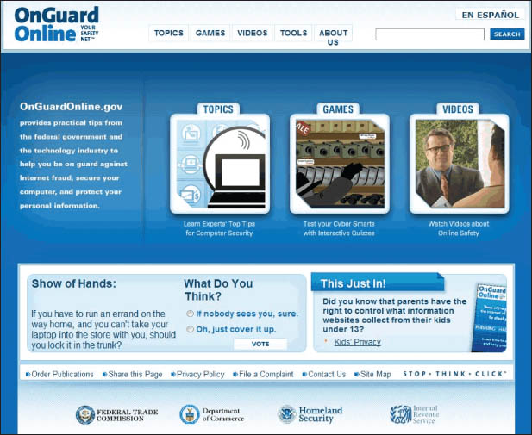
Computer Crime & Cybercrime
Notes:
This is Figure 9.15.

Slide 20
Computer Crime & Cybercrime
Types of computer crime
Identify theft is when a criminal gains access to personal information in order to impersonate someone.
Criminals sometime use phishing attacks—legitimate-looking e-mails or Web sites created in an attempt to obtain confidential data about a person.

Slide 21
Computer Crime & Cybercrime
Types of computer crime
Malware (short for malicious software) refers to programs that intentionally harm a computer system or allow individuals to gain access to it without the owner’s permission.

Slide 22
Computer Crime & Cybercrime
Types of computer crime
Spyware is software that gathers private information and tracks Web use and then provides that information to third parties.
Adware is a form of spyware that generates annoying pop-up and banner ads
Keyloggers record keystrokes to provide cybercriminals with confidential data

Slide 23
Computer Crime & Cybercrime
Types of computer crime
A computer virus is code concealed inside a program that can harm or destroy files.
Many are spread through e-mail attachments.
File infectors attach themselves to files.
Boot sector viruses execute each time you start the computer.
Macro viruses attach to data files and take advantage of application macros.

Slide 24
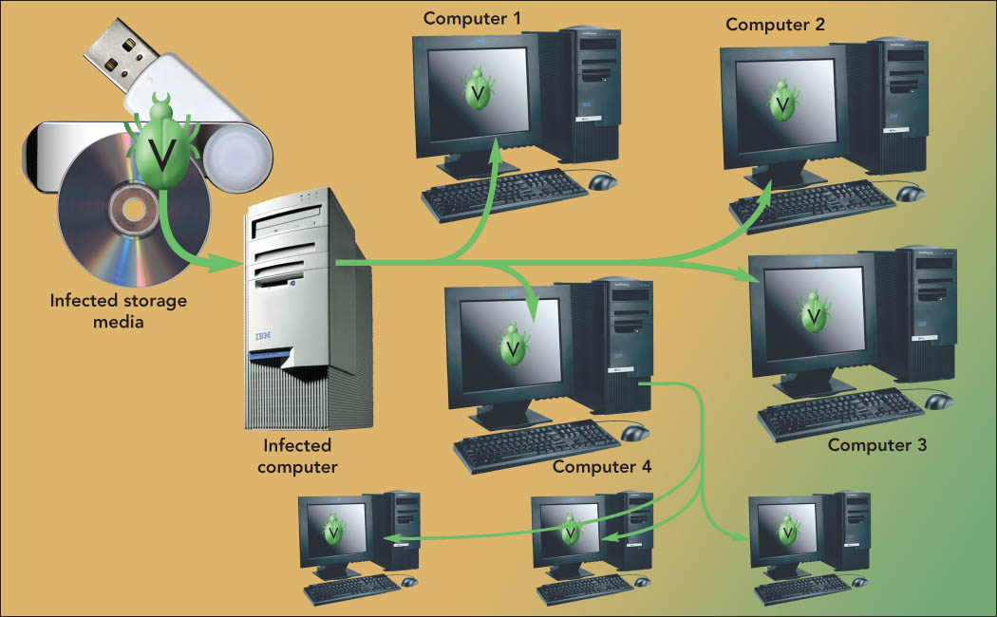
Computer Crime & Cybercrime
Notes:
This is Figure 9.17.

Slide 25
Computer Crime & Cybercrime
More rogue programs
A time bomb is a virus program that remains dormant on a computer system until it is activated by a specific event.
A worm is similar to a virus but does not need the action of a user to execute the code and cause damage.

Slide 26
Computer Crime & Cybercrime
More rogue programs
A denial of service (DoS) attack assaults an Internet server with so many requests that it cannot function.
A Trojan horse is a normal-looking program that includes concealed instructions created to cause harm.

Slide 27
Computer Crime & Cybercrime
Fraud, Theft, and Piracy
Memory shaving
Software piracy
Cybergaming Crime
Tricks for Obtaining Passwords
Salami Shaving and Data Diddling
Forgery

Slide 28
Computer Crime & Cybercrime
Types of computer criminals
Hackers
Cybergangs
Crackers
Virus authors
Swindlers
Shills
Cyberstalkers
Sexual predators
Cyberbullies

Slide 29
Computer Crime & Cybercrime
Cyberstalkers
Use the Internet, social networking sites, and e-mail to harass or threaten an individual.
Most perpetrators are men.
Most victims are college-age women.
Cyberbullies
Send threatening messages via e-mail or text message.
Usually involves minors.

Slide 30
Security
Computer security risk
Any intentional or unintentional action that results in damaging a computer system or its data
Increased by wireless LANs because transmissions occur over shared airwaves instead of dedicated lines

Slide 31
Security
Security options available for wireless networks include:
WEP (Wired Equivalent Privacy)
WPA (Wi-Fi Protected Access)
WPA2
Vacation hacking is tricking travelers into using phony Wi-Fi hot spots called evil twins.

Slide 32
Security
Threats to the security of computer systems include:
Corporate espionage
Information warfare
Security loophole detection programs
Attacks on safety-critical systems
Terrorism

Slide 33
Security
Protecting your computer system
Use an uninterruptible power supply (UPS) to provide additional power during outages or electrical current fluctuations.
Control access to computer systems though appropriate password selection and know-and-have authentication, which requires using tokens to generate a login code.

Slide 34
Security
Protecting your computer system
Use biometric authentication—the use of voice recognition, retinal scans, and fingerprint scans for authentication purposes.
Incorporate firewalls, which can be hardware or software, to prevent unauthorized access.

Slide 35
Security
Protecting yourself
Do business with reputable companies.
Don’t give out personal information.
Be cynical of chat room information.
Read documents carefully.
Remain cautious when using the Internet.
Notes:
This is Figure 9.25.

Slide 36
The Encryption Debate
Cryptography
The study of encoding messages
Encryption
A method of coding or mixing up a message so that it can be understood only by the intended recipient

Slide 37
The Encryption Debate
Public Key Encryption
Uses two keys:
Public key to encrypt
Private key to decrypt
Essential for e-commerce
Used to implement:
Digital signatures, which guarantee that messages haven’t been tampered with
Digital certificates, which validate identity

Slide 38
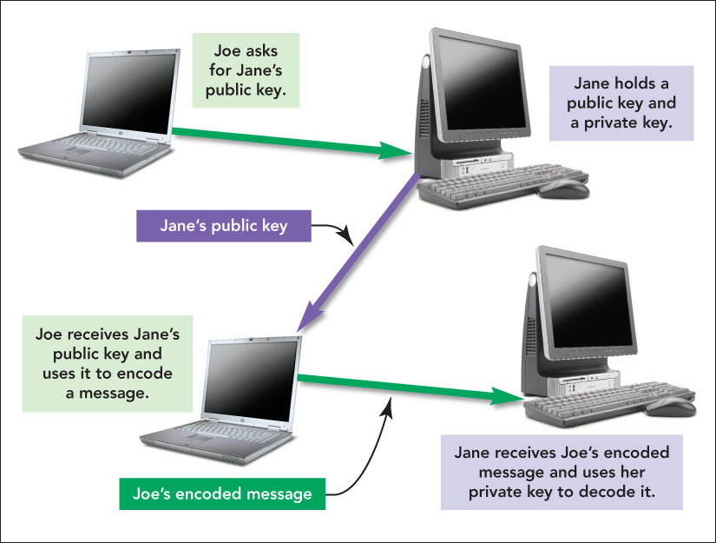
The Encryption Debate
Notes:
This is Figure 9.30.

Slide 39
The Encryption Debate
Public Key Infrastructure (PKI)
Uniform set of encryption standards
No dominant standard
Public fear of a monopoly if a PKI is chosen

Slide 40
The Encryption Debate
Encryption and Public Security Issues
The U.S. government continues its search for ways to balance the public’s right to privacy and the government’s need to know.

Slide 41
Prosecuting Violators
E-discovery is the obligation of parties to a lawsuit to exchange documents that exist only in electronic form.
Computer forensics refers to legal evidence found in computers and digital storage media.

Slide 42
Summary
Lack of complete federal regulations to protect the right to privacy for individuals allows numerous Web sites to collect and accumulate personal information.
Computer crime and cybercrime are on the rise and include such crimes as identity theft, malware, fraud, and theft.

Slide 43
Summary
Computer criminals, such as crackers, cybergang members, and virus authors, are often the cause of the increase in computer security risks.
Security risks are events, actions, and situations that could lead to losses.

Slide 44
Summary
Although no computer system can be totally safe, you can take simple steps to protect your computer and data.
Encryption can be used to guard privacy online through public key encryption.
The government must keep trying to find a balance between its need to know and the privacy rights of individuals.

