Slide 1

Computers Are Your Future
Eleventh Edition
Chapter 6: The Internet and the World Wide Web

Slide 2
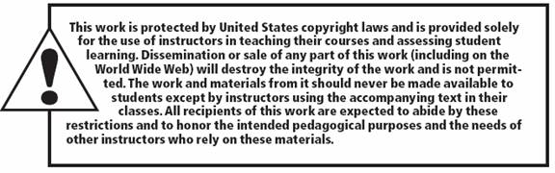
All rights reserved. No part of this publication may be reproduced, stored in a retrieval system, or transmitted, in any form or by any means, electronic, mechanical, photocopying, recording, or otherwise, without the prior written permission of the publisher. Printed in the United States of America.
Copyright © 2011 Pearson Education, Inc.
Publishing as Prentice Hall
2

Slide 3
Objectives
Explain how the Internet works.
Describe methods for accessing the Internet.
Define and differentiate between the Internet and the World Wide Web.
Explain the concept of hypertext.

Slide 4
Objectives
Contrast Web browsers and Web servers.
Explain the parts of a URL and how to access Web pages.
Contrast Web subject guides and search engines

Slide 5
Objectives
Explain how search operators can improve Web search results.
Evaluate the reliability of information on a Web page.
List the most popular Internet services and explain what they do.
Identify and describe the three types of e-commerce.

Slide 6
Objectives
Spot the indicators of a secure Web site.
Recognize the hazards of using the Web.
Become familiar with safe surfing procedures.

Slide 7
How the Internet Works
The Internet is a universal system of computers and networks.
Cyberspace, a term used to refer to the Internet, is the unlimited span of networks using the same data exchange methods.

Slide 8
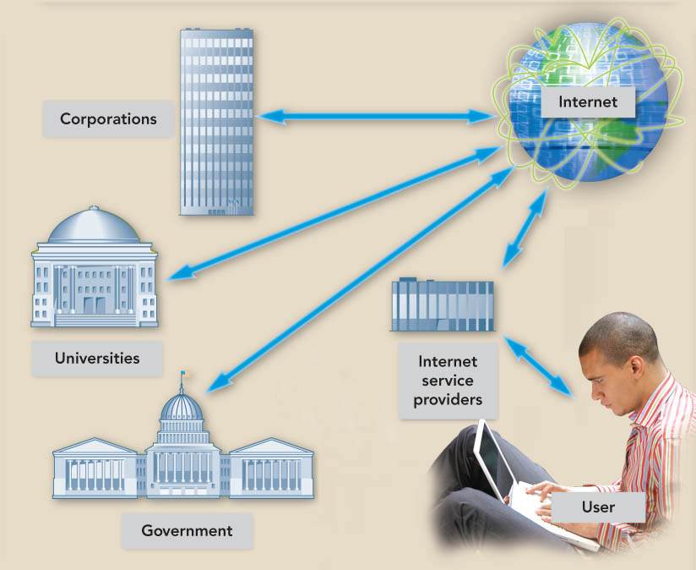
How the Internet Works
Volunteers maintain the Internet networks.
Private and public groups provide the equipment.
Network service providers such as AT&T and Sprint maintain the Internet backbone, the main high-speed routes.
Notes:
This is Figure 6.3.

Slide 9

How the Internet Works
Interoperability is the ability to work with different brands and models of computers.
Transmission Control Protocol/Internet Protocol (TCP/IP) provides methods for packaging and transmitting information.
Notes:
This is Figure 6.4.

Slide 10
Accessing the Internet:
Going Online
Internet service providers (ISPs)
  Supply and sustain user connections to the Internet.
  Maintain the hardware and software required for those connections.
  Protect their sites and networks from outside threats.

Slide 11
Accessing the Internet:
Going Online
  Methods to access the Internet
    Dial-up access connects users to the Internet through a modem and a telephone line.
    Digital subscriber line (DSL) is a high-speed online connection that requires a special external modem with telephone lines.
    Cable access provides a high-speed Internet connection using a cable modem, not a phone line.

Slide 12
Accessing the Internet:
Going Online
  Methods to access the Internet
    Satellite access requires a satellite dish in addition to a phone line and modem for an Internet connection.
      Satellite for high-speed downloading
      Phone line and modem for uploading
    Fiber-optic service (FiOS) provides extremely fast Internet access through fiber-optic lines that run directly to users’ homes. No modems are required.

Slide 13
The Internet and the Web: What’s the Difference?
The World Wide Web, also known as the Web or WWW:
  Contains billions of documents
  Is a portion of the Internet
  Uses the Internet as a means to transport information
  Is a separate entity from the Internet

Slide 14
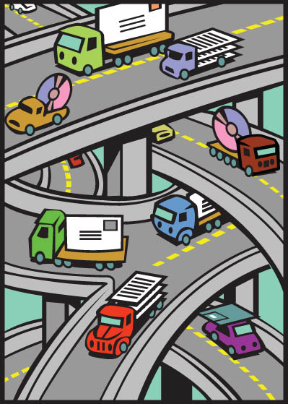
The Internet and the Web: What’s the Difference?
The Web contains the information.
The Internet transports information to and from users.
Notes:
This is Figure 6.7.

Slide 15
The Internet and the Web: What’s the Difference?
A Web page is a document that may include text, graphics, sound, animation, and video.
A Web site is a collection of Web pages.
A Web browser is a program that displays Web pages and linked items.
Notes:
Click to add notes

Slide 16
The Internet and the Web: What’s the Difference?
Hyperlinks or links are words and images that bring other documents into view when clicked.
Hypertext uses links to move to additional related information.
Hypertext Markup Language (HTML) uses tags to specify how a Web page should display.
Notes:
Click to add notes

Slide 17
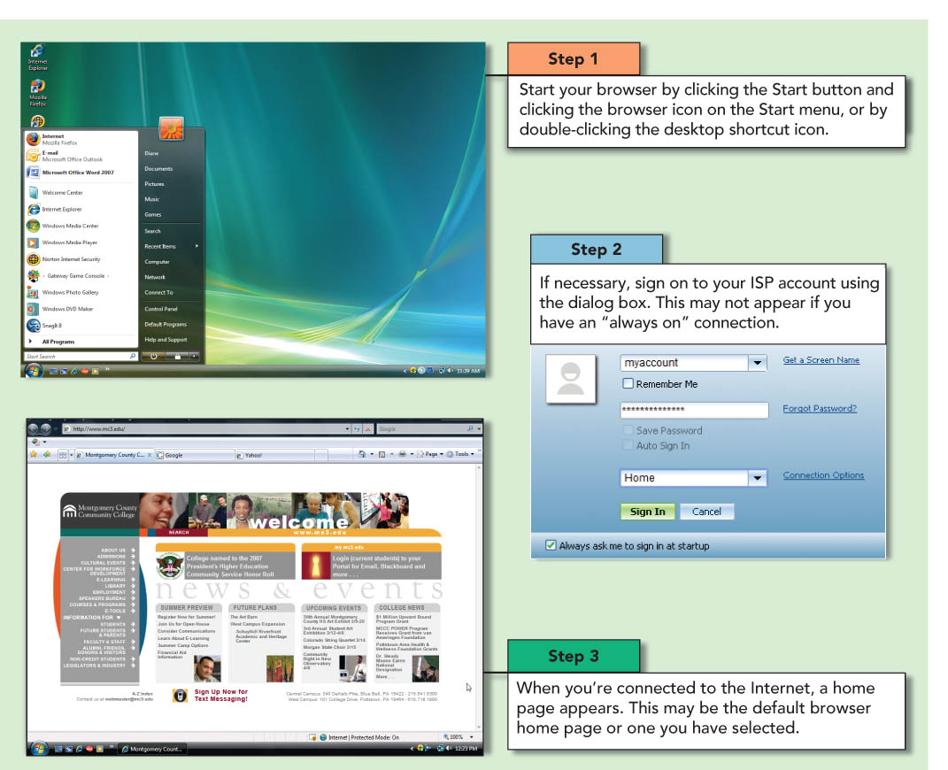
The Internet and the Web: What’s the Difference?
A Web browser is a program that displays a Web document and permits access to linked documents.
Plug-ins are software programs that browsers use for extra features such as sound and video.
Notes:
This is Figure 6.10.

Slide 18
The Internet and the Web: What’s the Difference?
The most popular Web browsers
  Mozilla Firefox
  Google Chrome
  Internet Explorer
  Opera
  Safari

Slide 19
The Internet and the Web: What’s the Difference?
Web sites and their associated information are stored on computers called Web servers.
Web servers are used to recognize information requests, process the requests, and send the requested documents.

Slide 20
The Internet and the Web: What’s the Difference?
Every device connected to the Internet, including PCs and servers, is given a unique network identifier called an Internet Protocol (IP) address.
The identification of an Internet resource’s type and location is performed through its Uniform Resource Locator (URL).

Slide 21
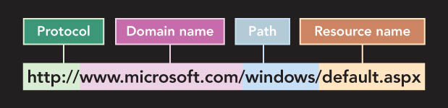
The Internet and the Web: What’s the Difference?
The complete URL is made up of the Hypertext Transfer Protocol (HTTP), domain name, path, and resource name.
Notes:
This is Figure 6.13.

Slide 22
The Internet and the Web: What’s the Difference?
Ways to access a Web page
  Type a URL into the address bar.
  Click a tab in the browser window.
  Click a hyperlink.
The history list compiles a list of the Web pages that the user has visited.

Slide 23
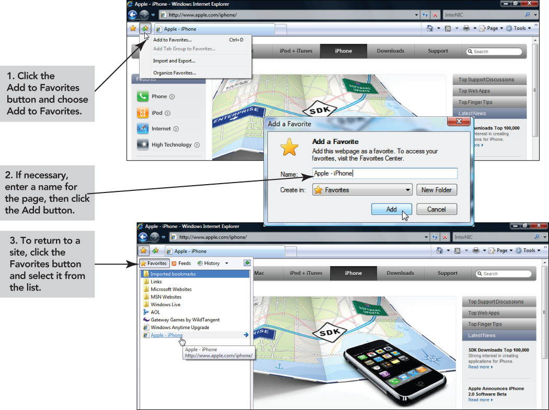
The Internet and the Web: What’s the Difference?
Notes:
This is Figure 6.16.

Slide 24
The Internet and the Web: What’s the Difference?
Downloading is the process of transferring a file or document from one computer to the user’s computer.
Uploading is the process of transferring a file or document from the user’s computer to another computer.
Notes:
Click to add notes

Slide 25
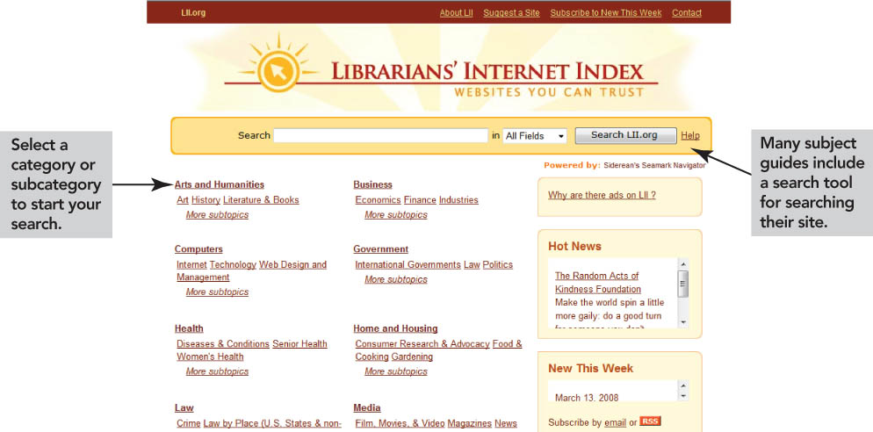
Finding Information on the Web
A subject guide, where Web pages are grouped under specific headings, is offered by some search sites.
Notes:
This is Figure 6.18.

Slide 26
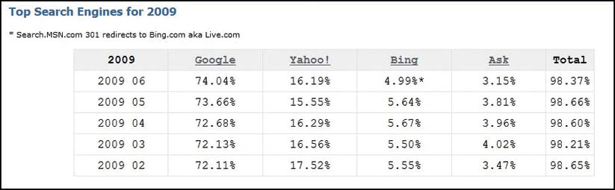
Finding Information on the Web
Search engines index databases of Web pages to enable fast information searches.
Notes:
This is Figure 6.19.

Slide 27
Finding Information on the Web
Specialized search engines index information such as job advertisements, and names and addresses.
Some Web site home pages include portals, which provide organized subject guide links to topics such as the news, local weather, and e-mail.
Notes:
Click to add notes

Slide 28
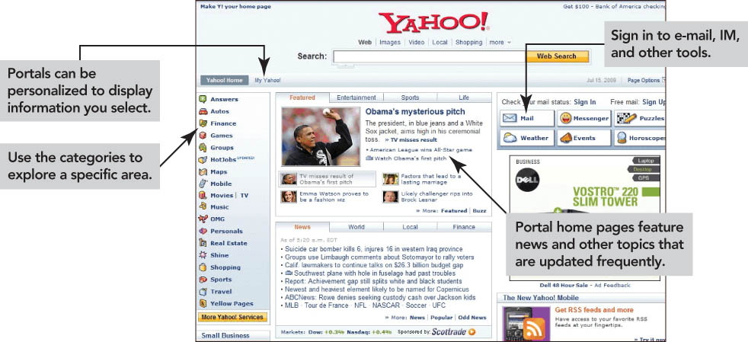
Finding Information on the Web
Example of a portal
Notes:
This is Figure 6.21.

Slide 29
Finding Information on the Web
Search operators are used to perform complex searches.
Inclusion operators, generally a plus sign (+), are used so that only Web pages including those criteria are retrieved.
Exclusion operators, generally a minus sign (-), are used so that only Web pages excluding those criteria are retrieved.
Notes:
Click to add notes

Slide 30
Finding Information on the Web
Wildcard symbols, such as ? and *, replace the zero or additional characters in search words to improve search accuracy.
In phrase searching, the user places quotation marks around a phrase to create a complete unit for search purposes. As a result, search engines retrieve only those sites that contain the exact phrase.
Notes:
Click to add notes

Slide 31
Finding Information on the Web
Boolean searches link search words by using logical operators such as AND, OR, and NOT.
Using the AND, OR, and NOT logical operators provides additional criteria for a search engine to use when retrieving documents.
Notes:
Click to add notes

Slide 32
Finding Information on the Web
Evaluate information obtained through the Web carefully for accuracy and validity.
Fact-checking standards are not applied to many Web pages.
Careful evaluation prevents use of biased or inaccurate information.
Notes:
Click to add notes

Slide 33
Finding Information on the Web
Use Web information for schoolwork.
  Access authoritative online sources.
  Locate published works.
  Provide appropriate online and offline reference citations in your work.
An Internet service is a set of standards or protocols that identify how computers communicate through the Internet.
Notes:
Click to add notes

Slide 34
Exploring Internet Services
Electronic mail (e-mail) is a type of application software that makes sending and receiving messages through computer networks possible.
An e-mail attachment is a computer file included with an e-mail message.
Notes:
Click to add notes

Slide 35
Exploring Internet Services
An e-mail address, a unique cyberspace address for each individual, consists of a user name, the name of the hosting e-mail service, and the top-level domain.
Unsolicited e-mails received by users, usually from advertisers, are called spam. Do not open spam.
Notes:
Click to add notes

Slide 36
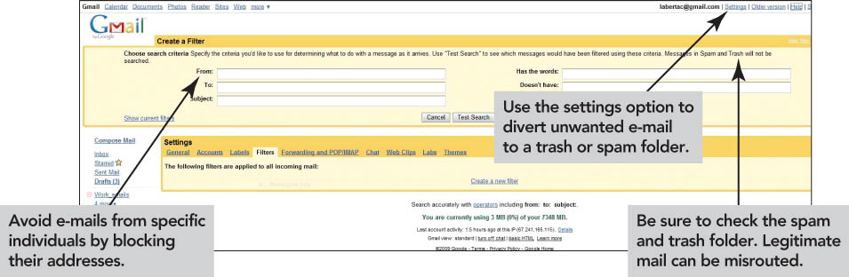
Exploring Internet Services
Notes:
This is Figure 6.26.

Slide 37
Exploring Internet Services
Instant messaging (IM) systems allow immediate, real-time communication with contacts.
  Requires additional software
  Notifies users when a contact is connected to the Internet
  May be susceptible to spimming—spam for instant messaging

Slide 38
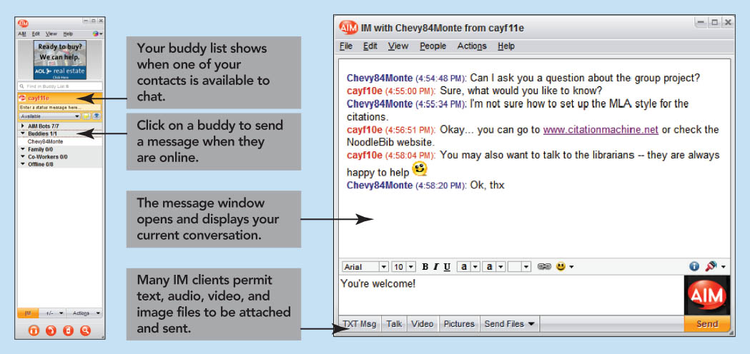
Exploring Internet Services
Notes:
This is Figure 6.27.

Slide 39
Exploring Internet Services
Internet relay chat (IRC) is a special type of Internet service that gives users the ability to join chat groups called channels.
Social networking helps people connect. Social networking sites like MySpace provide the ability to create large communities online.
Notes:
Click to add notes

Slide 40
Exploring Internet Services
Usenet is an international discussion system available through the Internet.
  It is made up of many newsgroups—discussion groups dedicated to one topic.
  Discussions within newsgroups are in threads, groupings of commentaries on a particular subject.
Notes:
Click to add notes

Slide 41
Exploring Internet Services
Usenet newsgroups are categorized in the following groups:
  Standard newsgroups of high-quality discussions
  Alt newsgroups created by anyone
  Biz newsgroups devoted to commercial use
Notes:
Click to add notes

Slide 42
Exploring Internet Services
Netiquette is a series of guidelines for good manners when using an Internet service.
Flames are angry messages sent by other users.
Notes:
Click to add notes

Slide 43
Exploring Internet Services
Electronic mailing lists are similar to newsgroups and forums, except that:
  Only subscribers can receive and view messages.
  Messages posted to the mailing list are automatically sent to everyone on the list.
Majordomo is a common freeware electronic mailing list manager.
Notes:
Click to add notes

Slide 44
Exploring Internet Services
File Transfer Protocol (FTP) is a method used to transfer files over the Internet.
  Use when files are too large to attach to e-mails.
  Avoid sending sensitive material to an anonymous FTP site.
  Use to upload Web pages.

Slide 45
E-Commerce
E-commerce is the conducting of business through the use of networks or the Internet.
Business-to-Business (B2B) E-Commerce refers to a business providing supplies to other businesses via the Internet.
Notes:
Click to add notes

Slide 46
E-Commerce
Consumer-to-Consumer (C2C) E-Commerce refers to the exchange of business between individuals. eBay is a good example.
Business-to-Consumer (B2C) E-Commerce refers to shopping online rather than at a physical store.
Notes:
Click to add notes

Slide 47
E-Commerce
Online Shopping
  Shop for good deals.
  Use shopping portals such as PriceGrabber.com to compare prices and products.
  Look for coupons and rebates.
Notes:
Click to add notes

Slide 48
E-Commerce
The DOT-COM Phenomenon
  E-commerce primarily uses Web sites with a .com suffix.
  The period between 1995 and 2000 is called the dot-com boom.
  Many dot-coms crashed in 2000.
  Amazon.com is a profitable company.
Notes:
Click to add notes

Slide 49
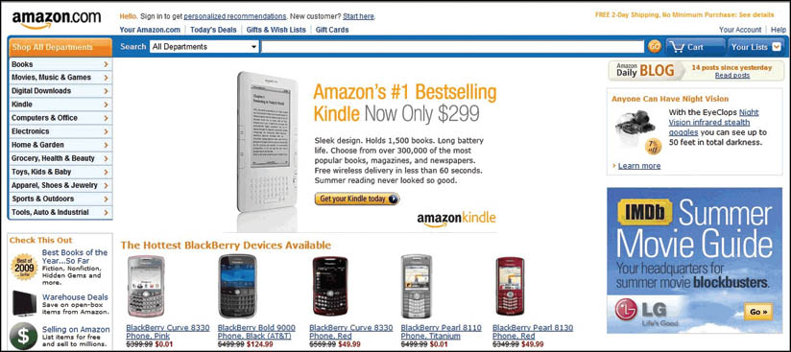
E-Commerce
Notes:
This is Figure 6.33.

Slide 50
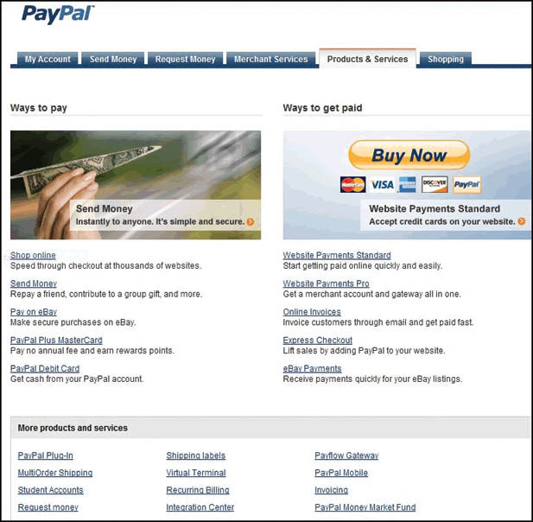
E-Commerce
Building Your Own Business
  Needs only a low capital investment
  Requires an ISP, a Web site, and the ability to ship purchases
Notes:
This is Figure 6.35.

Slide 51
E-Commerce
Other Growth Areas
  Travel reservations
  Banking
  Online stock trading
  Nonretail services, such as health, news, and dating services
Notes:
Click to add notes

Slide 52
E-Commerce
Guidelines for Safe Surfing
  Install antivirus and antispyware utilities to avoid malware, programs designed to damage computer systems.
  Buy only from legitimate businesses.
  Use secure sites with https:// in address, a locked padlock symbol, etc.
  Protect your identity.
  Protect children from unhealthy contact.
Notes:
Click to add notes

Slide 53
Summary
The Internet is a global computer network.
The Internet enables computers connected to it to exchange data.
Public or private Internet service providers supply users with access to the Internet.

Slide 54
Summary
The World Wide Web, which is made up of billions of hypertext documents, uses the Internet.
Web browsers display Web documents and give users the ability to use linked documents.
A URL is made up of a protocol, a domain, a path, and a resource name.

Slide 55
Summary
Search engines permit users to search the databases of the Web.
Web subject guides provide limited search results based on indexes.
The use of search operators and/or Boolean operators improves the efficiency of a search.

Slide 56
Summary
Information found on the Web should be critically evaluated for being reputable and accurate.
Some of the most widely used Internet services are IM, IRC, FTP, Usenet, and electronic mailing lists.

Slide 57
Summary
E-commerce includes B2B, C2C, and B2C.
Follow safe surfing guidelines: avoid malware, use secured sites, and protect children.

