Slide 1

Computers Are Your Future
Eleventh Edition
Chapter 4: System Software

Slide 2
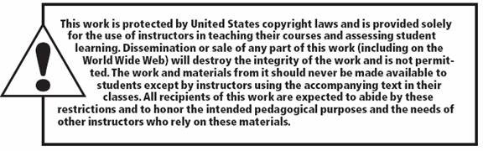
All rights reserved. No part of this publication may be reproduced, stored in a retrieval system, or transmitted, in any form or by any means, electronic, mechanical, photocopying, recording, or otherwise, without the prior written permission of the publisher. Printed in the United States of America.
Copyright © 2011 Pearson Education, Inc.
Publishing as Prentice Hall
2

Slide 3
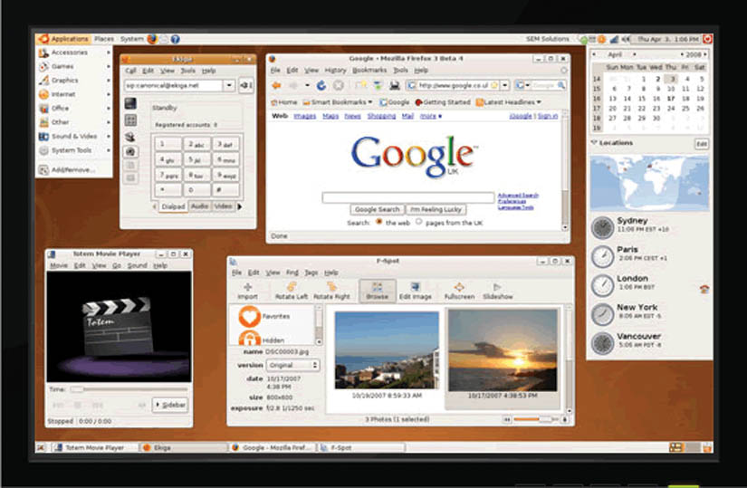
System Software

Slide 4
Objectives
List the two major components of system software.
Explain why a computer needs an operating system.
List the five basic functions of an operating system.
Explain what happens when you turn on a computer.

Slide 5
Objectives
List the three major types of user interfaces.
Discuss the strengths and weaknesses of the most popular operating systems.
List the seven system utilities that are considered essential.
Discuss data backup procedures.

Slide 6
Objectives
Understand troubleshooting techniques and determine probable solutions to any operating system problems you may encounter.

Slide 7
System Software
System software consists of all the programs that enable the computer and its peripheral devices to function smoothly.
System software is divided into two main categories:
  The operating system
  System utilities (utility programs)

Slide 8
The Operating System
The operation system (OS) is a set of programs that coordinates:
  Hardware functions
  Interaction between application software and computer hardware

Slide 9
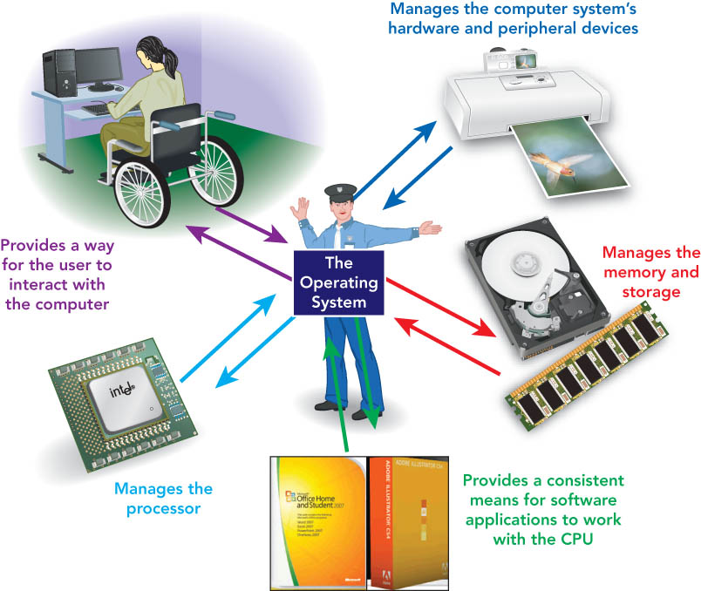
The Operating System
Five basic functions
  Starts the computer
  Manages applications
  Manages memory
  Handles input and output device messages
  Provides a user interface for communication
Notes:
This is Figure 4.1.

Slide 10
The Operating System
Starting the computer
  Loads the OS into RAM
  Called booting
    Cold boot
    Warm boot
  Involves six steps

Slide 11
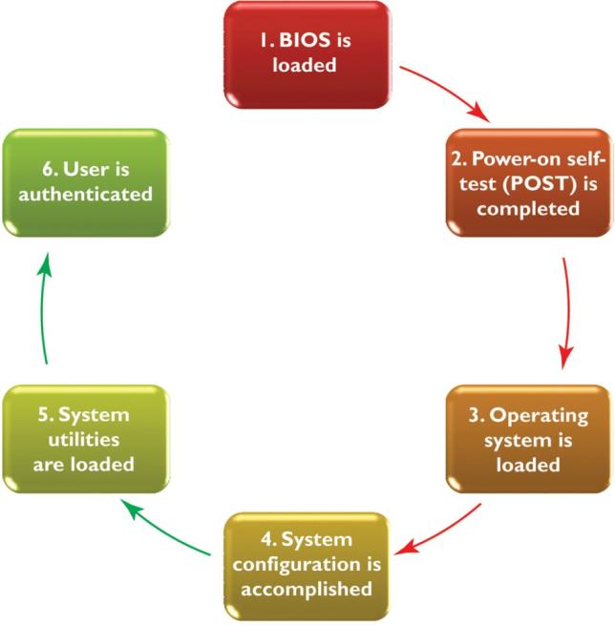
The Operating System
Notes:
This is Figure 4.2.

Slide 12
The Operating System
Function 1: Starting the computer
  Step 1:Load BIOS (Basic Input/Output System) instructions into memory to allow computer to:
    Accept keyboard input.
    Show information on the monitor.

Slide 13
The Operating System
Function 1: Starting the computer
  Step 2: Conduct the power-on self-test (POST) to confirm that both the computer and its peripheral devices are working properly. If any part of the POST fails:
    A beep will sound.
    An error message will appear on the monitor.
    The computer will stop.

Slide 14
The Operating System
Function 1: Starting the computer
  Step 3: Load the operating system.
    BIOS looks for the operating system.
    BIOS loads into memory the kernel, the central part of the operating system.
    The operating system loads the system configuration information.

Slide 15
The Operating System
Function 1: Starting the computer
  Step 4: Check the system configuration.
    The registry, a database, stores information about software and peripherals choices.
    The OS checks the configuration for drivers, utility programs containing instructions for the proper functioning of peripheral devices.
    The OS installs and loads needed drivers.

Slide 16
The Operating System
Function 1: Starting the computer
  Step 5: Load system utilities, such as:
    Antivirus software
    Speaker volume control
  Step 6: Authenticate users.
    If necessary, enter an authentication/login, a user name and password.

Slide 17
The Operating System
Function 2: Managing applications
  Multitasking operating systems permit more than one application to run at the same time.
    The foreground application is the active one.
    Background applications appear inactive.
  Preemptive multitasking ensures that all applications have fair access to the CPU.

Slide 18
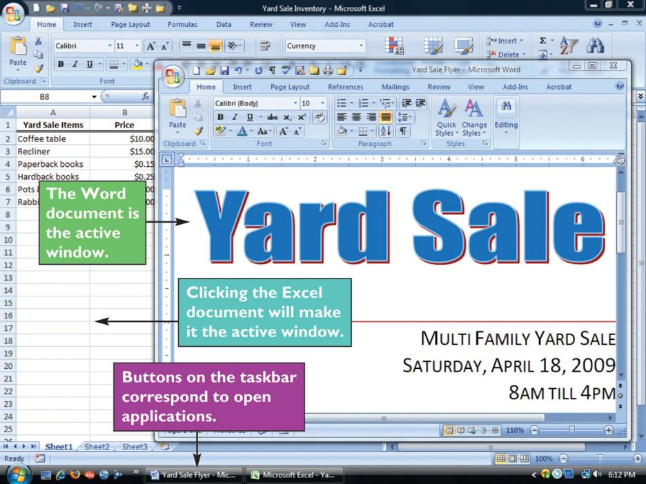
The Operating System
Notes:
This is Figure 4.5.

Slide 19
The Operating System
Function 3: Managing memory
  A buffer, an area that holds data and instructions temporarily, makes programs run faster.
  RAM memory functions as the buffer.
  The OS gives each program a portion of RAM memory and keeps them from interfering with each other.

Slide 20
The Operating System
Function 3: Managing memory
  Virtual memory uses a portion of the hard disk to extend RAM.
    Pages are units of fixed size and contain program instructions and data.
    When RAM is full, copies of pages are temporarily stored in a swap file, a special hard disk file.
    Transferring files between RAM and the hard disk is called paging.

Slide 21
The Operating System
Function 3: Managing memory
  Adding more RAM is often the best way to improve computer performance because:
    Paging slows the computer.
    Accessing data from the hard disk is slower than accessing it from RAM.

Slide 22
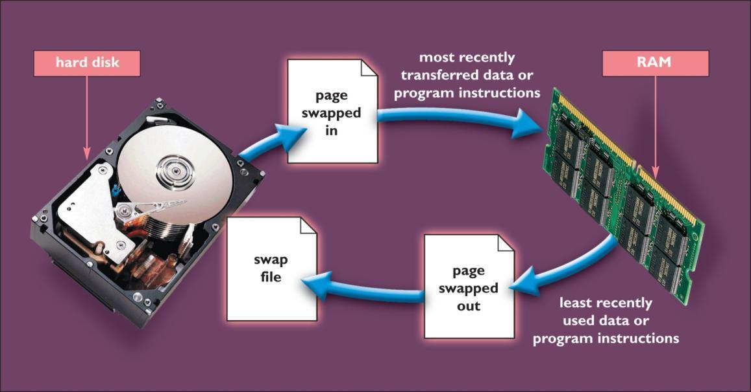
The Operating System
Notes:
This is Figure 4.7.

Slide 23
The Operating System
Function 4: Handling input and output
  Device drivers enable communication between the computer and the devices.
  Interrupts, signals created by input and output devices, notify the OS when actions are taken.

Slide 24
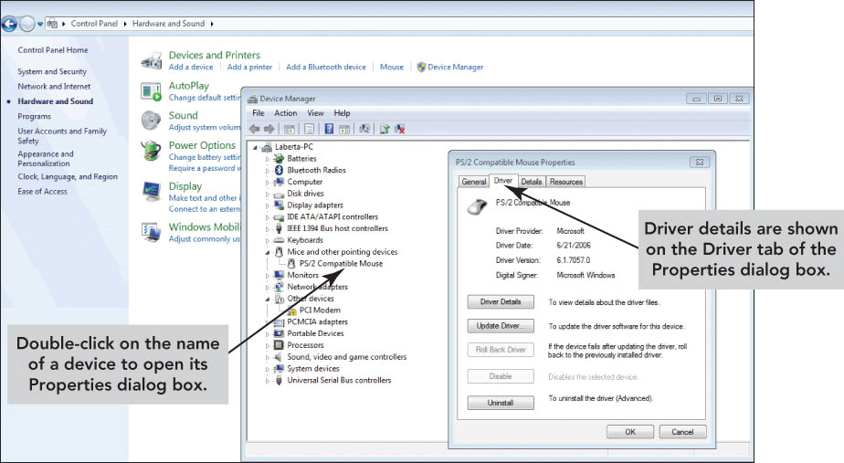
The Operating System
Function 4: Handling input and output
Notes:
This is Figure 4.8.

Slide 25
The Operating System
Function 5: Providing the user interface
    The user interface allows the user to:
    Start application programs
    Manage storage devices
    Safely shut down the computer

Slide 26
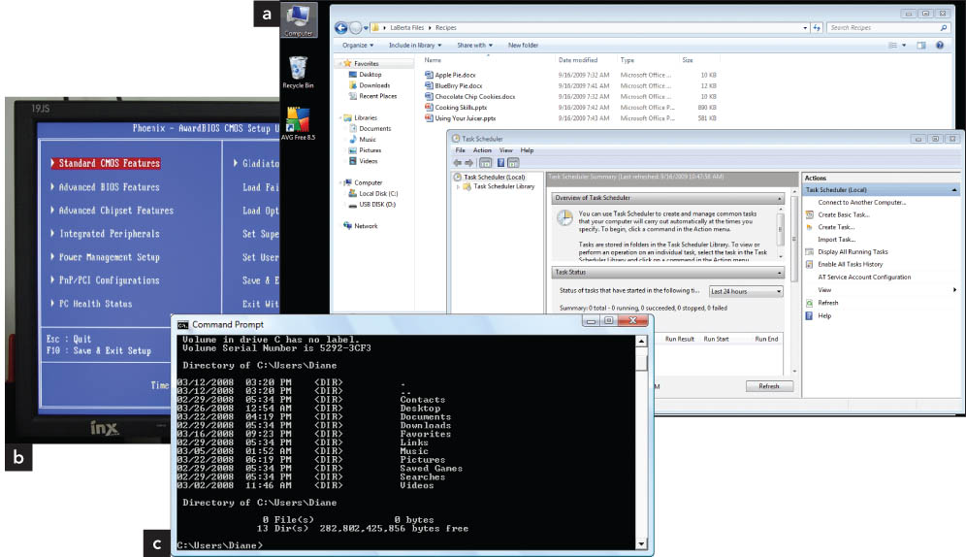
The Operating System
Function 5: Providing the user interface
Graphical user interface
Menu-driven user interface
Command-line user interface
Examples of (a) graphical, (b) menu-driven, and (c) command-line user interfaces
Notes:
This is Figure 4.9.

Slide 27
The Operating System
Function 5: Providing the user interface
  The graphical user interface (GUI) uses icons, which are small images that:
    Represent computer resources used to initiate actions
    Appear on the desktop, the work area created after the OS loads into memory

Slide 28
The Operating System
Function 5: Providing the user interface
  The menu-driven user interface:
    Provides text-based menus
    Displays available user options
  The command-line user interface:
    Requires the user to type commands to instruct the OS to perform the desired actions

Slide 29
Exploring Popular
Operating Systems
Operating Systems | Market Share
Windows XP | 60.55%
Windows Vista | 22.64%
Mac OSX | 7.11%
Linux | 1.97%
Windows 7 | 1.69%
Windows 2000 | 0.78%
Windows 2003 | 0.65%
iPhone OSX | 0.40%
Windows 98 | 0.13%
WAP | 0.07%
Notes:
This is Figure 4.21.

Slide 30
Exploring Popular
Operating Systems
Microsoft Windows
  The most popular operating system
  Several iterations
Notes:
This is Figure 4.12.

Slide 31
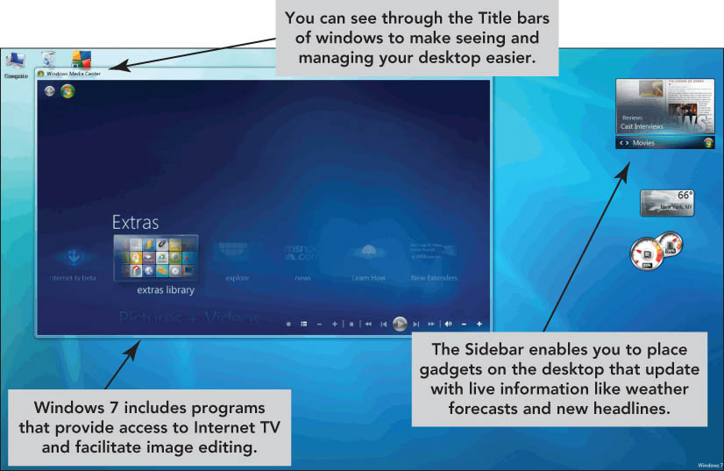
Exploring Popular
Operating Systems
Microsoft Windows
Windows 7 is the latest version.
Notes:
This is Figure 4.13.

Slide 32
Exploring Popular
Operating Systems
Microsoft Windows 7
Feature | Versions
 | Home Premium | Professional | Ultimate
Improved desktop navigation including Windows Touch, a feature that enables touch screen input | X | X | X
Starts programs faster; finds documents quicker | X | X | X
Web experiences are faster, easier, and safer | X | X | X
Watch, pause, and re-wind TV on your PC | X | X | X
Create a home network with HomeGroup | X | X | X
Notes:
This is Figure 4.15.

Slide 33
Exploring Popular
Operating Systems
Microsoft Windows 7 cont’d
Feature | Versions
 | Home Premium | Professional | Ultimate
Create a home network with HomeGroup | X | X | X
Run Windows XP productivity programs in XP Mode |  | X | X
Connect to company networks easier and with more security with Domain Join |  | X | X
Back up to a home or business network |  | X | X
Protect data on your PC and portable storage devices against loss or theft with BitLocker |  |  | X
Work in the language of your choice and switch between any of 35 languages |  |  | X
Notes:
This is Figure 4.15.

Slide 34
Exploring Popular
Operating Systems
Microsoft Windows Vista
  Has translucent windows, three-dimensional animation, and live taskbar thumbnails
  Supports tablet PCs and other mobile devices
  Has new and improved features such as:
    Search
    Networking tools
    Integrated speech recognition
    Gadgets—applications that appear as icons

Slide 35
Exploring Popular
Operating Systems
Microsoft Windows Server 2008
  Used in corporate environments to support client/server systems
  Benefits include:
    Security
    Web server
    Administration
    Virtualization

Slide 36
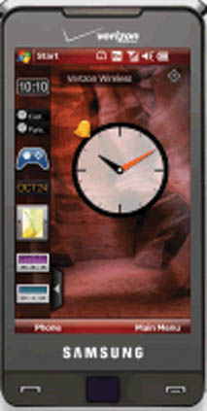
Exploring Popular
Operating Systems
Microsoft Windows Mobile
  Designed for smartphones and PDAs
  Includes simplified versions of Windows programs
  Supports synchronizing with corresponding programs on desktop computers
Notes:
This is Figure 4.16.

Slide 37
Exploring Popular
Operating Systems
Mac OS
  Used on Macintosh personal computers
  Stable and simple to use
  Latest version is Mac OS X Snow Leopard
UNIX
  Features preemptive multitasking
  Has many versions that are not compatible
  Hard to use

Slide 38
Exploring Popular
Operating Systems
Linux
  Is open source software, meaning the source code is available to users
  Powerful and free
  Gaining acceptance for Web servers
Embedded operating systems
  Used in cell phones, kitchen appliances, etc.
  Include Windows CE and Symbian OS

Slide 39
Exploring Popular
Operating Systems
MS-DOS (DOS)
  Short for Microsoft disk operating system
  A command-line user interface OS
PC versus Mac versus Linux
  A platform is the chip and operating system.
  PCs dominate.

Slide 40
System Utilities:
Housekeeping Tools
System utilities (utility programs)
  Software programs that are essential to effective management of the computer system
  Perform tasks such as:
    Backing up files
    Providing antivirus protection
    Compressing files

Slide 41
System Utilities:
Housekeeping Tools
Backup software copies data found on the hard disk to a backup device.
    Full backups include all files and data.
    Incremental backups include only those files changed or added since the previous backup.
  Drive imaging software creates a mirror image of the entire hard drive.

Slide 42
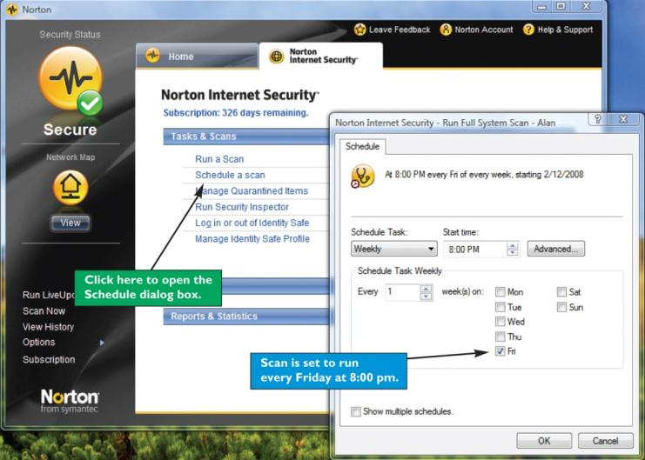
System Utilities:
Housekeeping Tools
Antivirus software protects the computer from viruses.
Popular antivirus programs:
  Norton AntiVirus
  McAfee VirusScan Plus
  AVG
Notes:
This is Figure 4.24.

Slide 43
System Utilities:
Housekeeping Tools
Searching for and managing files
  File manager is the utility software that organizes and manages data.
    Copy files
    Determine how and where files are stored
    Delete files
  A search utility enables you to locate files.

Slide 44
System Utilities:
Housekeeping Tools
Scanning and defragmenting disks
  Disk scanning programs find and resolve disk file storage problems.
  Disk cleanup utilities remove unnecessary files to save space.
  Disk defragmentation programs reorganize stored data in a more efficient manner.

Slide 45
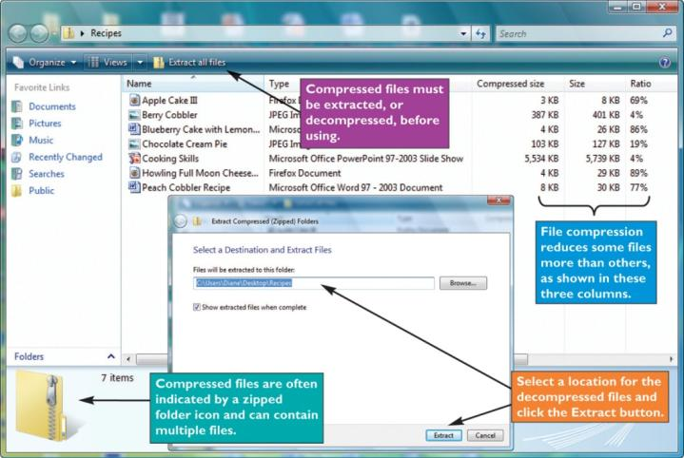
System Utilities:
Housekeeping Tools
File compression utilities
  Decrease the size of files, resulting in faster downloads
  Create archives by storing files in a special format
Notes:
This is Figure 4.28.

Slide 46
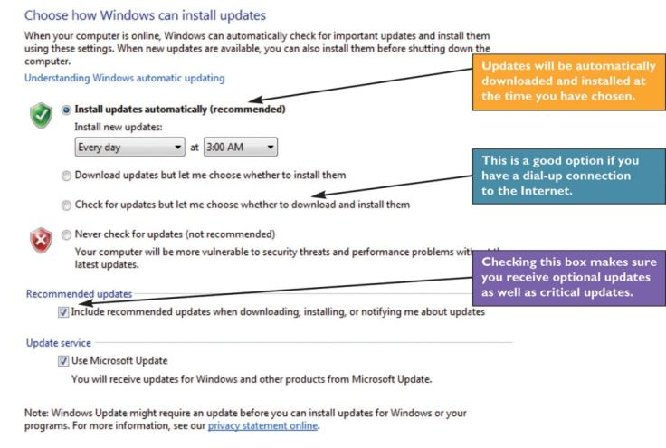
System Utilities:
Housekeeping Tools
Systems Update
  Windows Update for Windows 7 and Vista automatically downloads and installs updates.
  It includes service packs, version upgrades, and security updates.
Notes:
This is Figure 4.29.

Slide 47
System Utilities:
Housekeeping Tools
Troubleshooting
  Keep a boot disk (emergency disk) to load the operating system during times of emergency.
  Use the Windows Help and Support utility.
  Shut down the system properly.
    Use correct procedure; don’t just turn the power off.
    Put in sleep mode, a lower-power state, as an alternative.

Slide 48
Summary
System software is made up of two main parts: the operating system and system utilities.
Computers need software to work. The operating system coordinates the functions of hardware and supports the application software.

Slide 49
Summary
The operating system has five functions: starting the computer, managing applications, managing memory, handling messages from input and output devices, and providing an interface for communication.

Slide 50
Summary
A six-step process occurs each time you start or restart a computer.
There are three types of user interfaces: graphical user interfaces (GUIs), menu-driven user interfaces, and command-line user interfaces.

Slide 51
Summary
For personal computers, Microsoft Windows and Mac OS X are the two major operating systems.
The seven essential system utilities are backup software, antivirus software, file managers, search tools, file compression utilities, disk scanning programs, and disk defragmentation programs.

Slide 52
Summary
Backup procedures should include a full backup, followed by periodic incremental backups.
Troubleshooting skills are required when you use a computer. Do only what you feel comfortable doing, then enlist the help of a professional.

