Slide 1
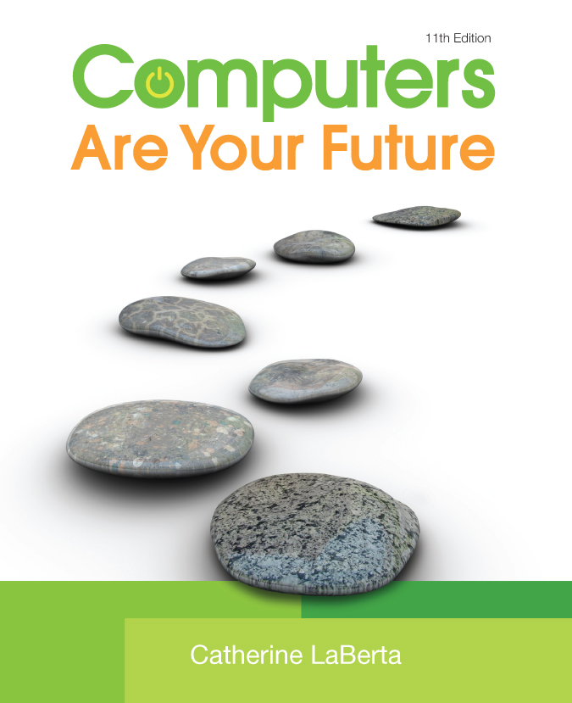
Computers Are Your Future Eleventh Edition
Chapter 3: Input/Output & Storage

Slide 2
All rights reserved. No part of this publication may be reproduced, stored in a retrieval system, or transmitted, in any form or by any means, electronic, mechanical, photocopying, recording, or otherwise, without the prior written permission of the publisher. Printed in the United States of America.
Copyright © 2011 Pearson Education, Inc.
Publishing as Prentice Hall
2

Slide 3
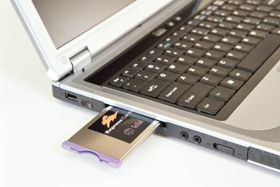
Input/Output & Storage
Notes:
This is Figure 3.28.

Slide 4
Objectives
Explain the purpose of the special keys on the keyboard and list the most frequently used pointing devices.
List the types of monitors and the characteristics that determine a monitor’s quality.

Slide 5
Objectives
Identify the two major types of printers and indicate the advantages and disadvantages of each.
Distinguish between memory and storage.
Discuss how storage media and devices are categorized.

Slide 6
Objectives
List factors that affect hard disk performance.
Explain how data is stored on hard disks and flash drives.
List and compare the various optical storage media and devices available for personal computers.

Slide 7
Objectives
Describe solid-state storage devices and compare them with other types of storage devices.

Slide 8
Input Devices: Giving Commands
Input is any data or instructions that are entered into a computer.
An input device is a type of hardware that gives users the ability to enter data and instructions into the computer’s random access memory (RAM).

Slide 9
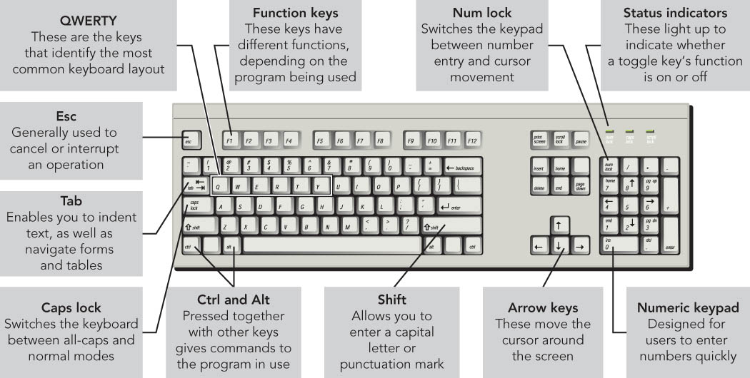
Input Devices: Giving Commands
The keyboard, the most common input device, enables data and instruction entry through the use of a variety of keys.
Notes:
This is Figure 3.2.

Slide 10
Input Devices: Giving Commands
A key matrix is a grid of circuits located under the keys.
A character map is a chart that tells the processor what key has been pressed.
When a key is pressed, the correct character appears at the insertion point—a blinking vertical line, underscore, or highlighted box.

Slide 11
Input Devices: Giving Commands
Keyboards communicate with the computer through connectors such as:
A Universal Serial Bus (USB) connector
A PS/2 cable
Infrared
Radio frequency
Bluetooth

Slide 12
Input Devices: Giving Commands
Special keys on a keyboard include:
Toggle keys: Either on or off
Function keys: Perform specific actions depending on the program
Modifier keys: Used for keyboard shortcuts, which result in speedy access to computer commands

Slide 13
Input Devices: Giving Commands
Alternate keyboards
A virtual keyboard appears on a touch-sensitive screen and accepts input with a stylus or finger.
A virtual laser keyboard, used with devices such as smartphones, provides an alternate way to do e-mail, word processing, and spreadsheets.

Slide 14
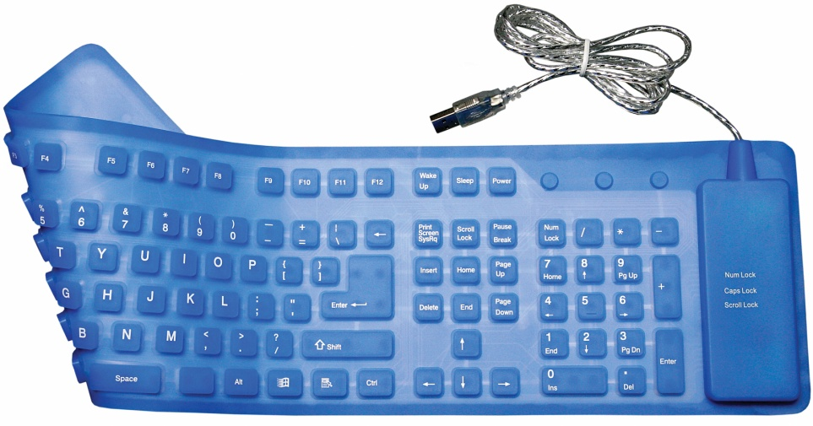
Input Devices: Giving Commands
Alternate keyboards
Flexible keyboards are full-sized, lightweight portable devices.
Wireless keyboards for media center PCs allow users to control media components.
Notes:
This is Figure 3.5.

Slide 15
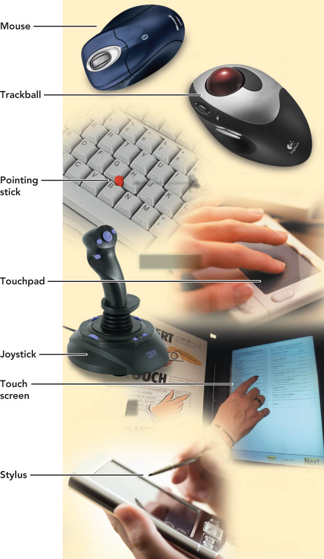
Input Devices: Giving Commands
A pointing device controls an on-screen pointer’s movements.
A pointer is an on-screen symbol that signifies the command, input, or possible response.
Notes:
This is Figure 3.7.

Slide 16
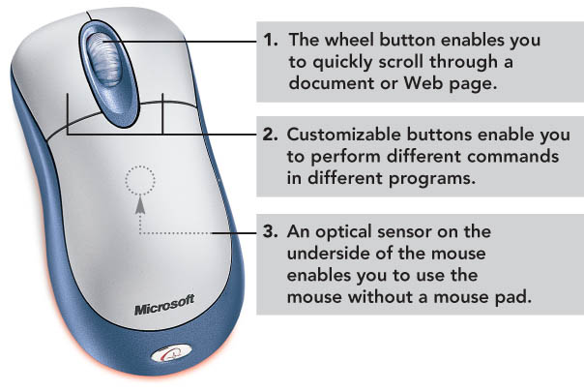
Input Devices: Giving Commands
The mouse is the most popular pointing device.
A wheel mouse has a wheel for easy vertical scrolling on documents and Web pages.
Notes:
This is Figure 3.8.

Slide 17
Input Devices: Giving Commands
Mouse alternatives
Trackball
Pointing stick
Touchpad
Joystick
Touch screen
Stylus

Slide 18
Input Devices: Giving Commands
Alternative specialized input devices include:
Microphones for voice or speech recognition
Scanner for optical character recognition (OCR)
Bar code reader
Optical mark reader (OMR)

Slide 19
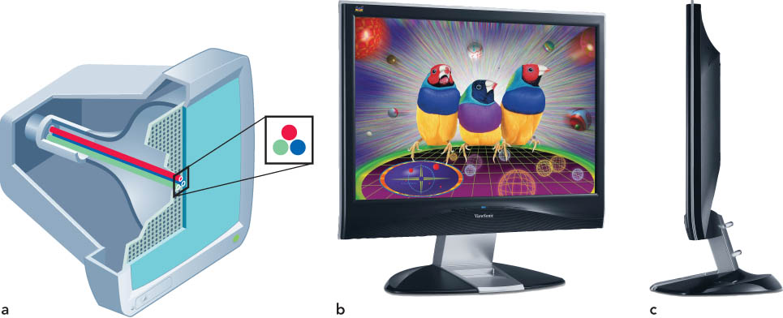
Output Devices: Engaging Our Senses
Output devices enable users to see, hear, or feel the end result of processing operations.
The two most popular output devices are monitors and printers.
Notes:
This is Figure 3.14.

Slide 20
Output Devices: Engaging Our Senses
Monitors display a temporary copy (soft copy) of processed data.
Types of monitors include:
Cathode-ray tube (CRT) monitors
Liquid crystal display (LCD) monitors

Slide 21
Output Devices: Engaging Our Senses
LCD monitors, called flat-panel displays:
Have a thin profile
Are used with newer desktops and notebooks
Are rapidly replacing CRT monitors
May accommodate high-definition video

Slide 22
Output Devices: Engaging Our Senses
Active-matrix monitors
Also known as thin-film transistor (TFT) technology
Used for better on-screen color quality
Field-emission displays are more rugged and not commonly used.

Slide 23
Output Devices: Engaging Our Senses
A monitor’s size is its diagonal measurement.
Monitor size is straightforward for LCDs but more complex for CRTs.
Quoted size is the size of the screen.
Viewable area is the area unobstructed by the housing.
Both must be disclosed by the manufacturer.

Slide 24
Output Devices: Engaging Our Senses
Resolution refers to the sharpness of an image. The number of pixels (picture elements) controls the resolution.

Slide 25
Output Devices: Engaging Our Senses
High-definition television (HDTV), a type of high-quality television, can be connected to personal computers.
Requires a video card to supply the required DVI or HDMI port on the computer and a corresponding output on the TV
Provides very high resolution: 1920 x 1080

Slide 26
Output Devices: Engaging Our Senses
Printers supply a hard copy of output displayed on a computer’s monitor.
Types of printers include:
Inkjet printers
Laser printers
Dot-matrix printers
Thermal-transfer printers
Photo printers
Plotters

Slide 27
Output Devices: Engaging Our Senses
Inkjet printers (nonimpact printers) are popular with home users and provide excellent images made up of small dots.
Advantages
Are inexpensive
Generate professional color output
Disadvantage
Are relatively slow

Slide 28
Output Devices: Engaging Our Senses
Laser printers (nonimpact printers) use electrostatic reproductive technology to produce high-quality output.
Advantages
Print faster than inkjet printers
Black-and-white printing costs less per page than inkjet printing
Disadvantage
Color laser printers are still more expensive

Slide 29
Output Devices: Engaging Our Senses
Dot-matrix printers (impact printers)
Older, less popular printers
Used mostly for printing multipart forms and backup copies
Advantage
Able to print 3,000 lines per minute
Disadvantages
Poor print quality
Noisy

Slide 30
Output Devices: Engaging Our Senses
Thermal-transfer printers
Thermal-wax or direct thermal
Use a heat process
Advantages
High-quality images from the high-quality thermal-wax printers
Popular for mobile printing
Disadvantage
The high-quality thermal printers are expensive.

Slide 31
Output Devices: Engaging Our Senses
Photo printers
Used to produce quality pictures
Often are inkjet printers
Can print directly from a digital camera or memory card
Plotters
Produce images through moving pens
Used for map-making

Slide 32
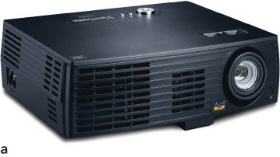
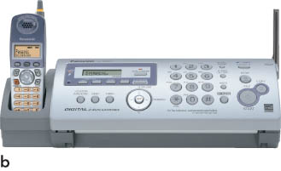
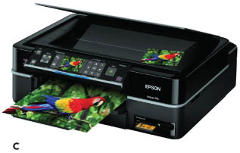
Output Devices: Engaging Our Senses
Other output devices include:
Speakers
LCD projectors
DLP (digital light-processing) projectors
Multifunction devices
Notes:
These are Figures 3.20a – 3.20c.

Slide 33
Storage: Holding Data for Future Use
Storage is the process of saving software and data.
Storage is also called mass storage, auxiliary storage, or secondary storage.

Slide 34
Storage: Holding Data for Future Use
Storage is dependent on two parts:
Recording media to hold the data
Hard disks
Floppy disks
Flash memory
CDs and DVDs
A storage device, which is hardware that contains the tools to place the data on the recording media

Slide 35
Storage: Holding Data for Future Use
Memory (RAM) versus storage
Storage devices retain data even if the computer’s power is turned off, whereas data stored in memory will be lost.
Storage devices are less expensive than memory.

Slide 36
Storage: Holding Data for Future Use
Memory (RAM) versus storage
Storage devices are required during the computer system’s start-up operations.
Storage devices are also used as an output device for saving data.

Slide 37
Storage: Holding Data for Future Use
A hard disk drive (hard disk) is:
The most important storage device
A high-capacity, high-speed device
Considered secondary storage (online or fixed storage), compared with memory/RAM, which is categorized as primary storage

Slide 38
Storage: Holding Data for Future Use
Hard disk drives
Are random access storage devices and permit direct retrieval of desired data
Contain a coating of magnetic material used for data storage

Slide 39
Storage: Holding Data for Future Use
Hard disks record data on concentric bands called tracks.
Tracks are divided into sectors.
A group of two or more sectors is a cluster.

Slide 40
Storage: Holding Data for Future Use
Notes:
This is Figure 3.22.

Slide 41
Storage: Holding Data for Future Use
The computer’s operating system stores in a table the file name and its location on the disk.
The file allocation table (FAT) is the table created by older versions of Microsoft Windows.
The new technology file system (NTFS) is the present system used for tracking file locations.

Slide 42
Storage: Holding Data for Future Use
A portion of a hard disk set aside as if it were a physically separate disk is a partition.
Partitions are often used to house different operating systems.
Having partitions for different operating systems allows users to interact with programs developed in either system.

Slide 43
Storage: Holding Data for Future Use
Hard disk performance
Affected by bad sectors, which are damaged portions of the disk that cannot reliably hold data

Slide 44
Storage: Holding Data for Future Use
Hard disk performance
Positioning performance: how quickly the read/write head can get into position to transfer data
Transfer performance: how quickly the transfer is made from the disk to storage

Slide 45
Storage: Holding Data for Future Use
Hard disk performance
Disk cache is a type of cache memory.
CPU looks in the disk cache before going to the hard disk.
Using the disk cache speeds up data retrieval.

Slide 46
Storage: Holding Data for Future Use
Network attached storage (NAS) is a form of storage that permits retrieval or storage of data by any computer connected to the network.
Remote storage (Internet hard drive) is storage on a server that is available through the Internet.

Slide 47
Storage: Holding Data for Future Use
A flash drive is a storage device that uses solid-state circuitry and has no moving parts.
Flash memory is nonvolatile electronic memory that stores data in blocks on a chip.
Flash drives are increasing in use.

Slide 48
Storage: Holding Data for Future Use
A USB flash drive (memory stick, thumb drive, or jump drive)
Is a popular portable or removable storage device
Replaces legacy technology of floppy disks and Zip disks
Does not require a device driver
Should be removed only when it is not actively in use

Slide 49
Storage: Holding Data for Future Use
CD-ROM or DVD-ROM (compact or digital video disc read-only memory)
Data can be read but not altered.
CD drive and DVD drive
Optical storage devices
Use laser beams to store data through:
Pits, the indentations, a binary 0
Lands, the flat reflective areas, a binary 1

Slide 50
Storage: Holding Data for Future Use
Additional types of optical storage
CD-R (compact disc-recordable)
CD-RW (compact disc-rewritable)
DVD+R (digital video recordable; plus)
DVD-R (digital video recordable; dash)
DVD+RW (digital video rewritable; plus)
DVD-RW (digital video rewritable; dash)
BD-ROM (Blu-ray Disc read only)
BD-R (Blu-ray Disc recordable)
BD-RE (Blu-ray Disc rewritable)

Slide 51
Storage: Holding Data for Future Use
Protecting your discs
Do not expose discs to excessive heat or sunlight.
Do not touch the underside of the disc. Hold the edges.
Do not write on the label side of the disc with a hard implement.
Do not stack discs.
Store discs in cases when not in use.

Slide 52
Storage: Holding Data for Future Use
Solid-state storage devices
Have no moving parts
Are nonvolatile
ExpressCard
A notebook accessory the size of a credit card
Can be used as a modem, as extra memory, or as a network adapter

Slide 53
Storage: Holding Data for Future Use
Flash memory cards
Another type of solid-state storage device
Used with MP3 players and smartphones
Smart card/chip card/integrated circuit card (ICC)
Combines flash memory with a small microprocessor
Able to store and process information

Slide 54
Storage: Holding Data for Future Use
Holographic storage
May make high-density storage possible
Able to create three-dimensional images
Eye-Fi wireless memory card
Combines standard flash memory card features with wireless circuitry
Enables a direct wireless network connection to devices such as digital cameras

Slide 55
Storage: Holding Data for Future Use
Racetrack memory
Under development as a possible replacement for flash memory and hard drives
Will operate at higher speeds and consume less power

Slide 56
Chapter Summary
The keyboard, the most common input device, includes special keys for cursor movement, toggling between modes, performing functions, and modifying key functions.
The mouse is the most common pointing device. Others include trackballs, pointing sticks, touchpads, joysticks, touch screens, and styluses.

Slide 57
Chapter Summary
Newer desktop and notebook monitors use LCDs.
Monitor quality is dependent on its size, viewable area, resolution, and refresh rate.
Printers use inkjet or laser technology. Laser printers are faster and produce high-quality text and graphics but are more expensive.

Slide 58
Chapter Summary
Memory must have the capacity to hold software and data in use.
Memory is temporary whereas storage is retains data when the power is off.
Storage is slower and has greater capacity than memory.

Slide 59
Chapter Summary
Storage media can be categorized in many ways: read-only or read/write; random access; magnetic, flash, or optical; and secondary, external, or portable.
Many factors can affect hard disk performance.

Slide 60
Chapter Summary
Disks store data in tracks, which are combined into sectors and clusters to provide a basic unit of storage.
There are a variety of CD and DVD formats for reading and writing data.
Solid-state storage media have no moving parts and are lightweight and durable.

