Slide 1
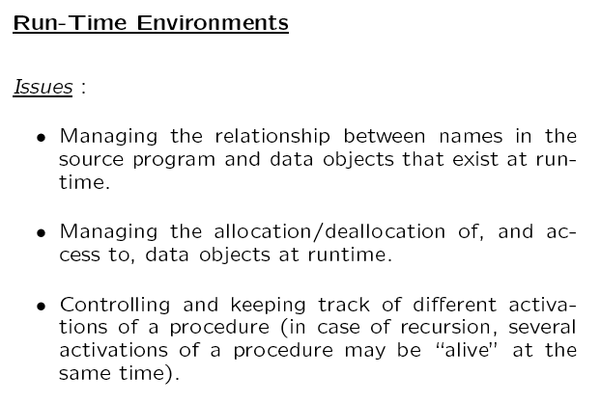

Slide 2
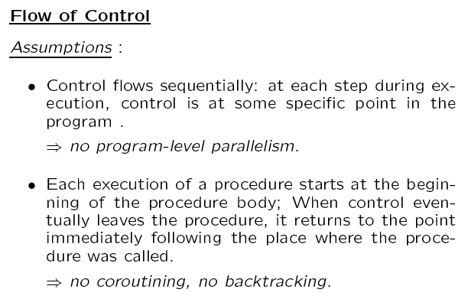

Slide 4
Characteristics for Dynamically Allocated Data Objects
The order in which objects are allocated does not determine the order in which they are deallocated.
Therefore we allocate them from the heap.
At Start
Free List
After Allocation
& Deallocation
Of Data Objects
Data Objects
Free List

Slide 7
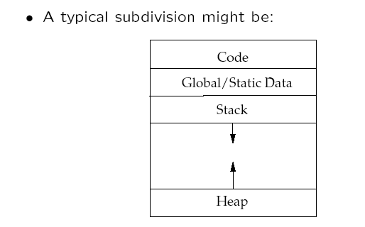

Slide 8
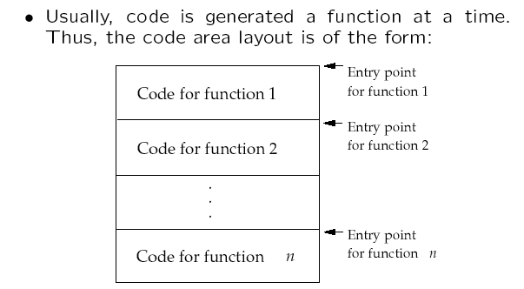
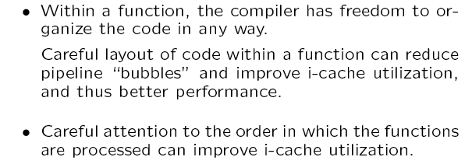

Slide 9
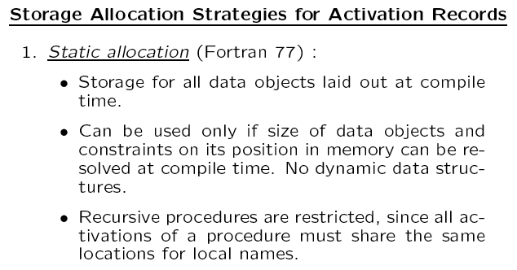

Slide 10
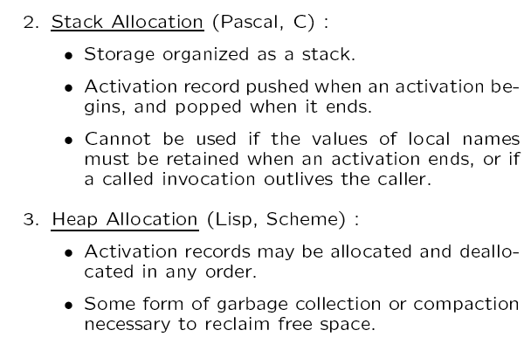

Slide 11
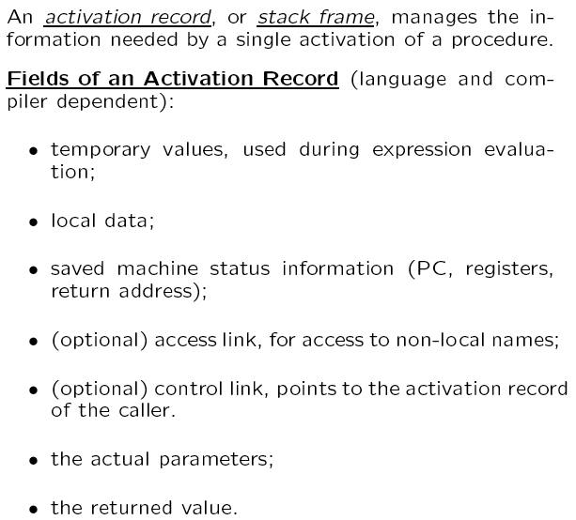

Slide 12
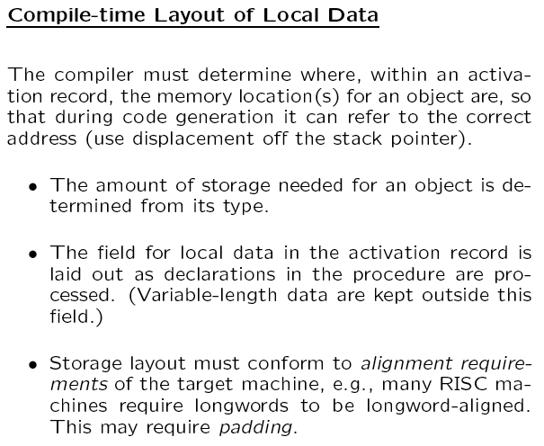

Slide 13
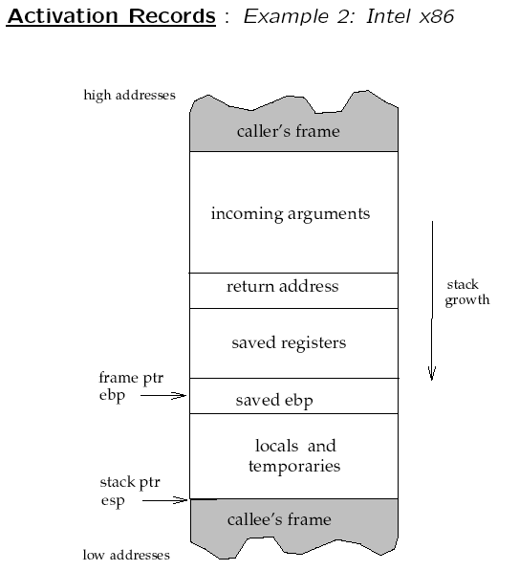

Slide 16
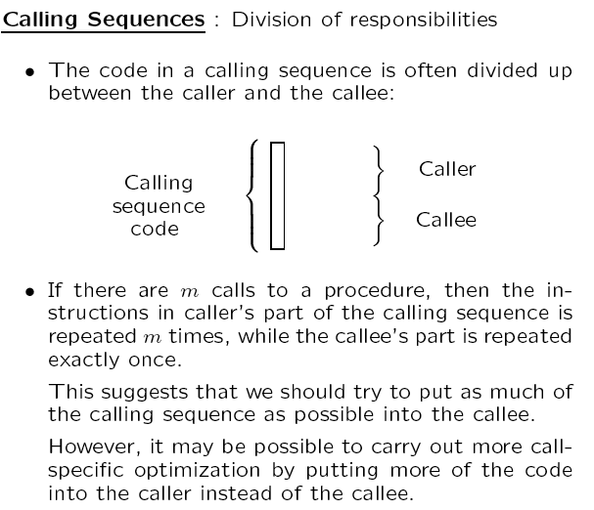

Slide 17
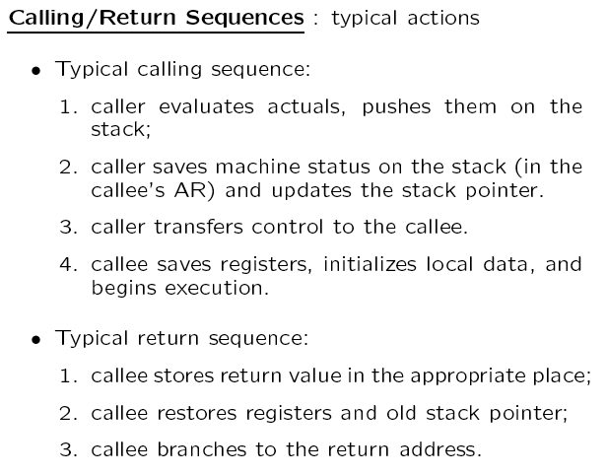

Slide 18
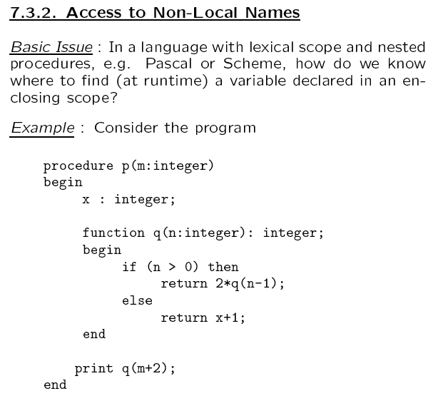

Slide 19
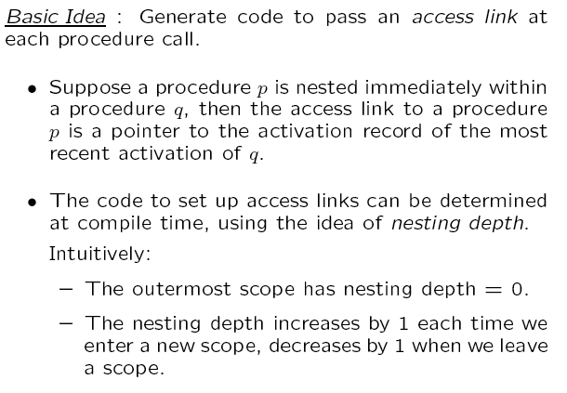

Slide 20
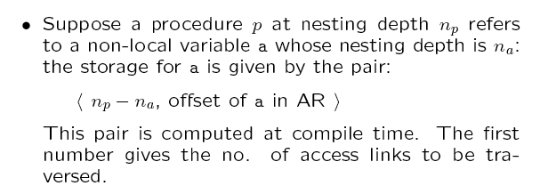

Slide 21
Example
Main
var I, J;
P1
var K, L;
P2
var Q;
Main: NL=1
P1: NL=2
NL=2
NL=3
use K → (1,0)
I : 0
J : 1
P1 : ……….
P3 : ……….
K : 0
L : 1
P2 : ……….
use J → (2,1)
use I → (1,0)
NL=1
P3
var H;
P2: NL=3
P3: NL=2
NL=2
use J → (1,1)
Q : 0
H : 0
offset
use I → (0,0)
number of access links
that must be traversed

Slide 22
Example Contd.
Call Chain: Main → P1 → P3 → P1 → P2
Main I J
P1 K L
P3 H
P1 K L
P2 Q
In P2 access K → (1,0)
In P2 access J → (2,1)
In P2 access I → (2,0)
………
Control Link /
Dynamic Link
Static Link /
Access Link

Slide 23
Example Contd.
Next call P3 – set up the access link
Main I J
P1 K L
P3 H
P1 K L
P2 Q
P3
P2 calls P3
c – current nesting level
d – nesting level of callee’s declaration
Traverse (c – d) links from P2 to find
where P3’s access link should point to
(c – d) = 3 - 1 = 2
P2 → P1 → Main
Access link of P3 points to Main
Control Link /
Dynamic Link
Static Link /
Access Link

Slide 24
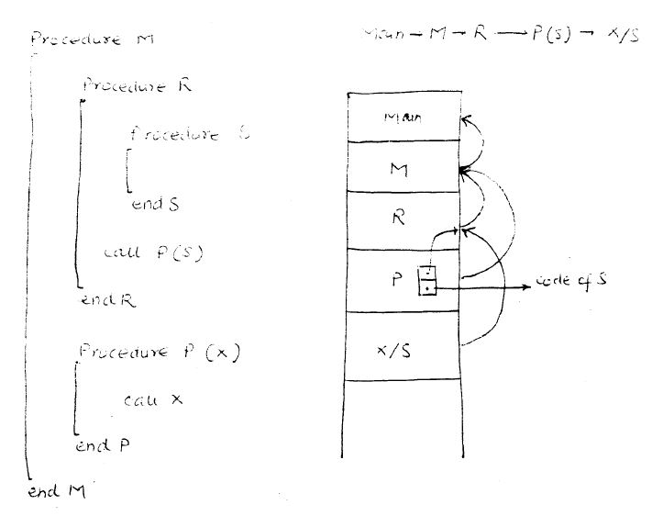
Procedure Parameters
Procedure M
Main → M → R → P(S) → X/S
Procedure R
Procedure S
End S
Call P(S)
End R
Procedure P(X)
Call X
End P
End M

Slide 25
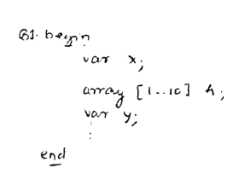
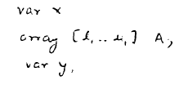
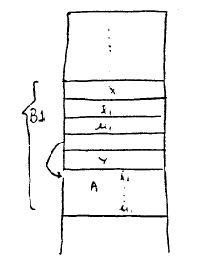
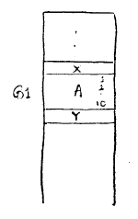
Dynamic Arrays – Maintaining Constant Offsets
B1: begin
Var X;
Array [1 .. 10] A;
Var Y;
end
Var X;
Array [l₁ .. U₁] A;
Var Y;
x
y

