Slide 5
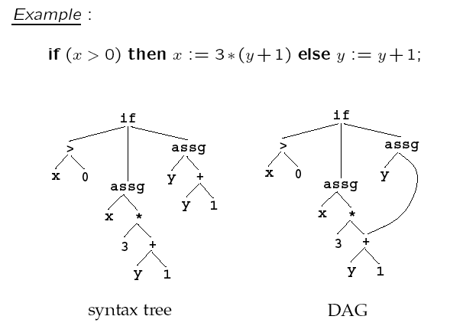

Slide 7
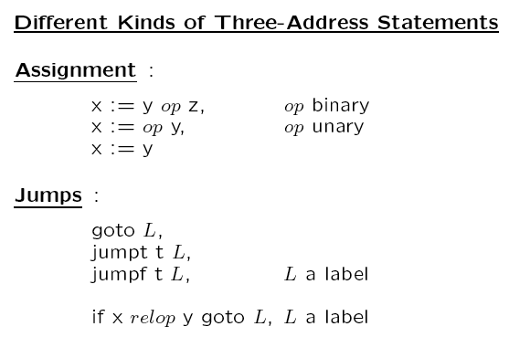

Slide 8
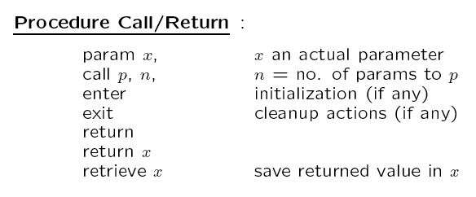

Slide 10
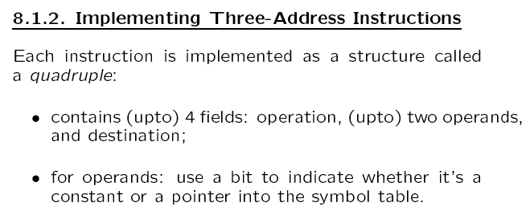
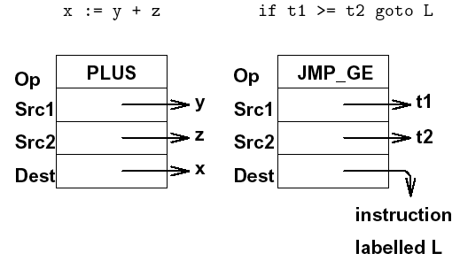

Slide 13
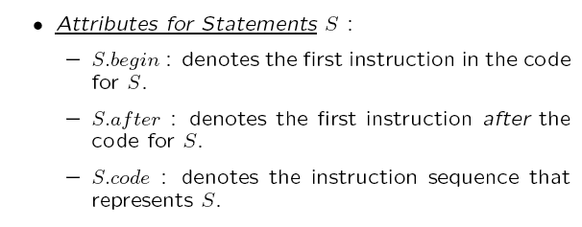

Slide 15
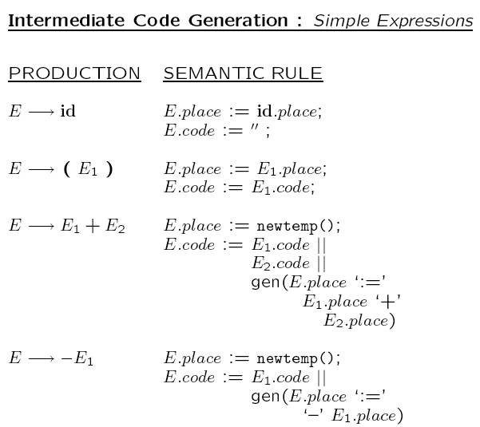

Slide 16
_
_
lo

Slide 17
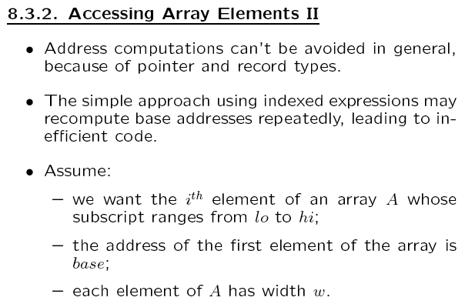
struct
The size of array element can be greater than 1 say w.

Slide 20
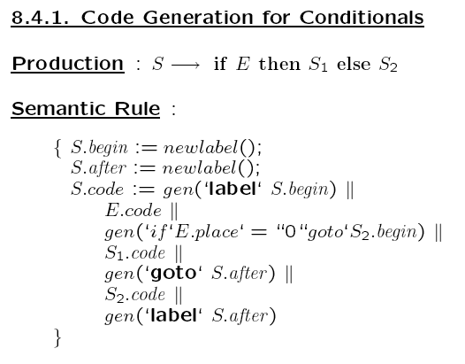
Structure of Generated Code
L1: Code for E
if E == FALSE goto L3
Code for S1
goto L2
L3: Code for S2
L2: …

Slide 21
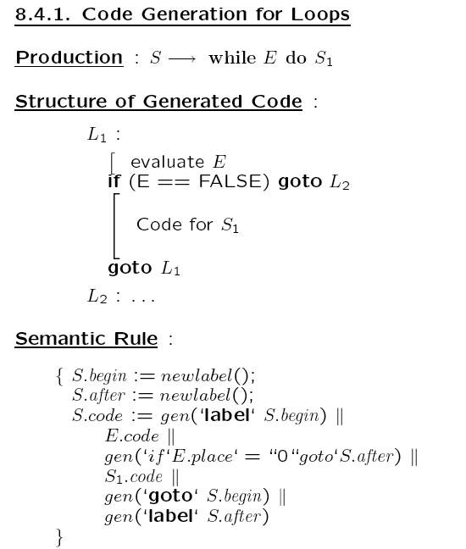
Code for E

Slide 22
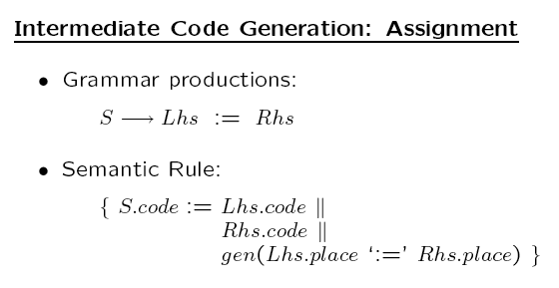

Slide 23
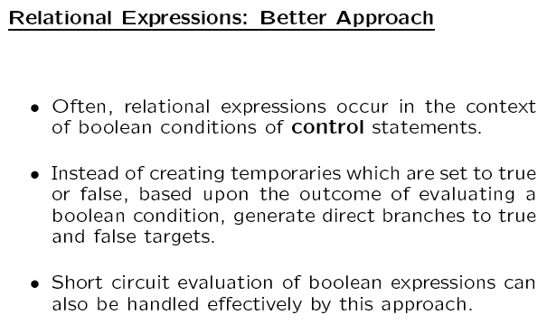

Slide 25
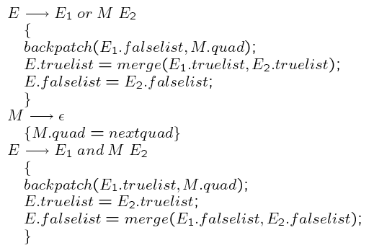

Slide 26
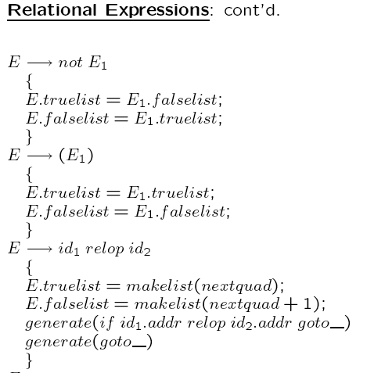

Slide 27
E → true
{
E.truelist = makelist ( nextquad );
generate ( goto__ )
}
E → false
{
E.falselist = makelist ( nextquad );
generate ( goto__ )
}

Slide 28
while a<b do
if x<y then S endif
endwhile
100: if a < b go to 102
101: go to 106
102: if x < y go to 104
103: go to 105 100
104: S.code
105: go to 100
106:

Slide 29
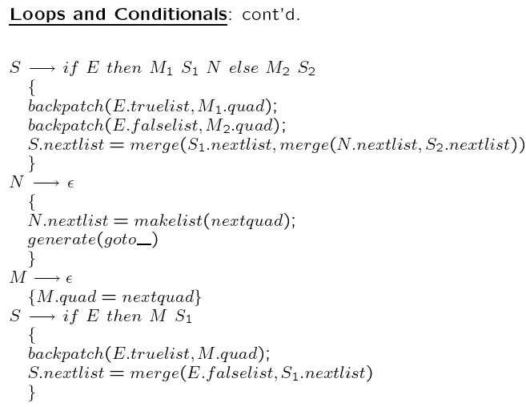

Slide 30
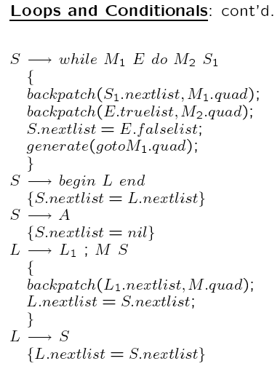
Optimization
takes place here

Slide 31
while a<b do
while x<y do
S
endwhile
endwhile
100: if a < b go to 102
101: go to 107
102: if x < y go to 104
103: go to 106 100
104: S.code
105: go to 102
106: go to 100
107: ….

Slide 32
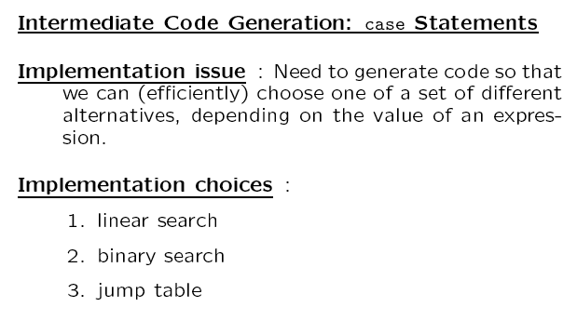

Slide 33
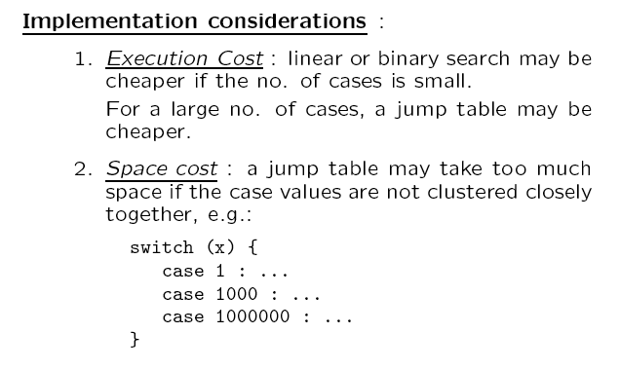

Slide 36
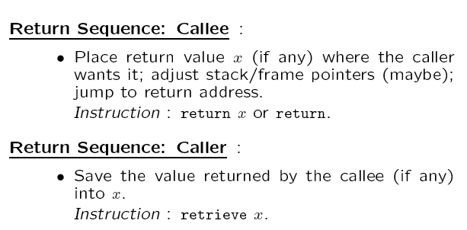

Slide 39
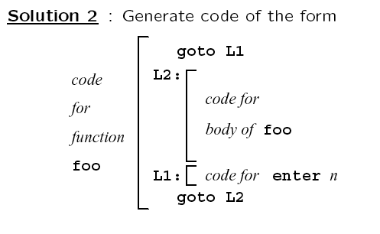

Slide 40
