Slide 1
CuSha:
Vertex-Centric Graph Processing on GPUs
Department of Computer Science and Engineering
University of California Riverside
Farzad Khorasani, Keval Vora,
Rajiv Gupta, Laxmi N. Bhuyan

Slide 2
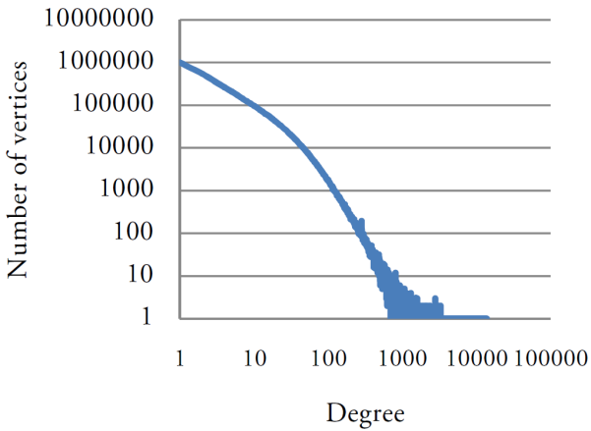
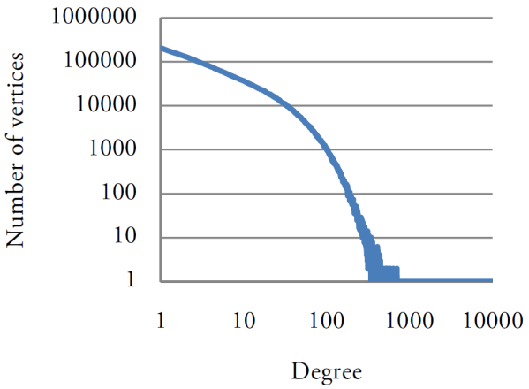
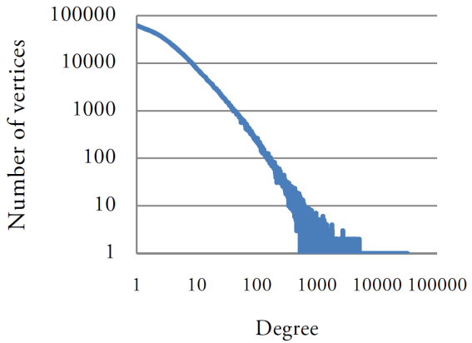
Real-World Graphs
LiveJournal
69 M Edges
5 M Vertices
Pokec
30 M Edges
1.6 M Vertices
HiggsTwitter
15 M Edges
0.45 M Vertices
Real-World Graphs:
- Large
- Sparse
- Varying vertex degree distribution (Power law)
Above graphs are publicly available at http://snap.stanford.edu/data/ .

Slide 3
Graphics Processing Units (GPUs)
GPUs:
SIMD (Single Instruction Multiple Data) underlying architecture.
Demand repetitive processing patterns on regular data.
GPU
Global Memory
Streaming Multiprocessor
Shared Memory
Streaming Multiprocessor
Shared Memory
Streaming Multiprocessor
Shared Memory
Warp 0
Warp 1
Warp n
Warp 0
Warp 1
Warp n
Warp 0
Warp 1
Warp n
Irregular nature of real graphs is in contrary with GPU architecture,
can lead to Irregular Memory Accesses & GPU Underutilization.
Notes:
SIMT is the term coined by Nvidia to emphasize on the fact threads in different warps can take different execution paths. And also threads inside a warp can take different execution paths by having all threads take all the paths while in each phase irrelevant threads are disabled.
A warp is a group of 32 threads executing instructions in lockstep. Threads inside a warp are SIMD.
The figure is very simplified.
Here we only focus on graphs fitting into GPU memory.

Slide 4
Previous Generic Graph Processing solutions on GPUs
Using CSR assign every vertex to one thread. [Harish et al, HiPC 2007]
Threads iterate through assigned vertex’s neighbors.
Introduces load imbalance for threads.
Inefficient mapping of model and underlying GPU architecture.
Non-coalesced memory accesses by different warp lanes.
Using CSR assign every vertex to one virtual warp. [Hong et al, PPoPP 2011]
Virtual warp lanes process vertex’s neighbors in parallel.
Non-coalesced accesses are decreased but still exist.
Load imbalance for different warps is still an issue.
Using CSR assemble the frontier for next iteration vertices. [Merrill et al, PPoPP 2012]
Suitable for only queue-based graph processing algorithms.
Non-coalesced accesses still exist.
Notes:
We consider the virtual warp centric technique because it’s the closest to our solution in which same algorithms can be implemented.

Slide 5
Construction of Compressed Sparse Row (CSR) format
InEdgeIdxs
0
2
4
6
7
9
10
12
14
VertexValues
x₀
x₁
x₂
x₃
x₄
x₅
x₆
x₇
SrcIndex
6
7
0
5
1
7
5
0
7
7
1
3
0
6
EdgeValues
9
4
3
2
4
1
2
2
7
4
3
5
6
1
3
2
0
5
7
4
1
7
6
1
6
1
9
2
2
4
5
3
3
4
2
4

Slide 6
Virtual Warp-Centric Method using CSR
InEdgeIdxs
0
2
4
6
7
9
10
12
14
VertexValues
x₀
x₁
x₂
x₃
x₄
x₅
x₆
x₇
SrcIndex
6
7
0
5
1
7
5
0
7
7
1
3
0
6
EdgeValues
9
4
3
2
4
1
2
2
7
4
3
5
6
1
Virtual Warp-Centric method:
- A physical warp can be broken into virtual warps with 2, 4, 8, 16 lanes.
- Warps process vertices in parallel.
- Threads inside virtual warp process vertex neighbors in parallel.
Pros:
- CSR Space-efficiency.
- A vertex neighbor indices are placed continuously.
Cons:
- Varying vertex degrees lead to underutilization & load imbalance.
- Content of neighbors for a vertex are randomly distributed leading to non-coalesced memory accesses.

Slide 7
{ Virtual Warp-Centric Method + CSR } performance
Application | Average global memory access efficiency | Average warp execution efficiency
Breadth-First Search (BFS) | 12.8%-15.8% | 27.8%-38.5%
Single Source Shortest Path (SSSP) | 14.0%-19.6% | 29.7%-39.4%
PageRank (PR) | 10.4%-14.0% | 25.3%-38.0%
Connected Components (CC) | 12.7%-20.6% | 29.9%-35.5%
Single Source Widest Path (SSWP) | 14.5%-20.0% | 29.7%-38.4%
Neural Network (NN) | 13.5%-17.8% | 28.2%-37.4%
Heat Simulation (HS) | 14.5%-18.1% | 27.6%-36.3%
Circuit Simulation (CS) | 12.0%-18.8% | 28.4%-35.5%
Caused by non-coalesced memory loads and stores.
Caused by GPU underutilization and Load imbalance.

Slide 8
A better solution?
- CSR is space-efficient.
- Space-efficiency had been necessary when GPUs had small amounts of global memory.
- What about now??
Graphics Card | Standard RAM config | Introduction year
GeForce GTX TITAN | 6 GB | 2013
GeForce GTX 780 | 3 GB | 2013
GeForce GTX 680 | 2 GB | 2012
GeForce GTX 580 | 1.5 GB | 2011
GeForce GTX 280 | 1 GB | 2009
GeForce GT 8800 | 512 MB | 2007
- Newer discrete GPUs have much larger global memory.
- Integrated GPUs and APUs memory space can be easily increased.
- How about newer graph representation formats that possibly consume more space but will not have CSR cons?

Slide 9
G-Shards representation
- Use shards!!!
- Representing graph with shards has improved I/O performance for disk based graph processing in Graphchi [Kyrola et al, OSDI 2012].
- Shards allow contiguous placement of graph data required by a set of computation.
- G-Shards representation employs shard concept and modifies it appropriately for GPU.
Shard 0
Shard 1
3
2
0
5
EdgeValue
EdgeValue
SrcIndex
DestIndex
SrcIndex
DestIndex
7
4
1
SrcValue
SrcValue
7
6
0
x₀
5
1
0
x₀
3
4
1
1
x₁
1
2
0
x₀
2
7
6
1
9
2
5
x₅
6
1
1
x₁
1
6
2
5
x₅
4
3
3
x₃
2
6
4
6
x₆
4
0
6
x₆
7
7
5
3
3
2
4
7
x₇
3
0
7
x₇
2
4
4
7
x₇
9
2
7
x₇
4
5
VertexValues
x₀
x₁
x₂
x₃
x₄
x₅
x₆
x₇

Slide 10
Construction of G-Shards representation format
- Rule 1: The edge’s destination index determines which shard the edge falls into.
- Rule 2: Edges in the shard are sorted with respect to their source index.
Shard 0
Shard 1
3
SrcIndex
EdgeValue
SrcIndex
EdgeValue
2
0
5
SrcValue
DestIndex
SrcValue
DestIndex
7
7
4
1
0
x₀
5
1
0
x₀
3
4
6
1
x₁
1
2
0
x₀
2
7
1
6
1
9
2
5
x₅
6
1
1
x₁
1
6
2
5
x₅
4
3
3
x₃
2
6
4
5
3
3
6
x₆
4
0
6
x₆
7
7
2
4
4
7
x₇
3
0
7
x₇
2
4
7
x₇
9
2
7
x₇
4
5
VertexValues
x₀
x₁
x₂
x₃
x₄
x₅
x₆
x₇
Notes:
We chose two shards for the representation of example graph. Number of shards is determined by some factors that will be introduced later.

Slide 11
Graph Processing with G-Shards
- Each shard is processed by a thread block.
- One iteration of graph algorithm happens in 4 steps.
1. Threads fetch corresponding VertexValue array content into block shared memory. Load requests coalesce into minimum number of transactions.
Shard 0
Shard 1
SrcIndex
EdgeValue
SrcIndex
EdgeValue
SrcValue
DestIndex
SrcValue
DestIndex
2. Using fetched values, consecutive block threads process consecutive shard edges, coalescing accesses.
0
x₀
5
1
0
x₀
3
4
1
x₁
1
2
0
x₀
2
7
5
x₅
6
1
1
x₁
1
6
3. Block threads write back updated shared memory elements into VertexValue array. Global memory stores are coalesced, similar to step 1.
5
x₅
4
3
3
x₃
2
6
6
x₆
4
0
6
x₆
7
7
7
x₇
3
0
7
x₇
2
4
7
x₇
9
2
7
x₇
4
5
4. To propagate computed results to other shards (plus the source shard itself), each warp in the block updates necessary SrcValue elements in one shard. Since entries are sorted based on SrcIndex, memory, accesses are coalesced.
VertexValues
x₀
x₁
x₂
x₃
x₄
x₅
x₆
x₇
Block Shared Memory
Notes:
During all steps, memory accesses are coalesced.

Slide 12
G-Shards susceptibility: small computation windows
- Small computation windows cause a portion of threads inside the warp being idle while other threads are updating the window element.
- This effect leads to GPU underutilization in G-Shards wearing down the performance.
Shard j-1
Shard j
Shard j+1
Threads of one warp
SrcIndex
SrcValue
It can be proved that three factors make computation windows smaller:
More graph vertices (Larger graph).
More sparsity.
Less vertices assigned to shards.
0
1
2
W_{i,j-1}
W_{i,j+1}
What should be done having a very large and sparse graph to avoid GPU underutilization?
Concatenate windows!!!
3
W_{i,j}
t
Notes:
With the help of figure, it can be verified that if t is for example 7, only one fourth of the threads in the warp will be engaged in updating the window. If t is more, for example 23, three fourth of threads in the warp will be involved in updaitng window content.

Slide 13
Concatenated Windows (CW) representation format
- Concatenated Windows (CW) graph representation format is built by concatenating all SrcIndex elements of windows that need to be updated by the shard.
- A Mapper array is required to fast access SrcValue entries in other shards.
- Concatenated SrcIndex elements alongside Mapper array for shard i form CW_{i} .
CW₀
for W_{0,0}
for W_{0,1}
for W_{0,2}
for W_{0,j}
Shard 0
Shard 1
CW₁
CW₀
CW₁
for W_{1,0}
for W_{1,1}
for W_{1,2}
for W_{1,j}
CW₂
for W_{2,0}
for W_{2,1}
for W_{2,2}
for W_{2,j}
EdgeValue
EdgeValue
SrcIndex
DestIndex
SrcIndex
DestIndex
Mapper
SrcValue
Mapper
SrcValue
CW_{j}
for W_{j,0}
for W_{j,1}
for W_{j,2}
for W_{j,j}
0
0
0
x₀
5
1
5
2
7
x₀
3
4
Shard 0
Shard 1
Shard 2
Shard j
1
1
1
x₁
1
2
5
3
8
x₀
2
7
0
7
2
x₅
6
1
6
4
9
x₁
1
6
W_{0,0}
W_{0,1}
W_{0,2}
W_{0,j}
0
8
3
x₅
4
3
7
5
10
x₃
2
6
W_{1,0}
W_{1,2}
W_{1,j}
W_{1,1}
1
9
4
x₆
4
0
7
6
11
x₆
7
7
W_{2,2}
10
x₇
3
0
6
11
x₇
2
4
W_{2,0}
3
5
12
W_{2,1}
W_{2,j}
6
x₇
9
2
7
12
13
x₇
4
5
7
13
W_{j,2}
W_{j,0}
W_{j,j}
x₀
x₁
x₂
x₃
x₄
x₅
x₆
x₇
W_{j,1}
VertexValues

Slide 14
Graph Processing with CW
- Processing graph using CW happens similar to graph processing using G-Shards, except for the fourth step.
- In the fourth step, threads are assigned to SrcIndex elements. Using Mapper array, threads update corresponding SrcValue elements.
k
k+1
m
m+1
m+2
n
n+1
n+2
p
Thread IDs
SrcIndex
Mapper
CW_{i}
for W_{i,j-1}
for W_{i,j}
for W_{i,j+1}
SrcValue
Shard j-1
SrcValue
Shard j
SrcValue
Shard j+1
k
m+1
n+1
k+1
m+2
n+2
W_{i,j-1}
W_{i,j}
W_{i,j+1}
m
n
p
Notes:
Although memory accesses are not fully coalesced in this case, produced memory requests are the same as G-Shards with added benefit of almost full GPU utilization.

Slide 15
CuSha Framework
- CuSha employs G-Shards and CW to process graphs on GPU.
- CuSha performs described four step procedure using user-defined functions and structures over the input graph.
- User-provided compute function must be atomic with respect to updating the destination vertex.
- The atomic operation will usually be inexpensive because it updates shared memory and also lock contention is low.
- If returned value of update_condition is true for any entry of any shard, algorithm is not converged. Therefore, the host launches a new kernel.
//Required code to implement SSSP in CuSha.
typedef struct Edge { unsigned int Weight; } Edge; //Structure requires a variable for edge weight
typedef struct Vertex { unsigned int Dist; } Vertex ; //Structure requires a variable for its distance
__device__ void init_compute( Vertex* local_V, Veretx* V ) {
local_V->Dist = V->Dist; //init_compute fetches distances from global memory to shared memory
}
__device__ void compute( Vertex* SrcV, StaticVertex* SrcV_static, Edge* E, Vertex* local_V ) {
if (SrcV->Dist != INF) //minimum distance of a vertex from source node is calculated
atomicMin ( &(local_V->Dist), SrcV->Dist + E->Weight );
}
__device__ bool update_condition( Vertex* local_V, Vertex* V ) {
return ( local_V->Dist < V->Dist ); //return true if newly calculated value is smaller.
}
Notes:
The problems with atomics on shared memory are 1) possible bank conflicts 2) lock-based implementation of atomics on shared for pre-Maxwell GPUs.

Slide 16
Performance: Speedups over Virtual Warp-Centric method
 | Cusha-GS over VWC-CSR | Cusha-CW over VWC-CSR
Averages Across Input Graphs
BFS | 1.94x-4.96x | 2.09x-6.12x
SSSP | 1.91x-4.59x | 2.16x-5.96x
PR | 2.66x-5.88x | 3.08x-7.21x
CC | 1.28x-3.32x | 1.36x-4.34x
SSWP | 1.90x-4.11x | 2.19x-5.46x
NN | 1.42x-3.07x | 1.51x-3.47x
HS | 1.42x-3.01x | 1.45x-3.02x
CS | 1.23x-3.50x | 1.27x-3.58x
Averages Across Benchmarks
LiveJournal | 1.66x-2.36x | 1.92x-2.72x
Pokec | 2.40x-3.63x | 2.34x-3.58x
HiggsTwitter | 1.14x-3.59x | 1.14x-3.61x
RoadNetCA | 1.34x-8.64x | 1.92x-12.99x
WebGoogle | 2.41x-3.71x | 2.45x-3.74x
Amazon0312 | 1.37x-2.40x | 1.57x-2.73x
Average over all | 1.72x - 4.05x | 1.89x - 4.89x
Experiment system specs:
Device: GeForce GTX780:12 SMs, 3 GB GDDR5 RAM.
Host: Intel Core i7-3930K Sandy bridge 12 cores (hyper-threading enabled) 3.2 GHz. DDR3 RAM. PCI-e 3.0 16x.
CUDA 5.5 on Ubuntu 12.04. Compilation with highest optimization level flag (-O3).
Above real-world graphs are publicly available at http://snap.stanford.edu/data/ .
Notes:
We tried VWC-CSR with virtual warp sizes 2, 4, 8, 16, and 32.
Memory allocation times are not included in processing time measurements.

Slide 17
Performance: Global Memory and Warp Execution Efficiency
Percentage
Profiled efficiencies are done on LiveJournal graph.
VWC-CSR has the configuration that results in its best performance.
Averaged over all benchmarks | Best VWC-CSR | CuSha-GS | CuSha-CW
Avg global memory store efficiency | 1.93% | 27.64% | 25.06%
Avg global memory load efficiency | 28.18% | 80.15% | 77.59%
Avg warp execution efficiency | 34.48% | 88.90% | 91.57%
Notes:
The global memory store efficiency is the ratio of the global memory store throughput achieved by the program to the global memory store throughput that is actually needed by the program. It indicates how well the threads within a kernel write to the global memory: a high value shows that more store operations are fullfilled with coalesced writes. The average of this value across all kernel iterations during a run is the average global memory store efficiency.
The global memory load efficiency indicates the ratio of achieved global memory load throughput to required load throughput.
Finally, the warp execution efficiency is defined as the ratio of the average active threads in a warp to the maximum possible active threads in a warp per multiprocessor. It indicates how well GPU hardware resources are utilized.
For both CuSha-GS and CuSha-CW, the average global memory load is higher than store mainly because of the heavy, but coalesced, memory reads of shard entries.
VWC-CSR has a much lower warp execution efficiency compared to CuSha mainly due to the impact of different number of neighbors in VWC-CSR. Since CuSha organizes graph edges in large shards, this effect is heavily reduced.

Slide 18
Memory occupied by different graph representations
Normalized Occupied Space
Consumed spaces are average over all benchmarks and normalized WRT the CSR average for each benchmark.
Space overhead of G-Shards over CSR is roughly:
(|E|-|V|) x size_of(Vertex) + |E| x size_of(index) bytes.
Space overhead of CW over G-Shards is roughly:
|E| x size_of(index) bytes.

Slide 19
H2D & D2H copy overhead
Normalized Processing Time
Measured times are done on LiveJournal graph.
VWC-CSR has the configuration that results in its best performance.
- CuSha takes more H2D copy time compared to VWC-CSR mainly because of the space overheads involved in using G-Shards and CW. However, computation friendly representations of G-Shards and CW allow faster processing, which in turn significantly improves the overall performance.
D2H copy only involves the final vertex values and hence, is negligible.
CuSha-CW takes more time to copy compared to CuSha-GS because of the additional Mapper array.

Slide 20
Summary
Use shards for efficient graph processing on GPUs.
G-Shards: a graph representation that suitably maps shards to GPU sub-components providing fully coalesced memory accesses that were not achievable by previous methods such as CSR.
Concatenated Windows (CW): a novel graph representation that modifies G-Shards and eliminates GPU underutilization when having large and sparse graphs.
CuSha: a framework to define vertex-centric graph algorithm and process input graphs using CUDA-enable devices. CuSha can use both of above methods.
CuSha achieves average speedup of 1.71x with G-Shards and 1.91x with CW over fine-tuned Virtual Warp-Centric method that uses CSR representation.

Slide 21
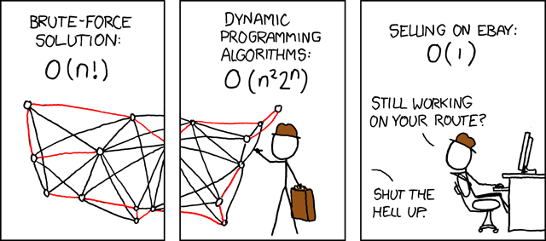
Thank You!
Any Questions?
Picture from http://xkcd.com

Slide 22
Computation Window
- Each shard region whose elements need to be accessed and updated together in step 4 is called a computation window.
Shard 0
Shard 1
SrcIndex
EdgeValue
SrcIndex
EdgeValue
SrcValue
DestIndex
SrcValue
DestIndex
Entries of shard 0 whose SrcIndex elements belong to shard 0.
0
x₀
5
1
0
x₀
3
4
W₀₀
1
x₁
1
2
Entries of shard 1 whose SrcIndex elements belong to shard 0.
0
x₀
2
7
W₀₁
5
x₅
6
1
1
x₁
1
6
5
x₅
4
3
3
x₃
2
6
Entries of shard 0 whose SrcIndex elements belong to shard 1.
W₁₀
6
x₆
4
0
6
x₆
7
7
Entries of shard 1 whose SrcIndex elements belong to shard 1.
7
x₇
3
0
W₁₁
7
x₇
2
4
7
x₇
9
2
7
x₇
4
5
VertexValues
x₀
x₁
x₂
x₃
x₄
x₅
x₆
x₇

Slide 23
Performance: Speedups over Multi-threaded CPU using CSR
 | Cusha-GS over MTCPU-CSR | Cusha-CW over MTCPU-CSR
Averages Across Input Graphs
BFS | 2.41x-10.41x | 2.61x-11.38x
SSSP | 2.61x-12.34x | 2.99x-14.27x
PR | 5.34x-24.45x | 6.46x-28.98x
CC | 1.66x-7.46x | 1.72x-7.74x
SSWP | 2.59x-11.74x | 3.03x-13.85x
NN | 1.82x-19.17x | 1.97x-19.59x
HS | 1.74x-7.07x | 1.80x-7.30x
CS | 2.39x-11.06x | 2.49x-11.55x
Averages Across Benchmarks
LiveJournal | 4.10x-26.63x | 4.74x-29.25x
Pokec | 3.26x-15.19x | 3.2x-14.89x
HiggsTwitter | 1.23x-5.30x | 1.23x-5.34x
RoadNetCA | 1.95x-9.79x | 2.95x-14.29x
WebGoogle | 1.95x-9.79x | 2.95x-14.29x
Amazon0312 | 1.65x-6.27x | 1.88x-7.20x
Average over all | 2.57x - 12.96x | 2.88x - 14.33x
Each CPU thread processes a group of adjacent vertices in every iteration.
Pthreads API is used.
1, 2, 4, 8, 16, 32, 64, and 128 threads tested for each graph and each benchmark.
Notes:
Memory allocation times are not included in processing time measurements.

Slide 24
Sensitivity Analysis of CW using synthetic RMAT graphs
Normalized Processing Time
35.5
We created RMAT graphs in different sizes and sparsities using SNAP library.
We evaluated CuSha performance for SSSP having G-Shards and CW as representations setting different maximum number of vertices assigned to shards (numbers close to x axis). An a_b graph has a million edges and b million vertices.
Varying graph size.
Varying graph sparsity.
Varying |N|: maximum number of vertices assigned to a shard.
Notes:
For the first two frequency distribution of different window sizes, |N| is set to 3k.

Slide 25
Template slide: copy this and edit copied

