Slide 1


Eamonn Keogh
Computer Science & Engineering Department
University of California - Riverside
Riverside, CA 92521
eamonn@cs.ucr.edu
What can Computer Science do for Malaria Research?

Slide 2
Outline
What is malaria?
How big of a problem is it?
Interventions that help mitigate malaria
Some facts about mosquitoes
Our efforts to help in the war on malaria
Conclusions

Slide 3
What is Malaria?
Malaria is a disease that involves high fevers, shaking chills, joint pain, flu-like symptoms, and anemia. In some cases it can produce coma and death.
There are more than 225 million cases of malaria each year, killing around 1-million people.

Slide 4
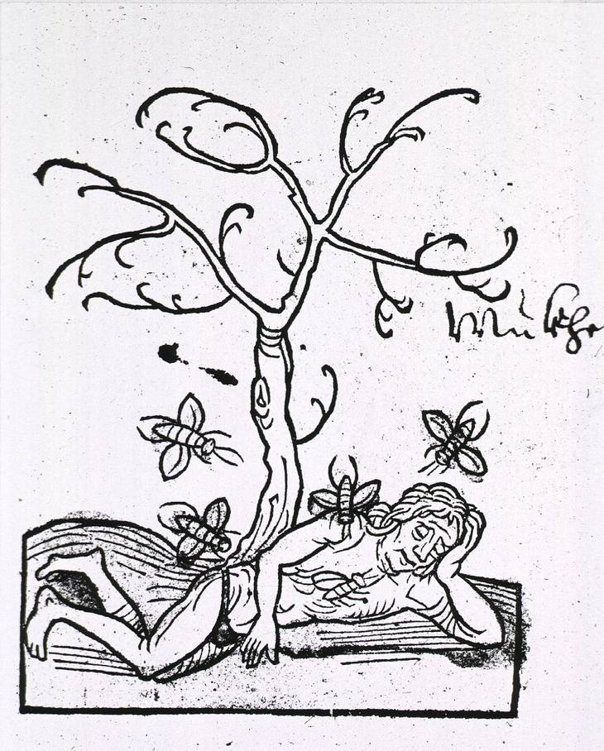
Where does Malaria come from?
Malaria has been known since ancient times.
Many believed it came from “bad air” (Italian: mala aria, “bad air”)
500 years ago, a handful of people believed that insects might be involved in human diseases.
Hortus Sanitatis
(The Garden of Health) 1497

Slide 5
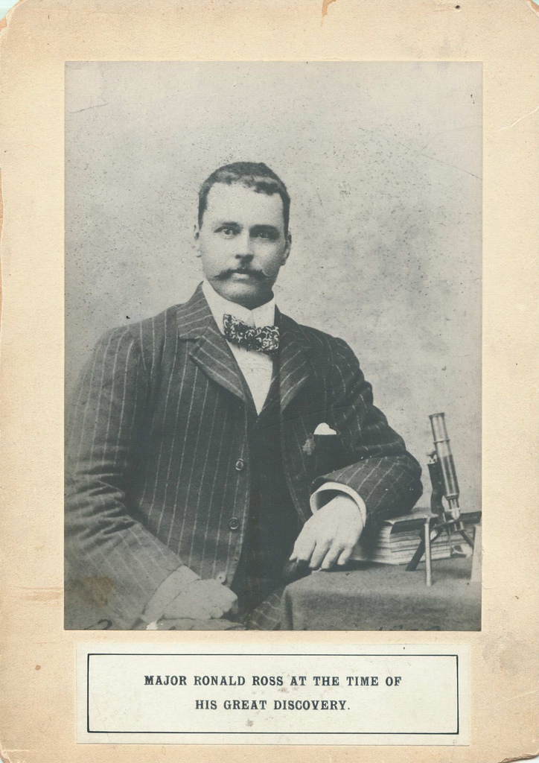
It was Sir Ronald Ross, an British army surgeon working in India, who proved in 1897 that malaria is transmitted by mosquitoes.
Sir Ronald Ross received the 1902 Nobel Prize for Physiology or Medicine for his work
(This was somewhat controversial, as many others made similar discoveries around the same time )

Slide 6
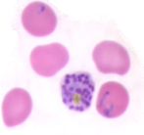
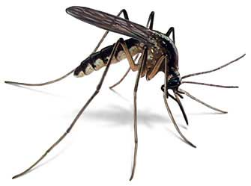
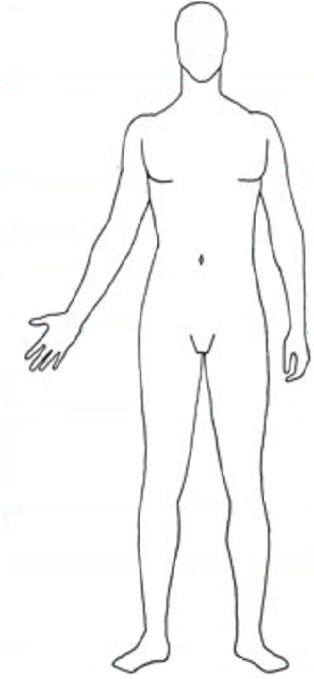
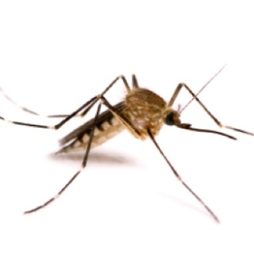
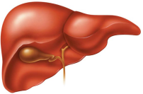

Malaria Parasites
Malaria Transmission Cycle
1st Vector
Next Human host
Initial Human host
Liver infection
2nd Vector
Blood infection

Slide 7
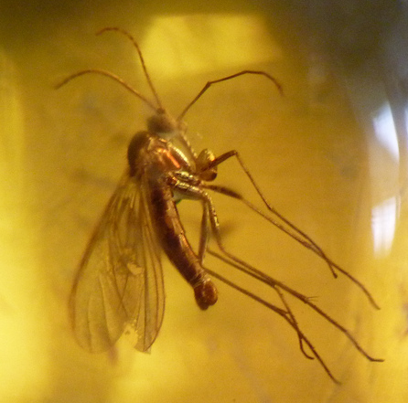
The Mosquito
There are 3,528 kinds of mosquitoes
  Only a handful take human blood
  Only the females take human blood
There are 100 trillion mosquitoes alive today
Mosquitoes have been around for at least 100 million years
  We know this from fossil records/DNA studies
Mosquitoes have spread malaria for at least 35 million years
  We know this from insects found in amber

Slide 8
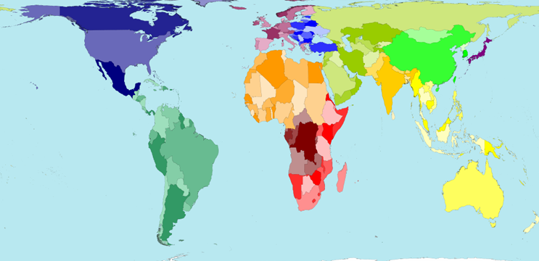
Where does malaria cause problems?

Slide 9
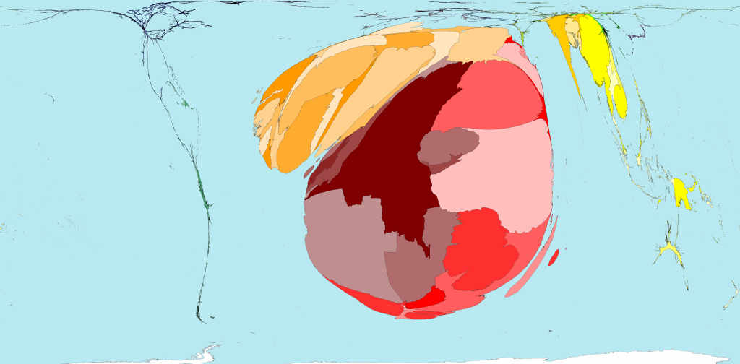
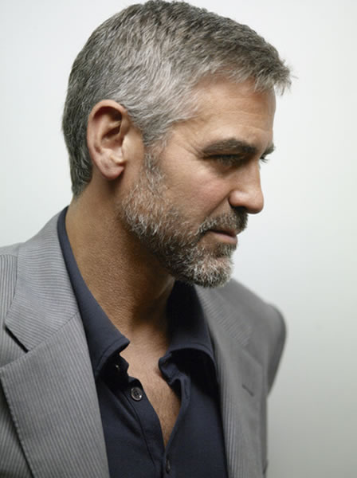
www.worldmapper.org

Slide 10
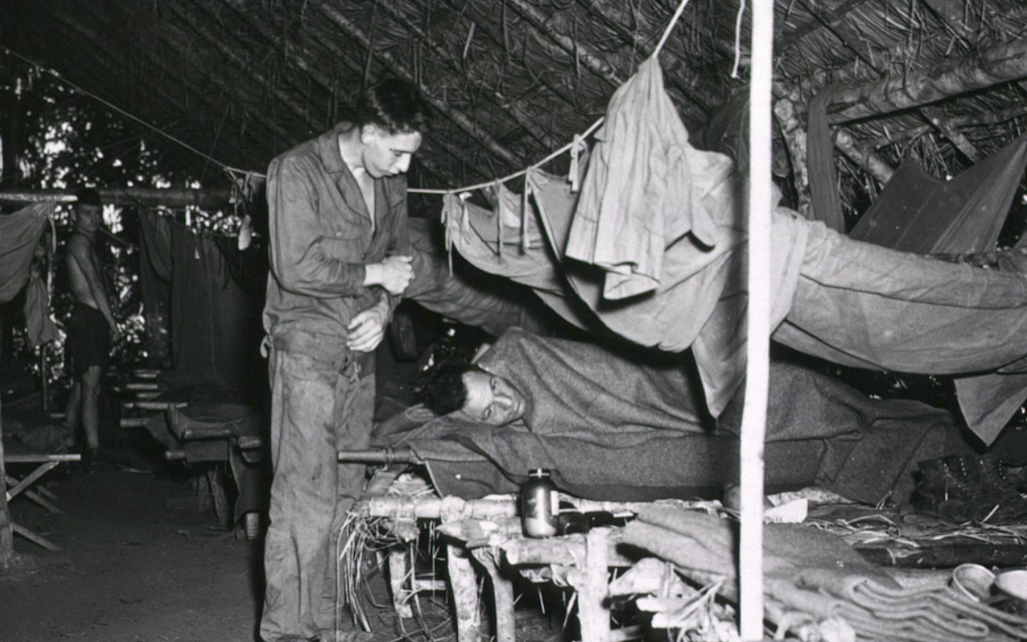
“In every US military campaign (in the 20th) century we lost more casualties to malaria than bullets” Navy Dr. (Capt.) Stephen L. Hoffman

Slide 11
Malaria causes poverty and poverty causes malaria
According to the United Nations Children’s Fund “Malaria is truly a disease of poverty. It afflicts primarily the poor, who tend to live in malaria-prone areas in dwellings that offer few, if any, barriers against mosquitoes”.
Sachs and Malaney argue that “as a general rule of thumb, where malaria prospers most, human societies have prospered least…. The extent of the correlation suggests that malaria and poverty are intimately related.”

Slide 12
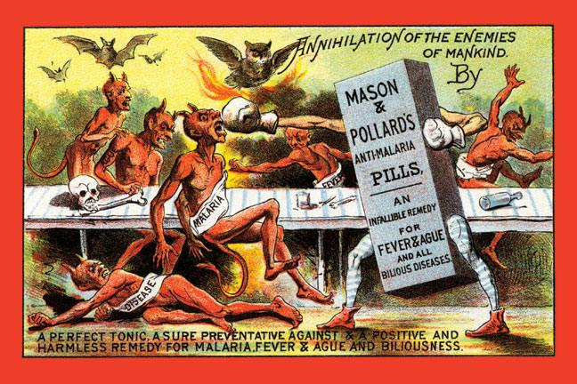
Given that we have known for over one hundred years how Malaria is spread, where is the magic pill or immunization?
For a variety of reasons, a cure or immunization continues to alluded mankind.
However there are some interventions that can help
“Ague” is an old word for malaria (It appears in several of Shakespeare's plays)

Slide 13
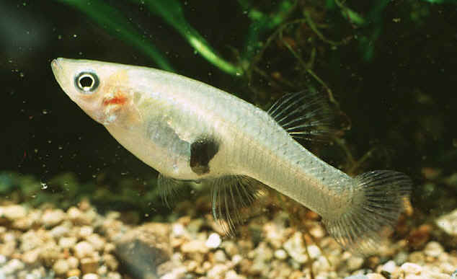
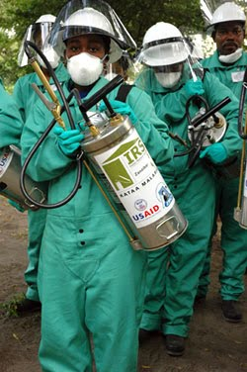
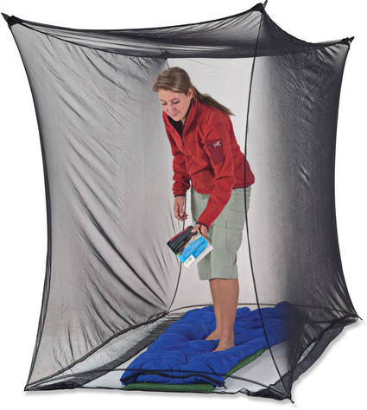
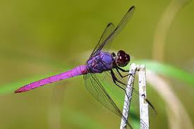
Interventions to Mitigate Malaria
The use of insecticidal treated mosquito nets
Spraying of insecticides (including controversial chemicals such as DDT)
Introduction of fish/turtles/crustaceans to eat mosquito larva
The introduction of dragonflies which eat adult mosquitoes.
Habitat reduction by draining ponds and pools
Use of chemical films to reduce the surface tension of water (drowning the pupa).
.. and hundreds more proven or tentative ideas

Slide 14
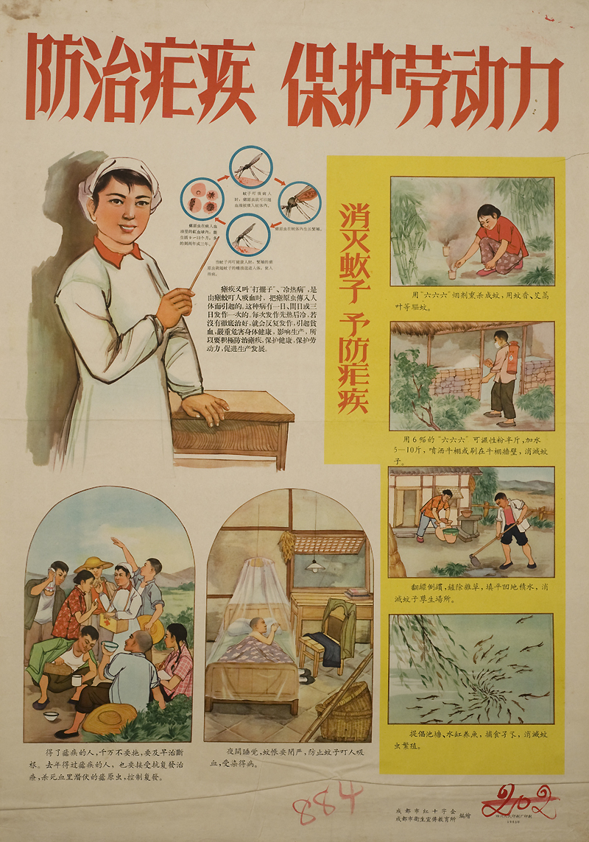
Some interventions have been around a long time, as this 1963 Chinese poster shows:
Use bed-nets
Spraying insecticides
Filling in ditches (habitat reduction)
Raising fish to eat the larvae

Slide 15
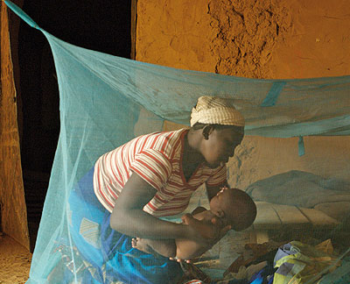
Interventions Cost Money!
Even cheap solutions have hidden costs
Insecticidal treated mosquito nets are cheap to make, but…
To make mosquito nets work, you need educators, incentive programs, maintenance etc
“...aid agencies and non-governmental organizations are quietly grappling with a problem: Data suggest that nearly half of Africans who have access to the nets refuse to sleep under them” (LA Times May-2-2010).

Slide 16
The Malaria Mantra
Do it cheap, or don’t bother

Slide 17

Suppose you want to do some intervention in Africa, and you have enough money for 65 sites….

Slide 18
The obvious thing to do is to spread your 65 efforts evenly across the target location..

Slide 19

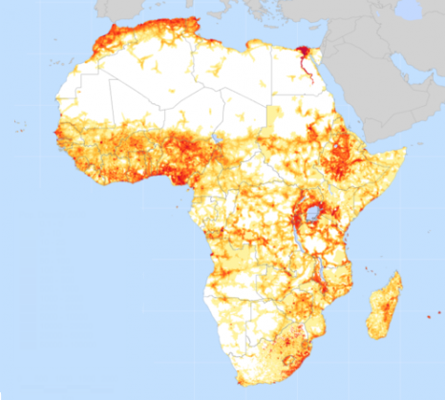
No mosquitoes
Some mosquitoes
Rampant mosquitoes
Suppose this is a true map of mosquito activity. We have wasted resources

Slide 20
No mosquitoes
Some mosquitoes
Rampant mosquitoes
This is how we should have spend our money, resources, time

Slide 21
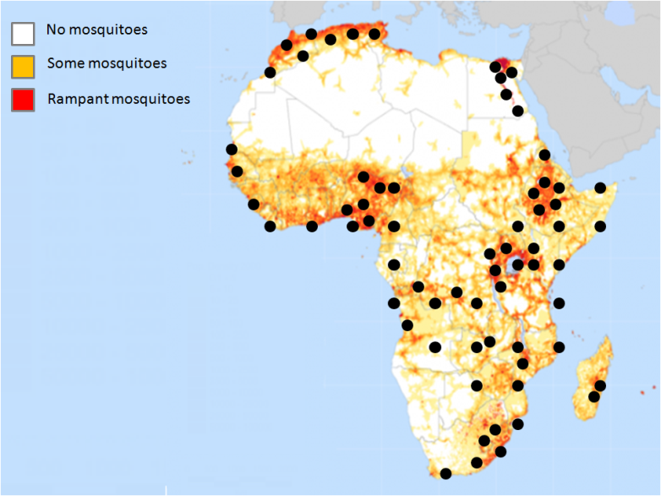
I have shown this example on all of Africa for visual clarity.
However most mosquitoes spend their entire lives less than a mile from where they where hatched, so we want to do this on a very fine grain area. (city-block sized parcels)

Slide 22
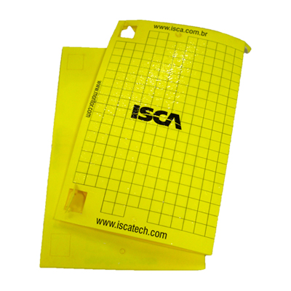
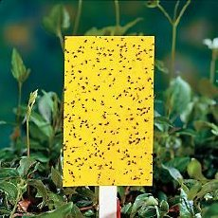
Planning interventions requires knowledge
We need to know where the problem is the greatest. Where are the mosquitoes?
We can measure surrogates
  Hospital admissions (too late)
  Weather data (too imprecise)
We can use sticky traps
  Inaccurate
  Costly
  Long time lag

Slide 23
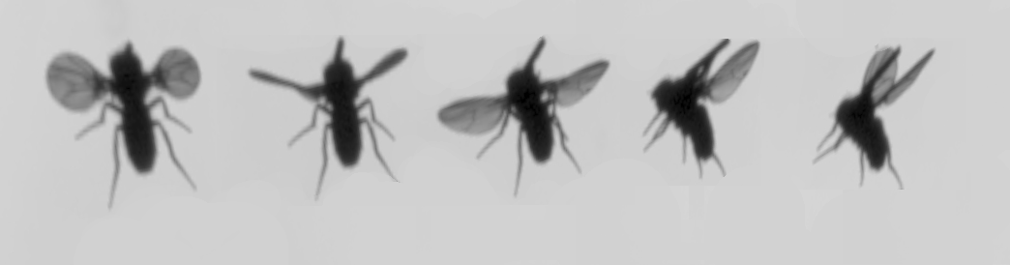
Our Contributions
We believe that we can count and classify insects with sensors.
  Must be cheap (to allow wide deployment, to deter thief)
  Must be low powered (we may not have mains electricity)
  Must be accurate

Slide 24
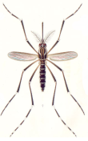
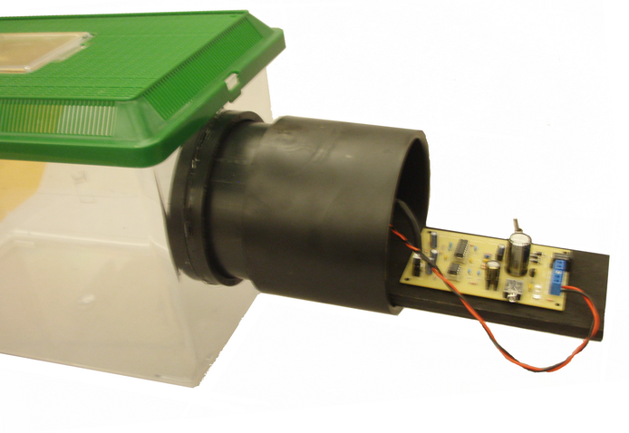
Phototransistor
Laser
Circuit Board
Insect Detected
Insect detection threshold
0
500
1000

Slide 25


One second of audio from the laser sensor. Only Bombus impatiens (Common Eastern Bumble Bee) is in the insectary.
0.2
0.1
0
-0.1
Background noise
Bee begins to cross laser
-0.2
4
0
0.5
1
1.5
2
2.5
3
3.5
4
x 10
4.5
-3
x 10
Single-Sided Amplitude Spectrum of Y(t)
4
3
Peak at 197Hz
|Y(f)|
60Hz interference
2
Harmonics
1
0
0
100
200
300
400
500
600
700
800
900
1000
Frequency (Hz)

Slide 26
-3
x 10
4
3
Peak at 197Hz
|Y(f)|
2
1
0
0
100
200
300
400
500
600
700
800
900
1000
Frequency (Hz)
100
200
300
400
500
600
700
800
Frequency (Hz)

Slide 27
-3
x 10
More peaks
4
|Y(f)|
3
2
1
0
0
100
200
300
400
500
600
700
800
900
1000
Frequency (Hz)
Bombus
impatiens
100
200
300
400
500
600
700
800
Frequency (Hz)

Slide 28

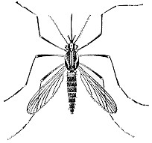
2000
1800
1600
1400
1200
Number of one-second fragments
1000
800
Culex
quinquefasciatu
600
Aedes aegypti
400
Bombus
impatiens
200
0
100
200
300
400
500
600
700
800
Frequency (Hz)

Slide 29
Peak at 210Hz
0
100
200
300
400
500
600
700
800
900
1000
Frequency (Hz)
Culex
quinquefasciatu
Aedes aegypti
Bombus
impatiens
100
200
300
400
500
600
700
800
Frequency (Hz)
Almost certainly a bee

Slide 30
Peak at 705 Hz
0
100
200
300
400
500
600
700
800
900
1000
Frequency (Hz)
Culex
quinquefasciatu
Aedes aegypti
Bombus
impatiens
100
200
300
400
500
600
700
800
Frequency (Hz)
Almost certainly a Aedes aegypti

Slide 31
Peak at 602 Hz
0
100
200
300
400
500
600
700
800
900
1000
Frequency (Hz)
Culex
quinquefasciatu
Aedes aegypti
Bombus
impatiens
100
200
300
400
500
600
700
800
Frequency (Hz)
Could be a Culex quinquefasciatu or a Aedes aegypti

Slide 32
More work needs to be done!
In the example on the previous page, we are 96.04% accurate.
We are working on extracting more features to improve this accuracy
We have a 100K grant from the Bill and Melinda gates foundation. Soon we will try for a million dollar phase II
We plan “spin-off” applications in agriculture

Slide 33
Conclusions
We have seen:
  What malaria is
  How big of a problem it is
  Some Interventions that help mitigate malaria
  A brief look at our efforts to help in the war on malaria
Thanks to my post-doc, Gustavo E.A.P.A. Batista and industrial collaborator Agenor Mafra-Neto
Questions?

