Slide 1
Using the UCR WBF Sensor
(this is a draft document, we welcome feedback corrections)

Slide 2
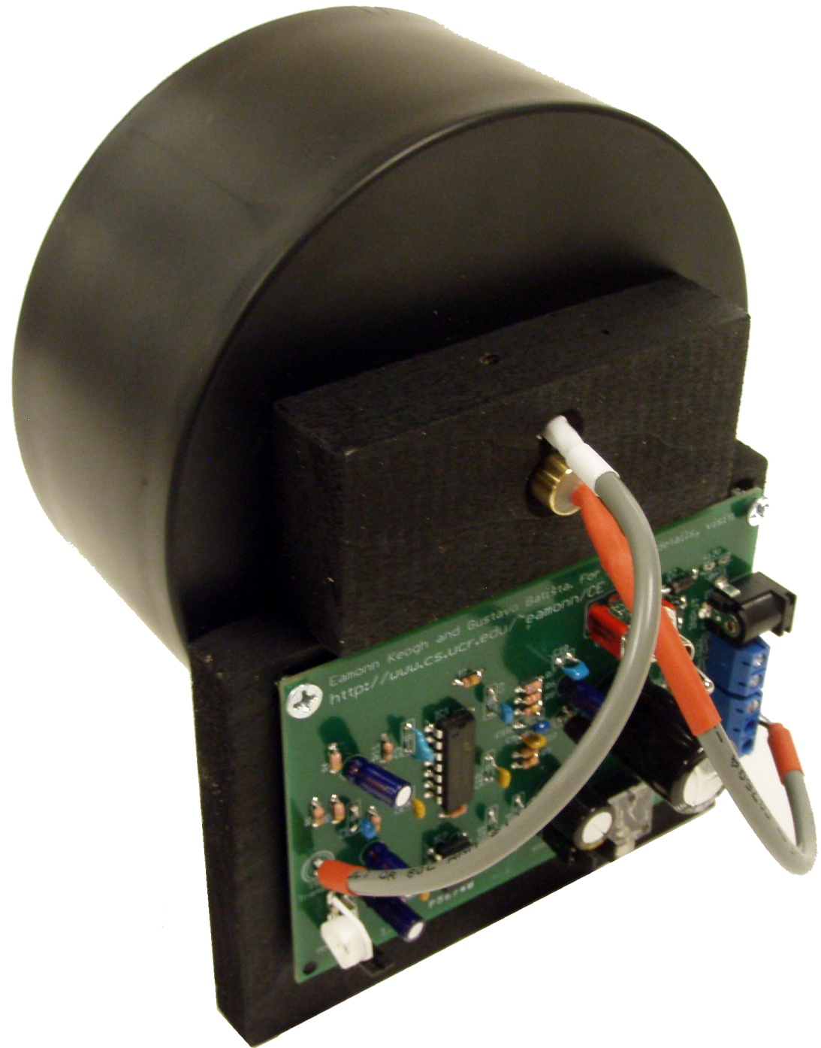
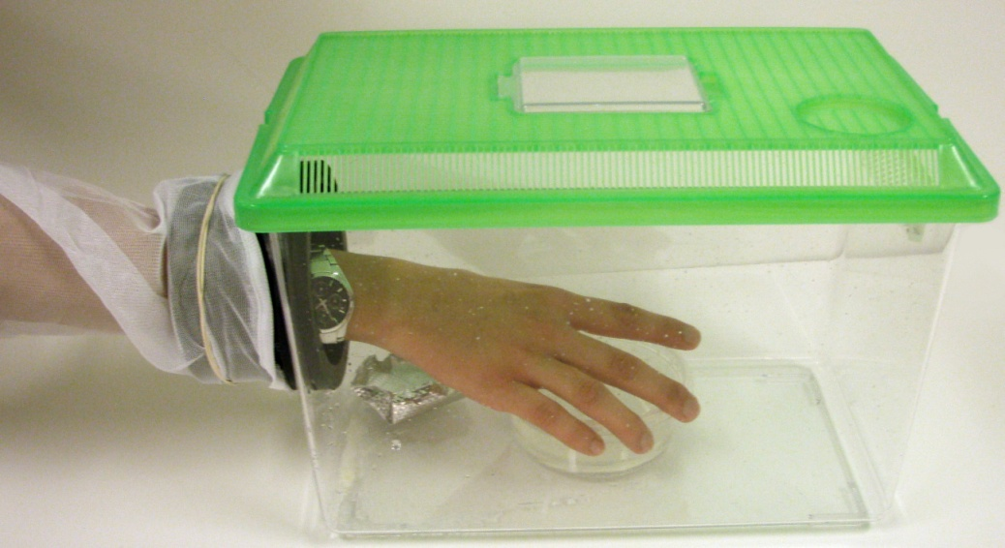
Pragmatic Tips on using the WBF Sensors
We have chosen to mount the sensor in 4-inch ABS pipe hardware. We did this because:
As you can see in the remainder of this document, this allows you to quickly to move the sensor between multiple insectaries.
It is easy to create adaptors to existing insect traps, such as the Zumba Trap, the CDC trap, the EVS trap etc.
ABS piping is available worldwide, it is inexpensive and easy to fabricate/modify.
While the sensors only need a tiny opening, we chose to use the 4-inch size because it allows a hand to pass through, an useful feature for changing water/food, aspirating insects etc.

Slide 3
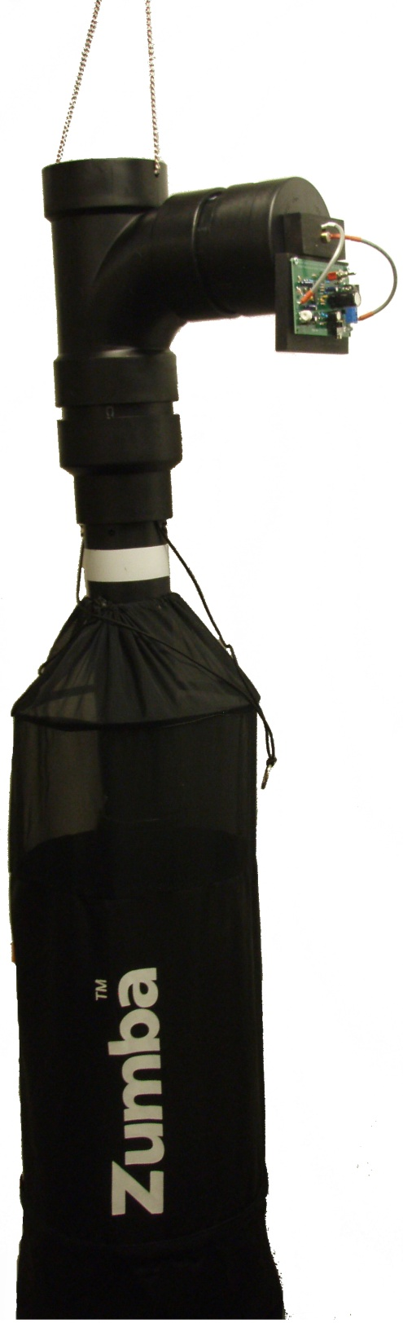
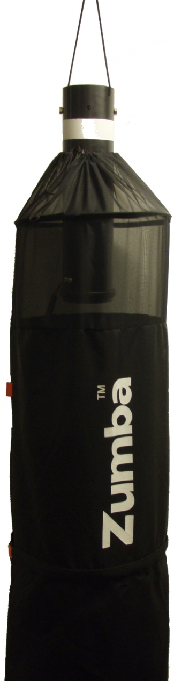
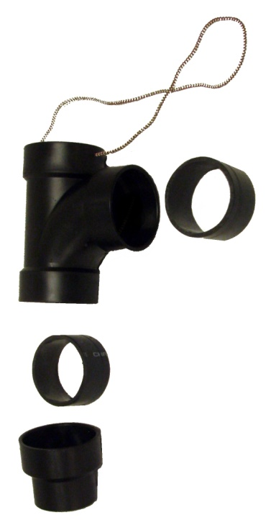
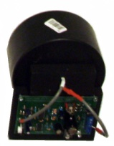
Adapter for an Existing Insect Trap
Sensor -Augmented
Zumba Trap
A State-of-the-Art Mosquito Trap:
Zumba^{tm} by ISCA Technologies
Trap opening
CO₂ release nozzles
Lure (hidden inside) scent escapes through mesh
Zumba Trap Adaptor
Electric fan (inside tube) creates suction, drawing and trapping insect that pass near trap opening.
Reflector placed inside tube
Battery and CO₂ container hidden by skirt.
Adaptor kit made from standard cheap ABS fitting
Trap has approximate size and shape of adult male.

Slide 4
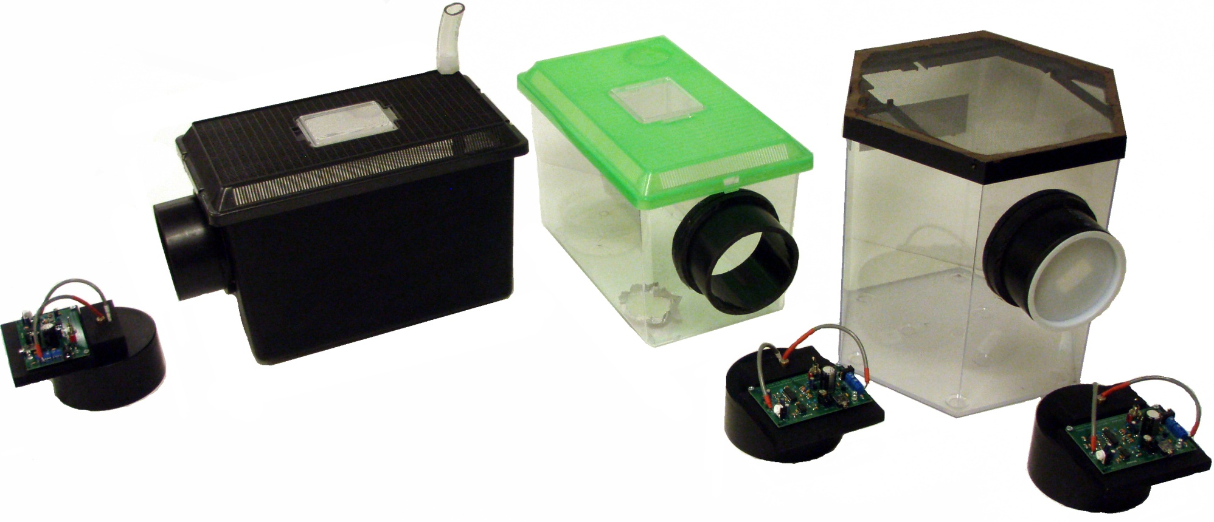
Purpose Build Insectaries
Blackout Insectary
(for obtaining circadian rhythms )
Demonstration Insectary
(use for public demonstrations)
Classic Insectary
Tube to allow feeding and watering without allowing light in.
Internal lights on timers control artificial day/night cycles.

Slide 5
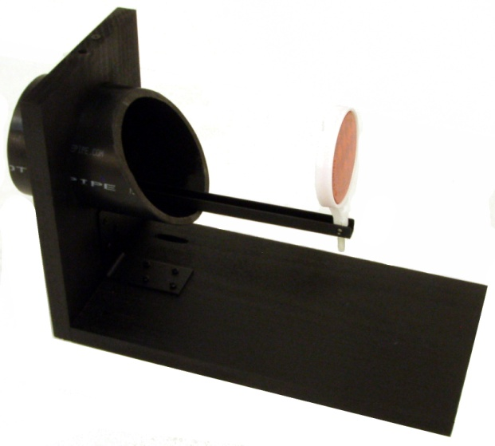
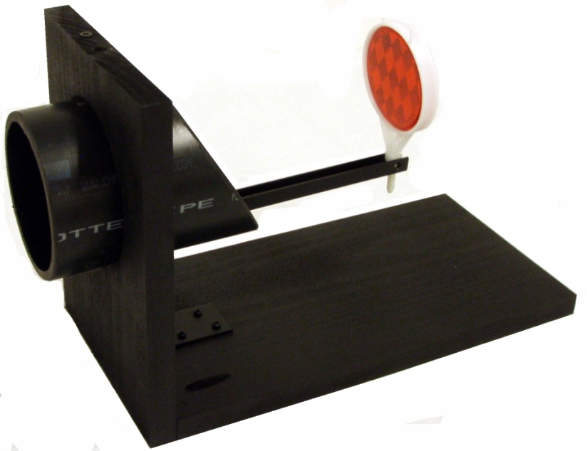
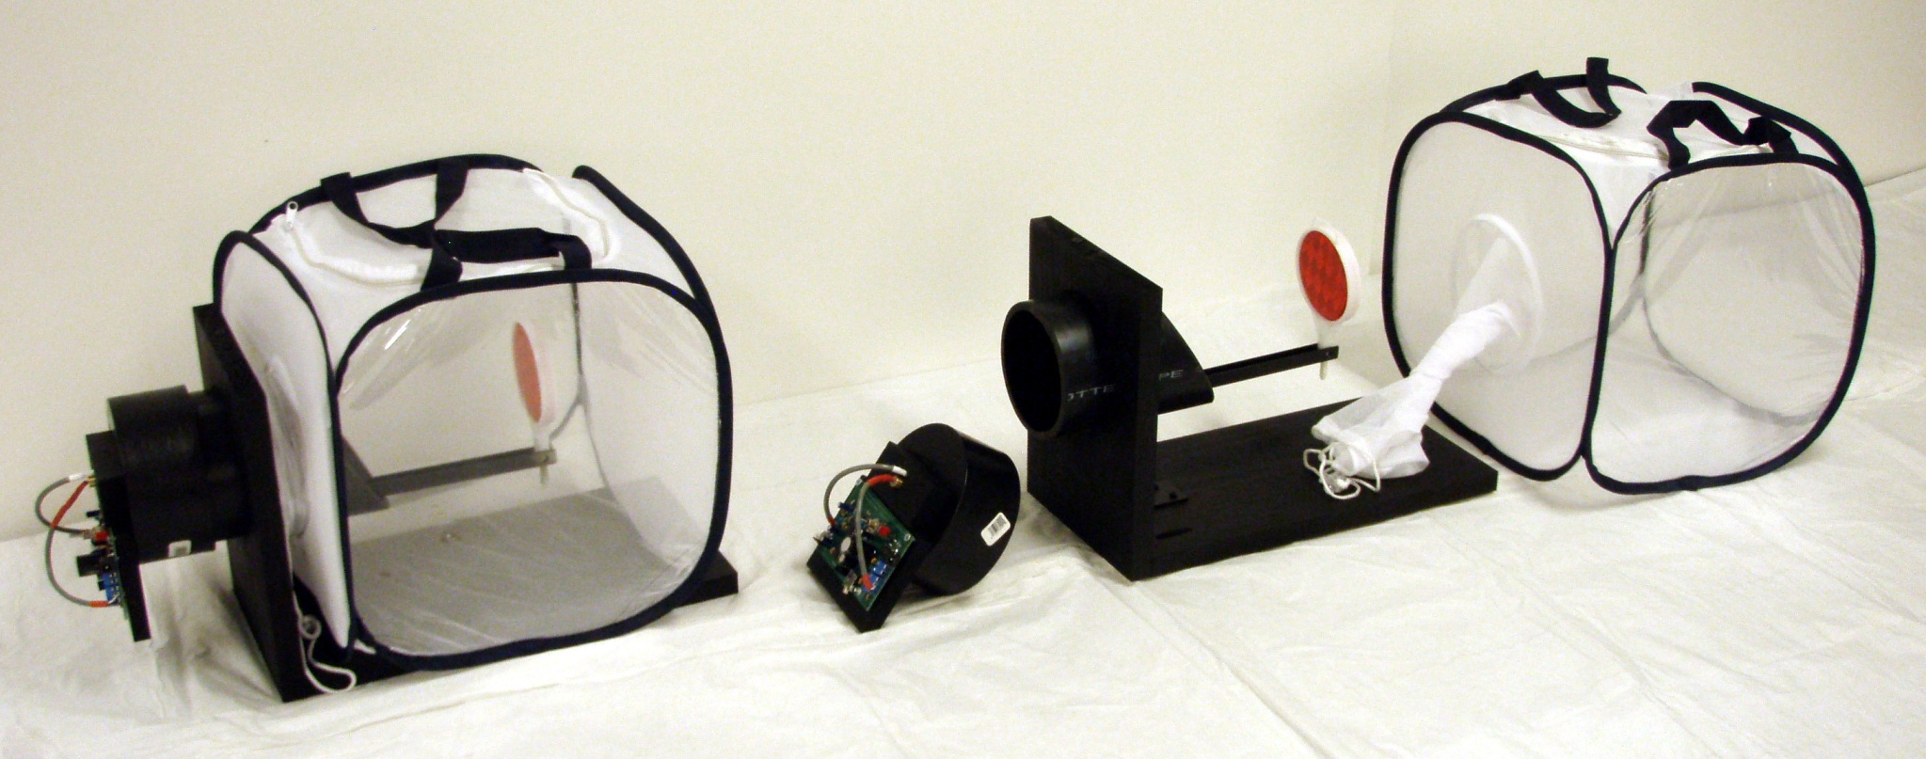
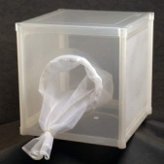
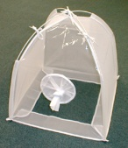
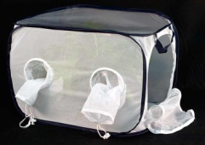
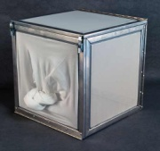
Adapter for Common “Sleeved” Insectaries
1-foot cube insectaries are ubiquitous worldwide. You can make this simple adapter (shown at the right) to record data from these insectaries.
The adaptor works with virtually any commercial cage

Slide 6
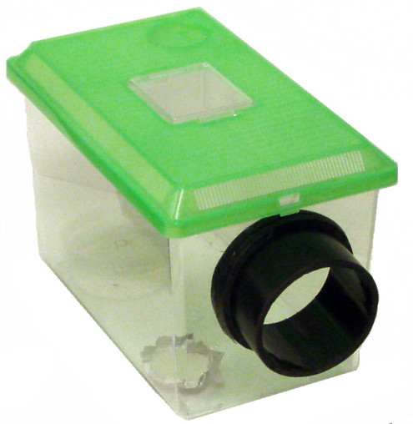
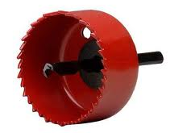
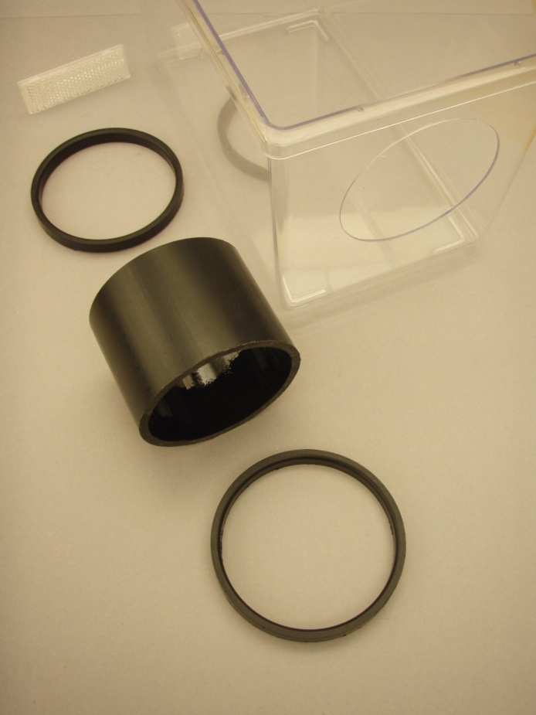
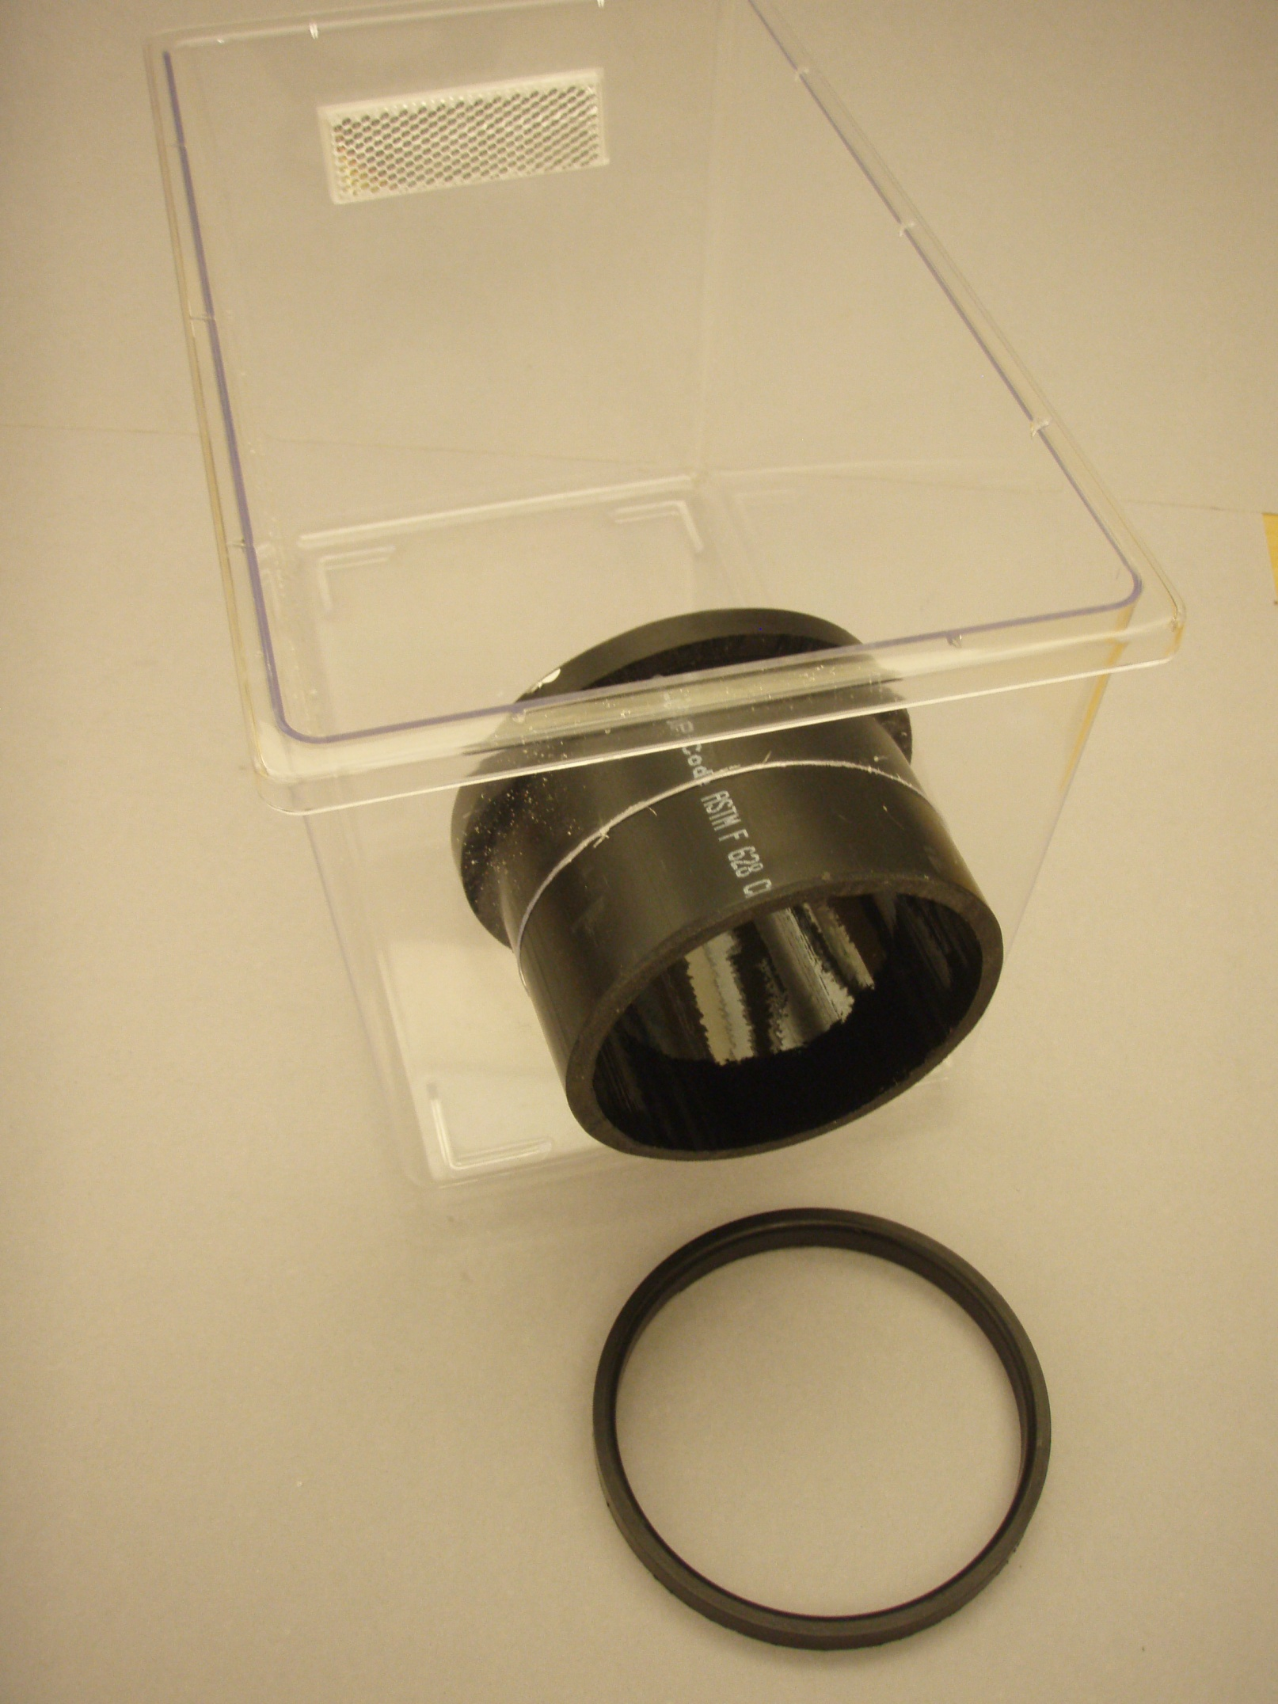
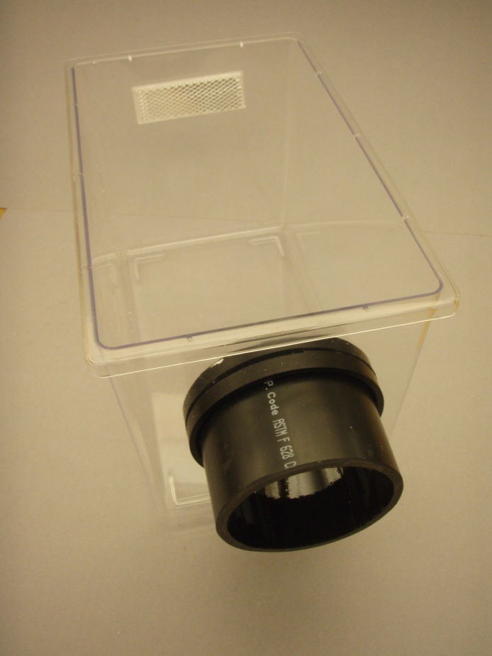
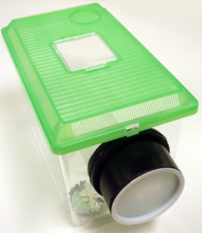
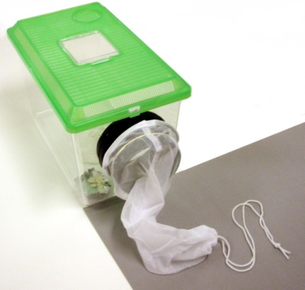

Hints on making an Insectary
Mesh for air access
Note that ABS pipe sizes are nominal. The four-inch pipe is actually about 4.5 inches in diameter.
The standard mesh (the green lid in the figure to the right) is fine enough for some insects, but may allow very small insects to escape. To prevent this, you can just sandwich fine mesh material between the tank and the lid.
Use a inexpensive acrylic aquarium or “critter cage”, they are easy to modify an clean.
Create hole with a 4.5 inch hole saw.
Attach reflector with double-side tape.
To prevent insects escaping when sensor is removed…
Use end-cap
Or add Sleeve
Create portal tube with 2 to 3 inches of 4-inch ABS.
Create retaining rings with thin slices cut from a 4-inch ABS coupling connector.
Attach retraining rings with epoxy or ABS cement.

Slide 7
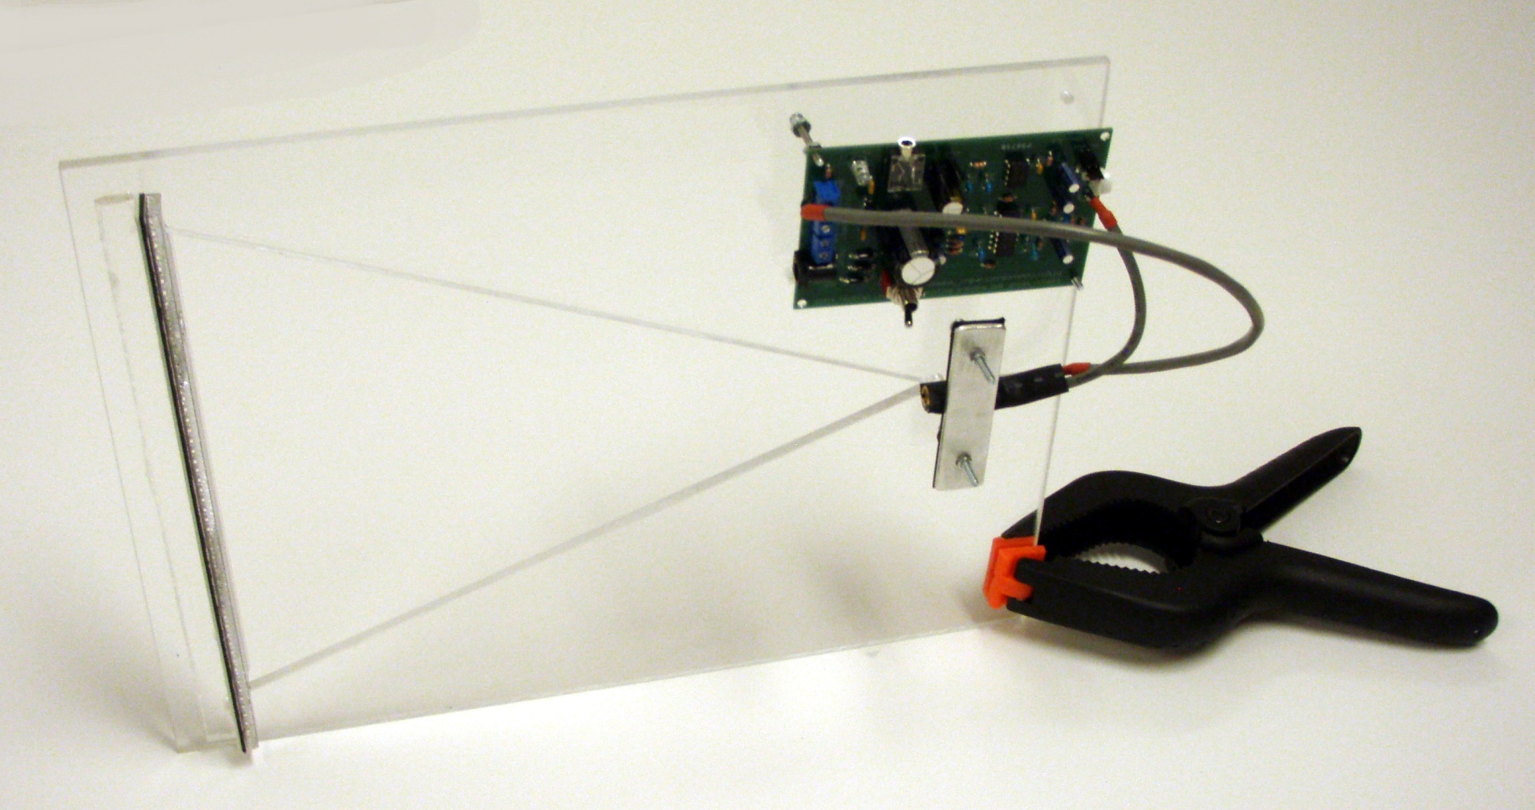

Slide 8
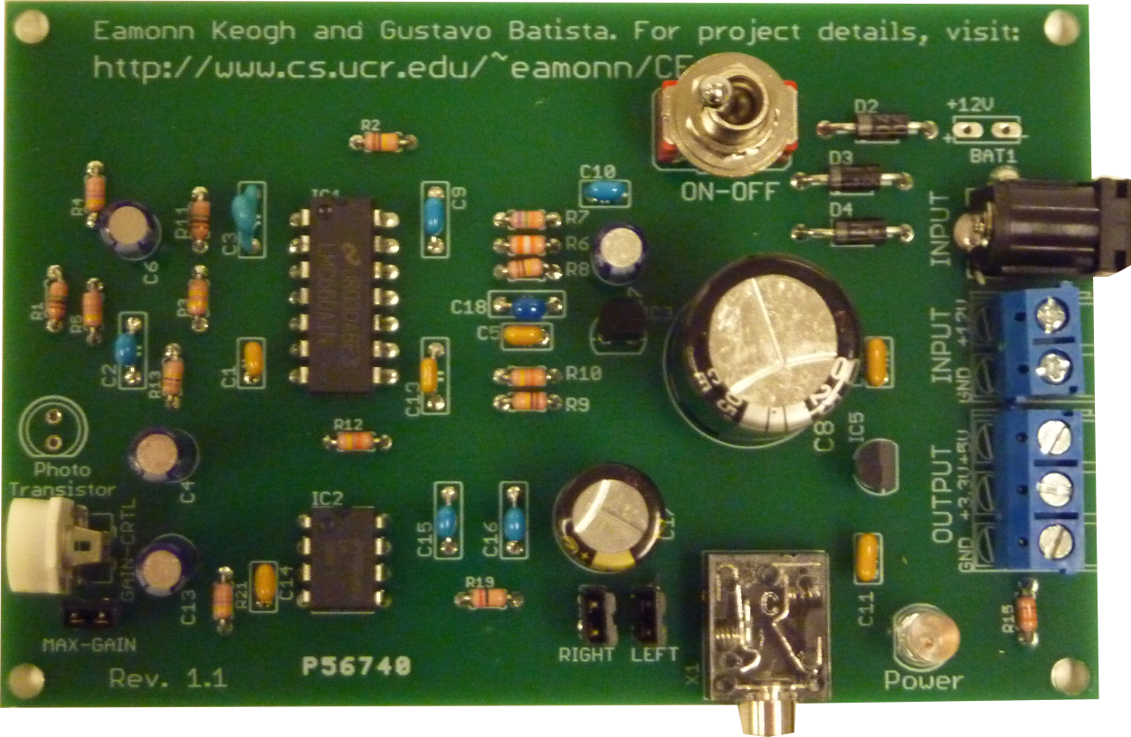
The electronic board
The electronic board converts light variations into audible sound. It is composed by a set of amplifiers and filters.
The board produces mono output that can be redirected to the right or left channel (or both) using shunt jumpers. The board also features a gain potentiometer to regulate the volume of the output sound.
On/off switch
Input power connector
2.1mm “center positive”
9V-12V DC
Solder point for the photo-transistor
Input power terminal block 9V-12V DC
Output power terminal block +3.3V and +5V DC
Gain potentiometer and
Max-gain shunt jumper
Left and right shunt jumpers
Power LED
Output sound connector
“earphone” type

Slide 9
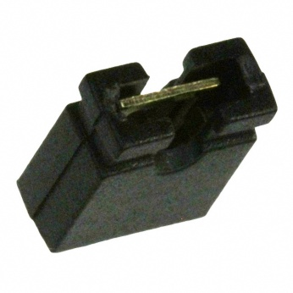
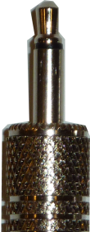

Shunt jumpers
The shunt jumpers are used to connect the board output sound to the left or right (or both) channels; and to regulate the board gain.
Shunt jumpers are a small plastic “caps” that are inserted into two terminals. When inserted the jumpers close the terminals.
ON – jumper inserted
OFF – jumper removed
Max-gain shunt jumper:
When ON the board outputs sound with maximum gain (volume). When OFF the gain is regulated by the potentiometer. Typically, let the jumper inserted (ON); however, some combinations of power sources and recorders with internal sound amplifiers can generate a very loud background noise. In this case, the jumper can be set to OFF position and the potentiometer regulated to reduce noise.
Right /mono Right
Left
Ground Ground
Right shunt jumper:
When ON redirects the board output to the right channel. When OFF no sound is directed to right channel.
Typically, this jumper is always ON.
Left shunt jumper:
When ON redirects the board output to the left channel. When OFF no sound is directed to left channel.
Typically, this jumper is ON for stereo “earphone” plugs and OFF for mono plugs.
Mono Stereo
BEWARE that letting the left jumper ON with mono plugs will attenuate the output sound.

Slide 10
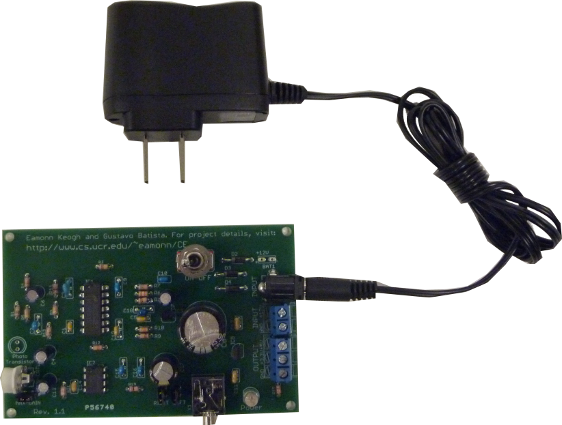
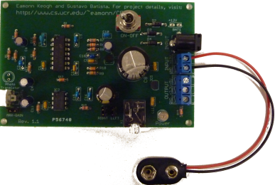
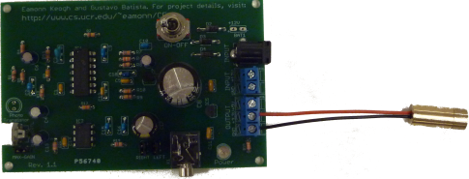
Power connectors
There are three different ways to connect power to the electronic board. For all of them, the input power should provide a voltage between 9V and 12V DC. The board requires only 300mW, and therefore it can also powered using standard 9V batteries.
Although the board has three input power connectors, NEVER connect more than one power source at the same time.
The board also features a output terminal block that provides 3.3V and 5V DC to power lasers that will be used with the sensor.
Power connector with a 2.1mm positive center pin. This connector can be used to connect a power supply to run the sensor for longer periods.
These are extra solder points to permanent battery connectors. Check the polarity orientation on the board silkscreen to correctly solder the wires.
Power terminal block can be used to make removable power connections. Use the screws to hold wires in place. This terminal can be used to power the board with a PC power supply unit or to connect battery wires.
This terminal block OUTPUTS +3.3 V and +5V DC. It should be used to power low-powered lasers. The 3.3V line can provide up to 250mA and the 5V line up to 100mA.

Slide 11
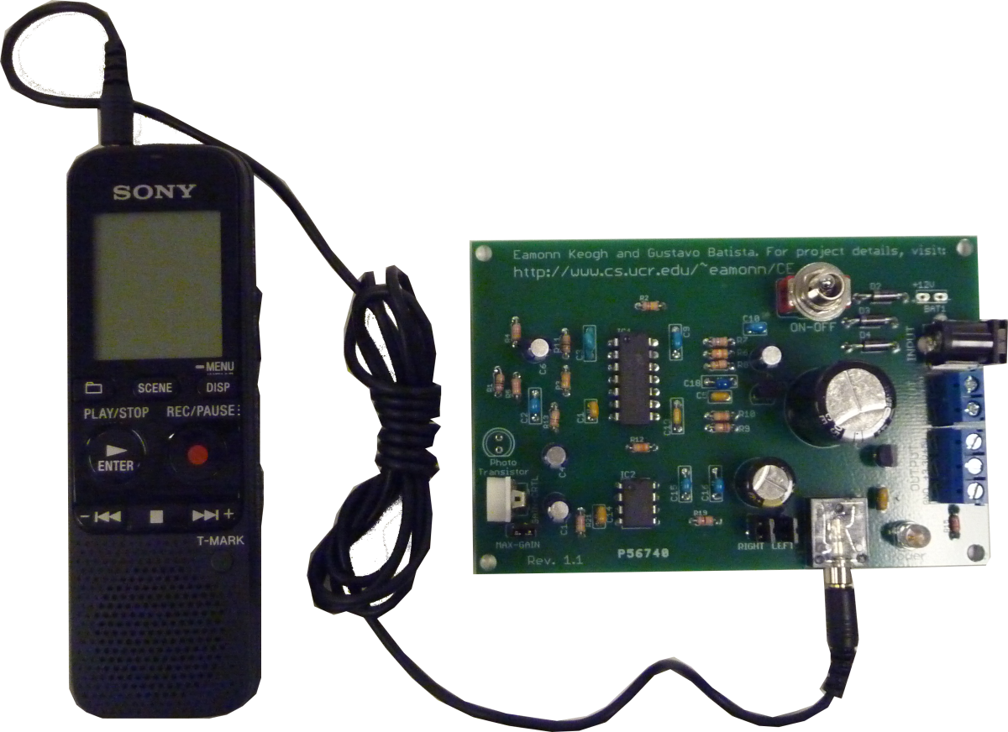
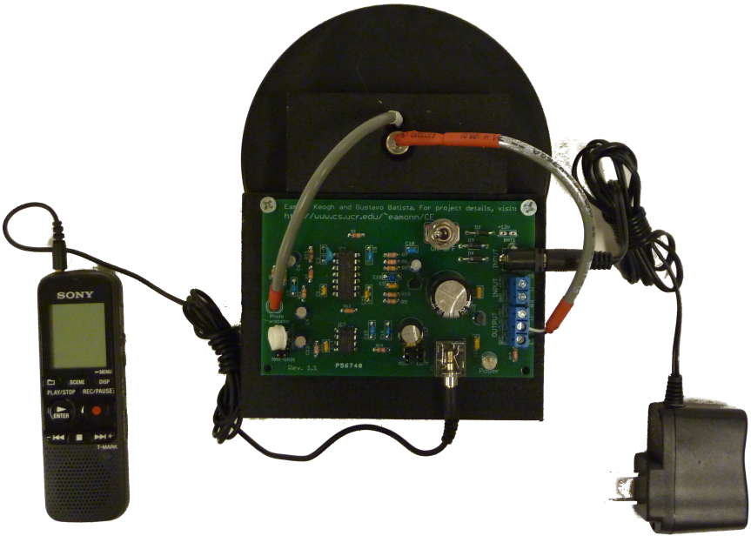
Recording
The recorder should be connected to the board using a “earphone” male/male cable. A good quality cable (possibly shielded) helps to reduce noise.
Although other recorder models may be used with good results, we have successfully used the model ICD-PS312 from Sony.
This I a typical setting we use in our experiments, with the sensor board powered with a power supply, laser powered by the sensor board, photo-transistor soldered to the board using a short cable and recorder with the recommended settings.
We recommend the following settings:
“Noise cut” set to off;
“Scene” set to “audio in” (important);
“Rec mode” set to 192kbps (mono);
“Mic sensitivity “ set to “low”.

