Slide 1
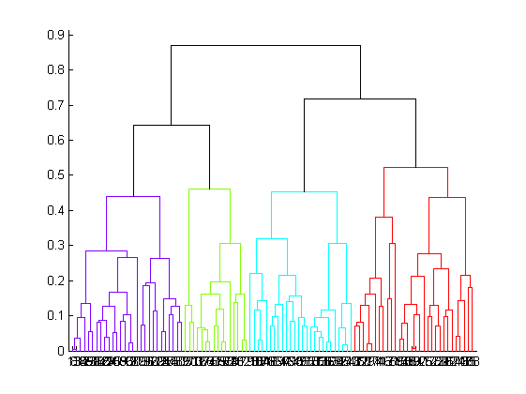
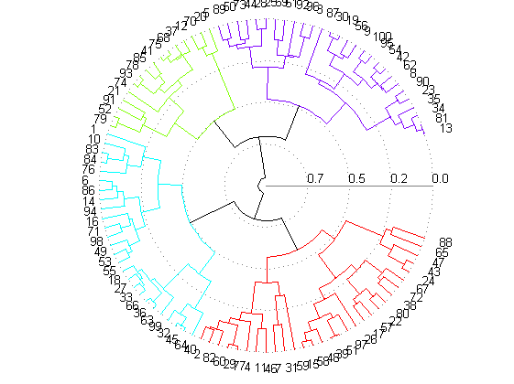
Why Trees?
Why are dendrograms part of AI?

Slide 2
I get a call from my boss, asking me to pick up a Cambodian professor from the airport.
Before I can get any more details, my phone dies.
I know almost nothing about Cambodia, I have never met (to my knowledge) a Cambodian.
In the baggage claim area, there are only three females, which one should I approach?

Slide 3
I know Cambodian is in the same subtree as Thailand
I know several Thai people
The lady in the middle looks like my Thai friends.

Slide 4
What religion is mostly likely for a person from Oman?
What religion is mostly likely for a person from Andorra?
Of course, hierarchal thinking can lead you astray..
What language do they speak in Paraguay?
I don’t know, but snice it is the South American
Subtree, and most of those counties speak Spanish
I will (correctly) guess Spanish.
What language do they speak in Guyana?
I don’t know, but snice it is the South American
Subtree, and most of those counties speak Spanish
I will guess Spanish. However, English is its official and most spoken language.

Slide 5
What does a Bayan sound like, look like?

Slide 6
Bayan

Slide 7
A hierarchy can be seen as a way to generalize.
Suppose we need to predict the properties of an unknown object, but we can place it in our hierarchy. We can try to think of a object that we do know, and has a fairly recent common ancestor with the unknown object…
Likewise, if we are just told the name of the subtree that an object is in, we can guess properties for it.
Can you tell me anything about a langur? No!
If I tell you it is a animal: It probably has two eyes
If I tell you it is a mammal: It probably has hair, is viviparous (live birth)
If I tell you it is a primate: It probably lives in trees, eat fruit, has color vision, is social
If I tell you it is a New World monkey: It probably has a prehensile tail, non-opposable thumb
The smaller the subtree, the more properties we can predict.
animal
mammal
primate
NW monkey

