Slide 1

Supported by
GreenMM: Energy Efficient GPU Matrix Multiplication through Undervolting
Hadi Zamani, Yuanlai Liu, Devashree Tripathy,
Laxmi Bhuyan, Zhizhong Chen
Notes:
Hi everybody, I’m Hadi Zamani from university of California Riverside
My advisor is Laxmi Bhuyan
I’m going to introduce our work, GreenMM: Energy Efficient GPU Matrix Multiplication through Undervolting

Slide 2

Outline
Introduction/ Motivation
GPU Undervolting Model
GPU Fault Model
GreenMM: Energy Saving Methodology
Evaluation
Summary
2
Notes:
First, I’ll give you an introduction and explain our motivation. Then I’ll be discussing GPU undervolting, GPU Fault Model and also our energy saving methodology. I’ll continue with Evaluation. and at the end, the summary will be provided.

Slide 3
Introduction
GPUs are well-suited for HPC
Application: Matrix multiplication (MM) is a key subroutine in the BLAS.
  LINPACK
  ScalaPACK
  LAPACK
Significant portion of energy is consumed by GPUs. Our
Harris, BLAS report 01
Wang, NC 10
3
Notes:
1. Modern GPUs with hundreds of computing cores make them well-suited for HPC applications, especially for numerical computations and vector processing.
2. Matrix multiplication (MM) is heavily used and a key subroutine in many software packages solving problems in linear algebra [20]. MM routine is critical to the performance and power of High Performance LINPACK benchmark (HPL) and many software packages solving problem in linear algebra such as LAPACK, ScaLAPACK, MUMPS and SuperLU. For instance, MM heavy applications such HPL and ScaLAPACK involves a time-consuming task to deal with MM computation which is more than 90% of the computation cost [39].
But given their high computational capabilities, the GPUs consume a significant portion of the total system power and energy.
We know that performance is a critical factor in HPC, we try to reduce the power and energy consumption without sacrificing the performance. To save the energy we reduce the voltage but the probability of faults raises. So, we have to come up with low overhead fault tolerant algorithms to cover these faults.

Slide 4
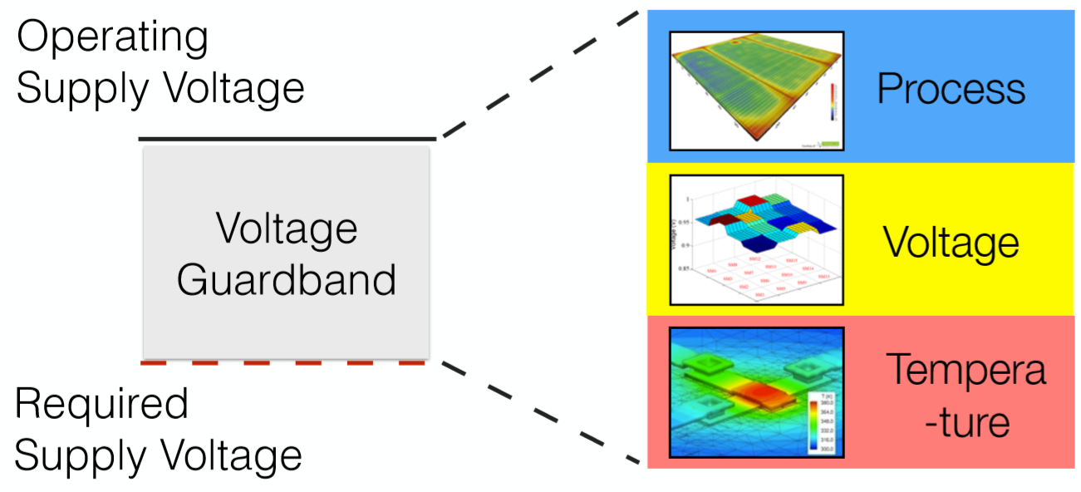
Motivation- Energy Inefﬁciency at the Voltage Guard-band
  20% voltage guard-band on different GPUs
      25% energy savings opportunity on GPU cards.
Reddi, Micro 15,10
4
Notes:
To combat the worst-case process, temperature and voltage variation (noise), traditional design methodology relies on voltage guard-banding and the voltage guardband is predicted to grow due to increased variations as technology scales.
On Average, there exists about 20% voltage guardband on different GPUs, which, if “eliminated” completely, can result in up to 25% energy savings.

Slide 5

Goal
Idea:
  Power is high – Reduce by undervolting below Vmin
  Ooops! Faults – Eliminate through fault-tolerant techniques
5
Notes:
So, our goal is to use the guardband opportunity to save energy as mush as possible. If we reduce the voltage at a fixed frequency, Dynamic and static power will be reduced by factors of squre and linear V and V respectively. But at the same time with reducing the voltage beyond the minimum operating voltage the probability of faults raises. So we should tackle the possible fault with FT algorithms which adds overhead in terms of performance and maybe power. So, in case of MM, we go beyond the minimum operating voltage but we correct the potential faults with a very low overhead ABFT.

Slide 6
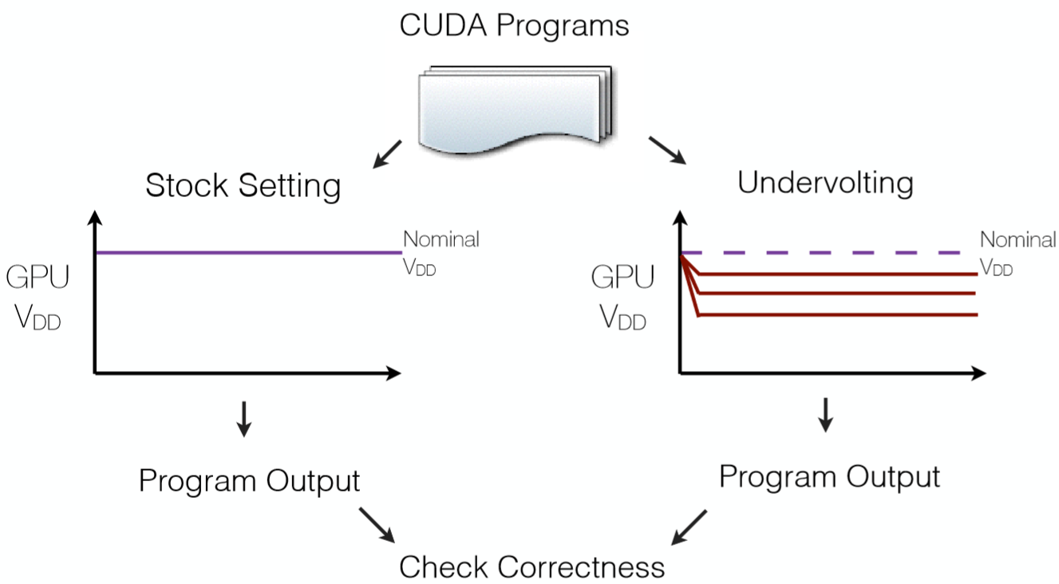
GPU Undervolting Model
How to find:
  Vmin
  Vsafemin
6
Notes:
Vmin is the point that p[rogram runs correctly but it fails if we reduce the voltage further.
(VsafeMin) refers to the lowest safe supply voltage under which the system can operate without crashing.
This is how we find the appropriate undervolting level. This phase should be done offline in profiling phase only once for each application on the underlying GPU.
We start from the nominal voltage.
We gradually increase the undervolt level. We run the program 100 times and record the outcome at each level. And observe the output.
As long as, we only experience SDC errors which can be handled in application level, we increase the undervolting level. We do this until we observe other types of faults such segmentation faults which can not be handled in application level.

Slide 7


GPU Fault Distribution
7
Notes:
We experimentally measure each program’s fault distribution and failure probability when operating below its Vmin point.
This helps us to determine whether more aggressive optimization of operating below the Vmin point is feasible.
There are four main types of error events:
silent data corruption; ii)
CUDA runtime errors,
GPU driver fault or segmentation fault;
Operating system crash
Silent data corruption (SDC) [15] refers to when a program ﬁnishes execution without any warning but the output is not correct.
We detect it by comparing the output against a golden output from a fault free reference.
.CUDA runtime errors refer to the execution of a program that fails at runtime. Such errors are explicitly reported by the CUDA runtime system.
Segmentation fault occurs when the GPU driver code executed by the CPU loses communication with the GPU. This can be detected by inspecting the standard error output.
The harshest error is the OS crash, after which a manual reboot is required. We stop the voltage reduction experiment once an OS crash happens.
Except than SDC faults, the other types faults can not be covered by using a fault tolerant algorithm no matter how it is powerful.
But the good news is, in some application, we have enough opportunity to go even beyond the Vmin since we only have SDC errors which can be covered in Application level with an appropriate FT algorithm.
*******************************************
In Fast Fourier Transform (FFT), Matrix Multiplication and Hotspot benchmarks, the SDC errors lead to 24%, 42% and 55% faulty executions, respectively [27].

Slide 8
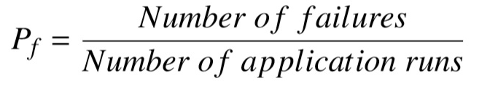
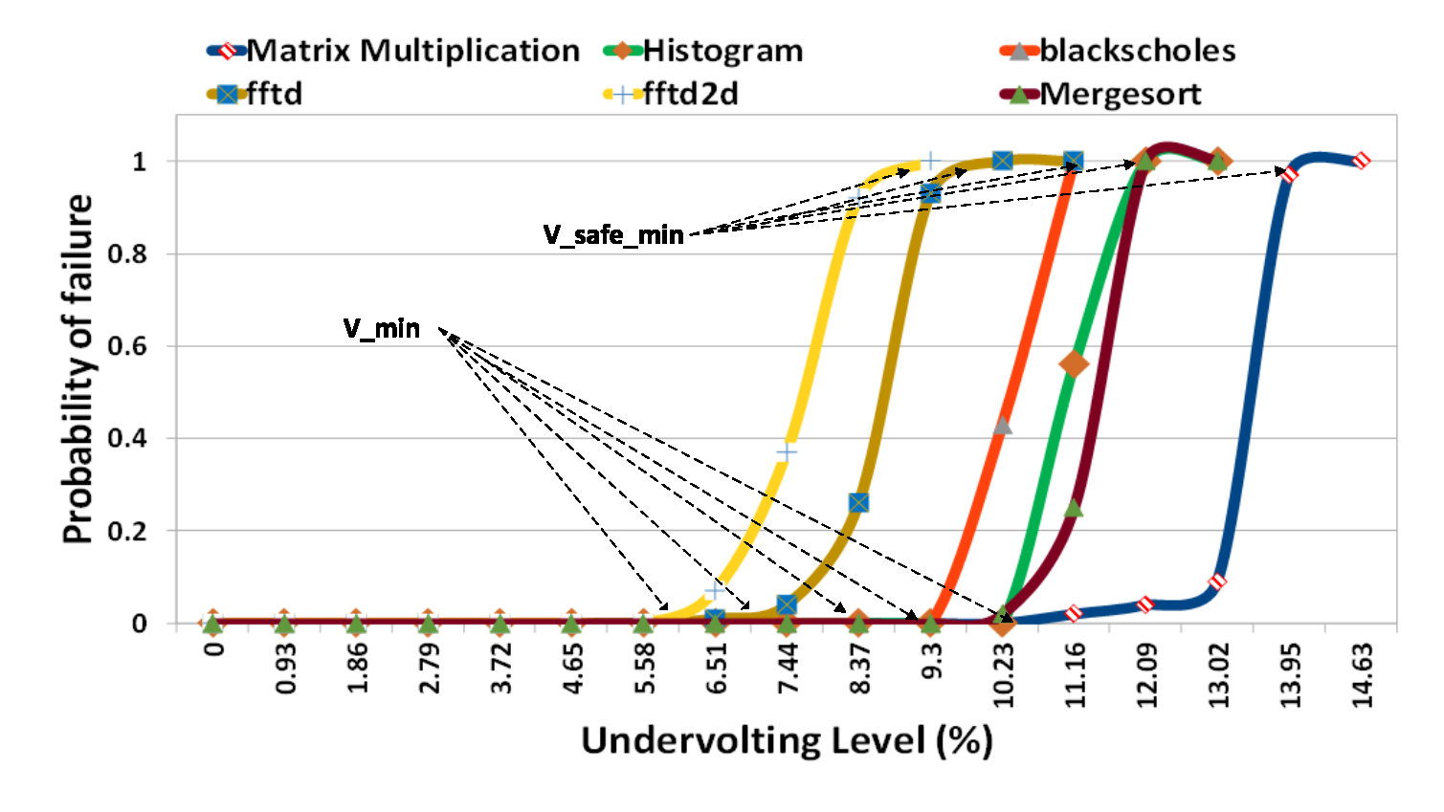
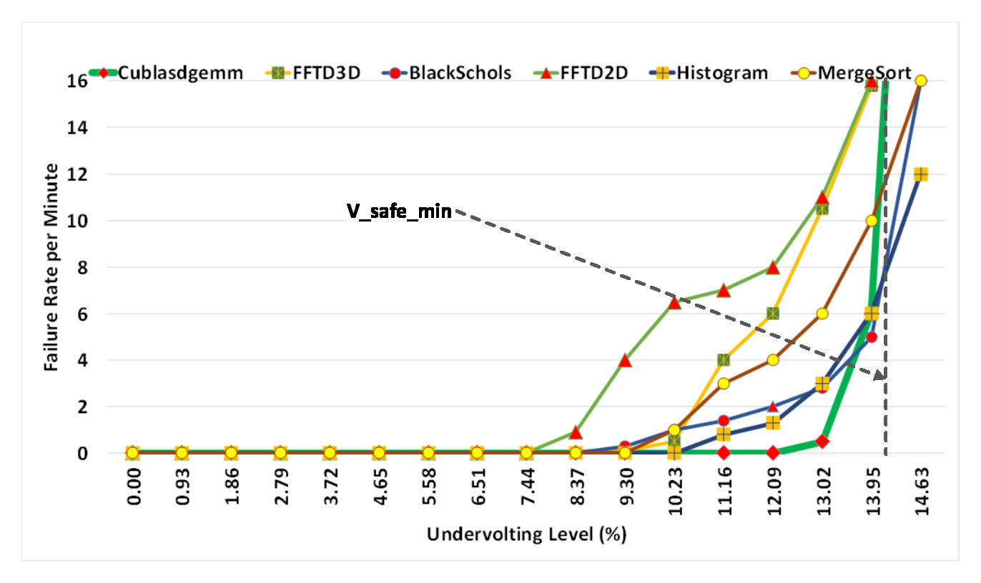


GPU Fault Model
Murthy, John Wiely, Weibull models 04
8
Notes:
So far we know how much we can reduce the voltage without experiencing the faults except than SDC faults. But we really don’t know how powerful our FT algorithm should be to tolerate the potential faults.
Inorder to configure our FT algorithm we should be aware the number of faults in the output.
Pf is derived by counting number of failures and divide it by total number of application runs. As shown here, we find the probability of failure for different applications as a function of undervolting level.
Here; Reliability of application R(t) at time t is the probability that there is failure in the system until time t. We find R(t) where t is the execution time.
The failure rate is obtained using Weibull lifetime reliability model, a well-accepted model for transient and permanent soft errors.
X-axis represents the undervolting level and Y-axis represents the failure rate per minute.
*************************************************************
Since we consider undervolting at a fixed frequency, the failure rate model is a function of supply voltage [38]

Slide 9
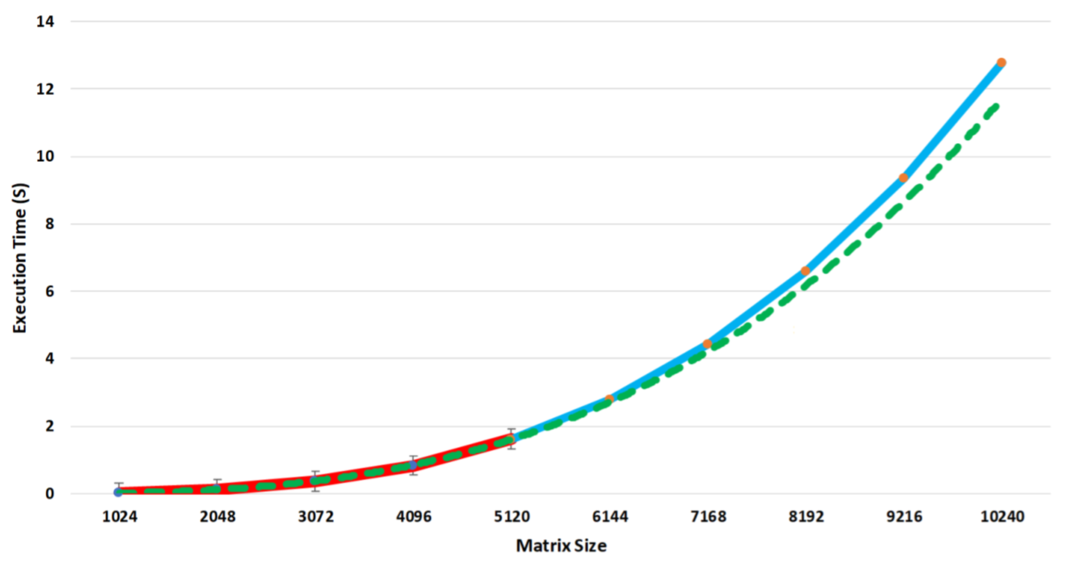
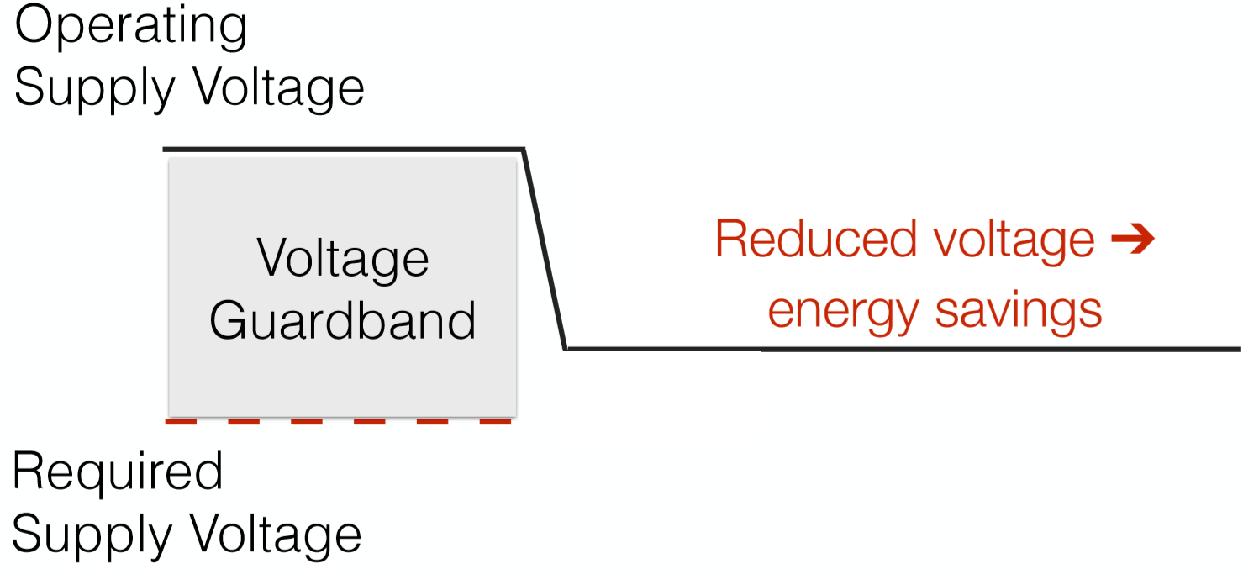


Offline Profiling
Phase 1: Find the optimum voltage
Phase 2: Predict the execution time
Rivest, Introduction to algorithms
Skiena, The algorithm design manual
9
Notes:
Before running the main application, we should be aware the proper undervolting level and also the number of faults ar each level of undervolting for the specific application.
The offline profiling phase is split into two phases:
Phase1 finds the optimum voltage and creates the fault rate. To reduce the performance overhead of profiling phase, Since the fault rate remains same, we run the application with small sizes.
Phase 2, Estimates the number of faults based on matrix size and fault rate(λ). And the number of faults in an application can be obtained by multiplying λ with the execution time.
We estimate the execution time of MM for a given matrix size on a specific GPU through a simple profiling. Due to different compute resources like SM, register file size, cache sizes and shared memory size, execution time of the MM for a given size could be vary in different GPUs. Due to memory constraints in our GPU, the GPU can not handle matrix multiplication of any arbitrary size. The time complexity of MM as a function of matrix size is following the cubic order; Where a and b are architecture-specific constants [36][31].
We run MM for different sizes to calculate the values of a and b for the underlying GPU. This figure shows the experimental execution time (blue) and the execution time calculated theoretically from the equation after finding the constant values. the red line shows sample points that were used to derive values of a and b which can be used for prediction of execution time for larger matrices, shown as green dashed line. Then, we compare the estimated execution time with the real experimental results for bigger matrices. As the results show, the estimation error is negligible

Slide 10
cuBLAS-MM ABFT
cuBLAS-MM is invoked at each step
10
Notes:
The basic idea of ABFT is to encode input matrices with checksums. Based on the number of faults, we decide on the number of checksum vectors.
We have built greenmm on top of cublas function, so whenever a multiplication is needed we call the cublas function to get the highest performance. We call the cublas function to produce the checksum vectors.
Depends on the number of faults we decide about the block size. We know that outer product Matrix Multiplication maintains checksum relationship in each iteration of computation [7],. At the end of computation at each iteration, we check full checksum relationship again and if the relationship does not hold, then our result is faulty; thereafter, faults are corrected.
*********************************************************
The algorithm to perform MM has several steps. During each iteration, we update checksum of the result matrix.. Then, we compute sum of each row and column in the result matrix and compare it with the row and column checksum. If the check is passed we move to the next iteration, otherwise, if any checksum does not match, we locate the exact position of error through comparing the checksums and correct it.
We generate the checksum weights vectors in the CPU and move them to the GPU. Due to frequent accesses to weights vector in GPU, to get peak performance, pitched device memory is used that allocates linear memory space for better efficiency in terms of performance and power.
We Divide input matrices into blocks given the number of faults and do MM without checksums.
Invoke cuBLAS-MM to update column checksum for each block according to algorithm
Invoke cuBLAS-MM to update C
Invoke cuBLAS-MM to update row checksum of B
Update row checksum of C by invoking cuBLAS-MM
Recalculate column and row checksums of C by invoking a simple kernel which adds elements of the result matrix.
Compare recalculated checksums and old checksums to locate the potential error. Any potential errors can be located by comparing the column and the row checksums. Since computers do floating point calculations in finite precision, the checksum relationship can not hold exactly due to round-off errors. So, we need a threshold to distinguish between roundoff errors and computation errors. Too large thresholds may hide the computation errors, while, too small thresholds may interrupt correct computation. In comparison phase, according to [40], e−10 has been chosen as a conservative threshold to distinguish between round-off and computation errors.
Correct any potential errors according to equation 6

Slide 11
Experimental Setup
GTX 980
  Memory: 4GB GDDR5
  Default Voltage: 1.075V
Power management commands (NMVL)
Nvidia-smi
MSI Afterburner
11
Notes:
All experiments are performed on NVIDIA GTX 980. Given the limited memory size of the GPU, we were able to evaluate the results for up to a matrix size of 10K.
Default voltage is 1.075V and we were able to reduce the nominal voltage of the GPU in step sizes of 10 - 12mV MSI After Burner [15] by decreasing the target power limit of the GPU, we can enforce specific operating voltage.
We use NVIDIA System Management Interface (Nvidia-smi), a widely used command line utility on top of NVIDIA Management Library(NVML), to measure power consumption of the GPU at 10ms intervals.

Slide 12
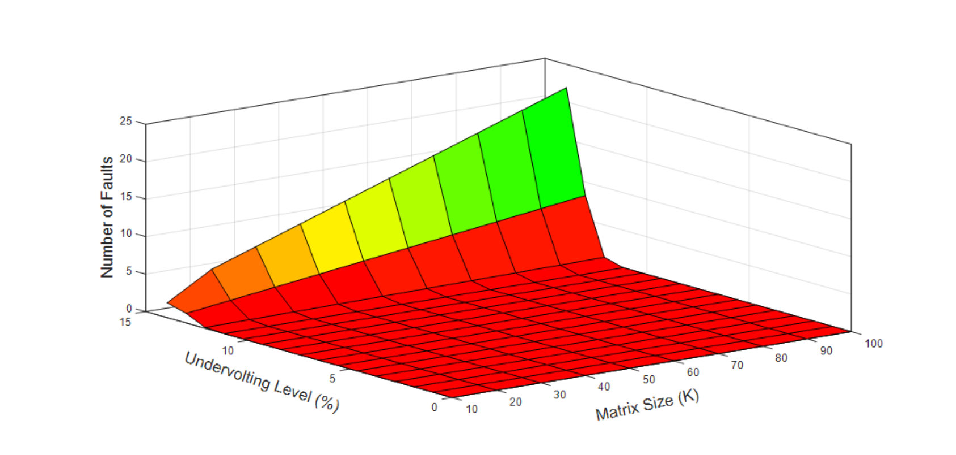
Evaluation- Estimated number of faults
Offline profiling phase
  Failure rate
  Estimated execution time
12
Notes:
Due to memory constraints on NVIDIA GTX 980, we use matrix of size 10K for GreenMM. If GPU memory supports matrices bigger than 10K, they may experience more number of faults. As the size of the matrix increases, the execution time as well as the number of faults also increase. The matrix size varies between 10K and 100K as the undervolting level is changed from 0% to13.95% in Y-axis; Z-axis shows then numberof faults. For a given undervolting level, the number of faults for large matrix sizes is more than the number of faults in small matrices.

Slide 13
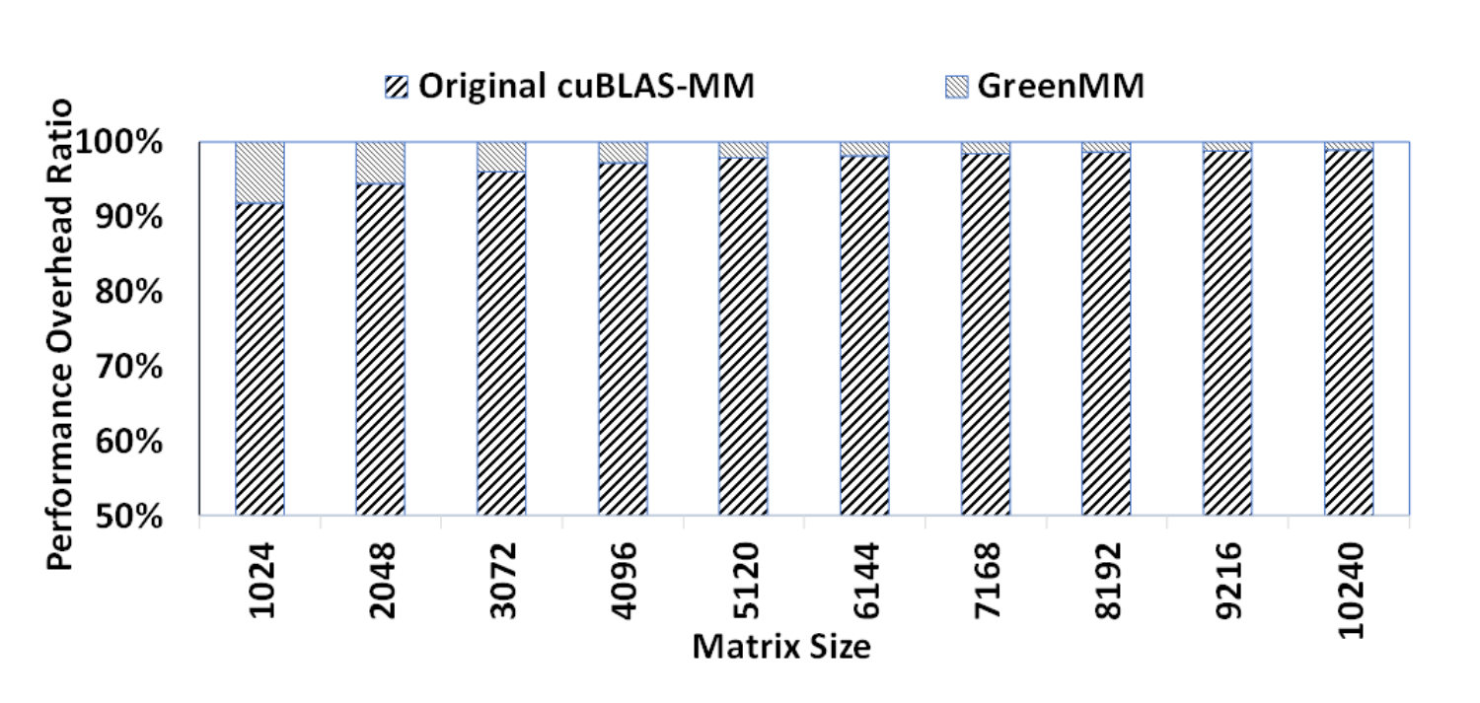
Evaluation- Performance
Maximum level of undervolting
Number of faults are 2
13
Notes:
Here, we evaluate the performance overhead of GreenMM. The overhead of fault tolerance is large for small matrices, however, the overhead decreases with increase in the matrix size. For small matrices, there is 9% performance overhead, while in case of bigger matrices (10K), performance overhead of FT-cuBLAS-MM comes down to 1.5%.
*********************************************************************

Slide 14
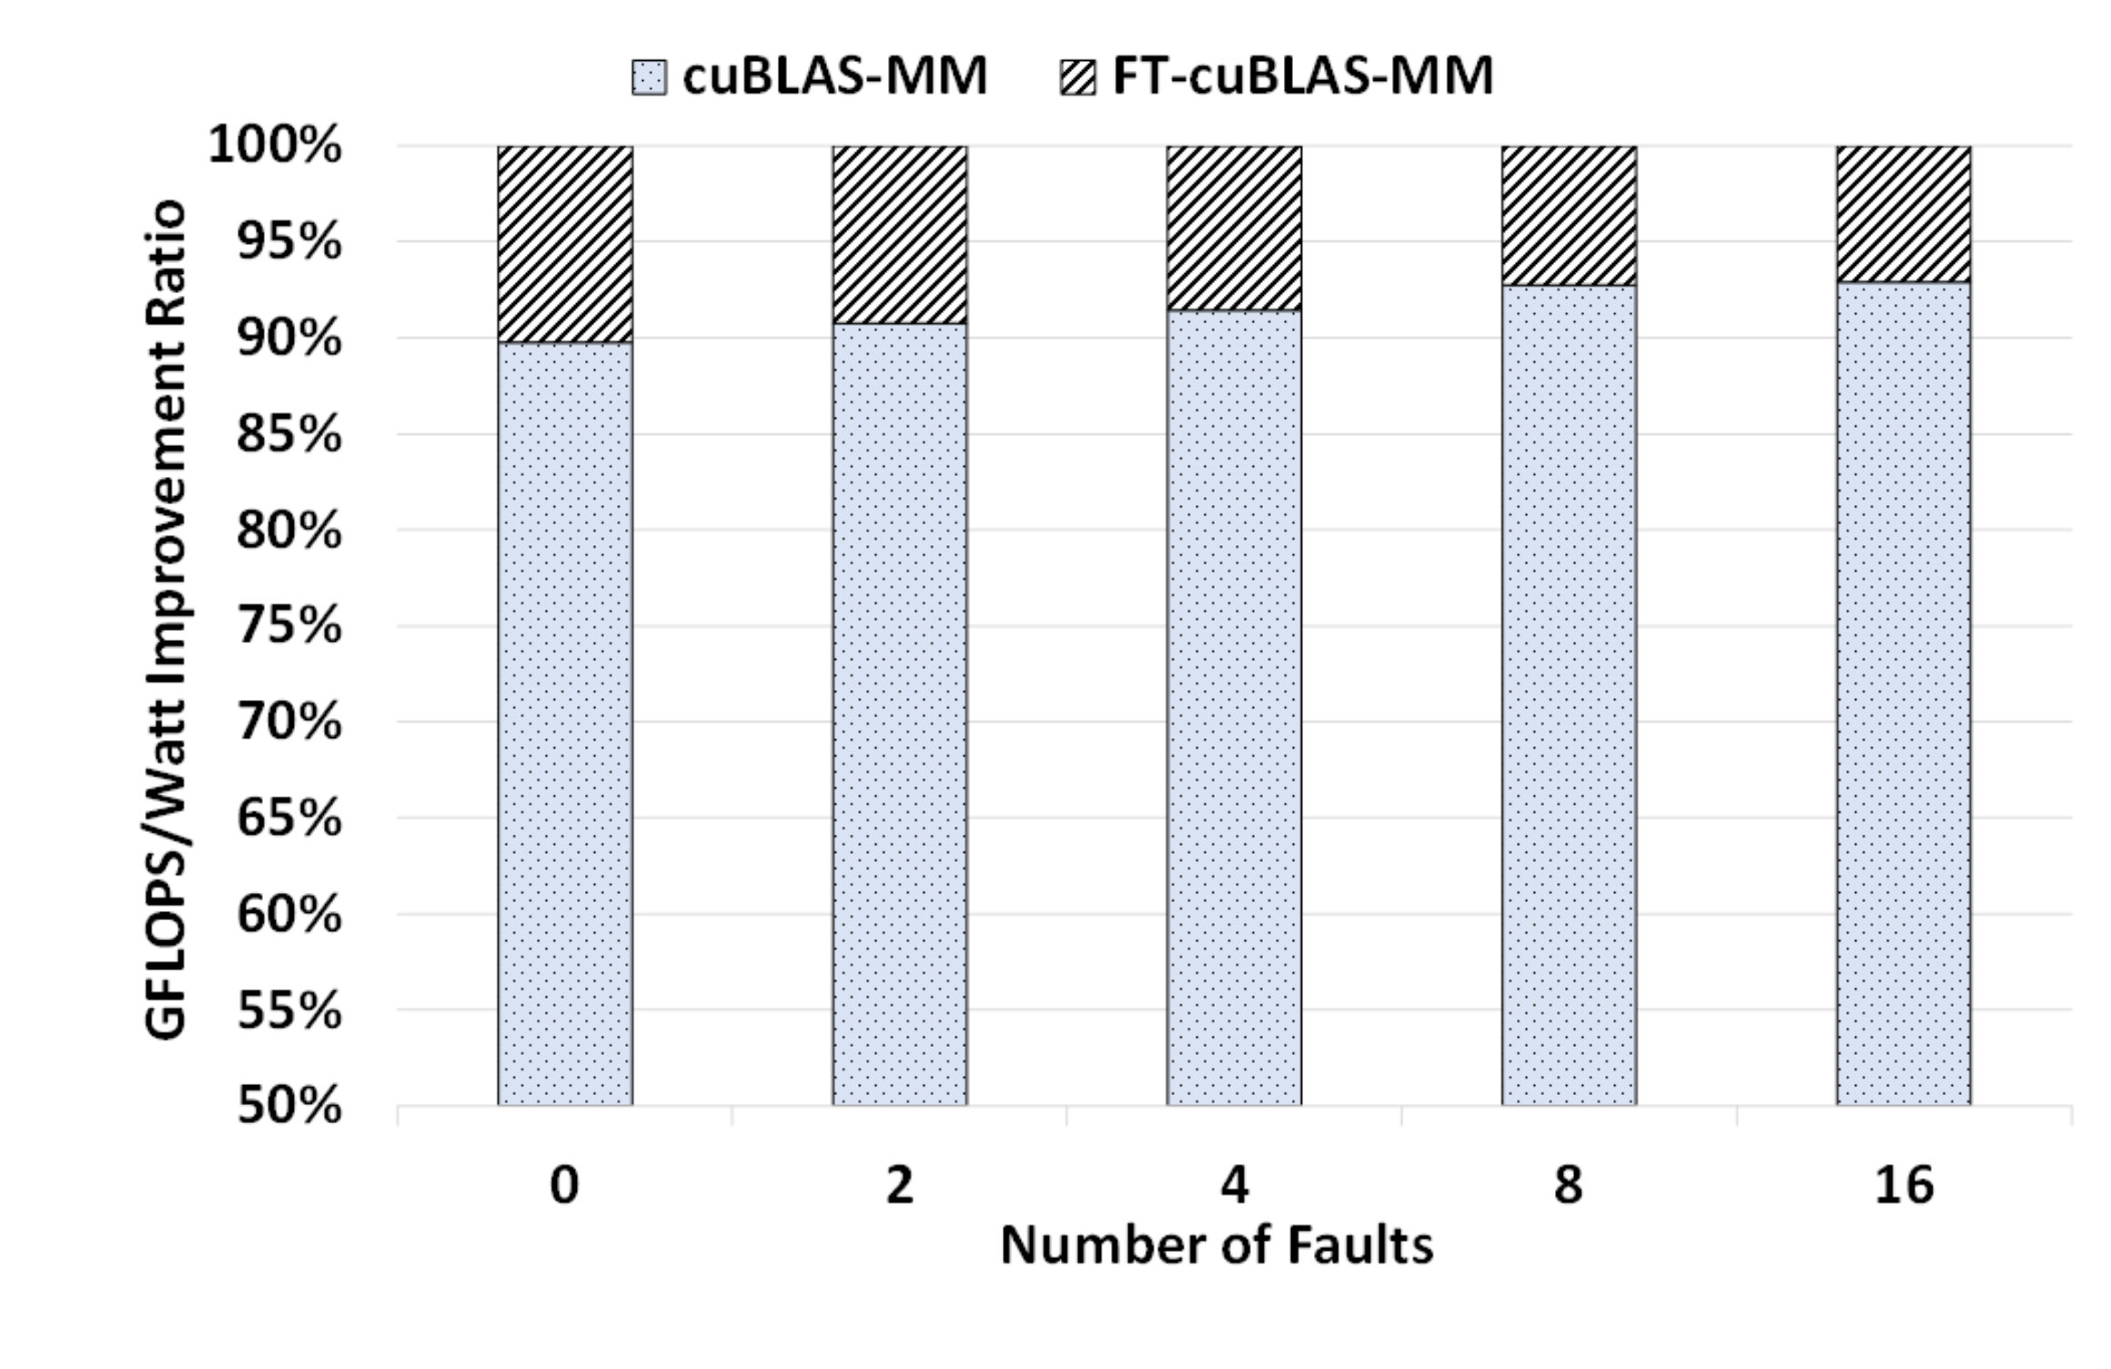
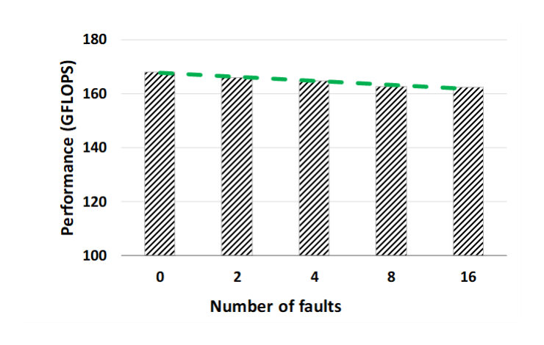
Evaluation- Performance (per Watt)
Memory limit constraints
Performance/watt ↑by 9%
Faults are manually injected
Performance overhead ↓1.5%
Performance overhead ↓1.5%
14
Notes:
Due to memory contraints, we were not able to go beyond 10K which only gives us up to 2 faults at maximum level of undervolting.
So, We evaluate the performance overhead by manually injecting faults into 10K matrix.
The performance is 165 GFLOPS in presence of 2 errors and 162 GFLOPS in presence of 16 faults. On average, the performance overhead for different number of faults is 1.5%
The performance doesn’t vary much in presence of different number of faults.
This is because; the detection phase accounts for majority of the overhead in the GreenMM.
For instance, when the matrix size is 10K, the detection phase takes 139ms while the correction phase takes only 0.24ms, which means the number of faults to be corrected has low impact on the performance.
But, despite the performance overhead of ABFT, GreenMM improves the performance per watt (GFLOPS/Watt) in comparison to the original cuBLAS-MM. This is because, we can save significant power by just undervolting the GPU.

Slide 15
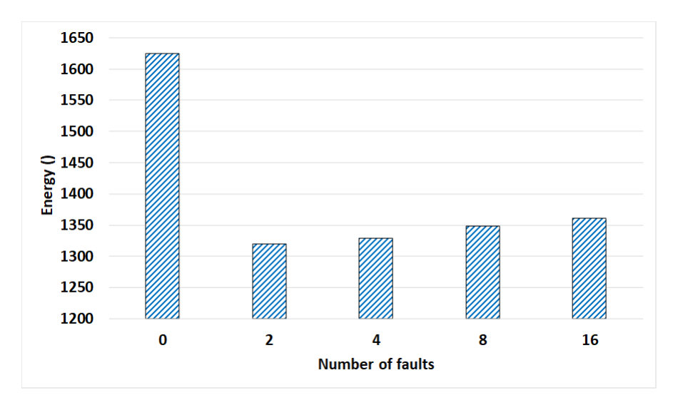
Evaluation- Energy
Matrix size is 10K
Faults are manually injected
Without undervolting
GreenMM
15
Notes:
To have an explicit comparison, we also plot the total energy consumption for 10K in presence of different number of faults. X-axis shows the number of faults and the Y-axis shows the total energy consumption. The first left column shows the original cu-BLAS-MM energy consumption, while the other column shows the energy consumption of GreenMM in presence of different number of faults.
The results show that when the original cu-BLAS-MM is used without any faults, the GPU consumes more than 1600 Joules, whereas, the GreenMM consumes about 1300 Joules in presence of 2 faults

Slide 16
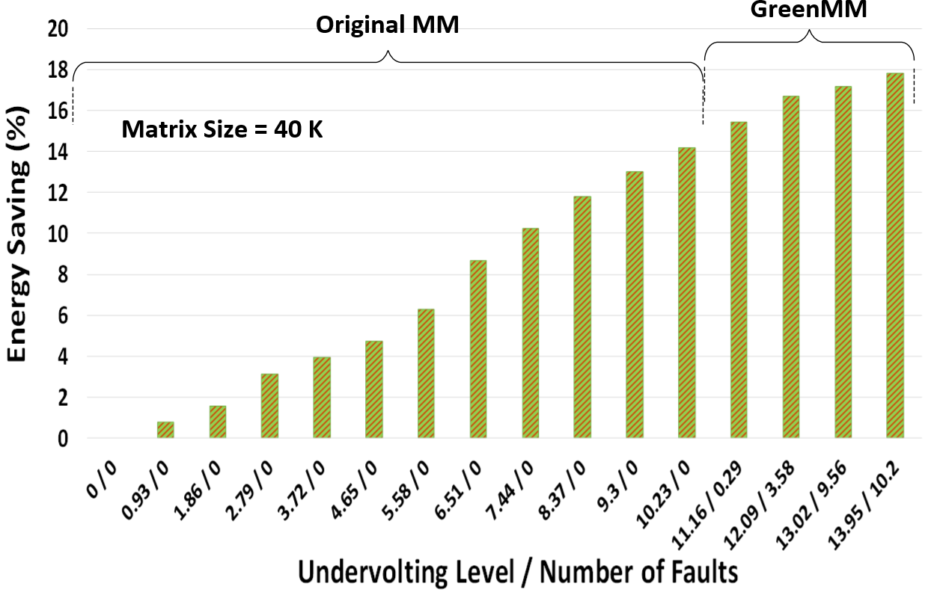
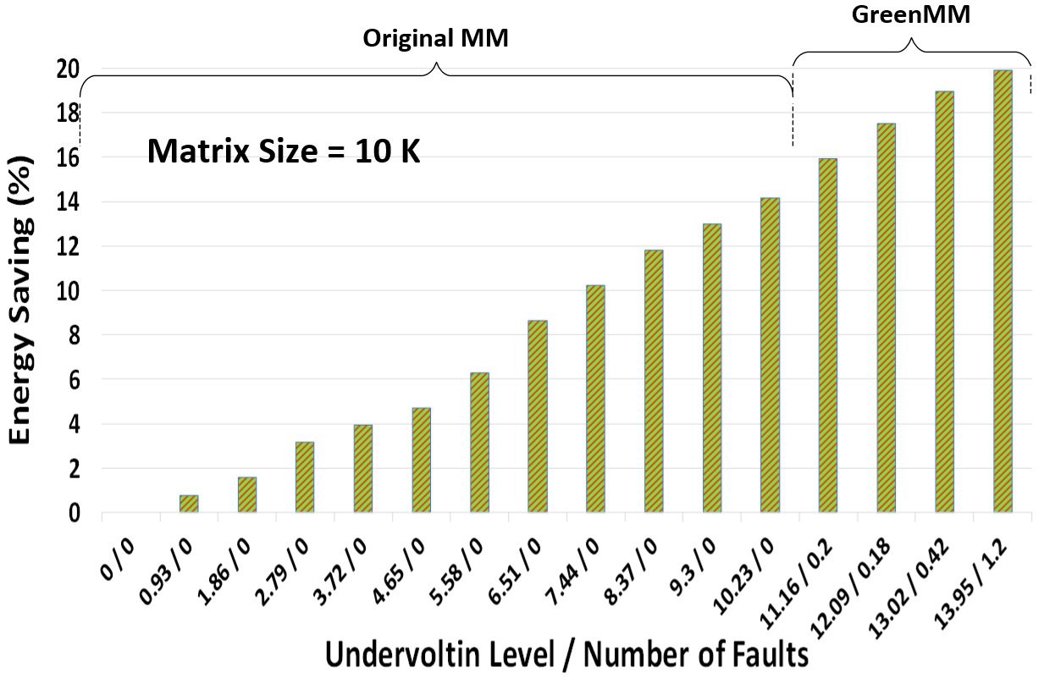
Evaluation- Energy
16
Notes:
The energy consumption of the GPU is calculated by multiplying power (at each undervolting level) with the execution time of MM. Figure 12 shows the energy saving in FT-cuBLAS-MM versus the original cuBLAS-MM in presence of different undervolting levels and number of faults. Since no fault occurs tillVmin, fault detection phase is disabled. The fault detection and correction phases are activated when we undervolt fromVmin tillVsafeMin. The X-axis denotes the undervoltinglevelandthecorrespondingnumberoffaults.Figure12(a)shows the energy saving at different undervolting levels for matrix size of 10K with and without fault tolerance. Undervolting level atVmin for the original cuBLAS-MM is 10.23% without any faults. UndervoltingbeyondVmin resultsinfaults;andthemaximumnumberoffaults is 1.2 at undervolting level of 13.95% as shown in Figure 9. So, offline FT-cuBLAS-MM is used to correct the faults. For a matrix of size 10K, the cuBLAS-MM can save energy up to 14% just by undervoltingandwithoutanyfaulttolerance,butwithGreenMMthe energy saving is increased up to 19.8% due to undervolting beyond Vmin. Figure 12 (b) shows the energy saving at different undervolting levels for matrix size 40K with and without fault tolerance. Undervolting beyondVmin, results in faults; and the maximum number of faultsis10.2atundervoltinglevel13.95%.OfflineFT-cuBLAS-MM with two weighted-check sum vectors can not cover those number of faults. Hence, we activate the Online FT-cuBLAS-MM to tolerate the faults. Although, going beyond Vmin results in more number of faults, we can still save 4% additional energy by activating the FT-cuBLAS-MM.Foramatrixofsize40K,whentherearenofaults, the cuBLAS-MM saves energy up to 14% with undervolting, but when using undervolting in combination with FT-cuBLAS-MM the energy saving increases to 18%.

Slide 17
Summary
  GreenMM framework
    Undervolt the GPU beyond the Vmin
    Employ ABFT to cover the faults
  Transparent
  Portable
  Saves energy up to 19.8% for 10K matrices
  Improves the GFLOPS/Watt by 9%
17

Slide 18
Thank you!
Questions?

Slide 19
Evaluation- Performance
Memory limit constraints
  We can not produce these number of faults
Faults are manually injected
Notes:
we evaluate the performance overhead by manually injecting faults into 10K matrix. Increase in the number of faults results in increased performance overhead, as shown in Figure 11. The performance is 165 GFLOPS in presence of 2 errors and 162 GFLOPS in presence of 16 faults. On average, the performance overhead for different number of faults is 1.5%

Slide 20
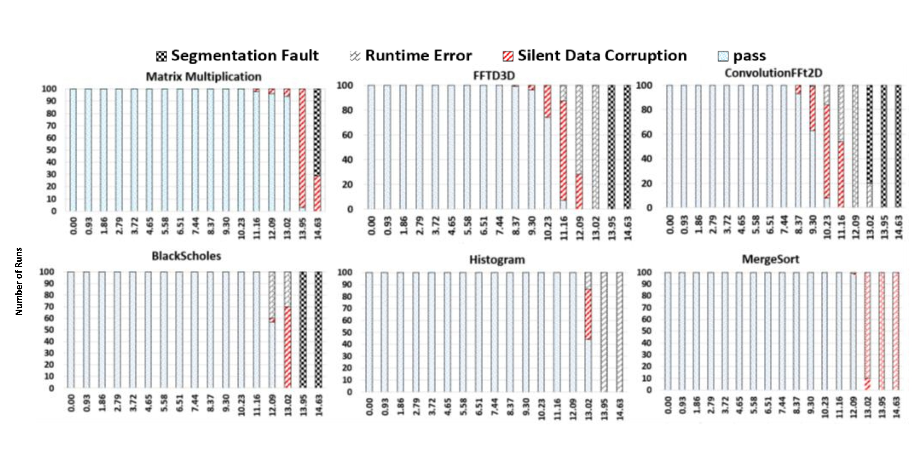
GPU Fault Distribution
7
Notes:
Change the picture(Quality is not good)
Talk about faults types:
Put only matrix multiplication
And mention the other applications
We experimentally measure each program’s fault distribution and failure probability when operating below its Vmin point.
This helps us to determine whether more aggressive optimization of operating below the Vmin point is feasible.
There are four main types of error events:
silent data corruption; ii)
CUDA runtime errors,
GPU driver fault or segmentation fault;
Operating system crash
Silent data corruption (SDC) [15] refers to when a program ﬁnishes execution without any warning but the output is not correct.
We detect it by comparing the output against a golden output from a fault free reference.
.CUDA runtime errors refer to the erroneous execution of a program that fails at runtime. Such errors are explicitly reported by the CUDA runtime system.
Segmentation fault occurs when the GPU driver code executed by the CPU loses communication with the GPU. This can be detected by inspecting the standard error output.
The harshest error is the OS crash, after which a manual reboot is required. We stop the voltage reduction experiment once an OS crash happens.
Except than SDC faults, the other types faults can not be covered by using a fault tolerant algorithm no matter how it is powerful.
But the good news is, in some application, we have enough opportunity to go even beyond the Vmin since we only have SDC errors.
In Fast Fourier Transform (FFT), Matrix Multiplication and Hotspot benchmarks, the SDC errors lead to 24%, 42% and 55% faulty executions, respectively [27].

Slide 21
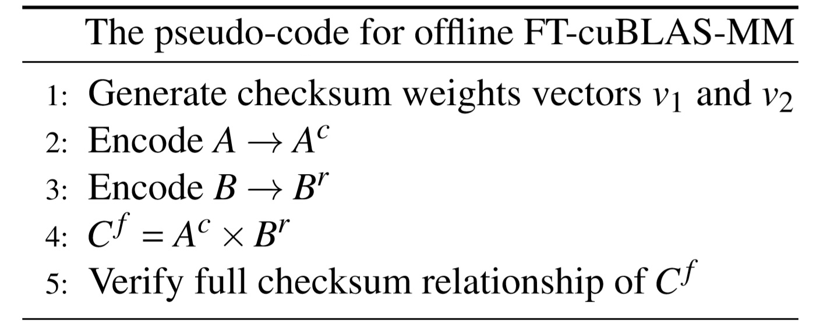



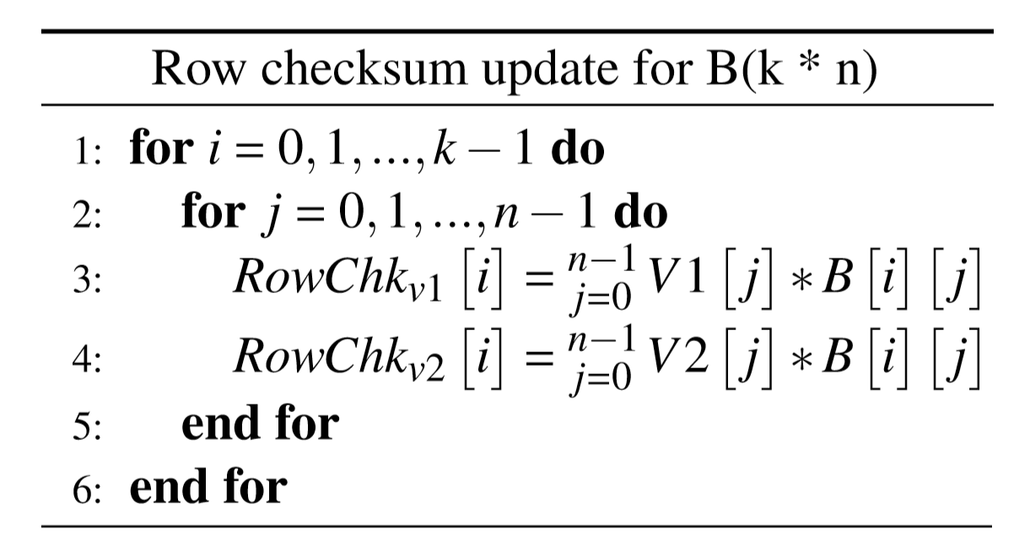
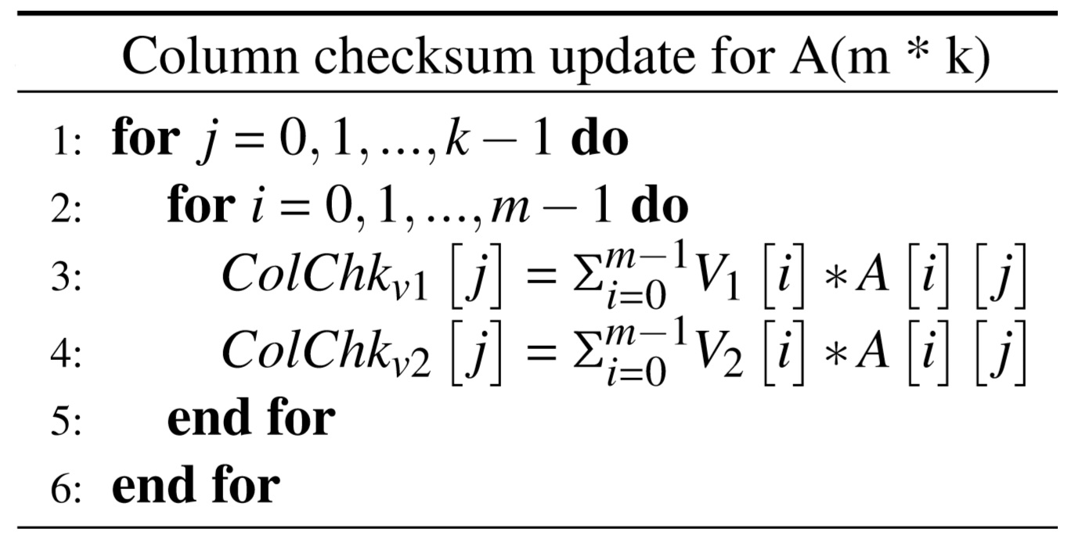
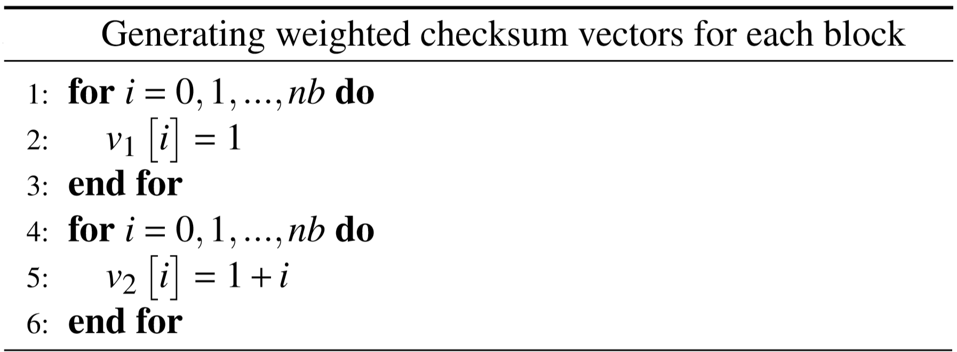
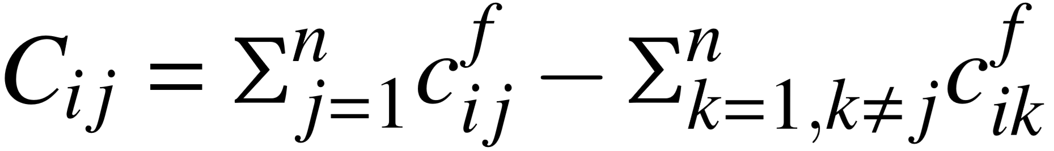
OfflineFT-cuBLAS-MM

Slide 22
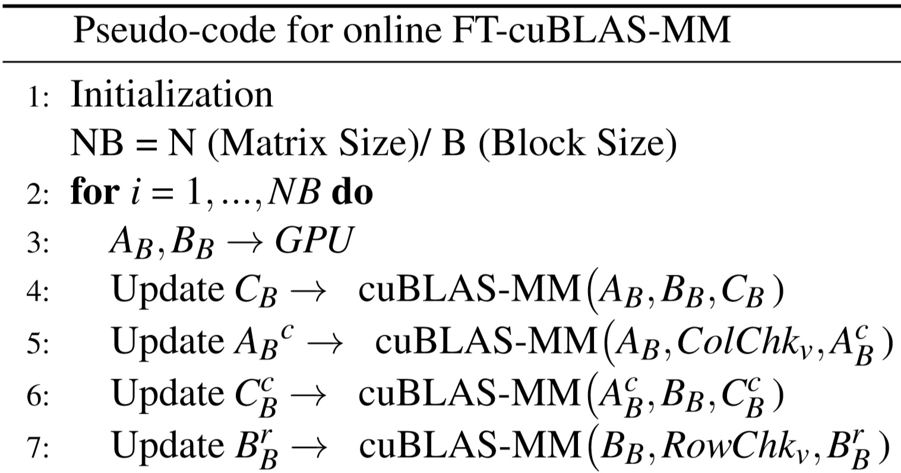
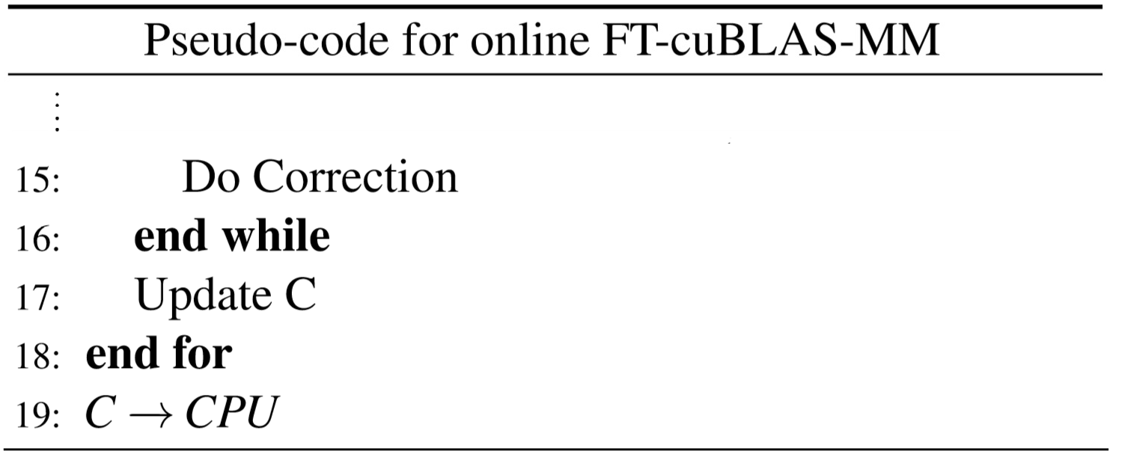
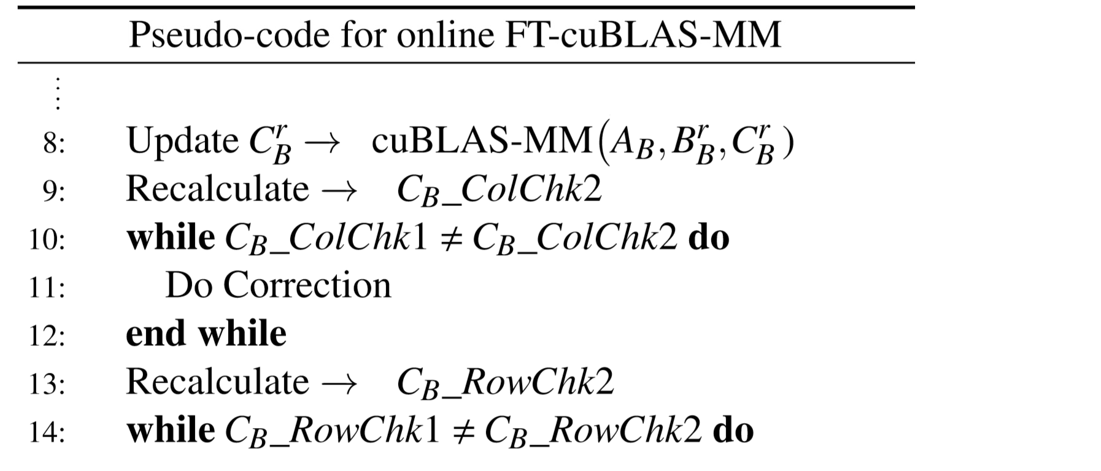
OnlineFT-cuBLAS-MM

Slide 23
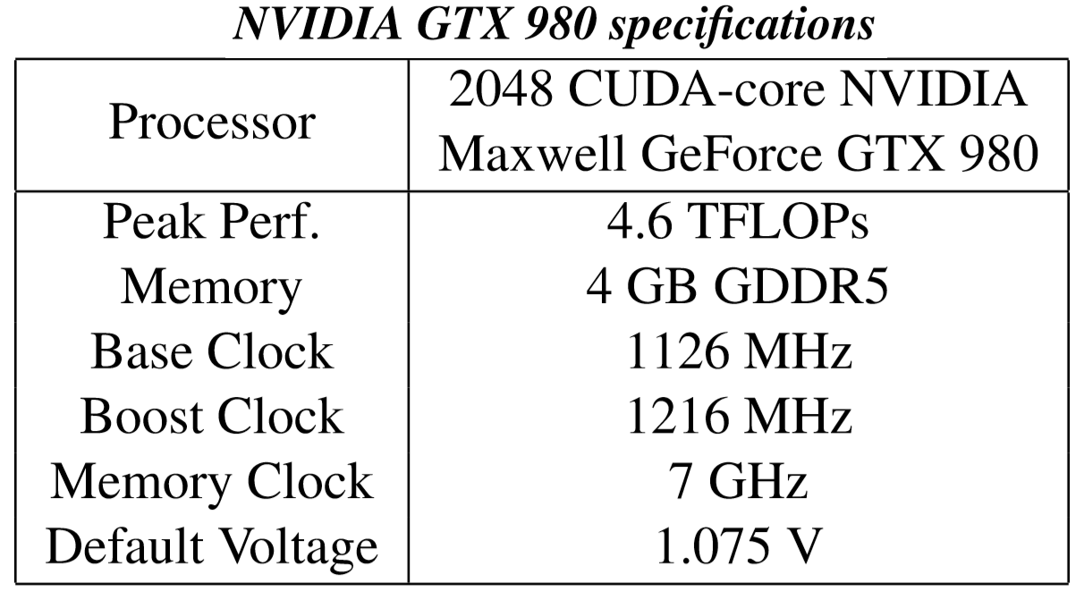
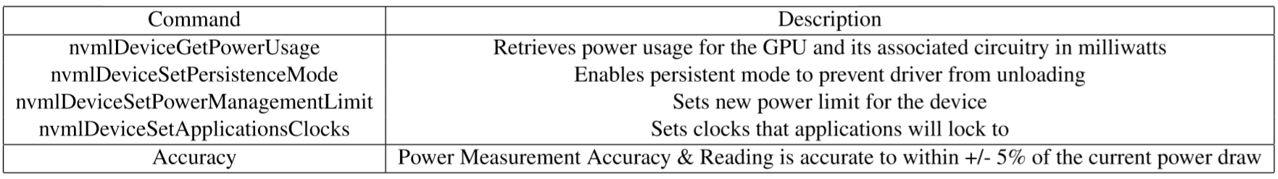
Experimental Setup
GTX 980
Power management commands

Slide 24
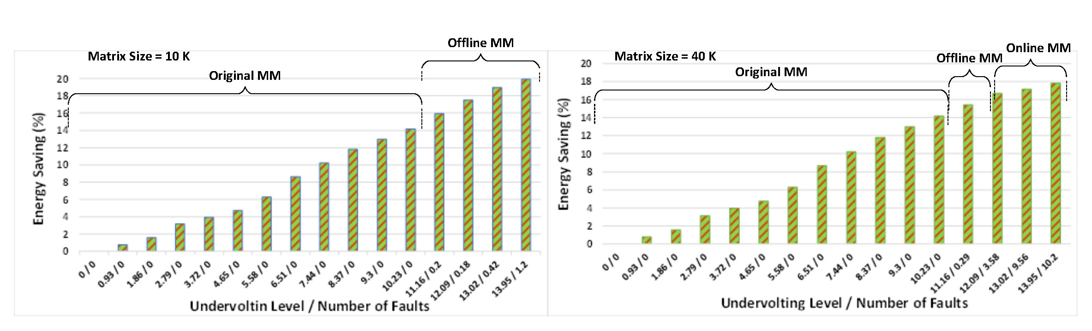
Evaluation- Energy
Energy saving opportunity for matrices with sizes of 10K and 40K
/20

Slide 26
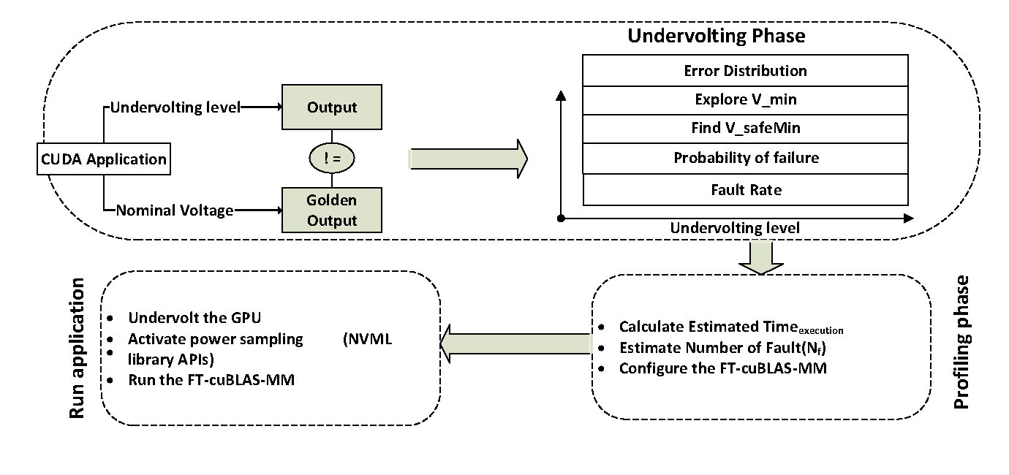
GreenMM- Offline Profiling Phase
/20

Slide 27
Experimental Setup
GTX 980
Power management commands

