Slide 1
Design and Implementation of Brain Computer Interface based Robot Motion Control
Authors: Devashree Tripathy, JagdishLal Raheja
CSIR - Central Electronics Engineering Research Institute, Pilani,
Academy of Science and Innovative Research, Council of Scientific and Industrial Research (CSIR), India
2

Slide 2
Contents
Introduction to Brain Computer Interface (BCI)
Robot Motion Control
EEG signal classification and detection
References
Conclusion & Future Work

Slide 3
BCI Concept:
direct communication pathway between a brain and an external device.
BCI aims at assisting, augmenting or repairing human cognitive or sensory-motor functions.
Notes:
A brain–computer interface (BCI), or a brain–machine interface, is a direct communication pathway between a brain and an external device.
Research on BCIs began in the 1970s at the University of California Los Angeles (UCLA) under a grant from the National Science Foundation, followed by a contract from DARPA. The papers published after this research also mark the first appearance of the expression brain–computer interface in scientific literature.
The field of BCI took momentum after that, mostly toward neuroprosthetics applications that aim at restoring damaged hearing, sight and movement. Signals from implanted prostheses can, after adaptation, be handled by the brain like a natural sensory organ. Following years of animal experimentation, the first neuroprosthetic devices implanted in humans appeared in the mid-nineties.

Slide 4
BCI motivation:
In USA, more than 200,000 patients live with the motor sequelae (consequences) of serious injury. There are two ways to help them restore some motor function:
Repair the damaged nerve axons
Build neuroprosthetic device

Slide 5
BCI Principle:
(a) In healthy subjects, primary motor area sends movement commands to muscles via spinal cord.
(b) But in paralyzed people this pathway is interrupted.
(c) A Computer based decoder is used, which translates this activity into commands for muscle control.

Slide 6
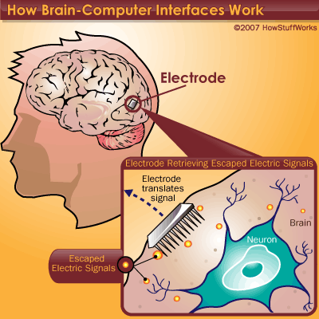
Working of BCI:
Every time we think, move,
feel or remember something,
our neurons are at work.
That work is carried out by
small electric signals that
zip from neuron to neuron as
fast as 250 mph
some of the electric signal
escapes, which can be detected,
interpret and use them to direct
a device of some kind.
Notes:
The reason a BCI works at all is because of the way our brains function. Our brains are filled with neurons, individual nerve cells connected to one another by dendrites and axons. Every time we think, move, feel or remember something, our neurons are at work. That work is carried out by small electric signals that zip from neuron to neuron as fast as 250 mph [source: Walker]. The signals are generated by differences in electric potential carried by ions on the membrane of each neuron.
Although the paths the signals take are insulated by something called myelin, some of the electric signal escapes. Scientists can detect those signals, interpret what they mean and use them to direct a device of some kind. It can also work the other way around. For example, researchers could figure out what signals are sent to the brain by the optic nerve when someone sees the color red. They could rig a camera that would send those exact signals into someone's brain whenever the camera saw red, allowing a blind person to "see" without eyes.

Slide 7
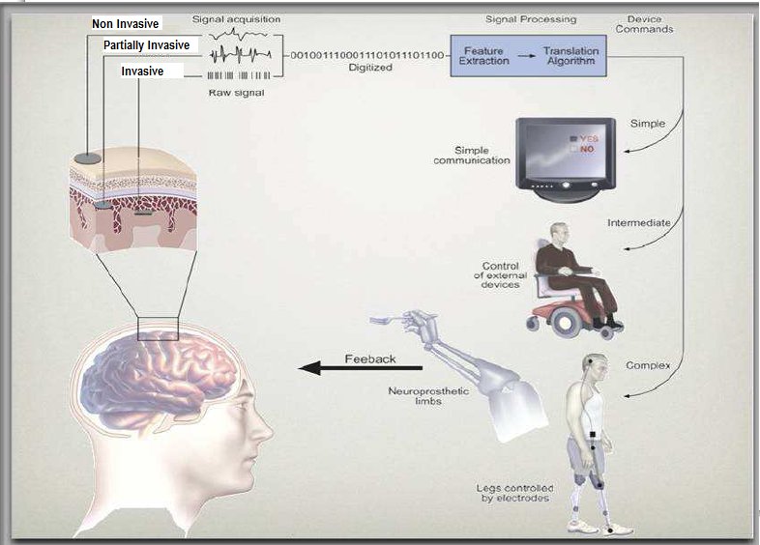
BCI System:

Slide 8
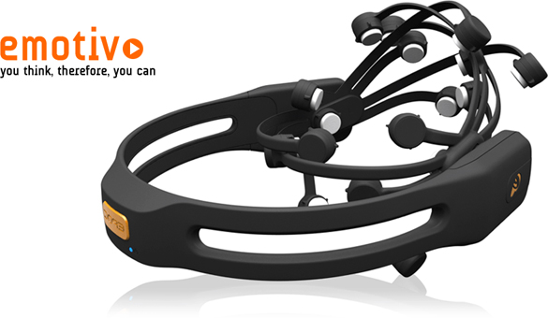

Slide 9
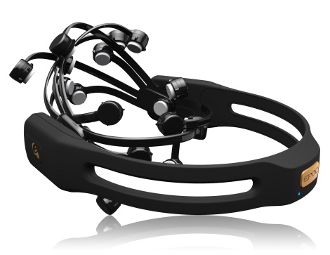
EPOC neuroheadset
The Emotiv EPOC is a neuro-signal acquisition and processing wireless neuroheadset.
It uses a set of sensors to tune into electric signals produced by the brain to detect player thoughts, feelings and expressions and connects wirelessly to most PCs.
-14 sensors
Included Free with the Emotiv EPOC: EmoKey
EmoKey links the Emotiv technology to your applications by easily converting
detected events into any combination of keystrokes.
EmoKey lets you create profiles that define how detections are mapped to keystroke
combinations.
Rs. 16,500

Slide 10
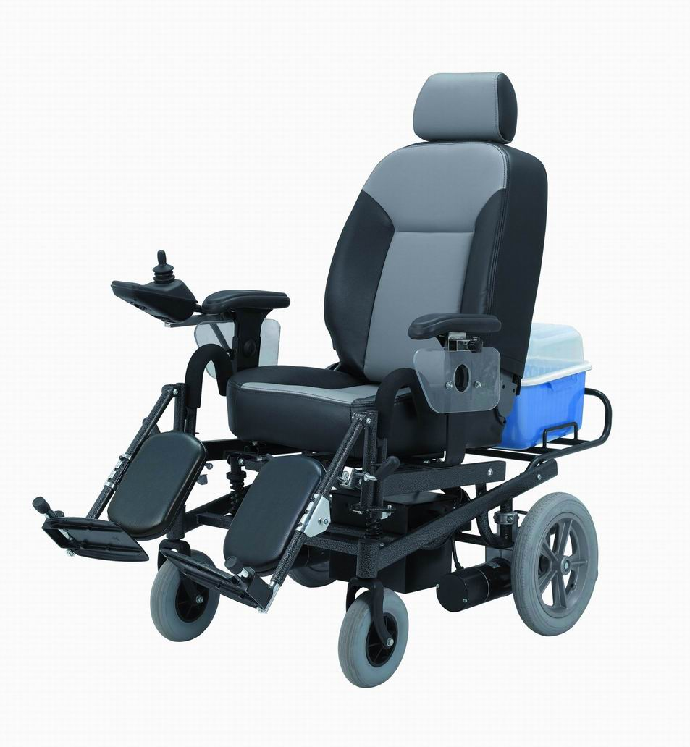
Application 2 : Robot Motion Control (Wheel Chair Movement)
SOFT LEFT 1
SOFT RIGHT 1
SOFT LEFT 2
SOFT RIGHT 2

Slide 11
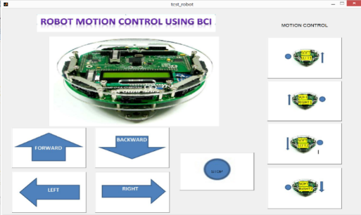
Flow Chart Of Robot Motion Control
ROBOT PROGRAMMING
Code for programming the DC motors of FIRE BIRD V for different motions according to Pin interfacing of ATMEGA 2560 with L293D (AVR Studio8 )
FEEDBACK
Signal Processing, Feature Extraction and Classification (EMOTIV EPOC Control Panel )
Facial Expressions and thoughts mapped into Keypad commands : SMILE to left click of mouse (EMOKEY)
Compile code written in AVR Studio8 and generate ‘.hex’ file (WIN AVR open source C compiler )
Controls cursor movement on screen using Eyes based on EOG signals (MOUSE EMULATOR )
‘.hex’ file loaded to the FLASH buffer and then written on the ATMEGA 2560 (Khazama AVR programmer)
Robot Motion Control

Slide 12
Results: Robot Motion Control
Actions performed: Smile and neutral

Slide 13
Conclusion: Robot Motion Control
Two actions (smile and neutral) were used
Average accuracy achieved for 3 subjects using 2 actions was 99%
The system developed is:
Inexpensive
Easy-to-use
Fast
Accurate
No visual adjustments are required to make the system work

Slide 14
Classification Of EEG Signals
Developed applications, “Patient assistance system” and “Robot motion control”, used pre-implemented classification algorithm of Emotiv SDK
Results showed:
Accuracy is more than 90% using 2 actions
On increasing the number of actions to 4, accuracy falls to 40%
Development of new algorithm for classification of EEG signals
Aim: Further improvement of classification accuracy

Slide 15
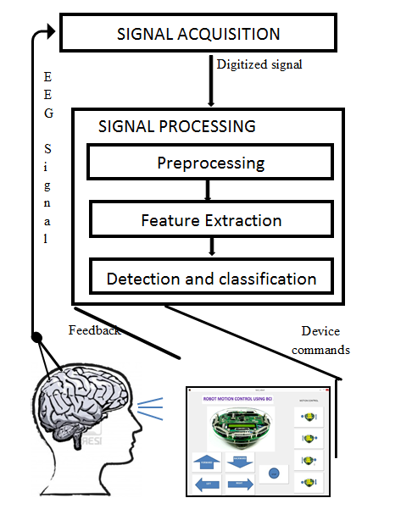
FLOW CHART

Slide 16
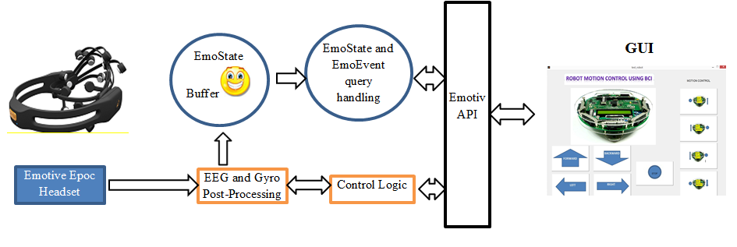
Interfacing of the EmoEngine and Emotiv EPOC with the GUI

Slide 17
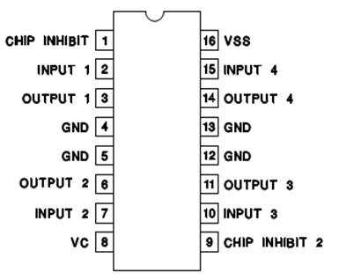
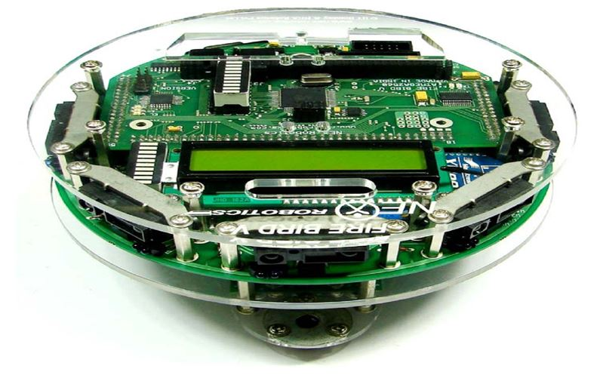
Interfacing Robot with PC
Hexa-decimal | Decimal Commands | Pins of ATMEGA2560 |  |  |  | Robot Motion
 |  | A3 | A2 | A1 | A0
0X06 | 8 | 0 | 1 | 1 | 0 | Forward
0X09 | 2 | 1 | 0 | 0 | 1 | Backward
0X05 | 4 | 0 | 1 | 0 | 1 | Left
0X0A | 6 | 1 | 0 | 1 | 0 | Right
0X00 | 5 | 0 | 0 | 0 | 0 | Stop
0X04 | 7 | 0 | 1 | 0 | 0 | Soft left 1
0X02 | 1 | 0 | 0 | 1 | 0 | Soft Right 1
0X01 | 3 | 0 | 0 | 0 | 1 | Soft left 2
0X08 | 9 | 1 | 0 | 0 | 0 | Soft Right 2

Slide 18
Implementation Platform
Simulation Tool | MATLAB 2012b
Processor | Intel Xeon @ 3.40 GHz
Memory (RAM) | 16 GB, DDR3
Operating System | Windows 8 (64 Bit)

Slide 19
Signal Acquisition : Database
Database Created at | Machine Vision lab, CEERI
No. of Subjects | 3
Neuroheadset | EMOTIV EPOC
Electrodes | 14 + 2 reference
Sampling Type | Single ADC sequential sampling
Sampling Rate | 128 Samples/sec
Actions | 4 (Blink, Smile, Neutral, Raise Brow)
Recording Duration | 2 minutes
No. of Trials | 10

Slide 20
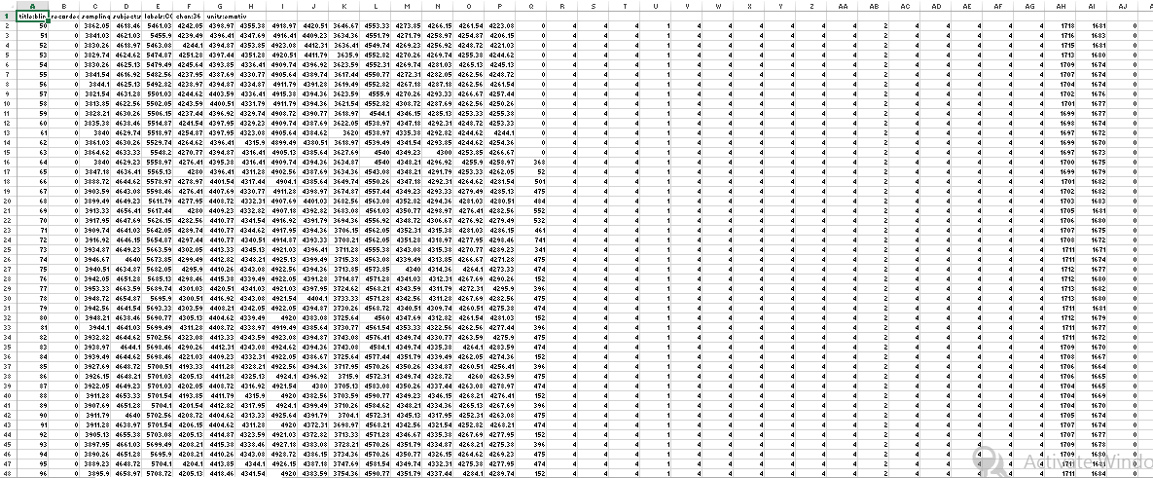
Signal Acquisition : Final Database Generation
Conversion of Data:*.EDF to *.CSV
Amplitude of signals in 14 channels
Data Matrix Extraction: signals in 14 channels
Final Database
3 subjects with 4 actions for each subject
Samples
Subject 2
Subject 3
Subject 1
Blink
Smile
Raise Brow
Neutral
Blink
Smile
Raise Brow
Neutral
Blink
Smile
Raise Brow
Neutral
10 trials for each action recorded for 2 minutes
.
.
.
.
Trial 1:
15360 X 14
Trial 2:
15360 X 14
Trial 10:
15360 X 14
20

Slide 21
FLOW CHART
Signal Acquisition
Signal Pre-processing
Feature Extraction
Multi Resolution Analysis
Principal Component Analysis
Classification and Detection

Slide 22
Signal Pre-processing
Digital 5th order sinc notch filters at 50 Hz and 60 Hz^{[6]}
Avoid initial disturbance and noise
Reject initial 30 seconds recording
Consider next 1 minute long recorded signal
[6] A S Vale-Cardoso and H N Guimarães,“The effect of 50/60 Hz notch filter application on human and rat ECG recordings”, 2010 Physiol. Meas. 31 45 doi:10.1088/0967-3334/31/1/004

Slide 23
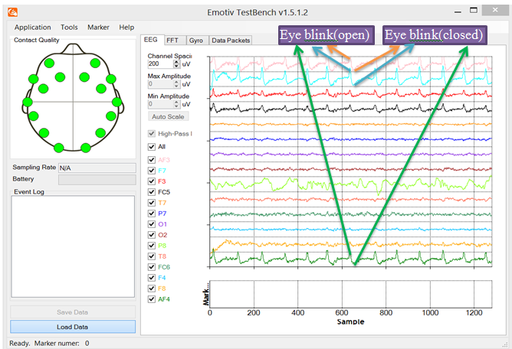
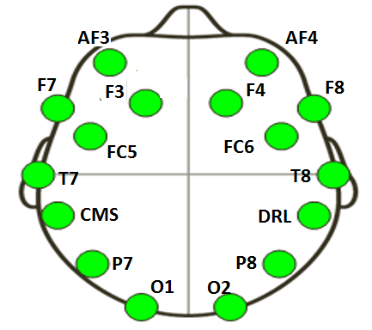
BLINK Signals Representation in Emotiv Testbench

Slide 24
SMILE Signals Representation in Emotiv Testbench

Slide 25
NEUTRAL Signals Representation in Emotiv Testbench

Slide 26
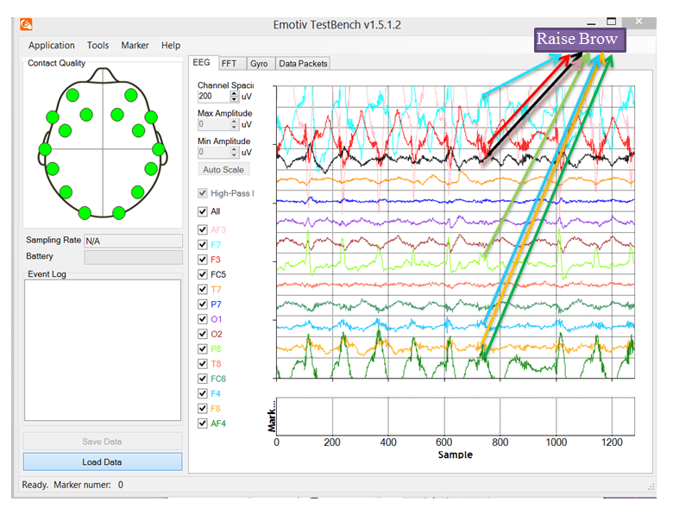
RAISE BROW Signals Representation in Emotiv Testbench

Slide 27
References
[1] J. R. Wolpaw, N. Birbaumer, D. J. McFarland, G. Pfurtscheller, and T.M.Vaughan,”Brain-computer interfaces for communication and control”, Clinical Neurophysiology, Vol. 113, . (2002), pp. 767-91
[2] N. Birbaumer,”Brain-computer- interface research: Coming of age”, Clinical Neurophysiology, Vol. 117, . (2006), pp. 479-483.
[3] E. A. Curran, and M. J. Stokes, ”Learning to control brain activity: A review of the production and control of EEG components for driving brain-computer interface (BCI) systems ”, Brain and Cognition, Vol. 51, . (2003), pp. 326-336.
[4] J. R. Wolpaw, N. Birbaumer, W. J. Heetderks, D. J. McFarland, P.H. Peckhm, G.Schalk, E. Donchin, L. A. Quatrano, C. J.Robinson, and T.M.Vaughan,”Brain-computer interface technology: A review of the first international meeting”, IEEE transactions on neural systems and rehabilation engineering, Vol. 8, no. 2 (2000), pp. 164-173.
[5] J. R. Wolpaw, D. J. McFarland, and T.M.Vaughan,”Brain-computer interface research at the Wadsworth Centre”, IEEE transactions on neural systems and rehabilation engineering, Vol. 8, no. 2 (2000), pp. 222-226.
[6] A S Vale-Cardoso and H N Guimarães,“The effect of 50/60 Hz notch filter application on human and rat ECG recordings”, 2010 Physiol. Meas. 31 45 doi:10.1088/0967-3334/31/1/004
[7] Murugappan Murugappan, Nagarajan Ramachandran and Yaacob Sazali,“Classification of human emotion from EEG using discrete wavelet transform”, J.Biomedical science and Engineering, 2010,3,390-396 doi:10.4236/jbise.2010.34054
[8] Mallat, S., "A theory for multiresolution signal decomposition: the wavelet representation," IEEE Pattern Analysis. and Machine Intelligence., vol. 11, no. 7, 1989, pp. 674–693.
[9] Dominic Heger, Felix Putze, and Tanja Schultz , ”Online Recognition of Facial Actions for Natural EEG-Based BCI Applications”, Affective Computing and Intelligent Interaction Lecture Notes in Computer Science Volume 6975, 2011, pp 436-446.Fourth International Conference, ACII 2011, Memphis, TN, USA, October 9–12, 2011, Proceedings, Part II.
[10] L. Boot,”Facial expressions in EEG/EMG recordings”, Master’s thesis, University of Twente (2009) .
[11] C. E. Reyes, J. L. C. Rugayan,C. Jason, G. Rullan, C. M. Oppus, G. L. Tangonan, “A study on ocular and facial muscle artifacts in EEG signals for BCI applications”,IEEE conference at CEBU, Phillipines, November 2012.
[12] Lindsay I Smith, ”A tutorial on Principal Components Analysis”, February 26, 2002
[13] Moller, Neural Networks, Vol. 6, 1993, pp. 525–533

