Slide 1




Simba: Tunable End-to-End Data Consistency For Mobile Apps
Dorian Perkins*†, Nitin Agrawal†, Akshat Aranya†, Curtis Yu*,
Younghwan Go^†, Harsha V. Madhyastha‡, and Cristian Ungureanu†
†NEC Labs America, *UC Riverside, ^KAIST, and ‡U Michigan

Slide 2






















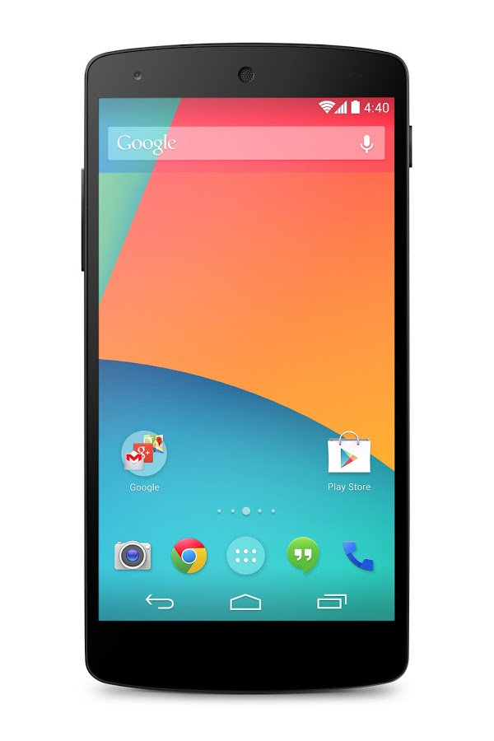



































Data is king: apps must be good at handling data

Slide 3

Writing an App: Photo Sharing
App components
Activities and GUI
CursorAdapter
Local database I/O
Local file I/O
Unify data model
(part of app logic)
REST methods (JSON, HTTP)
N/W management
Push notifications
Data caching
Conflict detection
Conflict resolution
Atomic syncing
Store and view photos locally
  Store album info in SQL tables, photos in local FS
  App logic to access both the tables and the FS
Row 1
photo info
Obj
photo
Provide sync with other users/devices
  Design network interaction with a cloud service
  May want to notify users of new photos
  May cache shared photos to avoid extra transfers
Ensure consistent album info and photo sync
  Another user changes the photo tag? conflict
  Album gets synced, but no photos? requires atomicity

Slide 4
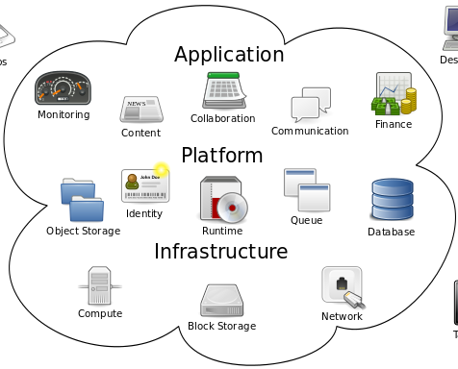


Running a Cloud Service
Service components
Mirror functionality for app components
+
Scalable data store
Client connection management
Failure recovery
Notification engine
Load balancing
Version assignment
Conflict handling
Too much for the developer?
Need infrastructure services for managing data

Slide 5
Writing data-centric apps is onerous!
Partitioned data model
  Silo objects & tables; apps forced to manage
  Requires atomicity across inter-dependent data
End-to-end consistency
  Failures, disconnections, bandwidth
  Diverse requirements
Disconnected progress
  Support offline operations
  Requires conflict detection / resolution

Slide 6




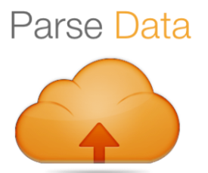

Emergence of Sync Services
objects
tables
Table-only or object-only sync
No atomicity across object and table data
Single consistency scheme

Slide 7
Motivation
Study
Simba
Evaluation

Slide 8
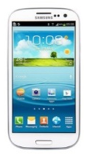
Study of Popular Mobile Apps
How do popular mobile apps behave?
  Roll-own or sync service (e.g., Dropbox, Parse, Kinvey)
Consistency: end-to-end observed by the user
  Concurrent edits on two devices, disconnections
  Studied various different consistency semantics
Client 1
update
Client 1
read
Disconnected operation
Concurrent + devices online
One/both device offline
Client 2
update
Client 2
read

Slide 9

Example: Evernote (roll own)
App for sharing notes, embedded images, videos
Claims “no dangling pointers” [Evernote Techblog]
  Guess what we found: dangling pointers!
Disconnect during sync: atomicity violation
  “Dangling pointers” and “half-formed” notes visible
  Multimedia notes → only icons appear on client #2

Slide 10

Example: Hiyu (uses Kinvey)
App for shared grocery lists
Sync semantics oblivious to consistency
  Last-writer-wins prevalent; inadequate for collaboration
  Leads to corruption & resurrection of deleted data
Inadequate error propagation
  Ad-hoc behavior when faced with inconsistency

Slide 11









Inadequate Consistency
Multiple consistency modes within/across apps
  Different data types warrant different consistency
Sync semantics oblivious to consistency
  Last-writer-wins prevalent; inadequate for many
  Leads to corruption & resurrection of deleted data
Atomicity violation of granular data
  “Dangling pointers” and “half-formed” notes visible
Limited offline support
  Many apps simply disable mobile offline operations
Inadequate error propagation
  Ad-hoc behavior when faced with inconsistency
Data-sync needs fixing!
More details in paper ☺

Slide 12
Need Better Sync Services
objects
Not lose data!
+
+
Choose: Eventual,
Causal, or Strong
+
tables
Control over data transfer
Challenge: provide high-level abstraction and
hide all complexity under the hood

Slide 13
Motivation
Study
Simba
Evaluation

Slide 14


sTable: Simba Table
Name | Photo
Snoopy
Lucy
Logical
Table Store
Object Store
_rowID | _rowVersion | Name | Photo
row1 | 1 | Snoopy | [ab1fd, 1fc2e]
row2 | 2 | Lucy | [x561a, 3f02a]
ab1fd
1fc2e
Physical
x561a
3f02a
Convenience
  Local programming abstraction
Nice properties
  Unified store & sync: atomic tabular & object data
  End-to-end tunable consistency across devices
  Offline support, Conflict detection & resolution

Slide 15
Writing an App: Photo Sharing
App components
Activities and GUI
CursorAdapter
Local database I/O
Local file I/O
Unify data model (part of app logic)
REST methods (JSON, HTTP)
N/W management
Push notifications
Data caching
Atomic syncing
Conflict detection
Conflict resolution
Store and view photos locally
  Store album info in SQL tables, photos in local FS
  App logic to access both the tables and the FS
Row 1
album info
Obj
photo
Provide sync with other users/devices
  Design network interaction with a cloud service
  May want to notify users of new photos
  May cache shared photos to avoid extra transfers
Ensure consistent album info and photo sync
  Another user changes photo tag – conflict!
  Album gets synced, but no photos? requires atomicity
Remember the tedious example?

Slide 16
Writing a Simba Photo App
Create a photo album
Add a new photo
Retrieve stored photo
Register read/write sync
createTable(“album”, “name VARCHAR, photo OBJECT”, Properties)
Strong
Causal
Eventual
  objs = writeData(“album”, {“name=Snoopy”}, {“photo”})
  objs[0].write(photoBuffer) // write object data
  cursor = readData(“album”, {“photo”}, “name=?”, {“Snoopy”})
  is = cursor.getInputStream().get(0) // inputstream for object
  is.read(buffer) // read object data into buffer
  registerReadSync(“album”,600,0,3G) // period=10min, pref=3G
  registerWriteSync(“album”,300,60,WIFI) // period=5min, pref=WiFi

Slide 17
Writing a Simba Photo App
Conflict resolution
beginCR(“album”);
rows = getConflictedRows(“album”);
for (row; rows; next row)
resolveConflict(“album”, row, MINE); // choice: mine, their, custom
endCR(“album”);
17

Slide 18
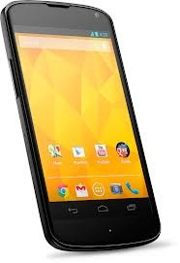
Writing Apps with Simba
Mobile App
Activity, GUI, app logic
App components
Activities and GUI
CursorAdapter
Conflict resolution (simplified)
Local database I/O
Local file I/O
Unify data model
(part of app logic)
REST methods
(JSON, HTTP)
Data caching
N/W mgmt
Push notifications
Atomic syncing
Conflict detection
CRUD
upcalls
Simba
Cloud
See FAST’15 paper for more details
“Reliable, Consistent, and Efficient Data Sync for Mobile Apps”
Simba SDK
Simba Client
Simba Sync Protocol
Apps write all data to unified storage API
  Simba handles all data management
  Well-defined consistency semantics
Apps can specify sync policy per sTable
  Period, delay tolerance, consistency
  Sync objects on WiFi, tables on 4G

Slide 19
Simba Cloud
Sync Protocol
S
Sync Protocol
S
Notifications
Notifications
Authenticator
Load Balancer
Simba Gateway DHT
Gateway
Gateway
Gateway
Sync Protocol
sTable DHT
Store node
Store node
Store node
Simba
Cloud Store
Table Store
(Cassandra)
Object Store
(Swift)

Slide 20
Simba Cloud
Sync Protocol
Sync Protocol
S
S
Notifications
Notifications
Simba Cloud

Slide 21
Simba Sync
Object
Store
S3
Data-sync
Store
Simba
Objects
get(id)/put(id)
Change-sets
sync(v1 → v2)
Need to query by version
  Object store must perform scan
Need to find rows which match change-set queries
Change-set
  Set of changes between any past version and the current version

Slide 22
Upstream Sync (Update)
Client
Gateway
ID | Ver | Name | File
1 | 0 | Friends | OID1
Simba Store
Subscription Manager
N
OID1
1
OID1
2
OID1
3
sTable
ID | Ver | Name | File
1 | 1 | Friends | [c1,c2,c3]
ID | Ver | Name | File
1 | 1 | Friends | [c1,c2]
Retrieve existing row
Increment version
Update tabular data
Write chunks to object store
Write table to table store
Send notification to subscribers
ID | Ver | Name | File
1 | 0 | Contacts | [c1,c2]
Swift
Cassandra

Slide 23
Downstream Sync (Update)
Client
PULL (version=0)
Gateway
ID | Ver | Name | File
1 | 0 | Contacts | OID1
ID | Ver | Name | File
1 | 1 | Friends | OID1
Simba Store
Subscription Manager
OID1
1
OID1
2
Object 1
sTable
Client pulls changes
Send tabular changes
Send object changes
ID | Ver | Name | File
1 | 1 | Friends | [c1,c2,c3]
Swift
Cassandra
OID1
3
OID1
1
OID1
2

Slide 24
Upstream Sync (Update)
Client
Gateway
Simba Store
Subscription Manager
1
Change Cache
N
0
OID1
1
OID1
2
sTable
Retrieve existing row
Increment version
Update tabular data
Write chunks to object store
Write table to table store
Insert change-set into cache
Send notification to subscribers
ID | Ver | Name | File
1 | 1 | Friends | [c1,c2,c3]
CS1
Cassandra
Swift

Slide 25
Downstream Sync (Update)
Client
PULL (version=0)
Gateway
ID | Ver | Name | File
1 | 0 | Friends | OID1
ID | Ver | Name | File
1 | 1 | Friends | OID1
Simba Store
Subscription Manager
Change Cache
0
1
OID1
1
OID1
2
Object 1
sTable
Client pulls changes
Lookup change-set
Send tabular changes
Send object changes
ID | Ver | Name | File
1 | 1 | Friends | [c3]
Swift
Cassandra
OID1
3

Slide 26
Motivation
Study
Simba
Evaluation

Slide 27
Evaluation
We seek to answer the following questions:
  How easy is it to write consistent apps with Simba?
  How does sCloud scale with tables and clients?
  How lightweight is the Simba Sync Protocol?
  How does sCloud perform on CRUD operations?
  How does consistency trade-off latency?

Slide 28


Fixing Apps with Simba
Todo.txt
  Interactive task list
Uses Dropbox to sync
  2 files:
    Active tasks
    Completed (archived) tasks
Modified to store tasks in 2 sTables
  Active (Strong), Completed (Eventual)
Universal Password Manager
  Store account credentials
Uses Dropbox to sync account DB
Observation:
  Concurrent modifications cause silent overwrites
Fix (2 approaches):
  Store entire DB as object in a sTable (easiest)
  Store each account as row in a sTable
Simba apps easy to write! (~3 hours)
Equivalent apps hard with Dropbox (incomplete after 3 days)

Slide 29
Scalability Setup
Susitna cluster at NMC PRObE
  32 nodes
    16 Store/Swift/Clients
    16 Gateway/Cassandra
  Susitna node specs:
    4x 16-core AMD Opteron 2.1GHz CPUs
    128GB DRAM
    2x 3TB 7200RPM data disks
    InfiniBand high-speed network

Slide 30
Scalability with Clients
Simba scales under high-client load
16 Gateways (Cassandra), 16 Stores (Swift) w/ key+data cache
128 tables, 9:1 reader-to-writer ratio, 500 operations/s

Slide 31
Scalability with Tables
Simba scales well across tables and objects
Many tables = Bottleneck.
Need better sync stores!
16 Gateways (Cassandra), 16 Stores (Swift) w/ key cache only
# Clients = 10 x # Tables, 9:1 reader-to-writer ratio, 500 operations/s

Slide 32
Conclusions
Building data-centric mobile app should be simple
  App developers focus on implementing app core logic
  sTable abstraction
  Manages unified table and object data
  Guarantees per-row atomicity
  Allows for per-table tunable consistency
Simba: scalable cloud data sync service
  Transparent handling of data sync and failures

Slide 33
THANK YOU!
Project: http://tinyurl.com/SimbaService
Code: https://github.com/SimbaService/Simba
Simba Cloud [EuroSys’15]:
http://dl.acm.org/authorize?N95496
Simba Client [FAST’15]:
https://www.usenix.org/conference/fast15/technical-sessions/presentation/go

