Slide 1
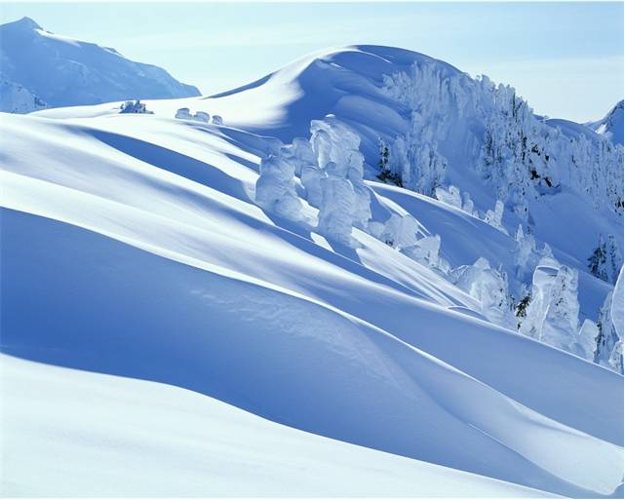
Montagna Del Pattino
Visit Us Today!

Slide 2
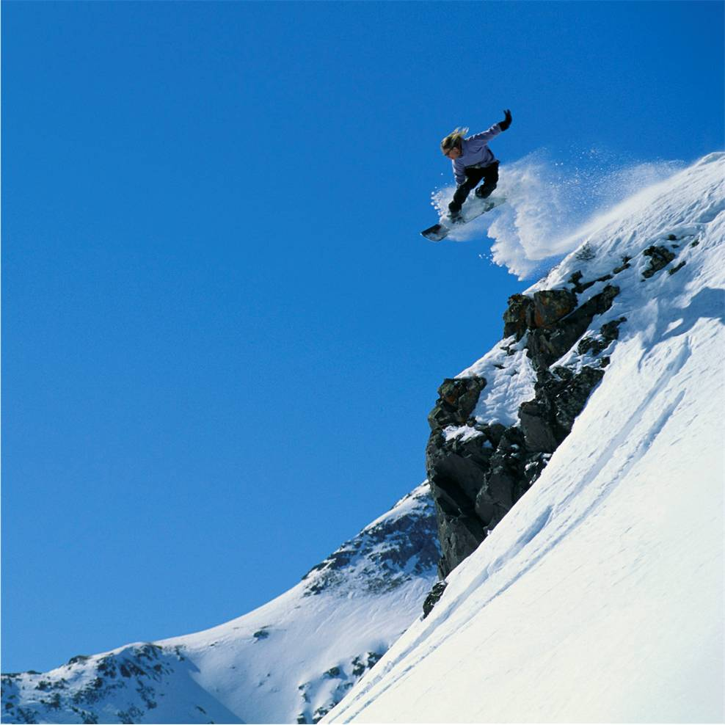
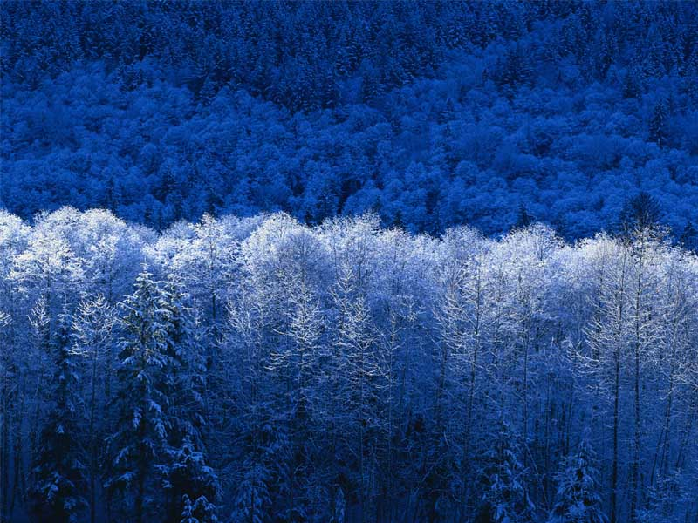
Plan Your Stay
High Energy
Relaxation
Whatever Your Style

Slide 3
Need Some Down Time?
Friday Evening
Dinner at the Montagna Vista Club
Saturday morning
Breakfast and gondola ride
Saturday afternoon
Facial at Pattino Day Spa
Tour of the Village Gallery and shopping
Saturday evening
Dinner show at Montagna Vista Club

Slide 4
Come to the Mountain

