Slide 1
CS 203 A: Advanced Computer Architecture
Instructor
Office Times: W, 3-5 pm
Laxmi Narayan Bhuyan
Office: Engg.II Room 351
E-mail: bhuyan@cs.ucr.edu
Tel: (951) 827-2244
TA: Li Yan
Office Hours: Tuesday 1-3 pm
Cell: (951)823-3326
email: lyan@cs.ucr.edu

Slide 2
CS 203A Course Syllabus, winter 2012
Text: Computer Architecture: A Quantitative Approach
By Hennessy and Patterson, 5th Edition
Introduction to computer Architecture, Performance (Chapter 1)
Review of Pipelining, Hazards, Branch Prediction (Appendix C)
Memory Hierarchy Design (Appendix B and Chapter 2)
Instruction level parallelism, Dynamic scheduling, and Speculation (Appendix C and Chapter 3)
Multiprocessors and Thread Level Parallelism (Chapter 5)
Prerequisite: CS 161 or consent of the instructor

Slide 3
Grading
Grading: Based on Curve
Test1: 35 points
Test 2: 35 points
Project 1: 15 points
Project 2: 15 points
The project is based on Simple Scalar simulator. See www.simplesacar.com

Slide 4
What is *Computer Architecture*
Computer Architecture =
  Instruction Set Architecture +
  Organization + Hardware + …
  The Instruction Set: a Critical Interface
software
instruction set
hardware

Slide 5
Computer Architecture
A Quantitative Approach, Fifth Edition
Chapter 1
Fundamentals of Quantitative Design and Analysis

Slide 6
Computer Technology
Introduction
Performance improvements:
  Improvements in semiconductor technology
    Feature size, clock speed
  Improvements in computer architectures
    Enabled by HLL compilers, UNIX
    Lead to RISC architectures
  Together have enabled:
    Lightweight computers
    Productivity-based managed/interpreted programming languages

Slide 7
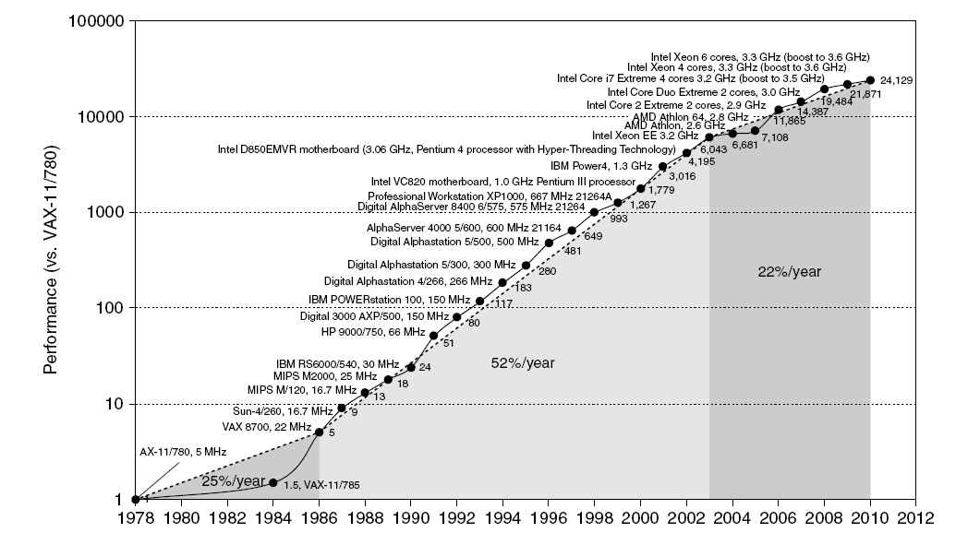
Single Processor Performance
Introduction
Move to multi-processor
RISC

Slide 8
Current Trends in Architecture
Introduction
Cannot continue to leverage Instruction-Level parallelism (ILP)
  Single processor performance improvement ended in 2003
New models for performance:
  Data-level parallelism (DLP)
  Thread-level parallelism (TLP)
  Request-level parallelism (RLP)
These require explicit restructuring of the application

Slide 9
Classes of Computers
Personal Mobile Device (PMD)
  e.g. start phones, tablet computers
  Emphasis on energy efficiency and real-time
Desktop Computing
  Emphasis on price-performance
Servers
  Emphasis on availability, scalability, throughput
Clusters / Warehouse Scale Computers
  Used for “Software as a Service (SaaS)”
  Emphasis on availability and price-performance
  Sub-class: Supercomputers, emphasis: floating-point performance and fast internal networks
Embedded Computers
  Emphasis: price
Classes of Computers

Slide 10
Parallelism
Classes of parallelism in applications:
  Data-Level Parallelism (DLP)
  Task-Level Parallelism (TLP)
Classes of architectural parallelism:
  Instruction-Level Parallelism (ILP)
  Vector architectures/Graphic Processor Units (GPUs)
  Thread-Level Parallelism
  Request-Level Parallelism
Classes of Computers

Slide 11
Flynn’s Taxonomy
Single instruction stream, single data stream (SISD)
Single instruction stream, multiple data streams (SIMD)
  Vector architectures
  Multimedia extensions
  Graphics processor units
Multiple instruction streams, single data stream (MISD)
  No commercial implementation
Multiple instruction streams, multiple data streams (MIMD)
  Tightly-coupled MIMD
  Loosely-coupled MIMD
Classes of Computers

Slide 12
Defining Computer Architecture
“Old” view of computer architecture:
  Instruction Set Architecture (ISA) design
  i.e. decisions regarding:
    registers, memory addressing, addressing modes, instruction operands, available operations, control flow instructions, instruction encoding
“Real” computer architecture:
  Specific requirements of the target machine
  Design to maximize performance within constraints: cost, power, and availability
  Includes ISA, microarchitecture, hardware
Defining Computer Architecture

Slide 13
Trends in Technology
Integrated circuit technology
  Transistor density: 35%/year
  Die size: 10-20%/year
  Integration overall: 40-55%/year
DRAM capacity: 25-40%/year (slowing)
Flash capacity: 50-60%/year
  15-20X cheaper/bit than DRAM
Magnetic disk technology: 40%/year
  15-25X cheaper/bit then Flash
  300-500X cheaper/bit than DRAM
Trends in Technology

Slide 14
Bandwidth and Latency
Bandwidth or throughput
  Total work done in a given time
  10,000-25,000X improvement for processors
  300-1200X improvement for memory and disks
Latency or response time
  Time between start and completion of an event
  30-80X improvement for processors
  6-8X improvement for memory and disks
Trends in Technology

Slide 15
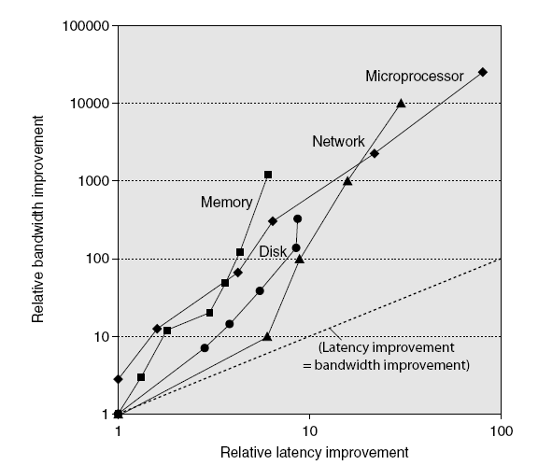
Bandwidth and Latency
Trends in Technology
Log-log plot of bandwidth and latency milestones

Slide 16
Transistors and Wires
Feature size
  Minimum size of transistor or wire in x or y dimension
  10 microns in 1971 to .032 microns in 2011
  Transistor performance scales linearly
    Wire delay does not improve with feature size!
  Integration density scales quadratically
Trends in Technology

Slide 17
Static Power
Static power consumption
  Current_{static} x Voltage
  Scales with number of transistors
  To reduce: power gating
Trends in Power and Energy

Slide 18
Dynamic Energy and Power
Dynamic energy
  Transistor switch from 0 -> 1 or 1 -> 0
  ½ x Capacitive load x Voltage²
Dynamic power
  ½ x Capacitive load x Voltage² x Frequency switched
Reducing clock rate reduces power, not energy
Trends in Power and Energy

Slide 19
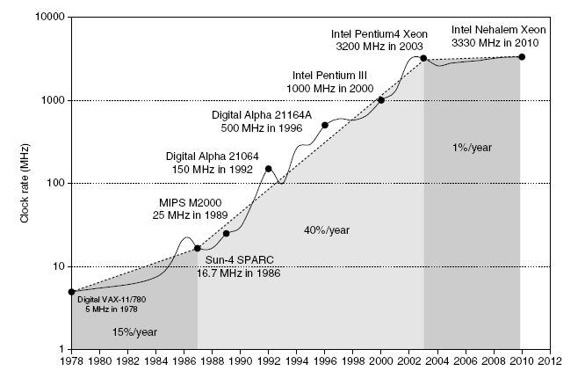
Power
Intel 80386 consumed ~ 2 W
3.3 GHz Intel Core i7 consumes 130 W
Heat must be dissipated from 1.5 x 1.5 cm chip
This is the limit of what can be cooled by air
Trends in Power and Energy

Slide 20
Measuring Performance
Typical performance metrics:
  Response time
  Throughput
Speedup of X relative to Y
  Execution time_{Y} / Execution time_{X}
Execution time
  Wall clock time: includes all system overheads
  CPU time: only computation time
Benchmarks
  Kernels (e.g. matrix multiply)
  Toy programs (e.g. sorting)
  Synthetic benchmarks (e.g. Dhrystone)
  Benchmark suites (e.g. SPEC06fp, TPC-C)
Measuring Performance

Slide 21
Principles of Computer Design
Principles
Take Advantage of Parallelism
  e.g. multiple processors, disks, memory banks, pipelining, multiple functional units
Principle of Locality
  Reuse of data and instructions
Focus on the Common Case

Slide 22
Compute Speedup – Amdahl’s Law
Speedup is due to enhancement(E):
Time_{Before}
Time_{After}
Let F be the fraction where enhancement is applied => Also, called parallel fraction and (1-F) as the serial fraction
F
S
Execution time_{after}
= ExTime_{before} x [(1-F) +
]
ExTime_{before}
ExTime_{after}
1
Speedup(E)
=
=
[(1-F) +
F
S
]

Slide 23



Principles of Computer Design
Principles
The Processor Performance Equation

Slide 24
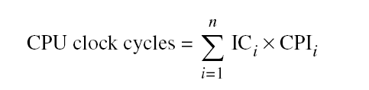
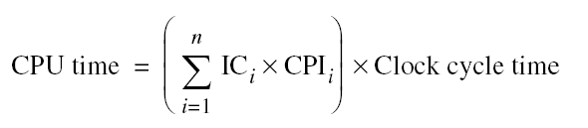
Principles of Computer Design
Principles
Different instruction types having different CPIs

Slide 25
Example
Instruction mix of a RISC architecture.
Add a register-memory ALU instruction format?
One op. in register, one op. in memory
The new instruction will take 2 cc but will also increase the Branches to 3 cc.
Q: What fraction of loads must be eliminated for this to pay off?

Slide 26
Solution
Instr. | F_{i} | CPI_{i} | CPI_{i}xF_{i} | I_{i} | CPI_{i} | CPI_{i}xI_{i}
ALU | .5 | 1 | .5 | .5-X | 1 | .5-X
Load | .2 | 2 | .4 | .2-X | 2 | .4-2X
Store | .1 | 2 | .2 | .1 | 2 | .2
Branch | .2 | 2 | .4 | .2 | 3 | .6
Reg/Mem |  |  |  | X | 2 | 2X
 | 1.0 |  | CPI=1.5 | 1-X |  | (1.7-X)/(1-X)
Exec Time = Instr. Cnt. x CPI x Cycle time
Instr. Cnt_{old} x CPI_{old} x Cycle time_{old} >= Instr. Cnt_{new} x CPI_{new} x Cycle time_{new}
1.0 x 1.5 >= (1-X) x (1.7-X)/(1-X)
X >= 0.2
ALL loads must be eliminated for this to be a win!

Slide 27
Choosing Programs to Evaluate Perf.
Toy benchmarks
  e.g., quicksort, puzzle
  No one really runs. Scary fact: used to prove the value of RISC in early 80’s
Synthetic benchmarks
  Attempt to match average frequencies of operations and operands in real workloads.
  e.g., Whetstone, Dhrystone
  Often slightly more complex than kernels; But do not represent real programs
Kernels
  Most frequently executed pieces of real programs
  e.g., livermore loops
  Good for focusing on individual features not big picture
  Tend to over-emphasize target feature
Real programs
  e.g., gcc, spice, SPEC2006 (standard performance evaluation corporation), TPCC, TPCD, PARSEC, SPLASH
Notes:
Livermore loops – commonly used FORTRAN subroutine

