Slide 1
Lec 9 – Limits to ILP and Simultaneous Multithreading

Slide 2
Review from Last Time
Interest in multiple-issue because wanted to improve performance without affecting uniprocessor programming model
Taking advantage of ILP is conceptually simple, but design problems are amazingly complex in practice
Conservative in ideas, just faster clock and bigger
Processors of last 5 years (Pentium 4, IBM Power 5, AMD Opteron) have the same basic structure and similar sustained issue rates (3 to 4 instructions per clock) as the 1st dynamically scheduled, multiple-issue processors announced in 1995
  Clocks 10 to 20X faster, caches 4 to 8X bigger, 2 to 4X as many renaming registers, and 2X as many load-store units
  ⇒ performance 8 to 16X
Peak v. delivered performance gap increasing

Slide 3
Outline
Review
Limits to ILP (another perspective)
Administrivia
Thread Level Parallelism
Multithreading
Simultaneous Multithreading
Power 4 vs. Power 5
Head to Head: VLIW vs. Superscalar vs. SMT
Commentary
Conclusion

Slide 4
Limits to ILP
Conflicting studies of amount
  Benchmarks (vectorized Fortran FP vs. integer C programs)
  Hardware sophistication
  Compiler sophistication
How much ILP is available using existing mechanisms with increasing HW budgets?
Do we need to invent new HW/SW mechanisms to keep on processor performance curve?
  Intel MMX, SSE (Streaming SIMD Extensions): 64 bit ints
  Intel SSE2: 128 bit, including 2 64-bit Fl. Pt. per clock
  Motorola AltaVec: 128 bit ints and FPs
  Supersparc Multimedia ops, etc.

Slide 5
Overcoming Limits
Advances in compiler technology + significantly new and different hardware techniques may be able to overcome limitations assumed in studies
However, unlikely such advances when coupled with realistic hardware will overcome these limits in near future

Slide 6
Limits to ILP
Initial HW Model here; MIPS compilers.
Assumptions for ideal/perfect machine to start:
1. Register renaming – infinite virtual registers
=> all register WAW & WAR hazards are avoided
2. Branch prediction – perfect; no mispredictions
3. Jump prediction – all jumps perfectly predicted (returns, case statements)
2 & 3 ⇒ no control dependencies; perfect speculation & an unbounded buffer of instructions available
4. Memory-address alias analysis – addresses known & a load can be moved before a store provided addresses not equal; 1&4 eliminates all but RAW
Also: perfect caches; 1 cycle latency for all instructions (FP *,/); unlimited instructions issued/clock cycle;

Slide 7
Limits to ILP HW Model comparison
 | Model | Power 5
Instructions Issued per clock | Infinite | 4
Instruction Window Size | Infinite | 200
Renaming Registers | Infinite | 48 integer + 40 Fl. Pt.
Branch Prediction | Perfect | 2% to 6% misprediction (Tournament Branch Predictor)
Cache | Perfect | 64KI, 32KD, 1.92MB L2, 36 MB L3
Memory Alias Analysis | Perfect | ??

Slide 8
Upper Limit to ILP: Ideal Machine
(Figure 3.1)
FP: 75 - 150
Integer: 18 - 60
Instructions Per Clock

Slide 9
Limits to ILP HW Model comparison
 | New Model | Model | Power 5
Instructions Issued per clock | Infinite | Infinite | 4
Instruction Window Size | Infinite, 2K, 512, 128, 32 | Infinite | 200
Renaming Registers | Infinite | Infinite | 48 integer + 40 Fl. Pt.
Branch Prediction | Perfect | Perfect | 2% to 6% misprediction (Tournament Branch Predictor)
Cache | Perfect | Perfect | 64KI, 32KD, 1.92MB L2, 36 MB L3
Memory Alias | Perfect | Perfect | ??

Slide 10
More Realistic HW: Window Impact
Figure 3.2
Change from Infinite window 2048, 512, 128, 32
FP: 9 - 150
Integer: 8 - 63
IPC

Slide 11
Limits to ILP HW Model comparison
 | New Model | Model | Power 5
Instructions Issued per clock | 64 | Infinite | 4
Instruction Window Size | 2048 | Infinite | 200
Renaming Registers | Infinite | Infinite | 48 integer + 40 Fl. Pt.
Branch Prediction | Perfect vs. 8K Tournament vs. 512 2-bit vs. profile vs. none | Perfect | 2% to 6% misprediction (Tournament Branch Predictor)
Cache | Perfect | Perfect | 64KI, 32KD, 1.92MB L2, 36 MB L3
Memory Alias | Perfect | Perfect | ??

Slide 12
More Realistic HW: Branch Impact
Figure 3.3
Change from Infinite window to examine to 2048 and maximum issue of 64 instructions per clock cycle
FP: 15 - 45
Integer: 6 - 12
IPC
Perfect
Tournament
BHT (512)
Profile
No prediction

Slide 13
Misprediction Rates

Slide 14
Limits to ILP HW Model comparison
 | New Model | Model | Power 5
Instructions Issued per clock | 64 | Infinite | 4
Instruction Window Size | 2048 | Infinite | 200
Renaming Registers | Infinite v. 256, 128, 64, 32, none | Infinite | 48 integer + 40 Fl. Pt.
Branch Prediction | 8K 2-bit | Perfect | Tournament Branch Predictor
Cache | Perfect | Perfect | 64KI, 32KD, 1.92MB L2, 36 MB L3
Memory Alias | Perfect | Perfect | Perfect

Slide 15
More Realistic HW:
Renaming Register Impact (N int + N fp)
Figure 3.5
FP: 11 - 45
Change 2048 instr window, 64 instr issue, 8K 2 level Prediction
Integer: 5 - 15
IPC
Infinite
256
128
64
32
None

Slide 16
Limits to ILP HW Model comparison
 | New Model | Model | Power 5
Instructions Issued per clock | 64 | Infinite | 4
Instruction Window Size | 2048 | Infinite | 200
Renaming Registers | 256 Int + 256 FP | Infinite | 48 integer + 40 Fl. Pt.
Branch Prediction | 8K 2-bit | Perfect | Tournament
Cache | Perfect | Perfect | 64KI, 32KD, 1.92MB L2, 36 MB L3
Memory Alias | Perfect v. Stack v. Inspect v. none | Perfect | Perfect

Slide 17
More Realistic HW:
Memory Address Alias Impact
Figure 3.6
Change 2048 instr window, 64 instr issue, 8K 2 level Prediction, 256 renaming registers
FP: 4 - 45
(Fortran,
no heap)
Integer: 4 - 9
IPC
Perfect
Global/Stack perf;
heap conflicts
Inspec.
Assem.
None

Slide 18
Limits to ILP HW Model comparison
 | New Model | Model | Power 5
Instructions Issued per clock | 64 (no restrictions) | Infinite | 4
Instruction Window Size | Infinite vs. 256, 128, 64, 32 | Infinite | 200
Renaming Registers | 64 Int + 64 FP | Infinite | 48 integer + 40 Fl. Pt.
Branch Prediction | 1K 2-bit | Perfect | Tournament
Cache | Perfect | Perfect | 64KI, 32KD, 1.92MB L2, 36 MB L3
Memory Alias | HW disambiguation | Perfect | Perfect

Slide 19
Realistic HW: Window Impact
(Figure 3.7)
Perfect disambiguation (HW), 1K Selective Prediction, 16 entry return, 64 registers, issue as many as window
FP: 8 - 45
IPC
Integer: 6 - 12
Infinite
256
128
64
32
16
8
4

Slide 20
Outline
Review
Limits to ILP (another perspective)
Administrivia
Thread Level Parallelism
Multithreading
Simultaneous Multithreading
Power 4 vs. Power 5
Head to Head: VLIW vs. Superscalar vs. SMT
Commentary
Conclusion

Slide 21
How to Exceed ILP Limits of this study?
These are not laws of physics; just practical limits for today, and perhaps overcome via research
Compiler and ISA advances could change results
WAR and WAW hazards through memory: eliminated WAW and WAR hazards through register renaming, but not in memory usage
  Can get conflicts via allocation of stack frames as a called procedure reuses the memory addresses of a previous frame on the stack

Slide 22
HW v. SW to increase ILP
Memory disambiguation: HW best
Speculation:
  HW best when dynamic branch prediction better than compile time prediction
  Exceptions easier for HW
  HW doesn’t need bookkeeping code or compensation code
  Very complicated to get right
Scheduling: SW can look ahead to schedule better
Compiler independence: does not require new compiler, recompilation to run well

Slide 23
Performance beyond single thread ILP
There can be much higher natural parallelism in some applications
(e.g., Database or Scientific codes)
Explicit Thread Level Parallelism or Data Level Parallelism
Thread: process with own instructions and data
  thread may be a process part of a parallel program of multiple processes, or it may be an independent program
  Each thread has all the state (instructions, data, PC, register state, and so on) necessary to allow it to execute
Data Level Parallelism: Perform identical operations on data, and lots of data

Slide 24
Thread Level Parallelism (TLP)
ILP exploits implicit parallel operations within a loop or straight-line code segment
TLP explicitly represented by the use of multiple threads of execution that are inherently parallel
Goal: Use multiple instruction streams to improve
  Throughput of computers that run many programs
  Execution time of multi-threaded programs
TLP could be more cost-effective to exploit than ILP

Slide 25
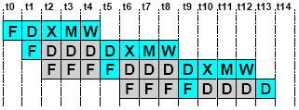
Pipeline Hazards
LW r1, 0(r2)
LW r5, 12(r1)
ADDI r5, r5, #12
SW 12(r1), r5
Each instruction may depend on the next
  Without bypassing, need interlocks
  LW r1, 0(r2)
  LW r5, 12(r1)
  ADDI r5, r5, #12
  SW 12(r1), r5
Bypassing cannot completely eliminate interlocks or delay slots

Slide 26
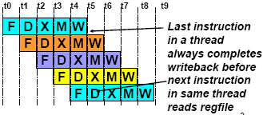
Multithreading
How can we guarantee no dependencies between instructions in a pipeline?
  One way is to interleave execution of instructions from different program threads on same pipeline
Interleave 4 threads, T1-T4, on non-bypassed 5-stage pipe
T1: LW r1, 0(r2)
T2: ADD r7, r1, r4
T3: XORI r5, r4, #12
T4: SW 0(r7), r5
T1: LW r5, 12(r1)

Slide 27
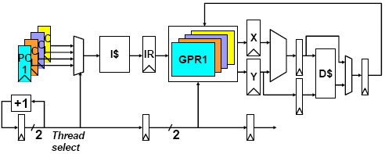
Simple Multithreaded Pipeline
Have to carry thread select down pipeline to ensure correct state bits read/written at each pipe stage

Slide 28
New Approach: Mulithreaded Execution
Multithreading: multiple threads to share the functional units of 1 processor via overlapping
  processor must duplicate independent state of each thread e.g., a separate copy of register file, a separate PC, and for running independent programs, a separate page table
  memory shared through the virtual memory mechanisms, which already support multiple processes
  HW for fast thread switch; much faster than full process switch ≈ 100s to 1000s of clocks
When switch?
  Alternate instruction per thread (fine grain)
  When a thread is stalled, perhaps for a cache miss, another thread can be executed (coarse grain)

Slide 29
Fine-Grained Multithreading
Switches between threads on each instruction, causing the execution of multiples threads to be interleaved
Usually done in a round-robin fashion, skipping any stalled threads
CPU must be able to switch threads every clock
Advantage is it can hide both short and long stalls, since instructions from other threads executed when one thread stalls
Disadvantage is it slows down execution of individual threads, since a thread ready to execute without stalls will be delayed by instructions from other threads
Used on Sun’s Niagara (will see later)

Slide 30
Course-Grained Multithreading
Switches threads only on costly stalls, such as L2 cache misses
Advantages
  Relieves need to have very fast thread-switching
  Doesn’t slow down thread, since instructions from other threads issued only when the thread encounters a costly stall
Disadvantage is hard to overcome throughput losses from shorter stalls, due to pipeline start-up costs
  Since CPU issues instructions from 1 thread, when a stall occurs, the pipeline must be emptied or frozen
  New thread must fill pipeline before instructions can complete
Because of this start-up overhead, coarse-grained multithreading is better for reducing penalty of high cost stalls, where pipeline refill << stall time
Used in IBM AS/400

Slide 31
Do both ILP and TLP?
TLP and ILP exploit two different kinds of parallel structure in a program
Could a processor oriented at ILP to exploit TLP?
  functional units are often idle in data path designed for ILP because of either stalls or dependences in the code
Could the TLP be used as a source of independent instructions that might keep the processor busy during stalls?
Could TLP be used to employ the functional units that would otherwise lie idle when insufficient ILP exists?

Slide 32
Simultaneous Multi-threading ...
One thread, 8 units
Two threads, 8 units
Cycle
M
M
FX
FX
FP
FP
BR
CC
Cycle
M
M
FX
FX
FP
FP
BR
CC
1
2
3
4
5
6
7
8
9
1
2
3
4
5
6
7
8
9
M = Load/Store, FX = Fixed Point, FP = Floating Point, BR = Branch, CC = Condition Codes

Slide 33
Simultaneous Multithreading (SMT)
Simultaneous multithreading (SMT): insight that dynamically scheduled processor already has many HW mechanisms to support multithreading
  Large set of virtual registers that can be used to hold the register sets of independent threads
  Register renaming provides unique register identifiers, so instructions from multiple threads can be mixed in datapath without confusing sources and destinations across threads
  Out-of-order completion allows the threads to execute out of order, and get better utilization of the HW
Just adding a per thread renaming table and keeping separate PCs
  Independent commitment can be supported by logically keeping a separate reorder buffer for each thread
Source: Micrprocessor Report, December 6, 1999
“Compaq Chooses SMT for Alpha”

Slide 34
Multithreaded Categories
Simultaneous
Multithreading
Time (processor cycle)
Superscalar
Fine-Grained
Coarse-Grained
Multiprocessing
Thread 1
Thread 3
Thread 5
Thread 2
Thread 4
Idle slot

Slide 35
Design Challenges in SMT
Since SMT makes sense only with fine-grained implementation, impact of fine-grained scheduling on single thread performance?
  A preferred thread approach sacrifices neither throughput nor single-thread performance?
  Unfortunately, with a preferred thread, the processor is likely to sacrifice some throughput, when preferred thread stalls
Larger register file needed to hold multiple contexts
Not affecting clock cycle time, especially in
  Instruction issue - more candidate instructions need to be considered
  Instruction completion - choosing which instructions to commit may be challenging
Ensuring that cache and TLB conflicts generated by SMT do not degrade performance

Slide 36
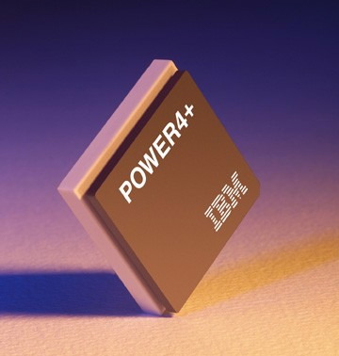
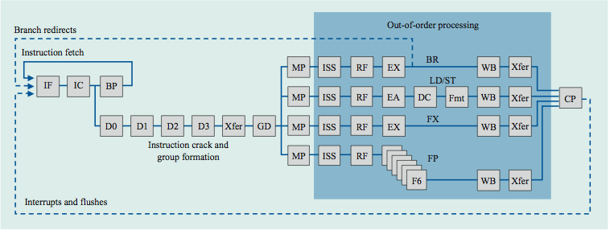
Power 4
Single-threaded predecessor to Power 5. 8 execution units in
out-of-order engine, each may
issue an instruction each cycle.

Slide 37
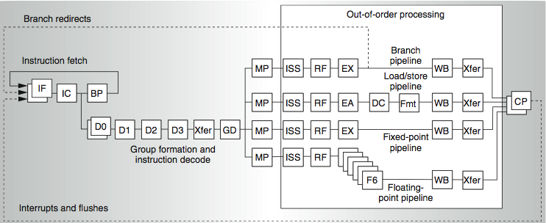
Power 4
2 commits (architected register sets)
Power 5
2 fetch (PC),
2 initial decodes

Slide 38
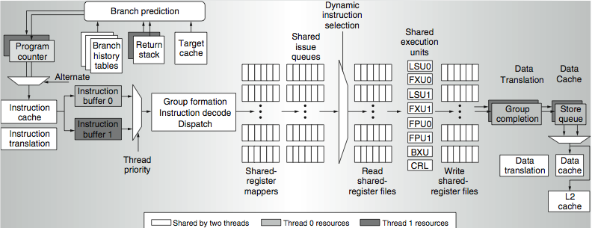
Power 5 data flow ...
Why only 2 threads? With 4, one of the shared resources (physical registers, cache, memory bandwidth) would be prone to bottleneck

Slide 39
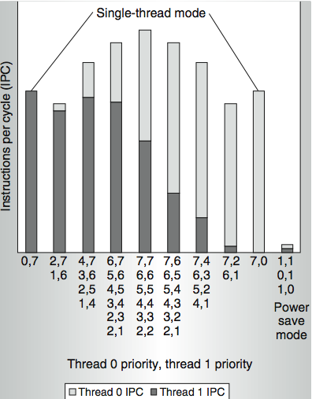
Power 5 thread performance ...
Relative priority of each thread controllable in hardware.
For balanced operation, both threads run slower than if they “owned” the machine.

Slide 40
Changes in Power 5 to support SMT
Increased associativity of L1 instruction cache and the instruction address translation buffers
Added per thread load and store queues
Increased size of the L2 (1.92 vs. 1.44 MB) and L3 caches
Added separate instruction prefetch and buffering per thread
Increased the number of virtual registers from 152 to 240
Increased the size of several issue queues
The Power5 core is about 24% larger than the Power4 core because of the addition of SMT support

Slide 41
Initial Performance of SMT
Pentium 4 Extreme SMT yields 1.01 speedup for SPECint_rate benchmark and 1.07 for SPECfp_rate
  Pentium 4 is dual threaded SMT
  SPECRate requires that each SPEC benchmark be run against a vendor-selected number of copies of the same benchmark
Running on Pentium 4 each of 26 SPEC benchmarks paired with every other (26² runs) speed-ups from 0.90 to 1.58; average was 1.20
Power 5, 8 processor server 1.23 faster for SPECint_rate with SMT, 1.16 faster for SPECfp_rate
Power 5 running 2 copies of each app speedup between 0.89 and 1.41
  Most gained some
  Fl.Pt. apps had most cache conflicts and least gains

Slide 42
Head to Head ILP competition
Processor | Micro architecture | Fetch / Issue / Execute | FU | Clock Rate (GHz) | Transis-tors Die size | Power
Intel Pentium 4 Extreme | Speculative dynamically scheduled; deeply pipelined; SMT | 3/3/4 | 7 int. 1 FP | 3.8 | 125 M 122 mm² | 115 W
AMD Athlon 64 FX-57 | Speculative dynamically scheduled | 3/3/4 | 6 int. 3 FP | 2.8 | 114 M 115 mm² | 104 W
IBM Power5 (1 CPU only) | Speculative dynamically scheduled; SMT; 2 CPU cores/chip | 8/4/8 | 6 int. 2 FP | 1.9 | 200 M 300 mm² (est.) | 80W (est.)
Intel Itanium 2 | Statically scheduled VLIW-style | 6/5/11 | 9 int. 2 FP | 1.6 | 592 M 423 mm² | 130 W

Slide 43
Performance on SPECint2000

Slide 44
Performance on SPECfp2000

Slide 45
Normalized Performance: Efficiency
Rank | I tanium2 | Pen t I um4 | A t h l on | Powe r 5
Int/Trans | 4 | 2 | 1 | 3
FP/Trans | 4 | 2 | 1 | 3
Int/area | 4 | 2 | 1 | 3
FP/area | 4 | 2 | 1 | 3
Int/Watt | 4 | 3 | 1 | 2
FP/Watt | 2 | 4 | 3 | 1

Slide 46
No Silver Bullet for ILP
No obvious over all leader in performance
The AMD Athlon leads on SPECInt performance followed by the Pentium 4, Itanium 2, and Power5
Itanium 2 and Power5, which perform similarly on SPECFP, clearly dominate the Athlon and Pentium 4 on SPECFP
Itanium 2 is the most inefficient processor both for Fl. Pt. and integer code for all but one efficiency measure (SPECFP/Watt)
Athlon and Pentium 4 both make good use of transistors and area in terms of efficiency,
IBM Power5 is the most effective user of energy on SPECFP and essentially tied on SPECINT

Slide 47
Limits to ILP
Doubling issue rates above today’s 3-6 instructions per clock, say to 6 to 12 instructions, probably requires a processor to
  issue 3 or 4 data memory accesses per cycle,
  resolve 2 or 3 branches per cycle,
  rename and access more than 20 registers per cycle, and
  fetch 12 to 24 instructions per cycle.
The complexities of implementing these capabilities is likely to mean sacrifices in the maximum clock rate
  E.g, widest issue processor is the Itanium 2, but it also has the slowest clock rate, despite the fact that it consumes the most power!

Slide 48
Limits to ILP
Most techniques for increasing performance increase power consumption
The key question is whether a technique is energy efficient: does it increase power consumption faster than it increases performance?
Multiple issue processors techniques all are energy inefficient:
  Issuing multiple instructions incurs some overhead in logic that grows faster than the issue rate grows
  Growing gap between peak issue rates and sustained performance
Number of transistors switching = f(peak issue rate), and performance = f( sustained rate),
growing gap between peak and sustained performance
⇒ increasing energy per unit of performance

Slide 49
Commentary
Itanium architecture does not represent a significant breakthrough in scaling ILP or in avoiding the problems of complexity and power consumption
Instead of pursuing more ILP, architects are increasingly focusing on TLP implemented with single-chip multiprocessors
In 2000, IBM announced the 1st commercial single-chip, general-purpose multiprocessor, the Power4, which contains 2 Power3 processors and an integrated L2 cache
  Since then, Sun Microsystems, AMD, and Intel have switch to a focus on single-chip multiprocessors rather than more aggressive uniprocessors.
Right balance of ILP and TLP is unclear today
  Perhaps right choice for server market, which can exploit more TLP, may differ from desktop, where single-thread performance may continue to be a primary requirement

Slide 50
And in conclusion …
Limits to ILP (power efficiency, compilers, dependencies …) seem to limit to 3 to 6 issue for practical options
Explicitly parallel (Data level parallelism or Thread level parallelism) is next step to performance
Coarse grain vs. Fine grained multihreading
  Only on big stall vs. every clock cycle
Simultaneous Multithreading if fine grained multithreading based on OOO superscalar microarchitecture
  Instead of replicating registers, reuse rename registers
Itanium/EPIC/VLIW is not a breakthrough in ILP
Balance of ILP and TLP decided in marketplace

