Slide 1
Lecture 4: Hazards, Introduction to Compiler Techniques, Chapter 2

Slide 2
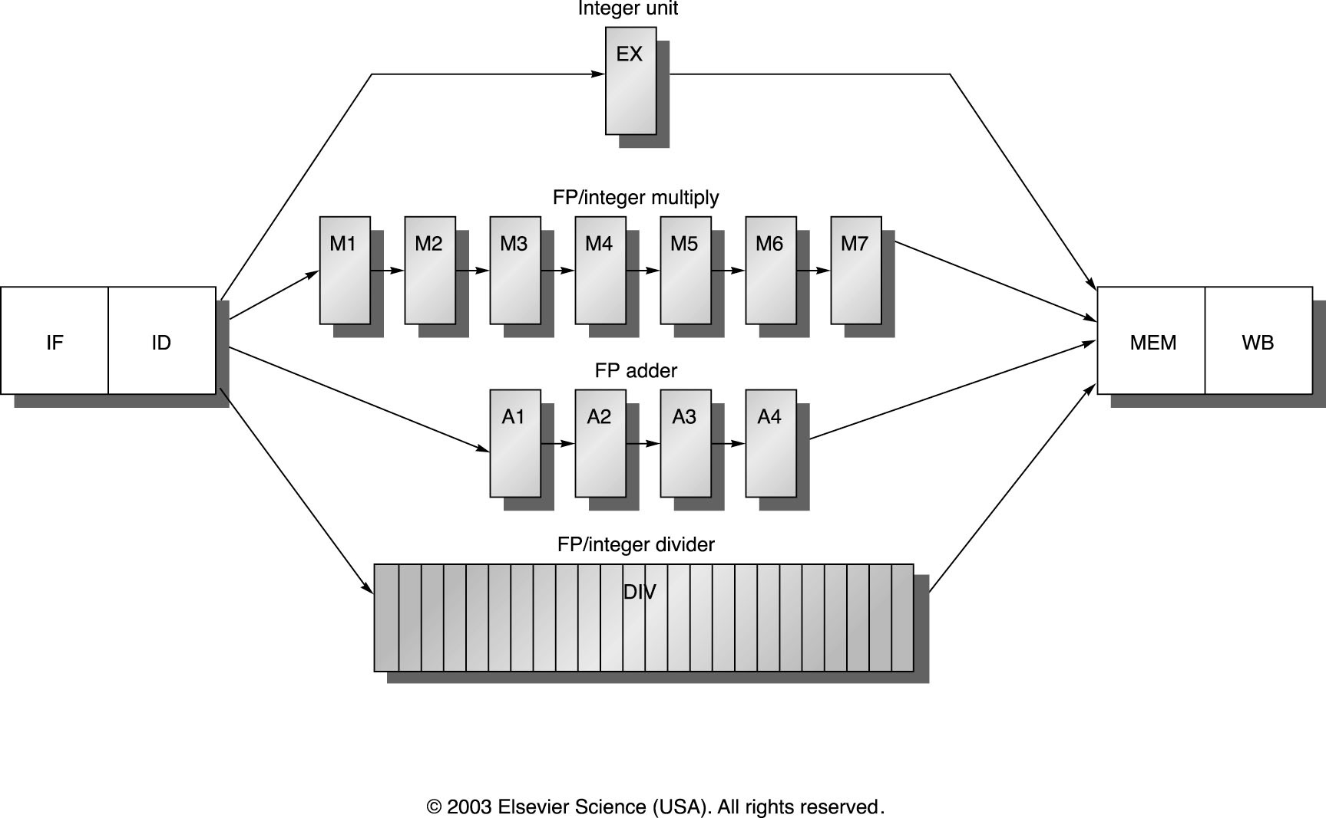
MIPS R4000 pipeline

Slide 3
MIPS FP Pipe Stages
FP Instr 1 2 3 4 5 6 7 8 …
Add, Subtract U S+A A+R R+S
Multiply U E+M M M M N N+A R
Divide U A R D²⁸ … D+A D+R, D+R, D+A, D+R, A, R
Square root U E (A+R)¹⁰⁸ … A R
Negate U S
Absolute value U S
FP compare U A R
Stages:
M First stage of multiplier
N Second stage of multiplier
R Rounding stage
S Operand shift stage
U Unpack FP numbers
A Mantissa ADD stage
D Divide pipeline stage
E Exception test stage

Slide 4
Appendix A
Fig. A.32
Fig. A.33
Fig. A.34

Slide 5
R4000 Performance
Not ideal CPI of 1:
Load stalls (1 or 2 clock cycles)
Branch stalls (2 cycles + unfilled slots)
FP result stalls: RAW data hazard (latency)
FP structural stalls: Not enough FP hardware (parallelism)
Notes:
Integer programs, major delay is branch stalls
FP its structural stalls

Slide 6
FP Loop: Where are the Hazards?
Consider the following example;
For (i=1000; i>0; i=i-1)
x[i] = x[i] + s;
MIPS code:
Loop: LD F0,0(R1) ;F0=vector element
ADDD F4,F0,F2 ;add scalar from F2
SD 0(R1),F4 ;store result
SUBI R1,R1,8 ;decrement pointer 8B (DW)
BNEZ R1,Loop ;branch R1!=zero
NOP ;delayed branch slot
Where are the stalls?

Slide 7
FP Loop Hazards
Loop: LD F0,0(R1) ;F0=vector element
ADDD F4,F0,F2 ;add scalar in F2
SD 0(R1),F4 ;store result
SUBI R1,R1,8 ;decrement pointer 8B (DW)
BNEZ R1,Loop ;branch R1!=zero
NOP ;delayed branch slot
Instruction Instruction Latency in producing result using result clock cycles
FP ALU op Another FP ALU op 3
FP ALU op Store double 2
Load double FP ALU op 1
Load double Store double 0
Integer op Integer op 1

Slide 8
FP Loop Showing Stalls
1 Loop: LD F0,0(R1) ;F0=vector element
2 stall
3 ADDD F4,F0,F2 ;add scalar in F2
4 stall
5 stall
6 SD 0(R1),F4 ;store result
7 SUBI R1,R1,8 ;decrement pointer 8B (DW)
8 stall
9 BNEZ R1,Loop ;branch R1!=zero
10 stall ;delayed branch slot
10 clocks: Rewrite code to minimize stalls?

Slide 9
Minimizing Stalls Technique 1: Compiler Optimization
Swap BNEZ and SD by changing address of SD
1 Loop: LD F0,0(R1)
2 SUBI R1,R1,8
3 ADDD F4,F0,F2
4 Stall
5 BNEZ R1,Loop ;delayed branch
6 SD 8(R1),F4 ;Address altered from 0(R1) to 8(R1) when moved past SUBI
What assumptions made when moved code?
OK to move store past SUBI even though changes register
OK to move loads before stores: get right data?
When is it safe for compiler to do such changes?
6 clocks, but actual work is only 3 cycles for LD, ADD and SD!!
Notes:
3 clocks doing work, 3 overhead (stall, branch, sub)

Slide 10
Compiler Technique 2: Loop Unrolling
1 Loop: LD F0,0(R1)
2 ADDD F4,F0,F2 ;1 cycle delay *
3 SD 0(R1),F4 ;drop SUBI & BNEZ – 2cycles delay *
4 LD F6,-8(R1)
5 ADDD F8,F6,F2 ; 1 cycle delay
6 SD -8(R1),F8 ;drop SUBI & BNEZ – 2 cycles delay
7 LD F10,-16(R1)
8 ADDD F12,F10,F2 ; 1 cycle delay
9 SD -16(R1),F12 ;drop SUBI & BNEZ – 2 cycles delay
10 LD F14,-24(R1)
11 ADDD F16,F14,F2 ; 1 cycle delay
12 SD -24(R1),F16 ; 2 cycles daly
13 SUBI R1,R1,#32 ;alter to 4*8; 1 cycle delay
14 BNEZ R1,LOOP ; Delayed branch
15 NOP
*1 cycle delay for FP operation after load. 2 cycles delay for store after FP. 1 cycle after SUBI.
15 + 4 x (1+2) + 1 = 28 clock cycles, or 7 per iteration
Loop Unrolling is essential for ILP Processors Why?
But, increase in Code memory and no. of registers.

Slide 11
Minimize Stall + Loop Unrolling
1 Loop: LD F0,0(R1)
2 LD F6,-8(R1)
3 LD F10,-16(R1)
4 LD F14,-24(R1)
5 ADDD F4,F0,F2
6 ADDD F8,F6,F2
7 ADDD F12,F10,F2
8 ADDD F16,F14,F2
9 SD 0(R1),F4
10 SD -8(R1),F8
11 SD -16(R1),F12
12 SUBI R1,R1,#32
13 BNEZ R1,LOOP ; Delayed branch
14 SD 8(R1),F16 ; 8-32 = -24
14 clock cycles, or 3.5 per iteration

Slide 12
Steps Compiler Performed to Unroll
Check OK to move the S.D after DSUBUI and BNEZ, and find amount to adjust S.D offset
Determine unrolling the loop would be useful by finding that the loop iterations were independent
Rename registers to avoid name dependencies
Eliminate extra test and branch instructions and adjust the loop termination and iteration code
Determine loads and stores in unrolled loop can be interchanged by observing that the loads and stores from different iterations are independent
requires analyzing memory addresses and finding that they do not refer to the same address.
Schedule the code, preserving any dependences needed to yield same result as the original code

Slide 13
Compiler Optimization + 2-issue Superscalar
EX: One LD/ST unit and one FP ALU
1 Loop: LD F0,0(R1)
2 LD F6,-8(R1)
3 LD F10,-16(R1) ADDD F4,F0,F2
4 LD F14,-24(R1) ADDD F8,F6,F2
5 SD 0(R1),F4 ADDD F12,F10,F2
6 SD -8(R1),F8 ADDD F16,F14,F2
7 SD -16(R1),F12
8 SUBI R1,R1,#32
9 BNEZ R1,LOOP ; Delayed branch
10 SD 8(R1),F16 ; 8-32 = -24
10 clock cycles, or 2.5 per iteration

Slide 14
2-Issue without Loop Unrolling
1 Loop: LD F0,0(R1)
2 SUBI R1,R1,8 ADDD F4,F0,F2
3 Stall
4 BNEZ R1,Loop
SD 8(R1),F4 - Branch Delay
Only One cycle improvement even with 2-issue superscalar!
HW: What if 2-issue no compiler optimization?

Slide 15
Static Multiple Issue: Very Long Instruction Word (VLIW) Architectures
Wide-issue processor that relies on compiler to
Packet together independent instructions to be issued in parallel
Schedule code to minimize hazards and stalls
Very long instruction words (3 to 8 operations)
Can be issued in parallel without checks
If compiler cannot find independent operations, it inserts nops
Advantage: simpler HW for wide issue
Faster clock cycle
Lower design & verification cost
Disadvantages:
Code size
Requires aggressive compilation technology

Slide 16
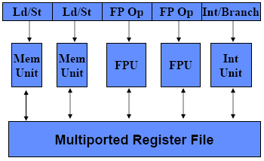
Traditional VLIW Hardware
Multiple functional units, many registers (e.g. 128)
Large multiported register file (for N FUs need ~3N ports)
Simple instruction fetch unit
No checks, direct correspondence between slots & FUs
Instruction format
16 to 24 bits per op => 5*16=80 bits to 5*24=120 bits wide
Can share immediate fields (1 per long instruction)

Slide 17
VLIW Code Example
Consider the following example;
For (i=1000; i>0; i=i-1)
x[i] = x[i] + s;
MIPS code:
Loop: LD F0,0(R1) ;F0=vector element
ADDD F4,F0,F2 ;add scalar from F2
SD 0(R1),F4 ;store result
SUBI R1,R1,8 ;decrement pointer 8B (DW)
BNEZ R1,Loop ;branch R1!=zero
NOP ;delayed branch slot

Slide 18
Loop Unrolling in VLIW
Memory Memory FP FP Int. op/ Clock reference 1 reference 2 operation 1 op. 2 branch
L.D F0,0(R1) L.D F6,-8(R1) 1
L.D F10,-16(R1) L.D F14,-24(R1) 2
L.D F18,-32(R1) L.D F22,-40(R1) ADD.D F4,F0,F2 ADD.D F8,F6,F2 3
L.D F26,-48(R1) ADD.D F12,F10,F2 ADD.D F16,F14,F2 4
ADD.D F20,F18,F2 ADD.D F24,F22,F2 5
S.D 0(R1),F4 S.D -8(R1),F8 ADD.D F28,F26,F2 6
S.D -16(R1),F12 S.D -24(R1),F16 7
S.D -32(R1),F20 S.D -40(R1),F24 DSUBUI R1,R1,#48 8
S.D -0(R1),F28 BNEZ R1,LOOP 9
Unrolled 7 times to avoid delays
7 results in 9 clocks, or 1.3 clocks per iteration (1.8X)
Average: 2.5 ops per clock, 50% efficiency
Note: Need more registers in VLIW (15 vs. 6 in SS)

Slide 19
How Can the HW Help the Compiler with Discovering ILP?
Compiler’s performance is critical for VLIW processors
Find many independent instructions & schedule them in best
possible way
What limits the compiler’s ability to discover ILP
Name dependencies (WAW & WAR)
Can eliminate with large number of registers
Branches
Limit compiler’s ability to schedule
Modern VLIW processors use branch prediction too
Dependencies through memory
Force the compiler to use conservative schedule
Can the HW help the compiler?
Ideally, with techniques simpler than those for superscalar processors

Slide 20
VLIW Vs. Superscalar
sequential stream of long instruction words
instructions scheduled statically by the compiler
number of simultaneously issued instructions is fixed during compile-time
instruction issue is less complicated than in a superscalar processor
Disadvantage: VLIW processors cannot react on dynamic events, e.g. cache misses, with the same flexibility like superscalars.
The number of instructions in a VLIW instruction word is usually fixed.
Padding VLIW instructions with no-ops is needed in case the full issue bandwidth is not be met. This increases code size. More recent VLIW architectures use a denser code format which allows to remove the no-ops.
VLIW is an architectural technique, whereas superscalar is a microarchitecture technique.
VLIW processors take advantage of spatial parallelism.

Slide 21
Intel/HP IA-64 “Explicitly Parallel Instruction Computer (EPIC)”
IA-64: instruction set architecture; EPIC is type
EPIC = 2nd generation VLIW?
Itanium™ is name of first implementation (2001)
Highly parallel and deeply pipelined hardware at 800Mhz
6-wide, 10-stage pipeline at 800Mhz on 0.18 µ process
128 64-bit integer registers + 128 82-bit floating point registers
Not separate register files per functional unit as in old VLIW
Hardware checks dependencies (interlocks => binary compatibility over time)
Predicated execution (select 1 out of 64 1-bit flags) => 40% fewer mispredictions?

Slide 22
Itanium™ EPIC Design Maximizes SW-HW Synergy
(Copyright: Intel at Hotchips ’00)
Architecture Features programmed by compiler:
Branch Hints
Explicit
Parallelism
Register Stack & Rotation
Data & Control
Speculation
Memory Hints
Predication
Micro-architecture Features in hardware:
Fetch
Issue
Register
Handling
Control
Parallel Resources
Memory Subsystem
4 Integer +
4 MMX Units
Instruction
Cache
& Branch Predictors
128 GR &
128 FR,
Register
Remap & Stack
Engine
2 FMACs
(4 for SSE)
Three levels of cache: L1, L2, L3
Fast, Simple 6-Issue
Bypasses & Dependencies
2 L.D/ST units
32 entry ALAT
Speculation Deferral Management

Slide 23
10 Stage In-Order Core Pipeline (Copyright: Intel at Hotchips ’00)
Front End
Pre-fetch/Fetch of up to 6 instructions/cycle
Hierarchy of branch predictors
Decoupling buffer
Execution
4 single cycle ALUs, 2 ld/str
Advanced load control
Predicate delivery & branch
Nat/Exception//Retirement
EXPAND
RENAME
WORD-LINE
DECODE
REGISTER READ
IPG
FET
ROT
EXP
REN
WL.D
REG
EXE
DET
WRB
INST POINTER
GENERATION
FETCH
ROTATE
EXECUTE
EXCEPTION
DETECT
WRITE-BACK
Instruction Delivery
Dispersal of up to 6 instructions on 9 ports
Reg. remapping
Reg. stack engine
Operand Delivery
Reg read + Bypasses
Register scoreboard
Predicated dependencies

Slide 24
Itanium processor 10-stage pipeline
Front-end (stages IPG, Fetch, and Rotate): prefetches up to 32 bytes per clock (2 bundles) into a prefetch buffer, which can hold up to 8 bundles (24 instructions)
Branch prediction is done using a multilevel adaptive predictor like P6 microarchitecture
Instruction delivery (stages EXP and REN): distributes up to 6 instructions to the 9 functional units
Implements registers renaming for both rotation and register stacking.

Slide 25
Itanium processor 10-stage pipeline
Operand delivery (WLD and REG): accesses register file, performs register bypassing, accesses and updates a register scoreboard, and checks predicate dependences.
Scoreboard used to detect when individual instructions can proceed, so that a stall of 1 instruction in a bundle need not cause the entire bundle to stall
Execution (EXE, DET, and WRB): executes instructions through ALUs and load/store units, detects exceptions and posts NaTs, retires instructions and performs write-back
Deferred exception handling for speculative instructions is supported by providing the equivalent of poison bits, called NaTs for Not a Thing, for the GPRs (which makes the GPRs effectively 65 bits wide), and NaT Val (Not a Thing Value) for FPRs (already 82 bits wides)

