Slide 1
Lecture 3 Pipeline Contd. (Appendix A)
CS 203A Advanced Computer Architecture
Instructor: L.N. Bhuyan
Some slides are adapted from Roth

Slide 2
Pipeline Hazards
Hazards are caused by conflicts between instructions. Will lead to incorrect behavior if not fixed.
Three types:
Structural: two instructions use same h/w in the same cycle – resource conflicts (e.g. one memory port, unpipelined divider etc).
Data: two instructions use same data storage (register/memory) – dependent instructions.
Control: one instruction affects which instruction is next – PC modifying instruction, changes control flow of program.

Slide 3
Data Hazards
Two different instructions use the same storage location
It must appear as if they executed in sequential order
add R1, R2, R3
sub R2, R4, R1
or R1, R6, R3
add R1, R2, R3
sub R2, R4, R1
or R1, R6, R3
add R1, R2, R3
sub R2, R4, R1
or R1, R6, R3
read-after-write
(RAW)
write-after-read
(WAR)
write-after-write
(WAW)
True dependence
(real)
anti dependence
(artificial)
output dependence
(artificial)
What about read-after-read dependence ?

Slide 4
Reducing RAW Hazards: Bypassing
Data available at the end of EX stage, why wait until WB stage?
Bypass (forward) data directly to input of EX
+ Reduces/avoids stalls in a big way
Large fraction of input operands are bypassed
Complex
Important: does not relieve you from having to perform WB
 | 1 | 2 | 3 | 4 | 5 | 6 | 7 | 8 | 9
add R1, R2, R3 | f | d | x | m | w
sub R2, R4, R1 |  | f | d | x | m | w
Can bypass from MEM also

Slide 5
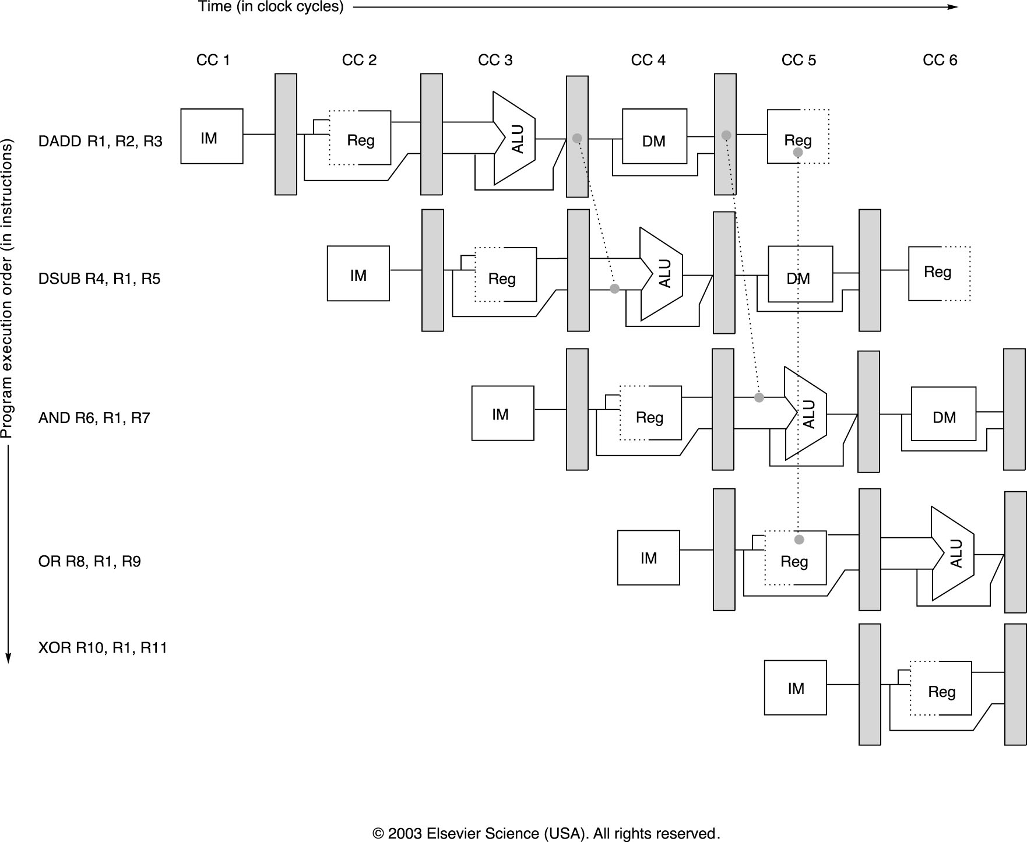
Minimizing Data Hazard Stalls by Forwarding
Notes:
Forwarding should be generalized to include passing a result directly to the functional unit that requires it.

Slide 6
But …
Even with bypassing, not all RAWs stalls can be avoided
Load to an ALU immediately after
Can be eliminated with compiler scheduling
 | 1 | 2 | 3 | 4 | 5 | 6 | 7 | 8 | 9
lw R1, 16(R3) | f | d | x | m | w
sub R2, R4, R1 |  | f | - | d | x | m | w
You can also stall before EX stage, but it is better to separate stall logic from bypassing logic

Slide 7
Compiler Scheduling
Compiler moves instructions around to reduce stalls
E.g. code sequence: a = b+c, d = e-f
before scheduling after scheduling
lw Rb, b lw Rb, b
lw Rc, c lw Rc, c
add Ra, Rb, Rc //stall lw Re, e
sw Ra, a add Ra, Rb, Rc//no stall
lw Re, e lw Rf, f
lw Rf, f sw Ra, a
sub Rd, Re, Rf //stall sub Rd, Re, Rf//no stall
sw Rd, d sw Rd, d

Slide 8
WAR: Why do they exist? (Antidependence)
Recall WAR
add R1, R2, R3
sub R2, R4, R1
or R1, R6, R3
Problem: swap means introducing false RAW hazards
Artificial: can be removed if sub used a different destination register
Can’t happen in in-order pipeline since reads happen in ID but writes happen in WB
Can happen in out-of-order reads, e.g. out-of-order execution

Slide 9
WAW (Output Depndence)
add R1, R2, R3
sub R2, R4, R1
or R1, R6, R3
Problem: scheduling would leave wrong value in R1 for the sub
Artificial: using different destination register would solve
Can’t happen in in-order pipeline in which every instruction takes same cycles since writes are in-order
Can happen in the presence of multi-cycle operations, i.e., out-of-order writes

Slide 10
RAW
WAR
EXAMPLE
WAW and
RAW
I1
I3
I5
I1. Load R1, A /R1← Memory(A)/
I2. Add R2, R1 /R2 ← (R2)+(R1)/
I3. Add R3, R4 /R3 ← (R3)+(R4)/
I4. Mul R4, R5 /R4 ← (R4)*(R5)/
I5. Comp R6 /R6 ← Not(R6)/
I6. Mul R6, R7 /R6 ← (R6)*(R7)/
Program order
I2
I4
I6
Flow
dependence
Anti-
dependence
Output
dependence,
also flow
dependence
Due to Superscalar Processing, it is possible that I4 completes before
I3 starts. Similarly the value of R6 depends on the beginning and end of I5
and I6. Unpredictable result!
A sample program and its dependence graph, where I2 and I3 share the
adder and I4 and I6 share the same multiplier. These two dependences can
be removed by duplicating the resources, or pipelined adders and multipliers.

Slide 11
Register Renaming
Rewrite the previous program as:
I1. R1b ← Memory (A)
I2. R2b ← (R2a) + (R1b)
I3. R3b ← (R3a) + (R4a)
I4. R4b ← (R4a) * (R5a)
I5. R6b ← -(R6a)
I6. R6c ← (R6b) * (R7a)
Allocate more registers and rename the registers that really do not have flow dependency. The WAR hazard between I3 and I4, and WAW hazard between I5 and I6 have been removed.
These two hazards also called Name dependencies

Slide 12
Control Hazards
Branch problem:
branches are resolved in EX stage
→ 2 cycles penalty on taken branches
Ideal CPI =1. Assuming 2 cycles for all branches and 32% branch instructions → new CPI = 1 + 0.32*2 = 1.64
Solutions:
Reduce branch penalty: change the datapath – new adder needed in ID stage.
Fill branch delay slot(s) with a useful instruction.
Fixed branch prediction.
Static branch prediction.
Dynamic branch prediction.

Slide 13
Control Hazards – branch delay slots
Reduced branch penalty:
Compute condition and target address in the ID stage: 1 cycle stall.
Target and condition computed even when instruction is not a branch.
Branch delay slot filling:
move an instruction into the slot right after the branch, hoping that its execution is necessary. Three alternatives (next slide)
Limitations: restrictions on which instructions can be rescheduled, compile time prediction of taken or untaken branches.

Slide 14
Example Nondelayed vs. Delayed Branch
Nondelayed Branch
Delayed Branch
or M8, M9 ,M10
add M1 ,M2,M3
add M1 ,M2,M3
sub M4, M5,M6
beq M1, M4, Exit
sub M4, M5,M6
or M8, M9 ,M10
beq M1, M4, Exit
xor M10, M1,M11
xor M10, M1,M11
Exit:
Exit:

Slide 15
Control Hazards: Branch Prediction
Idea: doing something is better than waiting around doing nothing
Guess branch target, start executing at guessed position
Execute branch, verify (check) your guess
+ minimize penalty if guess is right (to zero)
May increase penalty for wrong guesses
Heavily researched area in the last 15 years
Fixed branch prediction.
Each of these strategies must be applied to all branch instructions indiscriminately.
Predict not-taken (47% actually not taken):
continue to fetch instruction without stalling;
do not change any state (no register write);
if branch is taken turn the fetched instruction into no-op, restart fetch at target address: 1 cycle penalty.

Slide 16
Control Hazards: Branch Prediction
Predict taken (53%): more difficult, must know target before branch is decoded. no advantage in our simple 5-stage pipeline.
Static branch prediction.
Opcode-based: prediction based on opcode itself and related condition. Examples: MC 88110, PowerPC 601/603.
Displacement based prediction: if d < 0 predict taken, if d >= 0 predict not taken. Examples: Alpha 21064 (as option), PowerPC 601/603 for regular conditional branches.
Compiler-directed prediction: compiler sets or clears a predict bit in the instruction itself. Examples: AT&T 9210 Hobbit, PowerPC 601/603 (predict bit reverses opcode or displacement predictions), HP PA 8000 (as option).

Slide 17
Control Hazards: Branch Prediction
Dynamic branch prediction
Later

Slide 18
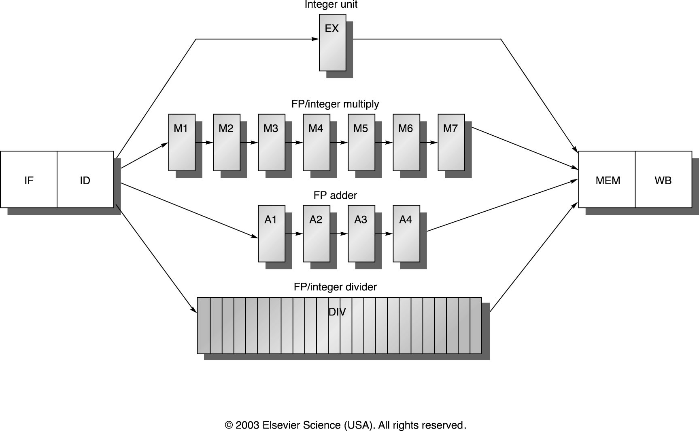
MIPS R4000 pipeline

Slide 19
MIPS FP Pipe Stages
FP Instr 1 2 3 4 5 6 7 8 …
Add, Subtract U S+A A+R R+S
Multiply U E+M M M M N N+A R
Divide U A R D²⁸ … D+A D+R, D+R, D+A, D+R, A, R
Square root U E (A+R)¹⁰⁸ … A R
Negate U S
Absolute value U S
FP compare U A R
Stages:
M First stage of multiplier
N Second stage of multiplier
R Rounding stage
S Operand shift stage
U Unpack FP numbers
A Mantissa ADD stage
D Divide pipeline stage
E Exception test stage

Slide 20
R4000 Performance
Not ideal CPI of 1:
Load stalls (1 or 2 clock cycles)
Branch stalls (2 cycles + unfilled slots)
FP result stalls: RAW data hazard (latency)
FP structural stalls: Not enough FP hardware (parallelism)
Notes:
Integer programs, major delay is branch stalls
FP its structural stalls

Slide 21
FP Loop: Where are the Hazards?
Loop: LD F0,0(R1) ;F0=vector element
ADDD F4,F0,F2 ;add scalar from F2
SD 0(R1),F4 ;store result
SUBI R1,R1,8 ;decrement pointer 8B (DW)
BNEZ R1,Loop ;branch R1!=zero
NOP ;delayed branch slot
Instruction Instruction Latency in producing result using result clock cycles
FP ALU op Another FP ALU op 3
FP ALU op Store double 2
Load double FP ALU op 1
Load double Store double 0
Integer op Integer op 0
Where are the stalls?

Slide 22
FP Loop Showing Stalls
1 Loop: LD F0,0(R1) ;F0=vector element
2 stall
3 ADDD F4,F0,F2 ;add scalar in F2
4 stall
5 stall
6 SD 0(R1),F4 ;store result
7 SUBI R1,R1,8 ;decrement pointer 8B (DW)
8 BNEZ R1,Loop ;branch R1!=zero
9 stall ;delayed branch slot
Instruction Instruction Latency in producing result using result clock cycles
FP ALU op Another FP ALU op 3
FP ALU op Store double 2
Load double FP ALU op 1
9 clocks: Rewrite code to minimize stalls?

Slide 23
Minimizing Stalls Technique 1: Compiler Optimization
1 Loop: LD F0,0(R1)
2 stall
3 ADDD F4,F0,F2
4 SUBI R1,R1,8
5 BNEZ R1,Loop ;delayed branch
6 SD 8(R1),F4 ;altered when move past SUBI
Swap BNEZ and SD by changing address of SD
Instruction Instruction Latency in producing result using result clock cycles
FP ALU op Another FP ALU op 3
FP ALU op Store double 2
Load double FP ALU op 1
6 clocks
Notes:
3 clocks doing work, 3 overhead (stall, branch, sub)

