Slide 1
Lecture 2
Performance, Instruction Set Principles, Pipeline Hazards
CS 203A
Advanced Computer Architecture
Instructor: L.N. Bhuyan

Slide 2
RISC Vs CISC
CISC (complex instruction set computer)
  VAX, Intel X86, IBM 360/370, etc.
RISC (reduced instruction set computer)
  MIPS, DEC Alpha, SUN Sparc, IBM 801

Slide 3
RISC vs. CISC
Characteristics of ISAs

Slide 4
RISC vs. CISC Instruction Set Design
The historical background:
  In first 25 years (1945-70) performance came from both technology and design.
  Design constraints:
    small and slow memories: compact programs are fast.
    small no. of registers: memory operands.
    attempts to bridge the semantic gap: model high level language features in instructions.
    no need for portability: same vendor application, OS and hardware.
    backward compatibility: every new ISA must carry the good and bad of all past ones.
  Result: powerful and complex instructions that are rarely used.
  IC technology and microprocessors in 1970s: lower costs, low power consumption, higher clock rates, cheaper and larger memories.

Slide 5
Top 10 80x86 Instructions

Slide 6
RISC vs. CISC Instruction Set Design
Emergence of RISC
  Very large scale integration (processor on a chip): silicon real-estate at a premium. Micro-store occupies about 70% of chip area: replace micro-store with registers ==> load/store ISA.
  Increased difference between CPU and memory speeds.
  Complex instructions were not used by new compilers.
  Software changes:
    reduced reliance on assembly programming, new ISA can be introduced.
    standardized vendor independent OS (Unix) became very popular in some market segments (academia and research) – need for portability
  Early RISC projects: IBM 801 (America), Berkeley SPUR, RISC I and RISC II and Stanford MIPS.

Slide 7
The MIPS Instruction Formats
All MIPS instructions are 32 bits long. The three instruction formats:
  R-type
  I-type
  J-type
The different fields are:
  op: operation of the instruction
  rs, rt, rd: the source and destination register specifiers
  shamt: shift amount
  funct: selects the variant of the operation in the “op” field
  address / immediate: address offset or immediate value
  target address: target address of the jump instruction
31
26
21
16
11
6
0
op
rs
rt
rd
shamt
funct
6 bits
5 bits
5 bits
5 bits
5 bits
6 bits
31
26
21
16
0
op
rs
rt
immediate
6 bits
5 bits
5 bits
16 bits
31
26
0
op
target address
6 bits
26 bits
Notes:
One of the most important thing you need to know before you start designing a processor is how the instructions look like.
Or in more technical term, you need to know the instruction format. One good thing about the MIPS instruction set is that it is very simple.
First of all, all MIPS instructions are 32 bits long and there are only three instruction formats: (a) R-type, (b) I-type, and (c) J-type.
The different fields of the R-type instructions are:
(a) OP specifies the operation of the instruction.
(b) Rs, Rt, and Rd are the source and destination register specifiers.
(c) Shamt specifies the amount you need to shift for the shift instructions.
(d) Funct selects the variant of the operation specified in the “op” field.
For the I-type instruction, bits 0 to 15 are used as an immediate field. I will show you how this immediate field is used differently by different instructions.
Finally for the J-type instruction, bits 0 to 25 become the target address of the jump.
+3 = 10 min. (X:50)

Slide 8
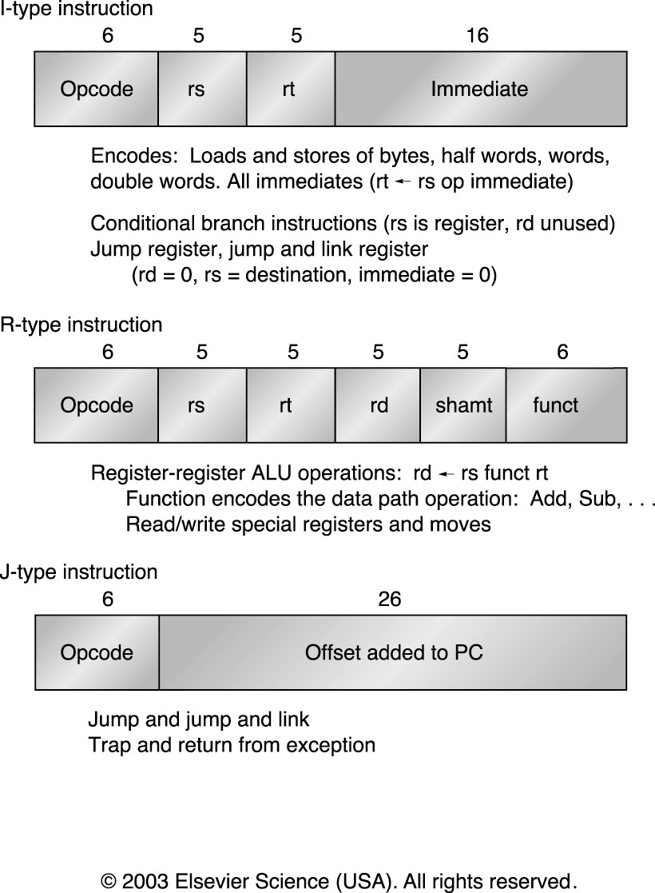
MIPS Instruction Layout

Slide 9
MIPS Addressing Modes/Instruction Formats
All instructions 32 bits wide
Register (direct)
op
rs
rt
rd
register
Immediate
op
rs
rt
immed
Displacement
op
rs
rt
immed
Memory
register
+
PC-relative
op
rs
rt
immed
Memory
PC
+

Slide 10
Summary: Instruction Set Design (MIPS)
Use general purpose registers with a load-store architecture: YES
Provide at least 16 general purpose registers plus separate floating-point registers: 31 GPR & 32 FPR
Support basic addressing modes: displacement (with an address offset size of 12 to 16 bits), immediate (size 8 to 16 bits), and register deferred; : YES: 16 bits for immediate, displacement (disp=0 => register deferred)
All addressing modes apply to all data transfer instructions : YES
Use fixed instruction encoding if interested in performance and use variable instruction encoding if interested in code size : Fixed
Support these data sizes and types: 8-bit, 16-bit, 32-bit integers and 32-bit and 64-bit IEEE 754 floating point numbers: YES
Support these simple instructions, since they will dominate the number of instructions executed: load, store, add, subtract, move register-register, and, shift, compare equal, compare not equal, branch (with a PC-relative address at least 8-bits long), jump, call, and return: YES
Aim for a minimalist instruction set: YES

Slide 11
Review: 5-stage Execution
5 canonical stage “RISC” load-store architecture
    Instruction fetch (IF):
      get instruction from memory/cache
    Instruction decode, Register read (ID):
      translate opcode into control signals and read regs
    Execute (EX):
      perform ALU operation, load/store address, branch outcomes
    Memory (MEM):
      access memory if load/store, everyone else idle
    Writeback/retire (WB):
      write results to register file

Slide 12
Review: Single-cycle Datapath for MIPS
Stage 5
Instruction
Memory
(Imem)
Data
Memory
(Dmem)
PC
Registers
ALU
Stage 1
Stage 2
Stage 3
Stage 4

Slide 13
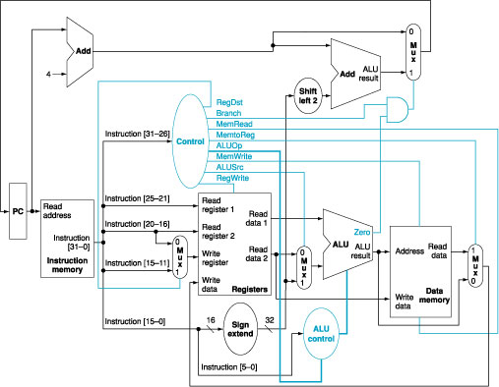
Datapath with Control Signals

Slide 14
Solution
Overlap execution of instructions
  Start instruction on every cycle, e.g. the new instruction can be fetched while the previous one is decoded – pipeline. Each cycle performing a specific task; number of stages is called pipeline depth (5 here)
Non-pipelined
time
1
2
3
4
5
6
7
8
9
10
11
12
13
14
15
IF
ID
EX
MEM
WB
IF
ID
EX
MEM
WB
IF
ID
EX
MEM
WB
Pipelined
IF
ID
EX
MEM
WB
IF
ID
EX
MEM
WB
IF
ID
EX
MEM
WB

Slide 15
Pipelined Datapath (with Pipeline Regs)
Fetch Decode Execute Memory Write
Back
0
M
u
x
1
IF/ID
ID/EX
EX/MEM
MEM/WB
A
d
d
4
A
d
d
r
e
A
d
d
s
u
l
t
S
h
i
f
t
l
e
f
t
2
n
R
e
a
d
o
r
e
g
i
s
t
e
r
1
P
C
A
d
d
r
e
s
s
i
t
R
e
a
d
c
u
d
a
t
a
1
r
R
e
a
d
t
s
Z
e
r
o
n
r
e
g
i
s
t
e
r
2
I
R
e
a
d
A
L
U
A
L
U
W
r
i
t
e
d
a
t
a
2
0
r
e
s
u
l
t
A
d
d
r
e
s
s
R
e
a
d
1
Imem
r
e
g
i
s
t
e
r
Regs
M
d
a
t
a
M
W
r
i
t
e
u
u
d
a
t
a
x
x
1
W
r
i
t
e
0
d
a
t
a
1
6
S
i
g
n
3
2
e
x
t
e
n
d
Dmem
5
64 bits
133 bits
102 bits
69 bits

Slide 16
Pipelined Control Review
  Start with single-cycle controller
  Group control lines by pipeline stage needed
  Extend pipeline registers with control bits
W
B
I
n
s
t
r
u
c
t
i
o
n
Mem
W
B
C
o
n
t
r
o
l
E
X
Mem
W
B
RegDst
ALUop
ALUSrc
Branch
MemRead
MemWrite
MemToReg
RegWrite
I
F
/
I
D
I
D
/
E
X
E
X
/
M
E
M
M
E
M
/
W
B

Slide 17
Pipeline Progress – Instn moves with all control signals, addresses, data items => different register lengths at different stages
M
U
X
1
+
target
+
PC+1
PC+1
R0
0
eq?
regA
R1
ALU
result
R2
Register file
PC
Inst
mem
regB
valA
Data
memory
M
U
X
instruction
R3
A
L
U
R4
ALU
result
mdata
R5
valB
R6
M
U
X
R7
data
offset
dest
valB
Bits 11-15
Bits 16-20
M
U
X
dest
dest
dest
IF/
ID
ID/
EX
EX/
Mem
Mem/
WB

Slide 18
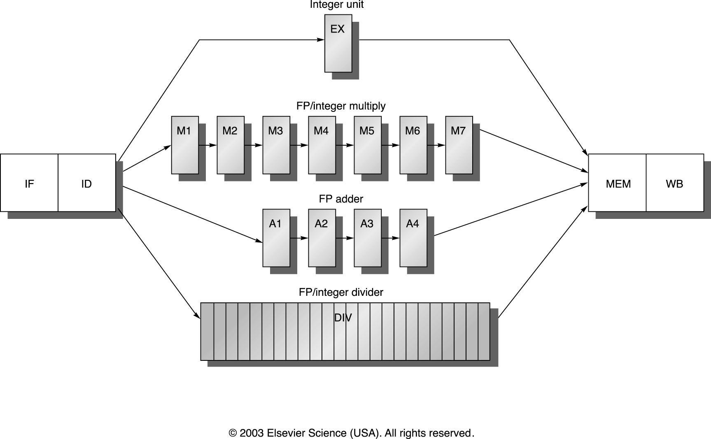
A pipeline with multi-cycle FP operations: Arithmetic Pipeline: Ex. MIPS R4000

Slide 19
Pipeline Hazards
Hazards are caused by conflicts between instructions. Will lead to incorrect behavior if not fixed.
  Three types:
    Structural: two instructions use same h/w in the same cycle – resource conflicts (e.g. one memory port, unpipelined divider etc).
    Data: two instructions use same data storage (register/memory) – dependent instructions.
    Control: one instruction affects which instruction is next – PC modifying instruction, changes control flow of program.

Slide 20
Handling Hazards
Force stalls or bubbles in the pipeline.
  Stop some younger instructions in the stage when hazard happen
  Make younger instr. Wait for older ones to complete
  Implementation: de-assert write-enable signals to pipeline registers
Flush pipeline
  Blow instructions out of the pipeline
  Refetch new instructions later – solving control hazards
  Implementation: assert clear signals on pipeline registers

Slide 21
Dealing with Structural Hazards
Stall
  + simple, low cost in h/w
  Decrease IPC
Replicate the resource
  + good for performance
  Increase h/w and area
  Used for cheap resources
Pipeline the resource
  + good for performance
  Complexity, e.g. RAM
  Useful for multicycle resources

Slide 22
Single Memory is a Structural Hazard
Time (clock cycles)
I
n
s
t
r.
O
r
d
e
r
Load
M
Reg
ALU
M
Reg
Instr 1
M
Reg
ALU
M
Reg
Instr 2
M
Reg
ALU
M
Reg
Instr 3
M
Reg
ALU
M
Reg
Instr 4
M
Reg
ALU
M
Reg
Can’t read same memory twice in same clock cycle

Slide 23
Speed Up Equation for Pipelining
CPI_{pipelined} = Ideal CPI + Pipeline stall clock cycles per instn
Ideal CPI x Pipeline depth Clock Cycle_{unpipelined}
Speedup = -------------------------- X --------
Ideal CPI + Pipeline stall CPI Clock Cycle_{pipelined}
Pipeline depth Clock Cycle_{unpipelined}
Speedup = ------------------------ X ---------------
1 + Pipeline stall CPI/Ideal CPI Clock Cycle_{pipelined}

Slide 24
Example: Dual-port vs. Single-port
Machine A: Dual ported memory
Machine B: Single ported memory, but has a 1.05 times faster clock rate
Ideal CPI = 1 for both
Loads are 40% of instructions executed
SpeedUp_{A} = Pipeline Depth/(1 + 0) x (clock_{unpipe}/clock_{pipe})
= Pipeline Depth
SpeedUp_{B} = Pipeline Depth/(1 + 0.4) x (clock_{unpipe}/(clock_{unpipe} / 1.05)
= (Pipeline Depth/1.4) x 1.05 = 0.75 x Pipeline Depth
SpeedUp_{A} / SpeedUp_{B} = Pipeline Depth/(0.75 x Pipeline Depth) = 1.33
Machine A is 1.33 times faster

Slide 25
Data Hazards
Two different instructions use the same storage location
  It must appear as if they executed in sequential order
add R1, R2, R3
sub R2, R4, R1
or R1, R6, R3
add R1, R2, R3
sub R2, R4, R1
or R1, R6, R3
add R1, R2, R3
sub R2, R4, R1
or R1, R6, R3
read-after-write
(RAW)
write-after-read
(WAR)
write-after-write
(WAW)
True dependence
(real)
anti dependence
(artificial)
output dependence
(artificial)
Where (How) do WAR and WAW hazards occur ?

Slide 26
Control Hazards
Branch problem:
  branches are resolved in EX stage
  → 2 cycles penalty on taken branches
  Ideal CPI =1. Assuming 2 cycles for all branches and 32% branch instructions → new CPI = 1 + 0.32*2 = 1.64
Solutions:
  Reduce branch penalty: change the datapath – new adder needed in ID stage.
  Fill branch delay slot(s) with a useful instruction.
  Fixed branch prediction.
  Static branch prediction.
  Dynamic branch prediction.

