Slide 1
CS203A
Graduate Computer Architecture
Lecture 14
Cache and Main Memory Design

Slide 2
How to Improve Cache Performance?
1. Reduce the miss rate,
2. Reduce the miss penalty, or
3. Reduce the time to hit in the cache.

Slide 3
1. Small and simple caches
Small on-chip L1 caches – less access time
Direct mapped cache faster because no hardware comparison between blocks, but higher miss ratio
Compromise – Direct L1 cache and Set-associative L2 cache
How to predict cache access time at the design stage? – Use CACTI program

Slide 4
Impact of Change in cc
Suppose a processor has the following parameters:
  CPI = 2 (w/o memory stalls)
  mem access per instruction = 1.5
Compare AMAT and CPU time for a direct mapped cache and a 2-way set associative cache assuming:
  AMAT_{d} = hit time + miss rate * miss penalty = 1*1 + 0.014*75 = 2.05 ns
  AMAT₂ = 1*1.25 + 0.01*75 = 2 ns < 2.05 ns
  Execution Times:
  CPU_{d} = (CPI*cc + mem. stall time)*IC = (2*1 + 1.5*0.014*75)IC = 3.575*IC
  CPU₂ = (2*1.25 + 1.5*0.01*75)IC = 3.625*IC > CPU_{d} !
Change in cc affects all instructions while reduction in miss rate benefit only memory instructions.
 | cc | Hit cycle | Miss penalty | Miss rate
Direct map | 1ns | 1 | 75 ns | 1.4%
2-way associative | 1.25ns(why?) | 1 | 75 ns | 1.0%

Slide 5
Miss Penalty for Out-of-Order (OOO) Exe. Processor.
In OOO processors, memory stall cycles are overlapped with execution of other instructions. Miss penalty should not include this overlapped part.
  mem stall cycle per instruction = mem miss per instruction x (total miss penalty – overlapped miss penalty)
For the previous example. Suppose 30% of the 75ns miss penalty can be overlapped, what is the AMAT and CPU time?
  Assume using direct map cache, cc=1.25ns to handle out of order execution.
  AMATd = 1*1.25 + 0.014*(75*0.7) = 1.985 ns
  With 1.5 memory accesses per instruction,
  CPU time =( 2*1.25 + 1.5 * 0.014 * (75*0.7))*IC = 3.6025 IC < CPU₂

Slide 6
Avg. Memory Access Time vs. Miss Rate
Associativity reduces miss rate, but increases hit time due to increase in hardware complexity!
Example: For on-chip cache, assume clock cycle time ratio (CCT) = 1.10 for 2-way, 1.12 for 4-way, 1.14 for 8-way vs. CCT direct mapped
Cache Size Associativity
(KB) 1-way 2-way 4-way 8-way
1 2.33 2.15 2.07 2.01
2 1.98 1.86 1.76 1.68
4 1.72 1.67 1.61 1.53
8 1.46 1.48 1.47 1.43
16 1.29 1.32 1.32 1.32
32 1.20 1.24 1.25 1.27
64 1.14 1.20 1.21 1.23
128 1.10 1.17 1.18 1.20
(Red means A.M.A.T. not improved by more associativity)

Slide 7
Fast Hit times via
Small and Simple Caches
Index tag memory and then compare takes time
⇒ Small cache can help hit time since smaller memory takes less time to index
  E.g., L1 caches same size for 3 generations of AMD microprocessors: K6, Athlon, and Opteron
  Also L2 cache small enough to fit on chip with the processor avoids time penalty of going off chip
Simple ⇒ direct mapping
  Can overlap tag check with data transmission since no choice
Access time estimate for 90 nm using CACTI model 4.0
  Median ratios of access time relative to the direct-mapped caches are 1.32, 1.39, and 1.43 for 2-way, 4-way, and 8-way caches

Slide 8
2: Increasing Cache Bandwidth via Multiple Banks
Rather than treat the cache as a single monolithic block, divide into independent banks that can support simultaneous accesses
  E.g.,T2 (“Niagara”) L2 has 8 banks
Banking works best when accesses naturally spread themselves across banks ⇒ mapping of addresses to banks affects behavior of memory system
Simple mapping that works well is “sequential interleaving”
  Spread block addresses sequentially across banks
  E,g, if there 8 banks, Bank 0 has all blocks whose address modulo 8 is 0; bank 1 has all blocks whose address modulo 8 is 1; …
Notes:
Answer is 3 stages between branch and new instruction fetch and 2 stages between load and use (even though if looked at red insertions that it would be 3 for load and 2 for branch)
Reasons:
1) Load: TC just does tag check, data available after DS; thus supply the data & forward it, restarting the pipeline on a data cache miss
2) EX phase does the address calculation even though just added one phase; presumed reason is that since want fast clockc cycle don’t want to sitck RF phase with reading regisers AND testing for zero, so just moved it back on phase

Slide 9
Memory Interleaving
Interleaved memory is more flexible than wide-access memory in that it can handle multiple independent accesses at once.

Slide 10
SUN Niagara 2
Characteristics of Sun T5120 Niagara 2
  2 pipelines per core
  4 hardware threads per pipeline
Notes:
(b) The bars show the average utilization (%) at each level in the core; the lines represent the range of peak high and peak low values (%).

Slide 11
Technique | Hit Time | Band-width |  | Miss penalty | Miss rate |  | HW cost/ complexity | Comment
Small and simple caches | + |  |  |  | – |  | 0 | Trivial; widely used
Way-predicting caches | + |  |  |  |  |  | 1 | Used in Pentium 4
Trace caches | + |  |  |  |  |  | 3 | Used in Pentium 4
Pipelined cache access | – | + |  |  |  |  | 1 | Widely used
Nonblocking caches |  | + |  | + |  |  | 3 | Widely used
Banked caches |  | + |  |  |  |  | 1 | Used in L2 of Opteron and Niagara
Critical word first and early restart |  |  |  | + |  |  | 2 | Widely used
Merging write buffer |  |  |  | + |  |  | 1 | Widely used with write through
Compiler techniques to reduce cache misses |  |  |  |  | + |  | 0 | Software is a challenge; some computers have compiler option
Hardware prefetching of instructions and data |  |  |  | + | + |  | 2 instr., 3 data | Many prefetch instructions; AMD Opteron prefetches data
Compiler-controlled prefetching |  |  | + |  |  | + | 3 | Needs non-blocking cache; in many CPUs

Slide 12
Popular Cache Indexing/Hashing
Ref: 1. Using prime numbers for cache indexing to eliminate conflict misses, HPCA 2004. 2. A new case for skewed-associativity, ISCA 1993.
Modulo Hash (Base)
XOR-based Hash (XOR)
Prime Modulo (pMod)
Prime Displacement (pDisp)
Multiple Hash Functions
  SKW
  SKW + pDisp
Universal Hash – Has been shown to be good for IP and TCP look-up

Slide 13
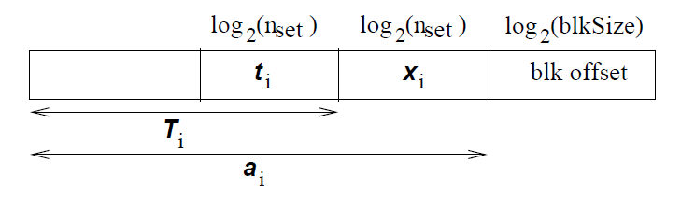
Single Hashing Function Schemes
Component Breakdown of address a:
Modulo Hashing: H(a_{i}) = a_{i} mod n_{set}
XOR Hashing: H(a_{i}) = t_{i} xor x_{i}
Prime Modulo Hashing: H(a_{i}) = a_{i} mod p
  p is the largest prime number that is smaller than the number of cache sets.
Prime Displacement Hash: H(a_{i}) = (p. t_{i} + x_{i}) mod n_{set}
  p is a random prime number

Slide 14
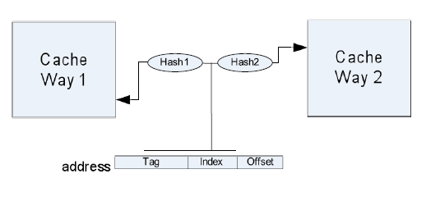
Multiple Hashing Functions Schemes
Skewed Caches: two separate hash functions for two cache banks.
SKW:
  Hash1: H(a_{i}) = t_{i} xor (x_{i} and T); T is a constant with same number of bits as x_{i}
  Hash2: H(a_{i}) = t_{i} xor (x_{i} and ~T) where ~T is complement of T
SKW+pDisp:
  Hash1: H(a_{i}) = (p1. t_{i} + x_{i}) mod n_{set}
  Hash2: H(a_{i}) = (p2. t_{i} + x_{i}) mod n_{set}

Slide 15
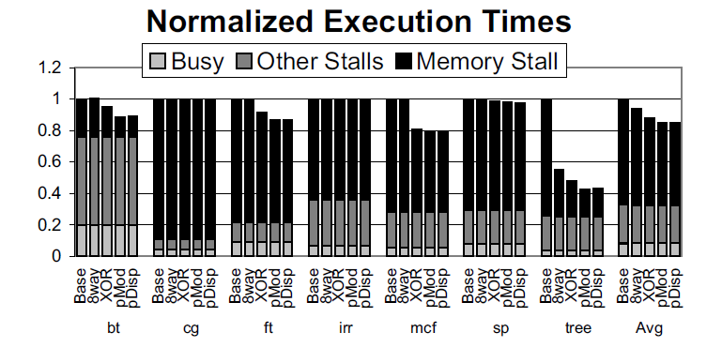
Single Hashing Function Schemes
Performance results of single hashing function schemes for applications with non-uniform cache accesses from the benchmarks SPECCPU, NAS, Sparsebench and tree. The cache is 4-way, unless stated otherwise.

Slide 16
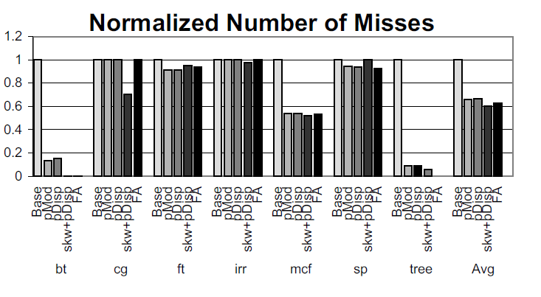
Overall Comparison
SKW+pDisp is the best among all multiple hashing functions schemes
pMod is the best among the single hashing function schemes
Note that FA in the figure means fully associative cache.

Slide 17
Main Memory Background
Random Access Memory (vs. Serial Access Memory)
Different flavors at different levels
  Physical Makeup (CMOS, DRAM)
  Low Level Architectures (FPM,EDO,BEDO,SDRAM)
Cache uses SRAM: Static Random Access Memory
  No refresh (6 transistors/bit vs. 1 transistor
  Size: DRAM/SRAM ­ 4-8,
  Cost/Cycle time: SRAM/DRAM ­ 8-16
Main Memory is DRAM: Dynamic Random Access Memory
  Dynamic since needs to be refreshed periodically
  Addresses divided into 2 halves (Memory as a 2D matrix):
    RAS or Row Access Strobe
    CAS or Column Access Strobe

Slide 18
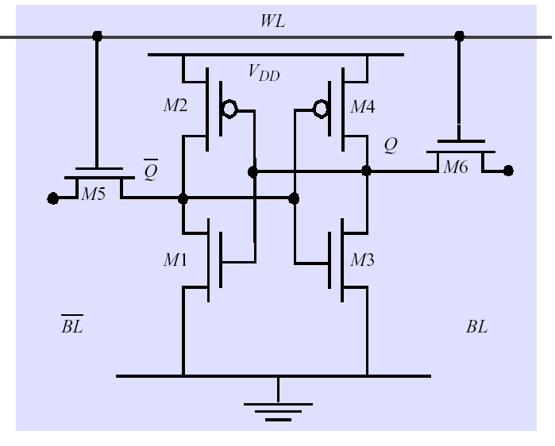
Static RAM (SRAM)
Six transistors in cross connected fashion
  Provides regular AND inverted outputs
  Implemented in CMOS process
Single Port 6-T SRAM Cell

Slide 19
Dynamic RAM
SRAM cells exhibit high speed/poor density
DRAM: simple transistor/capacitor pairs in high density form
Word Line
C
Memory Access Time
Memory Cycle Time
Memory Refreshing
.
.
.
Bit Line
Sense Amp

Slide 20
DRAM logical organization (4 Mbit)
Access time of DRAM = Row access time + column access time + refreshing
Column Decoder
D
…
1
Sense
Amps & I/O
1
Q
A0…A1
Memory
Array
0
Row Decoder
…
(2,048 x 2,048)
Storage
W
ord Line
Cell
Square root of bits per RAS/CAS

Slide 21
Other Types of DRAM
Synchronous DRAM (SDRAM): Ability to transfer a burst of data given a starting address and a burst length – suitable for transferring a block of data from main memory to cache.
Page Mode DRAM: All bits on the same ROW (Spatial Locality)
  Don’t need to wait for wordline to recharge
  Toggle CAS with new column address
Extended Data Out (EDO)
  Overlap Data output w/ CAS toggle
  Later brother: Burst EDO (CAS toggle used to get next addr)
Rambus DRAM (RDRAM)
- Pipelined control

Slide 22
Main Memory Organizations
C
P
U
C
P
U
C
P
U
M
u
l
t
i
p
l
e
x
o
r
C
a
c
h
e
C
a
c
h
e
C
a
c
h
e
B
u
s
B
u
s
B
u
s
M
e
m
o
r
y
M
e
m
o
r
y
M
e
m
o
r
y
M
e
m
o
r
y
M
e
m
o
r
y
b
a
n
k
0
b
a
n
k
1
b
a
n
k
2
b
a
n
k
3
wide memory organization
interleaved
memory organization
M
e
m
o
r
y
one-word wide
memory organization
DRAM access time >> bus transfer time

Slide 23
Memory Access Time Example
Assume that it takes 1 cycle to send the address, 15 cycles for each DRAM access and 1 cycle to send a word of data.
Assuming a cache block of 4 words and one-word wide DRAM, miss penalty = 1 + 4x15 + 4x1 = 65 cycles
With main memory and bus width of 2 words, miss penalty = 1 + 2x15 + 2x1 = 33 cycles. For 4-word wide memory, miss penalty is 17 cycles. Expensive due to wide bus and control circuits.
With interleaved memory of 4 memory banks and same bus width, the miss penalty = 1 + 1x15 + 4x1 = 20 cycles. The memory controller must supply consecutive addresses to different memory banks. Interleaving is universally adapted in high-performance computers.

