Slide 1
CS203A
Graduate Computer Architecture
Lecture 13
Cache Design

Slide 2
Cache Organization to reduce miss rate
Assume total cache size not changed:
What happens if:
Change Block Size:
Change Associativity:
3) Change Compiler:
Which of 3Cs is obviously affected?
Notes:
Ask which affected?
Block size
1) Compulsory
2) More subtle, will change mapping

Slide 3
Larger Block Size
(fixed size&assoc)
Reduced
compulsory
misses
Increased
Conflict
Misses
What else drives up block size?

Slide 4
Associativity
Conflict

Slide 5
3Cs Relative Miss Rate
Conflict

Slide 6
Fast Hit Time + Low Conflict => Victim Cache
How to combine fast hit time of direct mapped
yet still avoid conflict misses?
Add buffer to place data discarded from cache
Jouppi [1990]: 4-entry victim cache removed 20% to 95% of conflicts for a 4 KB direct mapped data cache
Used in Alpha, HP machines
TAGS
DATA
Tag and Comparator
One Cache line of Data
Tag and Comparator
One Cache line of Data
Tag and Comparator
One Cache line of Data
Tag and Comparator
One Cache line of Data
To Next Lower Level In
Hierarchy

Slide 7
Reducing Misses by Hardware Prefetching of Instructions & Data
E.g., Instruction Prefetching
  Alpha 21064 fetches 2 blocks on a miss
  Sequential prefetch
  Cache Pollution if unused!
  Extra block placed in “stream buffer”
  On miss check stream buffer
Works with data blocks too:
  Jouppi [1990] 1 data stream buffer got 25% misses from 4KB cache; 4 streams got 43%
  Palacharla & Kessler [1994] for scientific programs for 8 streams got 50% to 70% of misses from
  2 64KB, 4-way set associative caches
  Data Prediction is difficult
Prefetching relies on having extra memory bandwidth that can be used without penalty
Question: What to prefetch and when to prefetch? Instruction prefetch is fine, but data?

Slide 8
Leave it to the Programmer?
Software Prefetching Data
Data Prefetch – Explicit prefetch instructions
  Load data into register (HP PA-RISC loads)
  Cache Prefetch: load into cache (MIPS IV, PowerPC, SPARC v. 9)
  Special prefetching instructions cannot cause faults; a form of speculative execution
Prefetching comes in two flavors:
  Binding prefetch: Requests load directly into register.
    Must be correct address and register!
  Non-Binding prefetch: Load into cache.
    Can be incorrect. Faults?
Issuing Prefetch Instructions takes time
  Is cost of prefetch issues < savings in reduced misses?
  Higher superscalar reduces difficulty of issue bandwidth

Slide 9
Summary: Miss Rate Reduction
3 Cs: Compulsory, Capacity, Conflict
  0. Larger cache
  1. Reduce Misses via Larger Block Size
  2. Reduce Misses via Higher Associativity
  3. Reducing Misses via Victim Cache
  4. Reducing Misses via Pseudo-Associativity
  5. Reducing Misses by HW Prefetching Instr, Data
  6. Reducing Misses by SW Prefetching Data
  7. Reducing Misses by Compiler Optimizations
Prefetching comes in two flavors:
  Binding prefetch: Requests load directly into register.
    Must be correct address and register!
  Non-Binding prefetch: Load into cache.
    Can be incorrect. Frees HW/SW to guess!

Slide 10
Review: Improving Cache Performance
1. Reduce the miss rate,
2. Reduce the miss penalty, or
3. Reduce the time to hit in the cache.

Slide 11
1. Reducing Miss Penalty:
Read Priority over Write on Miss
Write-through w/ write buffers => RAW conflicts with main memory reads on cache misses
  If simply wait for write buffer to empty, might increase read miss penalty (old MIPS 1000 by 50% )
  Check write buffer contents before read;
  if no conflicts, let the memory access continue
Write-back want buffer to hold displaced blocks
  Read miss replacing dirty block
  Normal: Write dirty block to memory, and then do the read
  Instead copy the dirty block to a write buffer, then do the read, and then do the write
  CPU stall less since restarts as soon as do read

Slide 12
Write Buffers
Write Buffers (for wrt-through)
  buffers words to be written in L2 cache/memory along with their addresses.
  2 to 4 entries deep
  all read misses are checked against pending writes for dependencies (associatively)
  allows reads to proceed ahead of writes
  can coalesce writes to same address
Write-back Buffers
  between a write-back cache and L2 or MM
  algorithm
    move dirty block to write-back buffer
    read new block
    write dirty block in L2 or MM
  can be associated with victim cache (later)
L1
to CPU
Write buffer
L2

Slide 13
Merging Write Buffer to
Reduce Miss Penalty
Write buffer to allow processor to continue while waiting to write to memory
If buffer contains modified blocks, the addresses can be checked to see if address of new data matches the address of a valid write buffer entry
If so, new data are combined with that entry
Increases block size of write for write-through cache of writes to sequential words, bytes since multiword writes more efficient to memory
The Sun T1 (Niagara) processor, among many others, uses write merging

Slide 14
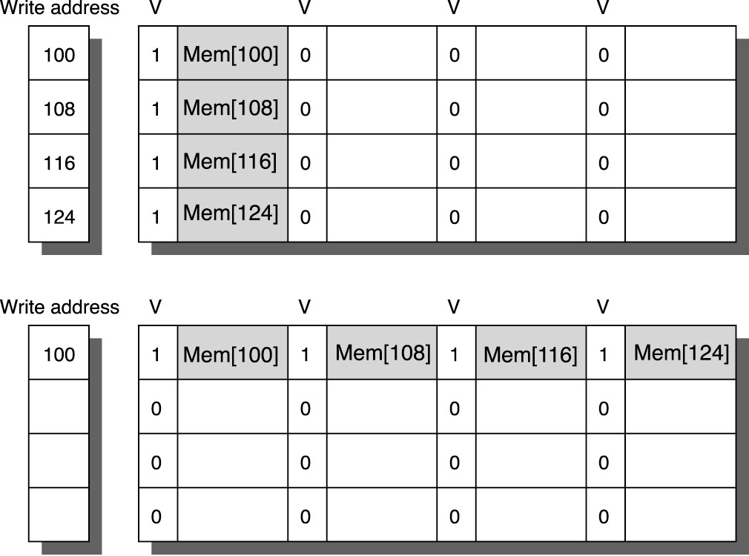
Write Merge

Slide 15
2. Reduce Miss Penalty:
Early Restart and Critical Word First
Don’t wait for full block to be loaded before restarting CPU
  Early restart—As soon as the requested word of the block arrives, send it to the CPU and let the CPU continue execution
  Critical Word First—Request the missed word first from memory and send it to the CPU as soon as it arrives; let the CPU continue execution while filling the rest of the words in the block. Also called wrapped fetch and requested word first
Generally useful only in large blocks,
Spatial locality => tend to want next sequential word, so not clear if benefit by early restart
block

Slide 16
3. Reduce Miss Penalty: Non-blocking Caches to reduce stalls on misses
Non-blocking cache or lockup-free cache allow data cache to continue to supply cache hits during a miss
  requires F/E bits on registers or out-of-order execution
  requires multi-bank memories
“hit under miss” reduces the effective miss penalty by working during miss vs. ignoring CPU requests
“hit under multiple miss” or “miss under miss” may further lower the effective miss penalty by overlapping multiple misses
  Significantly increases the complexity of the cache controller as there can be multiple outstanding memory accesses
  Requires muliple memory banks (otherwise cannot support)
  Penium Pro allows 4 outstanding memory misses

Slide 17
Lock-Up Free Cache Using MSHR (Miss Status Holding Register)

Slide 18
Value of Hit Under Miss for SPEC
0->1
1->2
2->64
Base
“Hit under n Misses”
Integer
Floating Point
FP programs on average: AMAT= 0.68 -> 0.52 -> 0.34 -> 0.26
Int programs on average: AMAT= 0.24 -> 0.20 -> 0.19 -> 0.19
8 KB Data Cache, Direct Mapped, 32B block, 16 cycle miss, SPEC 92

Slide 19
4: Add a second-level cache
L2 Equations
AMAT = Hit Time_{L1} + Miss Rate_{L1} x Miss Penalty_{L1}
Miss Penalty_{L1} = Hit Time_{L2} + Miss Rate_{L2} x Miss Penalty_{L2}
AMAT = Hit Time_{L1} +
Miss Rate_{L1} x (Hit Time_{L2} + Miss Rate_{L2} + Miss Penalty_{L2})
Definitions:
  Local miss rate— misses in this cache divided by the total number of memory accesses to this cache (Miss rate_{L2})
  Global miss rate—misses in this cache divided by the total number of memory accesses generated by the CPU
  Global Miss Rate is what matters

Slide 20
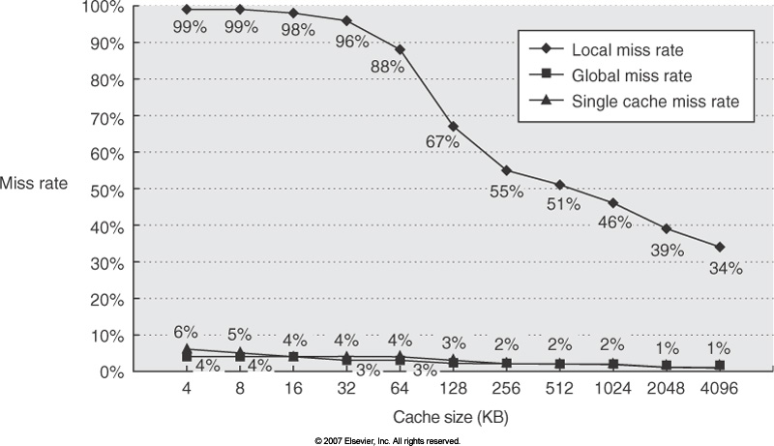
Comparing Local and Global Miss Rates
32 KByte 1st level cache;
Increasing 2nd level cache
Global miss rate close to single level cache rate provided L2 >> L1
Don’t use local miss rate
L2 not tied to CPU clock cycle!
Cost & A.M.A.T.
Generally Fast Hit Times and fewer misses
Since hits are few, target miss reduction
Cache Size
Log

Slide 21
Example
For every 1000 instructions, 40 misses in L1 and 20 misses in L2;
Hit cycle in L1 is 1, L2 is 10; Miss penalty from L2 to memory is 100 cycles; there are 1.5 memory references per instruction. What is AMAT and average stall cycles per instruction?
  AMAT = [1 + 40/1000 * (10 + 20/40 * 100) ] *cc = 3.4 cycles
  AMAT without L2 = 1 + 40/1000 * 100 = 5 cycles => An improvement of 1.6 cycles due to L2
  Average stall cycles per instruction = 1.5 * 40/1000 * 10 + 1.5 * 20/1000 * 100 = 3.6 cycles
Note: We have not distinguished reads and writes. Access L2 only on L1 miss, i.e. write back cache

Slide 22
L2 cache block size & A.M.A.T.
32KB L1, 8 byte path to memory

Slide 23
Reducing Miss Penalty Summary
Four techniques
  Read priority over write on miss
  Early Restart and Critical Word First on miss
  Non-blocking Caches (Hit under Miss, Miss under Miss)
  Second Level Cache
Can be applied recursively to Multilevel Caches
  Danger is that time to DRAM will grow with multiple levels in between
  First attempts at L2 caches can make things worse, since increased worst case is worse

Slide 24
Cache Optimization Summary
Technique MR MP HT Complexity
Larger Block Size + – 0
Higher Associativity + – 1
Victim Caches + 2
Pseudo-Associative Caches + 2
HW Prefetching of Instr/Data + 2
Compiler Controlled Prefetching + 3
Compiler Reduce Misses + 0
Priority to Read Misses + 1
Early Restart & Critical Word 1st + 2
Non-Blocking Caches + 3
Second Level Caches + 2
miss rate
miss penalty

Slide 25
How to Improve Cache Performance?
1. Reduce the miss rate,
2. Reduce the miss penalty, or
3. Reduce the time to hit in the cache.

Slide 26
1. Small and simple caches
Small on-chip L1 caches – less access time
Direct mapped cache faster because no hardware comparison between blocks, but higher miss ratio
Compromise – Direct L1 cache and Set-associative L2 cache
How to predict cache access time at the design stage? – Use CACTI program

Slide 27
Impact of Change in cc
Suppose a processor has the following parameters:
  CPI = 2 (w/o memory stalls)
  mem access per instruction = 1.5
Compare AMAT and CPU time for a direct mapped cache and a 2-way set associative cache assuming:
  AMAT_{d} = hit time + miss rate * miss penalty = 1*1 + 0.014*75 = 2.05 ns
  AMAT₂ = 1*1.25 + 0.01*75 = 2 ns < 2.05 ns
  Execution Times:
  CPU_{d} = (CPI*cc + mem. stall time)*IC = (2*1 + 1.5*0.014*75)IC = 3.575*IC
  CPU₂ = (2*1.25 + 1.5*0.01*75)IC = 3.625*IC > CPU_{d} !
Change in cc affects all instructions while reduction in miss rate benefit only memory instructions.
 | cc | Hit cycle | Miss penalty | Miss rate
Direct map | 1ns | 1 | 75 ns | 1.4%
2-way associative | 1.25ns(why?) | 1 | 75 ns | 1.0%

Slide 28
Miss Penalty for Out-of-Order (OOO) Exe. Processor.
In OOO processors, memory stall cycles are overlapped with execution of other instructions. Miss penalty should not include this overlapped part.
  mem stall cycle per instruction = mem miss per instruction x (total miss penalty – overlapped miss penalty)
For the previous example. Suppose 30% of the 75ns miss penalty can be overlapped, what is the AMAT and CPU time?
  Assume using direct map cache, cc=1.25ns to handle out of order execution.
  AMATd = 1*1.25 + 0.014*(75*0.7) = 1.985 ns
  With 1.5 memory accesses per instruction,
  CPU time =( 2*1.25 + 1.5 * 0.014 * (75*0.7))*IC = 3.6025 IC < CPU₂

Slide 29
Avg. Memory Access Time vs. Miss Rate
Associativity reduces miss rate, but increases hit time due to increase in hardware complexity!
Example: For on-chip cache, assume CCT = 1.10 for 2-way, 1.12 for 4-way, 1.14 for 8-way vs. CCT direct mapped
Cache Size Associativity
(KB) 1-way 2-way 4-way 8-way
1 2.33 2.15 2.07 2.01
2 1.98 1.86 1.76 1.68
4 1.72 1.67 1.61 1.53
8 1.46 1.48 1.47 1.43
16 1.29 1.32 1.32 1.32
32 1.20 1.24 1.25 1.27
64 1.14 1.20 1.21 1.23
128 1.10 1.17 1.18 1.20
(Red means A.M.A.T. not improved by more associativity)

Slide 30
Fast Hit times via
Small and Simple Caches
Index tag memory and then compare takes time
⇒ Small cache can help hit time since smaller memory takes less time to index
  E.g., L1 caches same size for 3 generations of AMD microprocessors: K6, Athlon, and Opteron
  Also L2 cache small enough to fit on chip with the processor avoids time penalty of going off chip
Simple ⇒ direct mapping
  Can overlap tag check with data transmission since no choice
Access time estimate for 90 nm using CACTI model 4.0
  Median ratios of access time relative to the direct-mapped caches are 1.32, 1.39, and 1.43 for 2-way, 4-way, and 8-way caches

Slide 31
2: Increasing Cache Bandwidth via Multiple Banks
Rather than treat the cache as a single monolithic block, divide into independent banks that can support simultaneous accesses
  E.g.,T1 (“Niagara”) L2 has 4 banks
Banking works best when accesses naturally spread themselves across banks ⇒ mapping of addresses to banks affects behavior of memory system
Simple mapping that works well is “sequential interleaving”
  Spread block addresses sequentially across banks
  E,g, if there 4 banks, Bank 0 has all blocks whose address modulo 4 is 0; bank 1 has all blocks whose address modulo 4 is 1; …
Notes:
Answer is 3 stages between branch and new instruction fetch and 2 stages between load and use (even though if looked at red insertions that it would be 3 for load and 2 for branch)
Reasons:
1) Load: TC just does tag check, data available after DS; thus supply the data & forward it, restarting the pipeline on a data cache miss
2) EX phase does the address calculation even though just added one phase; presumed reason is that since want fast clockc cycle don’t want to sitck RF phase with reading regisers AND testing for zero, so just moved it back on phase

Slide 32
Technique | Hit Time | Band-width |  | Miss penalty | Miss rate |  | HW cost/ complexity | Comment
Small and simple caches | + |  |  |  | – |  | 0 | Trivial; widely used
Way-predicting caches | + |  |  |  |  |  | 1 | Used in Pentium 4
Trace caches | + |  |  |  |  |  | 3 | Used in Pentium 4
Pipelined cache access | – | + |  |  |  |  | 1 | Widely used
Nonblocking caches |  | + |  | + |  |  | 3 | Widely used
Banked caches |  | + |  |  |  |  | 1 | Used in L2 of Opteron and Niagara
Critical word first and early restart |  |  |  | + |  |  | 2 | Widely used
Merging write buffer |  |  |  | + |  |  | 1 | Widely used with write through
Compiler techniques to reduce cache misses |  |  |  |  | + |  | 0 | Software is a challenge; some computers have compiler option
Hardware prefetching of instructions and data |  |  |  | + | + |  | 2 instr., 3 data | Many prefetch instructions; AMD Opteron prefetches data
Compiler-controlled prefetching |  |  | + |  |  | + | 3 | Needs non-blocking cache; in many CPUs

