Slide 1
Lec 11 – Multicore Architectures and Network Processors

Slide 2
Intel Clovertown Machine – 2 Quad-core Xeon Processor
Multi-Core Architecture
  Increased resource density
  Major Challenges
    Parallelism in legacy program scalability
  Current solutions
    Software
      Naïve multithreading
    Hardware
      Receive Side Scaling (RSS) in NIC
No Multithreading

Slide 3
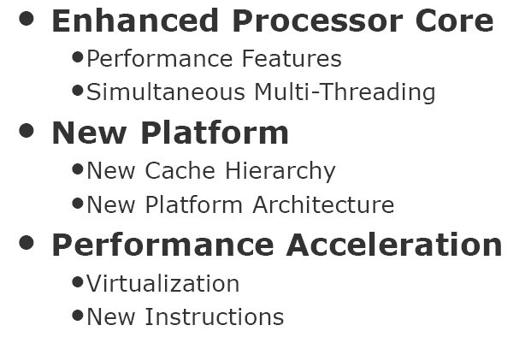
Nehalem Architecture – 2-Way SMT

Slide 4
Naïve Thread Scheduling
Major reasons for poor scalability
  Round-Robin workload distribution among threads.
    Waste of cache locality
  O(1) scheduler in the OS
    Overhead in load balance
    Waste of cache locality
Potential Solutions
  Improving cache locality
  Smarter load balance

Slide 5
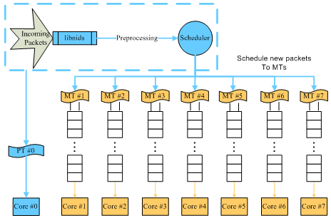
Optimized Multithreading
A connection affinity based multithreading
    Load Balance the packets
  System architecture
    packets in the same connection go to the same thread
    each thread is affinitized to a designated core

Slide 6
Experimental Results for L7 Filter, A DPI Program (ANCS 2008)
Throughput and Utilization in Native Kernel.
Summary
  Throughput is improved by 51%.
  Performance scales close to linear as more cores are used.

Slide 7
SUN Niagara 2
Characteristics of Sun T5120 Niagara 2
  2 pipelines per core
  4 hardware threads per pipeline
Notes:
(b) The bars show the average utilization (%) at each level in the core; the lines represent the range of peak high and peak low values (%).

Slide 8
Hierarchical HRW (ANCS 2009)
Tested for L7 Filter on Sun Niagra 2 Architecture
Proposed Idea
  Apply HRW at each level
  Pick a core first, then pick a pipeline of the selected core, then pick a thread of the selected pipeline
What is HRW?
  Highest Random Weight, IEEE Trans on Networking, 1998
  Based on a Hash function that maps a connection to a core at the same time load balancing among homogeneous cores
  Extend to packet level load balancing, heterogeneous cores, cache/thread locality,

Slide 9
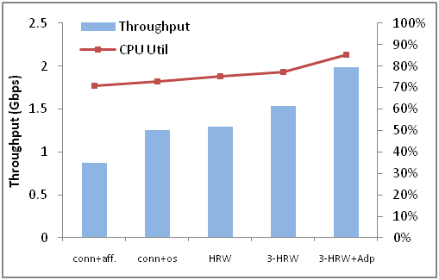
Results (ANCS 2009)
Throughput and Core Utilization
  59.2% improvement in system throughput
Notes:
Fig. 4 illustrates the throughput and CPU utilization results obtained from different optimizations. The "conn+aff." reflects the basic connection locality + thread affinity optimization, as proposed in their paper [7]. We adopt this optimization as our baseline set up. It is clearly presented that our adaptive multilayer hash scheduler ("3-HRW+Adp") increases the system throughput by 130% (0.87 Gbps VS 1.99Gbps). It is arguably reasonable to question the fairness of this comparison because the testbed in that paper was an Intel dual quad-core Clovertown machine, whereas we use a 64-thread 8-core Sun Niagara 2 machine. Therefore, we did a simple optimization ("conn+os") for the connection locality technique by using the default software scheduler on Solaris, which provides a better load balance compared to the thread affinity set up. This optimization can increase the throughput by 43% (1.25 Gbps VS 0.87 Gbps). To keep our result report reasonable, we choose the “conn+os” case as the default case which our optimizations are compared to. We also observe that HRW alone only increases the throughput by 3.2%, while the multilayer HRW achieves a throughput of 1.54 Gbps, an additional improvement of 20%. The ultimate system throughput can be increased by 59.2% compared to "conn+os" using the adaptive multilayer scheduler.
The CPU utilization shows a pattern of growth as throughput increases. This is because better load balance reduces CPU idle time. Therefore, more CPU time is spent in matching connection buffers. If the per core CPU workload is unevenly distributed, some of the cores might be idling after they finish the workload in their runqueue, while those cores with higher workloads keep running blindly, blocking workload deeper in the runqueue. In the next subsection, we will present the workload distribution situation at the core, the pipeline and the thread level.

Slide 10
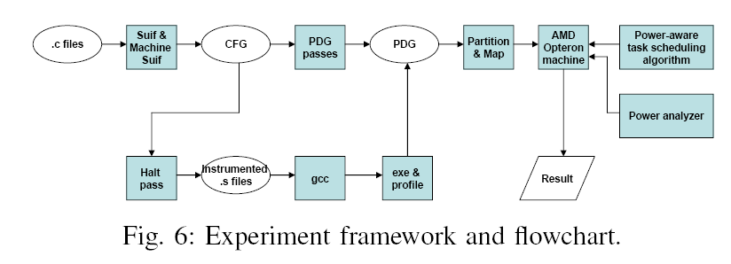
Power Aware Scheduling of Network Applications (INFOCOM 2010)
Use SUIF compiler to generate basic blocks and program dependency graph (PDG). Partition and map the application on an AMD machine with two Quad-Core Opteron 2350 processors. Apply power-aware scheduling algorithm to improve power consumption.

Slide 11
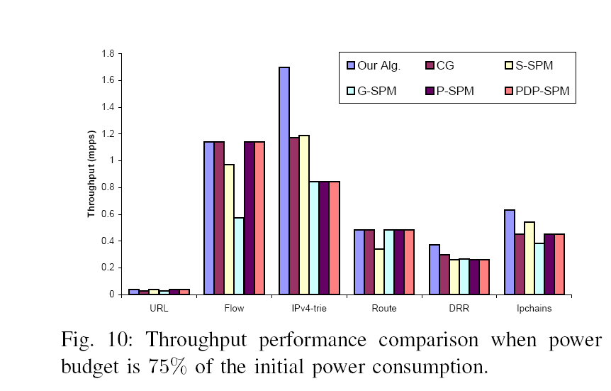

Slide 12
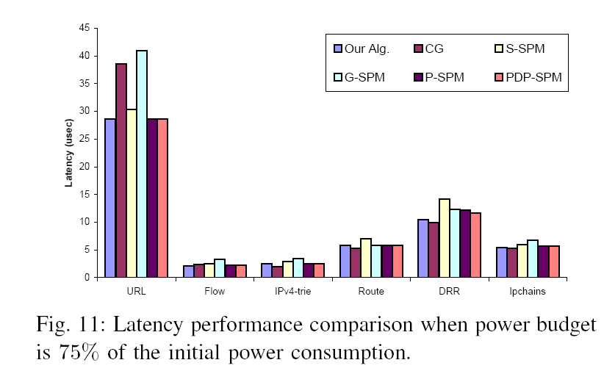

Slide 13
Network Processors

Slide 14
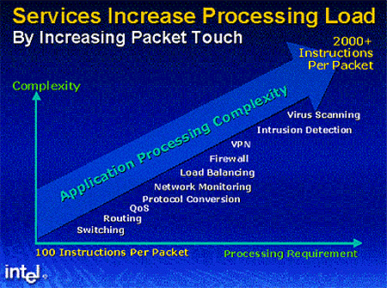

Slide 15
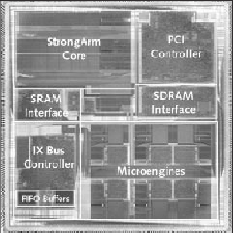
What the Internet Needs?
ASIC
(large,
expensive to develop,
not flexible)
Increasing Huge
Amount of Packets
&
Routing,
Packet Classification,
Encryption, QoS,
New Applications
and Protocols, etc…..
High processing power
Support wire speed
Programmable
Scalable
Specially for network applications
…
General Purpose RISC
(not capable enough)

Slide 16
Typical NP Architecture
SDRAM
(Packet buffer)
SRAM
(Routing table)
Bus
Bus
Input ports
Output ports
multi-threaded processing elements
Co-processor
Network Processor

Slide 17
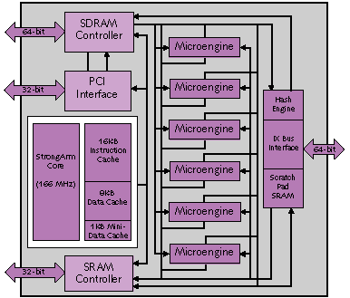
IXP1200 Block Diagram
StrongARM processing core
Microengines introduce new ISA
I/O
  PCI
  SDRAM
  SRAM
  IX : PCI-like packet bus
On chip FIFOs
  16 entry 64B each

Slide 18
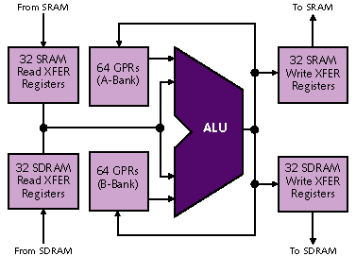
IXP1200 Microengine
4 hardware contexts
  Single issue processor
  Explicit optional context switch on SRAM access
Registers
  All are single ported
  Separate GPR
  256*6 = 1536 registers total
32-bit ALU
  Can access GPR or XFER registers
Shared hash unit
  1/2/3 values – 48b/64b
Standard 5 stage pipeline
  For IP routing hashing
4KB SRAM instruction store – not a cache!
Barrel shifter

Slide 19
IXP 2400 Block Diagram
XScale core replaces StrongARM
Microengines
  Faster
  More: 2 clusters of 4 microengines each
Local memory
Next neighbor routes added between microengines
Hardware to accelerate CRC operations and Random number generation
16 entry CAM
DDR DRAM
controller
ME0
ME1
Scratch
/Hash
/CSR
ME3
ME2
XScale
Core
MSF Unit
PCI
ME4
ME5
QDR SRAM
controller
ME7
ME6

Slide 20
72
IXP2400
DDRAM
MEv2
1
MEv2
2
Rbuf
64 @ 128B
S
P
I
3
or
C
S
I
X
32b
MEv2
4
MEv2
3
PCI
(64b)
66 MHz
Intel®
XScale™
Core
32K IC
32K DC
G
A
S
K
E
T
Tbuf
64 @ 128B
32b
64b
MEv2
5
MEv2
6
Hash
64/48/128
Scratch
16KB
QDR
SRAM
1
QDR
SRAM
2
MEv2
8
MEv2
7
CSRs
-Fast_wr -UART
-Timers -GPIO
-BootROM/Slow Port
E/D Q
E/D Q
18
18
18
18

Slide 21
18
18
18
IXP2800
Stripe
RDRAM
1
RDRAM
2
RDRAM
3
MEv2
1
MEv2
2
MEv2
3
MEv2
4
Rbuf
64 @ 128B
S
P
I
4
or
C
S
I
X
16b
MEv2
8
MEv2
7
MEv2
6
MEv2
5
PCI
(64b)
66 MHz
Intel®
XScale™
Core
32K IC
32K DC
G
A
S
K
E
T
64b
Tbuf
64 @ 128B
16b
MEv2
9
MEv2
10
MEv2
11
MEv2
12
Hash
48/64/128
Scratch
16KB
QDR
SRAM
1
QDR
SRAM
2
QDR
SRAM
3
QDR
SRAM
4
MEv2
16
MEv2
15
MEv2
14
MEv2
13
CSRs
-Fast_wr -UART
-Timers -GPIO
-BootROM/SlowPort
E/D Q
E/D Q
E/D Q
E/D Q
18
18
18
18
18
18
18
18

Slide 22
MicroEngine v2
D-Push
Bus
S-Push
Bus
From Next Neighbor
Control
Store
4K/8K
Instructions
Local
Memory
640 words
128
GPR
128
GPR
128 Next
Neighbor
128 D
Xfer In
128 S
Xfer In
LM Addr 1
2 per
CTX
B_op
A_op
LM Addr 0
Prev B
Prev A
P-Random #
A_Operand
B_Operand
CRC Unit
Multiply
TAGs
0-15
Lock
0-15
Status
and
LRU
Logic
(6-bit)
Find first bit
32-bit Execution
Data Path
CRC remain
CAM
Add, shift, logical
Other
Local CSRs
ALU_Out
Status
Entry#
To Next Neighbor
Timers
128 D
Xfer Out
128 S
Xfer Out
Timestamp
D-Pull Bus
S-Pull Bus

Slide 23
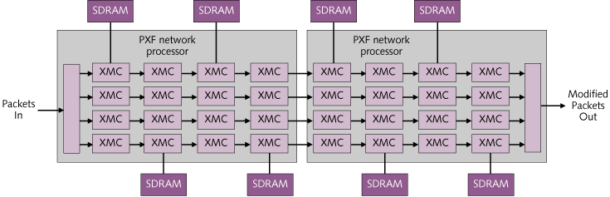
Example Toaster System: Cisco 10000
Almost all data plane operations execute on the programmable XMC
Pipeline stages are assigned tasks – e.g. classification, routing, firewall, MPLS
  Classic SW load balancing problem
External SDRAM shared by common pipe stages
Notes:
XMC: Express Micro Controller
2-way RISC VLIW

Slide 24
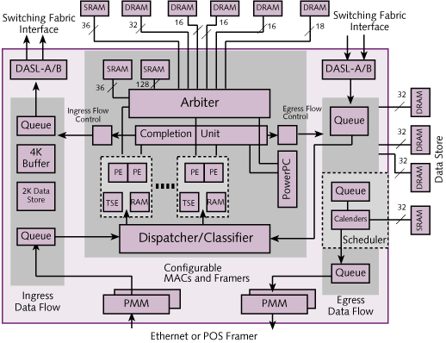
IBM PowerNP
16 pico-procesors and 1 powerPC
Each pico-processor
  Support 2 hardware threads
  3 stage pipeline : fetch/decode/execute
Dyadic Processing Unit
  Two pico-processors
  2KB Shared memory
  Tree search engine
Focus is layers 2-4
PowerPC 405 for control plane operations
  16K I and D caches
Target is OC-48

Slide 25
C-Port C-5 Chip Architecture

Slide 26

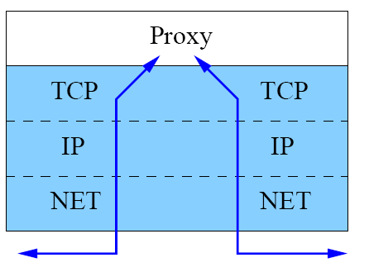
Design of a Web Switch (IEEE Micro 2006)
Internet
Problems with Application level Processing
Vertical Processing in network – A change in paradigm!
Overhead to copy data between two connections
  Data goes up through O/S interrupt and protocol stack
  Data is copied from kernel space to user space and vice versa
Oh, the PCI Bottleneck!
It takes a 1 GHz CPU to handle a 1 Gb network. Now at 10Gb, but don’t have a 10 GHz CPU!
IP
TCP
APP. DATA
GET /cgi-bin/form HTTP/1.1
Host: www.site.com…
Switch
Application level Processing

Slide 27
Partition the Workload

Slide 28
Latency

Slide 29
Throughput

