Slide 1
Lec 10 – Example Architectures - Simultaneous Multithreading

Slide 2
Simultaneous Multithreading (SMT)
Simultaneous multithreading (SMT): insight that dynamically scheduled processor already has many HW mechanisms to support multithreading
Large set of virtual registers that can be used to hold the register sets of independent threads
Register renaming provides unique register identifiers, so instructions from multiple threads can be mixed in datapath without confusing sources and destinations across threads
Out-of-order completion allows the threads to execute out of order, and get better utilization of the HW
Just adding a per thread renaming table and keeping separate PCs
Independent commitment can be supported by logically keeping a separate reorder buffer for each thread
Source: Micrprocessor Report, December 6, 1999 “Compaq Chooses SMT for Alpha”

Slide 3
Multithreaded Categories
Simultaneous
Multithreading
Time (processor cycle)
Superscalar
Fine-Grained
Coarse-Grained
Multiprocessing
Thread 1
Thread 3
Thread 5
Thread 2
Thread 4
Idle slot

Slide 4
Design Challenges in SMT
Since SMT makes sense only with fine-grained implementation, impact of fine-grained scheduling on single thread performance?
A preferred thread approach sacrifices neither throughput nor single-thread performance?
Unfortunately, with a preferred thread, the processor is likely to sacrifice some throughput, when preferred thread stalls
Larger register file needed to hold multiple contexts
Not affecting clock cycle time, especially in
Instruction issue - more candidate instructions need to be considered
Instruction completion - choosing which instructions to commit may be challenging
Ensuring that cache and TLB conflicts generated by SMT do not degrade performance

Slide 5
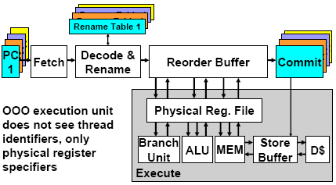
Simultaneous Multithreaded Processor

Slide 6
Intel Pentium-4 Xeon Processor
Hyperthreading == SMT
Dual physical processors, each 2-way SMT
Logical processors share nearly all resources of the physical processor
Caches, execution units, branch predictors
Die area overhead of hyperthreading ~5 %
When one logical processor is stalled, the other can make progress
No logical processor can use all entries in queues when two threads are active
A processor running only one active software thread to run at the same speed with or without hyperthreading

Slide 8
Intel Xeon Performance

Slide 9
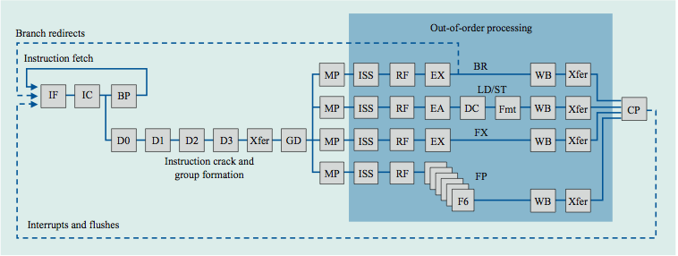
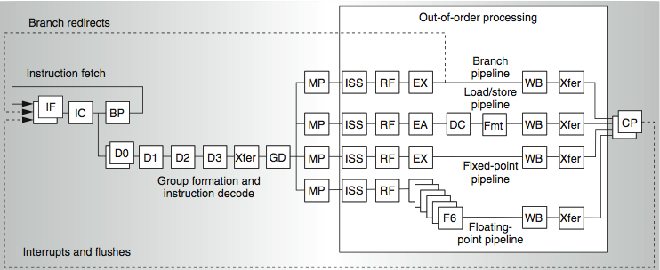
Power 4
2 commits (architected register sets)
Power 5
2 fetch (PC), 2 initial decodes

Slide 10
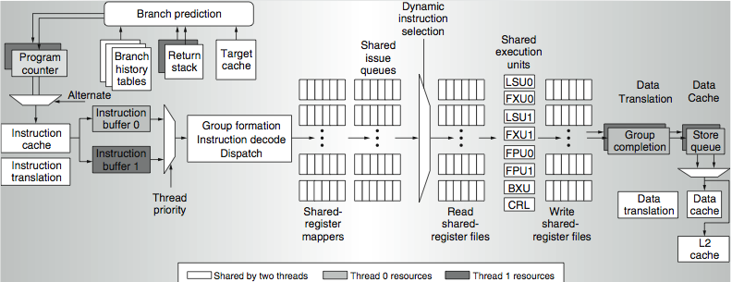
Power 5 data flow ...
Why only 2 threads? With 4, one of the shared resources (physical registers, cache, memory bandwidth) would be prone to bottleneck

Slide 11
Changes in Power 5 to support SMT
Increased associativity of L1 instruction cache and the instruction address translation buffers
Added per thread load and store queues
Increased size of the L2 (1.92 vs. 1.44 MB) and L3 caches
Added separate instruction prefetch and buffering per thread
Increased the number of virtual registers from 152 to 240
Increased the size of several issue queues
The Power5 core is about 24% larger than the Power4 core because of the addition of SMT support

Slide 12
Initial Performance of SMT
Pentium 4 Extreme SMT yields 1.01 speedup for SPECint_rate benchmark and 1.07 for SPECfp_rate
Pentium 4 is dual threaded SMT
SPECRate requires that each SPEC benchmark be run against a vendor-selected number of copies of the same benchmark
Running on Pentium 4 each of 26 SPEC benchmarks paired with every other (26² runs) speed-ups from 0.90 to 1.58; average was 1.20
Power 5, 8 processor server 1.23 faster for SPECint_rate with SMT, 1.16 faster for SPECfp_rate
Power 5 running 2 copies of each app speedup between 0.89 and 1.41
Most gained some
Fl.Pt. apps had most cache conflicts and least gains

Slide 13
Head to Head ILP competition
Processor | Micro architecture | Fetch / Issue / Execute | FU | Clock Rate (GHz) | Transis-tors Die size | Power
Intel Pentium 4 Extreme | Speculative dynamically scheduled; deeply pipelined; SMT | 3/3/4 | 7 int. 1 FP | 3.8 | 125 M 122 mm² | 115 W
AMD Athlon 64 FX-57 | Speculative dynamically scheduled | 3/3/4 | 6 int. 3 FP | 2.8 | 114 M 115 mm² | 104 W
IBM Power5 (1 CPU only) | Speculative dynamically scheduled; SMT; 2 CPU cores/chip | 8/4/8 | 6 int. 2 FP | 1.9 | 200 M 300 mm² (est.) | 80W (est.)
Intel Itanium 2 | Statically scheduled VLIW-style | 6/5/11 | 9 int. 2 FP | 1.6 | 592 M 423 mm² | 130 W

Slide 14
Performance on SPECint2000

Slide 15
Performance on SPECfp2000

Slide 16
Normalized Performance: Efficiency
Rank | I tanium2 | Pen t I um4 | A t h l on | Powe r 5
Int/Trans | 4 | 2 | 1 | 3
FP/Trans | 4 | 2 | 1 | 3
Int/area | 4 | 2 | 1 | 3
FP/area | 4 | 2 | 1 | 3
Int/Watt | 4 | 3 | 1 | 2
FP/Watt | 2 | 4 | 3 | 1

Slide 17
No Silver Bullet for ILP
No obvious over all leader in performance
The AMD Athlon leads on SPECInt performance followed by the Pentium 4, Itanium 2, and Power5
Itanium 2 and Power5, which perform similarly on SPECFP, clearly dominate the Athlon and Pentium 4 on SPECFP
Itanium 2 is the most inefficient processor both for Fl. Pt. and integer code for all but one efficiency measure (SPECFP/Watt)
Athlon and Pentium 4 both make good use of transistors and area in terms of efficiency,
IBM Power5 is the most effective user of energy on SPECFP and essentially tied on SPECINT

Slide 18
Limits to ILP
Doubling issue rates above today’s 3-6 instructions per clock, say to 6 to 12 instructions, probably requires a processor to
issue 3 or 4 data memory accesses per cycle,
resolve 2 or 3 branches per cycle,
rename and access more than 20 registers per cycle, and
fetch 12 to 24 instructions per cycle.
The complexities of implementing these capabilities is likely to mean sacrifices in the maximum clock rate
E.g, widest issue processor is the Itanium 2, but it also has the slowest clock rate, despite the fact that it consumes the most power!

Slide 19
Limits to ILP
Most techniques for increasing performance increase power consumption
The key question is whether a technique is energy efficient: does it increase power consumption faster than it increases performance?
Multiple issue processors techniques all are energy inefficient:
Issuing multiple instructions incurs some overhead in logic that grows faster than the issue rate grows
Growing gap between peak issue rates and sustained performance
Number of transistors switching = f(peak issue rate), and performance = f( sustained rate), growing gap between peak and sustained performance ⇒ increasing energy per unit of performance

Slide 20
Commentary
Itanium architecture does not represent a significant breakthrough in scaling ILP or in avoiding the problems of complexity and power consumption
Instead of pursuing more ILP, architects are increasingly focusing on TLP implemented with single-chip multiprocessors
In 2000, IBM announced the 1st commercial single-chip, general-purpose multiprocessor, the Power4, which contains 2 Power3 processors and an integrated L2 cache
Since then, Sun Microsystems, AMD, and Intel have switch to a focus on single-chip multiprocessors rather than more aggressive uniprocessors.
Right balance of ILP and TLP is unclear today
Perhaps right choice for server market, which can exploit more TLP, may differ from desktop, where single-thread performance may continue to be a primary requirement

Slide 21
And in conclusion …
Limits to ILP (power efficiency, compilers, dependencies …) seem to limit to 3 to 6 issue for practical options
Explicitly parallel (Data level parallelism or Thread level parallelism) is next step to performance
Coarse grain vs. Fine grained multihreading
Only on big stall vs. every clock cycle
Simultaneous Multithreading if fine grained multithreading based on OOO superscalar microarchitecture
Instead of replicating registers, reuse rename registers
Itanium/EPIC/VLIW is not a breakthrough in ILP
Balance of ILP and TLP decided in marketplace

Slide 22
Multicore Multithreaded Architecture
Examples:
SUN Niagra
Intel Neahlem
Network Processors

Slide 23
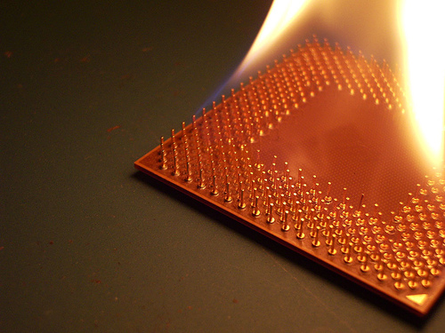
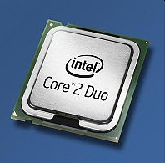
Intel Core 2 Duo Introduction
Motivation
A Multi-Core on our desks
A new microarchitecture to replace Netburst
Intel Core 2 Duo
A dual-core CPU
ISA with SIMD Extension
Intel Core microarchitecture
Memory Hierarchy System

Slide 24
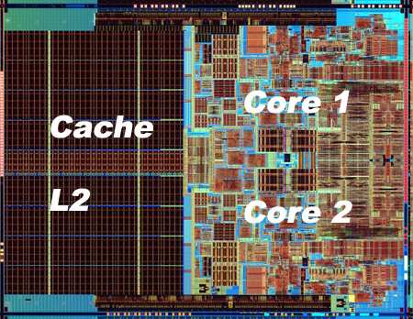
Core 2 Duo Microarchitecture
The Cores
Single-die(107 mm²),
Two identical core(L1 cache 64K x 2),
Shared L2 cache 6M
No Hyper-threading, no L3 cache
Keep front-side bus
Larger L2 cache

Slide 25
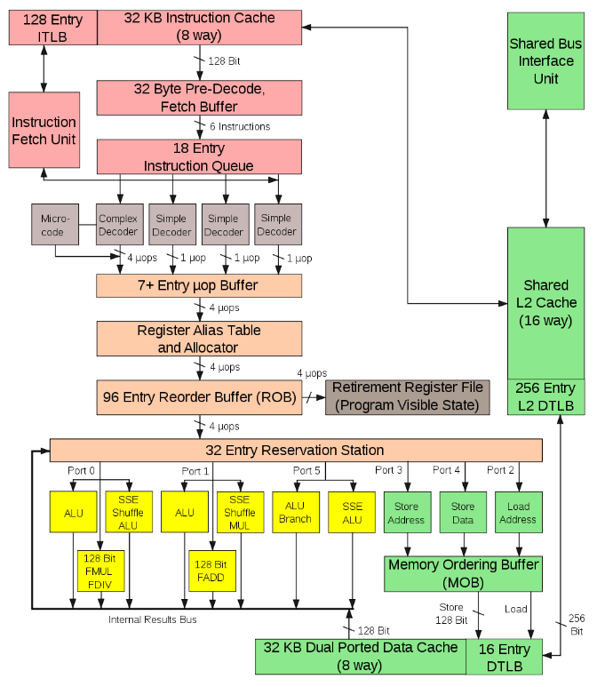
Microarchitecture
• 14-stage Pipeline
• 4 wide decode
• 4 wide Retire
• Macro-fusion
• Enhanced ALUs
• Deeper Buffers
Notes:
Each Core CPU fetchs 128 bits of instructions, decodes 4+1 x86 instructions, issues 7 uops, reorders and renames 4 uops, dispatches 6 uops to execution units and retires up to 4 uops each cycle

Slide 26
Intel Clovertown Machine – 2 Quad-core Xeon Processor
Multi-Core Architecture
Increased resource density
Major Challenges
Parallelism in legacy program scalability
Current solutions
Software
Naïve multithreading
Hardware
Receive Side Scaling (RSS) in NIC
No Hyperthreading

Slide 27
Nehalem Architecture – 2-Way SMT

Slide 28
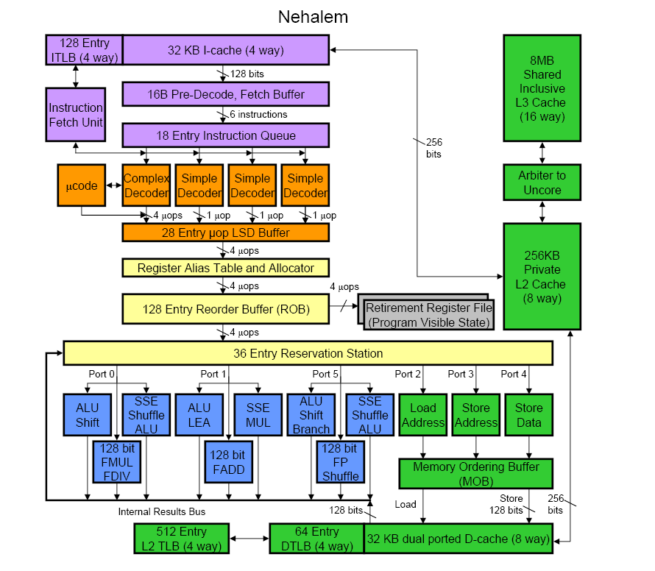
Nehalem – Enhanced Core 2 Datapath

Slide 29
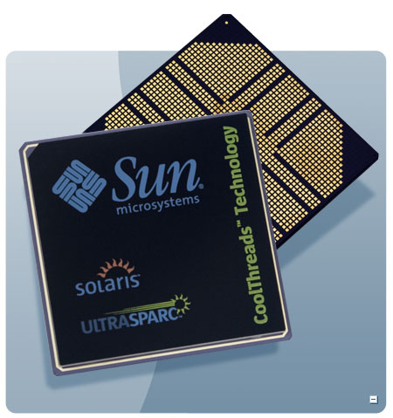
T1 (“Niagara”)
Target: Commercial server applications
High thread level parallelism (TLP)
Large numbers of parallel client requests
Low instruction level parallelism (ILP)
High cache miss rates
Many unpredictable branches
Frequent load-load dependencies
Power, cooling, and space are major concerns for data centers
Metric: Performance/Watt/Sq. Ft.
Approach: Multicore, Fine-grain multithreading, Simple pipeline, Small L1 caches, Shared L2

Slide 30
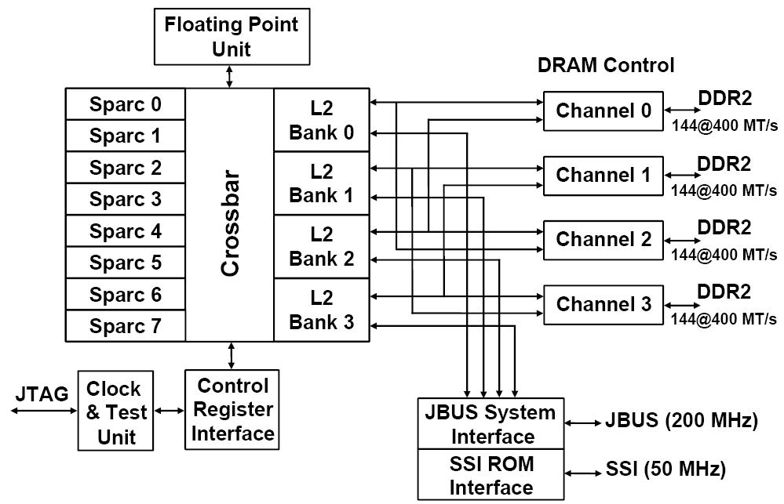
T1 Architecture
Also ships with 6 or 4 processors

Slide 31
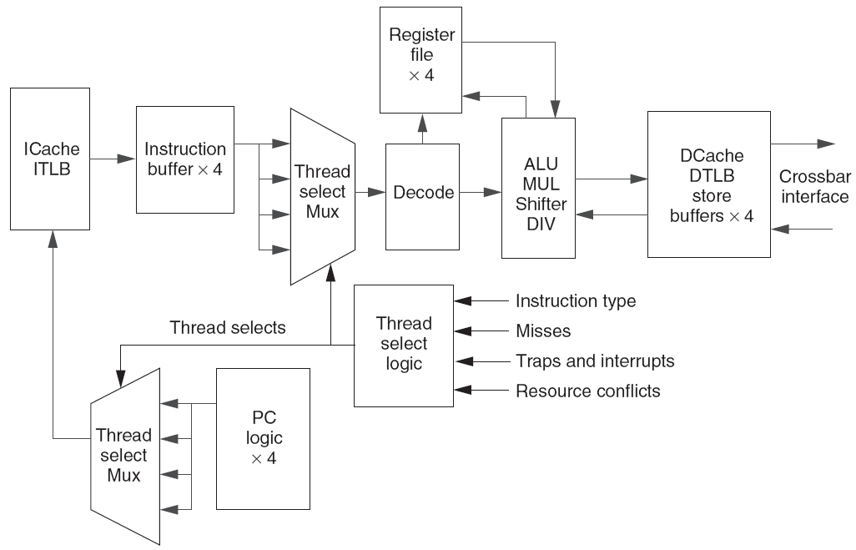
T1 pipeline
Single issue, in-order, 6-deep pipeline: F, S, D, E, M, W
3 clock delays for loads & branches.
Shared units:
L1 $, L2 $
TLB
X units
pipe registers
Hazards:
Data
Structural

Slide 32
T1 Fine-Grained Multithreading
Each core supports four threads and has its own level one caches (16KB for instructions and 8 KB for data)
Switching to a new thread on each clock cycle
Idle threads are bypassed in the scheduling
Waiting due to a pipeline delay or cache miss
Processor is idle only when all 4 threads are idle or stalled
Both loads and branches incur a 3 cycle delay that can only be hidden by other threads
A single set of floating point functional units is shared by all 8 cores
floating point performance was not a focus for T1

Slide 33
Microprocessor Comparison
Processor | SUN T1 | Opteron | Pentium D | IBM Power 5
Cores | 8 | 2 | 2 | 2
Instruction issues / clock / core | 1 | 3 | 3 | 4
Peak instr. issues / chip | 8 | 6 | 6 | 8
Multithreading | Fine-grained | No | SMT | SMT
L1 I/D in KB per core | 16/8 | 64/64 | 12K uops/16 | 64/32
L2 per core/shared | 3 MB shared | 1MB / core | 1MB/ core | 1.9 MB shared
Clock rate (GHz) | 1.2 | 2.4 | 3.2 | 1.9
Transistor count (M) | 300 | 233 | 230 | 276
Die size (mm²) | 379 | 199 | 206 | 389
Power (W) | 79 | 110 | 130 | 125

Slide 34
Performance Relative to Pentium D

Slide 35
Performance/mm², Performance/Watt

Slide 36
Niagara 2
Improve performance by increasing threads supported per chip from 32 to 64
8 cores * 8 threads per core
Floating-point unit for each core, not for each chip
Hardware support for encryption standards EAS, 3DES, and elliptical-curve cryptography
Niagara 2 will add a number of 8x PCI Express interfaces directly into the chip in addition to integrated 10Gigabit Ethernet XAU interfaces and Gigabit Ethernet ports.
Integrated memory controllers will shift support from DDR2 to FB-DIMMs and double the maximum amount of system memory.

Slide 37
SUN Niagara 2
Characteristics of Sun T5120 Niagara 2
2 pipelines per core
4 hardware threads per pipeline
Notes:
(b) The bars show the average utilization (%) at each level in the core; the lines represent the range of peak high and peak low values (%).

